Slide 1
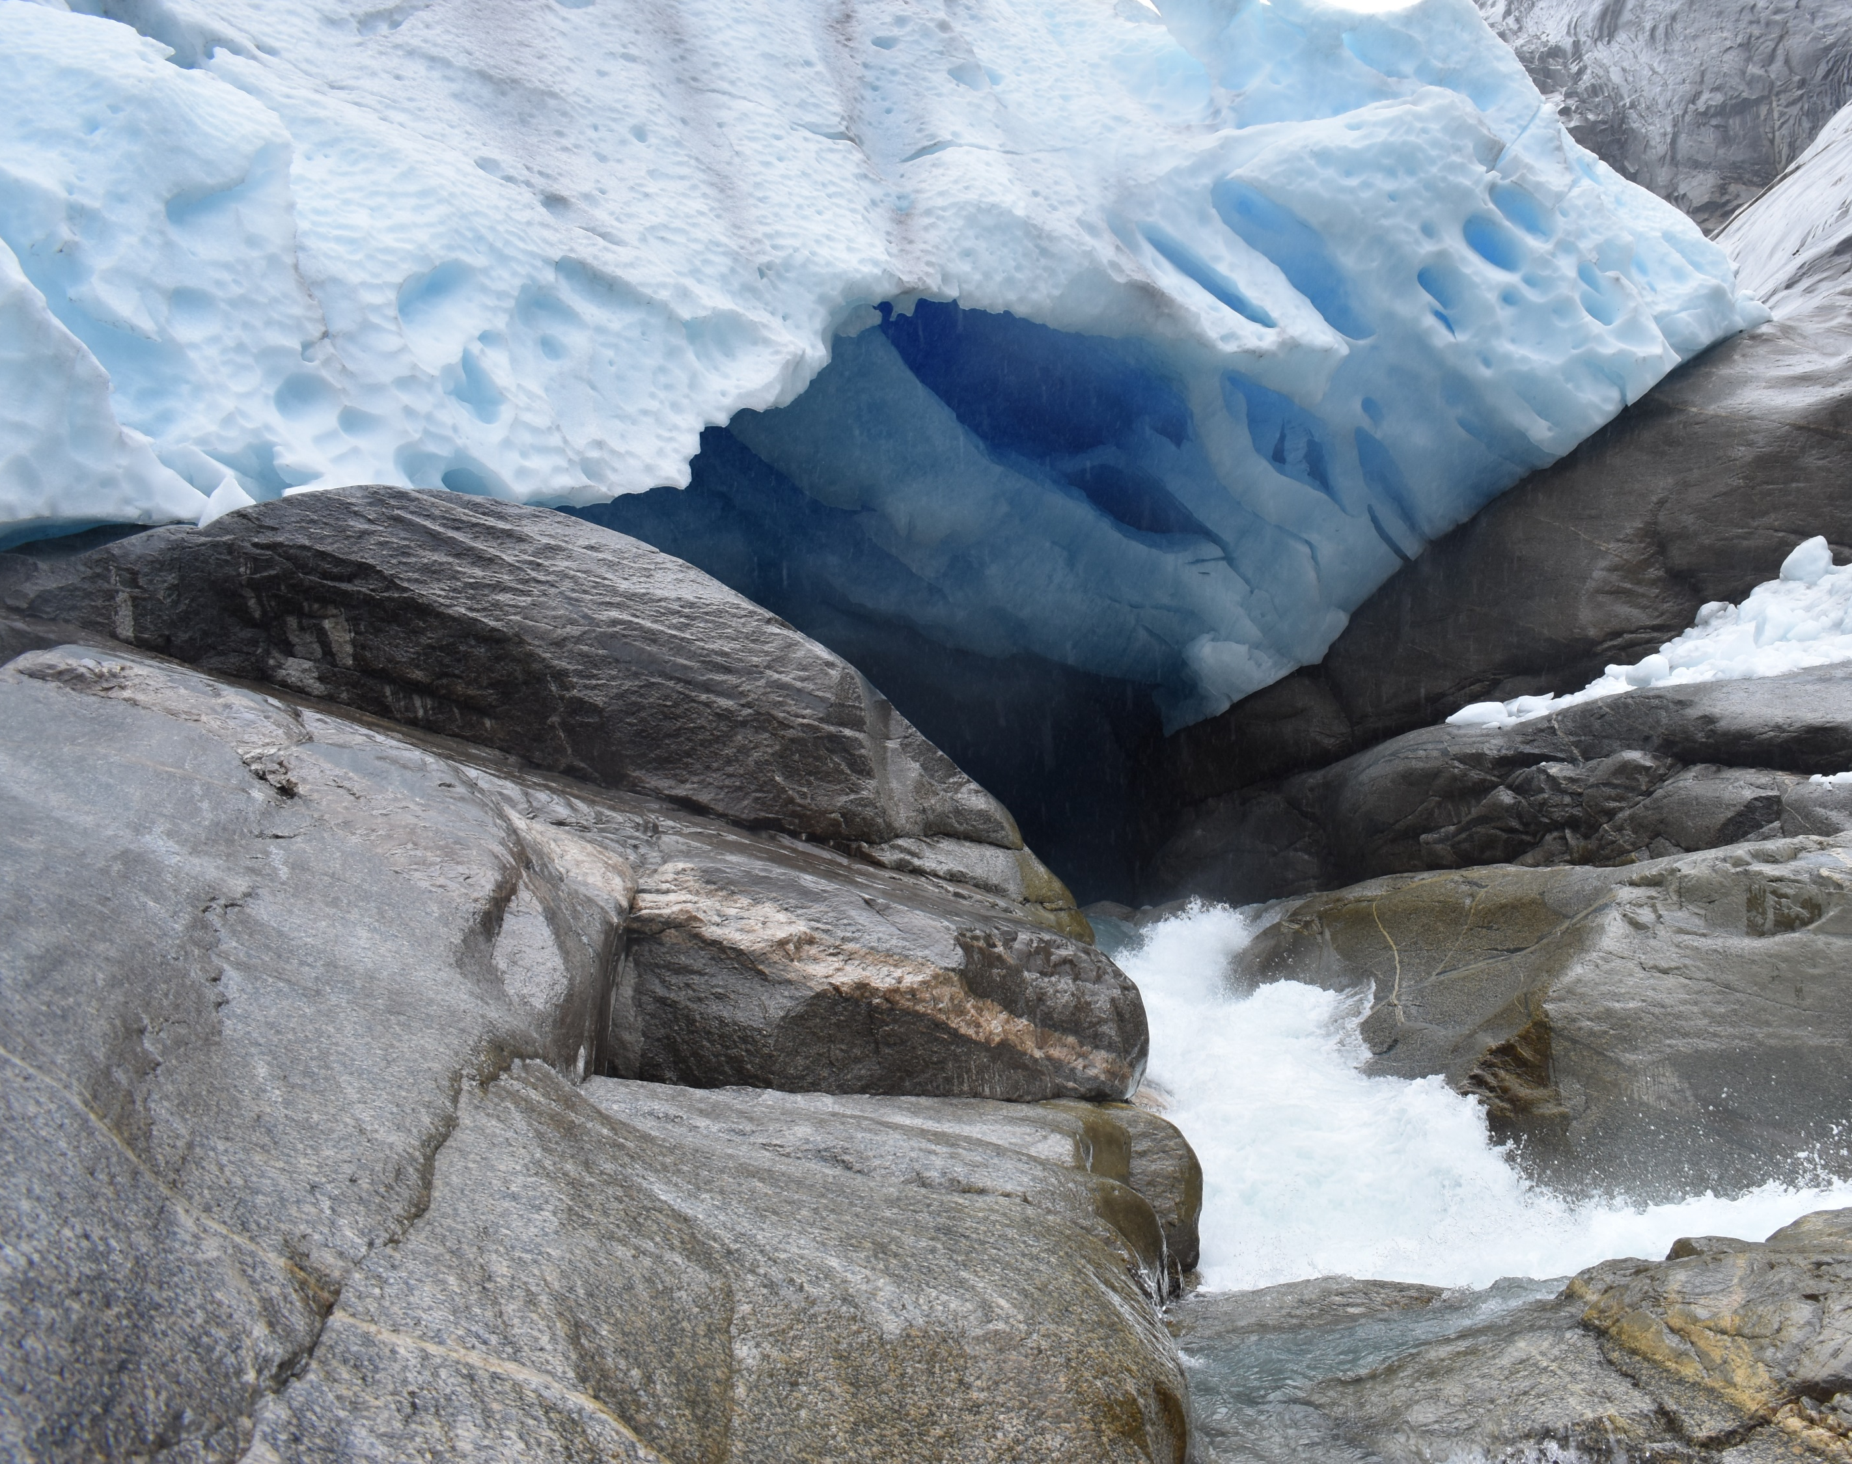

Life cycle of glacial lakes in Norway:
Insights from machine learning algorithms on Landsat series and Sentinel-2
Ghazal Moghaddam
Irina Rogozhina
Liss Marie Andreassen

Slide 2

Why Study Glaciers and Glacial lakes?
Glacier Retreat
Formation and Growth of Glacial Lakes
Hydropower production
Hazard management
Notes:
Due to the globally rapid melting of glaciers, glacial lakes formation and……..

Slide 3
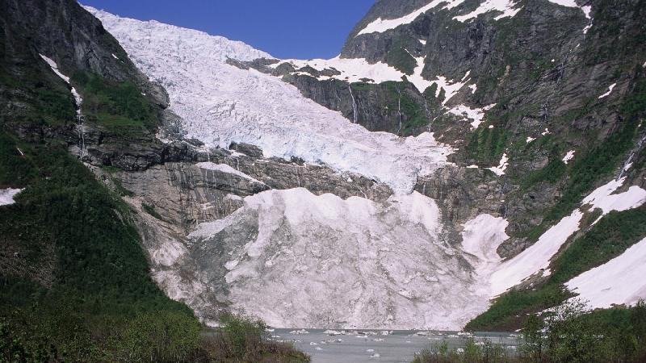
Bøyabreen – Norway
1993
Photo: NVE.no Hinrich Bernard Basemann
Notes:
……extension is increasing in many regions worldwide.

Slide 4
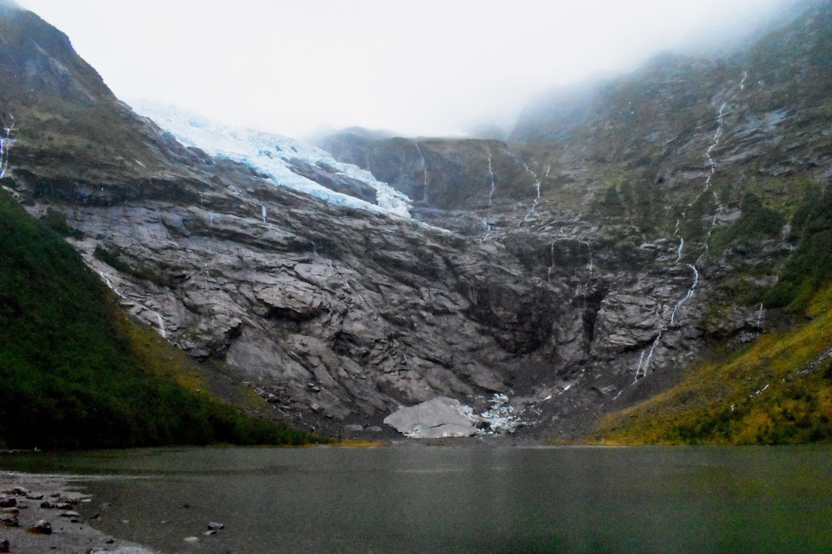
Bøyabreen – Norway
2019
Photo: Ghazal Moghaddam
Notes:
As well as other countries with a large number of glaciers, in Norway….

Slide 5
Glacier Retreat
Formation and Growth of Glacial Lakes
Hydropower production
Hazard management
Notes:
…….runoff for hydropower production and hazard management are the initial reasons……

Slide 6
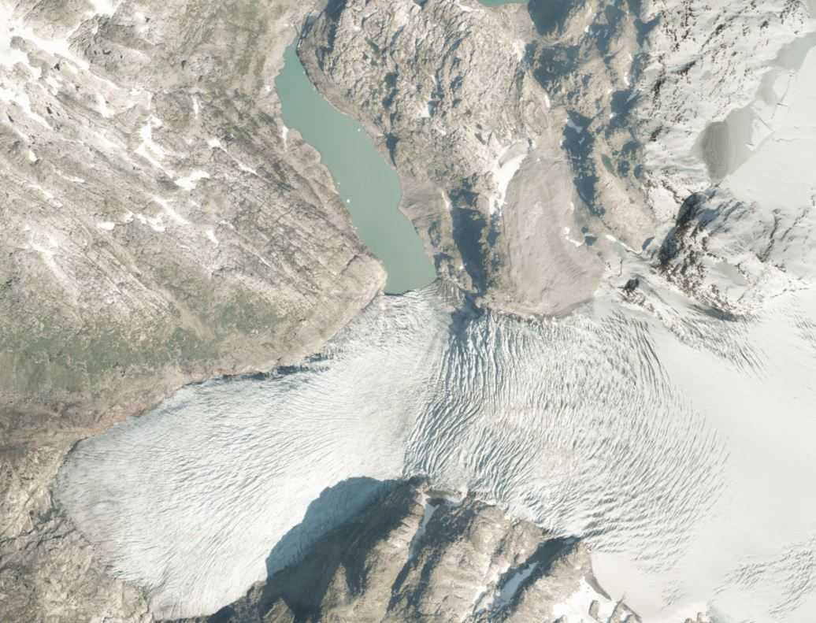
Norgeibilder.no Orthophoto 2019.07.26
Notes:
…..to investigate changes in glaciated areas.

Slide 7
Aims of Study
Assess the potential use of machine learning algorithms with Landsat and Sentinel imagery for the recognition of glacial lakes and tracing their life cycle in Norway following a consistent method.
    How accurate?
    Recognize glacial lakes in early stages of formation?
    Possibility of substituting Landsat with Sentinel images.
    Challenges of recognition.
Notes:
In this study, I tried to use a consistent method on 2 datasets from Landsat series and Sentinel-2 satellite images. Especially because recent advances in machine learning techniques have presented new opportunities to automize glacial lake mapping and studying their evolution.

Slide 8
Methods
Datasets
Landsat imagery
    1988 – 2019
Sentinel-2 imagery
    2018 – 2019
Machine Learning Algorithms
  Maximum Likelihood Classification
  Support Vector Machine
Glacial Lake Extraction
  DEM for elimination of shadow related misclassifications
Notes:
I used MLC and SVM as 2 of the most common methods of machine learning algorithms implemented in 2 software of ArcGIS and ENVI. This study zooms into pros and cons of each classification method and satellite product through the prism of glacial lake processes occurring over disparate temporal and spatial scales.

Slide 9
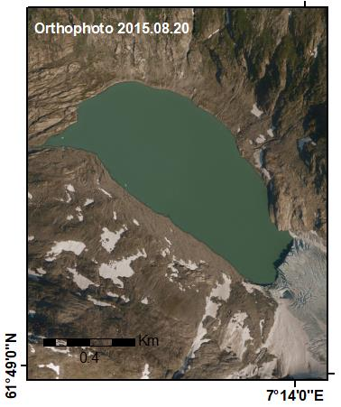
Findings
Orthophoto
2015.08.20
Notes:
Each satellite has its characterization….

Slide 10
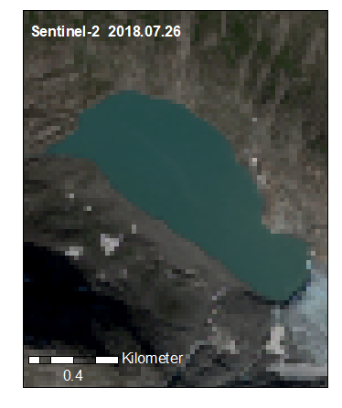
Findings
Sentinel-2
2018.07.26
Notes:
…. based on its spatial, spectral…..

Slide 11
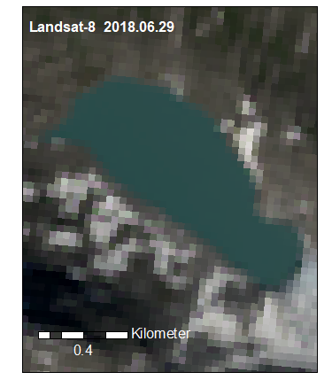
Findings
Landsat-8 OLI
2018.06.29
Notes:
…… and temporal resolution.

Slide 12
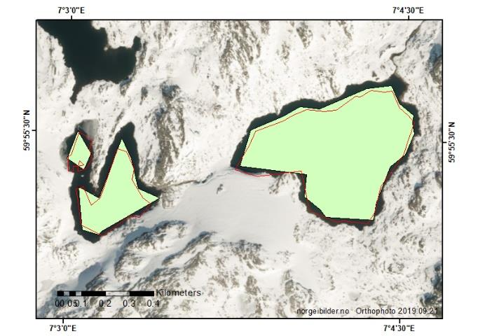
Landsat-8 OLI
VS
Sentinel-2
Recognition skills of methods:
Quality of satellite image
Careful selection of training samples
Notes:
Based on my analysis, I conclude that the recognition skills of supervised
classification methods largely depend on the quality of satellite images and careful selection of
training samples.

Slide 13
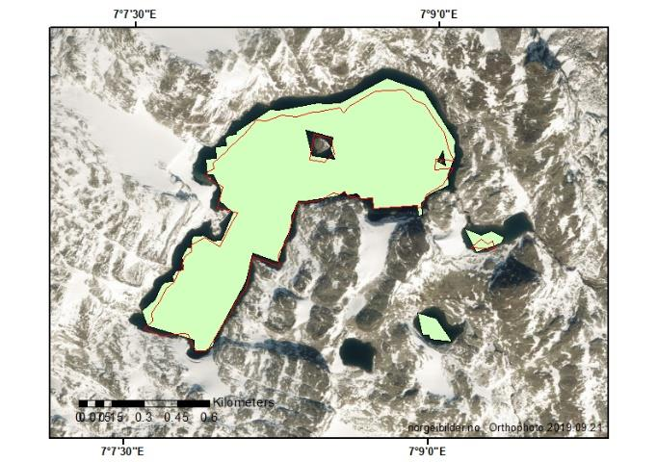
Landsat-8 OLI
VS
Sentinel-2
Adverse effect on classification results due to:
Weather conditions
  Cloud, snow, ice cover
Image disturbances
  Atmospheric correction
  Shadowed slopes
Notes:
Some of the factors that adversely affect the classification results are
unfavourable weather conditions such as cloud, snow and ice cover, image disturbances through
atmospheric corrections and shadows on slopes that lead to misclassifications.

Slide 14
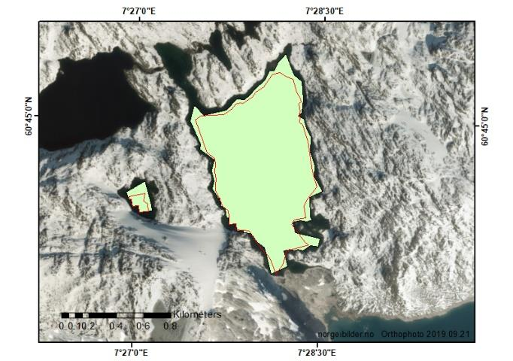
Landsat-8 OLI
VS
Sentinel-2
Thermal band is not necessary
DEM-based correction of shadows
Complementary datasets
Notes:
I conclude that higher resolution of Sentinel images does not enhance their ability to recognize glacial lakes compared to Landsat images, except for very small lakes. It can also be deduced that the lack of thermal bands in Sentinel is not necessarily a large shortcoming in applications presented in this study since the DEM-based corrections of shadows are deemed more efficient compared to thermal bands. And that the 2 datasets have a good potential to be used as complementary.

Slide 15
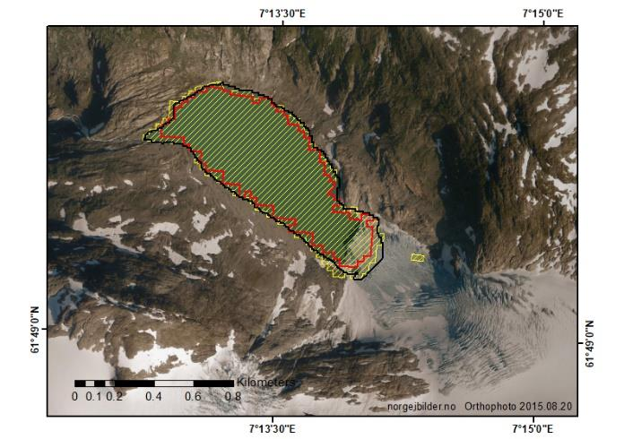
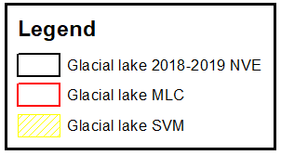
MLC
VS
SVM
Accuracy rate above 90%
SVM is superior
Notes:
By comparison of MLC and SVM’s performance, SVM has clearly proven to be superior to MLC, even though both methods presented an acceptable accuracy rate of over 90% for classification.

Slide 16
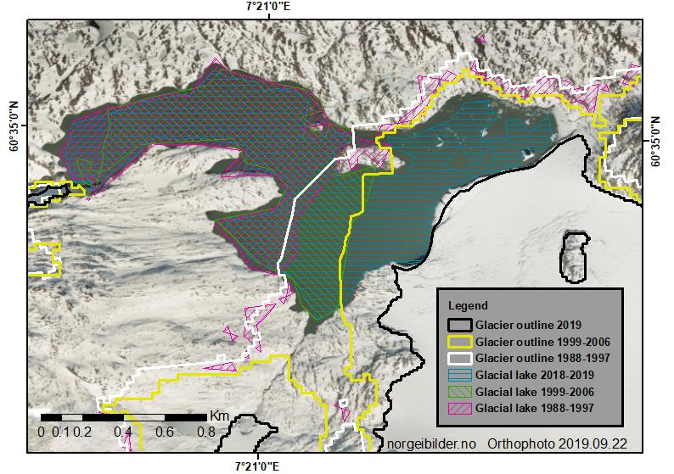
1988
2019
Glacial lake life cycle
Significant growth
Expanded along one margin due to retreat of the glacier
Correlating glacier outlines for the same period
Notes:
The recognized outlines of glacial lakes, were investigated in contrast in three time spans of study. In the figure here, a detailed interpretation of historical changes has been enabled by the availability of complete glacier outlines and high-quality images of Landsat -8. Interestingly, the significant expansion of the lake along one of its margins, is suggesting that the lake growth was driven by the retreat of glaciers. The glacier outlines from different period of the study closely correlate with corresponding changes in the glacial lake outlines.

Slide 17
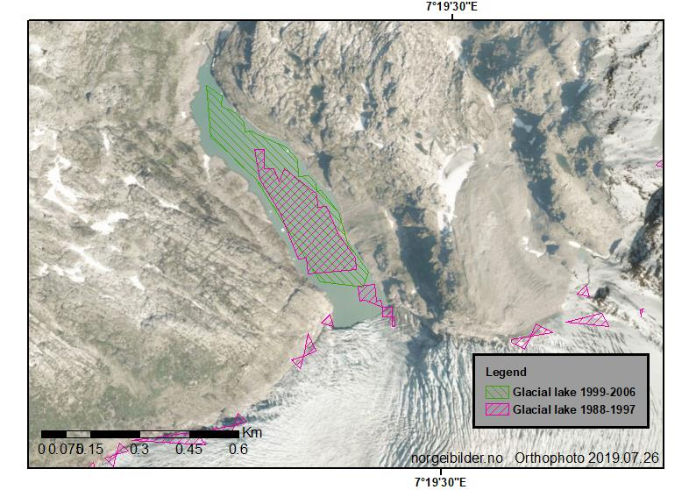
1988
2019
Curious Case of
Demmevatnet
Failed to recognize in 2018-2019
  Snow and cloud free satellite image
History of GLOF
  Visual inspection of the image
Empty lake due to a GLOF event one month prior to the satellite image date
Notes:
On the other hand, in the same area, MLC “failed” to recognize the lake in the figure located at the margin of a glacier outlet in southern Norway. This seeming failure only affected the MLC recognition skill during the most recent period (2018-2019), potentially indicating some issues with the lake signature in the Landsat image retrieved. As a curious incident, a more thorough investigation seemed necessary, especially in the light of the knowledge of GLOF background in this lake.

Slide 18
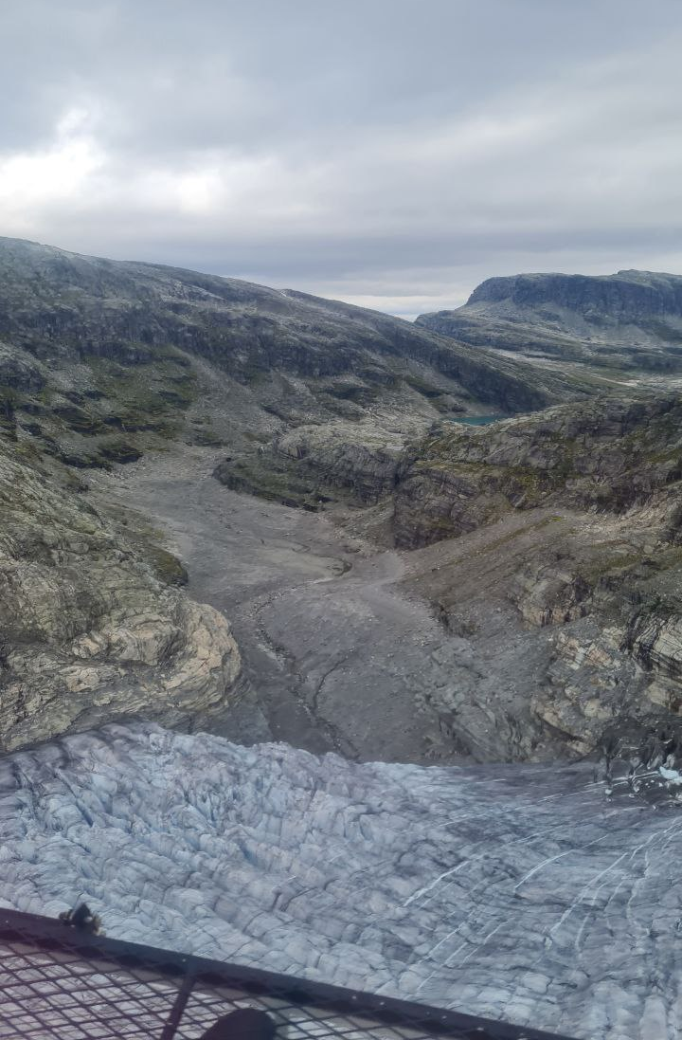
Glacial Lake Outburst Flood
Photo: Ghazal Moghaddam 2021.08.13
Norgeibilder.no Orthophoto 2019.07.26
Notes:
The satellite image and its composite of bands were visually inspected, revealing no snow, ice or
cloud cover, and indeed the missing lake. Further investigation involved the NVE’s GLOF
database that confirmed an event a month prior, emptying the lake.

Slide 19
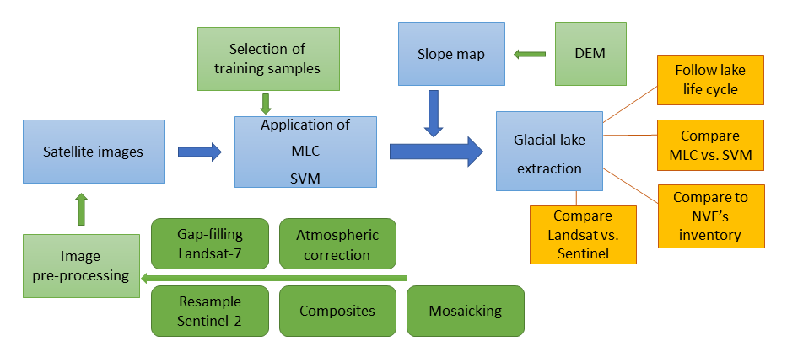
Notes:
Through the process of this study, I have observed that achieving precise glacial lake outlines is dependent on a variety of factors related to the specifics of each classification method and satellite dataset in use. Preceding the classification by the selected methods…..

Slide 20
Methods
Image pre-processing
Gaps in Landsat 7
Atmospheric correction
Thermal atmospheric correction
Resample Sentinel-2 bands
Notes:
….. I have performed pre-processing on the images in use and I can conclude that some of these pre-processing steps add to complexity of the classified results….

Slide 21
Methods
Image pre-processing
Composite
  Landsat
    Blue
    NIR
    SWIR1
    SWIR2
    Thermal band
  Sentinel-2
    No Thermal band
Mosaicking
Notes:
….. However, Areas and time periods for which it was possible to mitigate the unfavourable dataset-related factors, provided deep insights into glacial lake changes through time.

