Slide 1

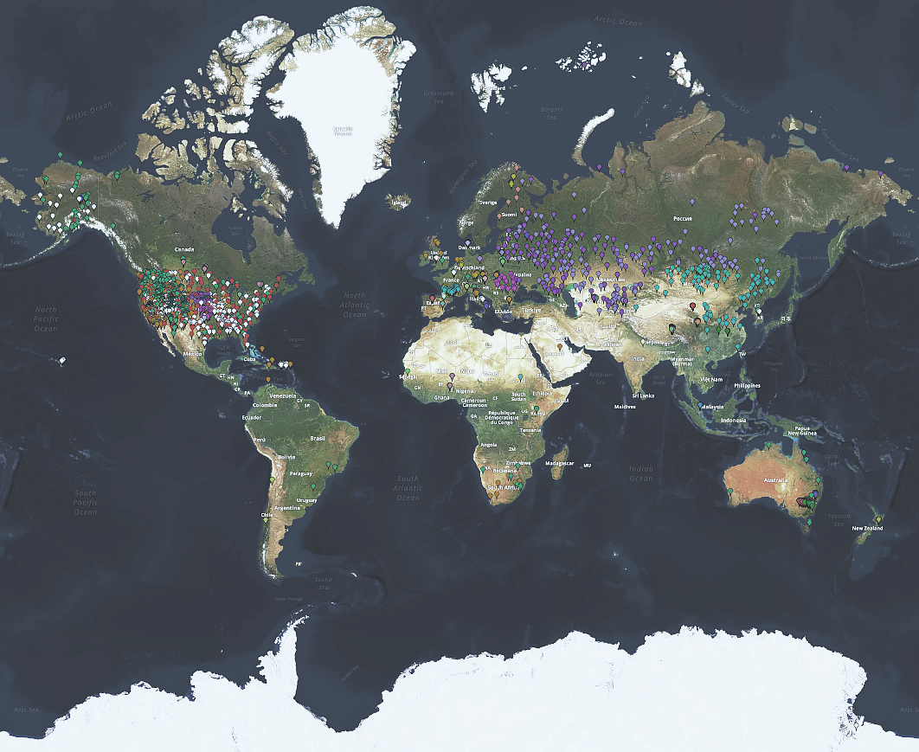




Scientific evolution of the International Soil Moisture Network (ISMN): Past, present and future developments in support of the Satellite Soil Moisture community
PETRAKOVIC Ivana¹, HIMMELBAUER Irene¹, ABERER Daniel¹, SCHREMMER Lukas¹, GORYL Philippe², CRAPOLICCHIO Raffaele², SABIA Roberto², SKIPAL Klaus ², DIETRICH Stephan³, OLARINOYE Tunde ³, BOEHMER Fay⁴, and DORIGO A. Wouter¹
¹ Research Area Climate and Environmental Remote Sensing (CLIMERS), Department of Geodesy and Geoinformation, TU Wien
² European Space Agency (ESA), ESA- ESRIN, Telespazio - Vega UK Ltd
³ International Center for Water Resources and Global Change (ICWRGC) Koblenz, Germany
⁴ German Federal Institute of Hydrology, Department M4 Geodata Center, WasserBLIcK, GRDC, Koblenz, Germany
https://ismn.earth/
© Authors. All rights reserved

Slide 2




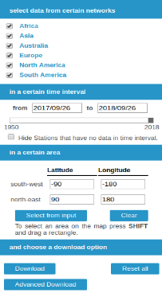
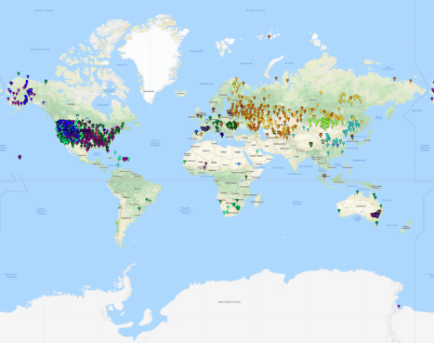
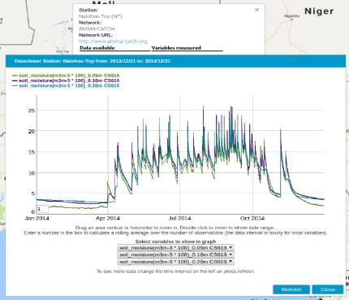




The International Soil Moisture Network (ISMN)
1) The International Soil Moisture Network (ISMN)
ISMN = a global in situ (surface and subsurface) soil moisture database
established in 2009 with international cooperation (ESA, WCRP GEWEX, CEOS, GTN-H)
Data collection
Data harmonization
Quality control
Database storage
Easy and FREE access to the data
Surface and Subsurface measurements
Long time series for climate trend detection
Harmonization of in situ data for a meaningful comparison
Quality control for reliability and accuracy
Availability on a global scale
Communication tool for provider and user
Metadata
Data portal
https://ismn.earth/
The International Soil Moisture Network (ISMN)
EGU 2022, Vienna, 23-27 May 2022
Ivana Petrakovic
© Authors (front page). All rights reserved

Slide 3
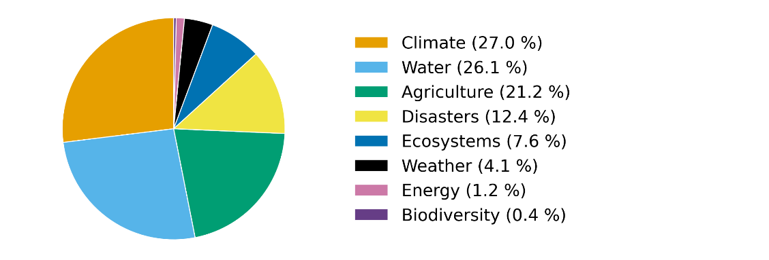
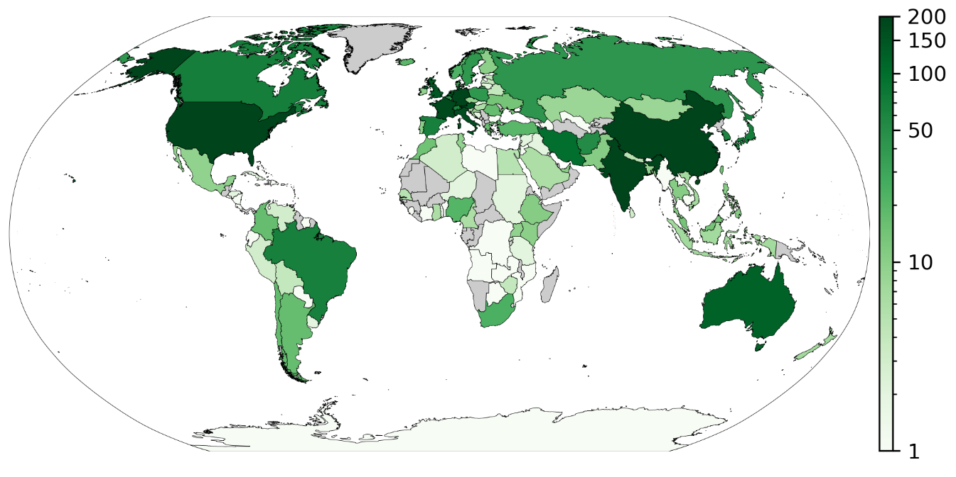
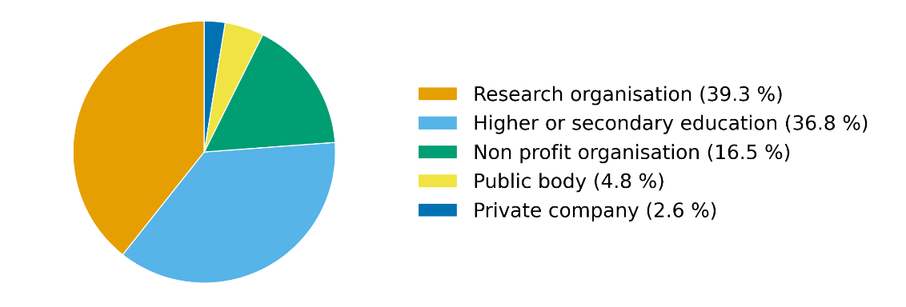
ISMN user community
1) The International Soil Moisture Network (ISMN)
~ 30 000 datasets stored in DB
<
~ 4000 registered users
Beneficial areas of ISMN data usage (status April 2022)
Statistics of organisations using ISMN data (status April 2022)
Graphs (status 04/2022): User statistics recorded in respect of the European General Data Protection Regulation.
Dorigo et al.: The International Soil Moisture Network: serving Earth system science for over a decade, Hydrol. Earth Syst. Sci., 25, 5749–5804, https://doi.org/10.5194/hess-25-5749-2021, 2021.
The International Soil Moisture Network (ISMN)
EGU 2022, Vienna, 23-27 May 2022
Ivana Petrakovic
© Authors (front page). All rights reserved

Slide 4
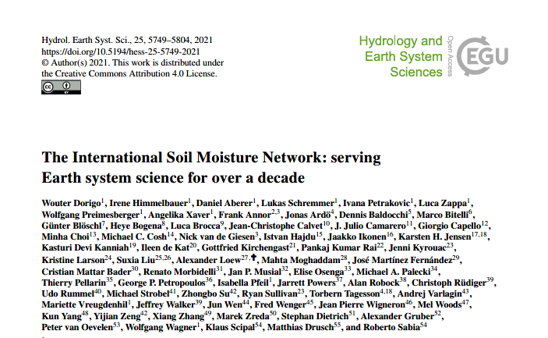
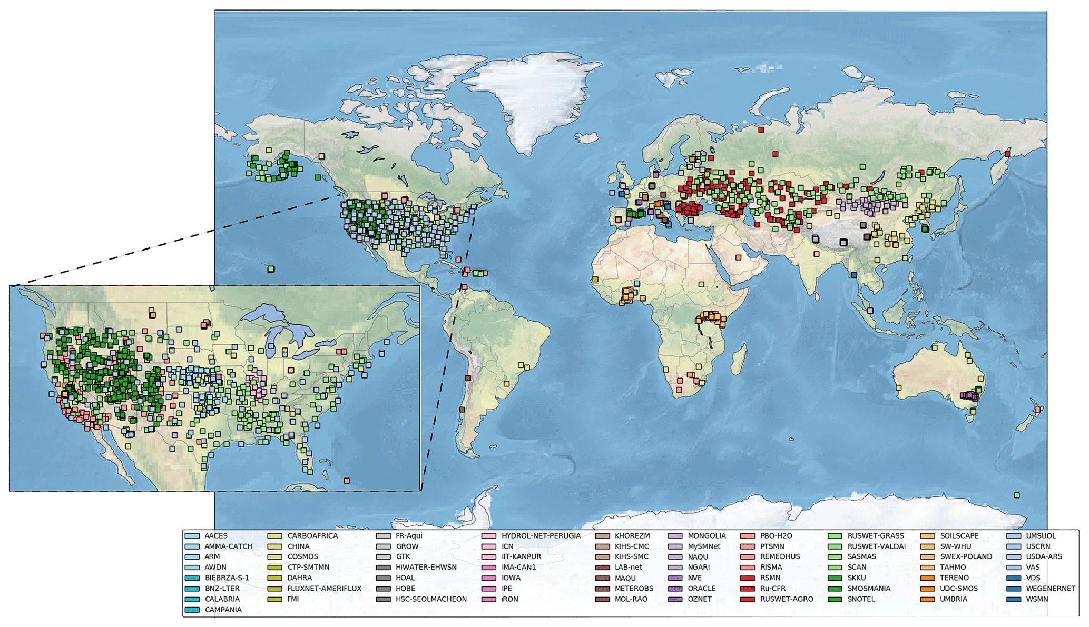
New ISMN Paper: Dorigo et al., 2021
1) The International Soil Moisture Network (ISMN)
The ISMN paper has been officially published on 9 November 2021 (HESS)
⇒ Content:
Overview of ISMN
New pyhton based quality control procedure ISMN python flag moduel – flagit: https://github.com/TUW-GEO/flagit
Impact of the ISMN on Earth system sciences (Literature overview of studies making use of ISMN)
Challenges and opportunities
Recent developments (since 2013 paper)
Summarize current shortcomings and future needs
The International Soil Moisture Network (ISMN)
EGU 2022, Vienna, 23-27 May 2022
Ivana Petrakovic
© Authors (front page). All rights reserved

Slide 5
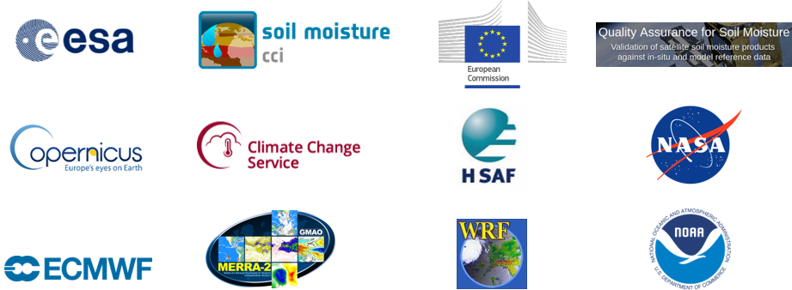
ISMN data usage
1) The International Soil Moisture Network (ISMN)
Involved products (concerning usage):
Satellite Validation: ESA CCI SM, C3S, CGLS, HSAF, QA4SM etc.
Model development and validation: NASA’s GLDAS Noah, ECMWF (ERA5, ERA-Interim, ERA-Land), MERRA2, LDAS-Monde etc.
Meteorological applications: TESSEL, Weather Research and Forecasting Model (WRF) , ERA-Interim/Land, ECMWF etc.
Drought monitoring: SP(E)I, PDSI, European Drought Observatory etc.
Other applications: validation of hybrid observation based products, assessment of the impact of assimilating satellite observations into land surface models, etc.
Purpose | [%]
Satellite Validation | 55.7
Model development and validation | 16.2
Meteorological applications | 7.5
Drought monitoring | 3.8
Other applications | 16.8
Dorigo et al.: The International Soil Moisture Network: serving Earth system science for over a decade, Hydrol. Earth Syst. Sci., 25, 5749–5804, https://doi.org/10.5194/hess-25-5749-2021, 2021.
The International Soil Moisture Network (ISMN)
EGU 2022, Vienna, 23-27 May 2022
Ivana Petrakovic
© Authors (front page). All rights reserved

Slide 6
Future of the ISMN
1) The International Soil Moisture Network (ISMN)
ISMN operations moving to a new host!
TU Wien scientific development of the ISMN within the ESA project “Fiducial Reference Measurement for Soil Moisture (FRM4SM)” (May 2021 – May 2023)
The International Soil Moisture Network (ISMN)
EGU 2022, Vienna, 23-27 May 2022
Ivana Petrakovic
© Authors (front page). All rights reserved

Slide 7




Future of the ISMN
1) The International Soil Moisture Network (ISMN)
FRM4SM
Fiducial Reference Measurement for Soil Moisture
AWST ... Applied Science Software Technology, Vienna, Austria
CESBIO ... Centre d’Etudes Spatiales de la Biosphère, Toulouse, France
Project duration: May 2021 – May 2023
• Error characterization of soil moisture insitu data
• Implementation of insitu findings into ISMN systems
• Evolution of Quality Assurance for Soil Moisture Service (QA4SM online validation service https://qa4sm.eu/ui/home)
• Implementation of FRM4SM subset of ISMN data into QA4SM
• Output: FRM Protocols and procedures for soil moisture (building upon community agreed standards)
The International Soil Moisture Network (ISMN)
EGU 2022, Vienna, 23-27 May 2022
Ivana Petrakovic
© Authors (front page). All rights reserved

Slide 8
Thank you for your attention!
Please contact us if you want to know more!
ismn@geo.tuwien.ac.at
ismn@bafg.de
ISMN - ismn.earth
CLIMERS - climers.geo.tuwien.ac.at

Slide 9
ISMN: supporting and advancing EO research through open source in-situ soil moisture observations
A new host for ISMN
Olarinoye, T., Boehmer, F., Dietrich , S., Zink, M., Himmelbauer, I., Schremmer, L., Petrakovic, I., Aberer, D., Korres, W., Kramer, K. and Dorigo, W.
Notes:
Long term financial support couldn‘t be assured at TU Vienna hence they searched for a new host
Mention colleagues

Slide 10

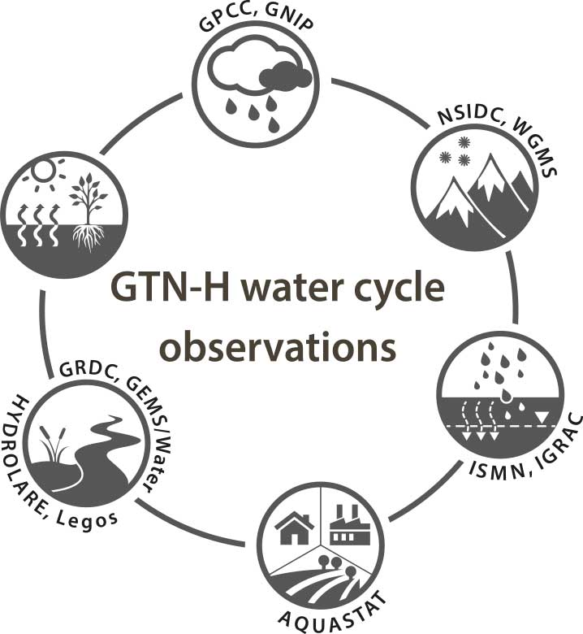




ISMN migration to a new host
Network of the global water
data centres, In-situ focus!
Joint programme of the World Meteorological Organization (WMO) and the Global Climate Observing System (GCOS); implemented in 2001
ISMN was only GTN-H member without long-term funding
ISMN
GRDC, GEMS/Water
data, users, providers
dataview/download
Notes:
Via GTN-H the idea arose to transfer network to the ICWRGC at the BfG in Germany
Joint programme of the World Meteorological Organization (WMO) and the Global Climate Observing System (GCOS); implemented in 2001
Key activities: development of discovery platform and data management matrix

Slide 11
Migration status
2018 Start of negotations with the German Government
2021 Clearance of finances from German Ministry for Digital and Transport
2021/2022 ISMN Migration
2023 ISMN in production at ICWRGC
Certification as WMO and FAO data centre
Set up of a scientific board
Nov 2021 - May 2022: Recruitment of staff and skills transfer
Dec 2021 - Feb 2022:
Feb 2022 - June 2022 technical transfer of software stack and data to new host
Jul – Dec 2022: Parallel operations
2017 GTN-H Panel Meeting
Cooperation agreement signed
More data acquisition, emphasis on global south
Data and scientific contributions are very welcome. Please get in touch with us: ismn@bafg.de
ismn@geo.tuwien.ac.at
Notes:
- More data acquisiton in global south and at NHMS

Slide 12

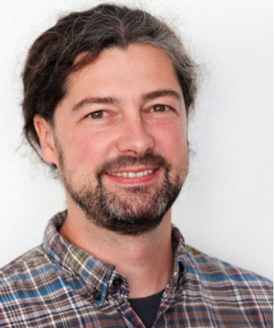

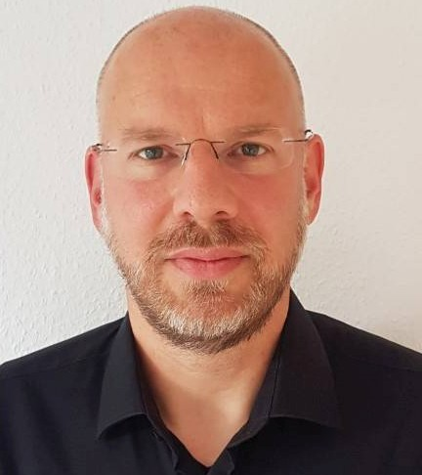

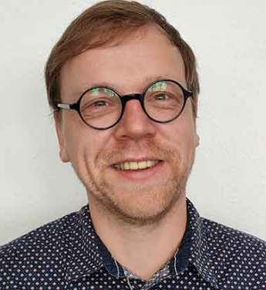


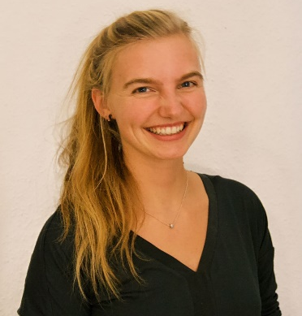

ISMN Team TUW
ISMN Team ICWRGC/BfG
Kajsen Kramer
IT solutions
Daniel Abrerer Quality Control
Stephan Dietrich Transfer coordination
Irene Himmelbauer
Project coordination
Positions for research and IT
Continuous collaboration of two teams
Wolfgang Korres
Research & Development
Wouter Dorigo
Project lead
Matthias Zink Project lead & management
Ivana Petrakovic
Data management
Fay Boehmer
Data management
Lukas Schremmer Frontend
Tunde Olarinoye Frontend/Product dev.

Slide 13
Wrap up…
During the transfer:
- Primary objective is to keep the database service uninterrupted during transfer phase
After:
- Continuous collaboration with TU Wien/ESA, sharing ideas for further development of ISMN
Outlook:
- Expanding more resources to data acquisition and intensify effort in data scarce regions
- Form a scientific advisory committee for ISMN; pursue the support of WMO and FAO
Finally:
- We hope we receive community-wide continuous support from soil moisture data providers and users
Notes:
- The takeover posed the challenge to migrate an operational service between two different teams, locations/hardware and organisations. A major objective is to keep the service continuously running throughout the migration. Here, we will present an overview of ISMN as well as the course and status of its migration.
Suggestion:
…to keep the database service uninterrupted throughout…

Slide 14
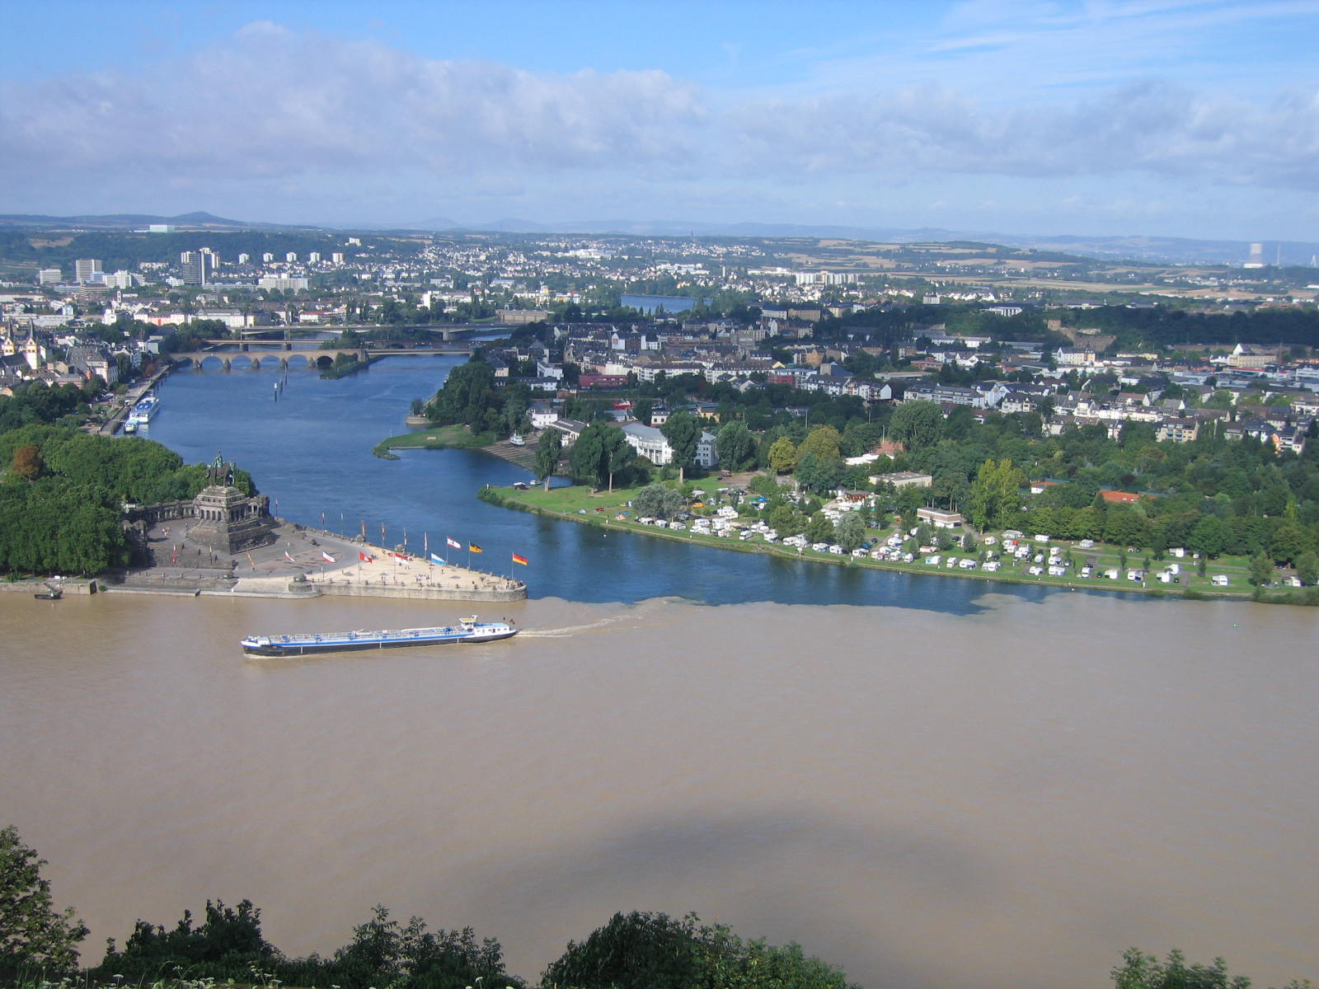

@ismn_earth
Thank you for listening
https://ismn.earth
ismn@bafg.de
ismn@geo.tuwien.ac.at

Slide 15

References:
Dorigo, W., Xaver, A., Vreugdenhil, M., Gruber, A., Hegyiová, A., Sanchis-Dufau, A., et al. (2013). Global Automated Quality Control of In situ Soil Moisture data from the International Soil Moisture Network. Vadose Zone Journal.
Dorigo, W., Himmelbauer, I., Aberer, D., Schremmer, L., Petrakovic, I., Zappa, L., Preimesberger, W., Xaver, A., Annor, F., Ardö, J., Baldocchi, D., Bitelli, M., Blöschl, G., Bogena, H., Brocca, L., Calvet, J.-C., Camarero, J. J., Capello, G., Choi, M., Cosh, M. C., van de Giesen, N., Hajdu, I., Ikonen, J., Jensen, K. H., Kanniah, K. D., de Kat, I., Kirchengast, G., Kumar Rai, P., Kyrouac, J., Larson, K., Liu, S., Loew, A., Moghaddam, M., Martínez Fernández, J., Mattar Bader, C., Morbidelli, R., Musial, J. P., Osenga, E., Palecki, M. A., Pellarin, T., Petropoulos, G. P., Pfeil, I., Powers, J., Robock, A., Rüdiger, C., Rummel, U., Strobel, M., Su, Z., Sullivan, R., Tagesson, T., Varlagin, A., Vreugdenhil, M., Walker, J., Wen, J., Wenger, F., Wigneron, J. P., Woods, M., Yang, K., Zeng, Y., Zhang, X., Zreda, M., Dietrich, S., Gruber, A., van Oevelen, P., Wagner, W., Scipal, K., Drusch, M., and Sabia, R.: The International Soil Moisture Network: serving Earth system science for over a decade, Hydrol. Earth Syst. Sci., 25, 5749–5804, https://doi.org/10.5194/hess-25-5749-2021, 2021.
Dorigo, W., Wagner, W., Albergel, C., Albrecht, F., Balsamo, G., Brocca, L., Chung, D., Ertl, M., Forkel, M., Gruber, A., Haas, E., Hamer, P. D., Hirschi, M., Ikonen, J., De Jeu, R., Kidd, R., Lahoz, W., Liu, Y. , Miralles, D., Mistelbauer, T., Nicolai-shaw, N., Parinussa, R., Pratola, C., Reimer, C., Van der Schalie, R., Seneviratne, S. I., Smolander, T. & Lecomete, P., (2017) ESA CCI Soil Moisture for improved Earth system understanding: State-of-the art and future directions. Remote Sensing of Environment.
Dorigo, W. A., Wagner, W., Hohensinn, R. , Hahn, S., Paulik, C., Xaver, A., Gruber, A., Drusch., M., Mecklenburg, S., van Oevelen, P., Robock, A., and Jackson, T., The International Soil Moisture Network: A data hosting facility for global in situ soil moisture measurements, Hydrology and Earth System Sciences 15 (5), pp. 1675?1698, 2011.

Slide 16
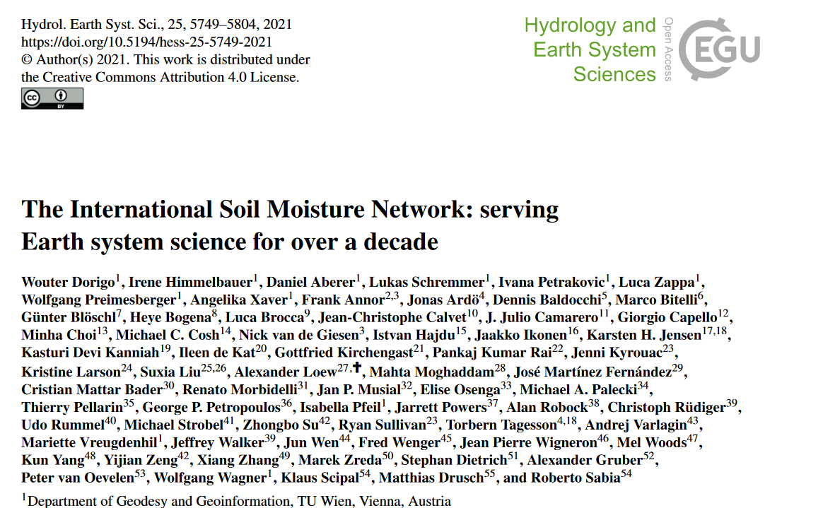
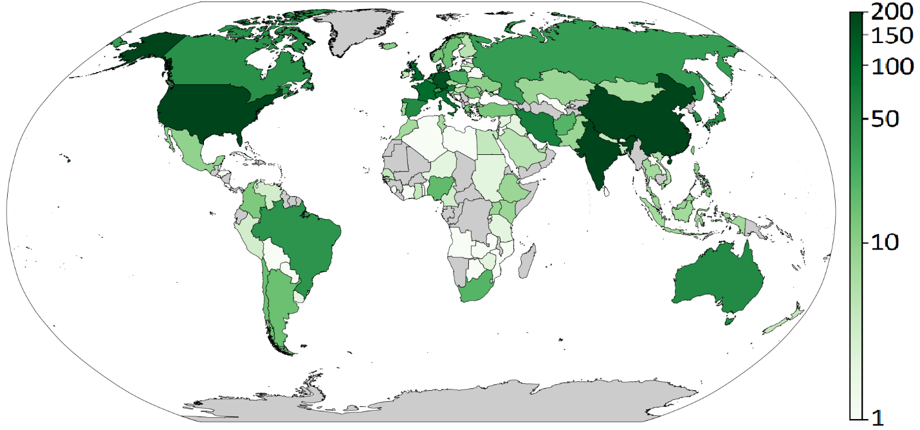
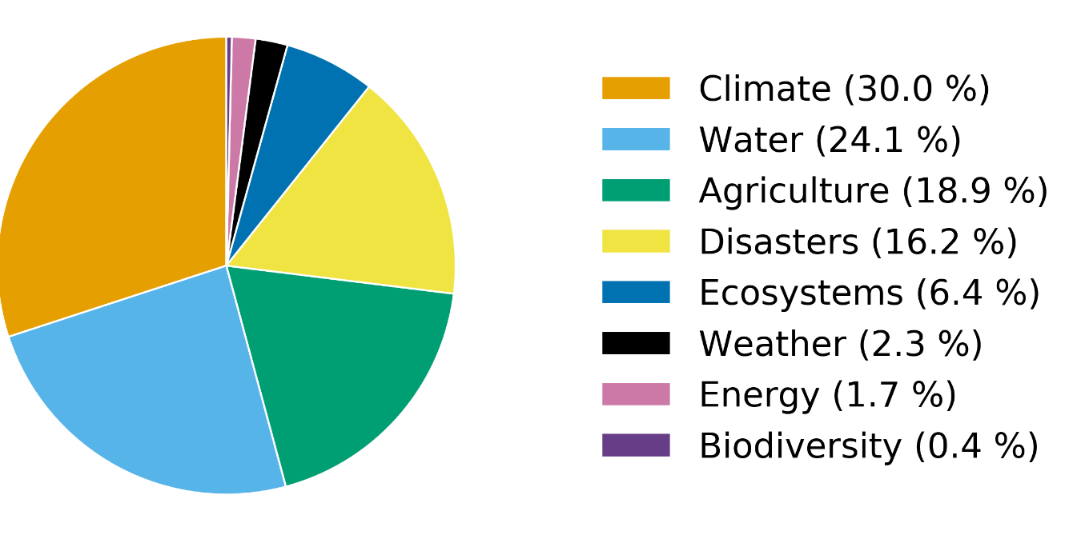
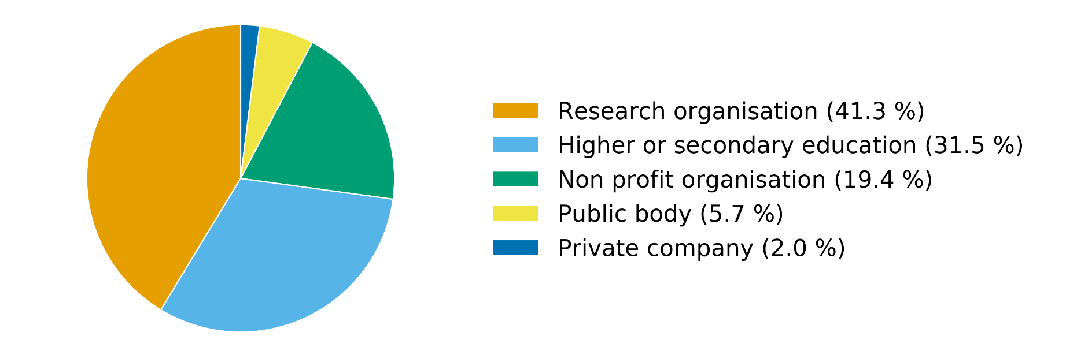
Over 10 years of ISMN
Number of ISMN users
ISMN data usage by sector
ISMN data usage by organisation type

Slide 17

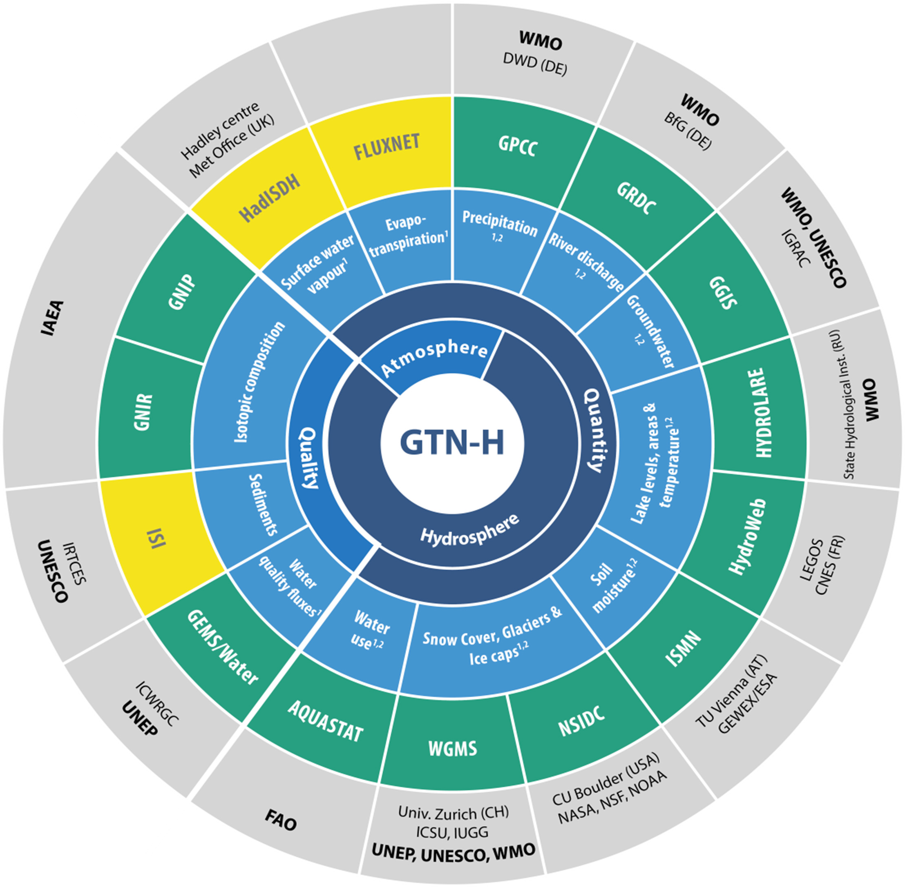

ISMN migration to a new host
Network of the global water
data centres, In-situ focus
Joint programme of the World
Meteorological Organization
(WMO) and the Global Climate
Observing System (GCOS); implemented
in 2001
Key Activity: Development of Discovery Platform and Data Management Matrix
Notes:
Long term financial support couldn‘t be assured at TU Vienna hence they searched for a new host
Via GTN-H the idea arose to transfer network to the ICWRGC at the BfG in Germany

Slide 18






www.waterandchange.org
Activities at the International Centre for Water Resources and Global Change (ICWRGC)

Slide 19
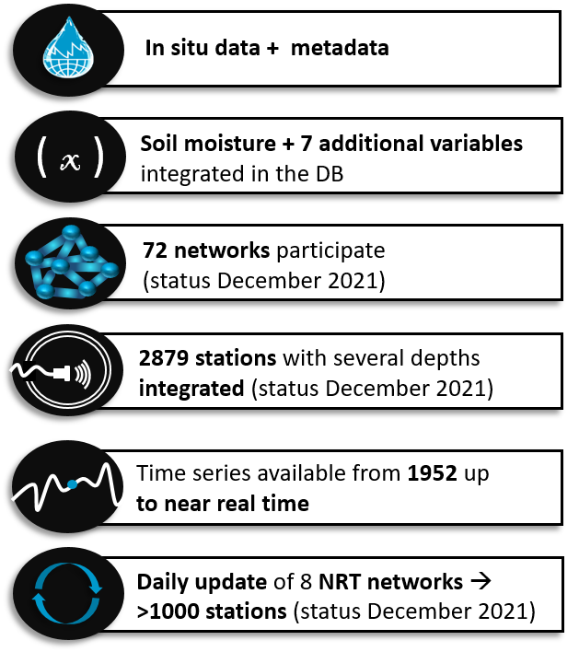
In-situ data availability
Surface temperature
Soil temperature
Air temperature
Snow depth
Snow water equivalent
Precipitation
Soil suction

Slide 20
The International Soil Moisture Network:
supporting and advancing EO research through open source in-situ soil moisture observations
Olarinoye, T., Boehmer, F., Dietrich , S., Zink, M., Himmelbauer, I., Schremmer, L., Petrakovic, I., Aberer, D., Korres, W., Kramer, K. and Dorigo, W.

