Slide 1



Design of wireless soil moisture sensor powered by bacteria charged paper battery
S.M.Meshram@tudelft.nl , S.Pande@tudelft.nl
Sumit M. Meshram, Dr. Saket Pande, Dr. Ludovic Jourdin

Slide 2


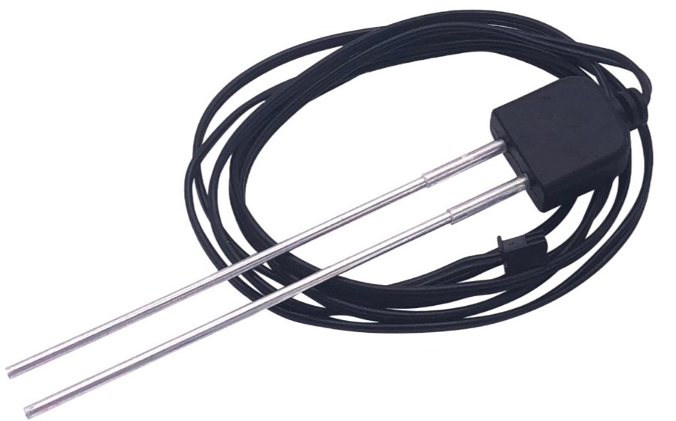
Need of biodegradable soil moisture sensor?
Expensive – cannot be used by poor smallholder farmers from developing countries
Toxic – harmful to environment
External power source – cannot be used in remote and off-grid
regions

Slide 3
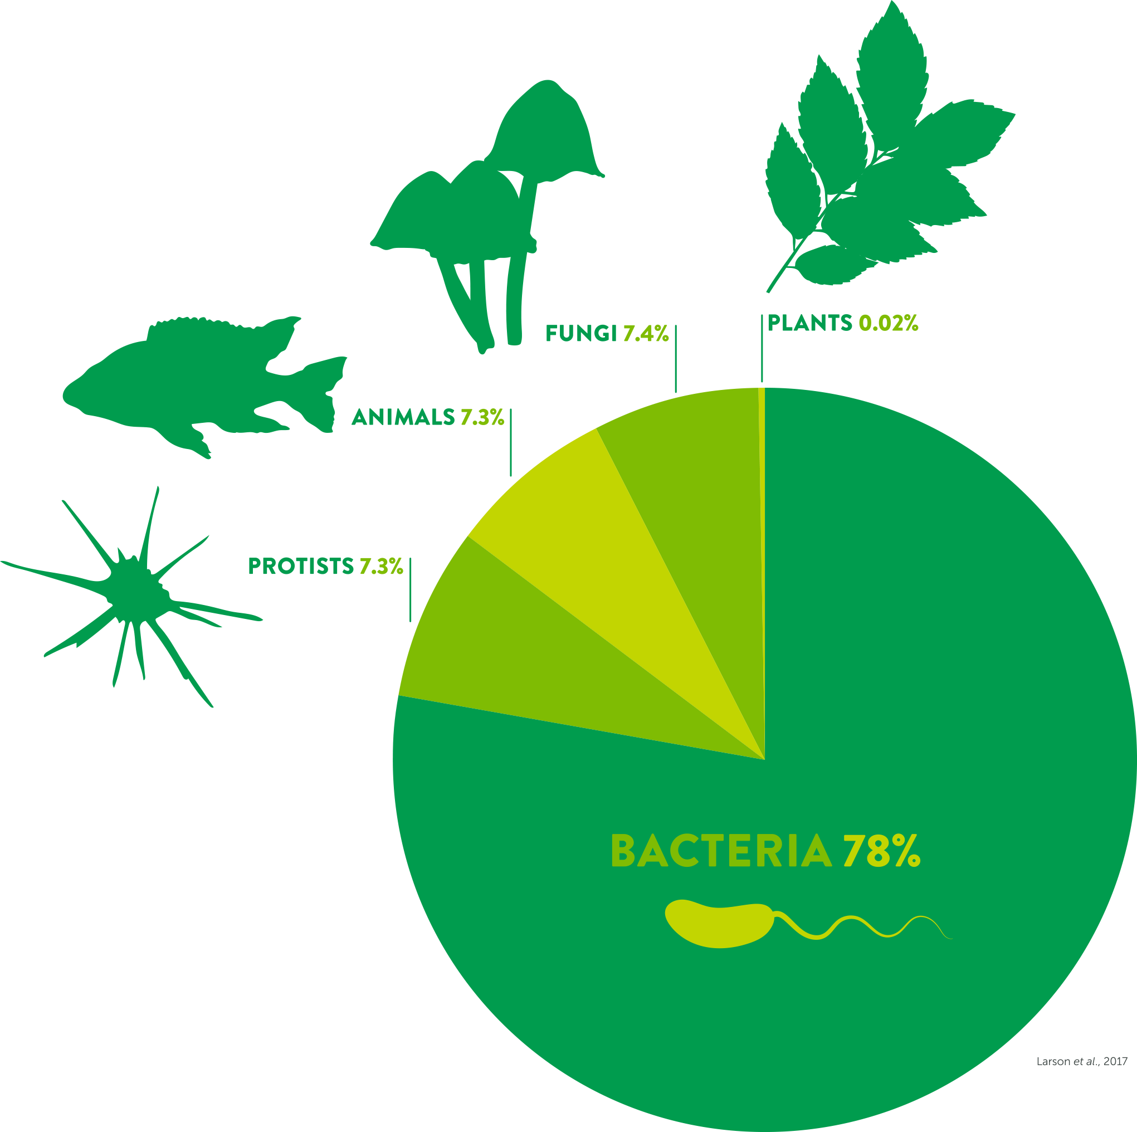
Introduction
Microbial Fuel Cell (MFC)
(converts chemical energy into electrical energy using microorganisms)
Sediment MFC
(organic compounds in soil)
Plant MFC
(organic matter excreted by roots)
Paper MFC
(cellulose paper as substrate)
Biodiversity on earth (Larsen et. al 2017)
Current Production
Proposed soil moisture sensor
SMFC
Bacterial Activity
Soil Moisture
Interrelationship between various components of SMFC

Slide 4
Research objectives
Develop a biodegradable MFC based paper battery will last for 4-6 months.
Measure the soil moisture wirelessly using semi-passive near field communication (NFC) tag.

Slide 5
Design steps and techniques to be used
Microbial fuel cell (MFC) technology - to find the electric current produced by the soil in the lab.
Origami technique (art of paper-folding) - for designing and developing biodegradable paper battery.
Embedding technology - for embedding NFC tags into the paper battery.
Inductive coupling - for measuring the soil moisture data using smartphone.

Slide 6
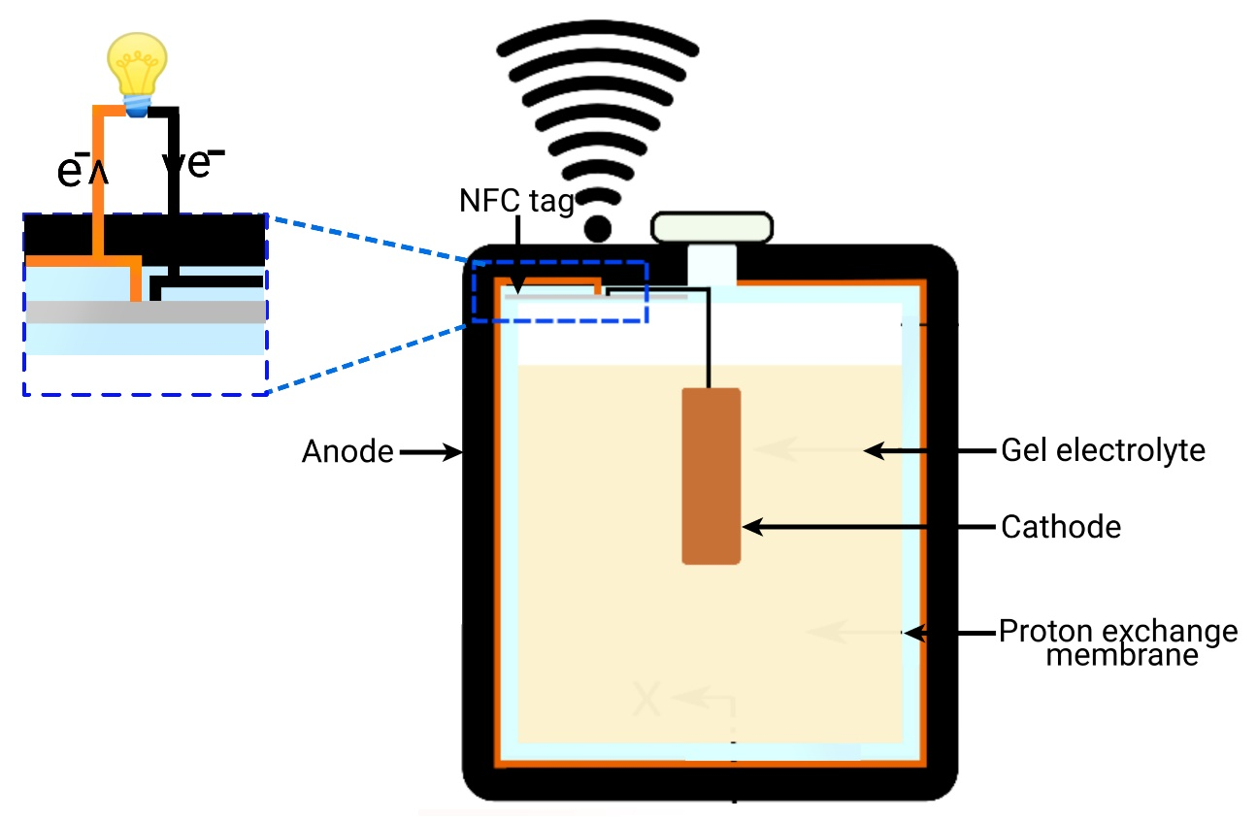
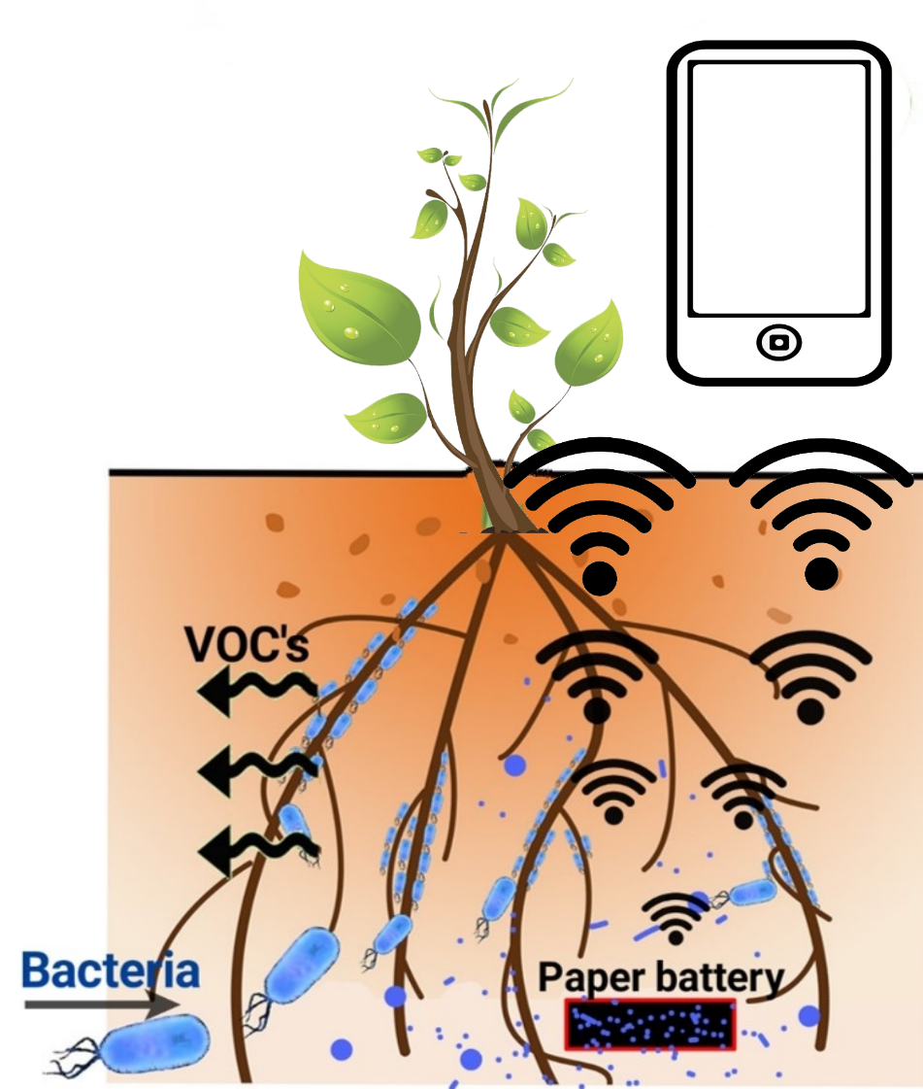
Expected outcome
Schematic representation of paper battery
Real time soil moisture monitoring system

Slide 7
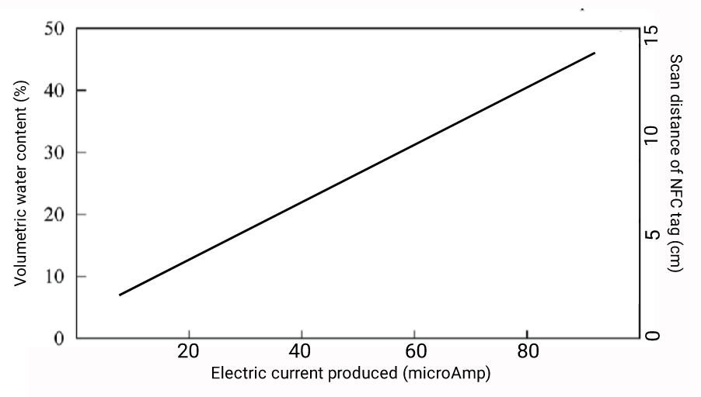
Expected Outcome
Expected relationship between soil moisture, current produced and scan distance

Slide 8




Acknowledgement
Acknowledgement
1) Government of Maharashtra, India - Funding agency
2) TU Delft, Netherlands
3) Plant-e, Startup company

