Slide 1
Coseismic and Postseismic Deformation of the January 24, 2020 Sivrice (Elazig) Earthquake Under the Constrain of Geodetic Observations
İlay Farımaz, Seda Özarpacı, Alpay Özdemir, M. Hilmi Erkoç, Efe Turan Ayruk, Semih Ergintav, Uğur Doğan, Ziyadin Çakır
This study is supported by TUBITAK 114Y250 and 118Y435 numbered projects.

Slide 2
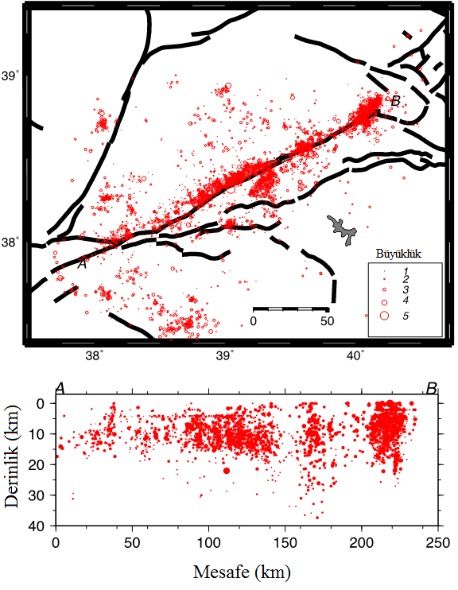
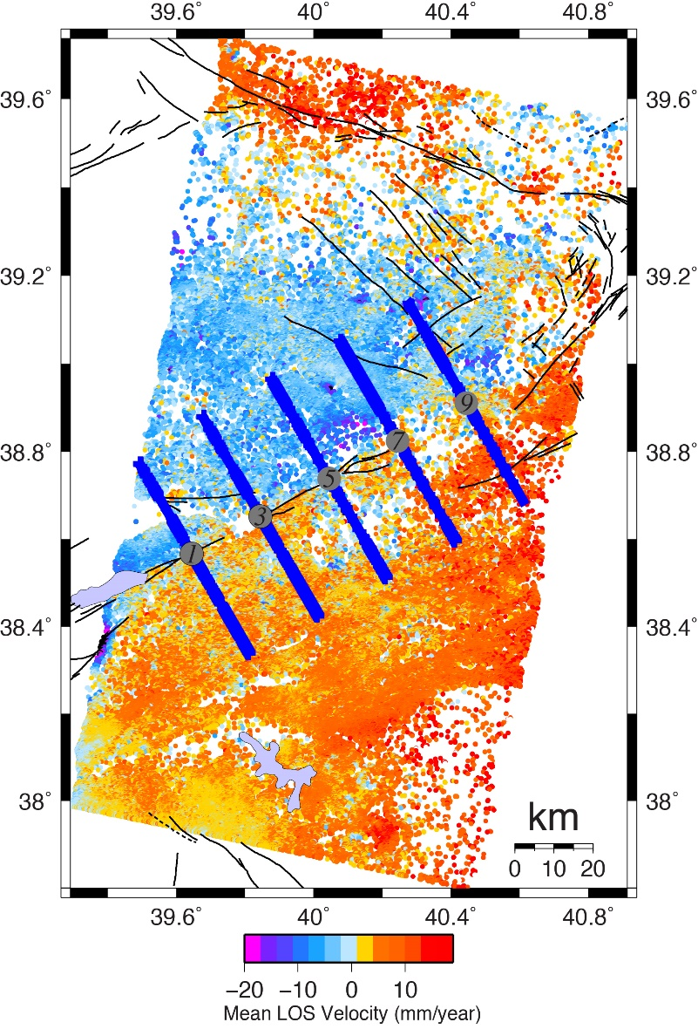
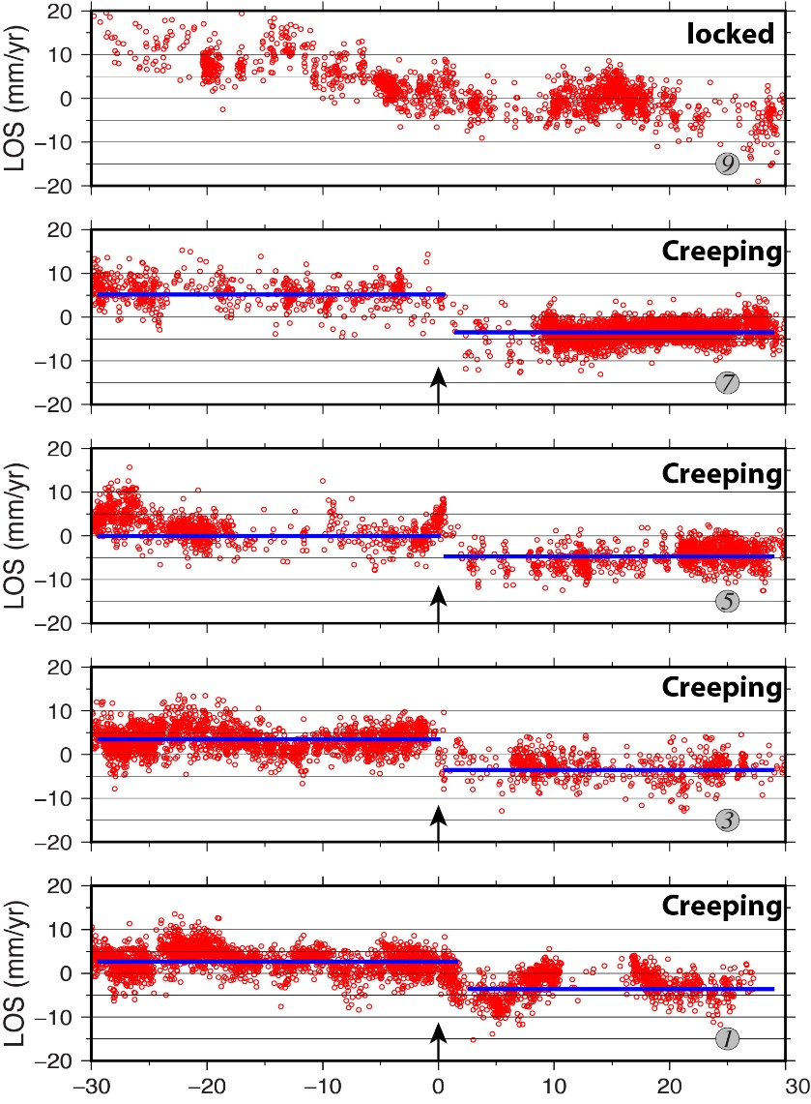
East Anatolian Fault and Motivation
(Ergintav, S.)
(Ergintav, S.)
Duman and Emre, 2013
(Çakır, Z.)
Notes:
I would like to start with our motivation for this study. Previous studies pointed that there is a seismic gap around Hazar Palu segment of the East Anatolian Fault. Ergintav et. al. shows seismological data. Here we can see gaps clearly. This leads us it is either locked or creeping.
InSAR velocity field is generated to see the status more clearly, it shows velocity gradient along the fault. This rapid velocity change points shallow creep, profiles also confirm this inference

Slide 3
Interseismic GPS Measurements
North(mm)
East(mm)
Notes:
Our team launched projects in between Lake Hazar-Palu to analyze this creeps’s temporal and spatial behaviour. Here are some GPS measurements within the scope of projects. The left is one of the CORS-TR stations and right one is campaign measurement. Through these projects, the interseismic behaviour is well known for us.

Slide 4
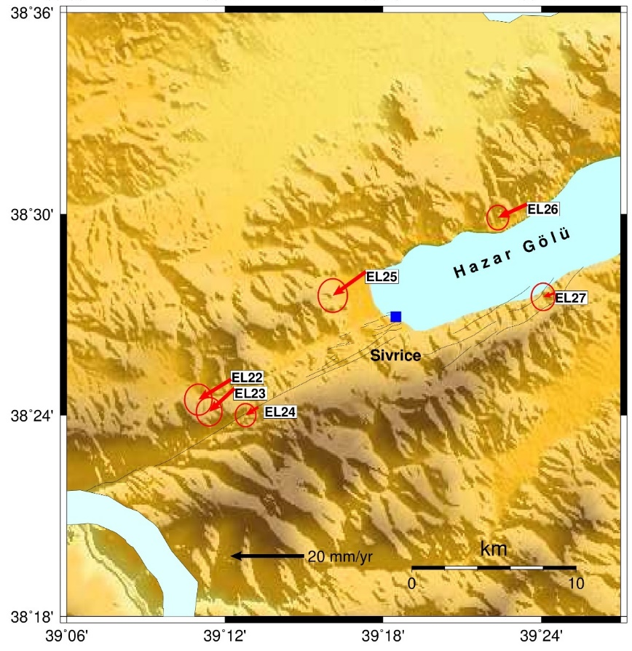
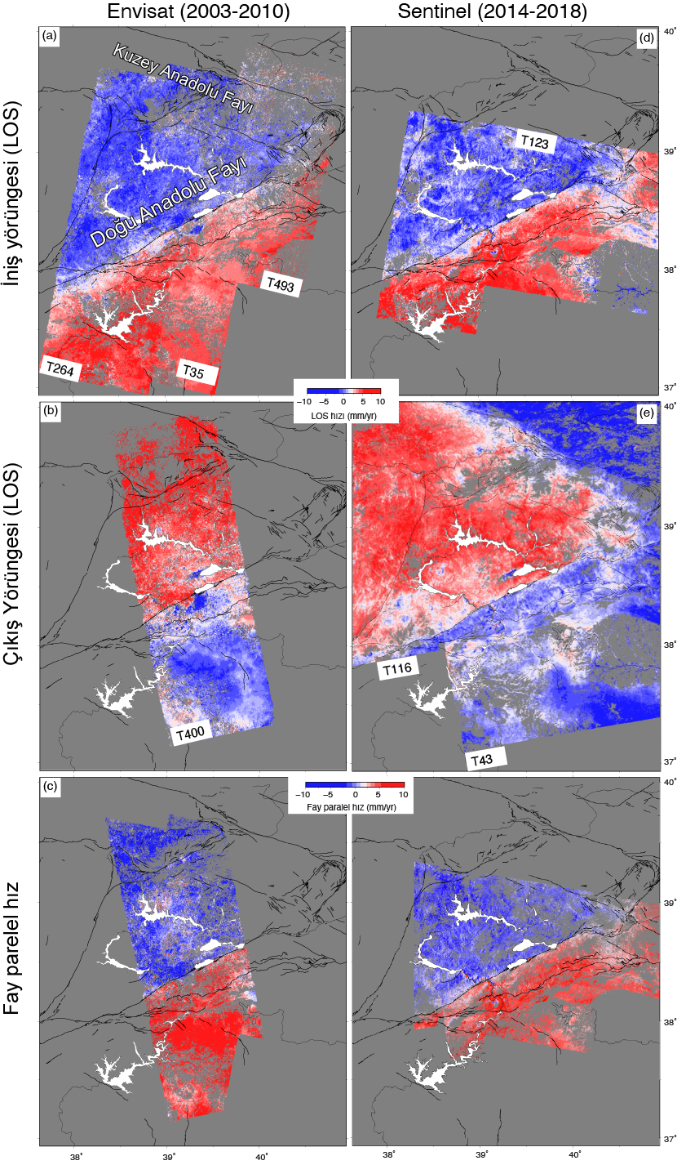
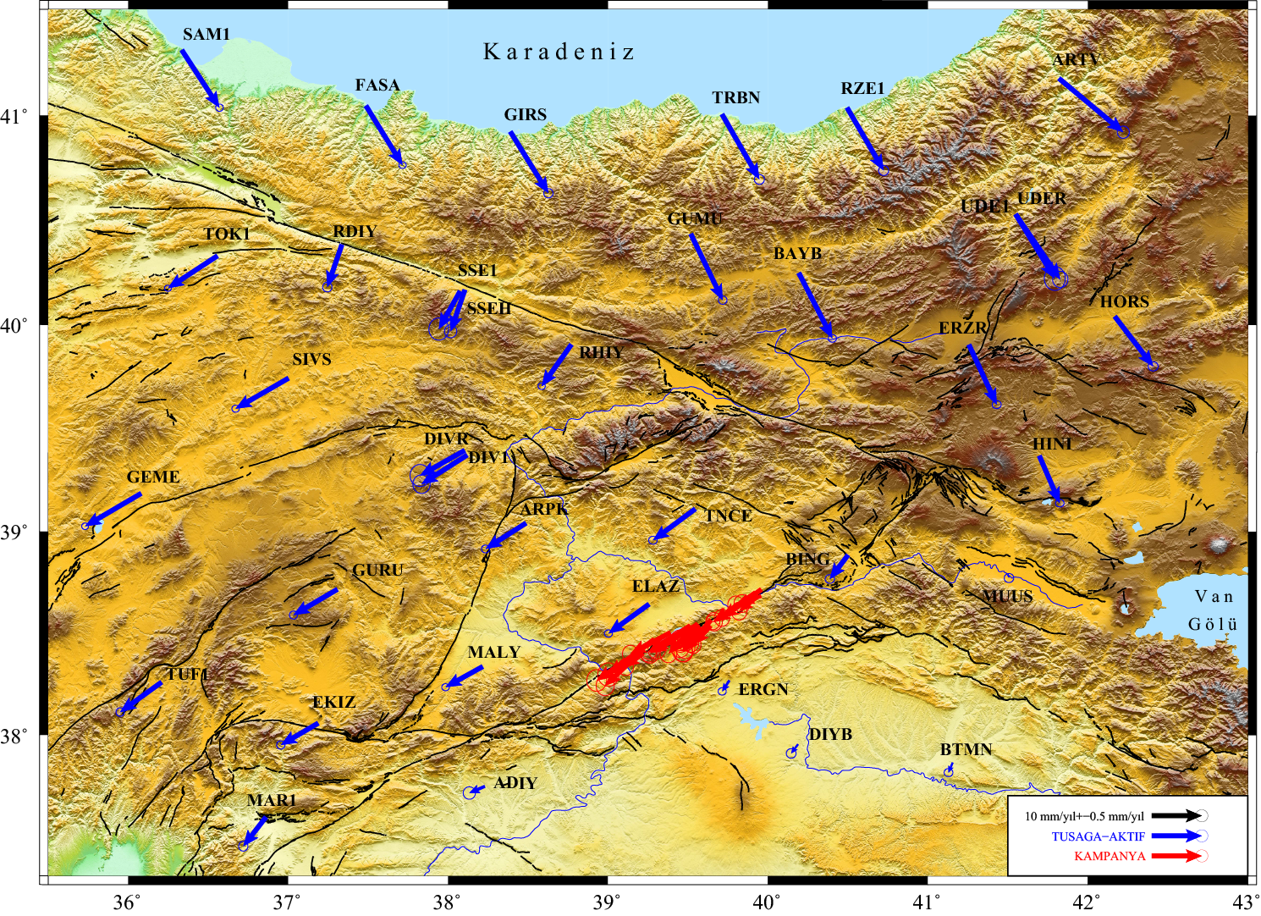

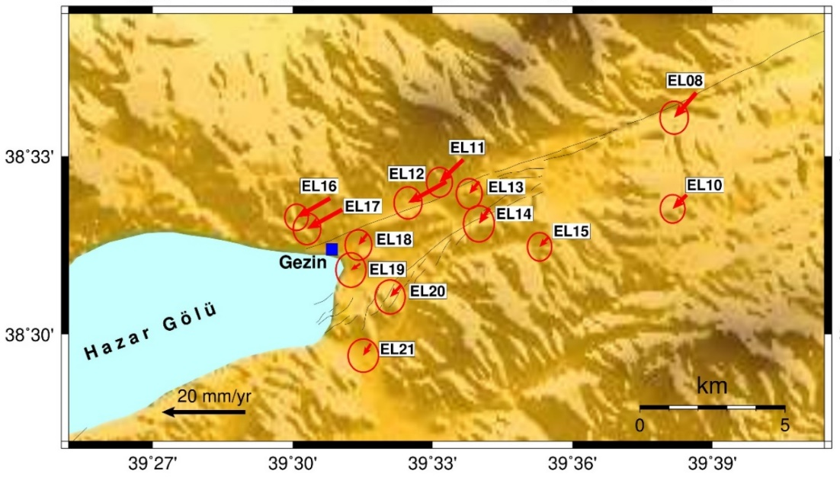
Interseismic Velocity Fields
Descending
(LOS)
Ascending
(LOS)
Fault parallel
Notes:
Here you can see Arabian fixed interseismic velocity field. It is observed on the north of the fault, there is velocities around 10mm/year. Velocity variations on fault’s north and south can be seen just like we saw in InSAR velocity field, even before modelling.

Slide 5
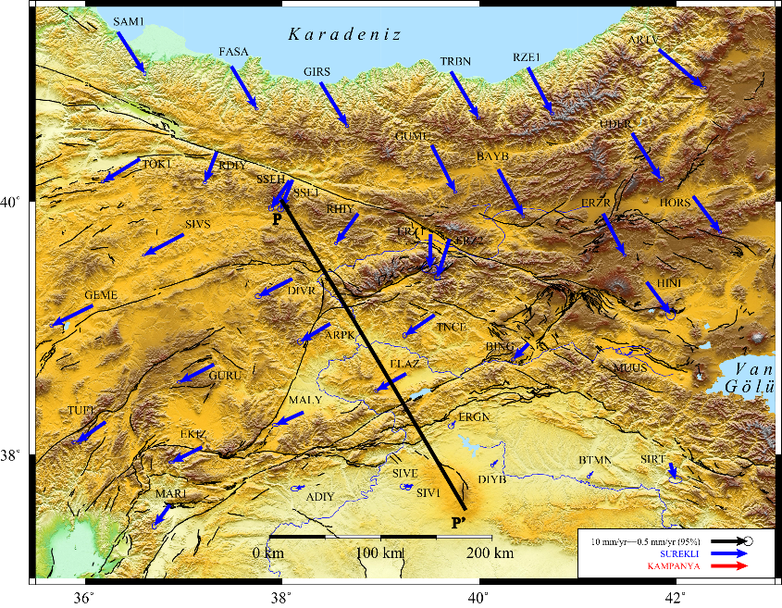
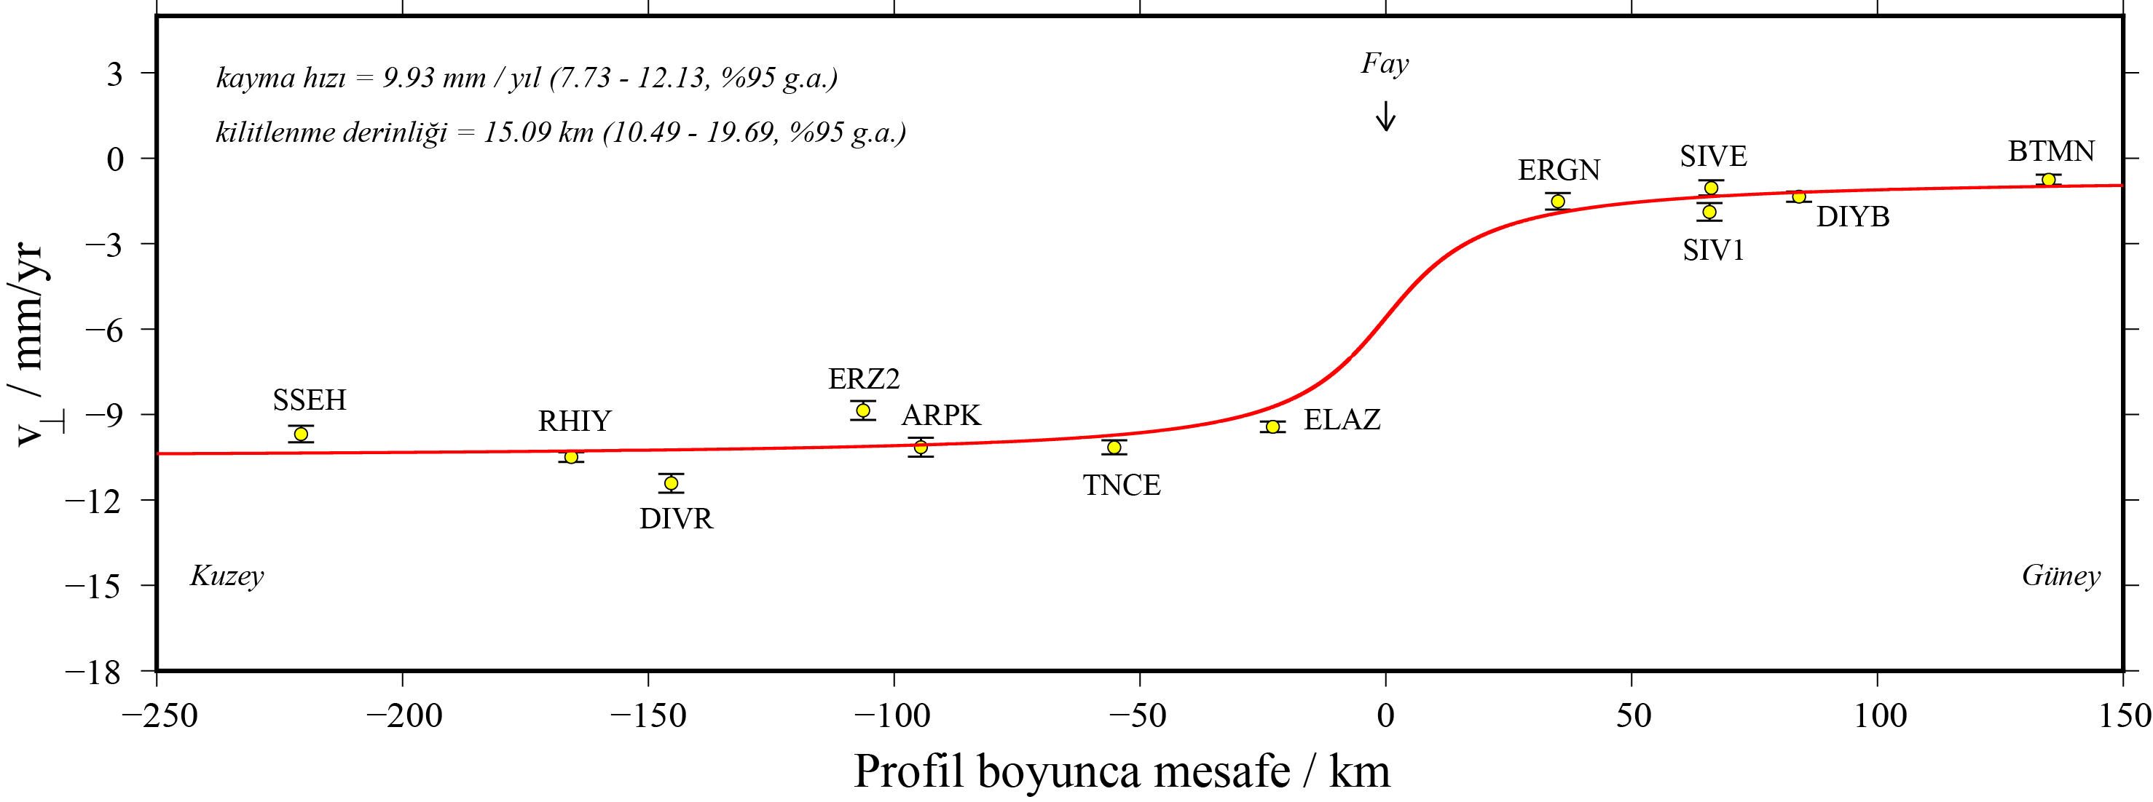
Far Field Elastic Modelling
Slip rate = 9.93 mm/year (7.73-12.13, %95 c.i.)
Locking depth = 15.09 km (10.49-19.69, %95 c.i. )
v_{II} mm/year
P
P’
Distance along profile / km
(Özarpacı, S.)
Notes:
We wanted to model the fault, for this purpose Slip rate and locking depth are estimated with elastic modelling using latest velocity field. It is clearly seen that the CORS data is on far field and so that, the effect on the fault can not be observed.

Slide 6
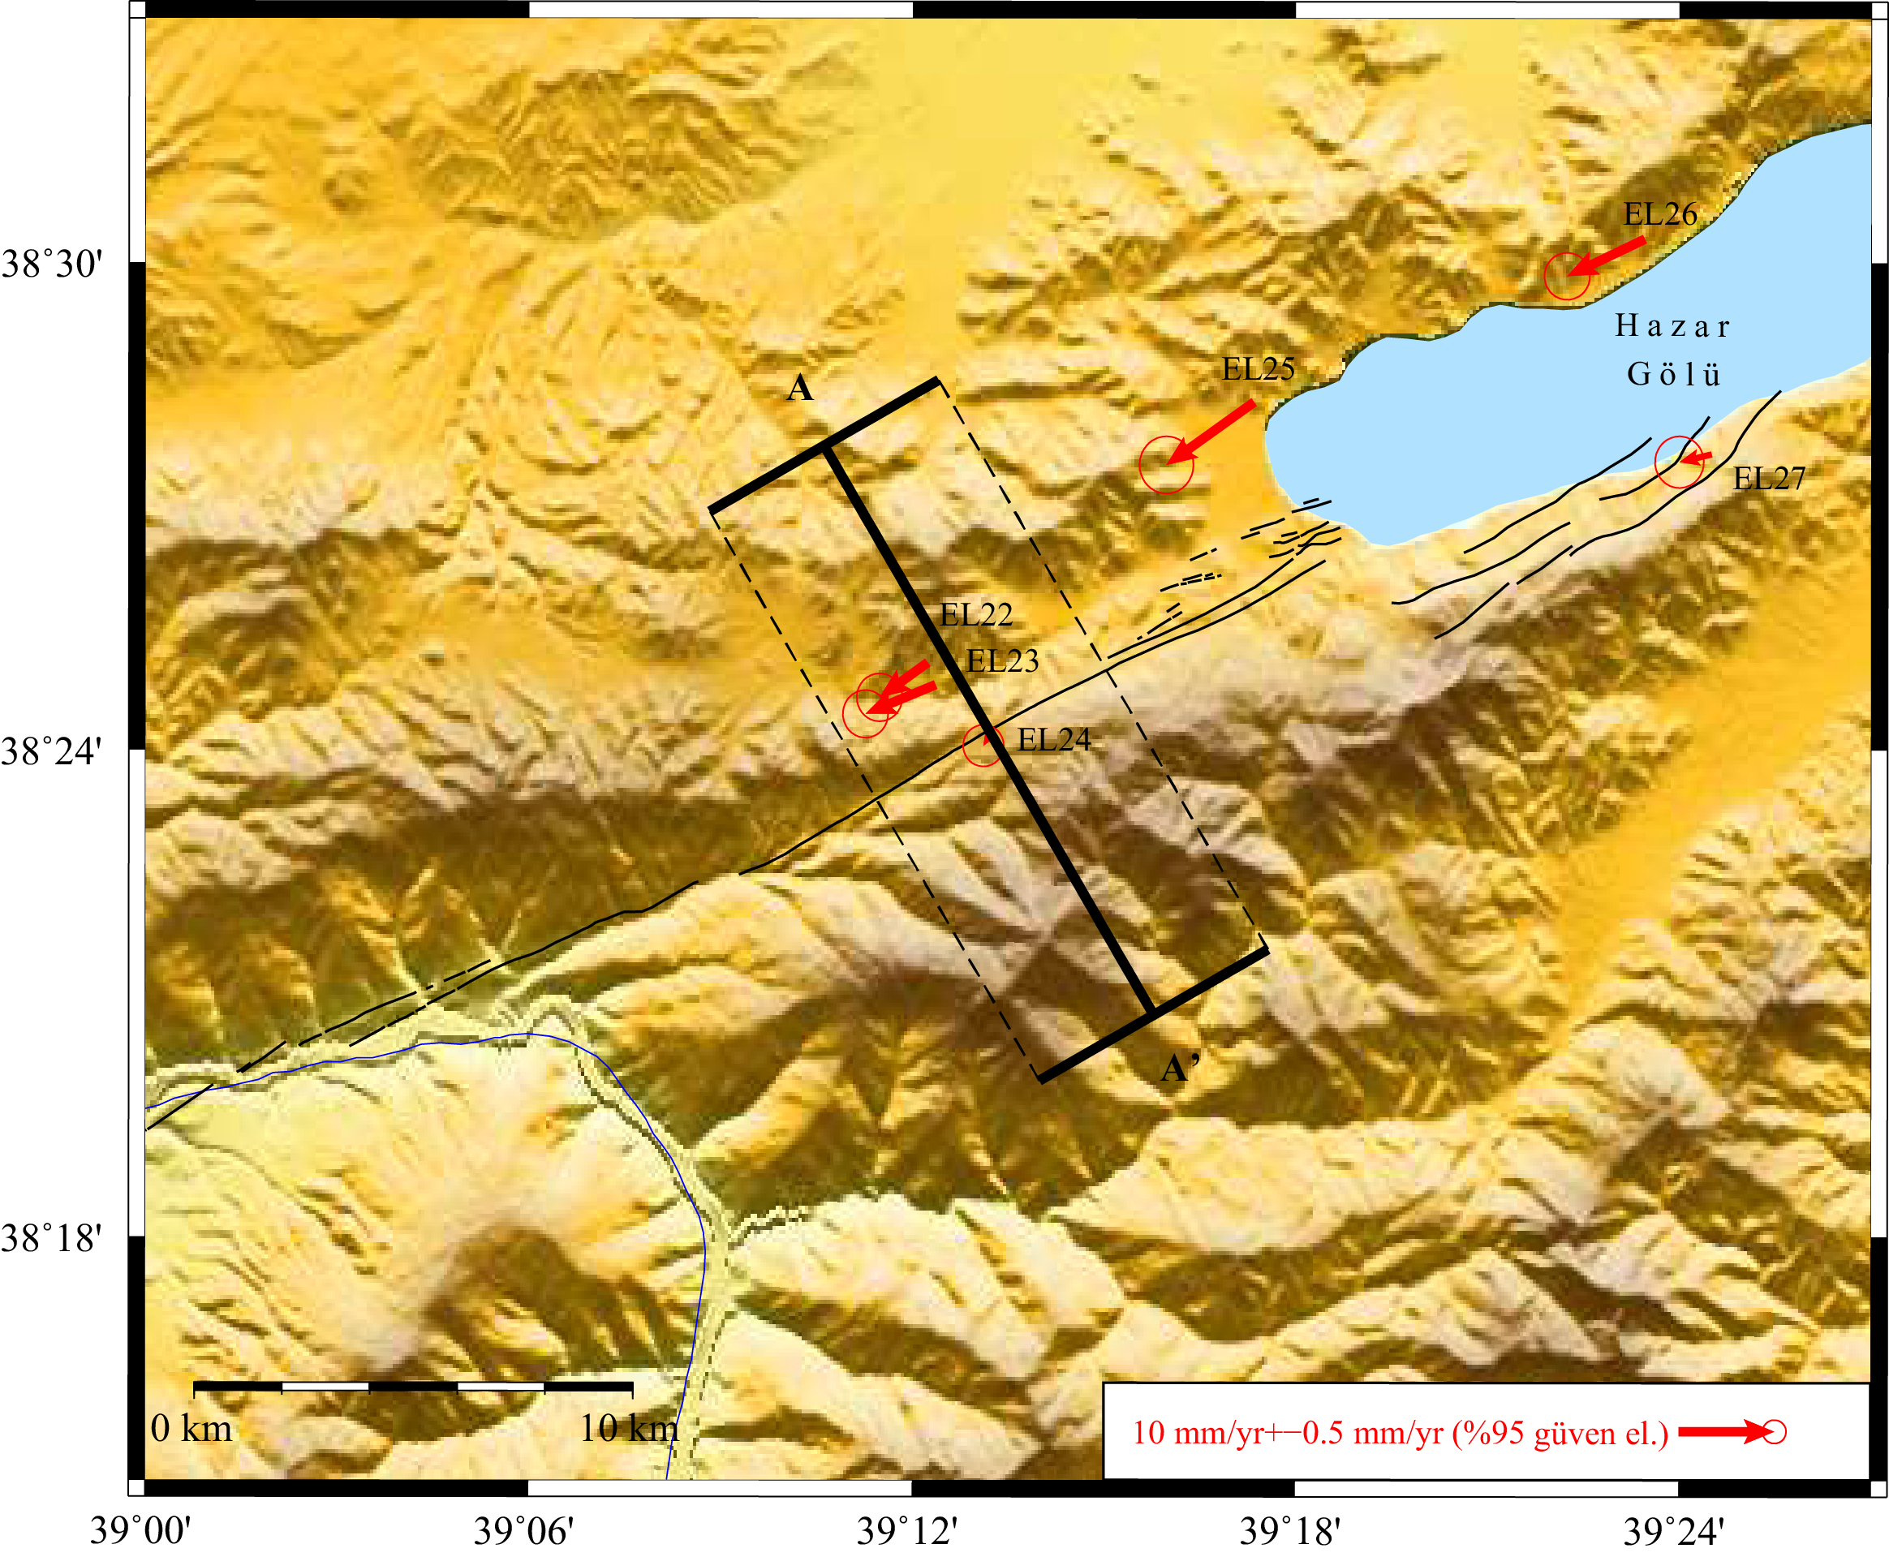
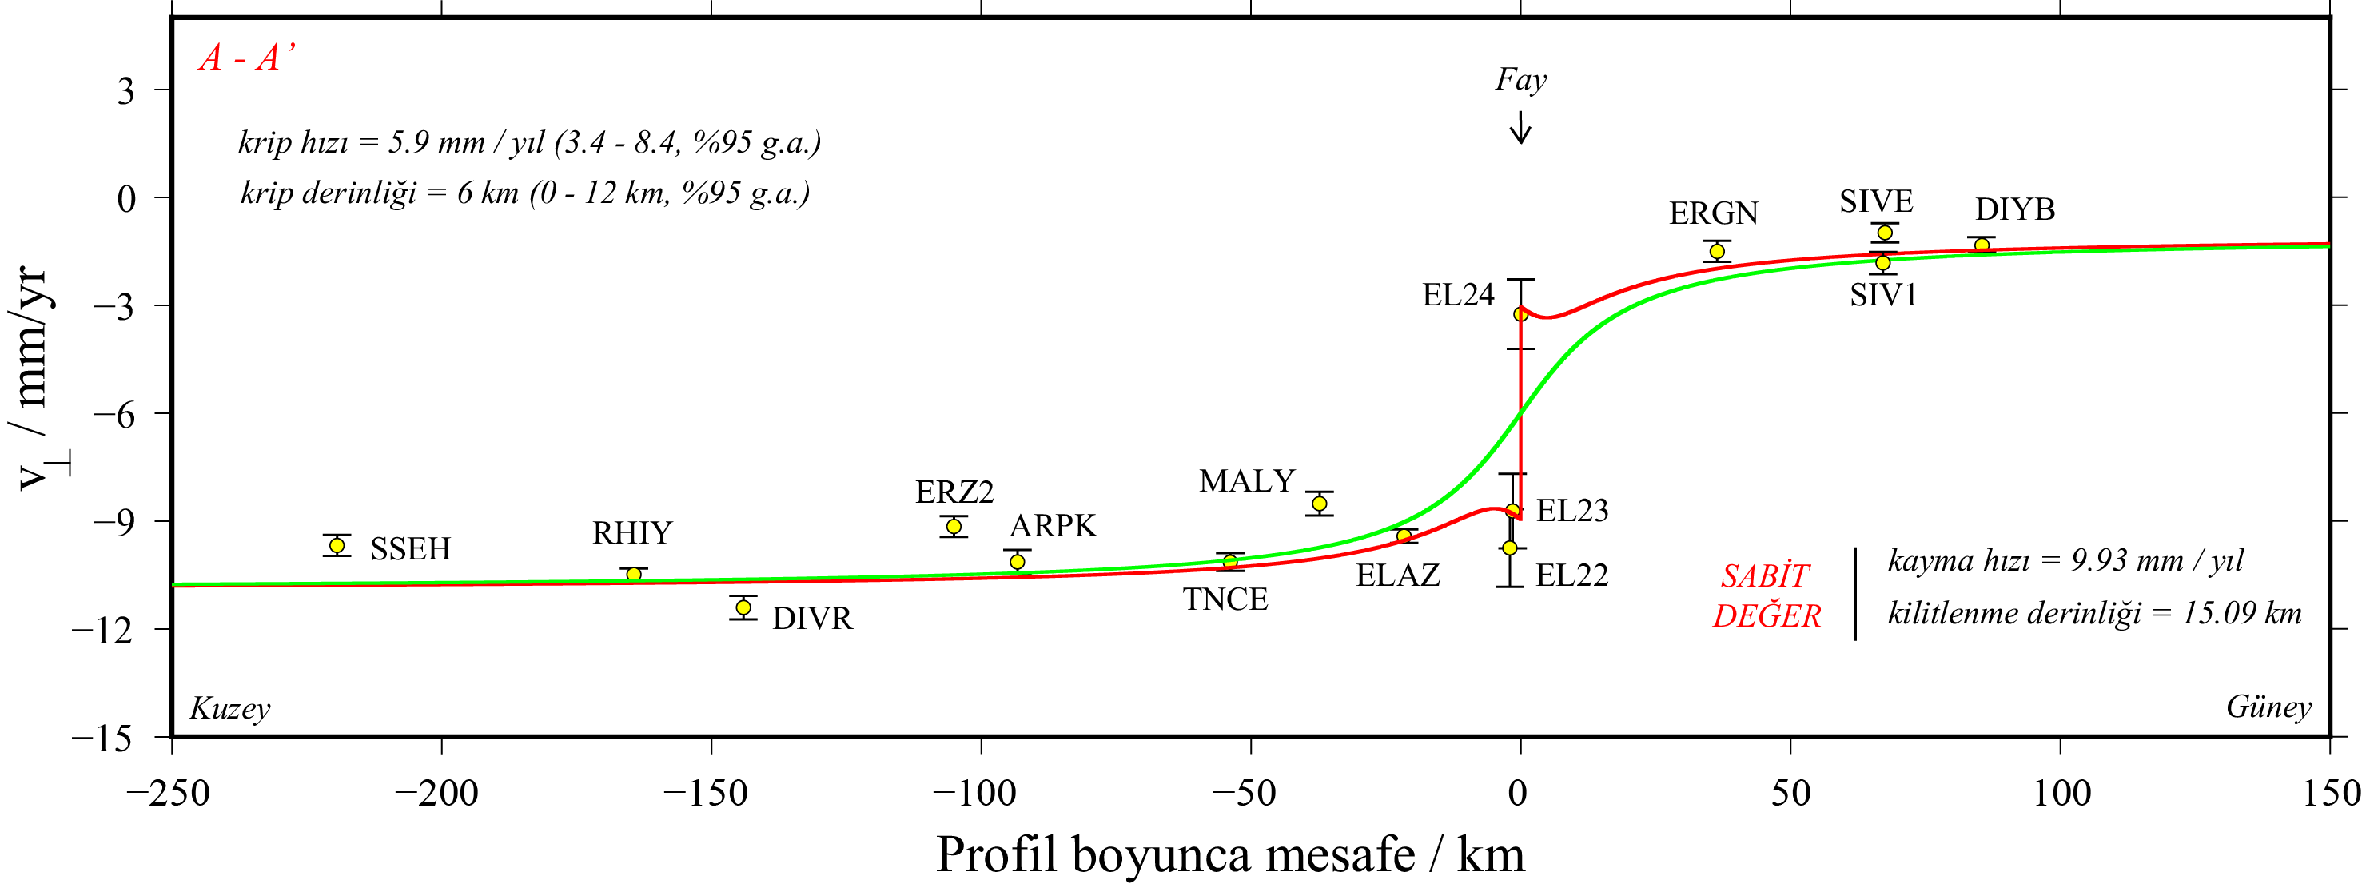
Interseismic Situation Close to Epicenter of the Earthquake
Creep rate = 5.9 mm/year (3.4-8.4, %95 c.i.)
creep depth =6 km (0-12 km, %95 c.i. )
v_{II} mm/year
Slip rate = 9.93 mm/year (7.73-12.13, %95 c.i.)
Locking depth = 15.09 km (10.49-19.69, %95 c.i. )
Distance along profile / km
Notes:
Thanks to campaign measurements, on near field we can observe and model the creep on Palu. Far field parameters are fixed, only creep rate and creep depth are estimated for near field.
This is a basic model, we will estimate 3D for next studies

Slide 7
24th January 2020 Sivrice Earthquake
5 periods of campaign measurement from previous project (2015-2017)
Campaign measurements over time within the scope of 118Y435 numbered project
Earthquake! Quickly planned,
extra measurements
right after earthquake
(25-30 January)
I
II
III
IV
V
VI
VII
Campaign measurement
Notes:
While our project is keep going, the earthquake occurred. After earthquake we went to the field as soon as possible. We establish a new GPS site and started to include some other sites from General Directorate of Mapping’s network.
Another creepmeter is placed on Kösebayır
The earthquake occurred on the other segment, westside of our study area.
We are lucky we monitor strain loading at the east part of the rupture zone

Slide 8
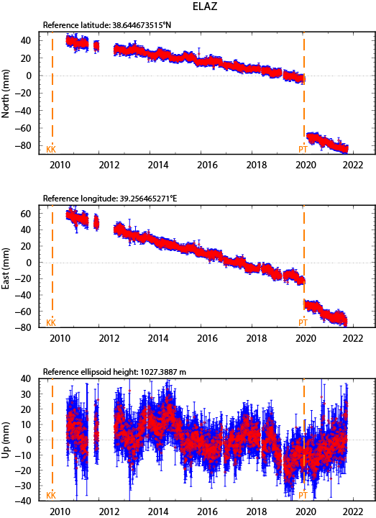
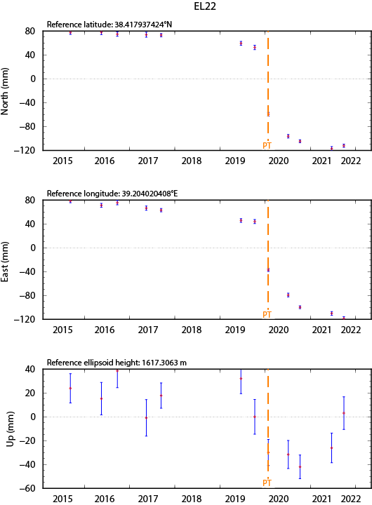
Coseismic + Postseismic GPS Time Series
Maximum horizontal deformation is on ELAZ station approximately 6 cm
Maximum coseismic displacement is on EL22 east component ~ -8 cm

Slide 9
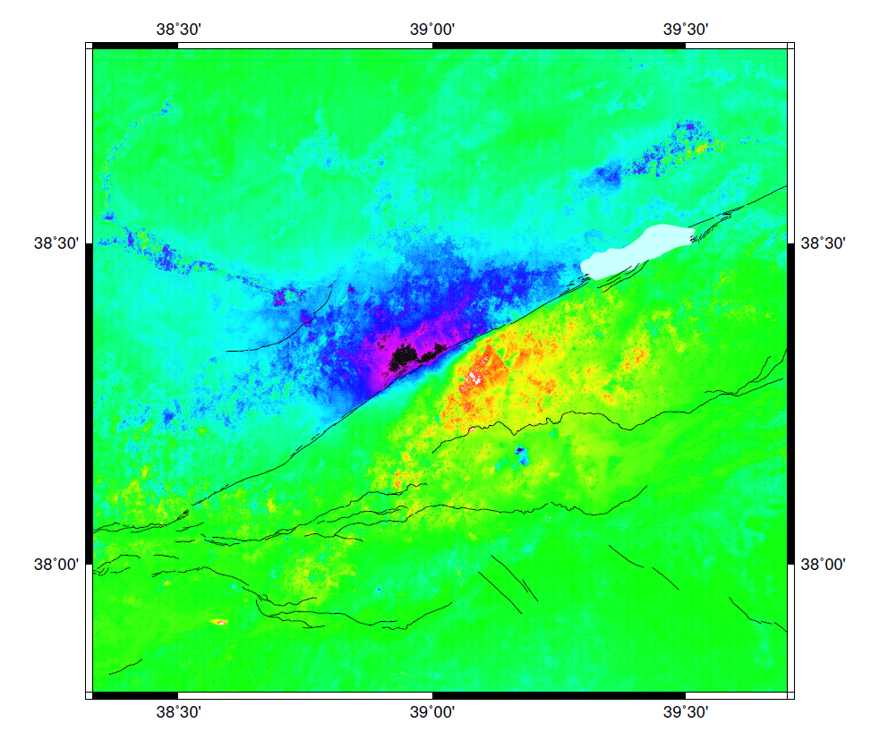

Coseismic GPS and InSAR Velocity Fields
Notes:
Insar velocity field includes coseismic and postseismic effects both.

Slide 10
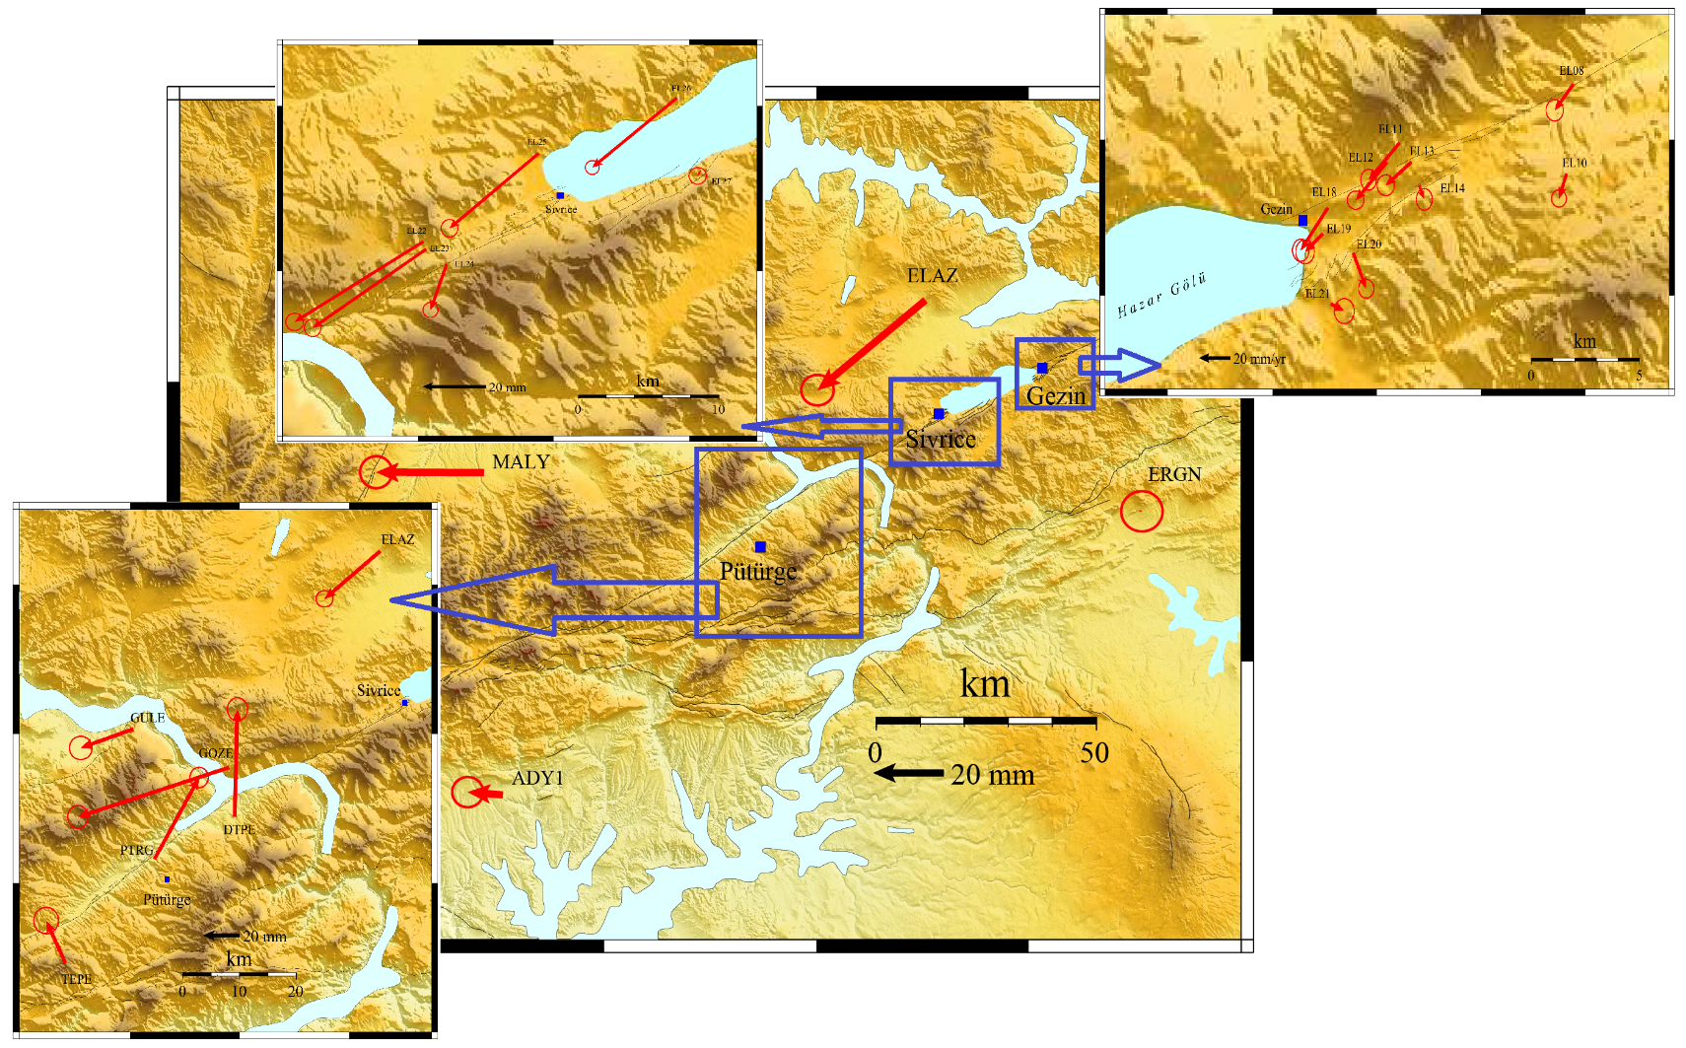
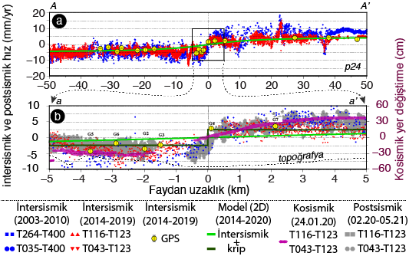
Post seismic InSAR and GPS Velocity Fields
 | Interseismic velocities |  |  |  | Postseismic velocities after logarithmic fitting |  |  |  | Differences
 | East (mm/yr) | North (mm/yr) | Stde (mm/yr) | Stdn (mm/yr) | East (mm/yr) | North (mm/yr) | Stde (mm/yr) | Stdn (mm/yr) | East (mm/yr) | North (mm/yr)
ELAZ | -8.5 | -4.52 | 0.02 | 0.02 | -8.22 | -4.56 | 0.02 | 0.02 | -0.28 | 0.04
ERGN | -1.08 | -1.66 | 0.02 | 0.02 | -1.38 | -1.12 | 0.02 | 0.02 | 0.3 | -0.54
MALY | -7.99 | -3.64 | 0.02 | 0.01 | -7.73 | -3.68 | 0.02 | 0.02 | -0.26 | 0.04
ADY1 | -1.62 | -3.7 | 0.3 | 0.28 | -2.02 | -2.94 | 0.22 | 0.25 | 0.4 | -0.76
TNCE | -7.99 | -5.17 | 0.02 | 0.02 | -7.7 | -5.19 | 0.02 | 0.02 | -0.29 | 0.02
EL22 | -8.49 | -5.61 | 2.47 | 2.36 | -8.91 | -5.53 | 0.76 | 0.86 | 0.42 | -0.08
EL23 | -7.22 | -6.33 | 2.06 | 2.25 | -6.86 | -6.32 | 0.71 | 0.79 | -0.36 | -0.01
EL24 | -3.81 | -2.18 | 0.94 | 1.16 | -3.41 | -2.21 | 0.64 | 0.57 | -0.4 | 0.03
EL25 | -9.01 | -6.8 | 1.61 | 1.84 | -8.97 | -6.48 | 0.81 | 0.93 | -0.04 | -0.32
EL26 | -8.18 | -3.94 | 1.26 | 1.26 | -7.94 | -3.64 | 0.6 | 0.68 | -0.24 | -0.3
Notes:
One and a half year deformation for GPS stations
We have also looked up for how much of postseismic effects is interseismic, here on this table you can see the differences. A logaritmşc fitting has been made on post seismic velocities, with tsview.

Slide 11
Results
We provide the latest GPS and InSAR velocity field and slip rate along East Anatolian Fault
Creep findings and parameters over Hazar Lake – Palu segment with GPS, for the first time.
Near field observations with GPS, InSAR and Creepmeter shows us that postseismic effect still lasts. It might be afterslip.
There is no deformations observed on far field.
We will study on Pütürge segment from now on.

Slide 12
Thank you..

