Slide 1



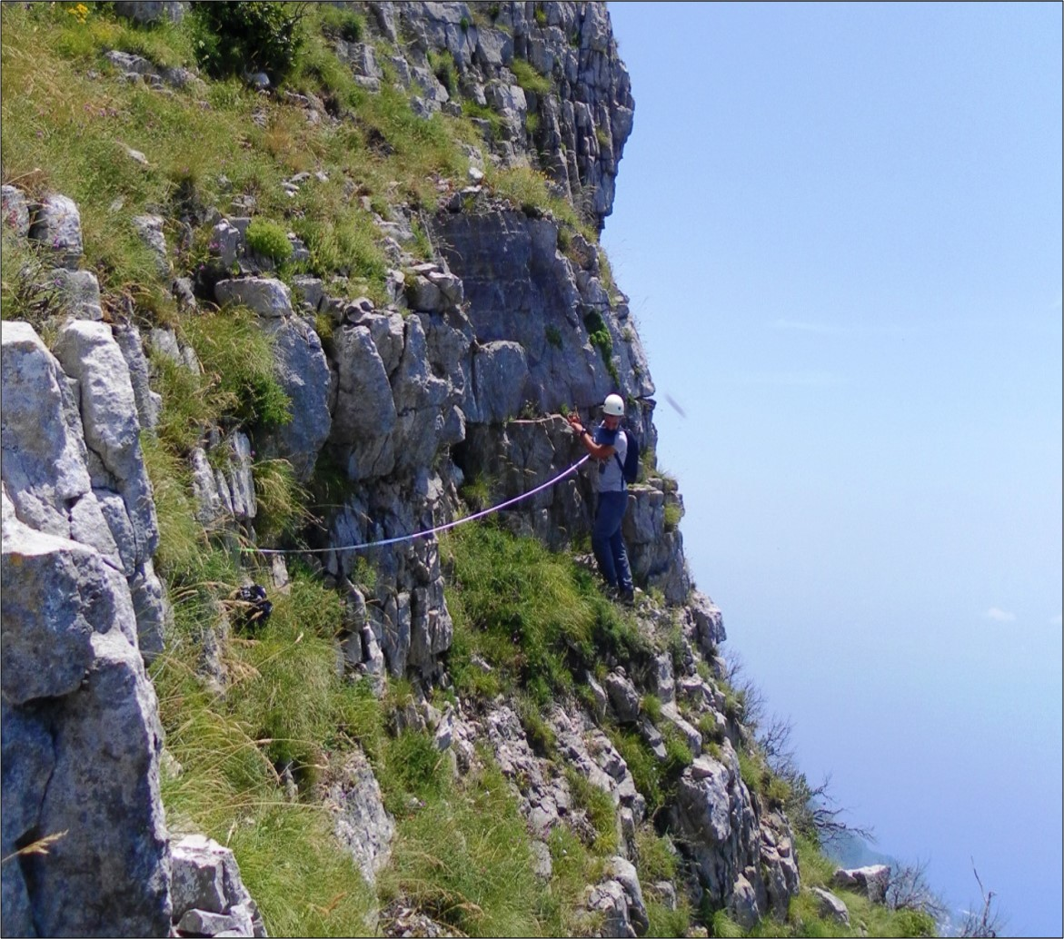


New granular rock-analogue materials for simulation of multi-scale fault and fracture processes
L. Massaro¹, J. Adam¹, E. Jonade¹, and Y. Yamada^{1,2}
¹ Department of Earth Sciences, Royal Holloway University of London, Egham, Surrey, TW20 0EX, United Kingdom.
² Department of Earth Resources Engineering, Kyushu University, Fukuoka, 819-0395, Japan.
Corresponding author: Luigi.Massaro.2018@live.rhul.ac.uk
24th May 2022

Slide 2
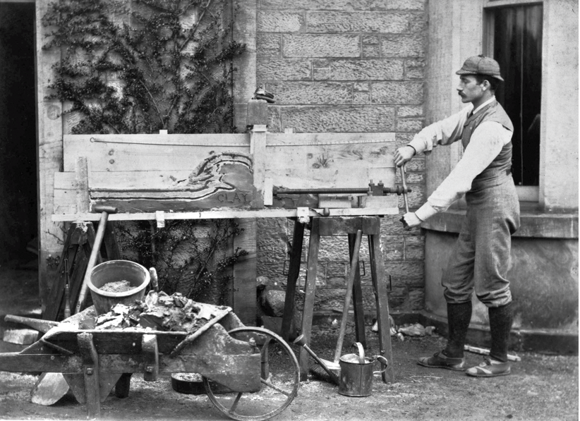
Analogue modelling techniques
Analogue modelling techniques provide an important tool for the spatial and temporal investigation of tectonic processes.
Dynamically scaled experiments enable the direct comparison between model and prototype.
Fig. 1. Henry Cadell with his deformation apparatus (H.M. Cadell, 1887).

Slide 3

Scaling theory
To obtain such a model, the physical and mechanical properties of rock prototype and model material are involved. The model materials, therefore, play a primary role in the definition of the processes that can be simulated and the structures that can be observed in the experiment.
Scaling theory, first developed by Hubbert, 1937.
Geometric Scaling = Lengths and angles
+ Time = Kinematic Scaling
+ Forces = Dynamic Scaling
$$\frac{C_{m}}{C_{p}}=\frac{ρ_{m}}{ρ_{p}}∙\frac{g_{m}}{g_{p}}∙\frac{L_{m}}{L_{p}}$$
Where C is cohesive strength, ρ is density, g is gravity, L is length
m and p are referred to model and prototype, respectively.
For experiments run at normal gravity conditions, the ratio g­­_{m} / g_{p} = 1.
Model Resolution: $\frac{Length model}{Length prototype} \frac{L_{m}}{L_{p}}=\frac{C_{m}}{C_{p}}∙\frac{ρ_{p}}{ρ_{m}}$

Slide 4

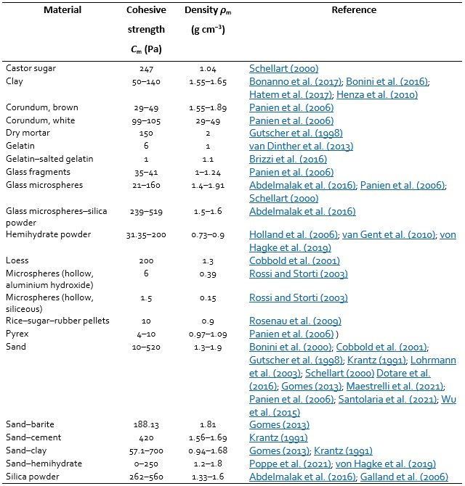
Granular materials like quartz sand are ideal for the simulation of upper crustal deformation processes due to the similar non-linear strain-dependent deformation behaviour of granular flow and brittle rock deformation.
We compared the key physical and mechanical properties of the most common analogue materials applied in the literature and calculated the model resolution (in terms of length equivalence between model and prototype) they can provide in dynamically scaled experiments.
A model resolution gap corresponding to the outcrop scale (1 m – 100 m) was identified.
1 cm model = 6.4 Km nature
Targeted GRAM scaling
Table 1. Model materials analysed for the dynamic scaling comparison and related values of cohesive strength and density.
Fig. 2. Length ratios model/prototype of the model materials listed in Table 1, calculated for a common prototype with 15 MPa of cohesive strength and 2.5 g cm⁻³ of density (Massaro et al., 2021).

Slide 5
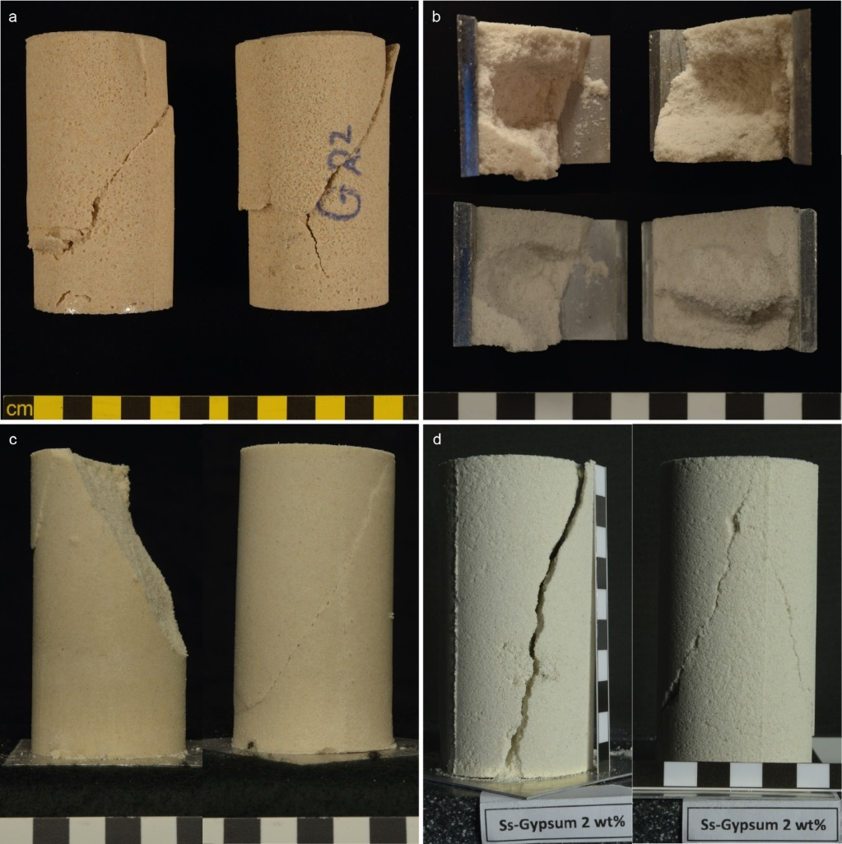
New Granular Rock-Analogue Material (GRAM): tested candidates
Starting from four potential aggregates based on quartz sand, we developed a new Granular Rock-Analogue Material (GRAM) composed of quartz sand, hemihydrate powder (hemihydrate calcium sulphate) and water, showing the following main characteristics (Massaro et al., 2021):
Deforms by tensile and shear fractures;
Preserves the non-linear deformation behaviour of granular materials;
Provides the required dynamic scaling for fault and fracture processes simulation.
The physical and mechanical properties of the candidate aggregates were tested with a Ring-shear tester and a Uniaxial compression tester.
Sand-Gelatine
Sand-Sugar
Sand-Vegetable oil
Sand-Hemihydrate
Fig. 3. Potential GRAM aggregates tested during the material development stage (Massaro et al., 2021).

Slide 6
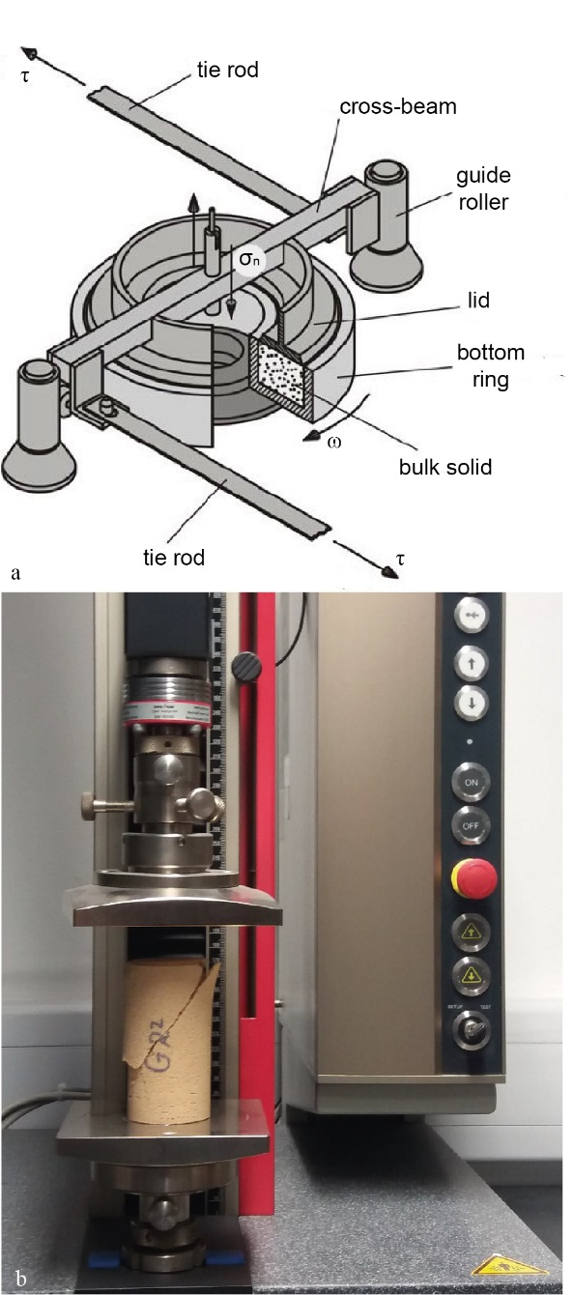
Material | Sample preparation |  |  | UCT | Ring-shear test
 | Form aggregates | Handling issues | Sample homogeneity | Shear and tensile fractures | Non-linear behaviour | Targeted scaling
Sand - Gelatine | ✓ | ✗
Sand - Sugar | ✓ | ✓ | ✗
Sand - Veg. Oil | ✓ | ✓ | ✓ | ✗ | ✓ | ✗
Sand - Hemihydrate | ✓ | ✓ | ✓ | ✓ | ✓ | ✓
Ring-shear test (RST)
Uniaxial compression test (UCT)
Fig. 4. Mechanical testers used: a) Ring-Shear tester (Schulze, 1994), b) Uniaxial Compression tester.
Table 2. Requirements checklist of the tested materials.

Slide 7
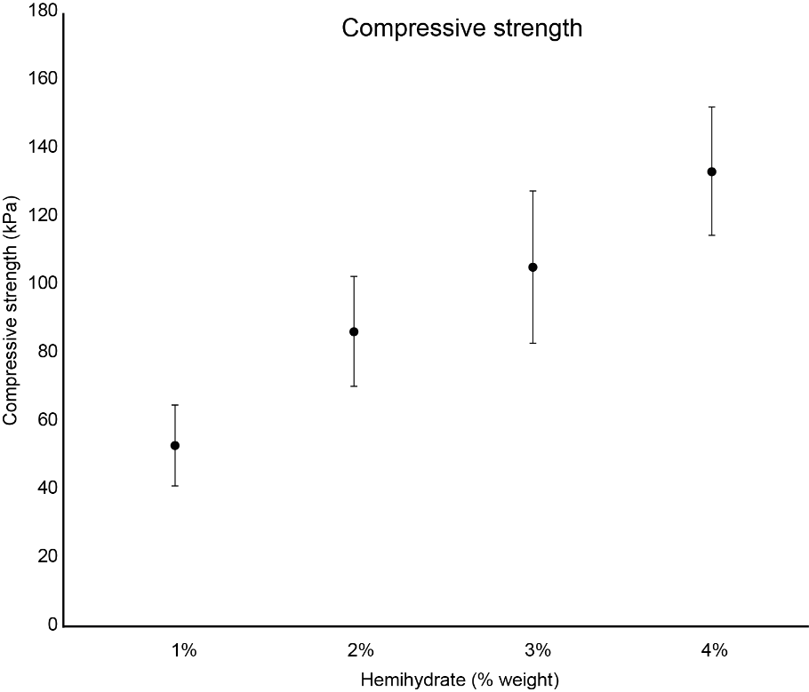
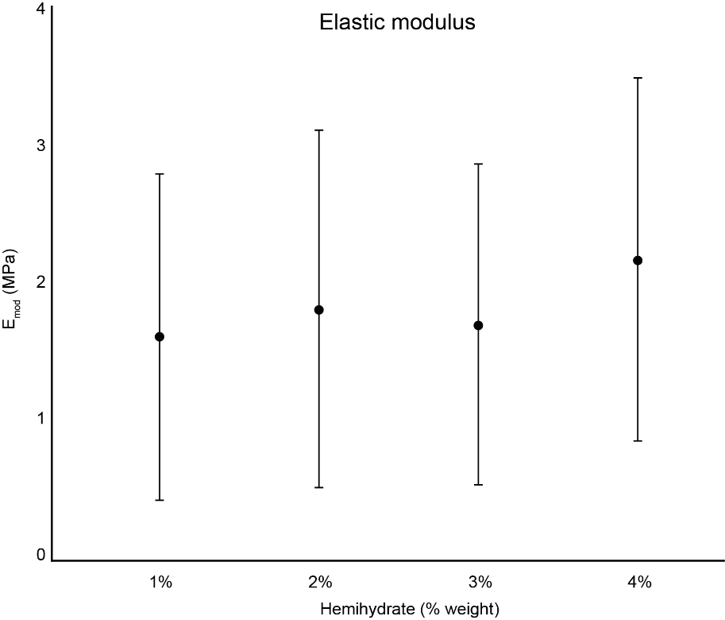
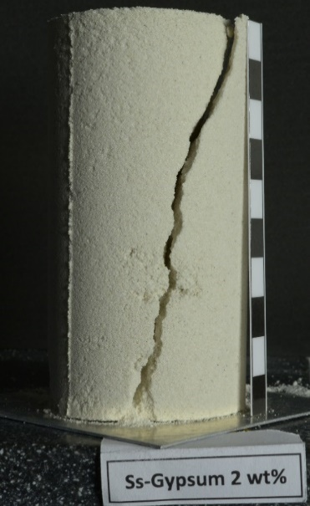
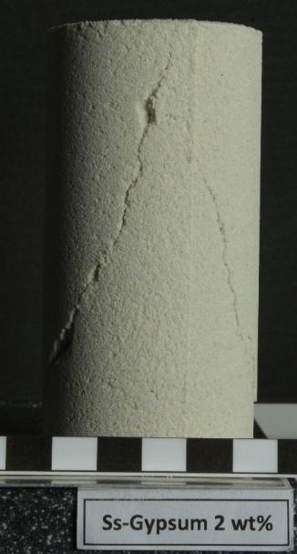
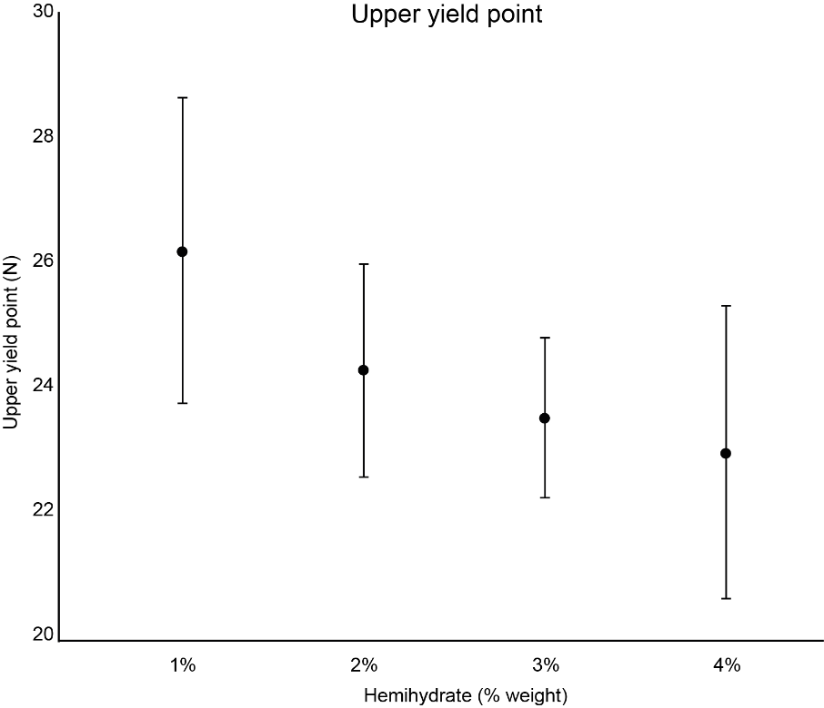
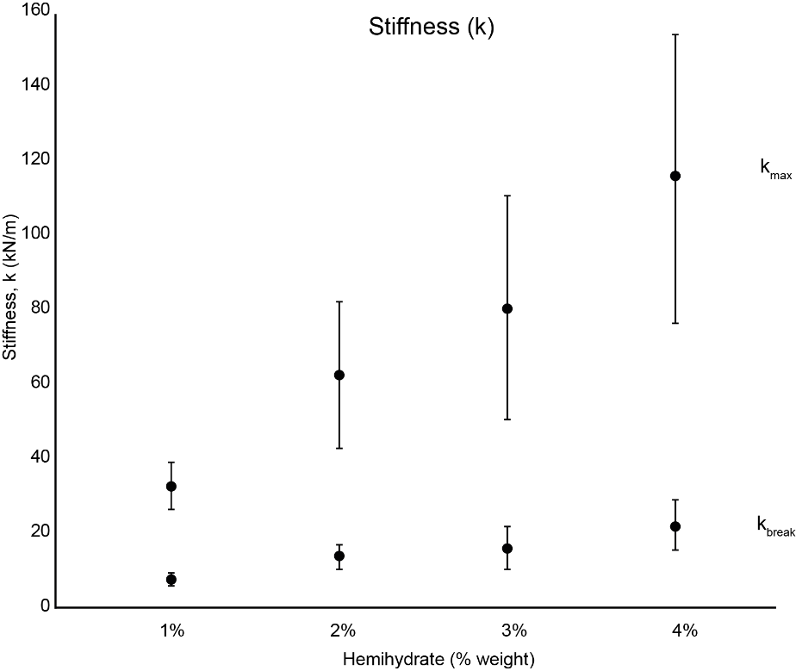
Uniaxial compression test
GRAM was tested in different mixing ratios, varying the percentage in weight of hemihydrate powder from 1% to 4%.
a
b
Fig. 5. a) sand-hemihydrate UCT samples and a) UCT results (Massaro et al., in prep).

Slide 8
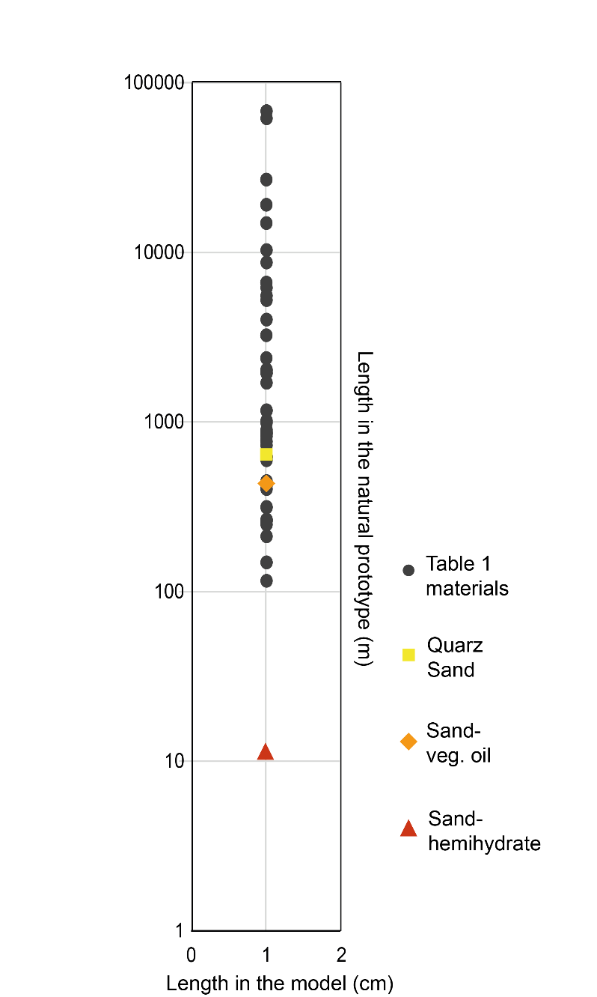
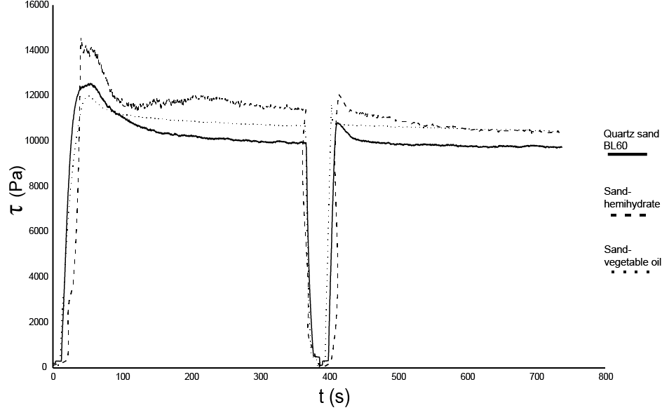
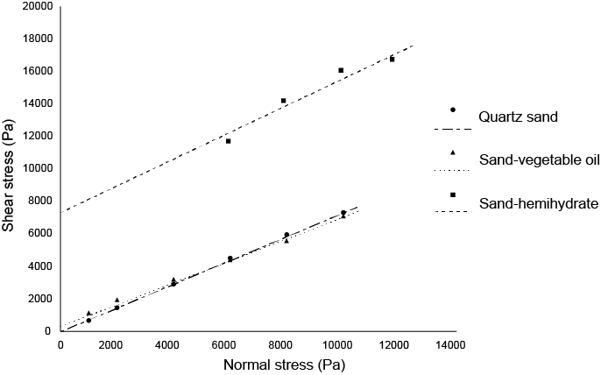
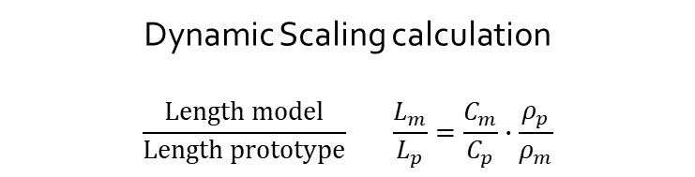
Ring-shear test
Model Resolution
Non-linear behaviour
Dynamic Scaling calculation
$$\frac{Length model}{Length prototype} \frac{L_{m}}{L_{p}}=\frac{C_{m}}{C_{p}}∙\frac{ρ_{p}}{ρ_{m}}$$
a
d
GRAM model resolution
1 cm in the model = 10.65 m in nature
c
b
Fig. 6. a) ring-shear test results and b) Mohr diagram for GRAM at 2% compared with quartz sand and send-vegetable oil samples (Massaro et al., 2021). c) model resolution of the tested materials.

Slide 9
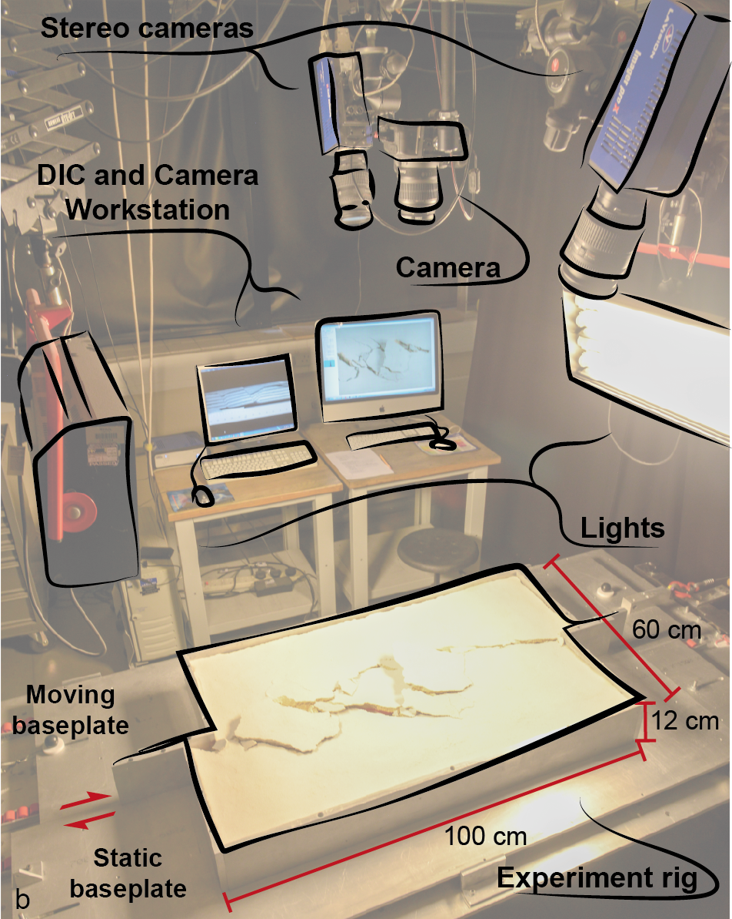
Experiment set-up
We performed strike-slip experiments with GRAM at 2% wt of hemihydrate.
The apparatus simulates the deformation in a horizontal material layer above a planar strike-slip fault.
Digital Image Correlation (DIC) analysis techniques were applied for high-resolution strain monitoring during the experiments (Adam et al., 2002; 2005).
The models were compared with quartz sand experiments run and with natural examples.
a
Fig. 7. Experiment set-up and schematic representation of the strike-slip rig (Massaro et al., 2021).

Slide 10
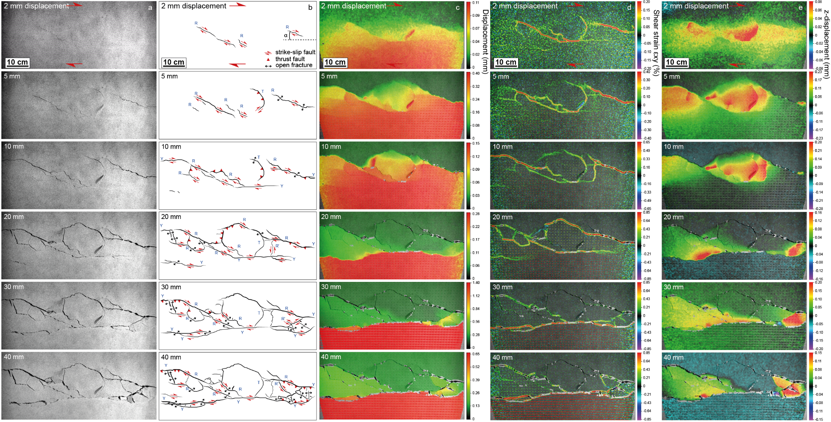
GRAM 2% Strike-slip Experiment
Fig. 8. DIC time-series images of Sand-Hemihydrate sample surface from top-view stereo cameras: a) image source data; b) structural maps; c) displacement (mm); d) shear strain ε_{xy} (%); e) z-displacement field (mm).

Slide 11
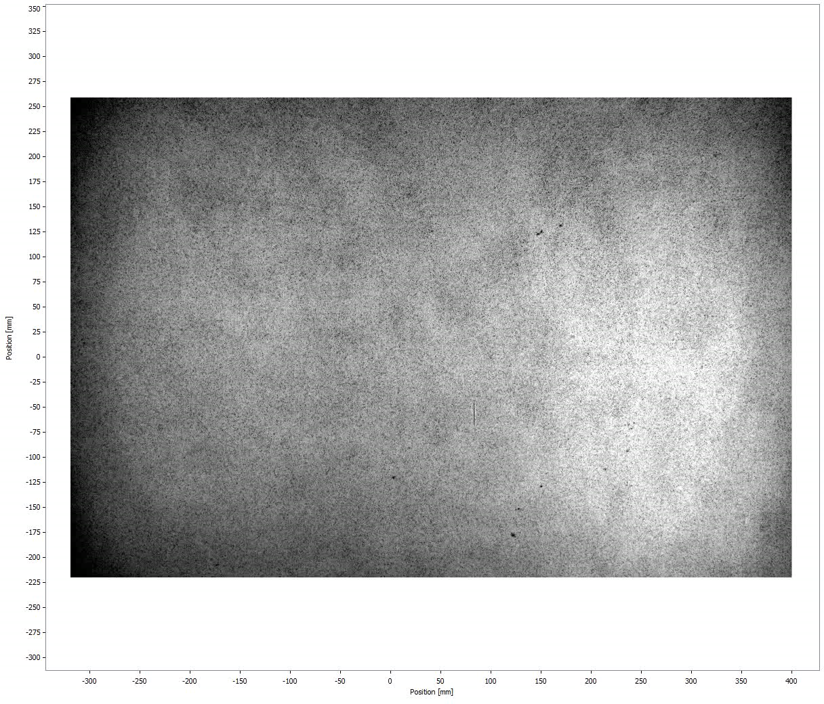
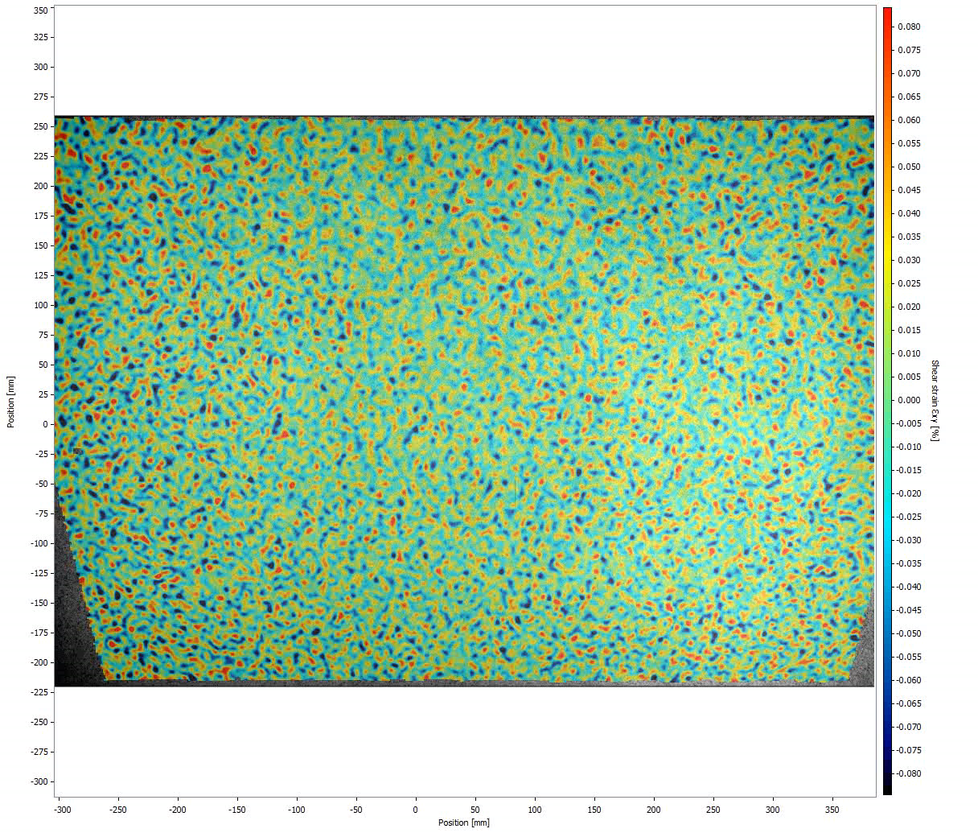
GRAM 2% Strike-slip Experiment
Image source data
Shear strain ε_{xy} (%)

Slide 12
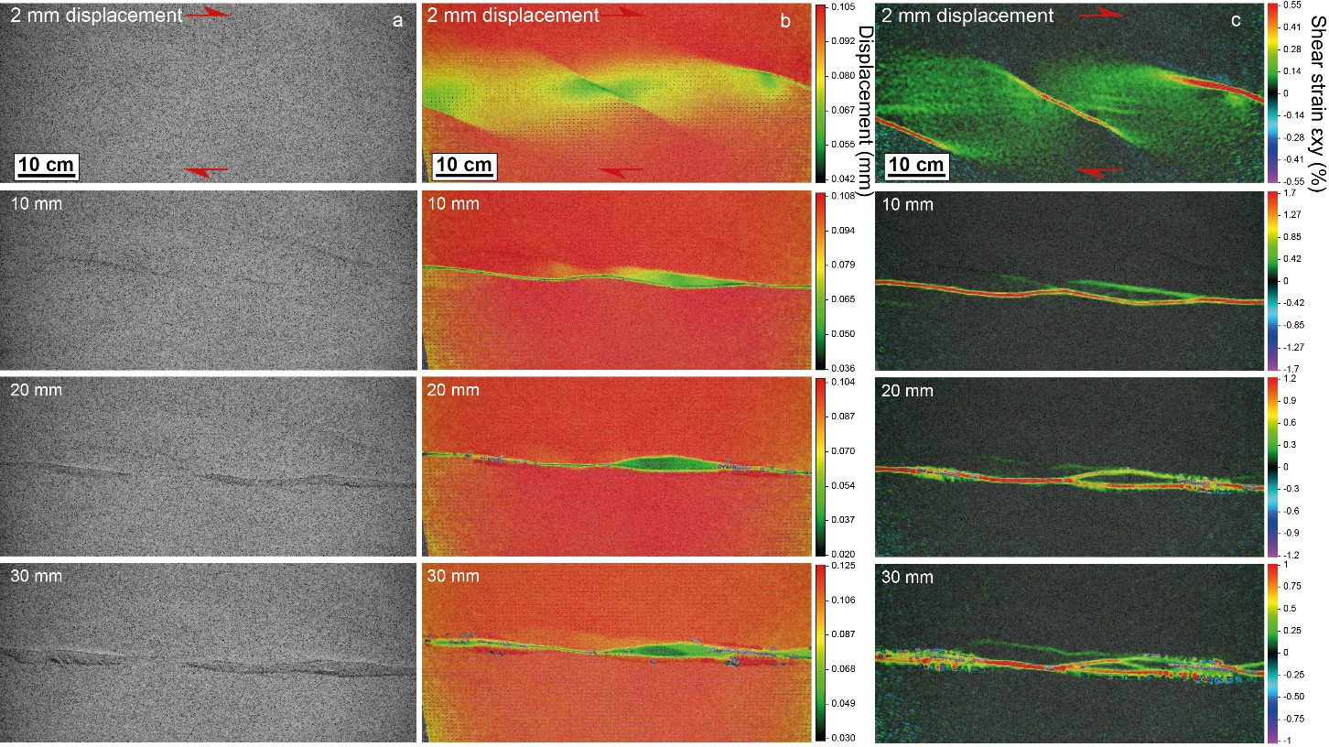
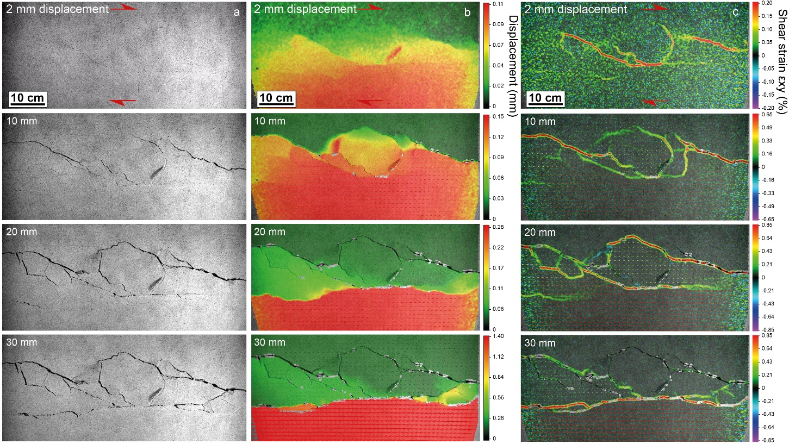
Model comparison with a different scale of resolution
GRAM strike-slip experiments were compared with quartz sand experiments (run in an identical setting). The investigation of a geological process at different scales of observation can ensure a better understanding of its geometrical and kinematic evolution.
Quartz Sand
Strike-slip Experiment
GRAM 2%
Strike-slip Experiment
Model resolution:
1 cm = 637 m
Model resolution:
1 cm = 10.65 m
Image source data
Displacement (mm)
Shear strain ε_{xy} (%)
Image source data
Displacement (mm)
Shear strain ε_{xy} (%)
Fig. 9. DIC time-series images of quartz sand and GRAM 2% samples surface from top-view stereo cameras: a) image source data; b) displacement (mm); c) shear strain ε_{xy} (%).

Slide 13
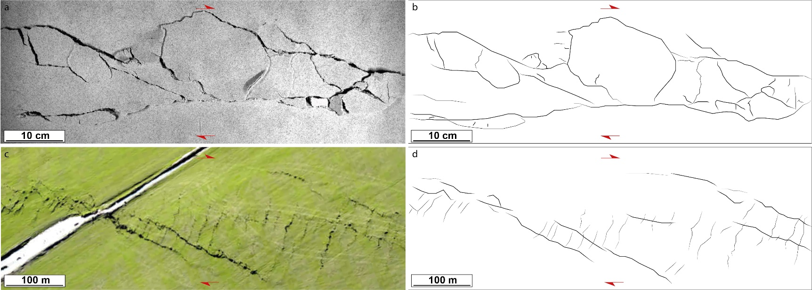
Model-nature comparison
Furthermore, the final model was compared with a natural example of strike-slip shear zone. The latter corresponded to a ‘low strain’ shear zone in its early stages, which could be better correlated with the 10 mm stage of the GRAM experiment (fig. 8).
Fig. 10. GRAM model comparison with natural strike-slip shear zone (Greendale Fault surface rupture, New Zealand; Quigley et al. 2010).

Slide 14



Conclusions
The developed material is suitable to simulate fault-fracture processes in scaled analogue experiments at the outcrop scale;
The provided model resolution can allow the investigation of fault damage zones evolution and development;
The investigation of deformation processes in a wider range of observation scales can improve the understanding of the geometrical and kinematic evolution of the process itself.
Thank you!
Videos of the experiments:
Massaro et al., 2021:
Artistic point of view:

Slide 15
References
Adam, J., Lohrmann, J., Hoth, S., Kukowski, N., Oncken, O., 2002. Strain variation and partitioning in thrust wedges: High-resolution data from scaled sandbox experiments by 2D-3D PIV analysis. Bollettino di Geofisica teorica ed applicata 42, 123-126.
Adam, J.U., J. L.;Wieneke, B.;Oncken, O.;Pfeiffer, K.;Kukowski, N.;Lohrmann, J.;Hoth, .; van der Zee, W.;Schmatz, J.;, 2005. Shear localisation and strain distribution during tectonic faulting—new insights from granular-flow experiments and high-resolution optical image correlation techniques. Journal of Structural Geology 27, 283-301.
Abdelmalak, M.M., Bulois, C., Mourgues, R., Galland, O., Legland, J.B., Gruber, C., 2016. Description of new dry granular materials of variable cohesion and friction coefficient: Implications for laboratory modeling of the brittle crust. Tectonophysics 684, 39-51.
Bonanno, E., Bonini, L., Basili, R., Toscani, G., Seno, S., 2017. How do horizontal, frictional discontinuities affect reverse fault-propagation folding? Journal of Structural Geology 102, 147-167.
Bonini, L., Basili, R., Toscani, G., Burrato, P., Seno, S., Valensise, G., 2016. The effects of pre-existing discontinuities on the surface expression of normal faults: Insights from wet-clay analog modeling. Tectonophysics 684, 157-175.
Bonini, L., Sokoutis, D., Mulugeta, G., Katrivanos, E., 2000. Modelling hanging wall accommodation above rigid thrust ramps. Journal of Struc. Geol. 22.
Brizzi, S., Funiciello, F., Corbi, F., Di Giuseppe, E., Mojoli, G., 2016. Salt matters: How salt affects the rheological and physical properties of gelatine for analogue modelling. Tectonophysics 679, 88-101.
Cobbold, P., Durand, S., Mourgues, R., 2001. Sandbox modelling of thrust wedges with fluid-assisted detachments. Tectonophysics 334, 245-258.
Dotare, T., Yamada, Y., Adam, J., Hori, T., Sakaguchi, H., 2016. Initiation of a thrust fault revealed by analog experiments. Tectonophysics.
Galland, O., Cobbold, P.R., Hallot, E., de Bremond d'Ars, J., Delavaud, G., 2006. Use of vegetable oil and silica powder for scale modelling of magmatic intrusion in a deforming brittle crust. Earth and Planetary Science Letters 243, 786-804.
Gomes, C.J.S., 2013. Investigating new materials in the context of analog-physical models. Journal of Structural Geology 46, 158-166.
Gutscher, M.A., Kukowski, N., Malavieille, J., Lallemand, S., 1998. Material transfer in accretionary wedges from analysis of a systematic series of analog experiments. Journal of Structural Geology 20, 407-416.
Hatem, A.E., Cooke, M.L., Toeneboehn, K., 2017. Strain localization and evolving kinematic efficiency of initiating strike-slip faults within wet kaolin experiments. Journal of Structural Geology 101, 96-108.
Henza, A.A., Withjack, M.O., Schlische, R.W., 2010. Normal-fault development during two phases of non-coaxial extension: An experimental study. Journal of Structural Geology 32, 1656-1667.
Holland, M., Urai, J.L., Martel, S., 2006. The internal structure of fault zones in basaltic sequences. Earth and Planetary Science Letters 248, 286-300.
Krantz, R.W., 1991. Measurements of friction coefficients and cohesion for faulting and fault reactivation in laboratory models using sand and sand mixtures. Tectonophysics 188, 203-207.
Lohrmann, J., Kukowski, N., Adam, J., Oncken, O., 2003. The impact of analogue material properties on the geometry, kinematics, and dynamics of convergent sand wedges. Journal of Structural Geology 25, 1691-1711.
Maestrelli, D., Bonini, M., Corti, G., Del Ventisette, C., Moratti, G., Montanari, D., 2021. A Database of Laboratory Analogue Models of Caldera Collapse Testing the Role of Inherited Structures. Frontiers in Earth Science 9.
Massaro, L., Adam, J., Jonade, E., & Yamada, Y. (2021). New granular rock-analogue materials for simulation of multi-scale fault and fracture processes. Geological Magazine, 1-24.
Panien, M., Schreurs, G., Pfiffner, A., 2006. Mechanical behaviour of granular materials used in analogue modelling: insights from grain characterisation, ring-shear tests and analogue experiments. Journal of Structural Geology 28, 1710-1724.
Poppe, S., Holohan, E.P., Rudolf, M., Rosenau, M., Galland, O., Delcamp, A., Kervyn, M., 2021. Mechanical properties of quartz sand and gypsum powder (plaster) mixtures: implications for laboratory model analogues for the Earth’s upper crust. Tecfonophysics.
Rosenau, M., Lohrmann, J., Oncken, O., 2009. Shocks in a box: An analogue model of subduction earthquake cycles with application to seismotectonic forearc evolution. Journal of Geophysical Research: Solid Earth 114.
Rossi, D., Storti, F., 2003. New artificial granular materials for analogue laboratory experiments: aluminium and siliceous microspheres. Journal of Structural Geology 25, 1893-1899.
Santolaria, P., Ferrer, O., Rowan, M.G., Snidero, M., Carrera, N., Granado, P., Muñoz, J.A., Roca, E., Schneider, C.L., Piña, A., Zamora, G., 2021. Influence of preexisting salt diapirs during thrust wedge evolution and secondary welding: Insights from analog modeling. Journal of Structural Geology 149, 104374.
Schellart, W.P., 2000. Shear test results for cohesion and friction coefficients for different granular materials; scaling implications for their usage in analogue modelling. Tectonophysics 324, 1-16.
van Dinther, Y., Gerya, T.V., Dalguer, L.A., Corbi, F., Funiciello, F., Mai, P.M., 2013. The seismic cycle at subduction thrusts: 2. Dynamic implications of geodynamic simulations validated with laboratory models. Journal of Geophysical Research: Solid Earth 118, 1502-1525.
van Gent, H.W., Holland, M., Urai, J.L., Loosveld, R., 2010. Evolution of fault zones in carbonates with mechanical stratigraphy - Insights from scale models using layered cohesive powder. Journal of Structural Geology 32, 1375-1391.
von Hagke, C., Kettermann, M., Bitsch, N., Bücken, D., Weismüller, C., Urai, J.L., 2019. The Effect of Obliquity of Slip in Normal Faults on Distribution of Open Fractures. Frontiers in Earth Science 7.
Wu, J.E., McClay, K., Frankowicz, E., 2015. Niger Delta gravity-driven deformation above the relict Chain and Charcot oceanic fracture zones, Gulf of Guinea: Insights from analogue models. Marine and Petroleum Geology 65, 43-62.
Acknowledgements
This presentation contains work conducted during a PhD study undertaken as part of the Natural Environment Research Council (NERC) Centre for Doctoral Training (CDT) in Oil & Gas. It is sponsored by the Geology Department of Royal Holloway, University of London, whose support is gratefully acknowledged. Experiments and material tests have been conducted in the Analogue Tectonic Modelling Laboratories of the Department of Earth Sciences, Royal Holloway University of London (ATML@RHUL).

