Slide 1
Determining Strain Accumulation Along NAF with Block Modelling
Efe Turan Ayruk, Seda Özarpacı, Alpay Özdemir, Volkan Özbey, Semih Ergintav, Uğur Doğan

Slide 2
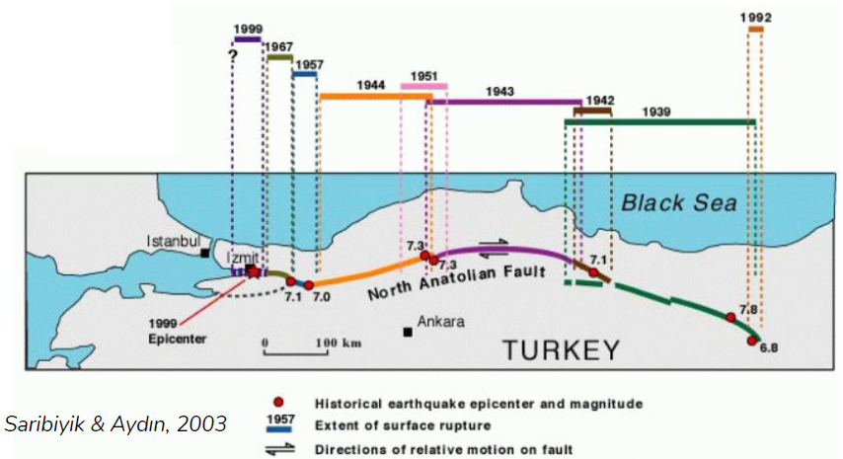
Earthquake Propogation

Slide 3
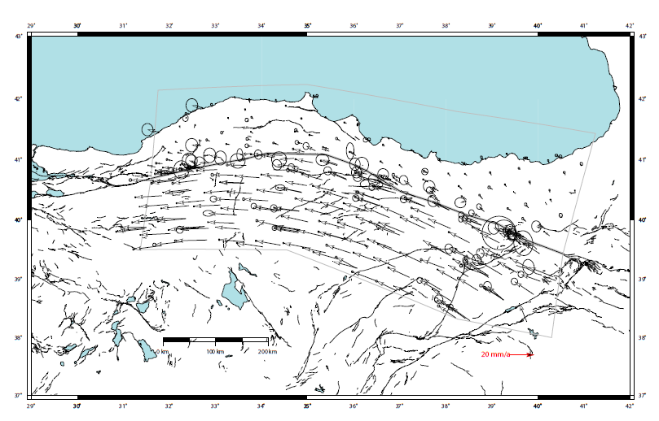
Interseismic Velocity Field

Slide 4
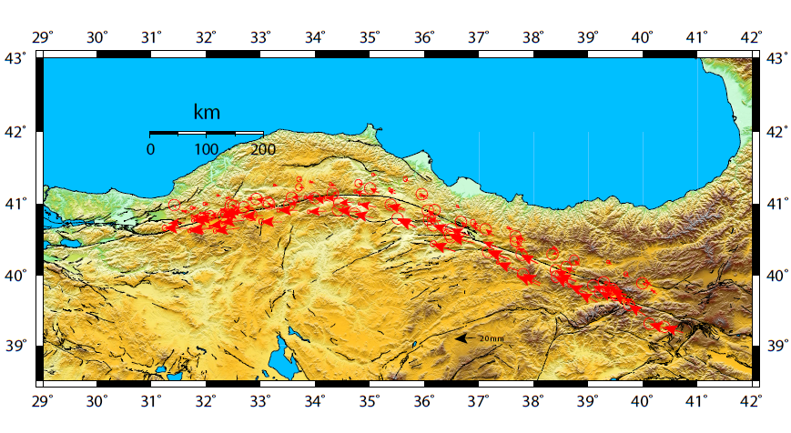
Strain Accumulation Zone of NAF

Slide 5
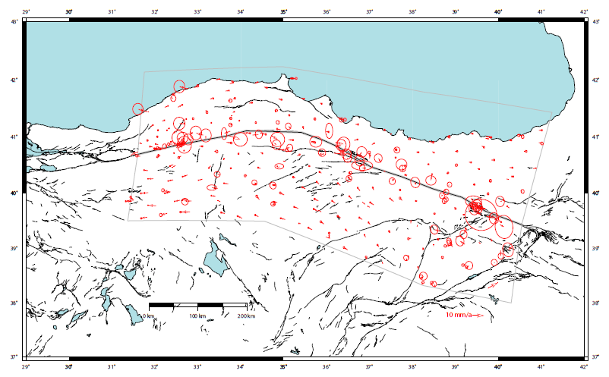
Residuals
Creeping

Slide 6
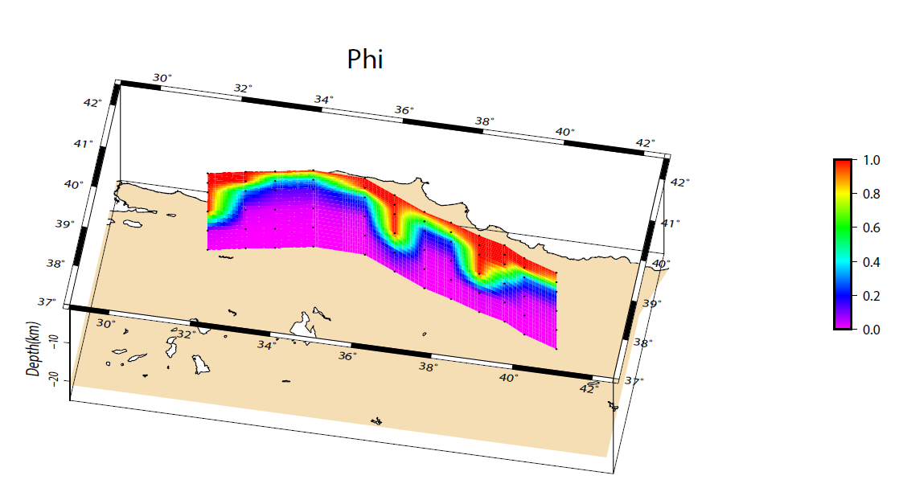
Locking Distribution

Slide 7
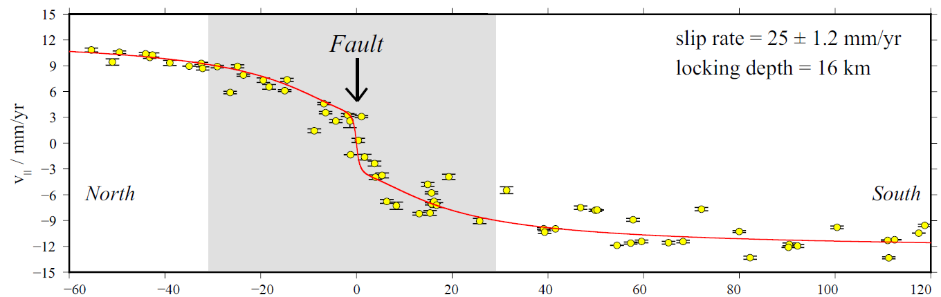
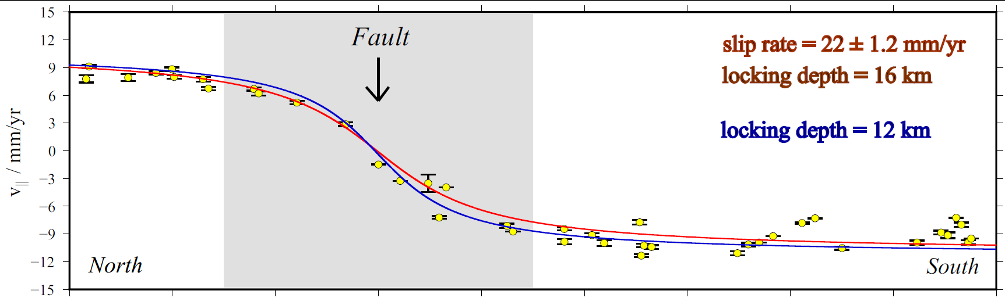

Slide 8
Conclusion
Here we present most current and densed dataset.
Priory results shows us some of the NAF segments are creeping and some of them are locked in depths.
Our results constrained by dataset.
We will combine our findings with multidiciplinary results.

Slide 9
Thank you all for your time … efeturanayr@gmail.com

