Slide 1




Medical Supply Needs Index

Slide 2

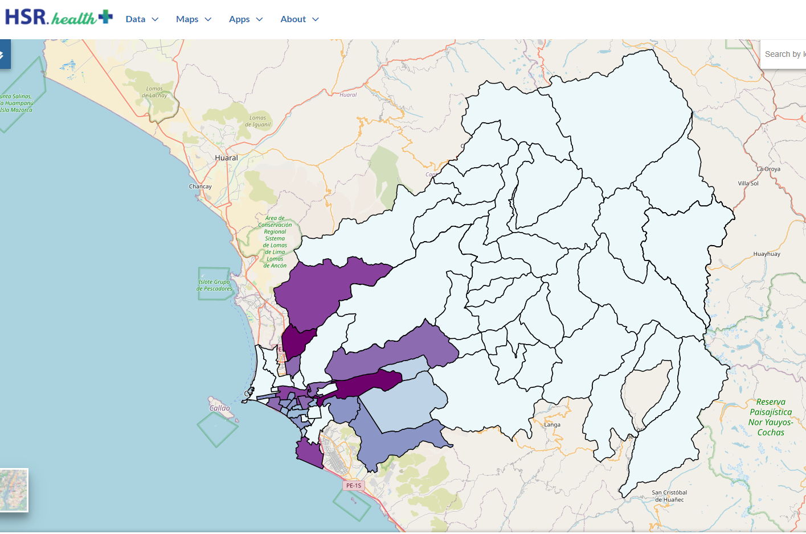
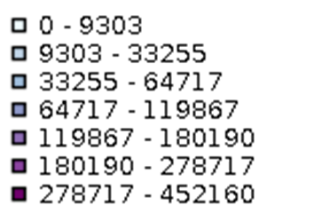

Peru Rimac River Basin Medical Supply Needs Index
Supply Need

Slide 3
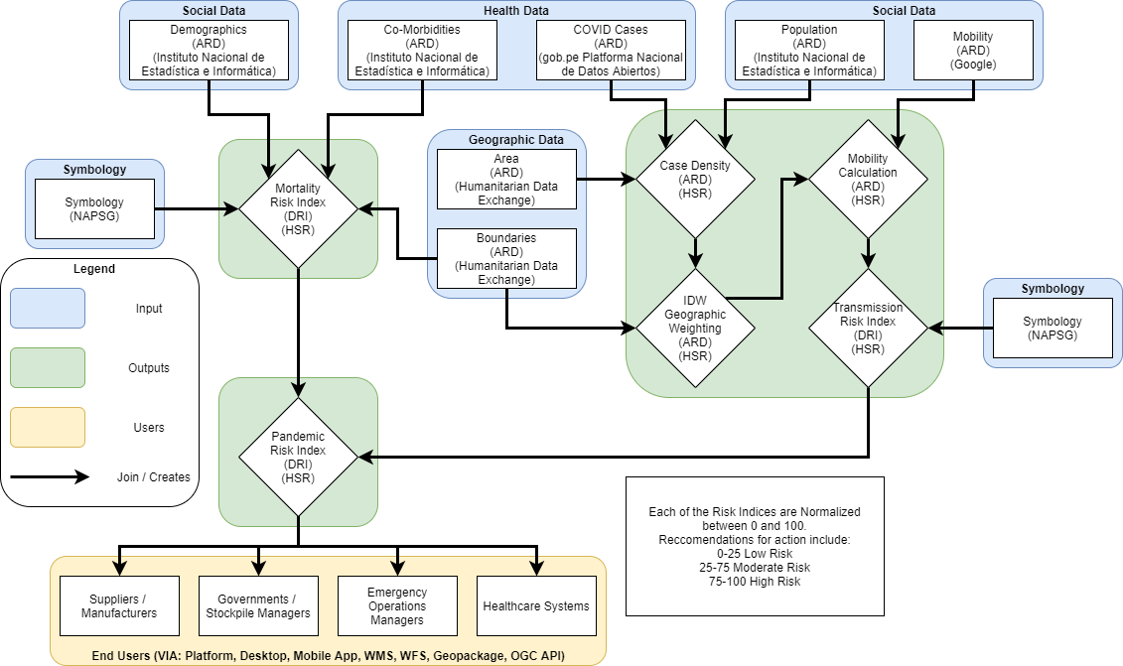
Pandemic Risk Index Workflow

Slide 4
Pandemic Risk Index Workflow
Mortality Risk
Index Components

Slide 5
Pandemic Risk Index Workflow
Transmission Risk
Index Components

Slide 6
Pandemic Risk Index Workflow
Pandemic Risk
Index Output

Slide 7
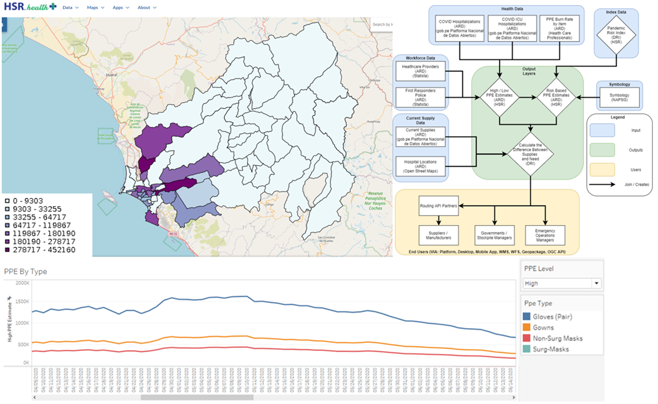
Medical Supply Needs Index Workflow

Slide 8
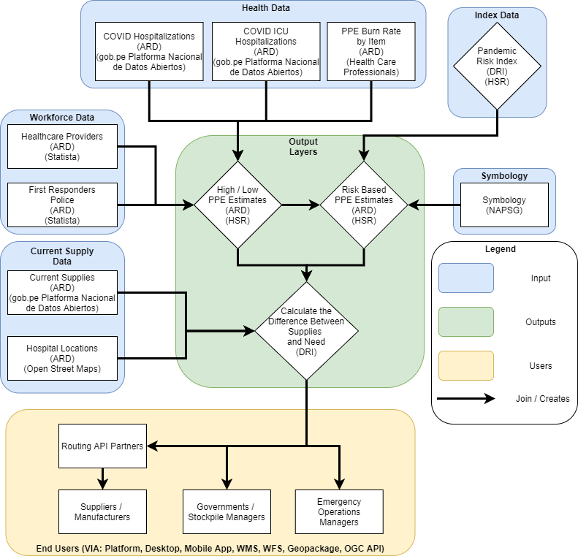
Medical Supply Needs Index Workflow
High / Low Medical Supply Needs Index Components

Slide 9
Medical Supply Needs Index Workflow
Index Based Medical Supply Needs Index Components

Slide 10
Medical Supply Needs Index Workflow
Medical Supply Needs Index Output

Slide 11
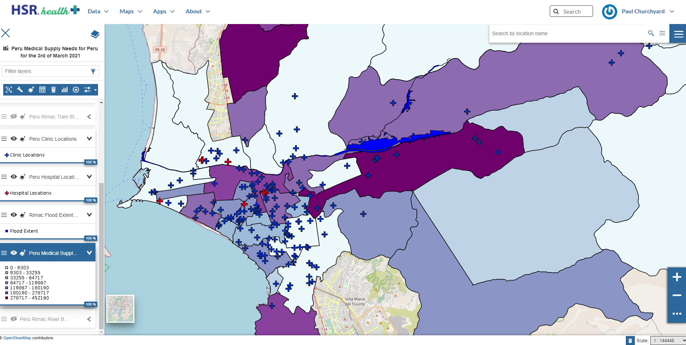
Rimac Basin Medical Supply Needs Index with
Hospital Locations, Clinic Locations, and Flood Extent

Slide 12
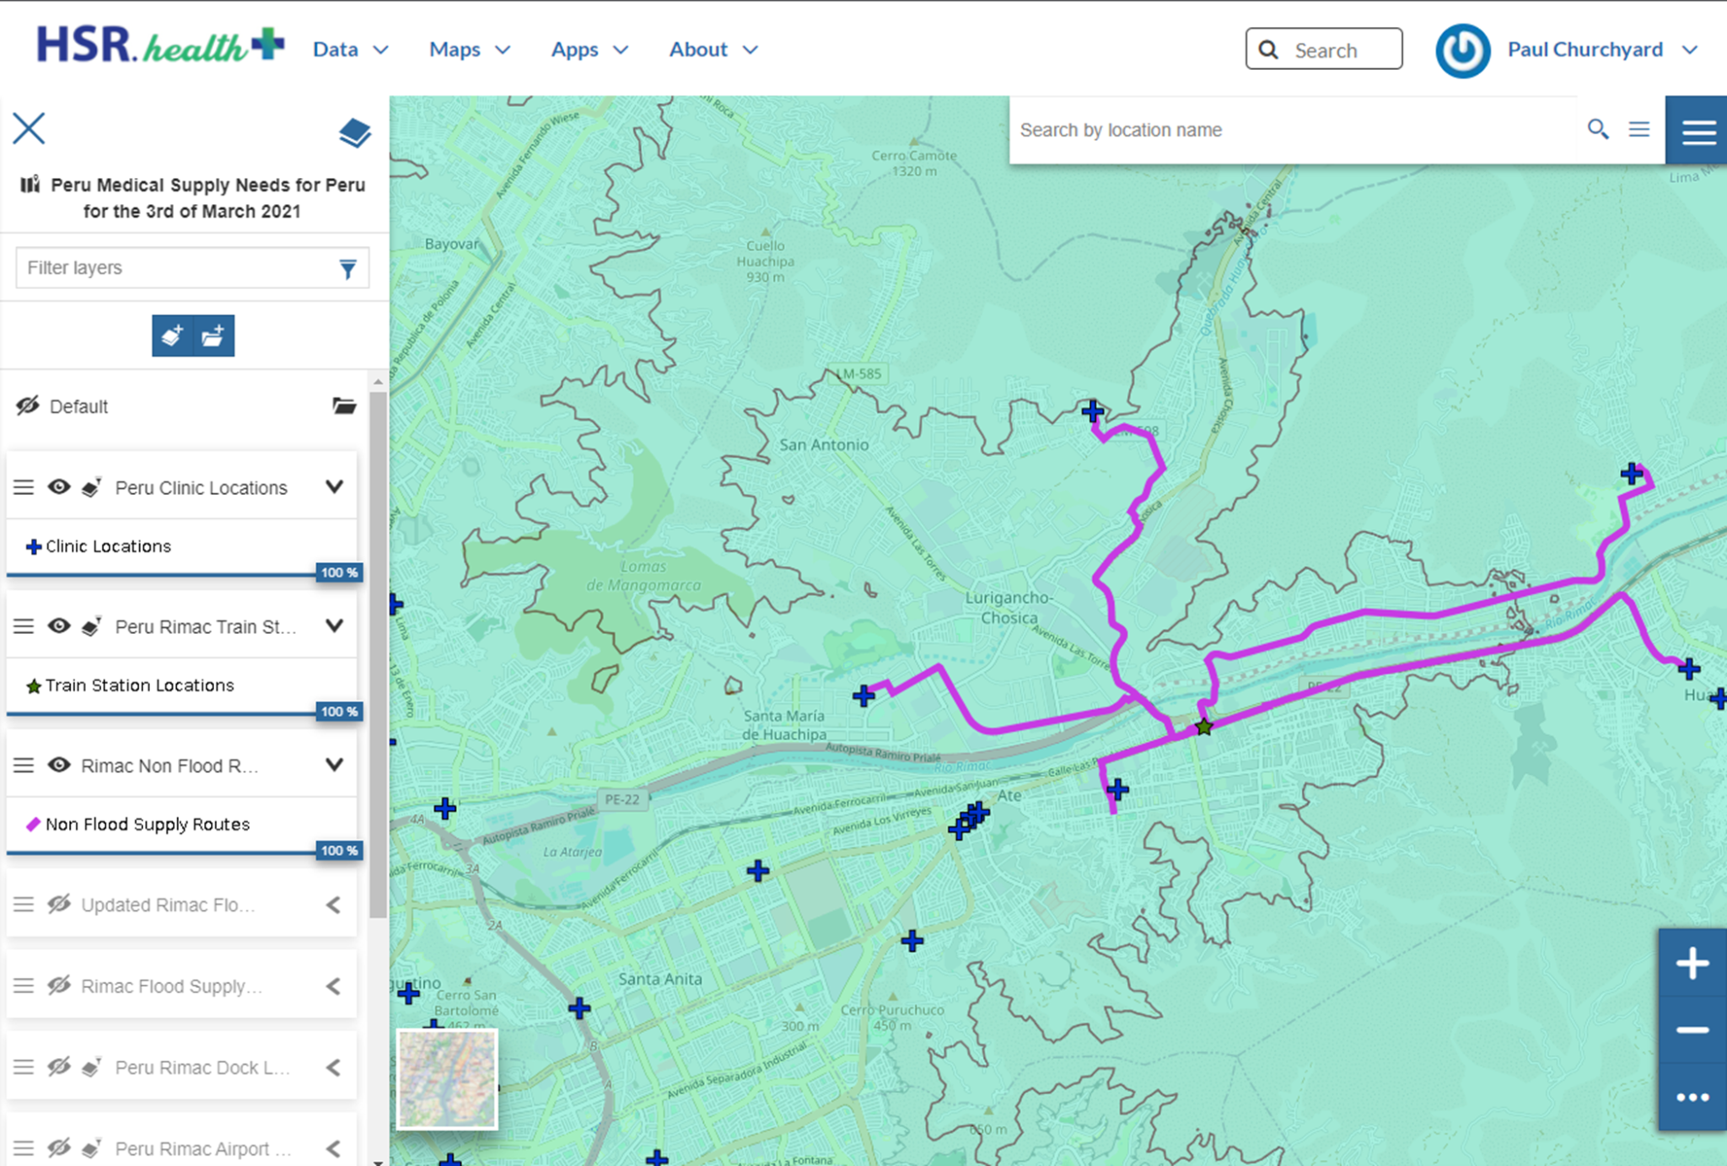

Rimac Pre-Flood Medical Supply Routes
1
2

Slide 13
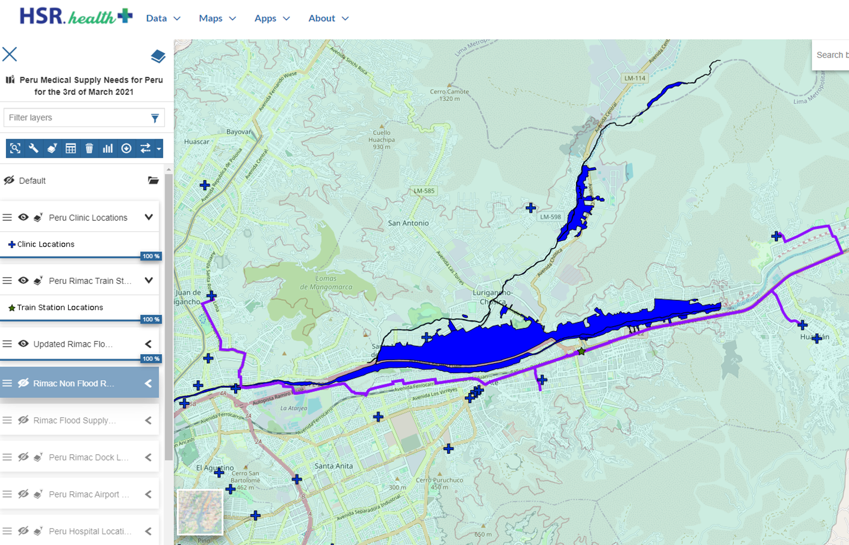
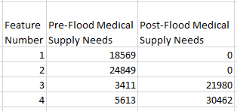
Rimac Post-Flood Medical Supply Routes
1
3
2
4

Slide 14
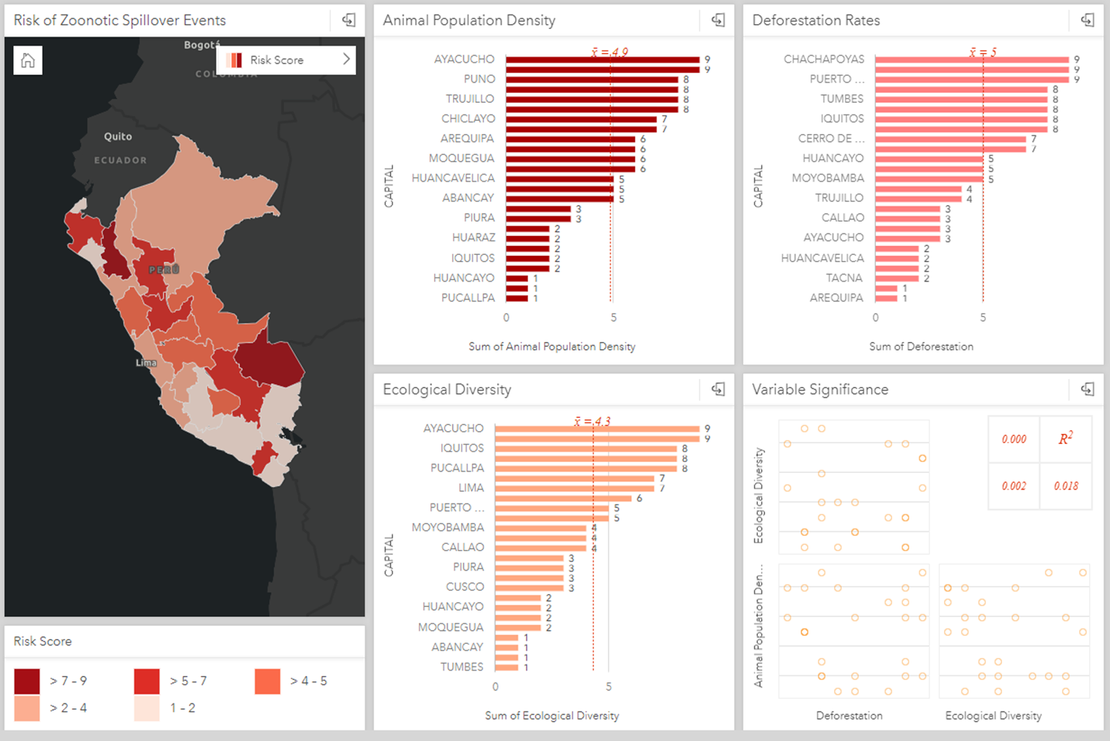
Zoonosis Related Work

Slide 15



Thank You!
Mapping the Way to Better .health
Leverages Advanced ML, AI, & Geospatial Tech to analyze health, social, and environmental data.
Identifies the impact of health disasters on broad markets at global, national, and local scales.
Enables improved response and mitigation efforts allowing organizations to anticipate and take advantage of health risks.
Paul A Churchyard, MPS
Chief Geospatial Engineer
paul@HSR.health
Ajay K Gupta, CISSP, MBA
Co-Founder & CEO
+1-(240) 731-0756 agupta@HSR.health
www.HSR.health
Joshua Lieberman, Ph.D.
Director of Innovation Programs
JLieberman@ogc.org
www.ogc.org

