Slide 1





North Atlantic thermocline vertical velocity reconstruction from observation-based geostrophic meridional velocity field
Diego Cortés Morales and Alban Lazar
UPMC IPSL-LOCEAN, Paris, France
May 27th 2022

Slide 2
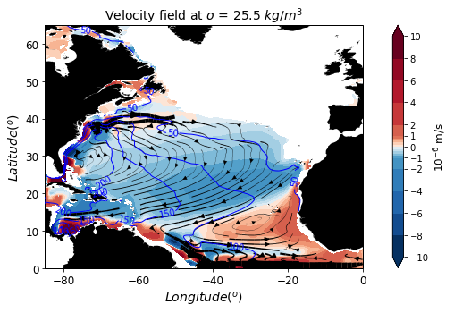
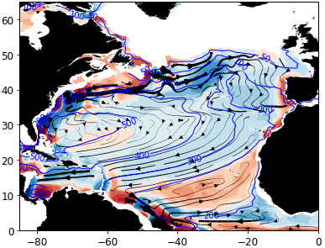
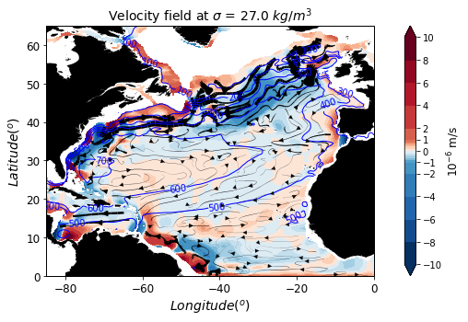
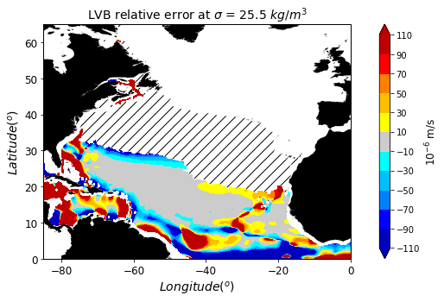
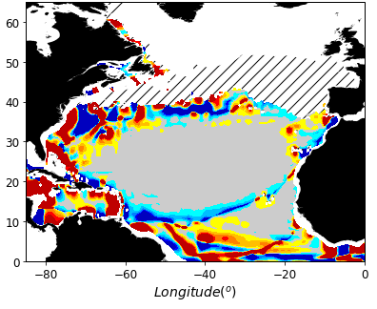
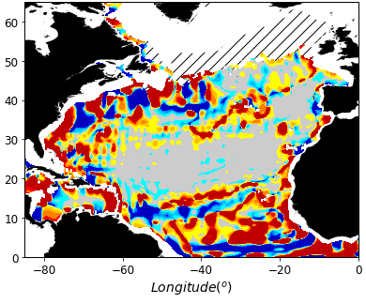




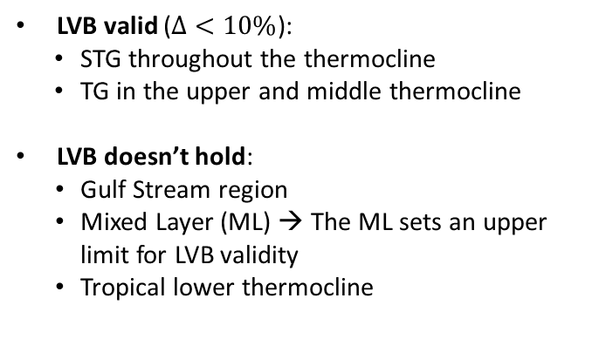
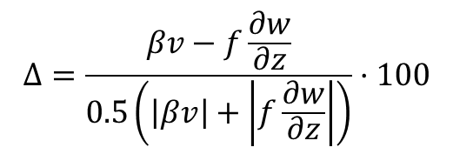


North Atlantic thermocline vertical velocity reconstruction from observation-based geostrophic meridional velocity field
1/4
LVB validation
Upper thermocline ($25.5 kg/m^{3}$)
Middle thermocline ($26.5 kg/m^{3}$)
Lower thermocline ($27 kg/m^{3}$)
Using (1993-2018) climatology NEMO OGCM simulation
Linear Vorticity Balance (LVB)
Velocities
$βv=f\frac{∂w}{∂z}$
CC
NEC
GD
MC
NECC
Relative error ($Δ$)
$$Δ=\frac{βv−f\frac{∂w}{∂z}}{0.5\left(\left|βv\right|+\left|f\frac{∂w}{∂z}\right|\right)}·100$$
Relative error ($Δ$)
LVB valid ($Δ<10\%$):
  STG throughout the thermocline
  TG in the upper and middle thermocline
  LVB doesn’t hold:
  Gulf Stream region
  Mixed Layer (ML) → The ML sets an upper limit for LVB validity
  Tropical lower thermocline
Figure 1. Velocity field (shading: vertical velocities; streamlines: horizontal velocities) (up) and LVB relative error (down).
dcortes@locean.ipsl.fr
Diego Cortés-Morales and Alban Lazar
May 27th

Slide 3
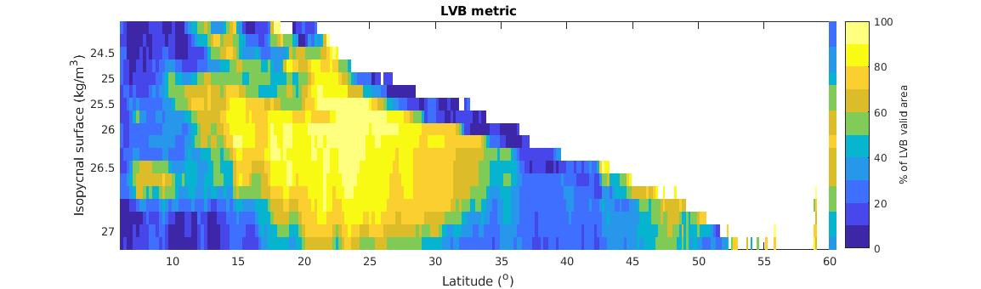
North Atlantic thermocline vertical velocity reconstruction from observation-based geostrophic meridional velocity field
1/4
LVB validation
Upper thermocline ($25.5 kg/m^{3}$)
Middle thermocline ($26.5 kg/m^{3}$)
Lower thermocline ($27 kg/m^{3}$)
Using (1993-2018) climatology NEMO OGCM simulation
Linear Vorticity Balance (LVB)
Velocities
$βv=f\frac{∂w}{∂z}$
CC
NEC
GD
MC
NECC
Relative error ($Δ$)
$$Δ=\frac{βv−f\frac{∂w}{∂z}}{0.5\left(\left|βv\right|+\left|f\frac{∂w}{∂z}\right|\right)}·100$$
Relative error ($Δ$)
LVB valid ($Δ<10\%$):
  STG throughout the thermocline
  TG in the upper and middle thermocline
  LVB doesn’t hold:
  Gulf Stream region
  Mixed Layer (ML) → The ML sets an upper limit for LVB validity
  Tropical lower thermocline
Figure 1. Velocity field (shading: vertical velocities; streamlines: horizontal velocities) (up) and LVB relative error (down).
Figure 2. Zonal percentage of zonal 56yr climatology LVB valid area (LVB relative error <10%).
dcortes@locean.ipsl.fr
Diego Cortés-Morales and Alban Lazar
May 27th

Slide 4
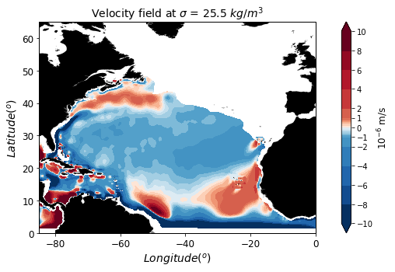
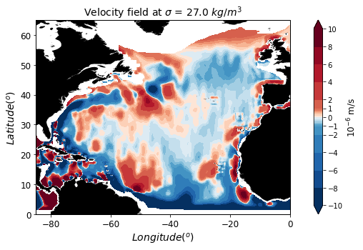
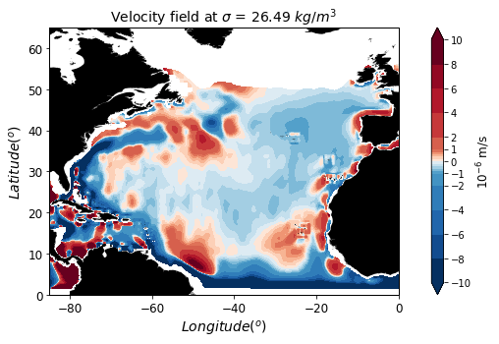
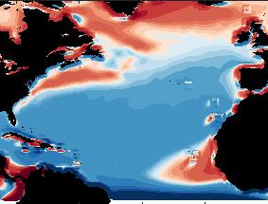








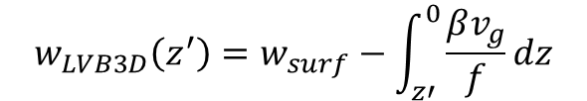

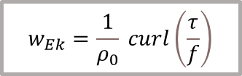

North Atlantic thermocline vertical velocity reconstruction from observation-based geostrophic meridional velocity field
2/4
$w$ reconstruction
$w_{LVB3D}$reconstruction
Using ARMOR3D $v_{g}$ Argo-based dataset
Upper thermocline ($25.5 kg/m^{3}$)
Upper thermocline ($25.5 kg/m^{3}$)
$$w_{LVB3D}\left(z^{′}\right)=w_{surf}−\int_{z′}^{0}{\frac{βv_{g}}{f}dz}$$
Wind forcing pattern transmitted into the thermocline:
  Upwelling over the TG and Gulf Stream continent separation.
  Downwelling over the STG.
  Downwelling in the equator band.
Baroclinicity of w field over the tropical and subtropical thermocline.
$$w_{Ek}=\frac{1}{ρ_{0}} curl\left(\frac{τ}{f}\right)$$
From ERA5
Middle thermocline ($26.5 kg/m^{3}$)
Middle thermocline ($26.5 kg/m^{3}$)
$$w_{Ek}$$
Lower thermocline ($27 kg/m^{3}$)
Figure 3. Ekman vertical velocity from ERA5 wind stress.
Figure 4. 𝑤 reconstruction from ${\text{ARMOR}\text{3}\text{D} v}_{g}$ (Mulet et al., 2012).
dcortes@locean.ipsl.fr
Diego Cortés-Morales and Alban Lazar
May 27th

Slide 5
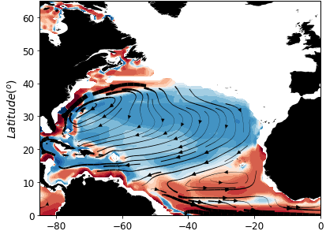
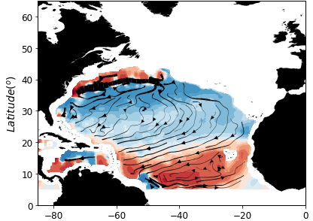
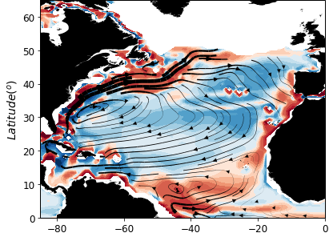
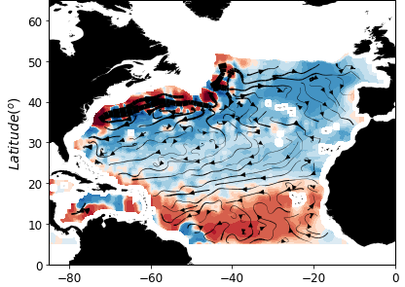
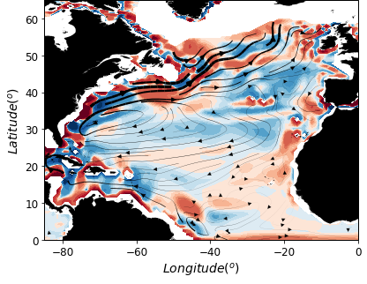
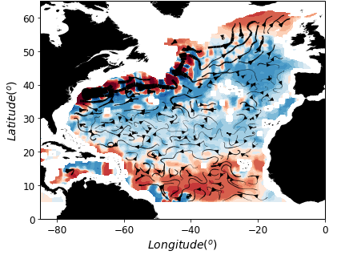


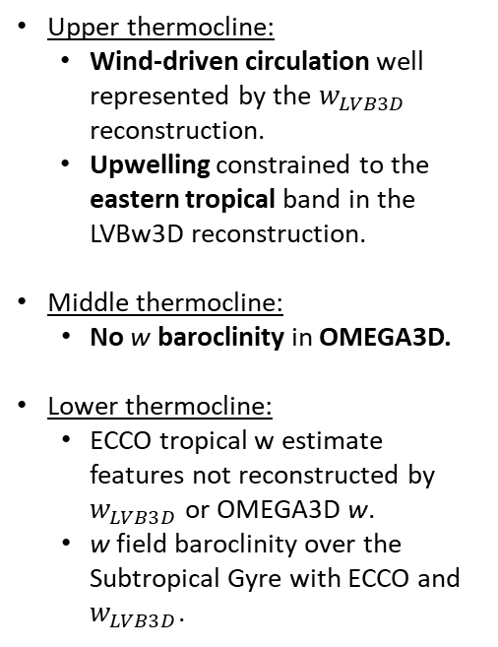
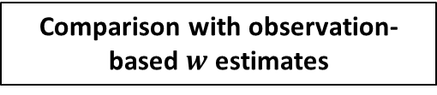



North Atlantic thermocline vertical velocity reconstruction from observation-based geostrophic meridional velocity field
3/4
ECCOv4r4
OMEGA3D
$w_{LVB3D}$reconstruction
Comparison with observation-based$w$ estimates
Upper thermocline ($25.5 kg/m^{3}$)
Upper thermocline:
  Wind-driven circulation well represented by the $w_{LVB3D}$ reconstruction.
  Upwelling constrained to the eastern tropical band in the LVBw3D reconstruction.
Middle thermocline:
  No w baroclinity in OMEGA3D.
  Lower thermocline:
  ECCO tropical w estimate features not reconstructed by $w_{LVB3D}$ or OMEGA3D w.
  w field baroclinity over the Subtropical Gyre with ECCO and $w_{LVB3D}$.
Middle thermocline ($26.5 kg/m^{3}$)
Lower thermocline ($27 kg/m^{3}$)
Figure 5. ECCOv4r4 reanalysis w (Forget et al., 2015; Fukumori et al., 2018)
Figure 6. OMEGA3D w (Buongiorno Nardelli, 2020)
Figure 4. 𝑤 reconstruction from ${\text{ARMOR}\text{3}\text{D} v}_{g}$ (Mulet et al., 2012)
dcortes@locean.ipsl.fr
Diego Cortés-Morales and Alban Lazar
May 27th

Slide 6

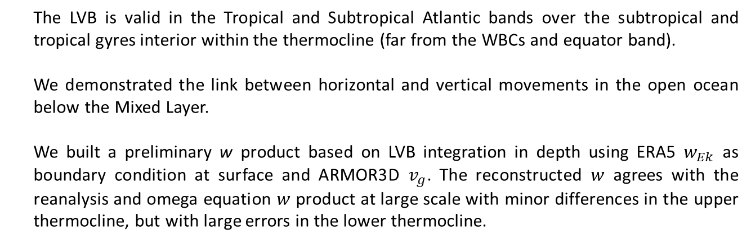
North Atlantic thermocline vertical velocity reconstruction from observation-based geostrophic meridional velocity field
4/4
Conclusions
The LVB is valid in the Tropical and Subtropical Atlantic bands over the subtropical and tropical gyres interior within the thermocline (far from the WBCs and equator band).
We demonstrated the link between horizontal and vertical movements in the open ocean below the Mixed Layer.
We built a preliminary w product based on LVB integration in depth using ERA5 $w_{Ek}$ as boundary condition at surface and ARMOR3D $v_{g}$. The reconstructed $w$ agrees with the reanalysis and omega equation $w$ product at large scale with minor differences in the upper thermocline, but with large errors in the lower thermocline.
QR for the abstract
Future perspectives
Addition of VB terms.
Analysis of the temporal and seasonal scale of the LVB.
Extension of the framework to the rest of the global ocean.
Computation of biogeochemical fluxes.
dcortes@locean.ipsl.fr
Diego Cortés-Morales and Alban Lazar
May 27th
Notes:
To conclude, I want to summarize the goals that we achieved:
We set the LVB validity in the interior of the Subtropical Gyre bounded by the Gulf Stream and the Mixed Layer and in the Eastern Tropical Gyre, where the LVB holds to a good approximation close to the continental slope.
Resulting in the connection between vertical and horizontal movements between the Ekman layer and the thermocline.
Finally, we manage to build a w reconstruction using Argo-based meridional velocities and ERA5 wind forcing.
Future perspectives
In future works, we will continue working on this topic and trying to improve our results including other terms from the Vorticity Balance equation to try to close the vorticity budget in the regions where the LVB doesn’t hold and to extend our results to the global ocean.

Slide 7
North Atlantic thermocline vertical velocity reconstruction from observation-based geostrophic meridional velocity field
4/4
Conclusions
The LVB is valid in the Tropical and Subtropical Atlantic bands over the subtropical and tropical gyres interior within the thermocline (far from the WBCs and equator band).
We demonstrated the link between horizontal and vertical movements in the open ocean below the Mixed Layer.
We built a preliminary w product based on LVB integration in depth using ERA5 $w_{Ek}$ as boundary condition at surface and ARMOR3D $v_{g}$. The reconstructed $w$ agrees with the reanalysis and omega equation $w$ product at large scale with minor differences in the upper thermocline, but with large errors in the lower thermocline.
QR for the abstract
Future perspectives
Addition of VB terms.
Analysis of the temporal and seasonal scale of the LVB.
Extension of the framework to the rest of the global ocean.
Computation of biogeochemical fluxes.
Thank you for your attention!!
dcortes@locean.ipsl.fr
Diego Cortés-Morales and Alban Lazar
May 27th
Notes:
To conclude, I want to summarize the goals that we achieved:
We set the LVB validity in the interior of the Subtropical Gyre bounded by the Gulf Stream and the Mixed Layer and in the Eastern Tropical Gyre, where the LVB holds to a good approximation close to the continental slope.
Resulting in the connection between vertical and horizontal movements between the Ekman layer and the thermocline.
Finally, we manage to build a w reconstruction using Argo-based meridional velocities and ERA5 wind forcing.
Future perspectives
In future works, we will continue working on this topic and trying to improve our results including other terms from the Vorticity Balance equation to try to close the vorticity budget in the regions where the LVB doesn’t hold and to extend our results to the global ocean.

