Slide 1




A comparison of different NDVI based methods for grapevines Kcb
Benoit Huet^{2,1}, Michel Le Page², David Tous³, Pascal Fanise², Sylvie Duthoit⁴, and Joaquim Bellvert⁵
¹ONERA, Toulouse, France ²IRD, CESBIO, Toulouse, France ³Safsampling, Verdu, Spain ⁴TerraNIS, Toulouse, France ⁵IRTA, Lleida, Spain
1
Notes:
1

Slide 2
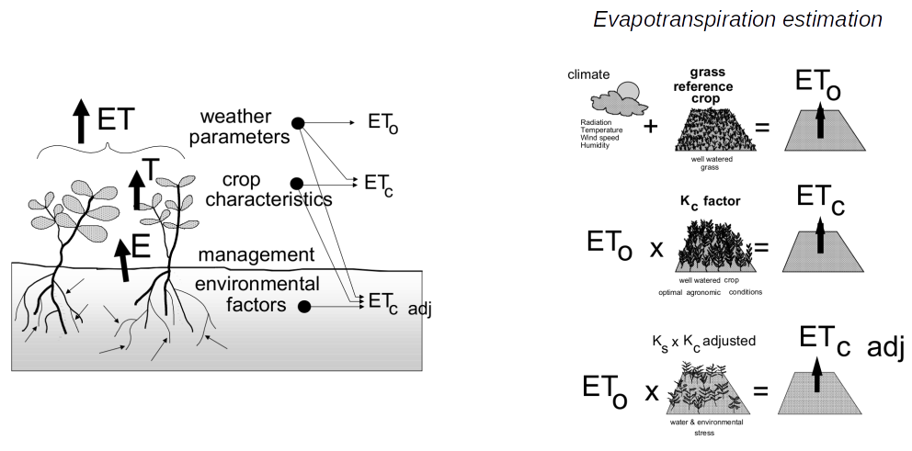
Introduction
ET: Evapotranspiration calculation
= K_{cb**} + K_{e***}
K_{c*}
©FAO irrigation and drainage paper Allen & al. 1998
Benoît HUET – EGU 2022
Kc*: Crop coefficient
Kcb**: Basal crop coefficient
Ke***: soil evaporation coefficient​
2

Slide 3
How to take into account the geometry of a vineyard in a water balance ?
Geometry
Kc**
Weather, Plant characteristics,
Soil
ET***
What we know : Kc=f (NDVI*): Satirr→ 1D
NDVI*: Normalized Difference Vegetation Index
Kc**: crop coefficient
ET***: Evapotranspiration
Benoît HUET – EGU 2022
3

Slide 4
Models
Benoît HUET – EGU 2022
4

Slide 5
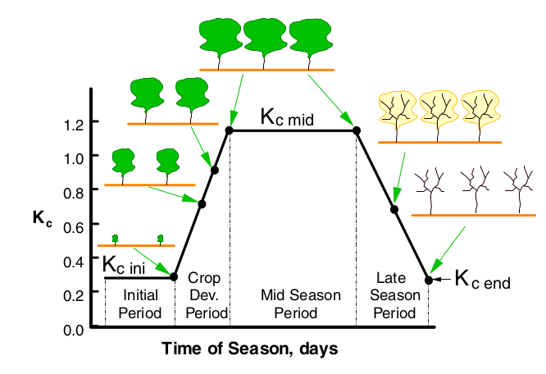
Allen & al. FAO 56
"FAO Generic"
©Crop evapotranspiration - Guidelines for computing crop water requirements - FAO Irrigation and drainage paper 56, Allen et al., 1998
Benoît HUET – EGU 2022
5

Slide 6
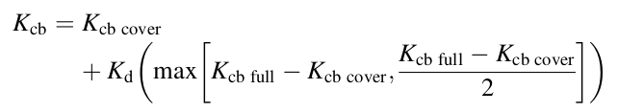
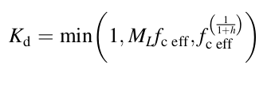
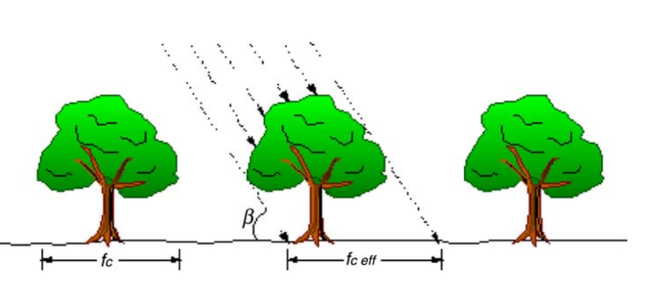

Allen & Pereira: Height & LAI
*
**
"Height" method
"LAI" method
©Estimating crop coefficients from fraction of ground cover and height Allen & Pereira 2009
Benoît HUET – EGU 2022
Kcb cover* : kcb of the cover without plants (0,15 )
Kcb full**: max Kcb (peak of the season)
6

Slide 7
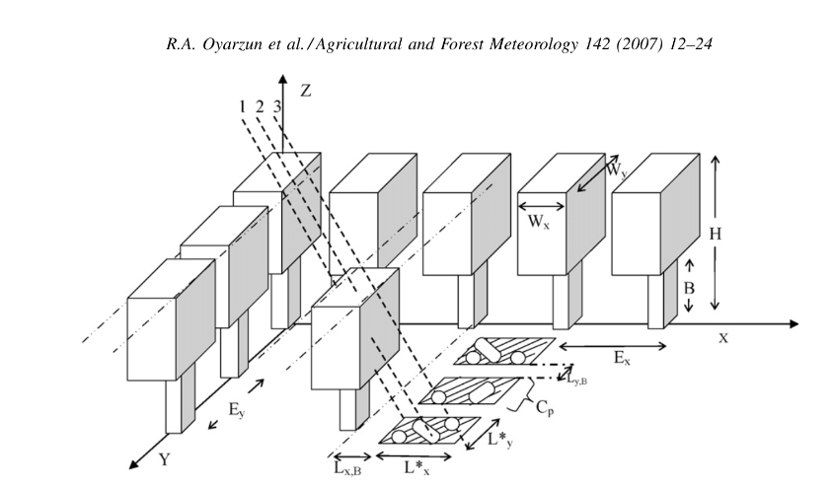

Oyarzun & al. Intercepted flux
*
Ex[m] = DATA
Wx[m] = f(NDVI)
Ey[m] = DATA
Wy[m] = f(NDVI)
H[m] = f(NDVI)
©A simple approach to modeling radiation interception by fruit-tree orchards Oyarzun & al. 2007
Benoît HUET – EGU 2022
7
*$f_{DIPAR}=$ fraction of Daily Intercepted Photosynthetically Active Radiation

Slide 8
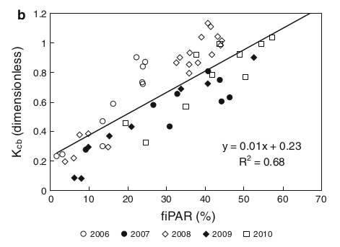
Oyarzun & al. Picon & al./ Lebon & al.
TV = TVp = Rgv* /[(1–α**)Rg*** ]ETP
fIPAR
©Modelling the seasonal dynamics of the soil water balance of vineyards
Eric Lebon A , Vincent Dumas B , Philippe Pieri C and Hans R. Schultz D 2003
©Effects of canopy size and water stress over the crop coefﬁcient of a “Tempranillo” vineyard in south-western Spain J. Picón-Toro • V. González-Dugo • D. Uriarte •L. A. Mancha • L. Testi 2012
Benoît HUET – EGU 2022
Rgv* : global radiation absorbed by the canopy
α**: vineyard albedo
Rg***: incident global radiation
8

Slide 9
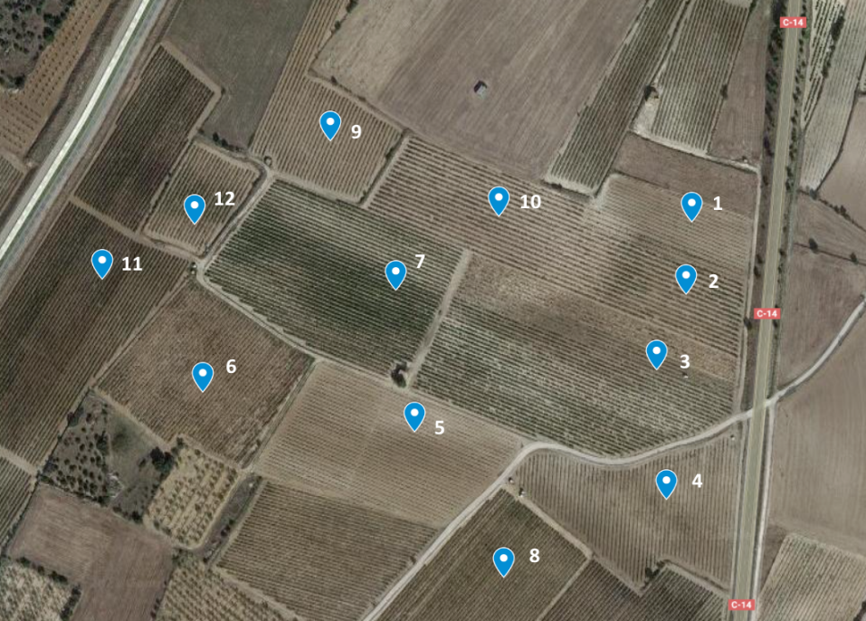
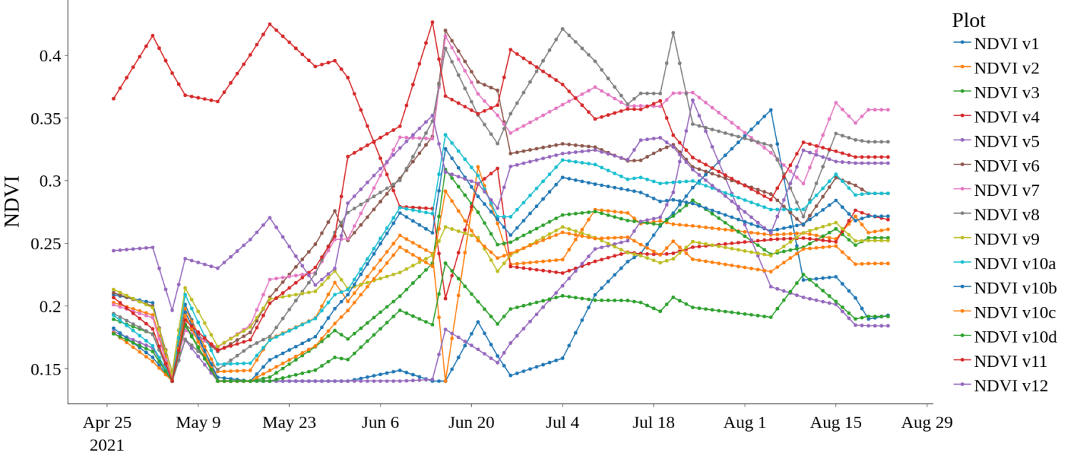

Data estimation
Height, LAI, fc, Width with NDVI
Assumptions:
→ Zones selected with GEE
→ Sentinel 2 NDVI
→ Only from April to October
→ NDVImin=0.14
→Savitzky Golay filter
Parcels ©Sentinel 2 image
Benoît HUET – EGU 2022
9

Slide 10
Measurements
Benoît HUET – EGU 2022
10

Slide 11
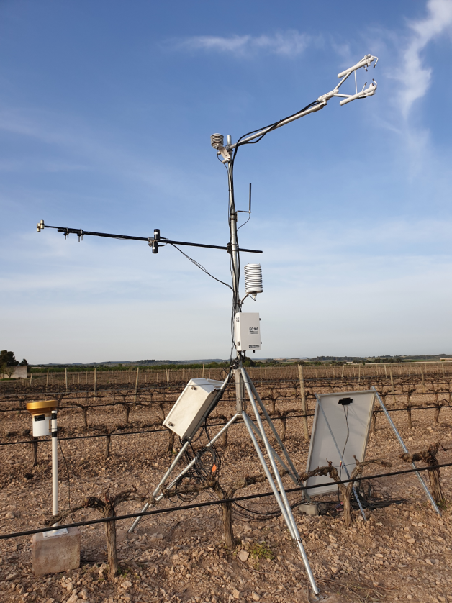
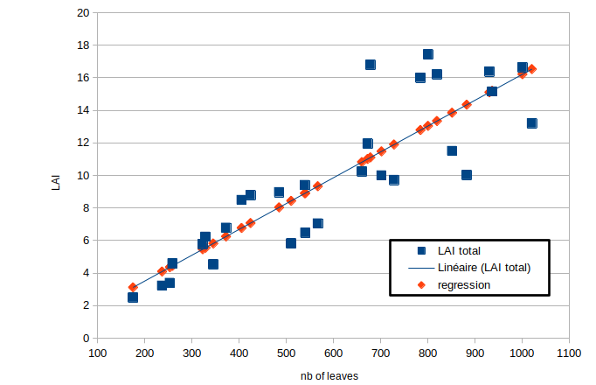
Vineyard in Verdù, Spain
Site : Verdù, Spain/ Age : 25 years
Characteristics : low inter-row vegetations, harsh climate, drip irrigation
Instruments from April to Sept 2021: a Campbell-Scientific IRGASON (H2O and C fluxes), an Apogee 4 bands net radiometer, three soil heat flux plates, two SKYE NDVI sensors, three DeltaT ML2x soil moisture sensors (5, 20 and 40 cm) on the row and one surface soil moisture sensor on the inter-row, rainfall, temperature and relative humidity sensors and IRT Cameras
Crop geometry (row width, row height)
Kcb: no irrigation, no rainfall -> Kc=ETa/Et0≈Kcb
LAI
Flux station ©CESBIO
Benoît HUET – EGU 2022

Slide 12
Results
Height modelling
Kcb estimation
ET calculation
Benoît HUET - CESBIO internship Vineyard modelling 2021
12

Slide 13
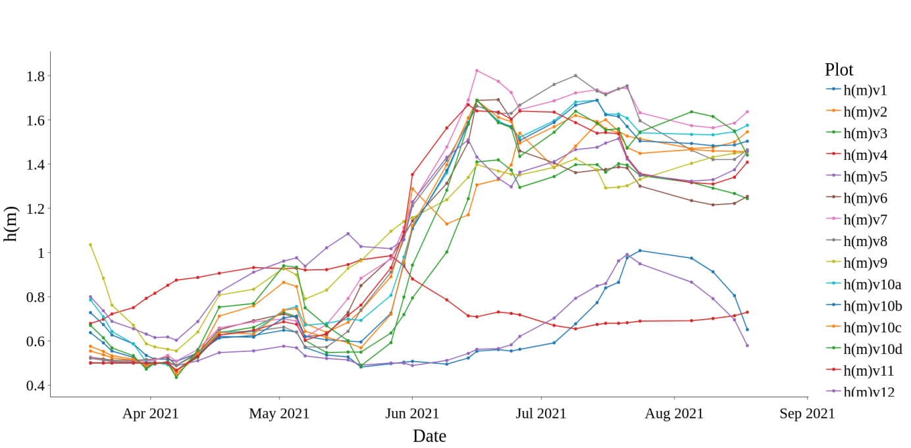
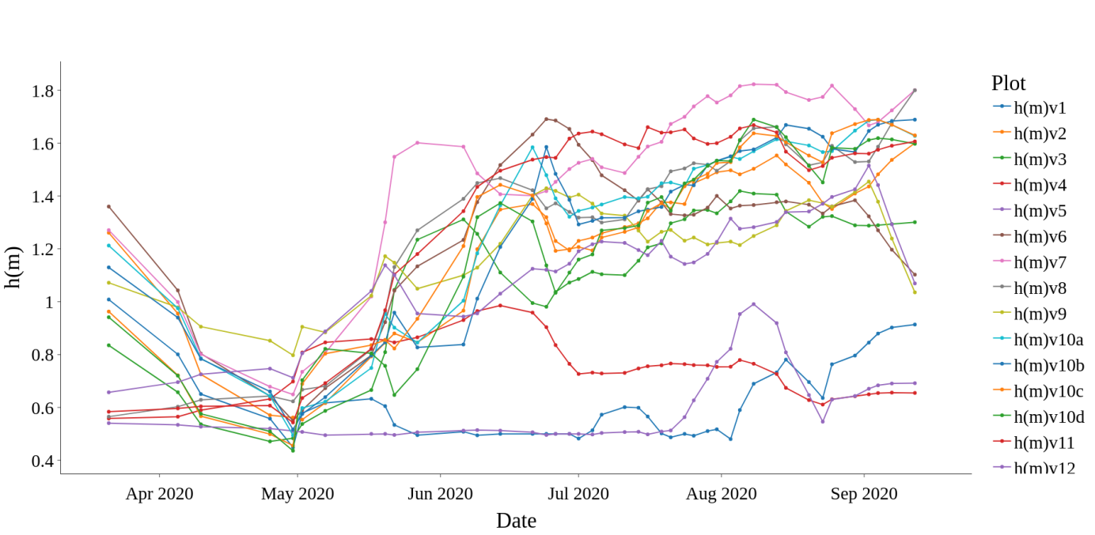
Height modelling
Height modelling in 2021
+
Cohesive model with the reality
Works for previous years
-
Singular behaviours (v1,4 & 5)
Variability factors
Farming, pruning (human interactions)
Grape variety and age
Ground particularities
Inter row vegetation cover
Height modelling in 2020
Benoît HUET – EGU 2022
13

Slide 14
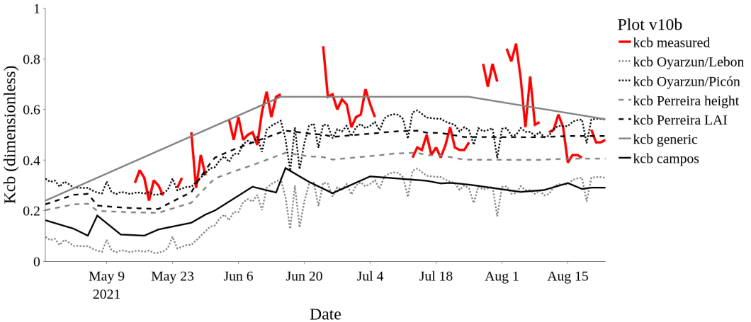
First step: Kcb estimation
Benoît HUET – EGU 2022
14

Slide 15
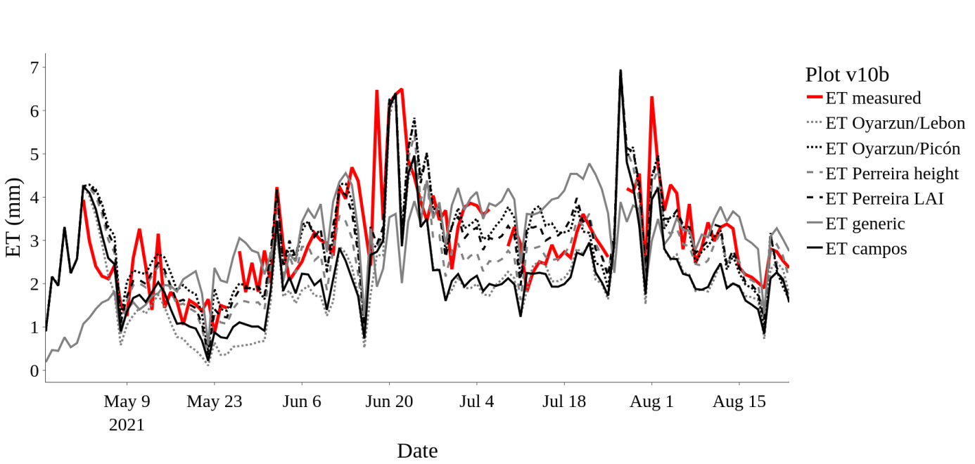
Second step: ET calculation
Oyar-Picon
Blue: rainfall produce very high levels of ET
Red: water deficit simulated
Benoît HUET – EGU 2022
15

Slide 16

Thank you for your attention
✉: benoit.huet@onera.fr
Benoît HUET – EGU 2022

