Slide 1












Carbon fluxes estimation with aleatoric and epistemic uncertainties at high spatial resolution over large areas
Laura Martínez-Ferrer, Álvaro Moreno-Martínez, Jordi Muñoz-Marí, Emma Izquierdo Verdiguier, John S. Kimball, Steven W. Running, Nicholas Clinton, Gustau Camps-Valls
Plant traits, adaptation, and biogeochemical cycles – from measurements to models
http://isp.uv.es @isp_uv_es laura.martinez-ferrer@uv.es

Slide 2
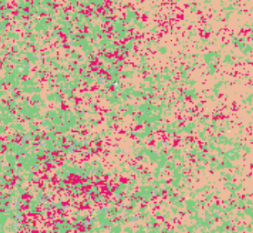


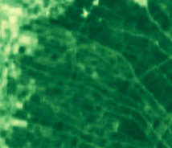
Gross Primary Production (GPP)
Abstract EGU22-10248
Why is it important?
GPP is the gross amount of CO₂ assimilated by plants through photosynthesis
It drives climate regulation and determines carbon sources and sinks of the ecosystem
Our goals:
High Spatial Resolution
Realistic uncertainties (beyond QFs)
7: Fill Value
4: Couldn’t retrieve pixel
3: Substandard due to other than geometry problems
2: Substandard due to geometry problems
1: Good, very usable, but not the best
0: Very best possible
[g/m²d]
MODIS GPP (500 m)
30m GPP
MODIS GPP QF

Slide 3
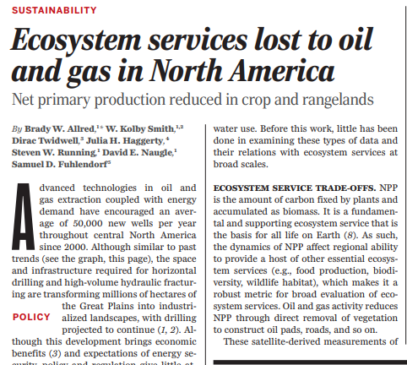
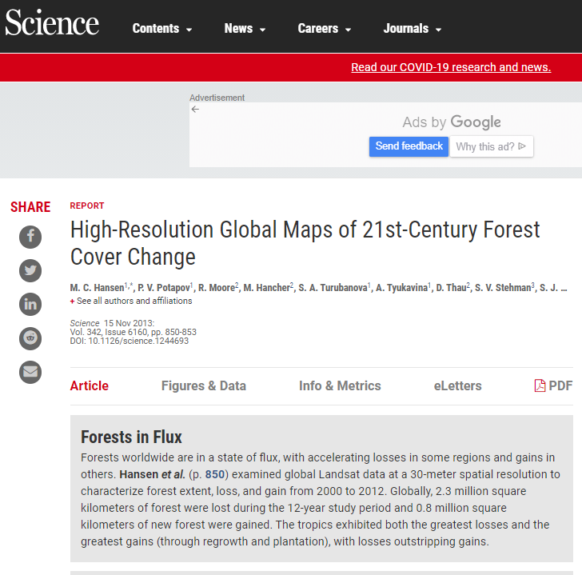
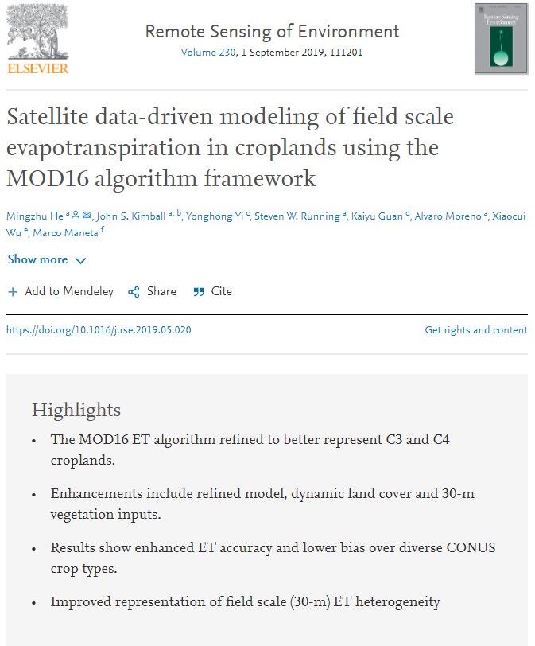
The needed but “hard” high resolution pathway:

Slide 4



Luckily, we have two good friends to help us…
Cloud computing
Machine Learning

Slide 5
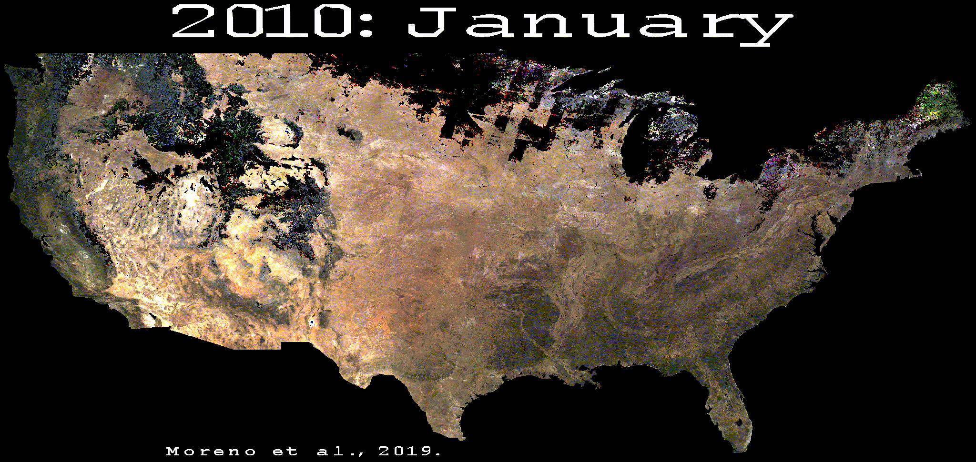

Workflow
Training
Abstract EGU22-10248
FLUXNET GPP
GLDAS/ERA5
Reflectance
WorldClim
Input propagated uncert = σ_{a}
model uncert = σ_{e}
Sensitivity analysis
Landsat
MODIS
HISTARFM¹
Ɛ_{reflectances}
Neural Network
Jacobian
σ_{a}
MC Dropout
Total uncertainty²
Reflectance
+
σ_{e}
GLDAS, ERA5, WorldClim
GPP at 30m
Google Earth Engine
Dataset
Algorithm
Product
1. Moreno-Martínez et al. (2020). Multispectral High Resolution Sensor Fusion for Smoothing and Gap-filling in the Cloud. Remote Sensing of Environment
2. Martínez-Ferrer et al. (2022). Quantifying Uncertainty in High Resolution Biophysical Variable Retrieval with Machine Learning. Submitted to Remote Sensing of Environment.

Slide 6
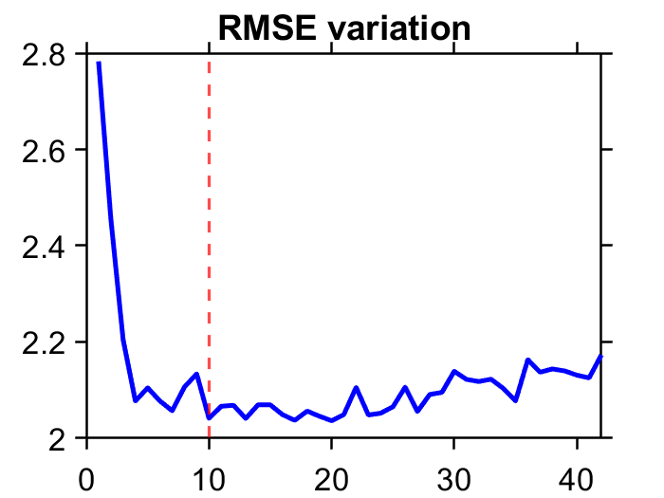
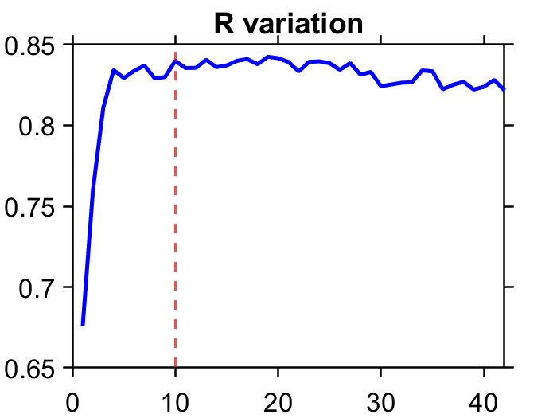



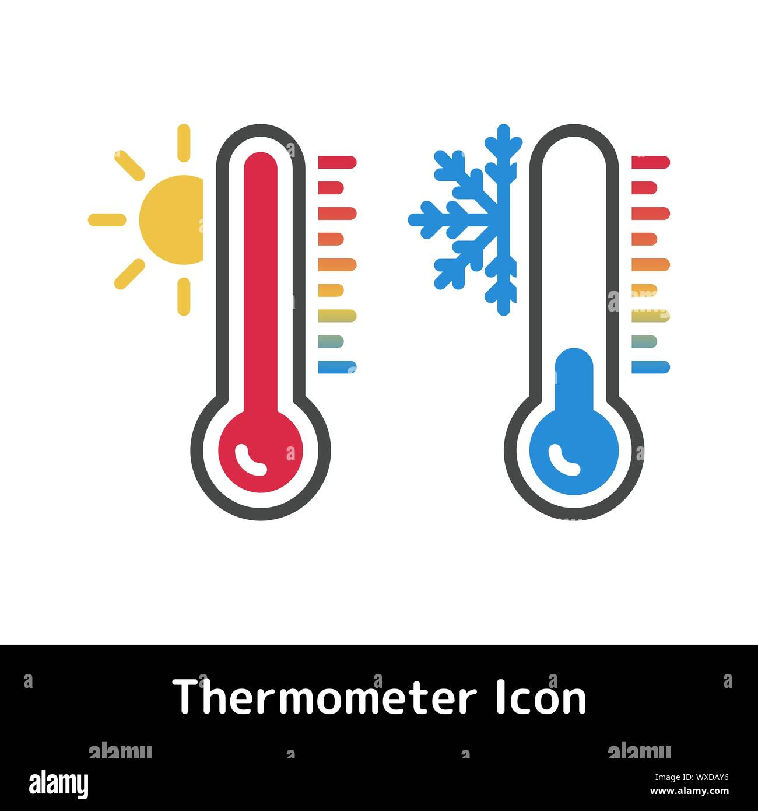
Sensitivity analysis
Abstract EGU22-10248
More than 40 input variables were considered (RS+Meteo+Climatic)
Selected inputs
B3: Red
B5: Shortwave infrared 1
B7: Shortwave infrared 2
kndvi*: Kernel NDVI
RAD: Downward radiation flux
DPT: Dew point temperature
bio6: Min temp of coldest month
bio7: Temp annual range
bio11: Mean temp of coldest quarter
Kept most relevant variables, removed redundant information, and improved model accuracy
* Camps-Valls et al. (2021). A unified vegetation index for quantifying terrestrial biosphere. Science Advances.

Slide 7
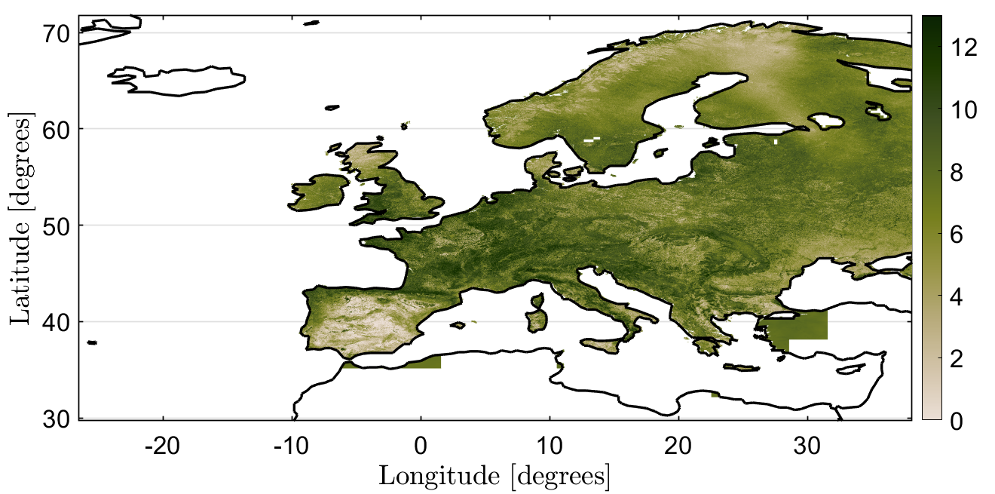
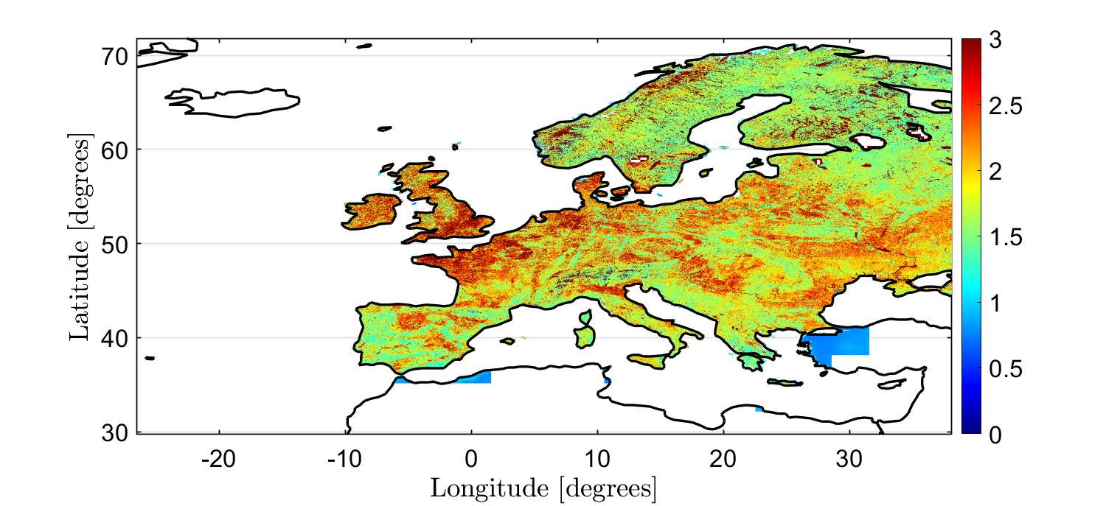
Results
GPP at 30m & total uncertainty (1st August 2013)
Abstract EGU22-10248
[g/m²d]
Global validation over a selection of sites.
R | RMSE[g/m²d] | ME[g/m²d]
0.82 | 2.04 | 0.04
☉ State-of-the-art accuracy but at 30 m resolution
☉ Most areas show 11.5% of total uncertainty
☉ Maximum total uncertainty reached 23%
☉ Cropland areas present higher uncertainty, forest vegetation the lowest
[g/m²d]

Slide 8
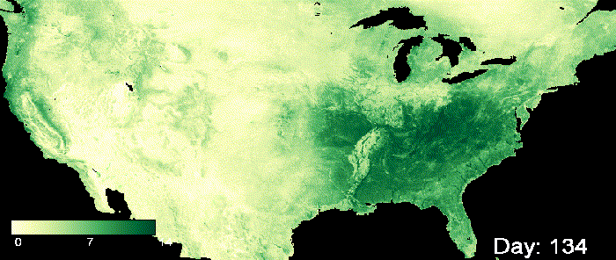
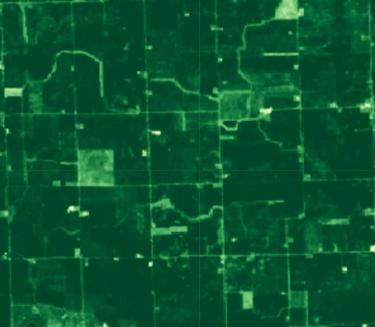
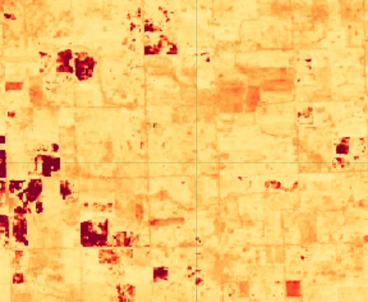

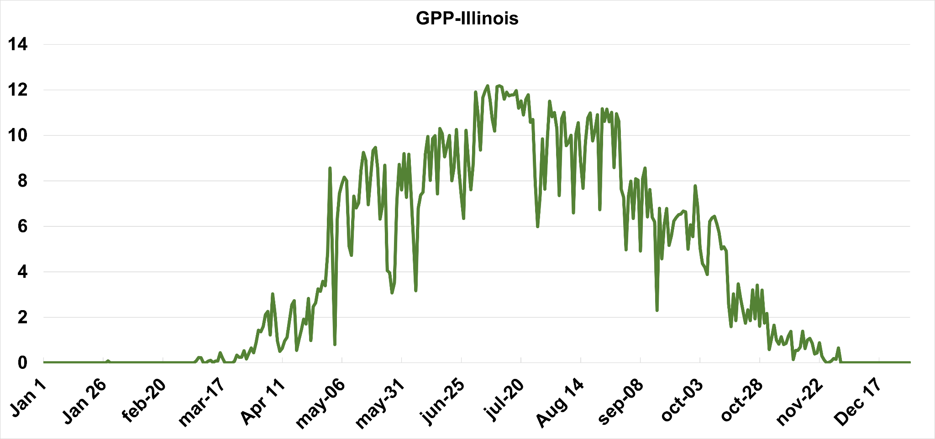
Abstract EGU22-10248
Daily GPP at 30m
13
3
[g/m²d]
0
0
GPP ESTIMATES
GPP UNCERTAINTY (model + input propagated errors)
☉ Captures key daily temporal variability
☉ Captures high spatial details while preserving continental patterns
[g/m²d]

Slide 9
Take-home messages
Abstract EGU22-10248
Gap-filled satellite data are needed to provide continuous GPP estimates
Cloud computing (GEE) along with ML methods permit to create accurate large scale high resolution data products
Our provided realistic uncertainties (error bars) are critical to assess Earth system models sources of uncertainties
Our HR GPP product enables to monitor the impact of small disturbances and precision agriculture
The proposed method could be used to model other key fluxes (e.g. ET, LH)
Generic modular scheme: transportable to Sentinel-2 platforms easily

Slide 10
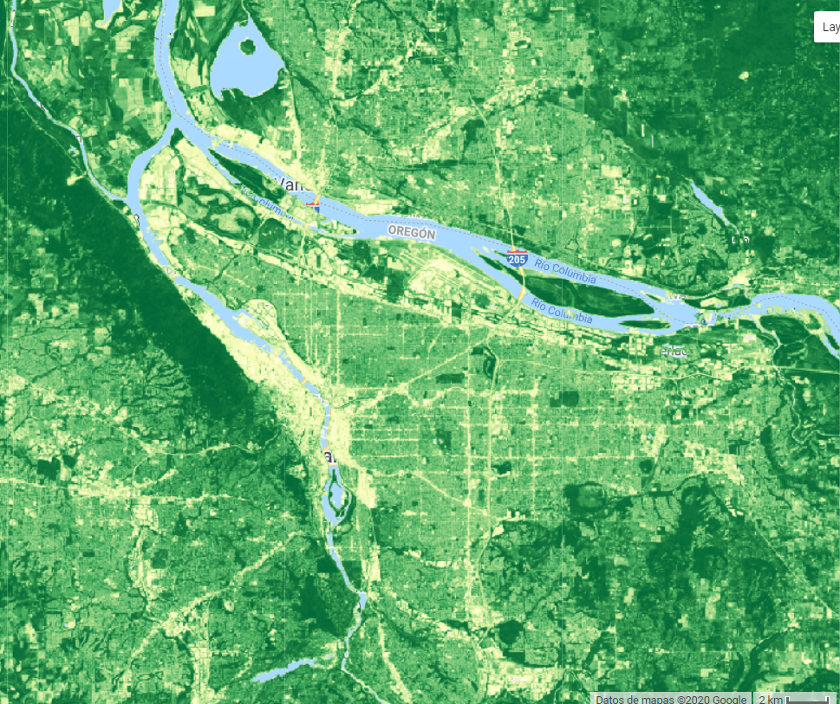
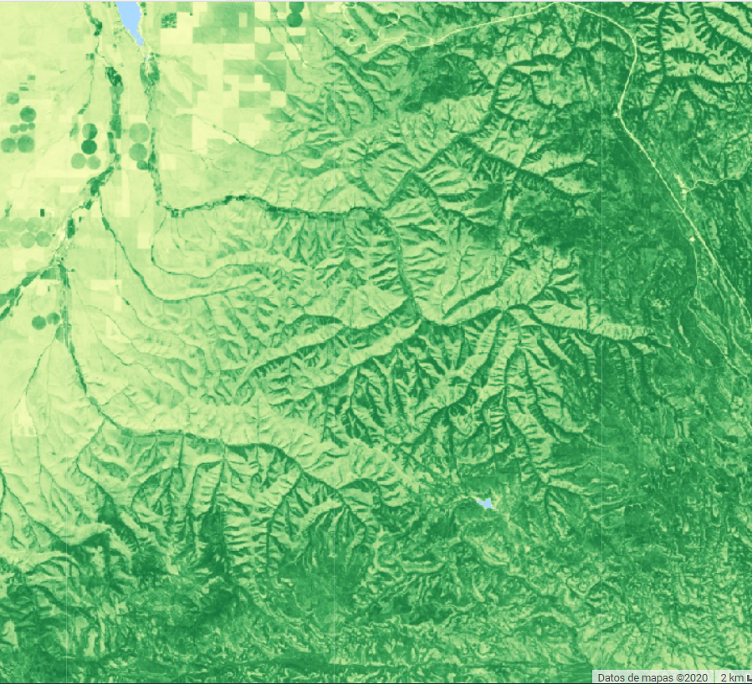
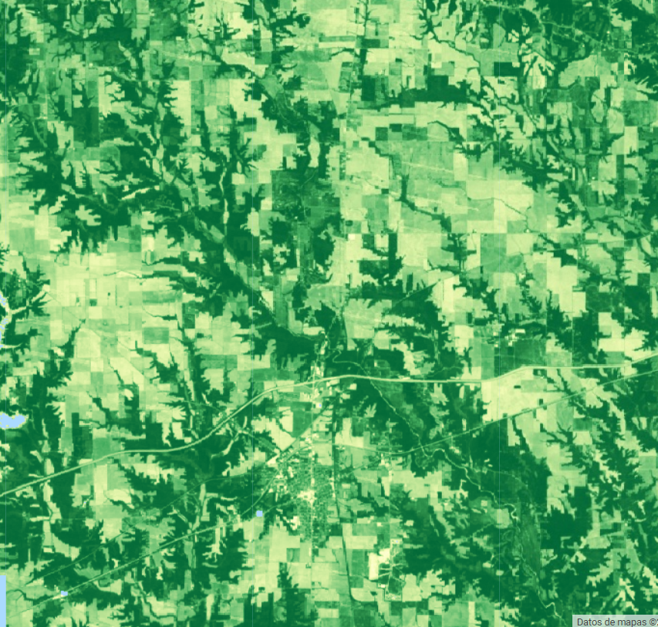
Thanks!
http://isp.uv.es
@isp_uv_es laura.martinez-ferrer@uv.es

