Slide 1





CHENILLE: Coupled beHavior undErstaNding of fauLts: from the Laboratory to the fiEld
Audrey Bonnelye(1,2), Pierre Dick(3), Stefan Lüth(1), Rüdiger Giese(1), Roman Esefelder(1), Fabrice Cotton(1), Marco Bohnhoff(1), Yves Guglielmi(4), Jan Henninges(1), Damien Jougnot (5),Carolin Boese (1), Grzegorz Kwiatek(1)
GFZ Potsdam, Germany
Frei Universität, Berlin, Germany
IRSN, France
LBNL, USA
Sorbonne Université

Slide 2
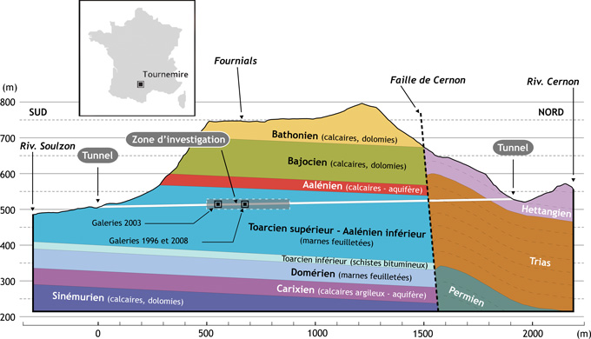
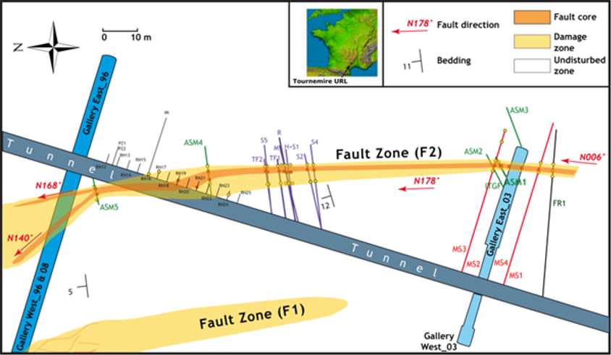
URL of Tournemire
Underground Research Laboratory : URL
Clay rich rocks are sedimentary rocks, prensenting fine grained particules. They are considered for geological storage of nuclear wastes.
Toarcian layer presents ~50% of clay minerals
Clay rich rocks are known to exhibit a strong anisotropy, related to mineral shape, pore shape and bedding.

Slide 3
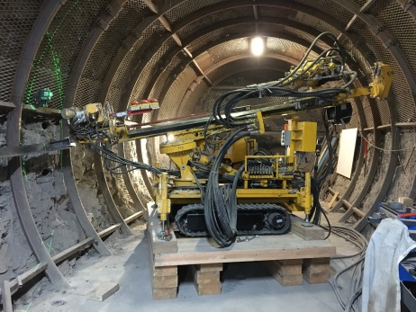
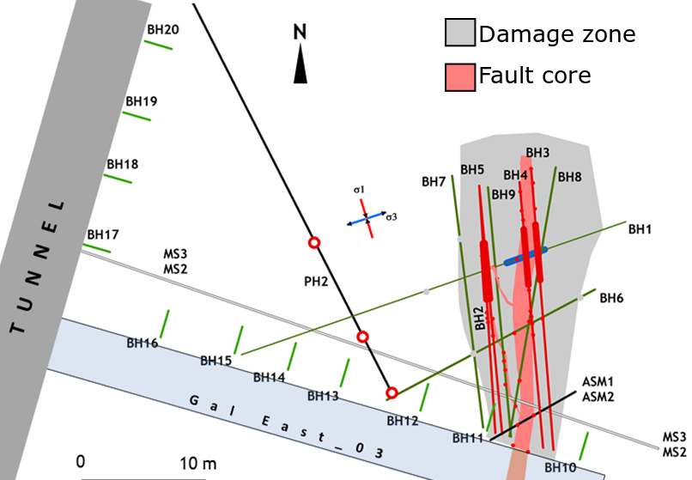
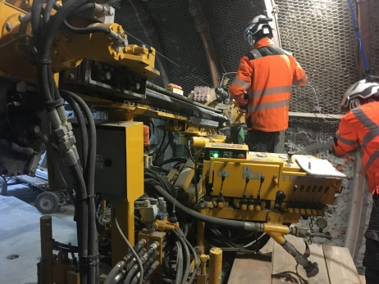
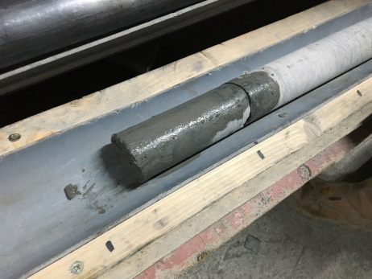
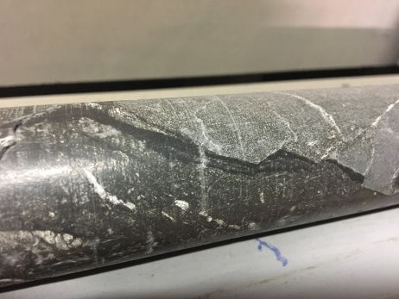
Borehole set-up
9 boreholes :
4 “heating boreholes” equipped with heaters and FO for distributed temperature measurement
4 acoustic monitoring boreholes for HF seismic
1 injection borehole equipped with in injection probe for gas injection and 3D displacement measurement
15 “short boreholes” for high resolution active seismic acquisition before/after experiment

Slide 4
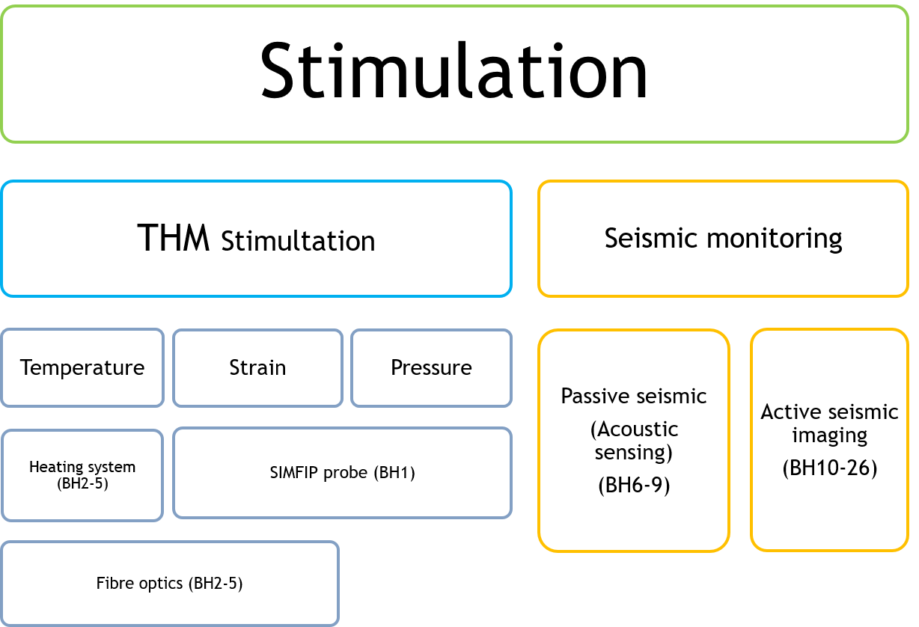
Planned activities

Slide 5
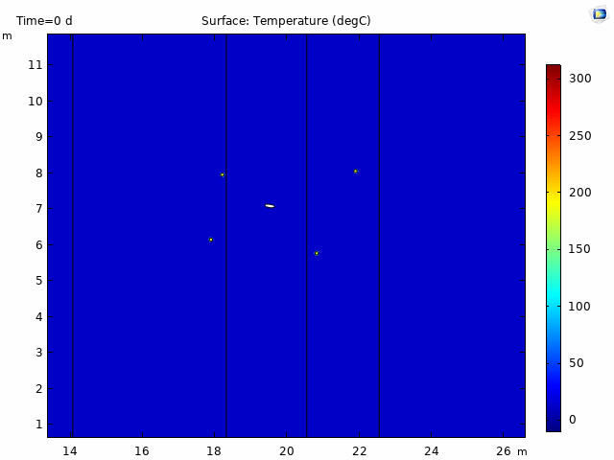
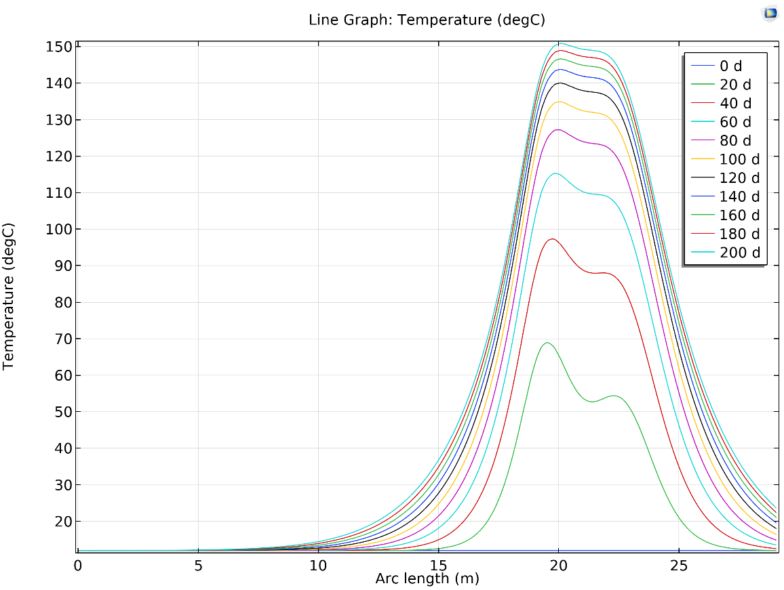
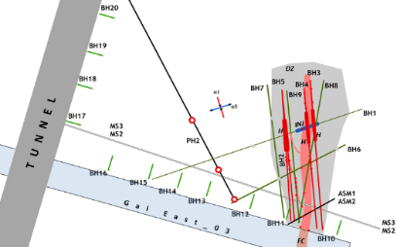
Thermal loading
Comsol simulations :

Slide 6
Thermal loading
HEATING (90 mm OD)
ROCK (Borehole 96 mm OD)
DTS provides :
High capacity / bandwidth: more information can be transmitted in time
“Passive“, low power, no downhole electronics required
Small dimensions, lightweight: easy to deploy in places difficult to access and where space is limited
Environmental ruggedness: can tolerate high temperatures (up to ~300 °C and higher)
Multiplexing, distributed sensing: high temporal and spatial resolution, long ranges (several km)
T°C resolution ±0.3, spatial resolution 1m
TCx4
CEMENT
TUBE
HEATER
60,3 mm OD
INSERTION
ROD
CABLE
SLIDE
SLIDE
FO +
GLASS ROD

Slide 7
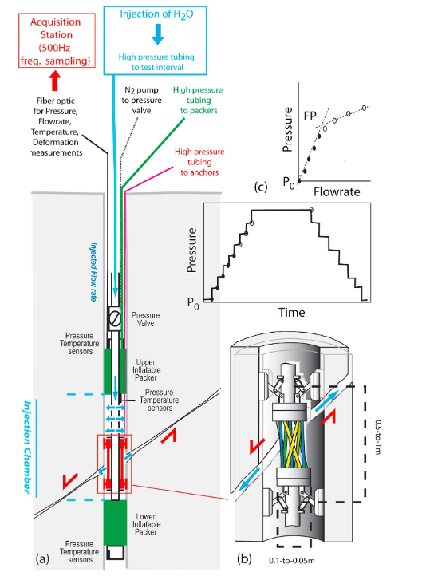
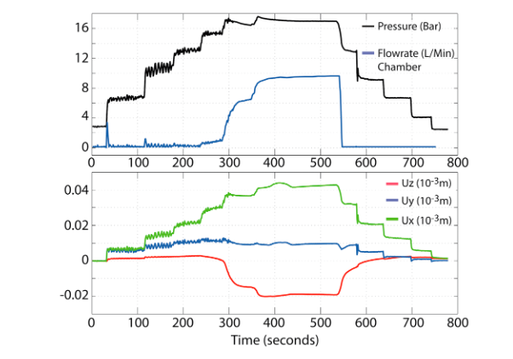
Hydraulic stimulation
Injection probe (SIMFIP) :
Control of pressure and pressurization rate
3D dispacament measurements
Guglielmi et al. 2015

Slide 8
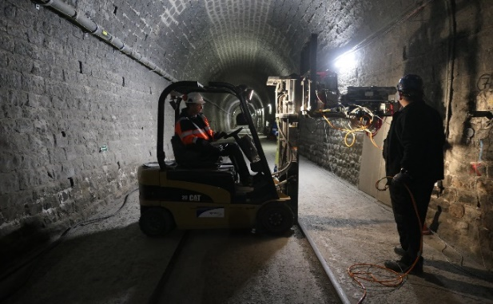
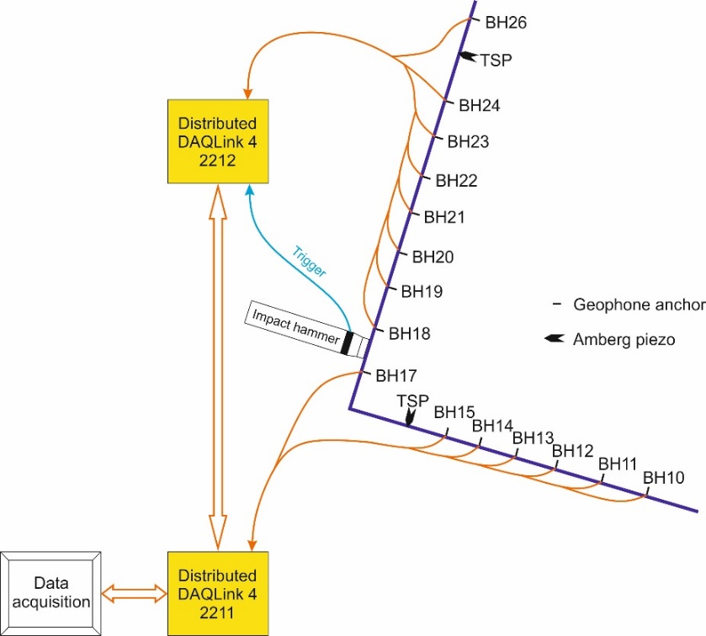
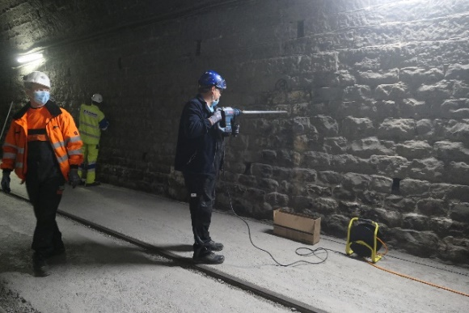
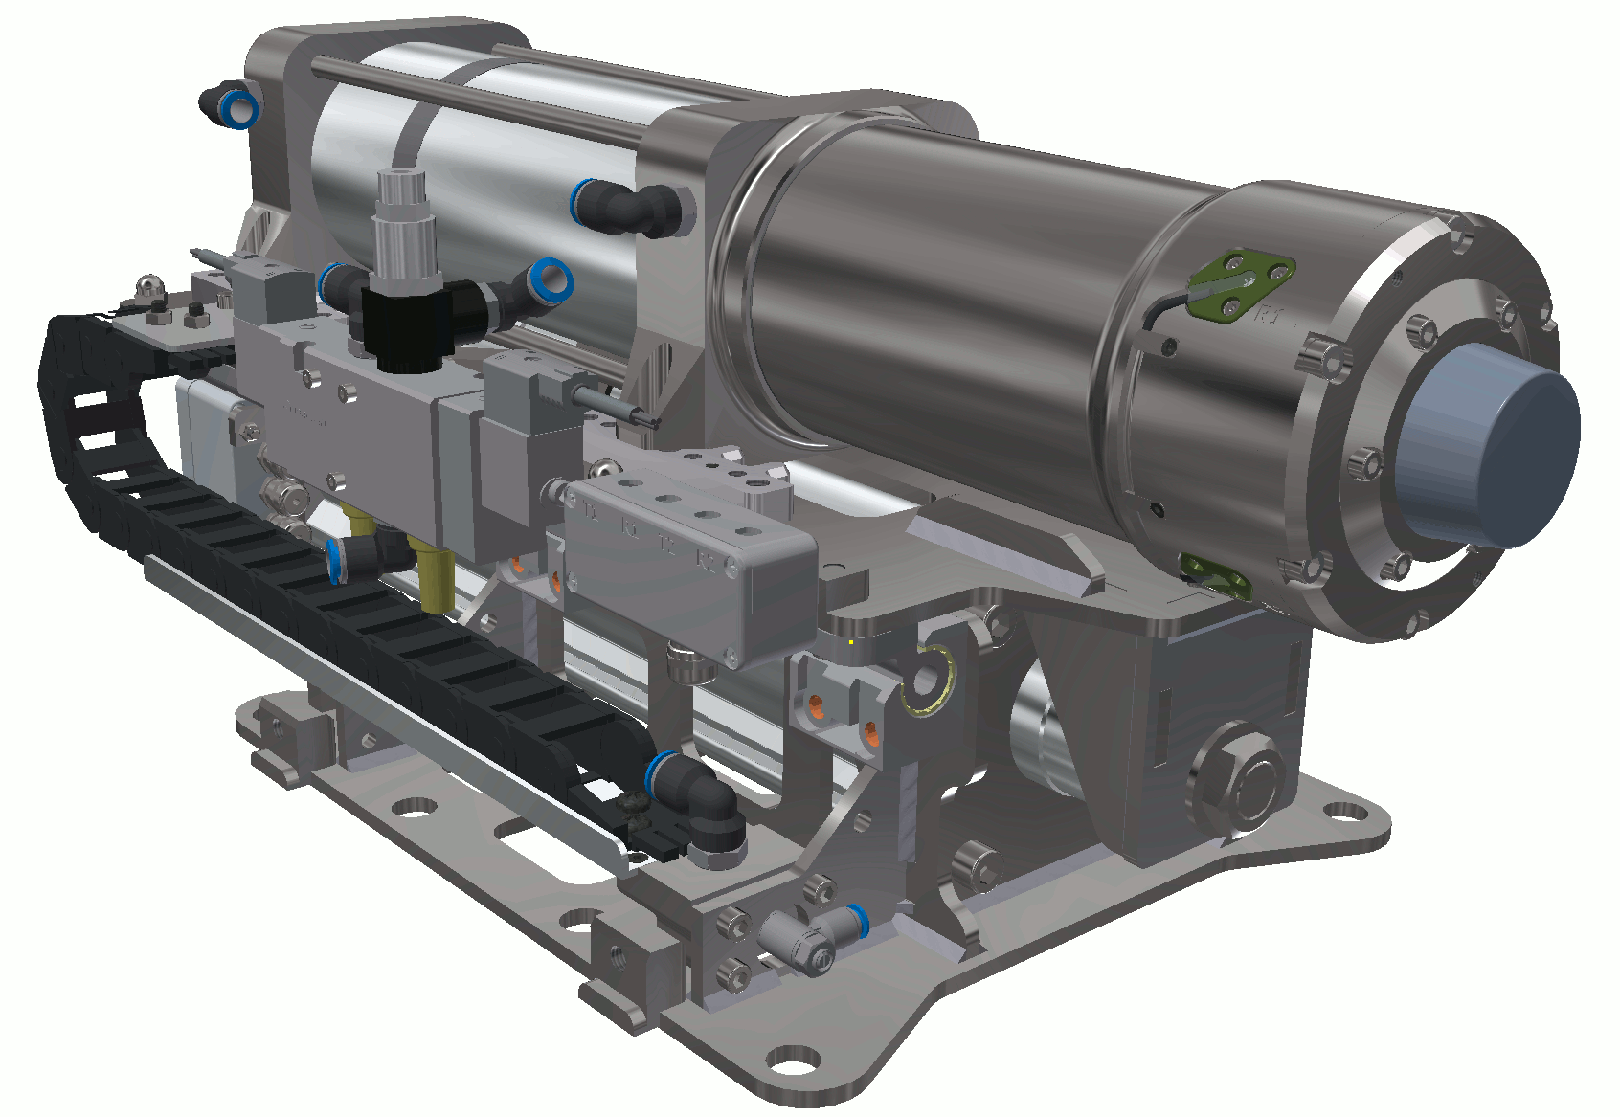
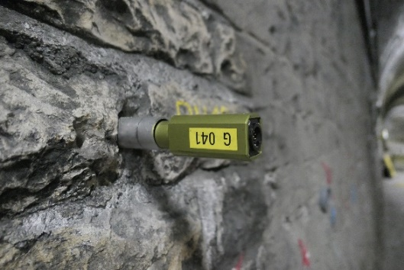
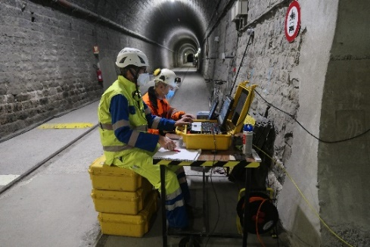
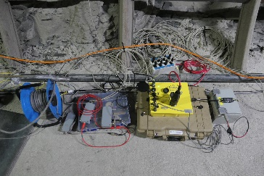
Active Seismic Survey
Pneumatically driven Impact Source
Installation of receiver tubes
Screwed 3C-receiver rods
Combined DAQLink and TSP recording

Slide 9
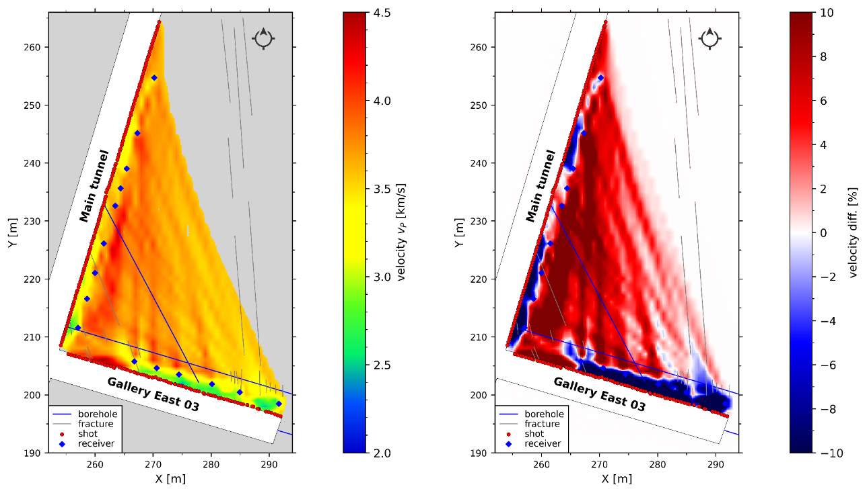
Active Seismic Survey
Traveltime tomography by simulr16
Low velocity zones near tunnel walls (EDZ)
  Lower velocities in the E part of Ga East 03
  High velocities at concrete tubing in the W part of the gallery
Velocities decreasing from west to east
Low coverage in area of interest near the fault structure

Slide 10
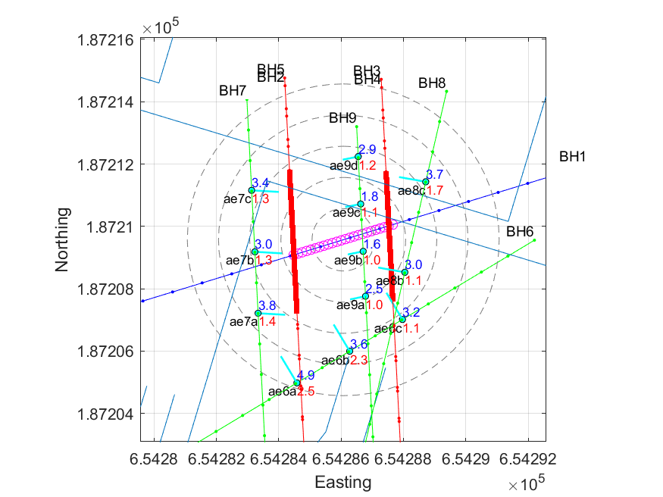
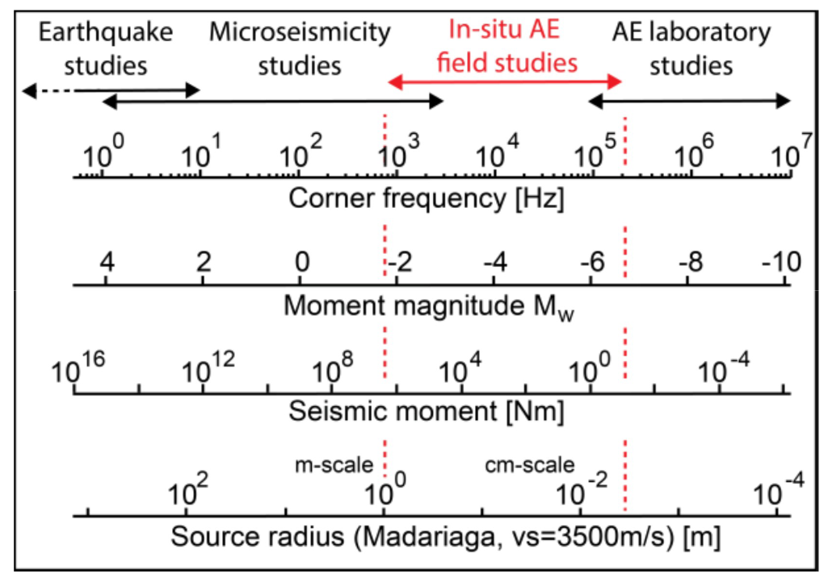
Passive Seismic Monitoring
Manthei and Plankers 2018
16 sensors :
12 high frequency field AE sensors (1-100kHz)
4 accelerometers
Boese et al., 2021

Slide 11
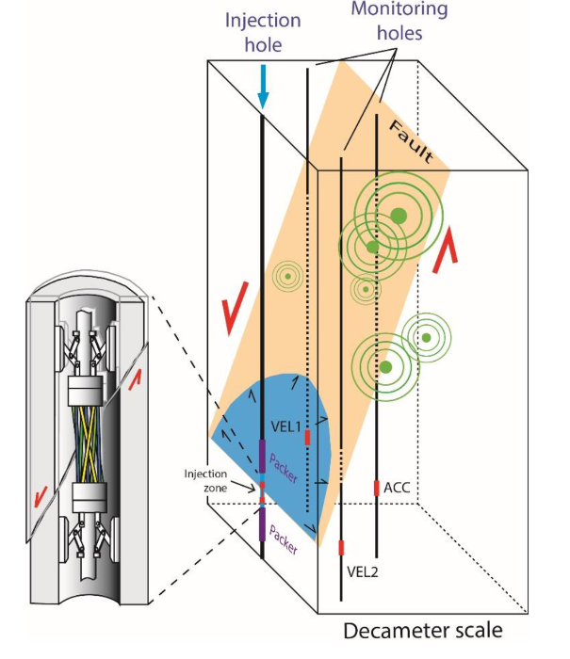
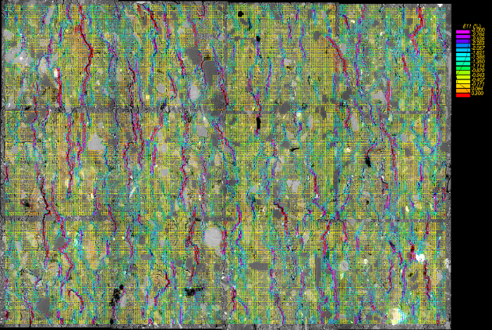
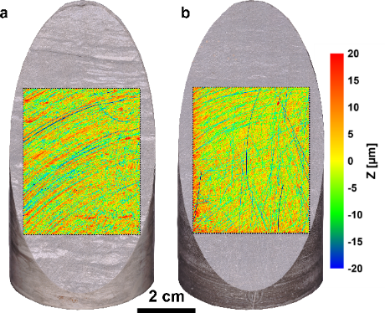
CHENILLE: Coupled beHavior undErstaNding of fauLts: from the Laboratory to the fiEld
µm
cm
10m
0,9mm
micro-mechanical testing
Triaxial testing
In-situ testing
Schuster et al., under review
Guglielmi et al. 2018
Thanks for your attention ☺

