Slide 1

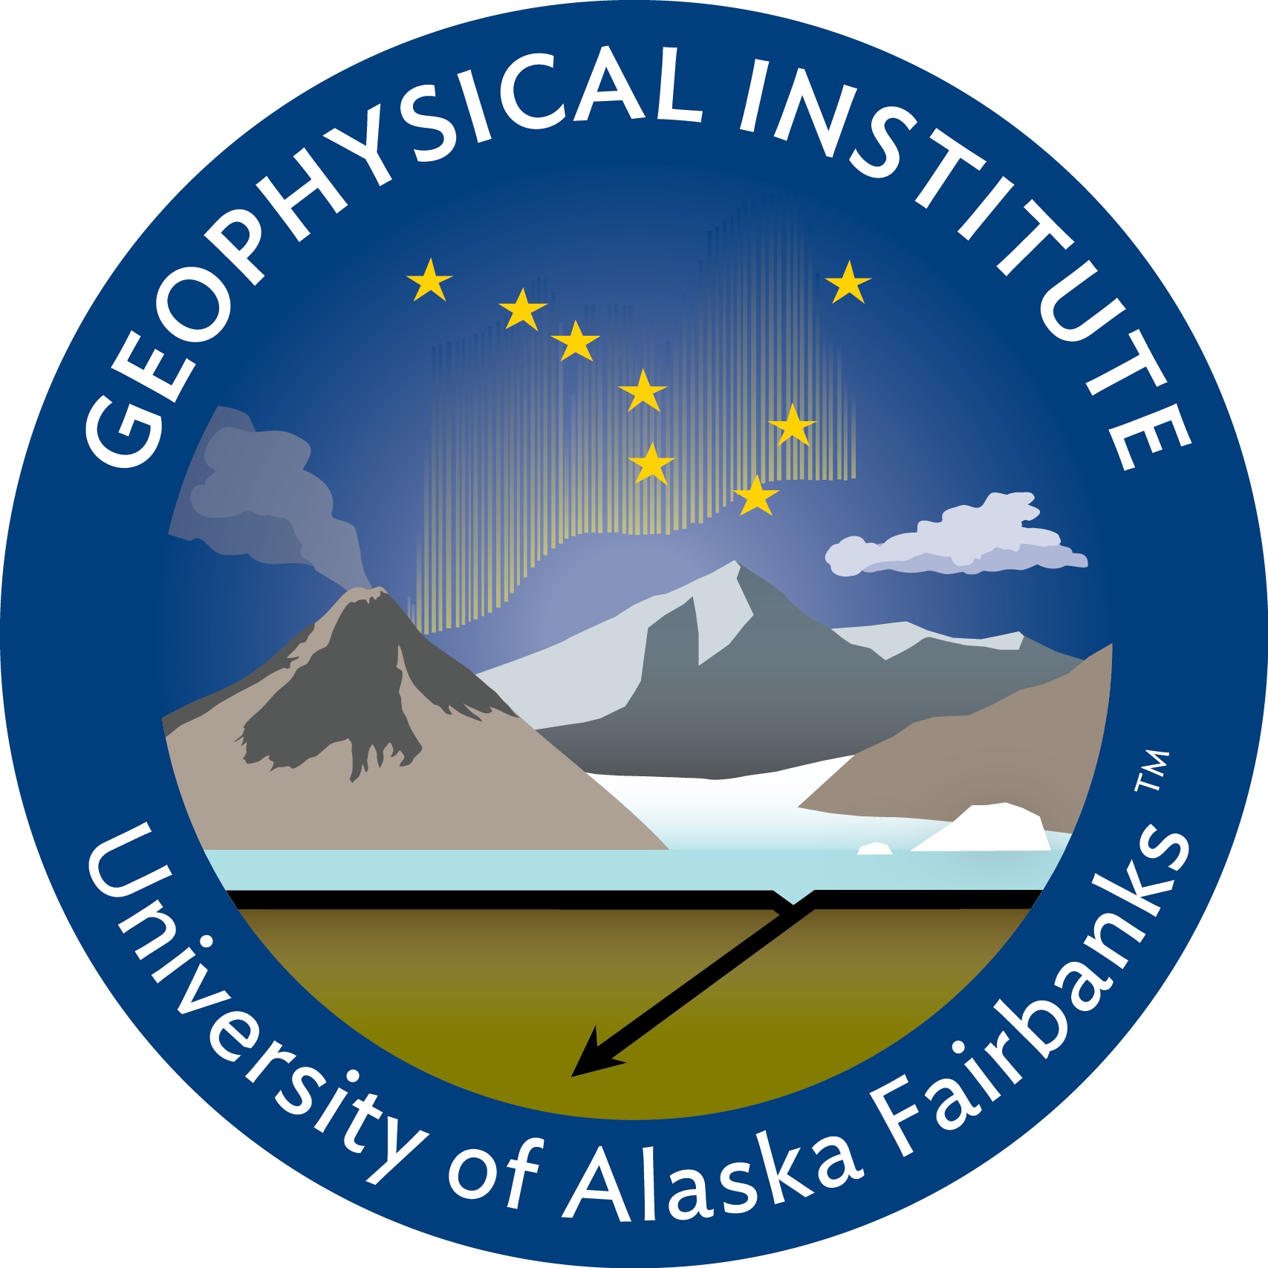
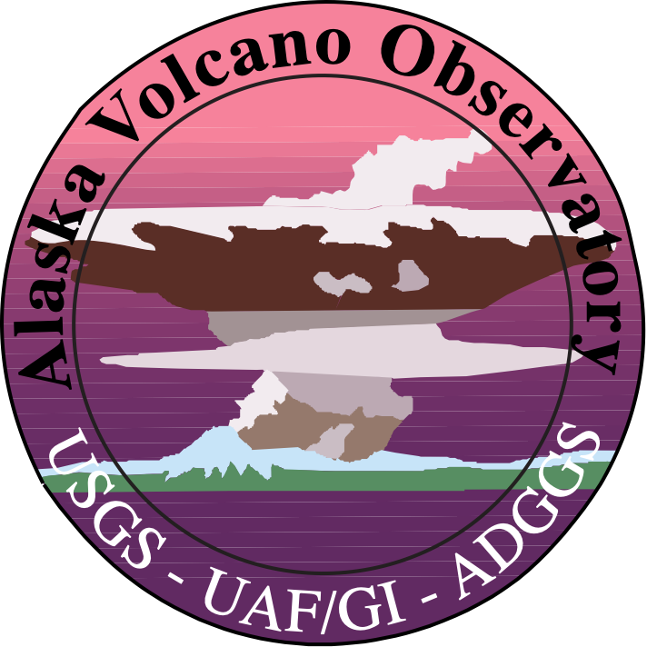
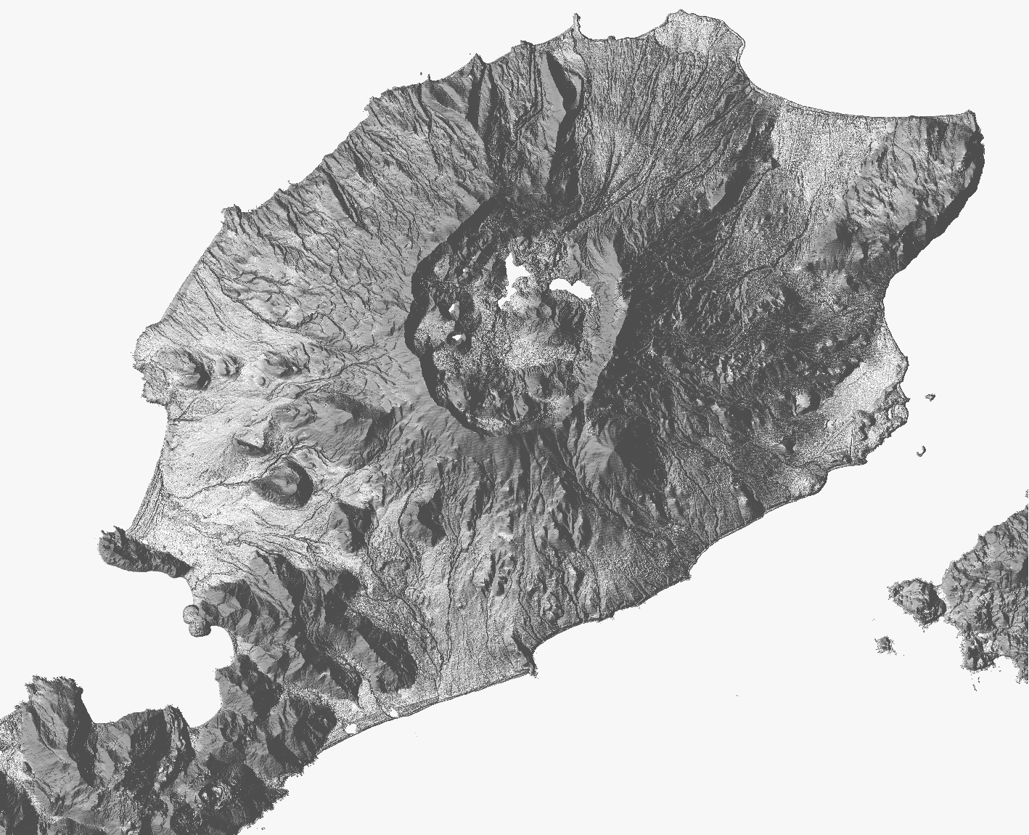
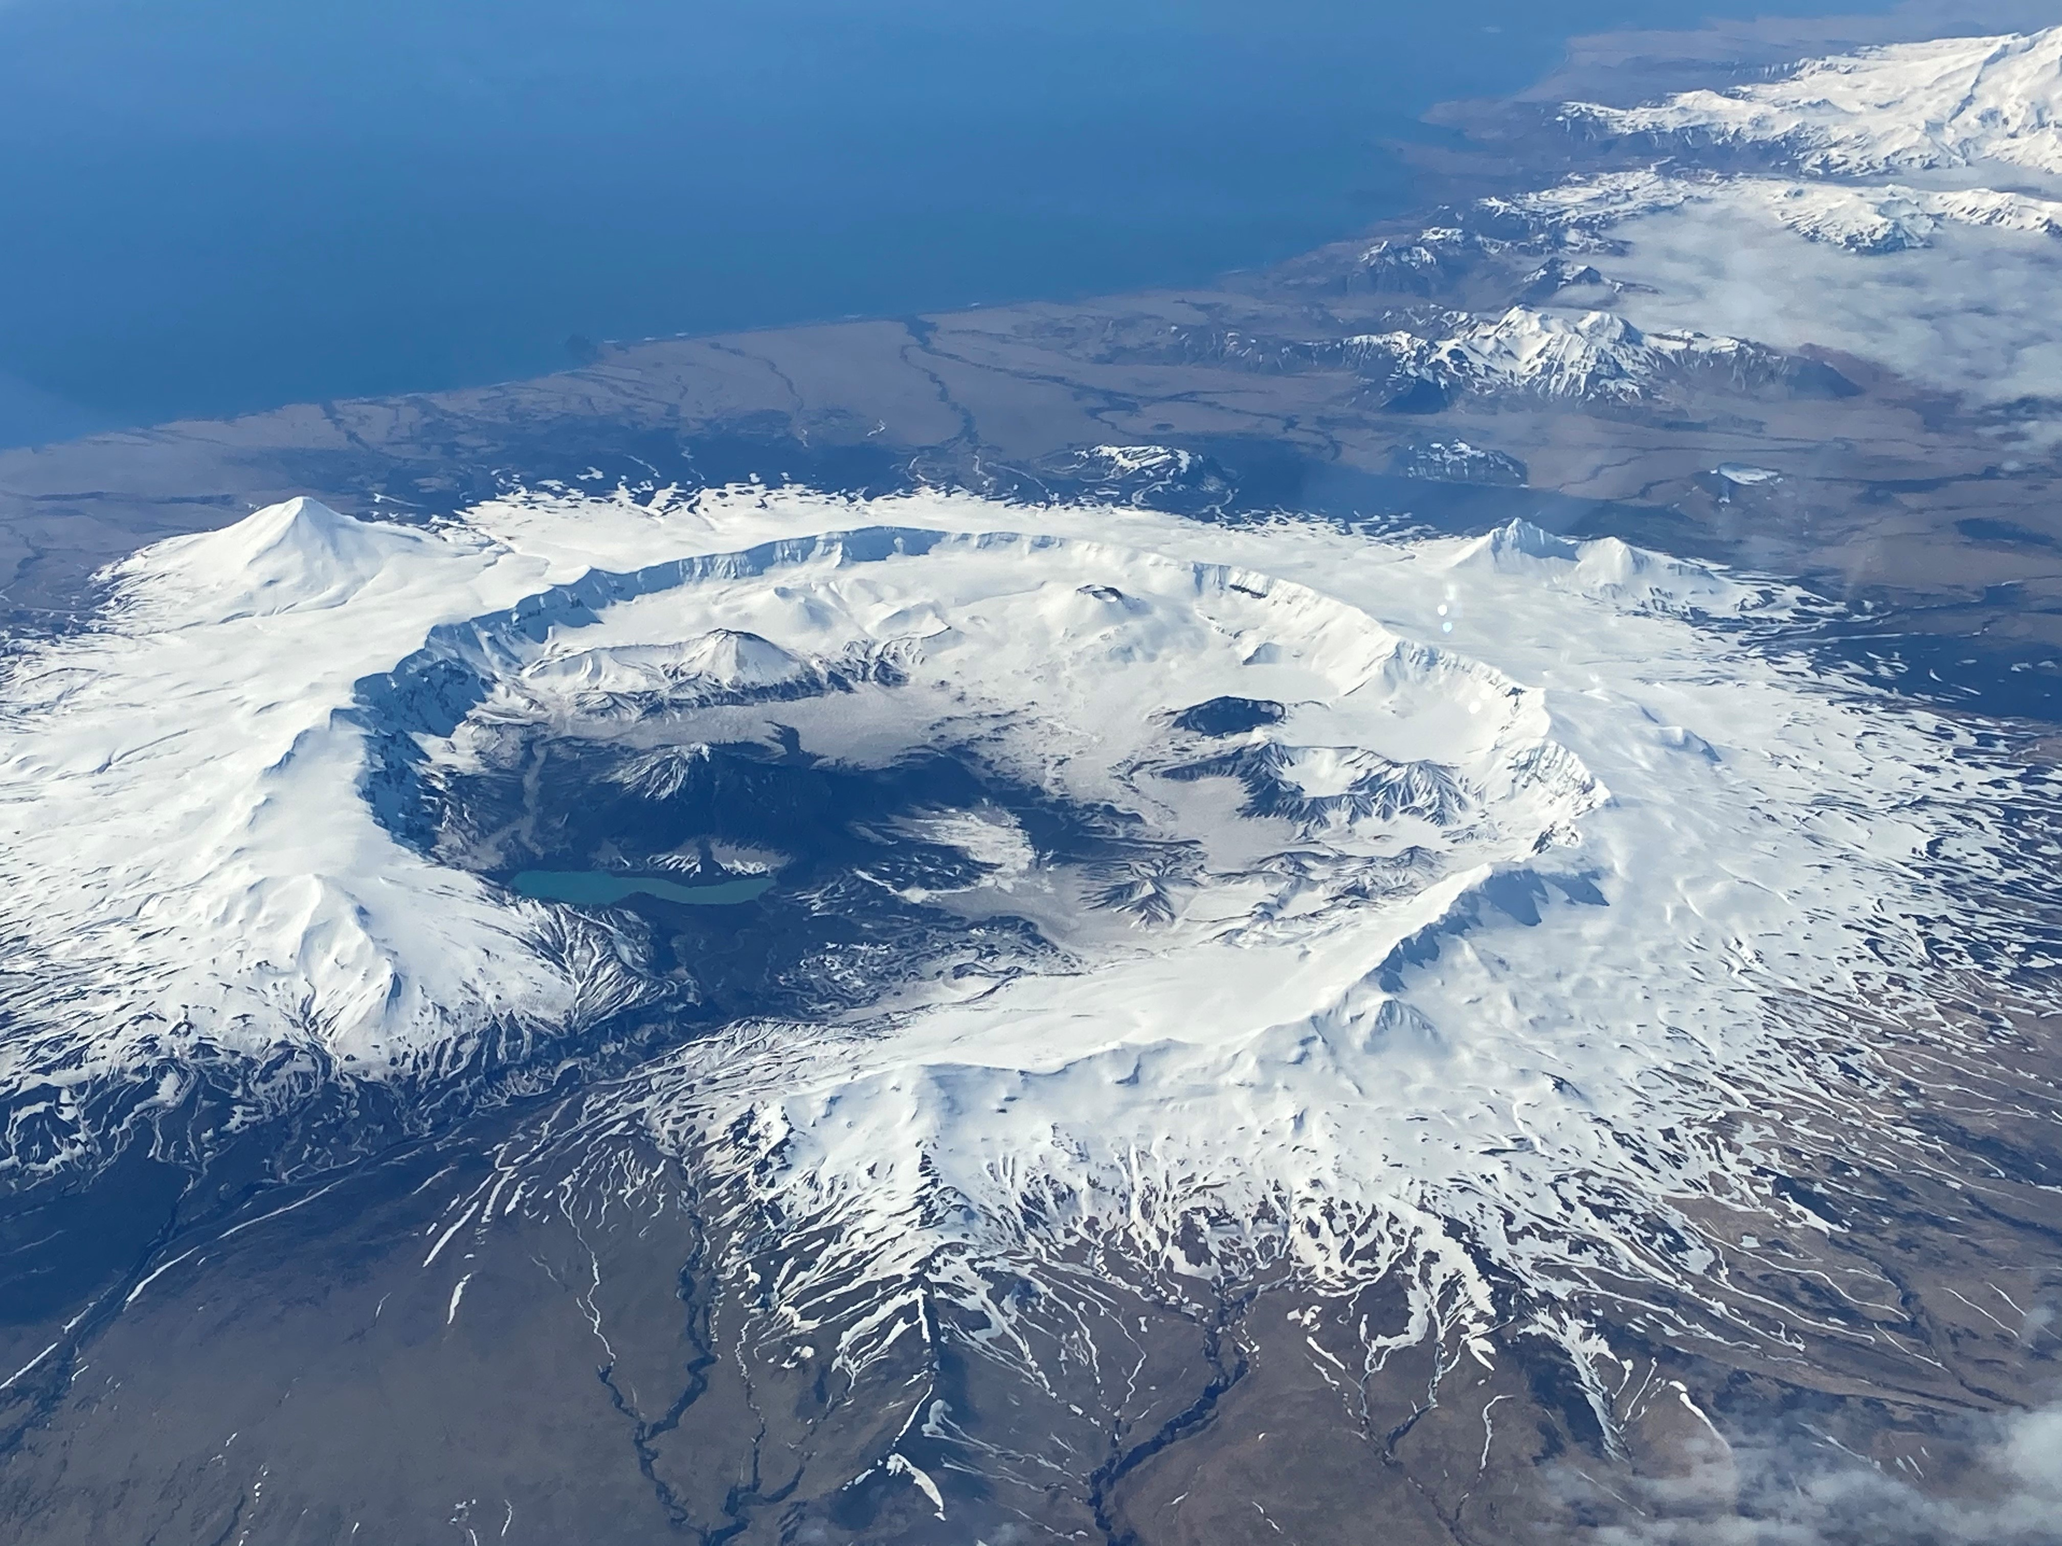

Spatiotemporal distribution of low-temperature thermal anomalies at volcanic calderas:
The case of Okmok volcano, Alaska
Claire Puleio (GI-UAF) & Társilo Girona (GI-UAF, Alaska Volcano Observatory)
Burke Mees
With thanks to:
NASA FINESST (Future Investigators in NASA Earth and Space Science and Technology)

Slide 2
Research Questions
1
Do we observe low-temperature thermal anomalies on the flanks of Okmok Caldera?
Subtle large-scale, long-term (years) radiance anomalies
2
If so, what causes these thermal anomalies?
What are the subsurface processes that could be driving these anomalies?

Slide 3
1
Do we observe low-temperature thermal anomalies on the flanks of Okmok Caldera?
Subtle large-scale, long-term (years) radiance anomalies

Slide 4
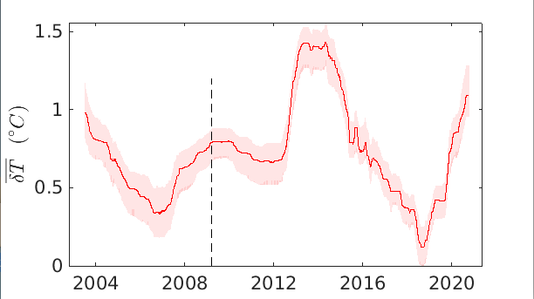
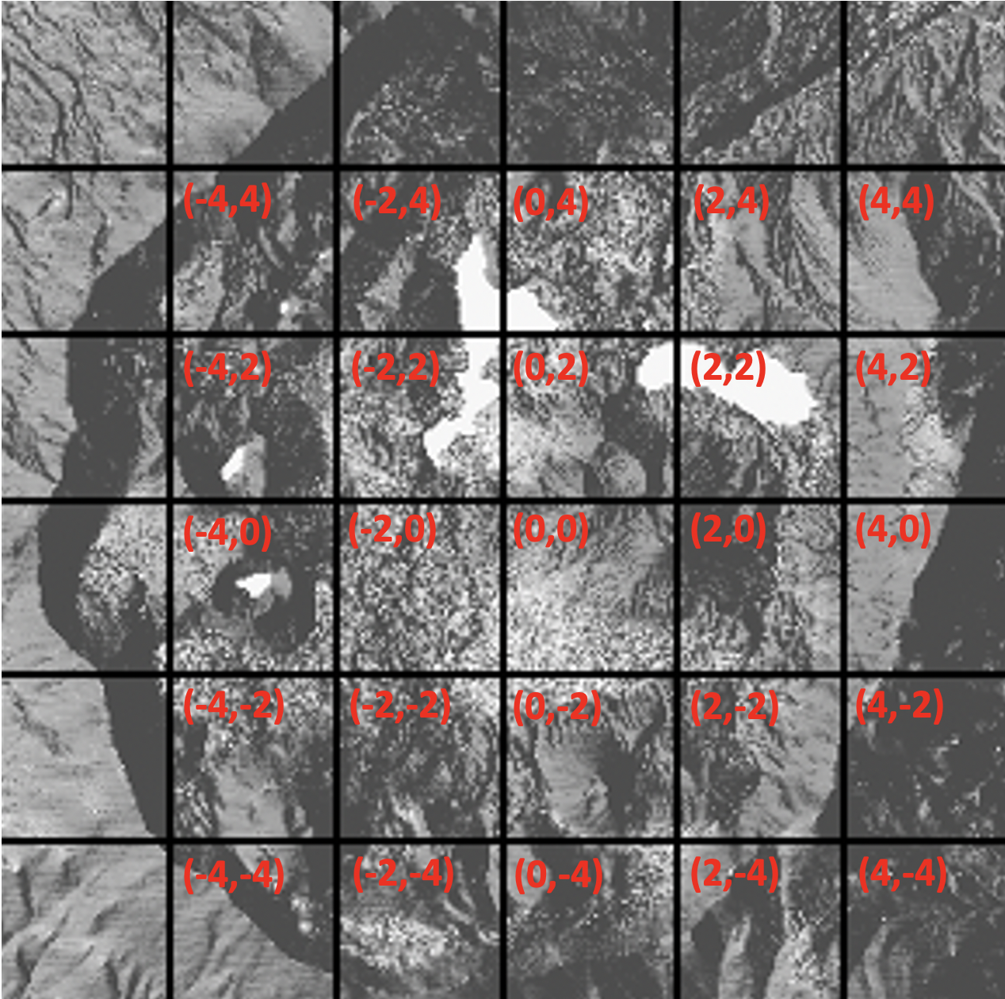
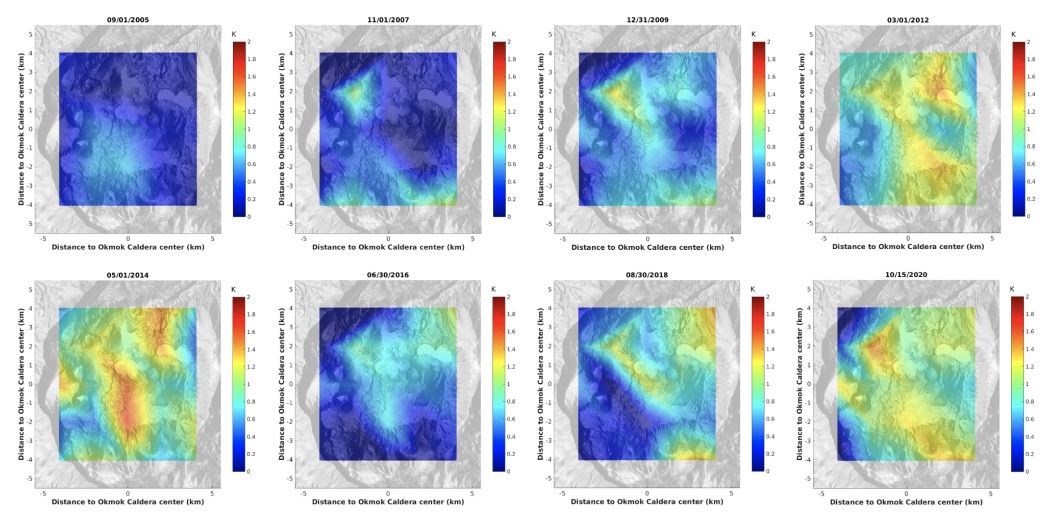
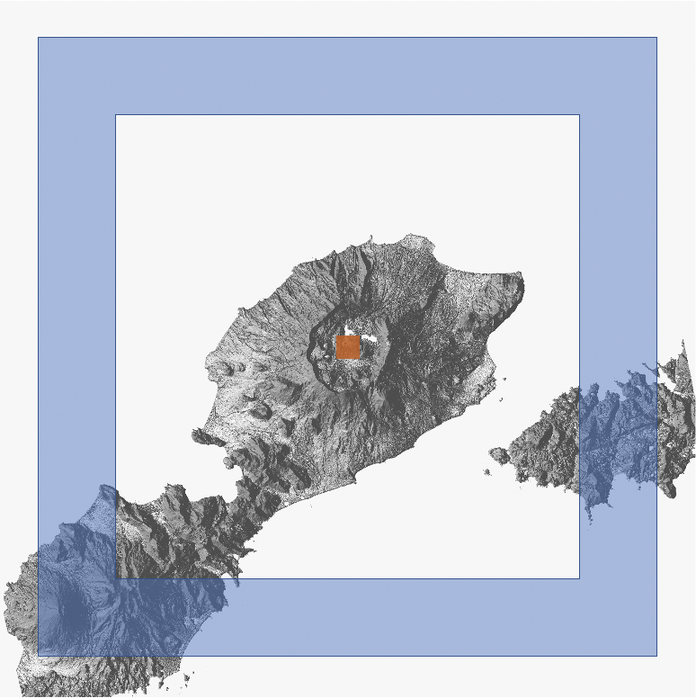
Methods
Download radiance data collected by the Moderate Resolution Imaging Spectroradiometers aboard NASA’s Terra and Aqua satellites
Shows how temperature at each gridpoint location is changing with time
Decide what locations to analyze
Apply a cloud mask
Extract radiance values
Determine median radiances
Calculate uncertainty of median radiances
Take the results for each location and combine to see thermal anomalies together for entire caldera
Compare the median radiance values at each gridpoint location to the surrounding area to determine thermal anomaly
Interpolate to fill in any gaps in data
Apply a low-pass filter that removes trends due to daily or seasonal components

Slide 5
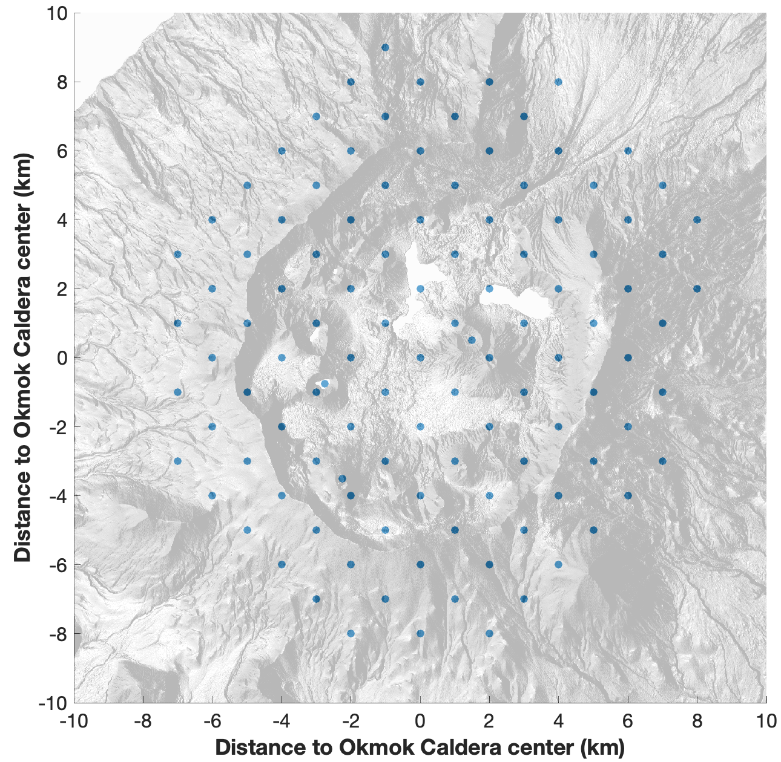

Slide 6
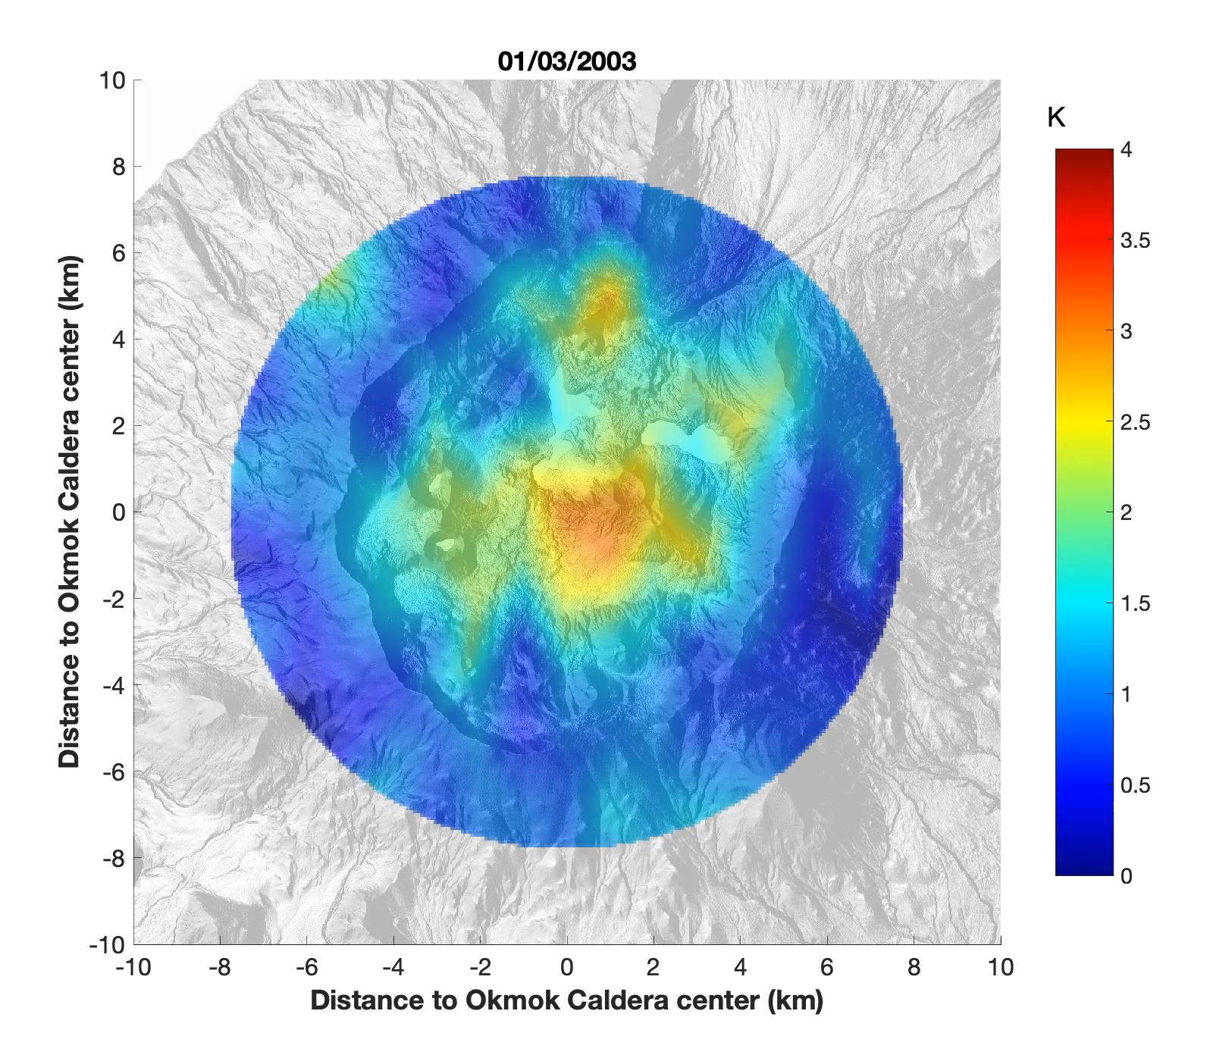
Subtle long-term, large-scale thermal anomalies at Okmok Caldera (July, 2002 – November, 2021)
Video

Slide 7
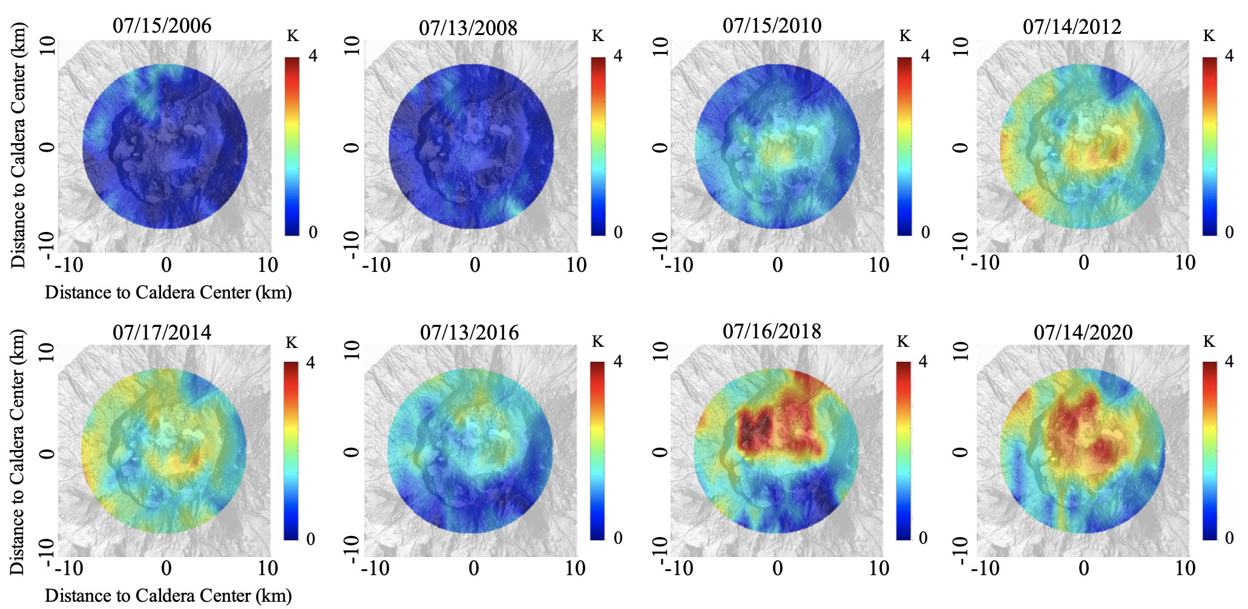
Subtle long-term, large-scale thermal anomalies at Okmok Caldera (July, 2002 – November, 2021)
Not much warming in the lead up to the 2008 eruption
~1.5-2.5 K of heating by 2010
~4K+ of heating in northern half of caldera peaking in 2018
2020 anomaly center consistent with inflation observations
~2.5 K of heating peaking in 2014
Results are preliminary

Slide 8
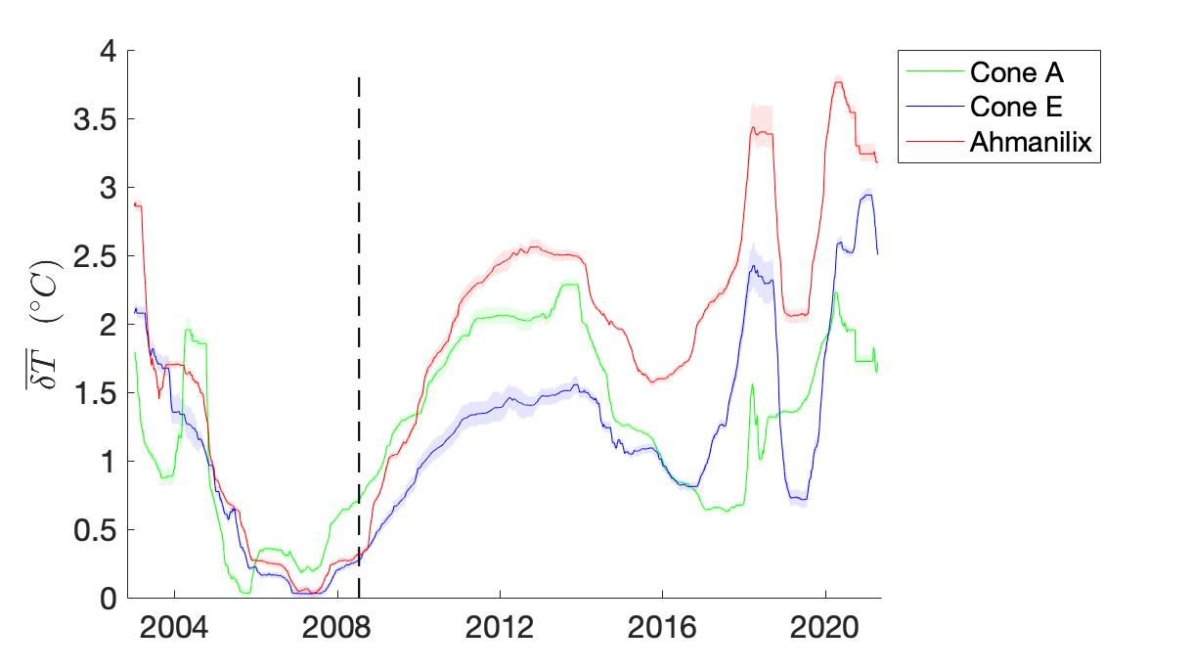
Subtle long-term, large-scale thermal anomalies at Okmok Caldera (July, 2002 – November, 2021)
Specific Cones
Slight warming at these cones in the lead up to the 2008 eruption
Warming at these cones peaking in ~2013, ~2018, and ~2020
Results are preliminary

Slide 9
2
If so, what causes these thermal anomalies?
What are the subsurface processes that could be driving these anomalies?

Slide 10
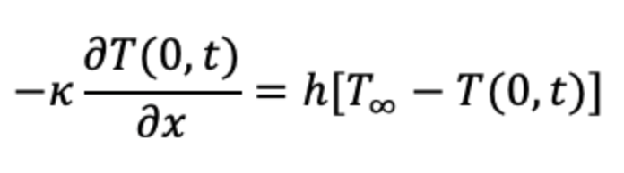
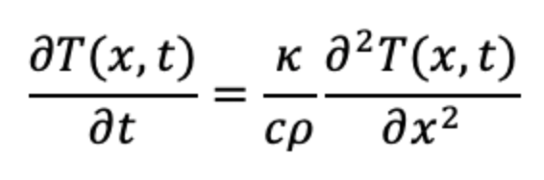

How long will it take to increase the surface by 1 Kelvin?
Convective boundary between ground surface and ambient air (T = 300K)
Convective Boundary Condition:
Heat transported to the surface by conduction
1D Heat Equation:
Condensation Zone:
Latent heat released during the condensation of magmatic and/or hydrothermal water vapor
T = 373K
Permeable flow of magmatic and/or hydrothermal gases
Magma Reservoir

Slide 11
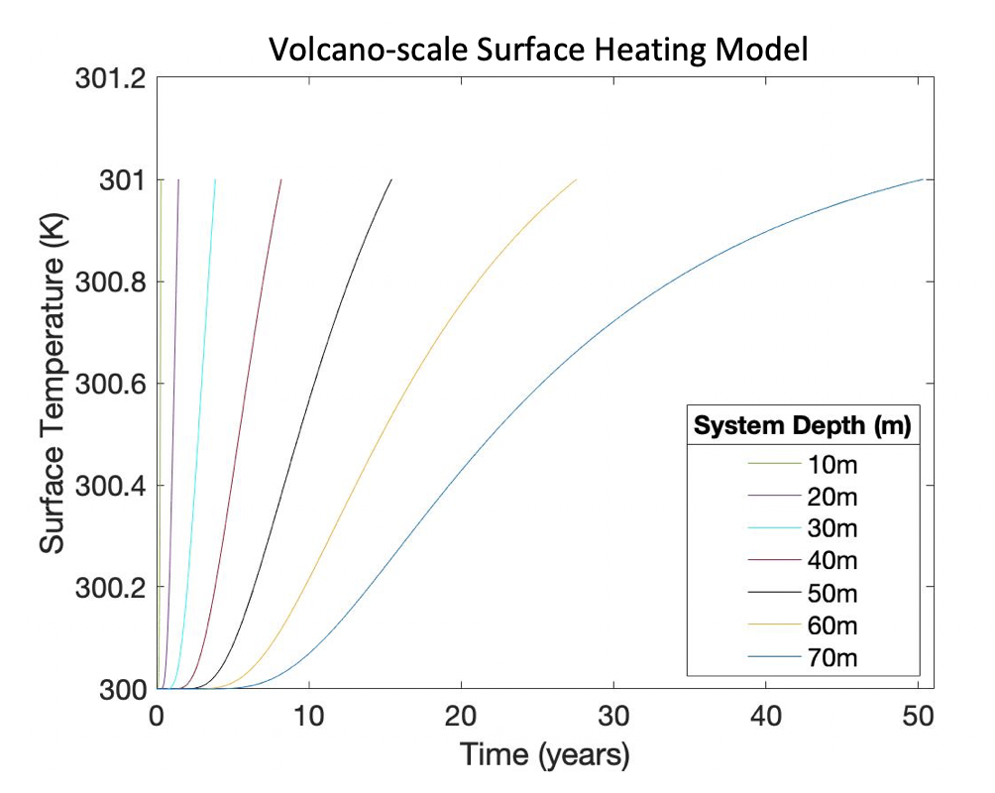
Time for the surface temperature to increase by 1 kelvin goes to infinity with increasing depth
Results are preliminary

Slide 12
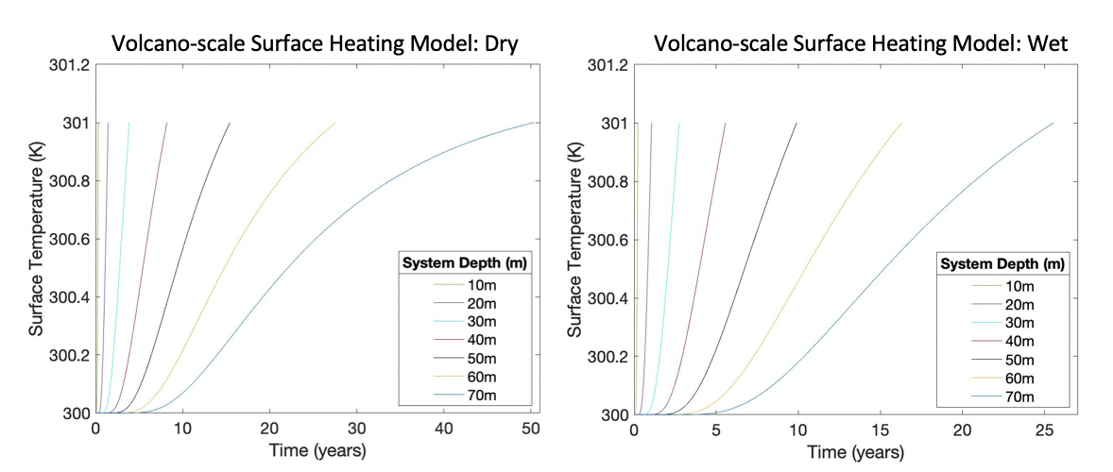
Time for the surface temperature to increase by 1 kelvin depends on density, thermal conductivity, and heat capacity, increases of which are analogous with soil moisture content
Results are preliminary

Slide 13
Research Questions
Do we observe low-temperature thermal anomalies on the flanks of Okmok Caldera?
Yes, we observe these subtle, large-scale, long-term (years) anomalies at Okmok and find some spatiotemporal consistencies with observed unrest
1
If so, what causes these thermal anomalies?
It is possible that the thermal anomalies at Okmok could be driven by the condensation of magmatic and/or hydrothermal water vapor at depth and that process is strongly influenced by soil moisture content.
2

Slide 14
Is this truly heating?
Are these radiance anomalies truly thermal anomalies or could they be due to emissivity anomalies?
Apply similar methodology, but adapted for emissivity!

Slide 15
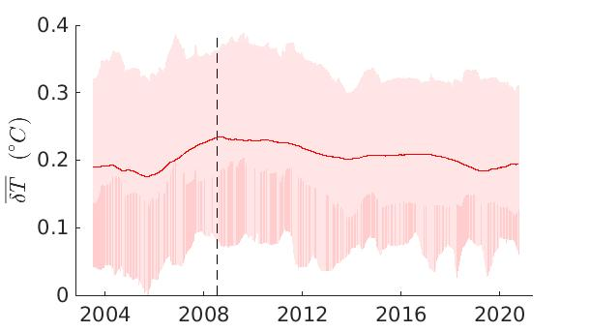
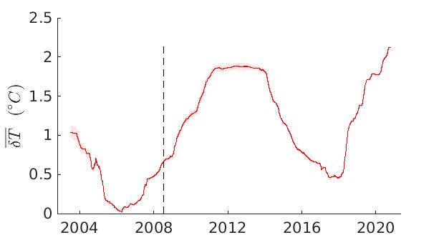
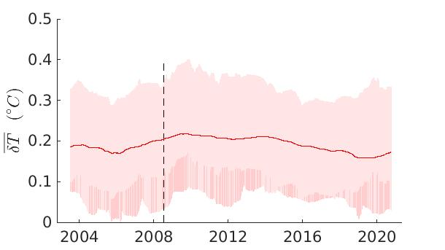
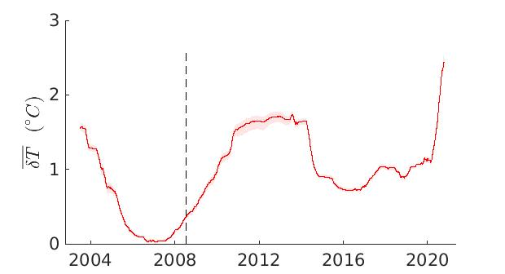
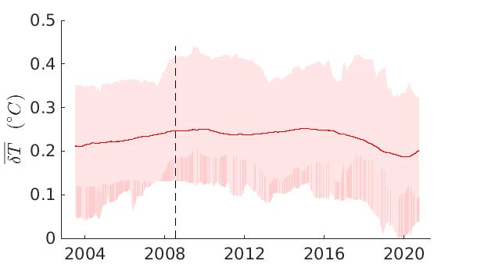
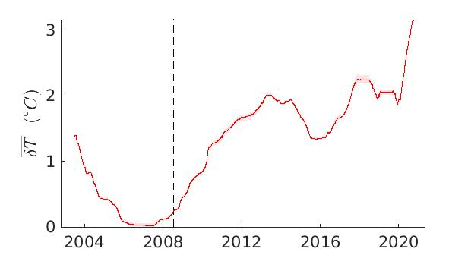



Emissivity Anomaly
Radiance Anomaly
Cone A
$$\overline{δE}$$
Cone E
$$\overline{δE}$$
Ahmanilix
$$\overline{δE}$$
Results are preliminary

