Slide 1




Investigating the origin of Mg-spinel exposures on Mons Hansteen Alpha, an evolved silicic volcanic structure on the Moon
by
Himela Moitra* and Saibal Gupta
Indian Institute of Technology Kharagpur, KHARAGPUR, India
*(himelamoitra@gmail.com)
EGU22-10274

Slide 2
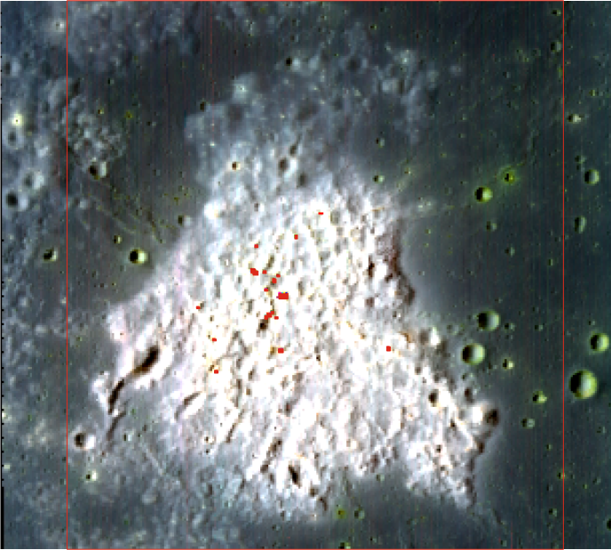
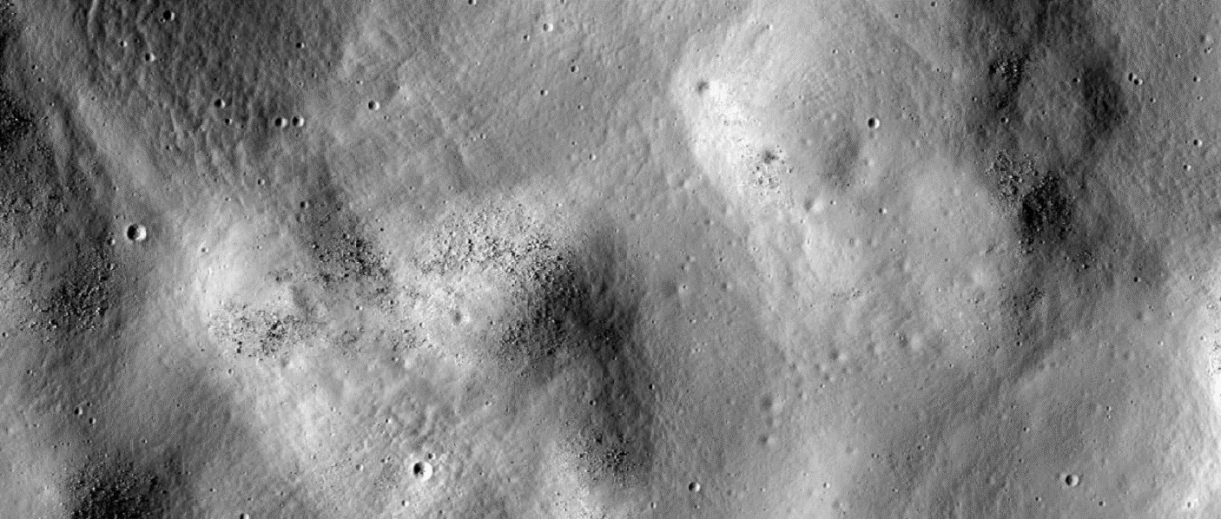

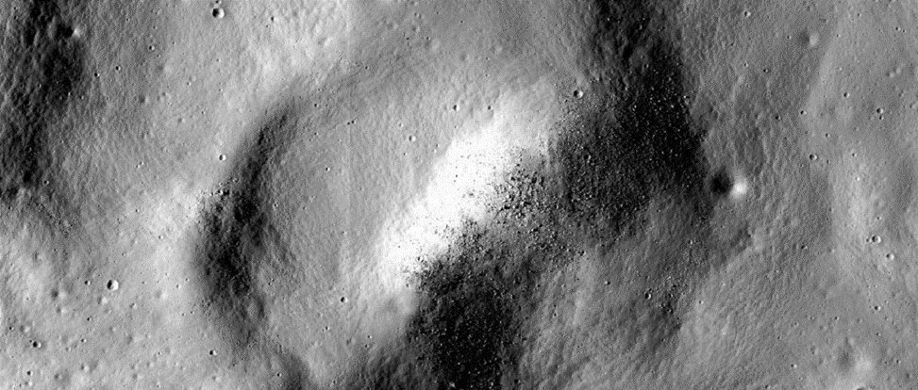
Mg-spinel on Mons Hansteen Alpha
How did the Mg-spinel appear in a silicic construct??

Slide 3
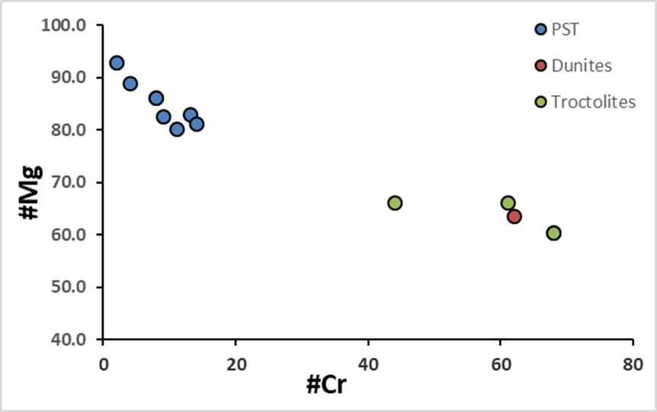
What do we know already?
CRUSTAL MELTING EXPERIMENTS FOR FELSIC LITHOLOGIES
Gullikson et al. (2016) had conducted experiments on 3 types of protoliths: Monzogabbro (14161,7069), Alkali gabbronorite (67975,117), KREEP basalt (15386,19)
CRUSTAL ASSIMILATION EXPERIMENTS FOR Mg-SPINEL
Prissel et al. (2014, 2016) conducted experiments and modelling on assimilation of crustal anorthite by both plagioclase saturated and unsaturated Mg-suite parental liquids, to produce Mg-rich and Cr-rich spinel compositions found on Moon

Slide 4
Wallrock and magma chosen
Magma compositions:
1. MSPL- Mg-Suite Parental Liquid (~normative An=50%)
2. MSPLDL- Mg-Suite Parental Liquid (Depleted in Ferroan Anorthosite component ~ normative An=30%)
Wallrock compositions:
1. Monzogabbro (14161,7069)
2. Plagioclase (An74)
3. Ferroan Anorthosite (FAN 65315), FAN+Si (90:10)
4. Noritic Anorthosite (67415), Nan+Si (90:10)

Slide 5
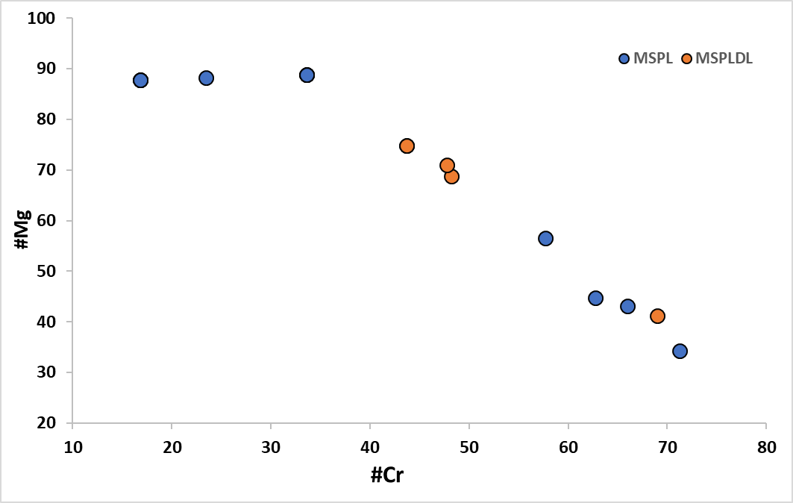
Spinel compositions obtained from Magma Chamber Simulator
MSPL almost always starts with spinel on the liquidus, with Mg-spinel like compositions
Assimilation of FANSi9010 by MSPL may produce Mg-spinel like compositions even during assimilation
Other assimilation models produce further Cr-rich spinels

Slide 6
The protolith problem
Partial melting of NAnSi9010 (noritic anorthosite+silica~ 90:10) may generate silica rich liquids (~65 wt % SiO₂), but they are still deficient in alkalis relative to the felsite or granite clasts obtained from Apollo samples
Partial melting of FANSi9010 (ferroan anorthosite+silica~ 90:10) may generate more silicic liquids (~70 wt% % SiO₂), but they are further poor in alkalis

Slide 7
Implications
Selective transport of just Mg-spinel formed near a magma intrusion by an erupting silicic magma seems unlikely
If we can manage to work out a source for more alkali in the silicic magma formed by crustal melting of anorthosite + silica zones, then we can get a probable theory for the origin of the Mg-spinel on a silicic construct!

Slide 8
Thank you!

