Slide 1




Assessment of the macroseismic/strong-ground motion distribution of the 2021 Crete (Arkalochori) earthquake sequence using a finite fault stochastic simulation approach
M. Ravnalis¹, Ch. Kkallas¹, C. Papazachos¹, Ch. Papaioannou²
¹ Geophysical Laboratory, Aristotle University of Thessaloniki, Thessaloniki, GREECE
² Institute of Engineering Seismology and Earthquake Engineering (ITSAK), Thessaloniki, GREECE

Slide 2
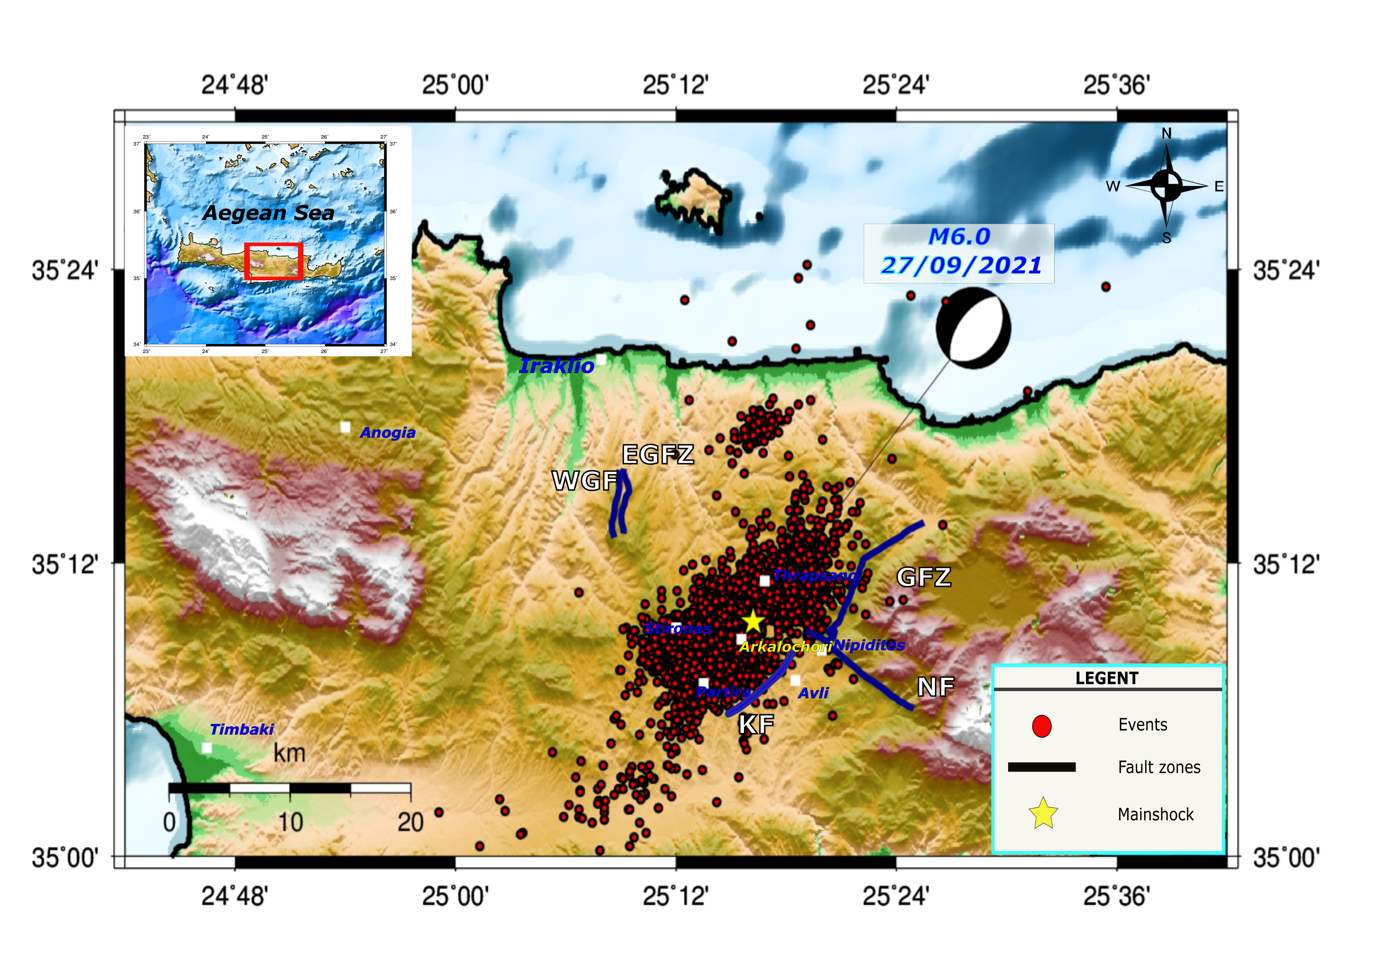
Crete region for mainshock M6.0, 2021
At 27/09/2021, 06:17 (UTC) a strong ground motion with moment magnitude M6.0 occurred on the island of Crete, approximately 25km SE of the city of Heraklion, near Arkalochori
The earthquake was also felt in the islands of the southern and eastern Aegean up to areas of Attica.
4795 events (01/09/2021-28/02/2022)
KF: Kastelli Fault; GFZ: Geraki Fault Zone; NF: Nipiditos Fault; WGF: West Giouchtas Fault; EGFZ: East Giouchtas Fault Zone;

Slide 3
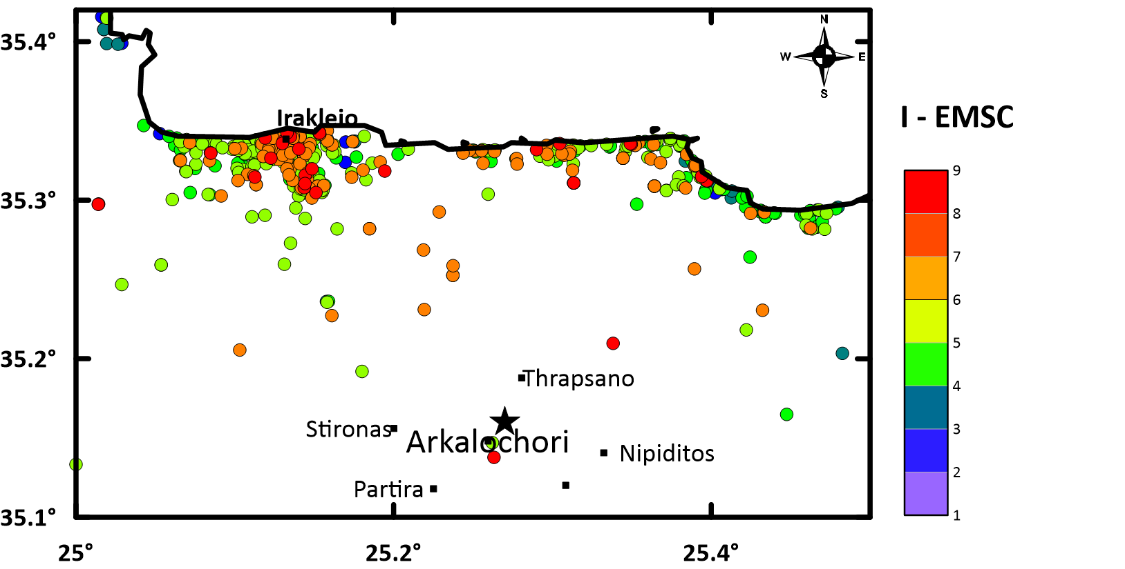
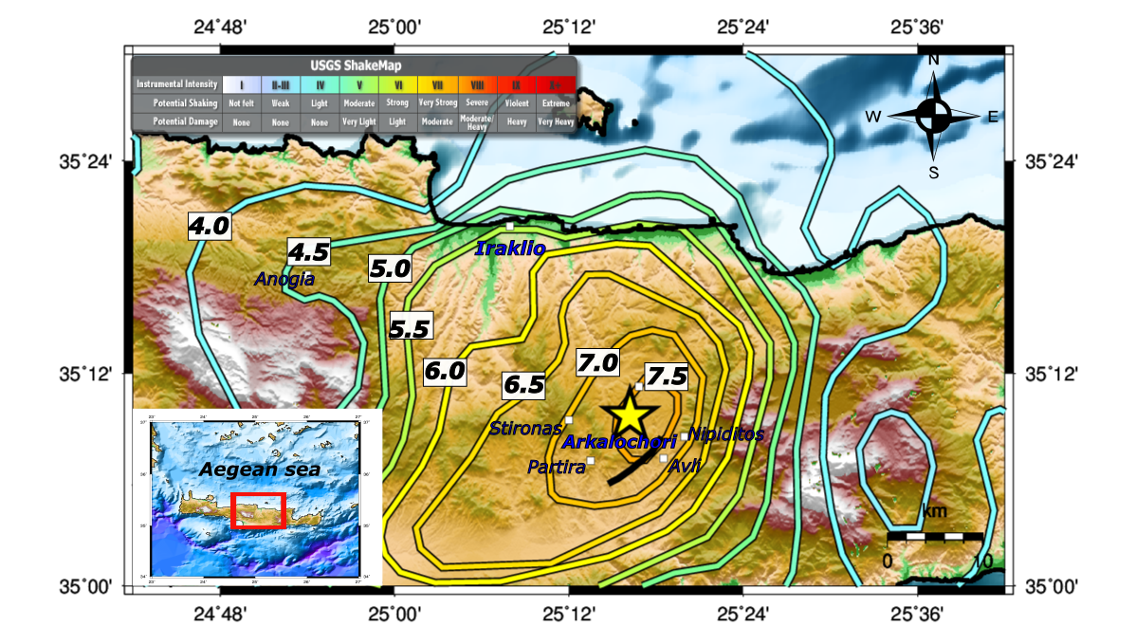
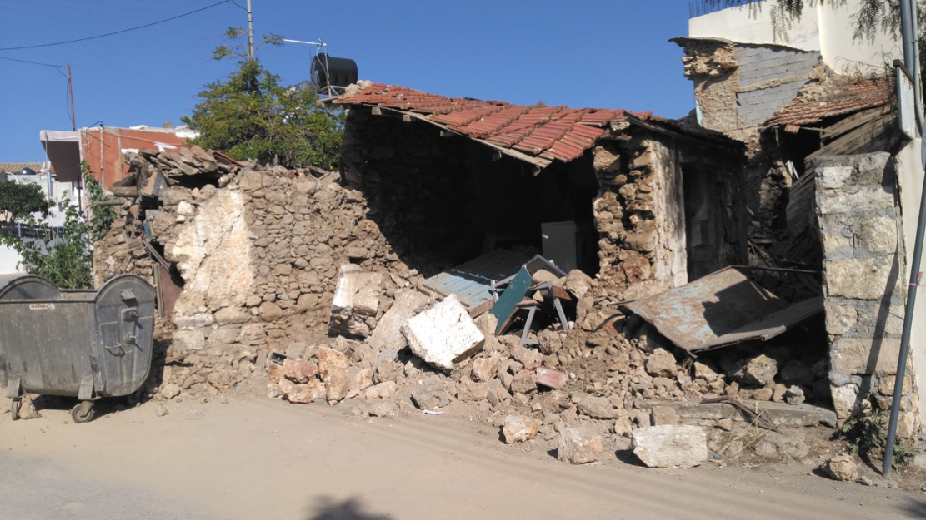
Crete region for mainshock M6.0, 2021
The highest macroseismic intensity value was assigned in the area of the central part of the Heraklion unit and had a value of I_{MM} = VIII (ITSAK shakemaps).
The earthquake caused one fatality, about 20 injuries and extensive building damage in the area of Arkalochori and in other villages of the area.

Slide 4
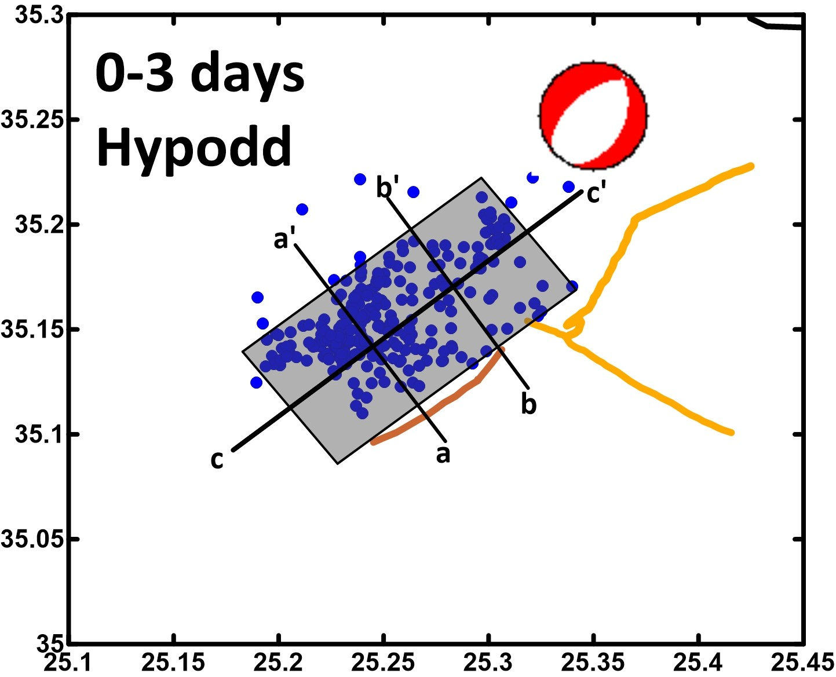
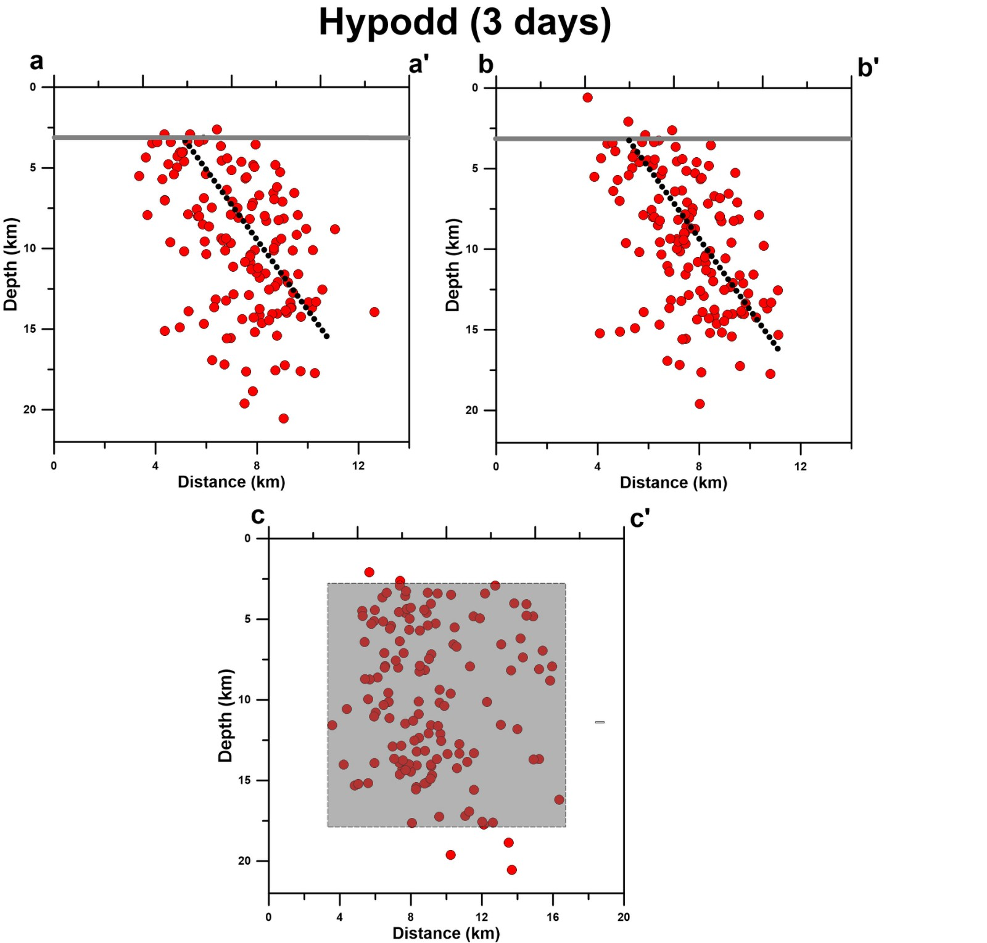
Relocation
GFZ
w~12km
NF
KF
L~14km
KF: Kastelli Fault; GFZ: Geraki Fault Zone; NF: Nipiditos Fault
Left: Cross sections after hypocenter relocation with hypoDD software for the first 3 days of the earthquake sequence.
Right: Spatial distribution of earthquake sequence after relocation with the sections a-a’, b-b; and c-c’ with the Faults noticed in this area.

Slide 5
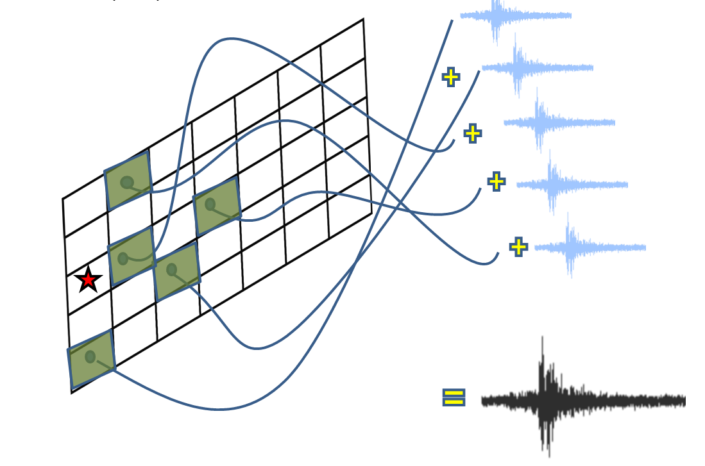
Simulation Approach: Finite-fault stochastic simulation (EXSIM)
A widely used tool that is employed to generate synthetic data to study the spatial distribution of strong ground motion after a significant earthquake.
EXSIM algorithm: Open-source FORTRAN algorithm that generates time series of ground motion for earthquakes (Motazedian and Atkinson 2005; Boore, 2009; Atkinson et al., 2009).
Parameter | Earthquake
 | Crete (27/09/2021, 06:17)
Moment magnitude, Mw | 6.0
Upper edge of fault (Latitude, Longitude) | 35.1960, 25.3190
Strike | 218^{Ο}
Dip | 60^{Ο}
Length | 14.0 km
width | 12.0 km
Ztop | 3.0 km
ΝL×ΝW | 6x5
dL | 2.8 km
dw | 2.5 km

Slide 6
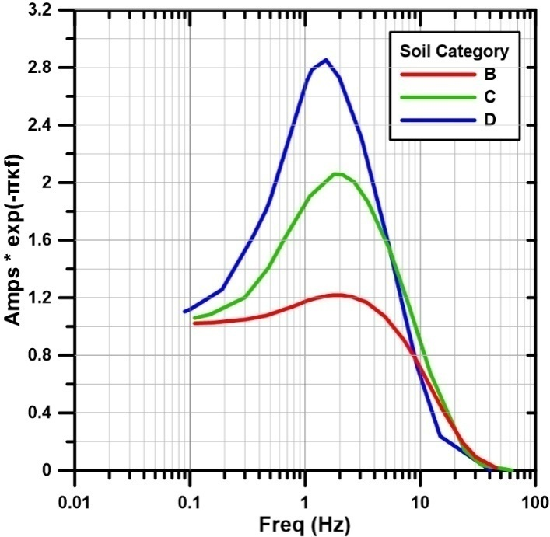
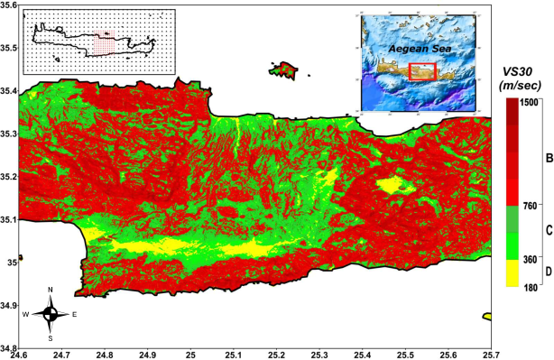
Site Conditions - Vs30 Spatial
Distribution
The combined effect of site amplification and attenuation for representative Ko for each site class. Margaris and Boore (1998), Klimis et al. (1999)
Spatial distribution of the Vs30 in Crete area for random points
~1200 points

Slide 7
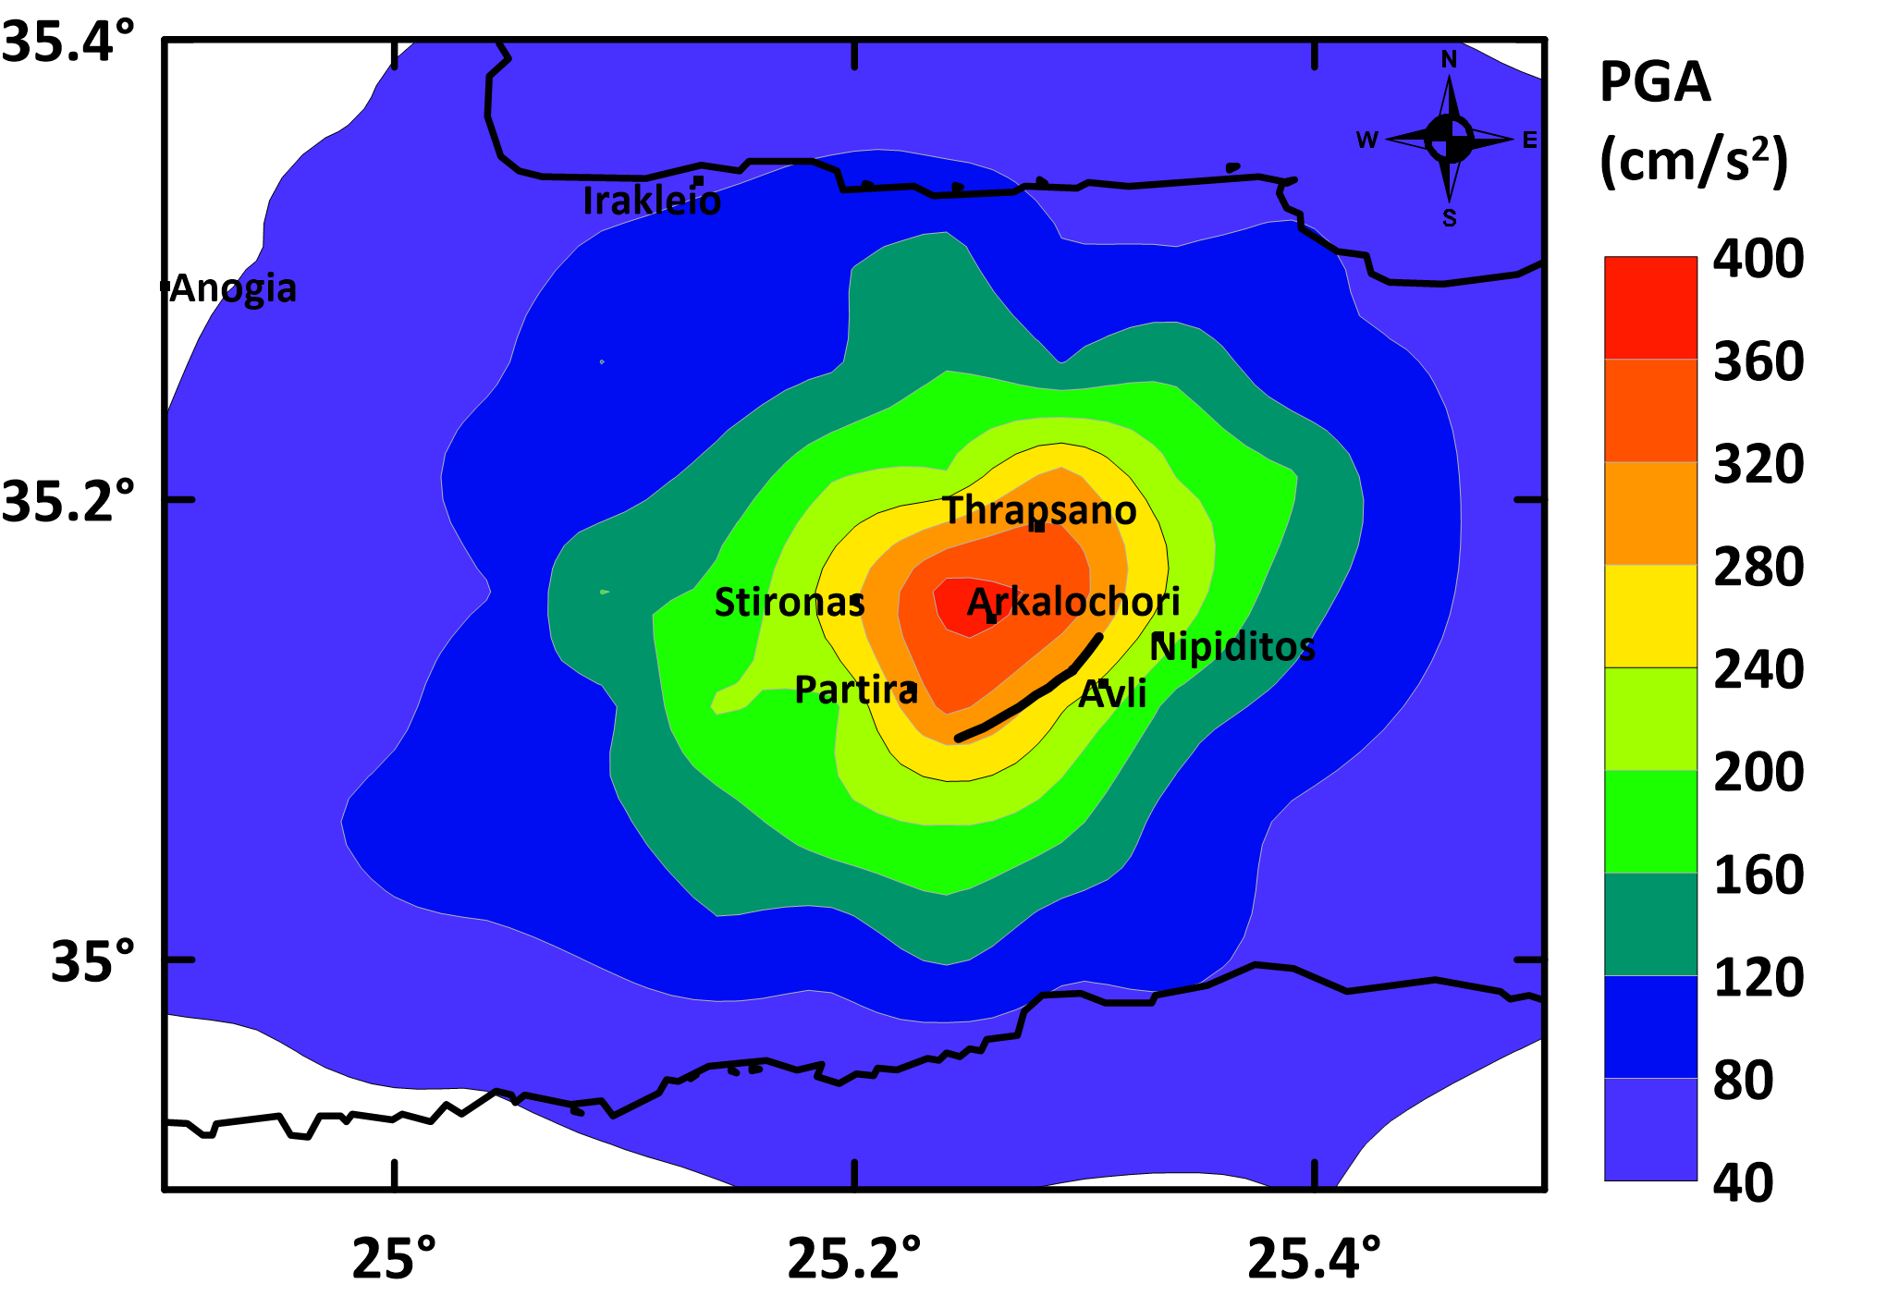
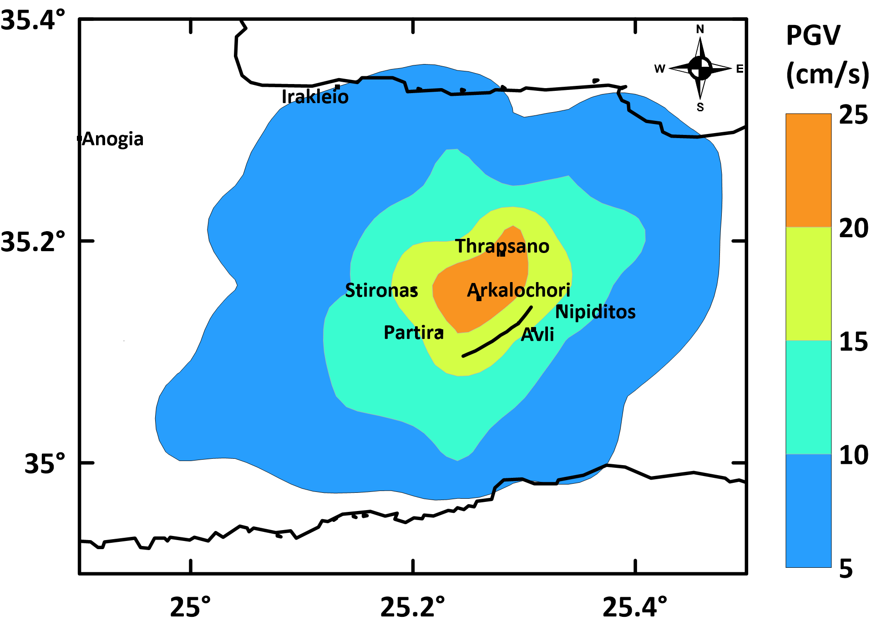
Finite fault stochastic simulation approach
City | PGA (cm/s²) | PGV (cm/s)
Arkalochori | 363 | 22.4
Thrapsano | 324 | 21.2
Nipiditos | 221 | 14.3
Partira | 305 | 18.4
Avli | 233 | 14.7
Stironas | 274 | 17.5
Irakleio | 74 | 5.0
Anogia | 37 | 2.4
Timbaki | 31 | 2.3

Slide 8
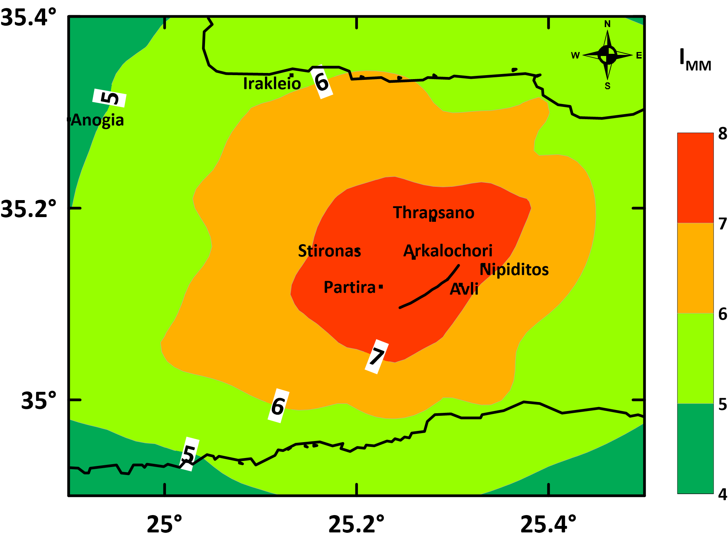
Finite fault stochastic simulation approach
City | I_{MM}
Anogia | 4.9
Arkalochori | 7.5
Avli | 7.3
Irakleio | 5.8
Nipiditos | 7.2
Partira | 7.4
Stironas | 7.5
Thrapsano | 7.3
Timbaki | 4.8
I_{MM} = 2.270 + 1.647 log₁₀(PGA) log10(PGA)≤1.6
I_{MM} = -1.361 + 3.822 log₁₀(PGA) log10(PGA)≥1.6
I_{MM} = 4.424 + 1.589 log₁₀(PGV) - 0.1 log10(PGV)≤0.3
I_{MM} = 4.018 + 2.671 log₁₀(PGV) - 0.1 log10(PGV)≥0.3
Caprio et al., 2015

Slide 9
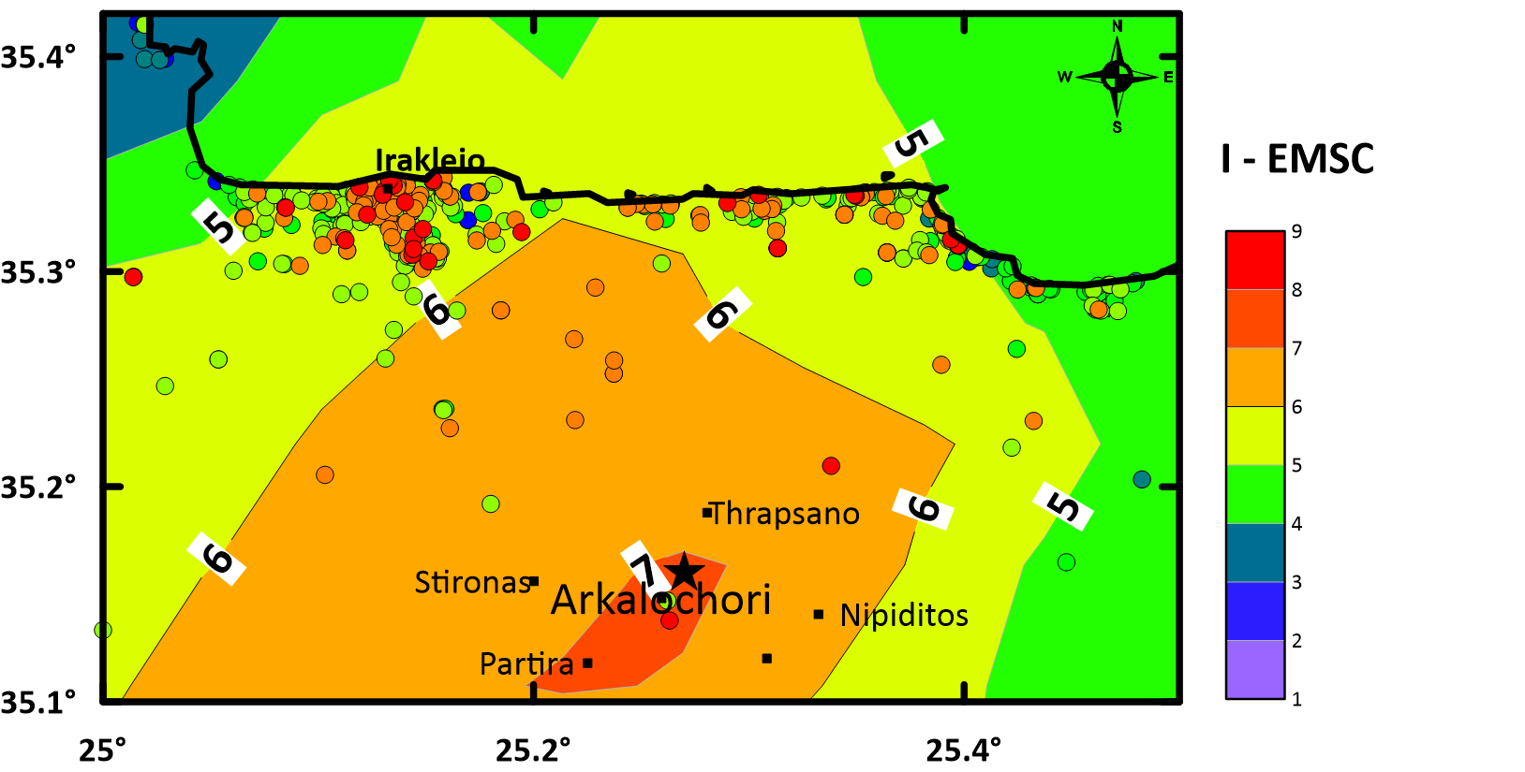
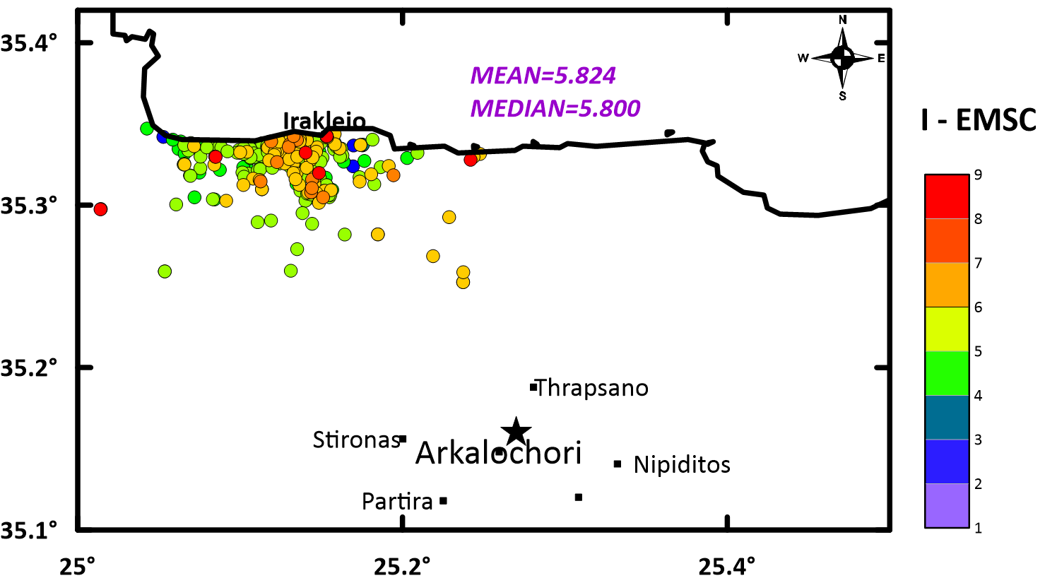
Smoothing technique
Solid circles: initial EMSC IDP
Contours of the smoothed EMSC IDP points

Slide 10
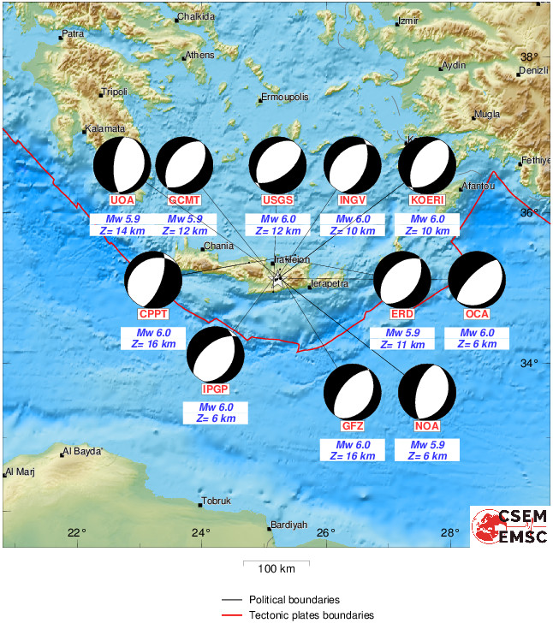
Results
The fault’s dimensions (length, L, and width, w) from relocation are very similar with the dimensions using equations (1) and (2), as proposed by Papazachos et al. (2004) (see above table).
GFZ Focal mechanism (Str1=218^{O}, Dip=60^{O}) is very similar with the focal mechanism from relocation which is used for the stochastic simulation approach.
logL=0.28M - 0.70 (1) | logw=0.50M - 1.86 (2)
M | L | w | L model | w model
6.0 | 13.8 | 9.54 | 14 | 12

Slide 11
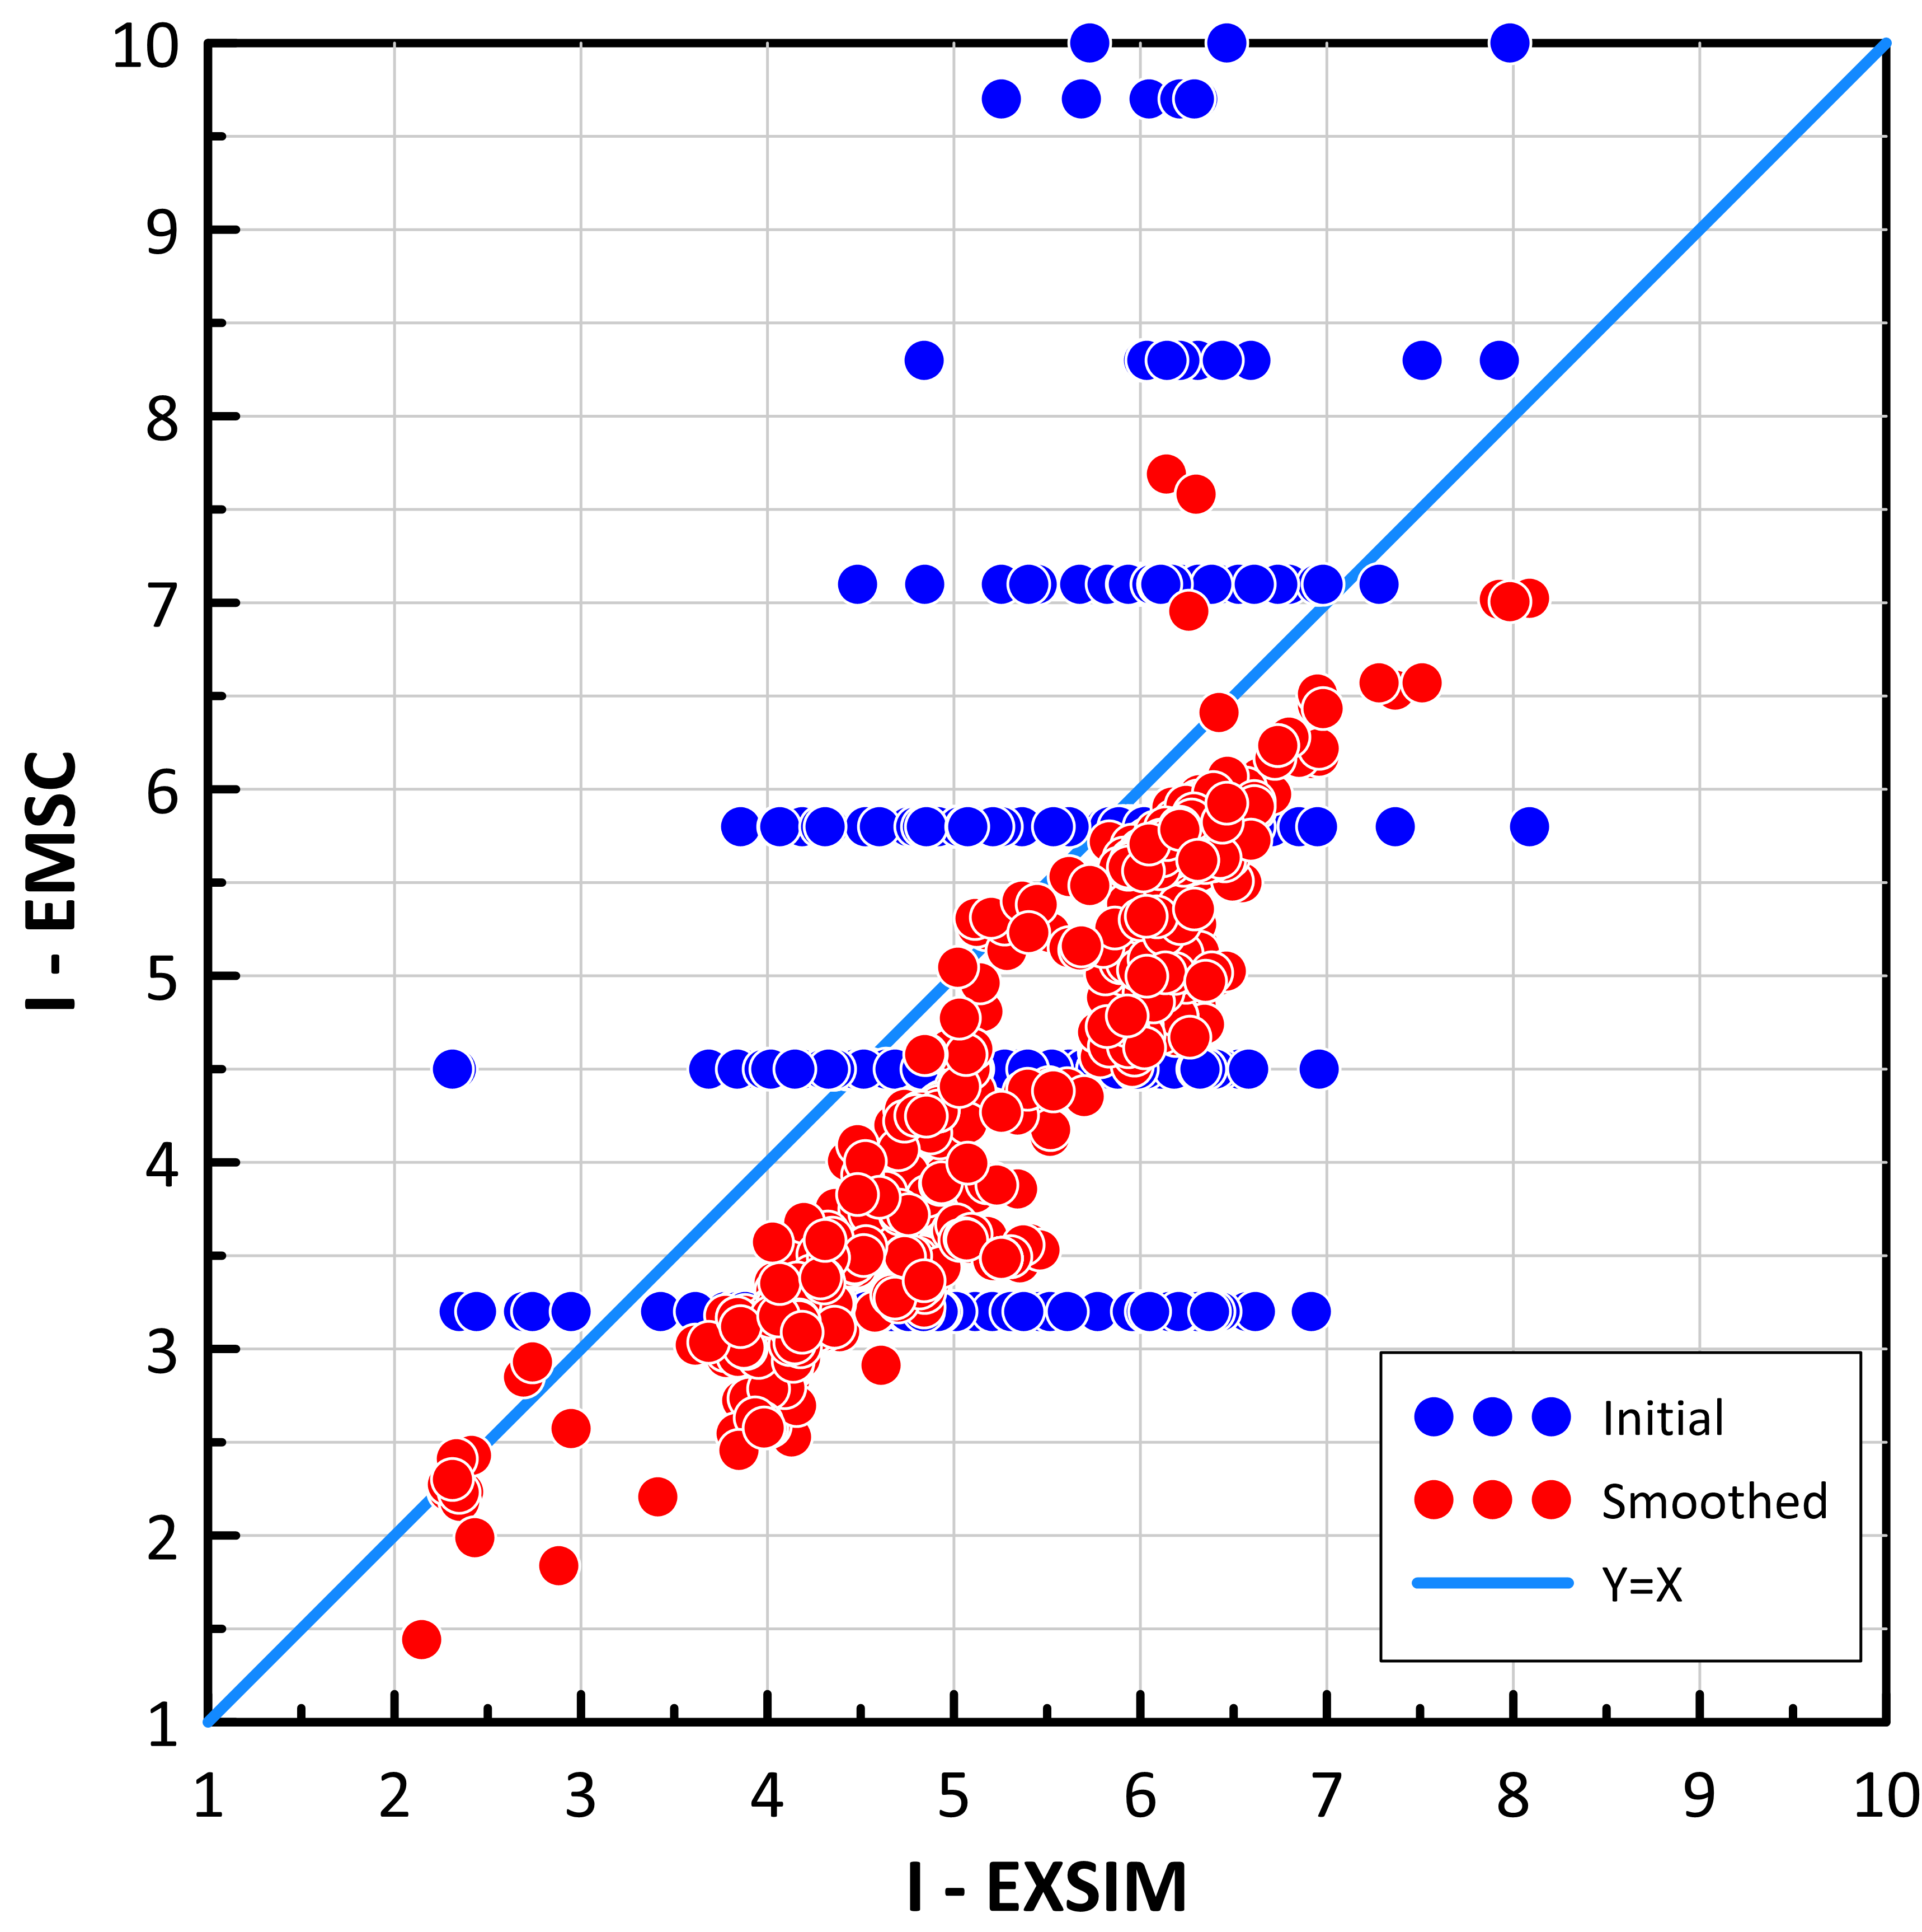
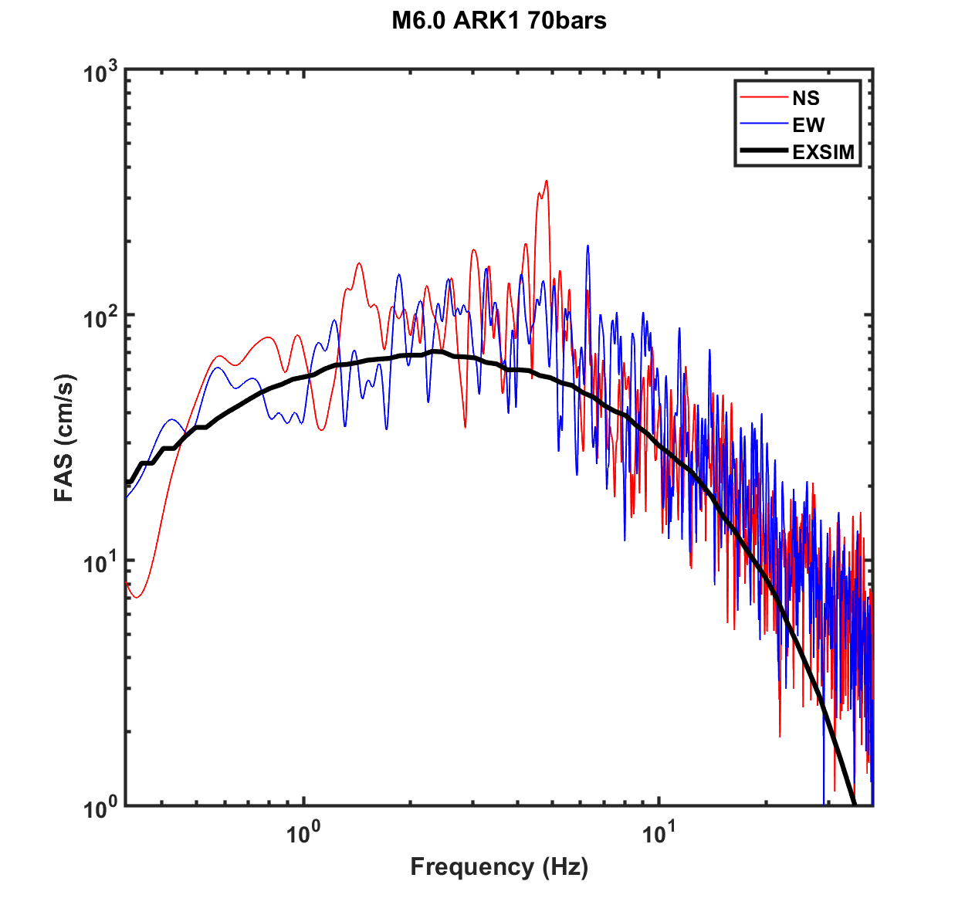
Results
A good agreement of the spatial distribution of the initial and modeled simulated macroseismic intensities is observed, showing that can reliably reconstruct the main features of the damage distribution approach for this earthquake.
Finally, smoothing technique applied in EMSC macroseismic data is initial for the good correlation of the data.

Slide 12
Thank you

Slide 13
References
Atkinson, G.M., Assatourians, K., Boore, D.M., Campbell, K., & Motazedian, D. (2009). A Guide to Differences between Stochastic Point-Source and Stochastic Finite-Fault Simulations. Bull. Seism. Soc. Am. 99: 3192–3201. https://doi.org/10.1785/0120090058
Boore, D. M. (2009). Comparing Stochastic Point-Source and Finite-Source Ground-Motion Simulations: SMSIM and EXSIM. BSSA, 99(6), 3202–3216. https://doi.org/10.1785/0120090056
Caprio, M., Tarigan, B., Worden, C. B., Wiemer, S., & Wald, D. J. (2015). Ground Motion to Intensity Conversion Equations (GMICEs): A Global Relationship and Evaluation of Regional Dependency. Bull. Seism. Soc. Am., 105(3), 1476–1490. https://doi.org/10.1785/0120140286
Klimis, N. S., Margaris, B. N., & Koliopoulos, P. K. (1999). Site-dependent amplification functions and response spectra in Greece. J. Earthq. Eng., 3(2), 237–270. https://doi.org/10.1080/13632469909350346
Margaris, B.N., & Boore, D.M. (1998). Determination of Δσ and Ko from Response Spectra of Large Earthquakes in Greece. Bull. Seism. Soc. Am. 88: 170-182.
Motazedian D., Atkinson G.M. (2005). Stochastic Finite-Fault Modeling Based on a Dynamic Corner Frequency. Bull. Seism. Soc. Am. 95:995–1010. https://doi.org/10.1785/012 0030207
Papazachos, B. C., Scordilis, E., Panagiotopoulos, D., Papazachos, C., & Karakaisis, G. (2004). Global relations between seismic fault parameters and moment magnitude of earthquakes. Bull. Geol. Soc. Gr., 36, 1482–1489. https://doi.org/10.12681/bgsg.16538
EMSC online database (https://www.seismicportal.eu/testimonies-ws/).
ITSAK strong motion network database (http://shakemaps.itsak.gr/).

