Slide 1








An advanced coupled modelling system to study interactions among the circulation, sea ice, and biogeochemistry in the Northwest Atlantic Ocean
Kyoko Ohashi, Arnaud Laurent, Christoph Renkl, Fehmi Dilmahamod, Shengmu Yang, Katja Fennel, Eric Oliver, and Jinyu Sheng
Dept. of Oceanography, Dalhousie University
Halifax, Nova Scotia, Canada
OS1.7 The North Atlantic: Natural variability and global change
EGU22-10294
24 May 2022

Slide 2
Modelling system
We are developing a coupled circulation-sea ice-biogeochemical modelling system to better understand the role of the northwest North Atlantic Ocean as a “biological carbon pump”
Physical
ROMS (circulation)
+ CICE (sea ice)
Biogeochemical
BIO_FENNEL (within ROMS)
physical variables
currents, SST, SSS, surface tilt, atmospheric variables
ROMS
CICE
surface stress, surface freshwater & heat fluxes, shortwave radiation

Slide 3
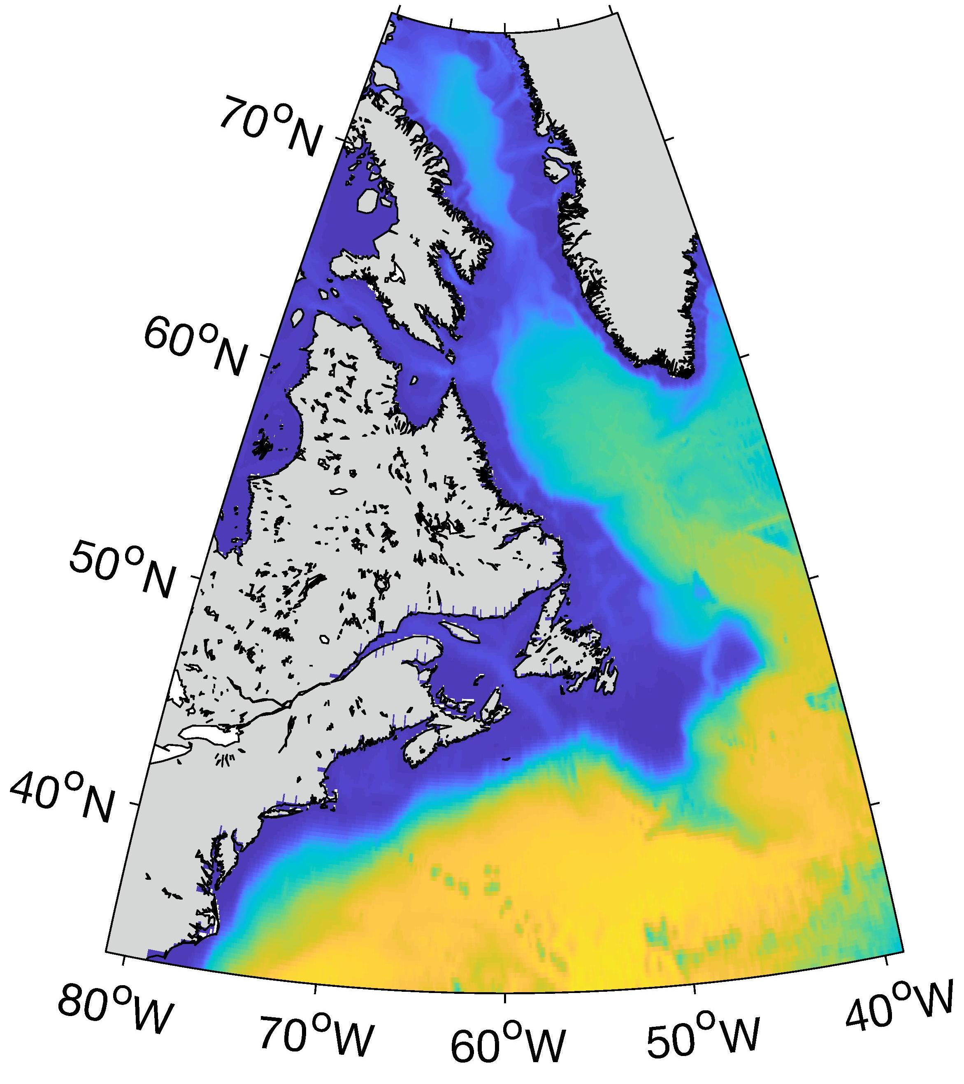
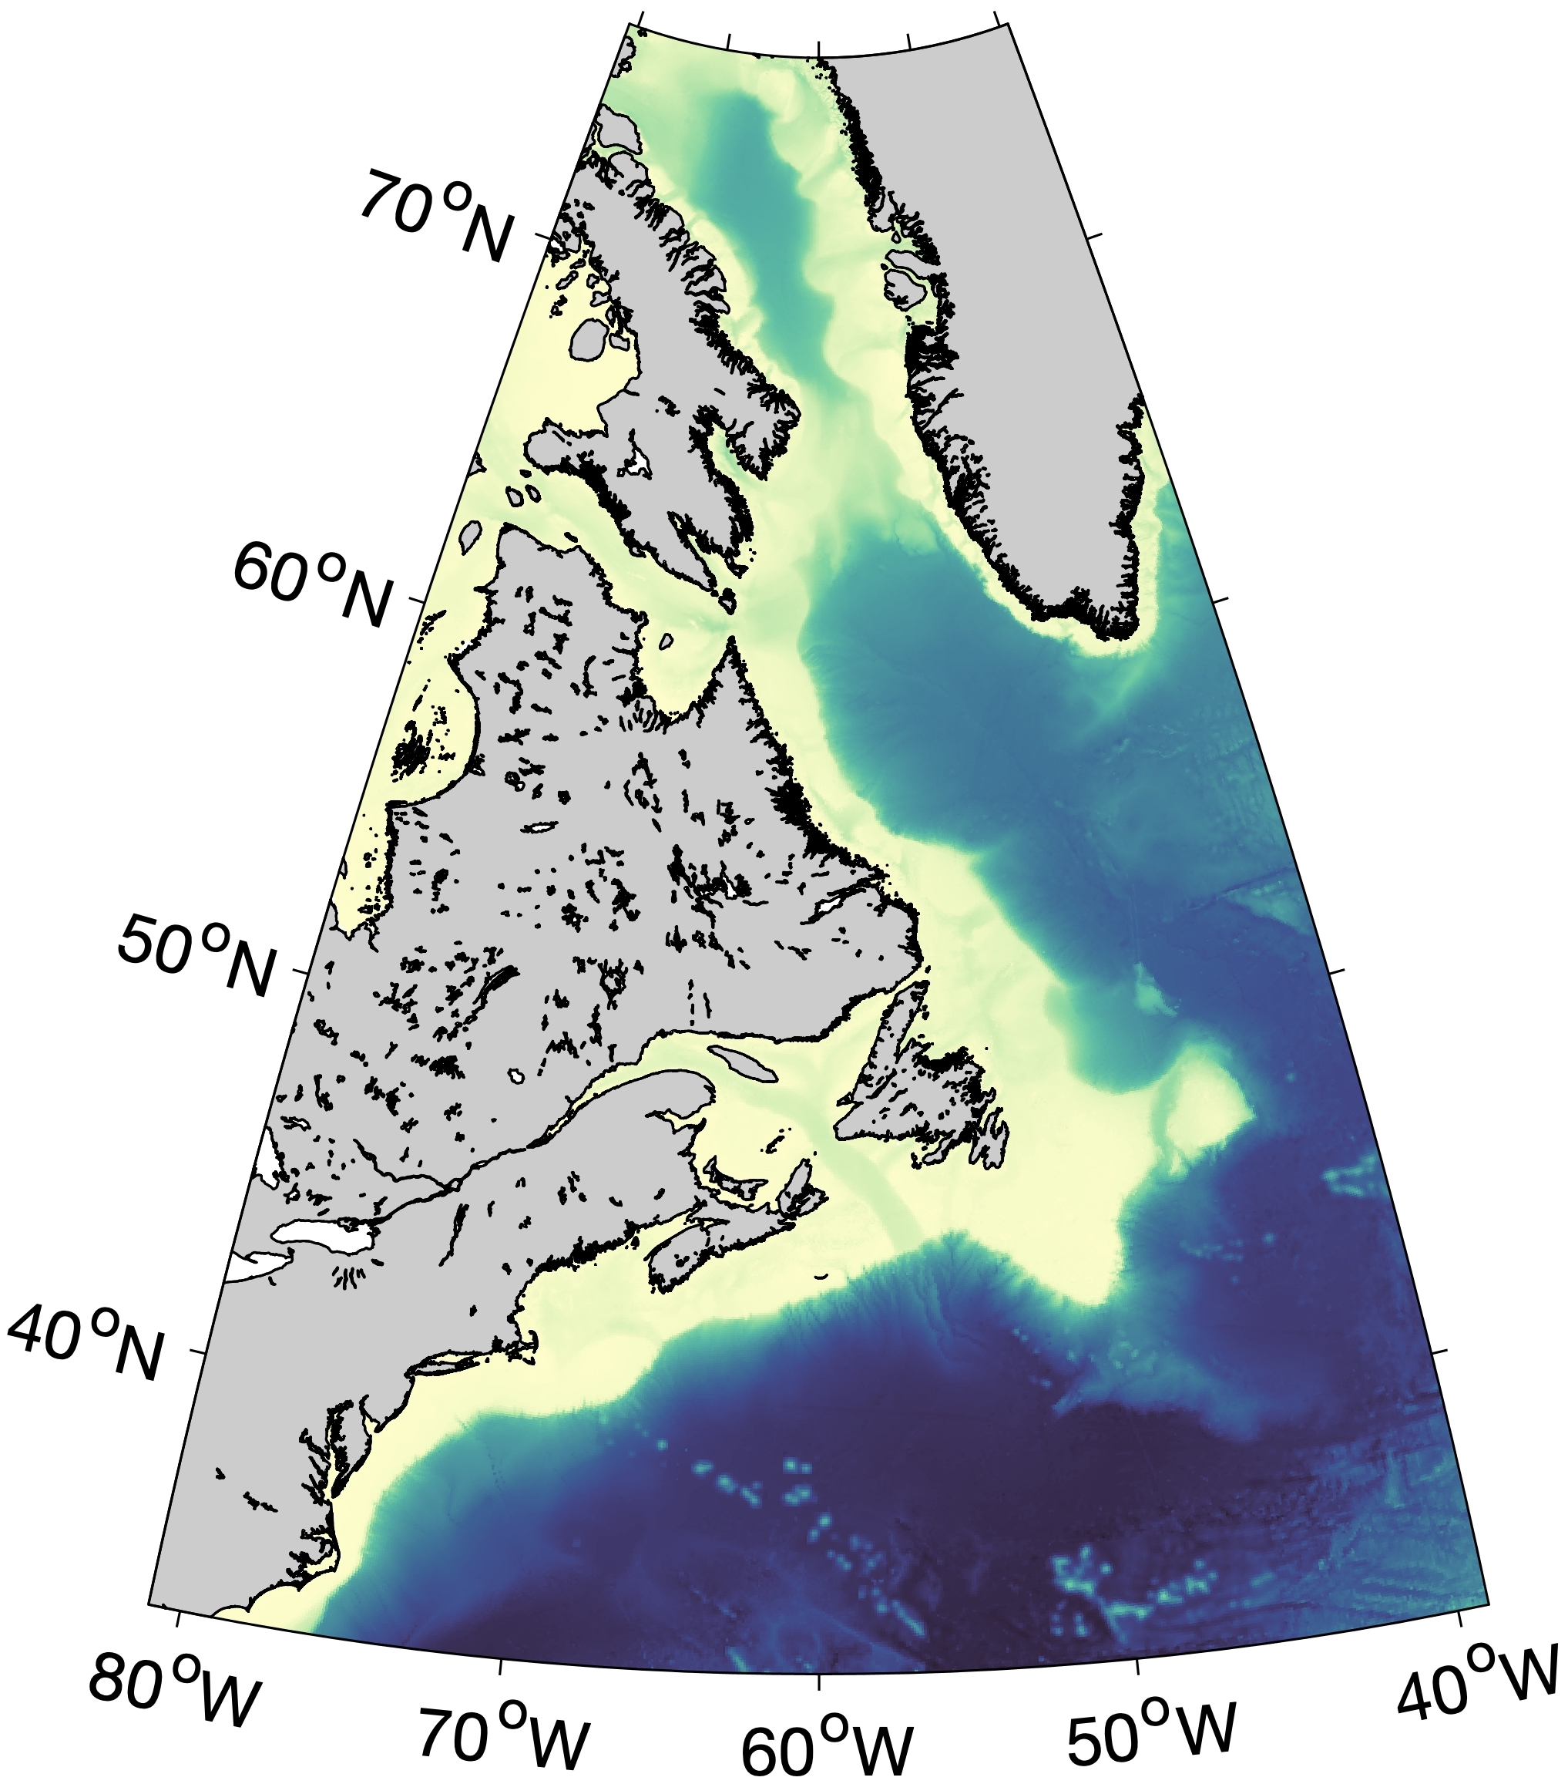
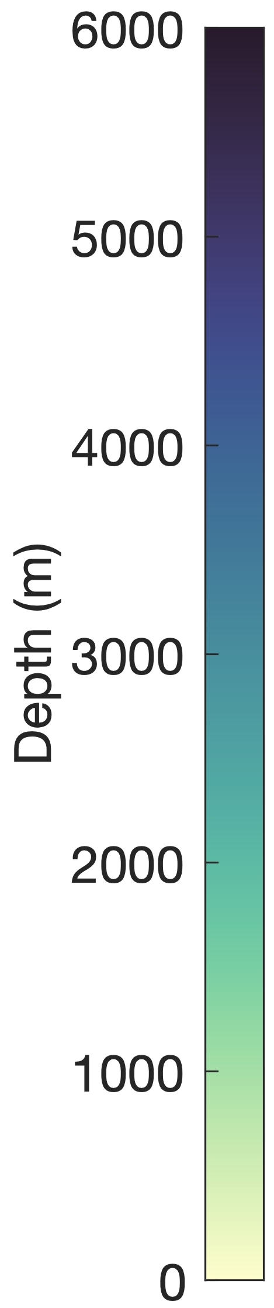
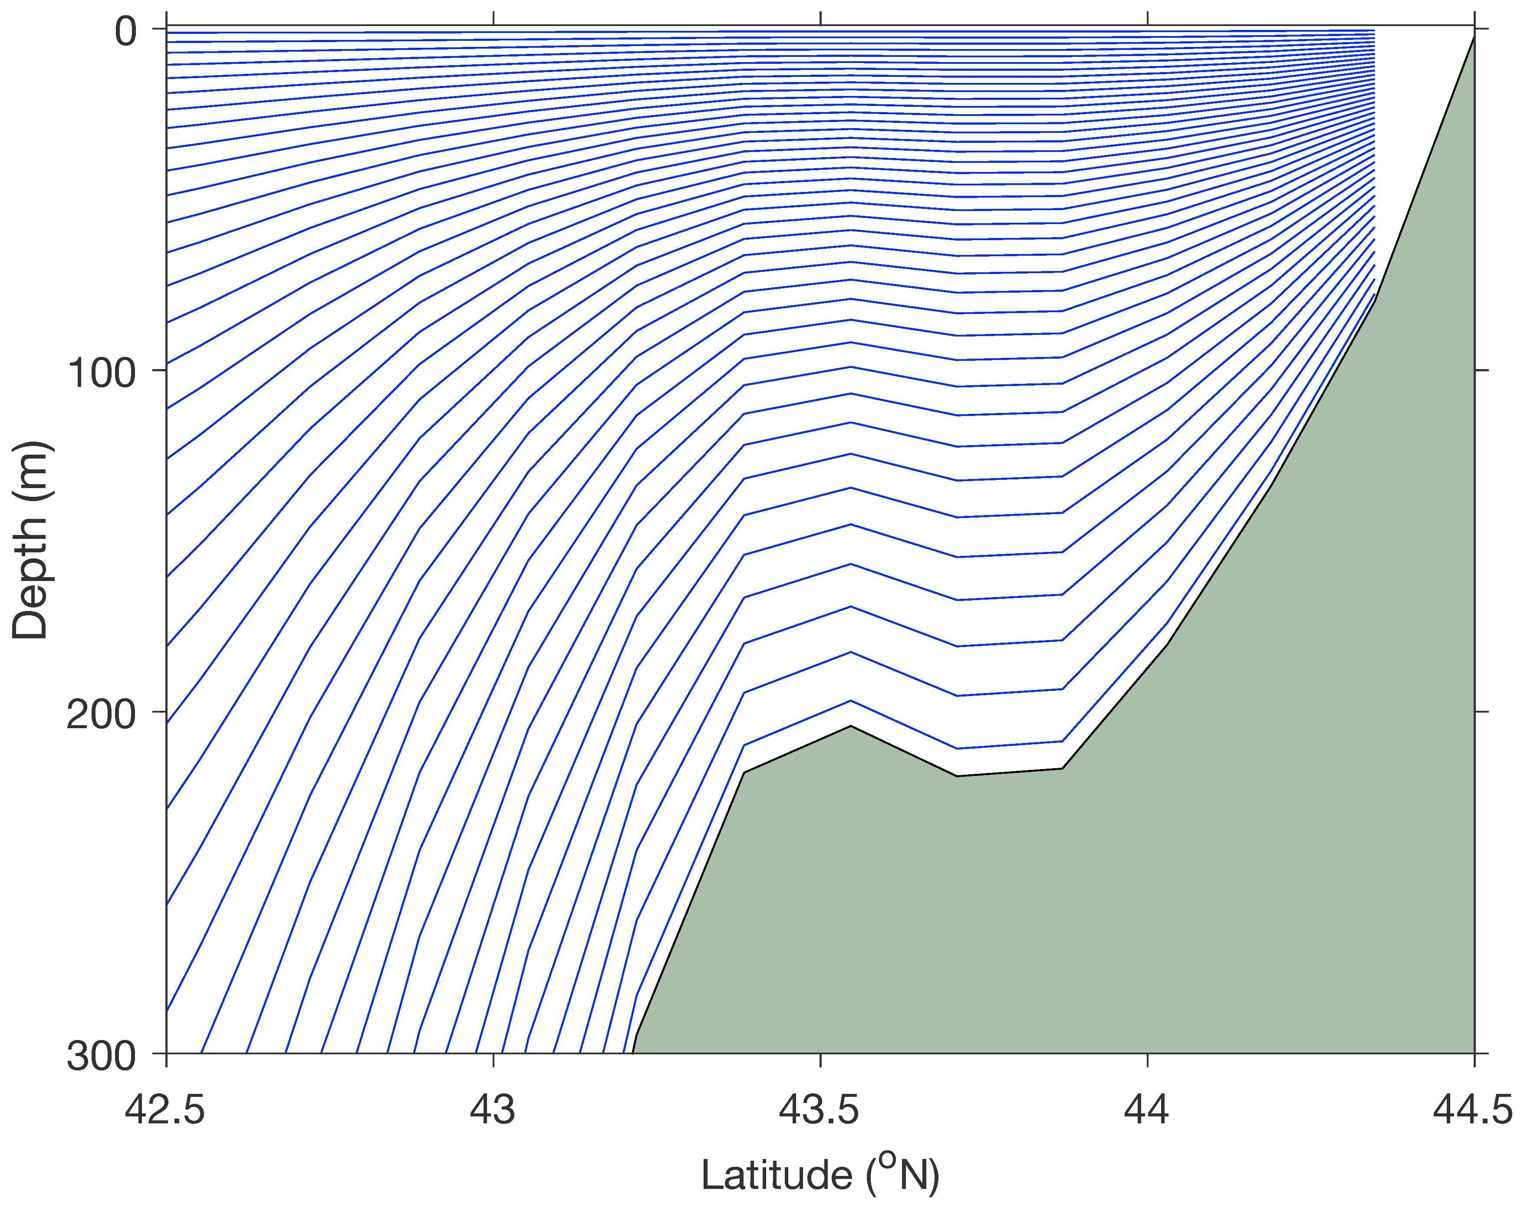
Model grid
ROMS/BIO_FENNEL and CICE use the same grid
Model bathymetry derived from GEBCO 2019 (www.gebco.net)
ROMS/BIO_FENNEL has 40 terrain-following layers
Horizontal resolution
~2 km
More layers near surface
Relatively uniform spacing
~8 km
(Cross-section at 63.62ºW)

Slide 4
Inputs (physical component)
Atmospheric input: ERA5 reanalysis (cds.climate.copernicus.eu)
Initial conditions and lateral boundary input: GLORYS12V1 reanalysis (marine.copernicus.eu)
Tidal forcing: TPXO tidal model solution (Egbert & Erofeeva, 2002)
Riverine freshwater input (37 rivers): Observations from St. Lawrence Global Observatory, Dai (2017), Water Services of Canada
Freshwater flux due to ice melt: Dataset of Bamber et al. (2018)
Simulation is prognostic – aside from boundary inputs and freshwater inputs, model state evolves freely
Notes:
ERA5: hourly, 0.25-deg grid
GLORYS: daily, 1/12-deg grid
TPXO9: 1/6-deg grid, 15 constituents

Slide 5
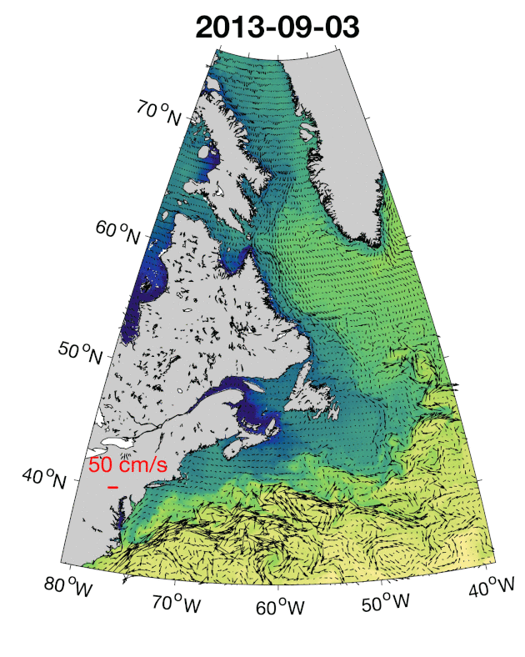
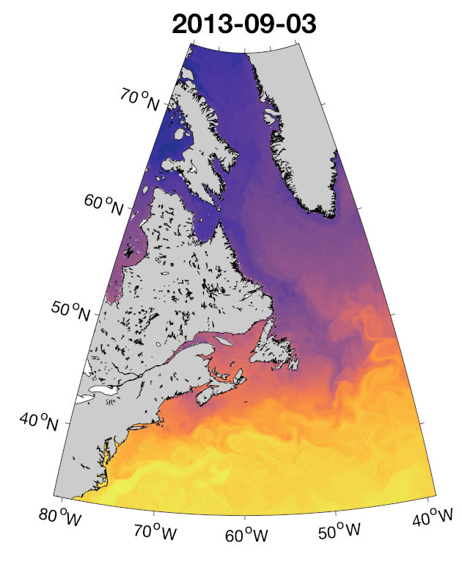
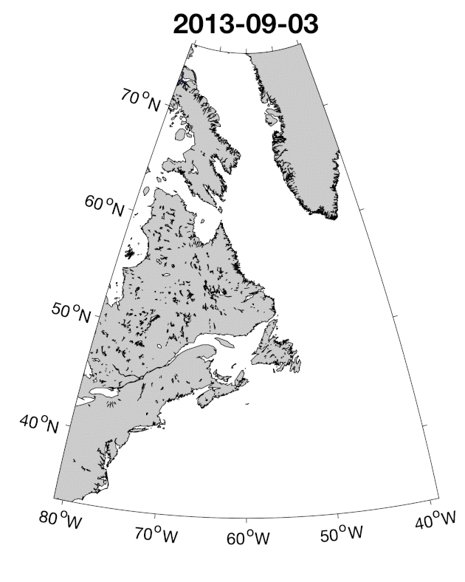
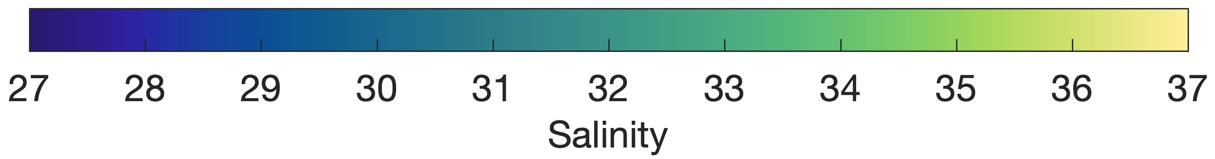
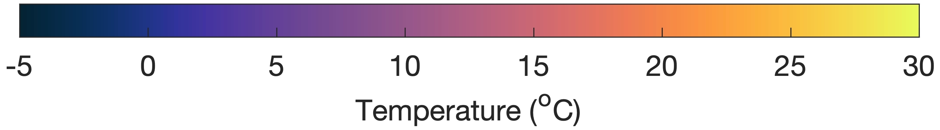
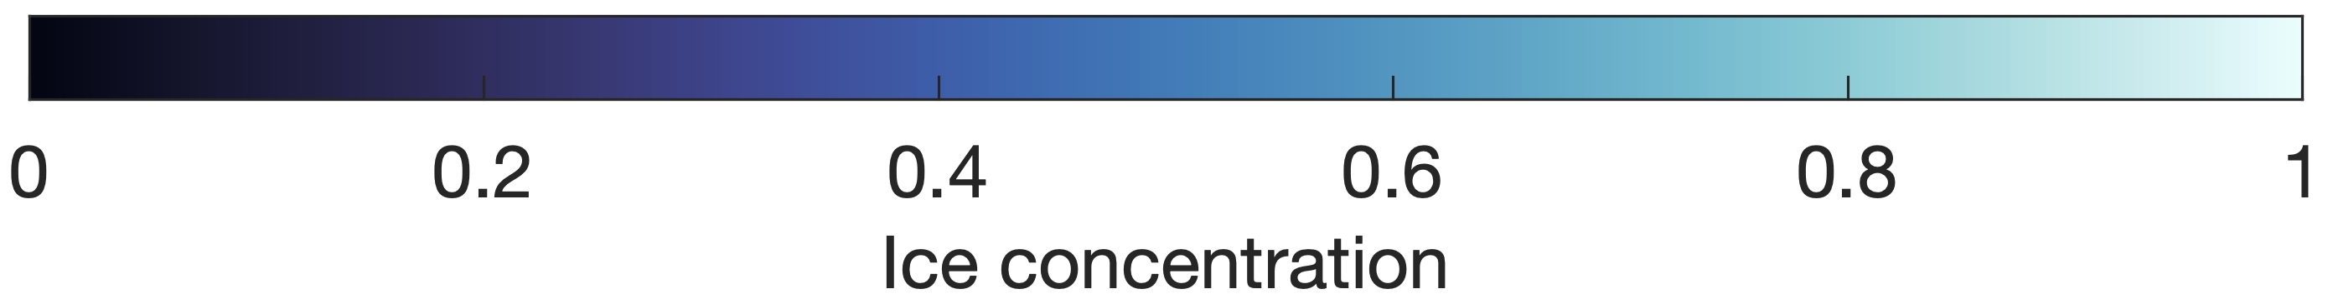
Daily-mean fields from prognostic simulation, Sep. 2013-Feb. 2014 (Simulation initialized on 1 September 2013)
Sea surface salinity & currents
Sea surface temperature
Sea ice concen-tration (> 0.01)

Slide 6
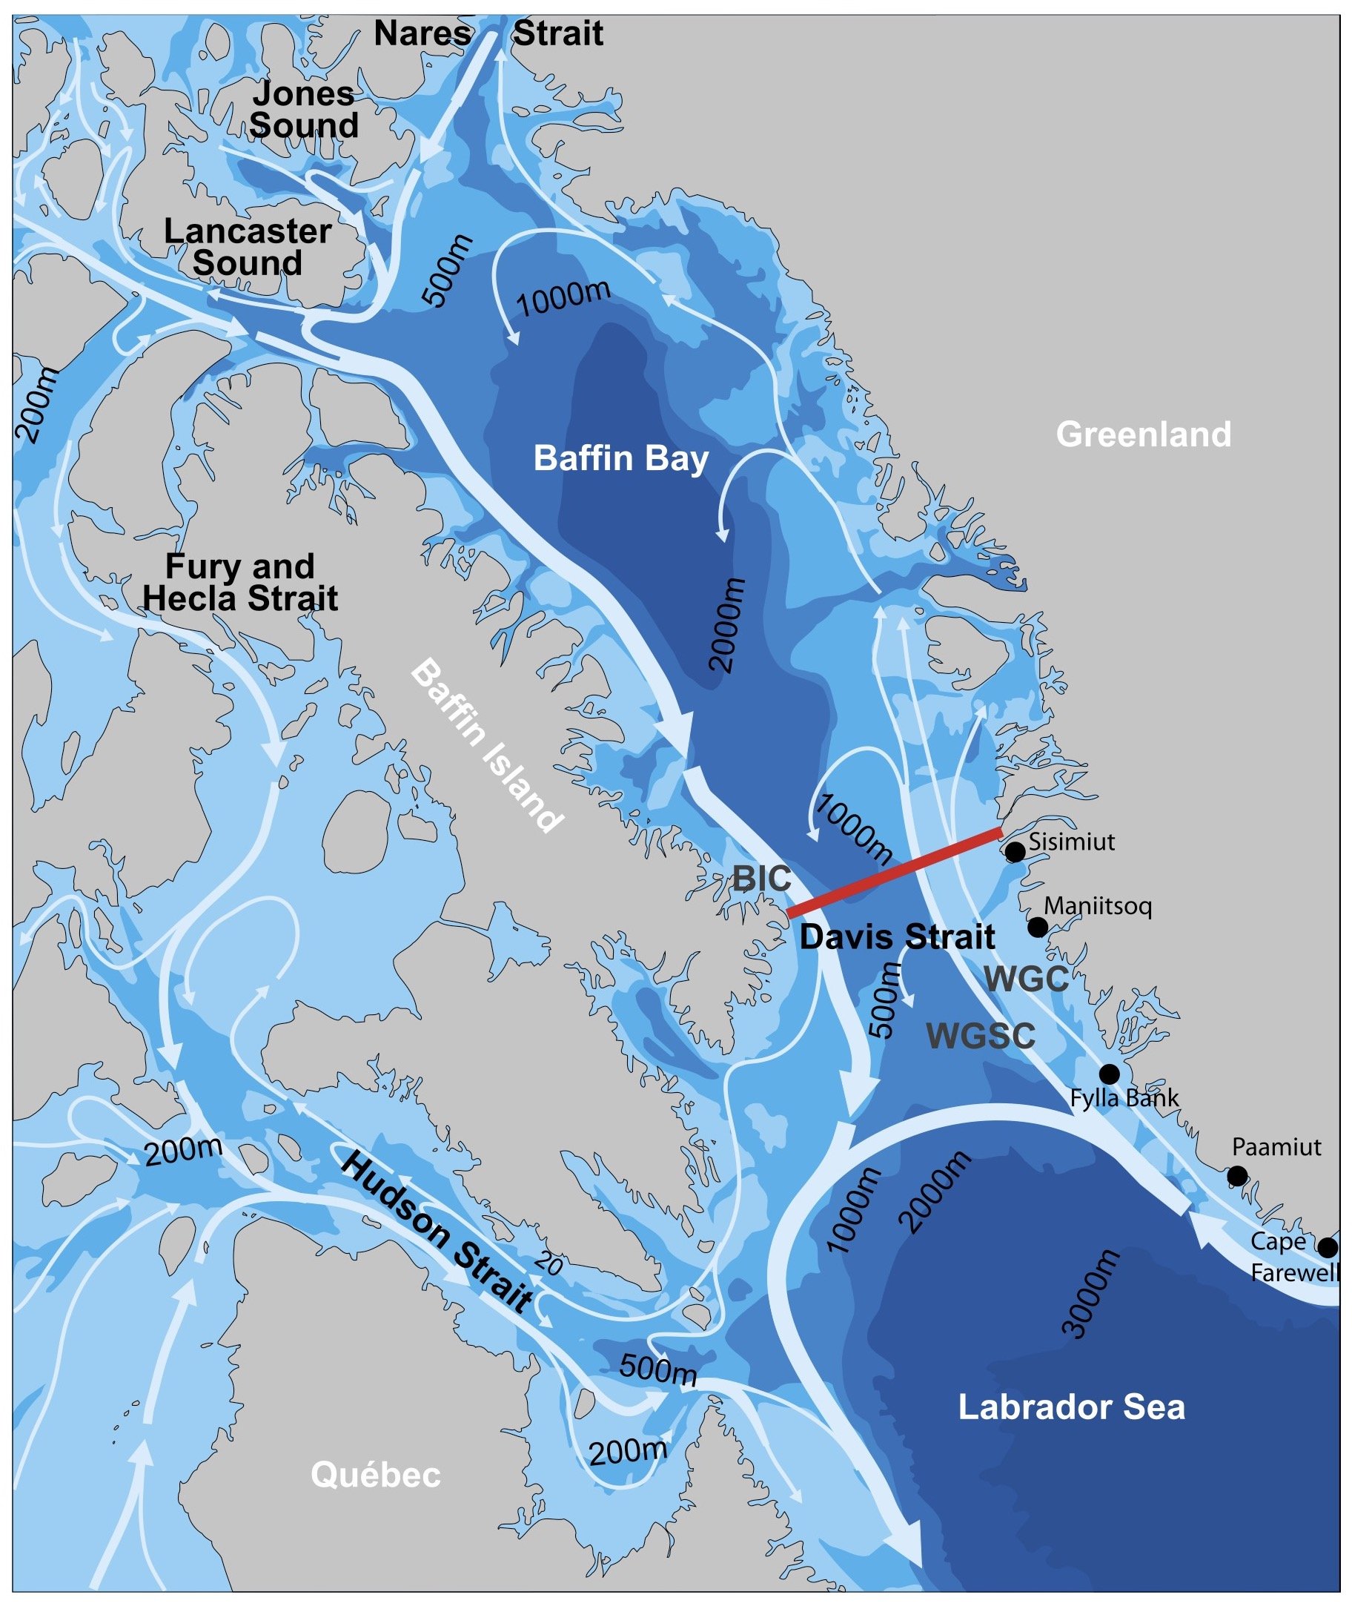
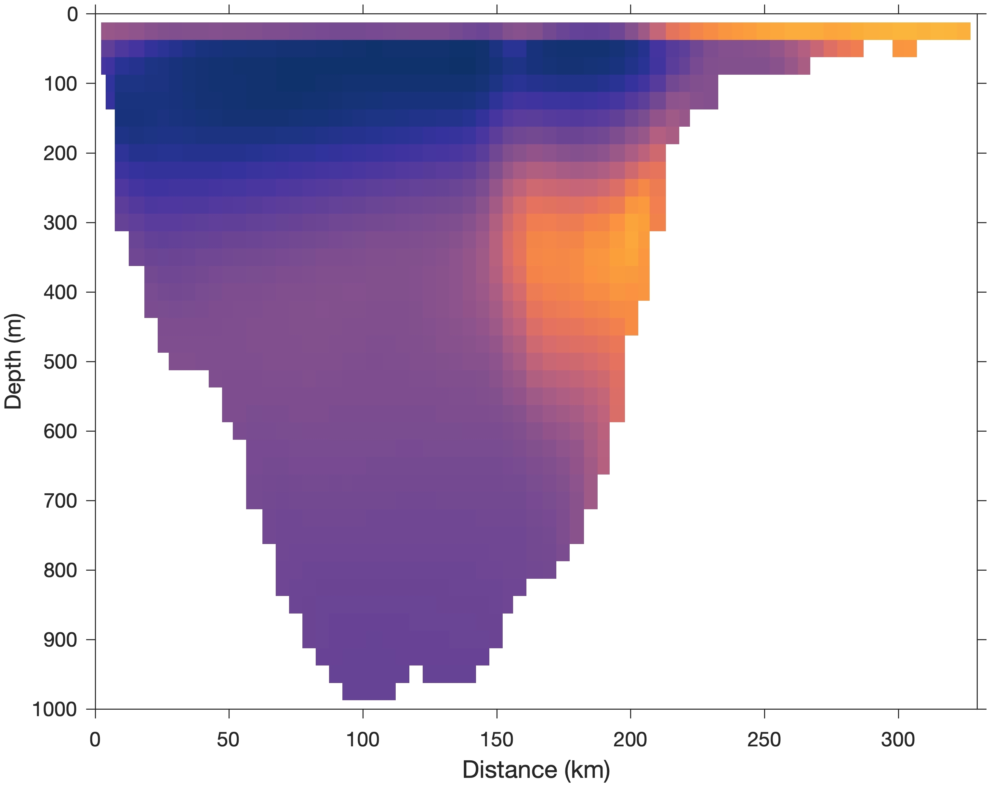
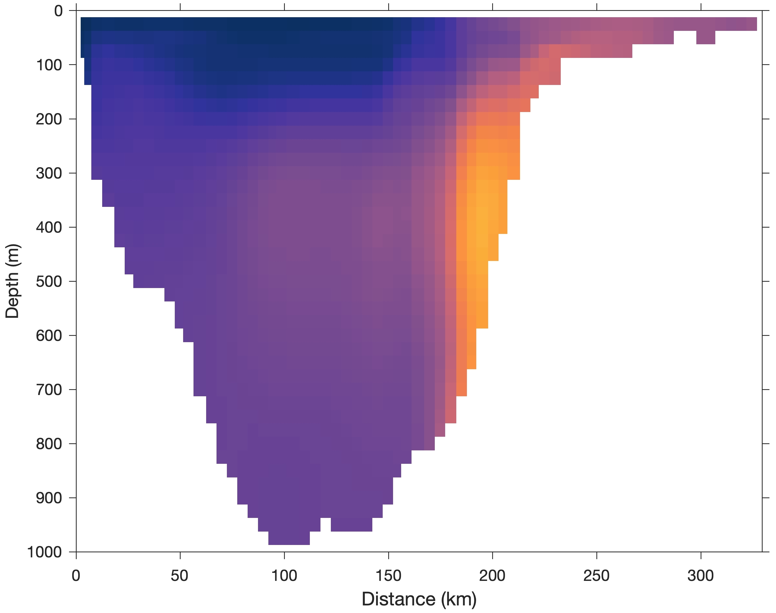
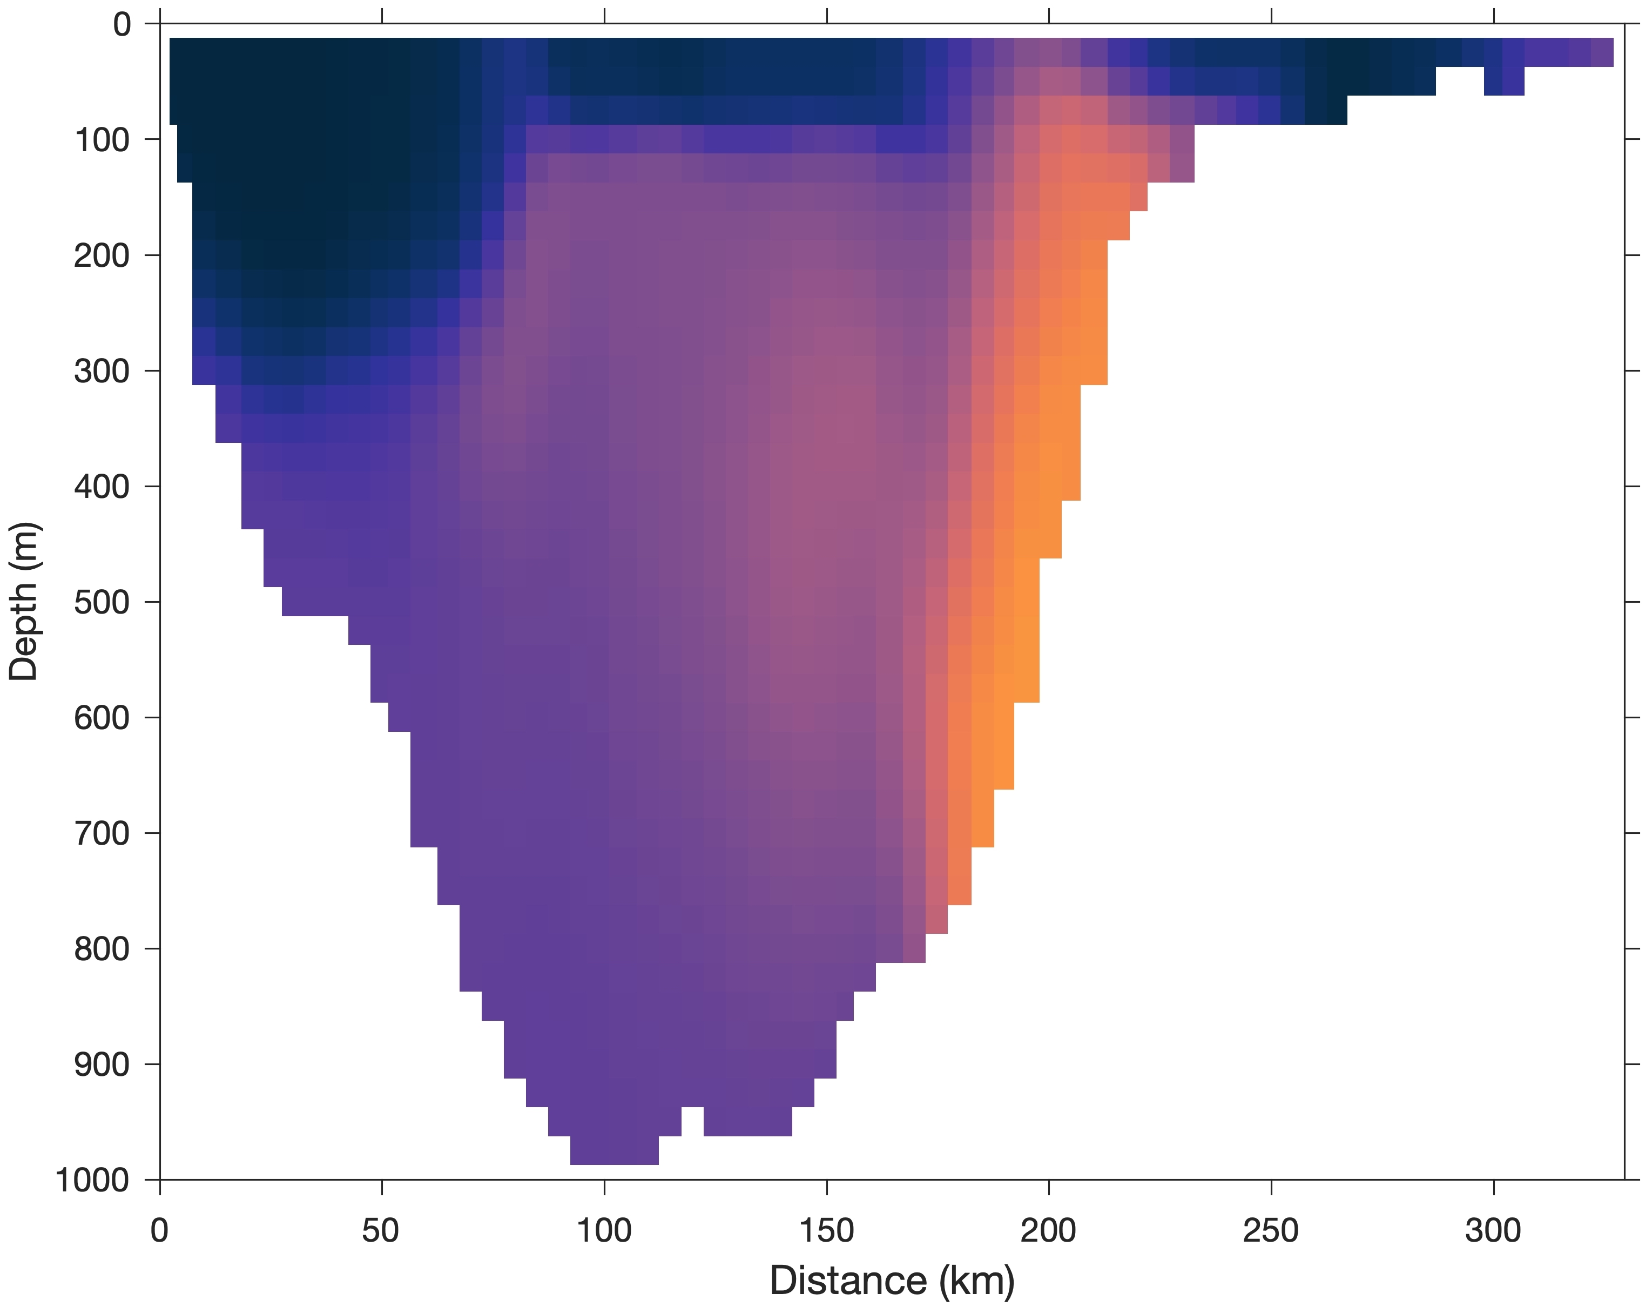
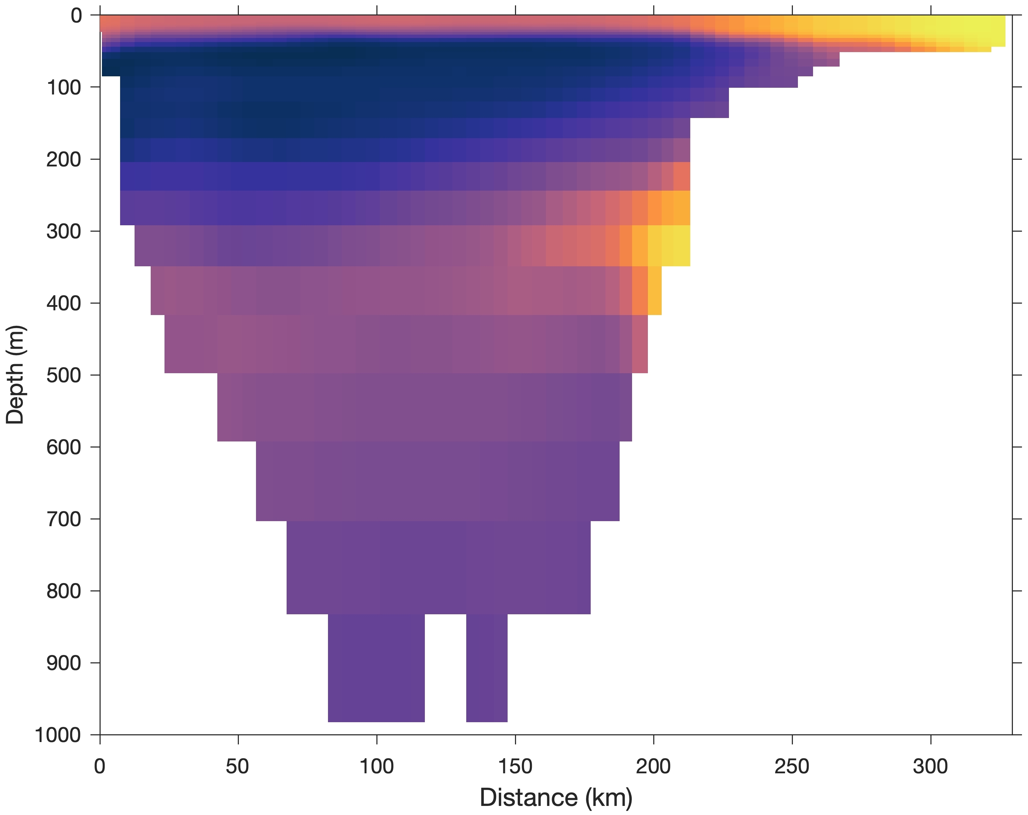
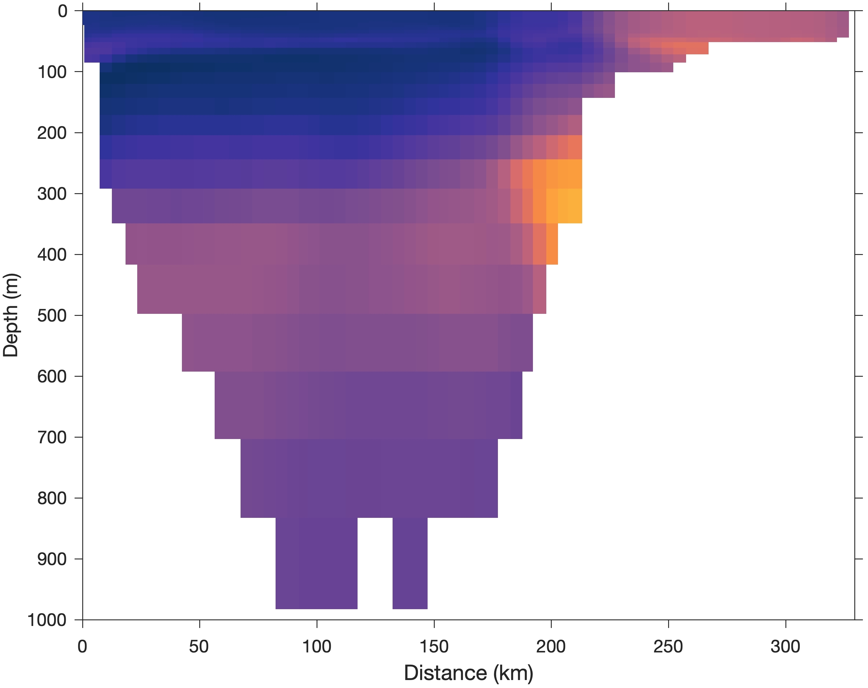
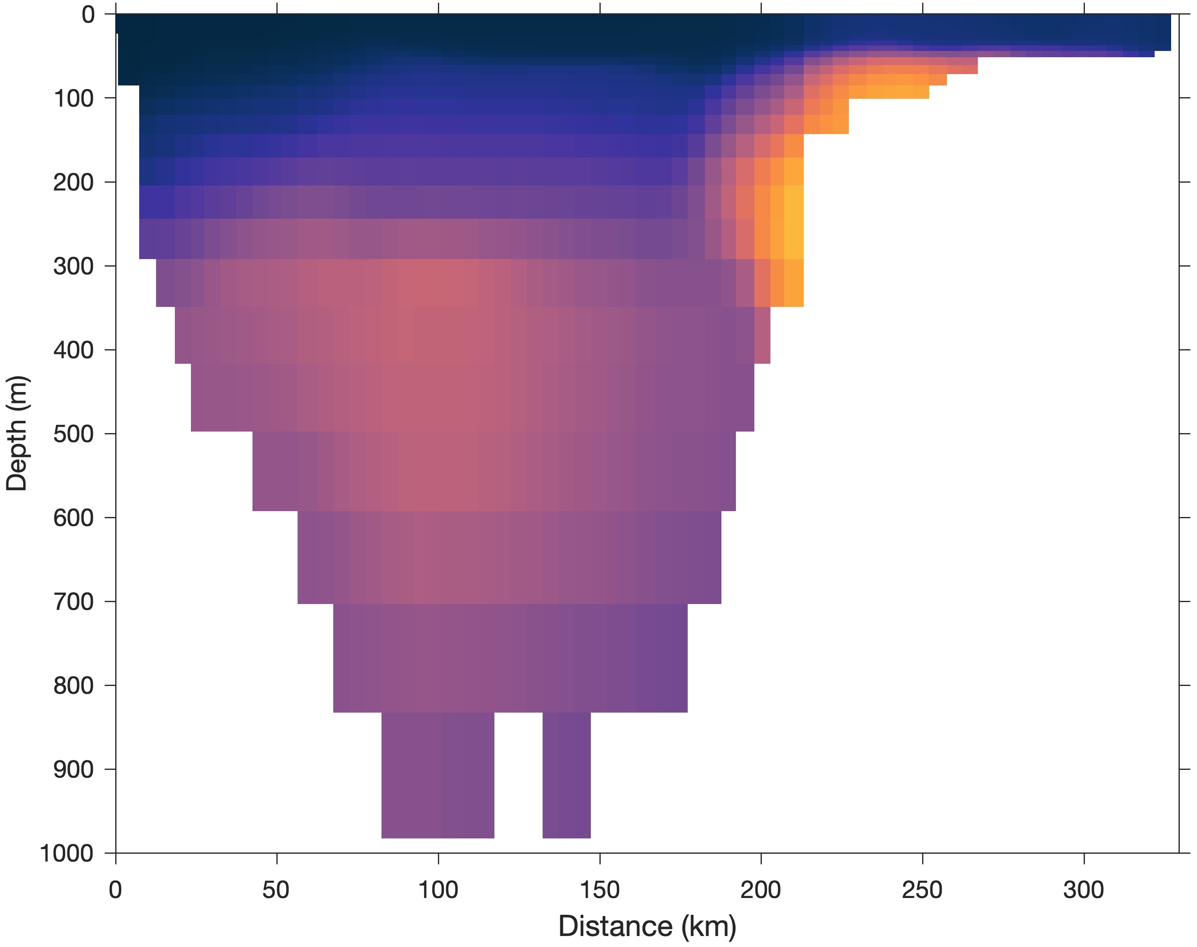
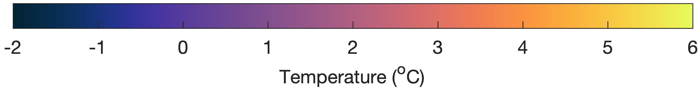
Monthly-mean simulated temperature across Davis Strait
Sep. 2013
Nov. 2013
Jan. 2014
Baffin Island
Greenland
Simulated
(Curry et al., 2014)
Erosion of West Greenland Irminger Water & Arctic Water
Excess mixing?
GLORYS reanalysis

Slide 7
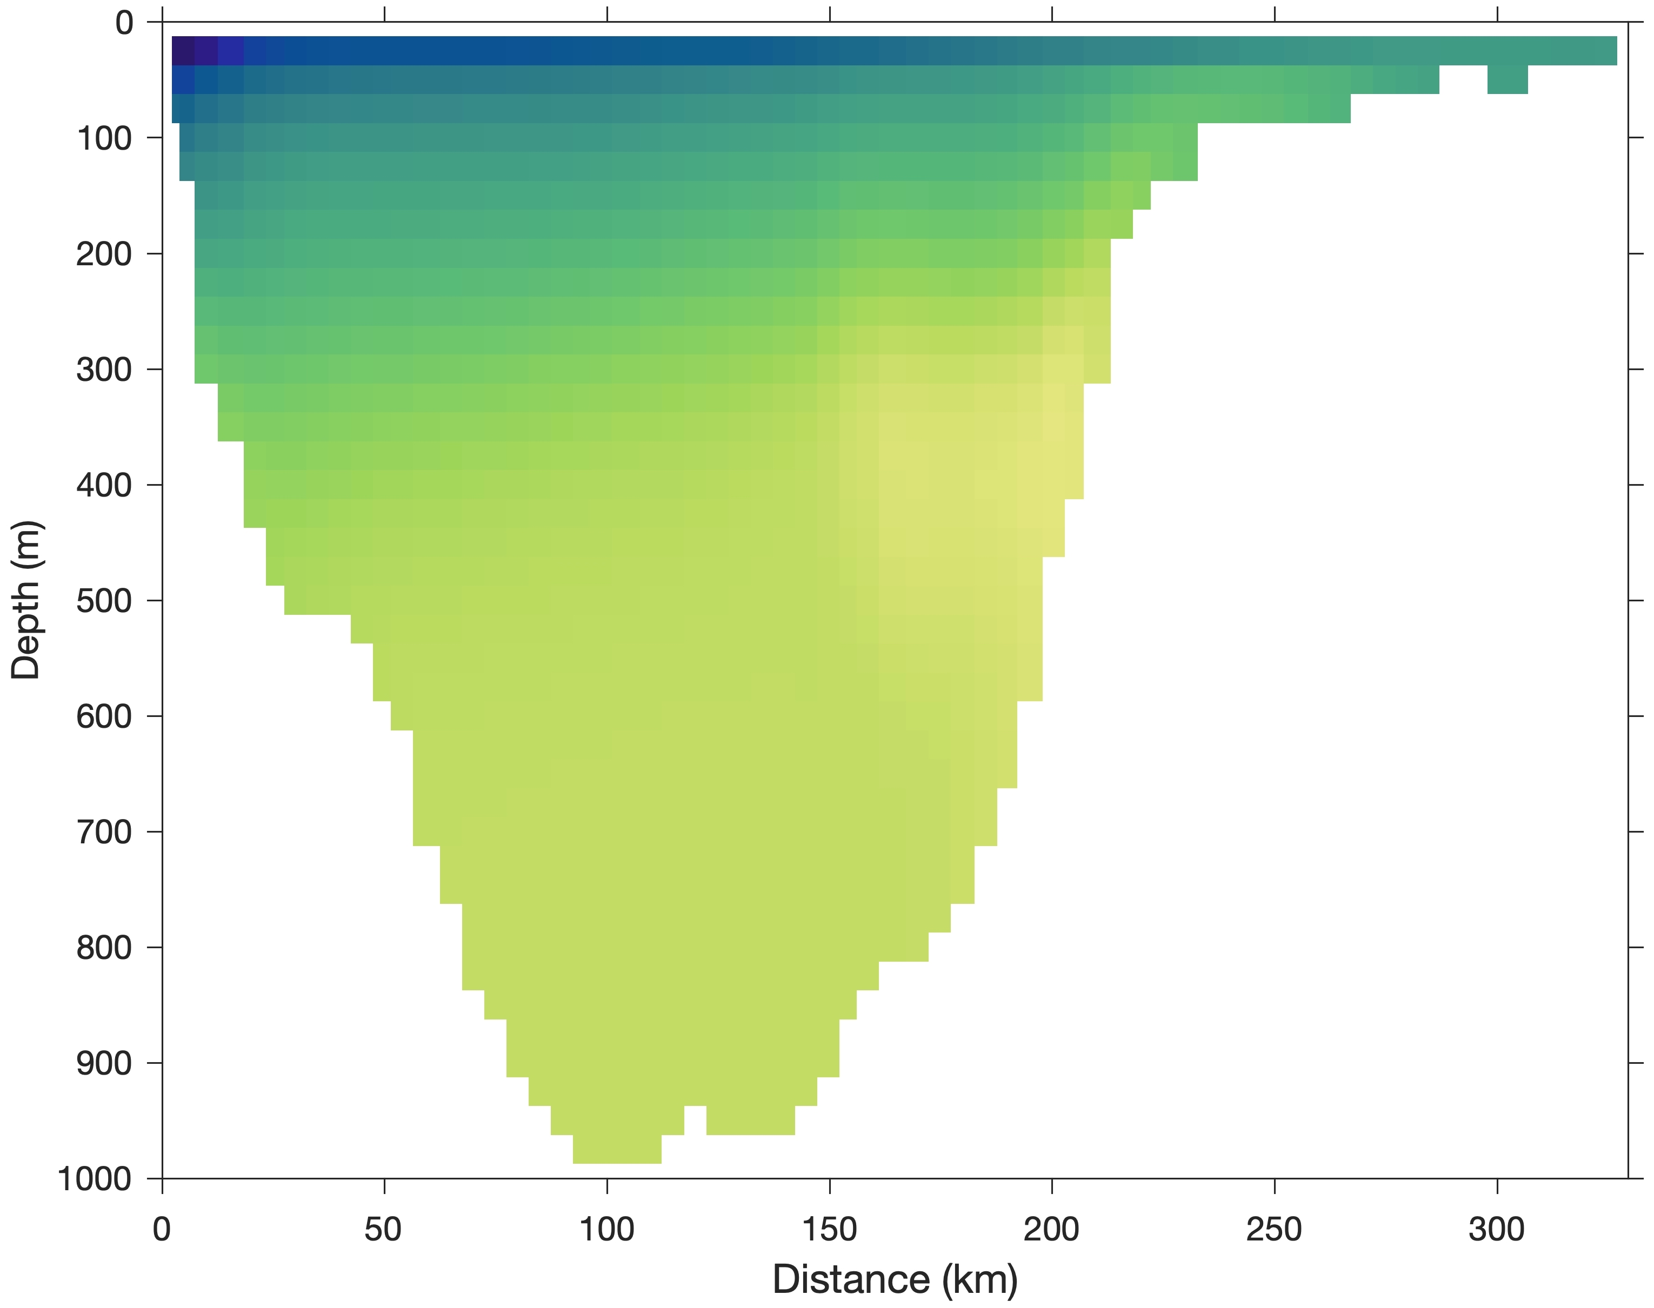
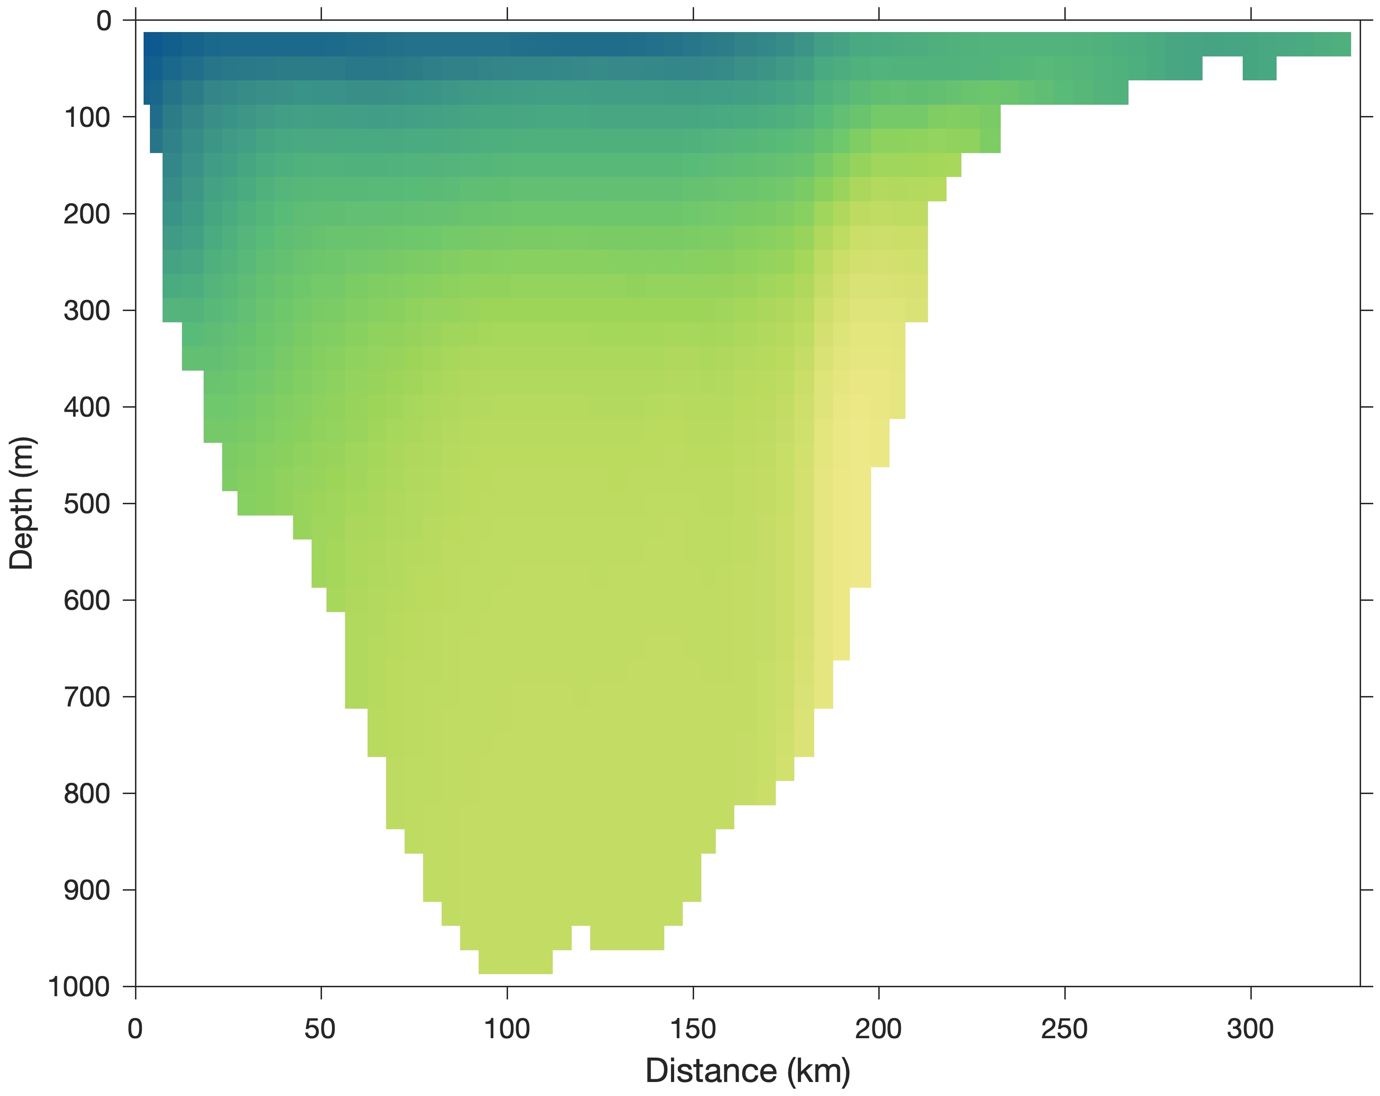
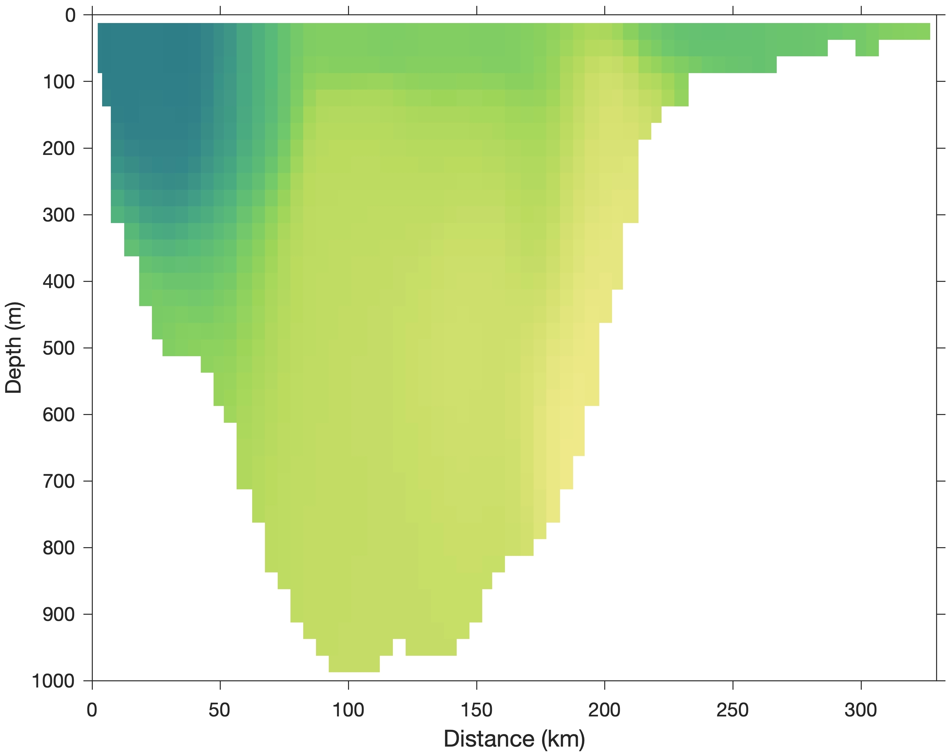
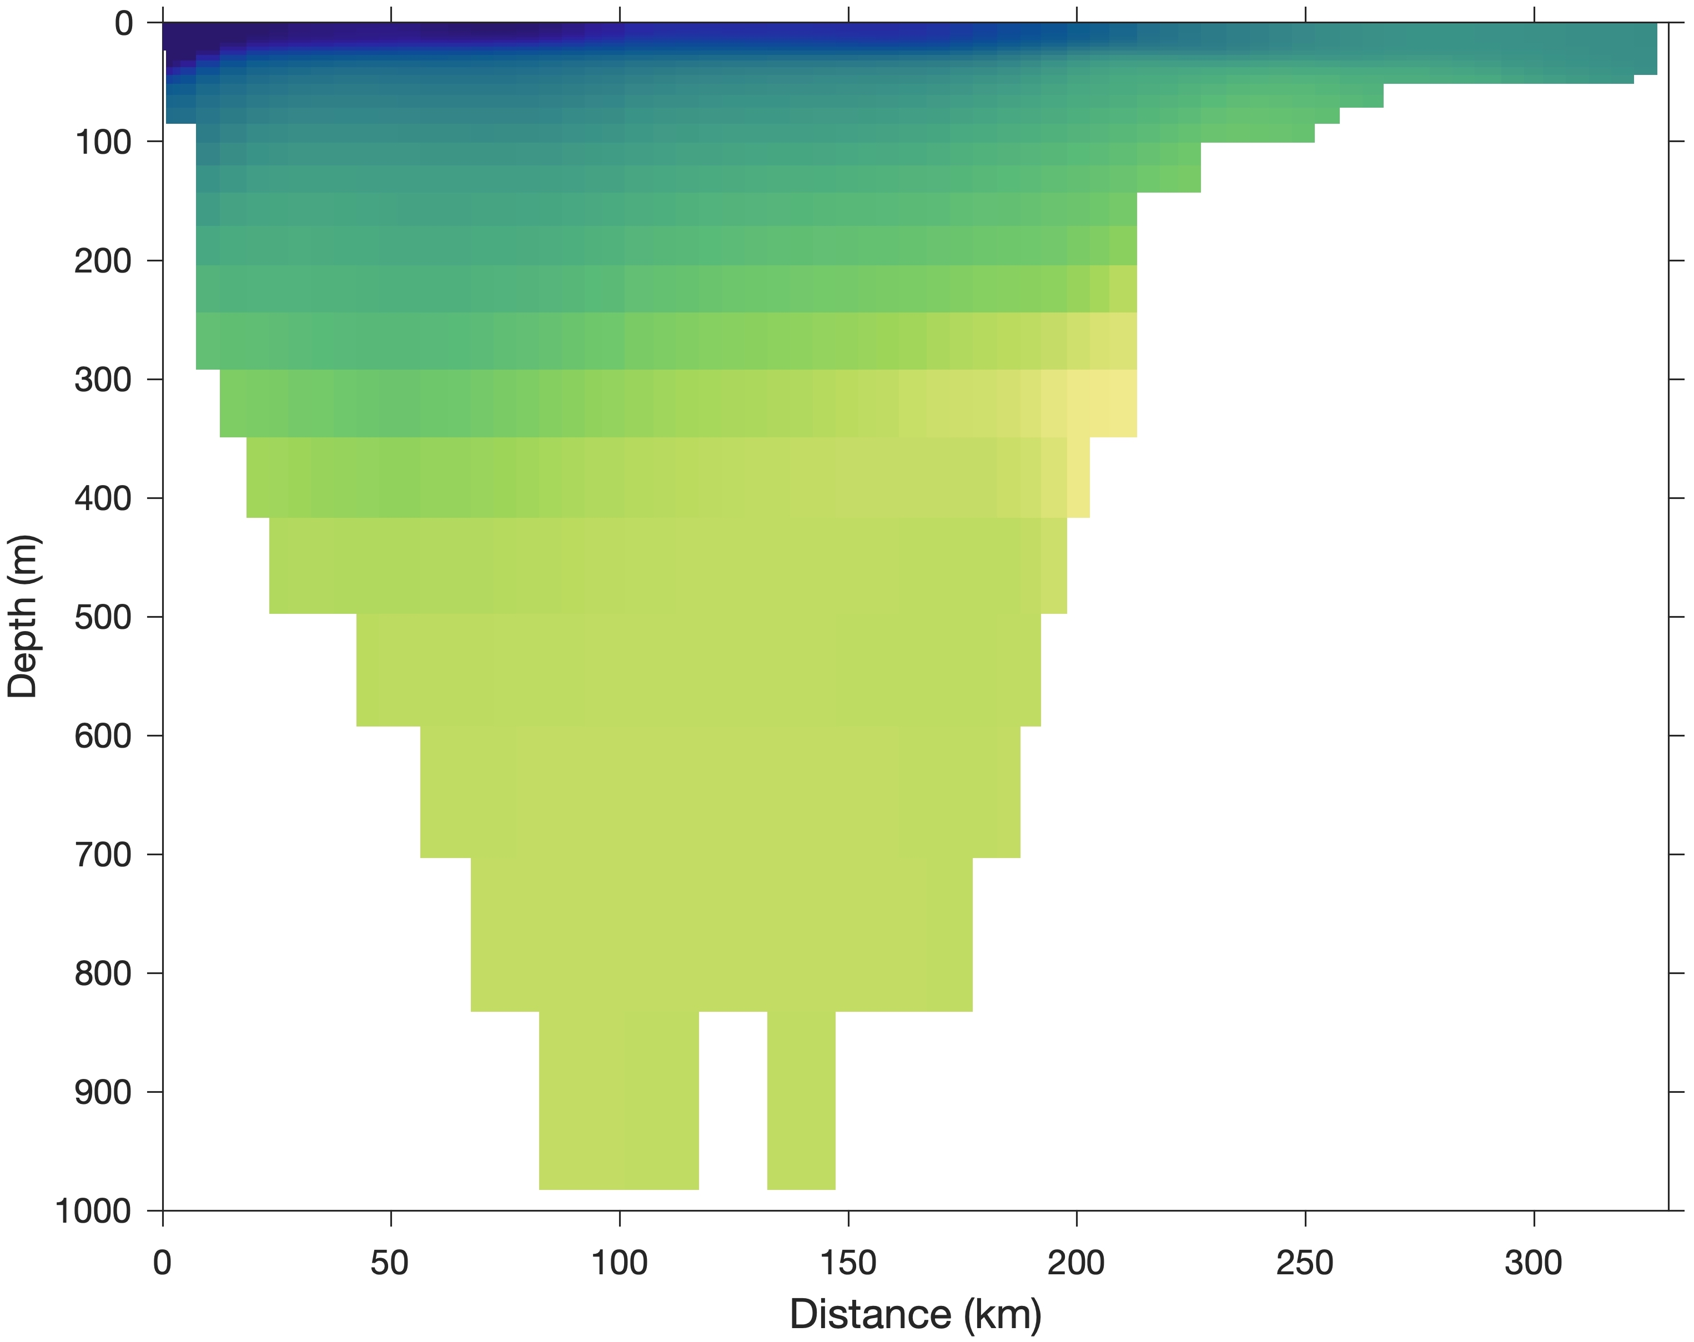
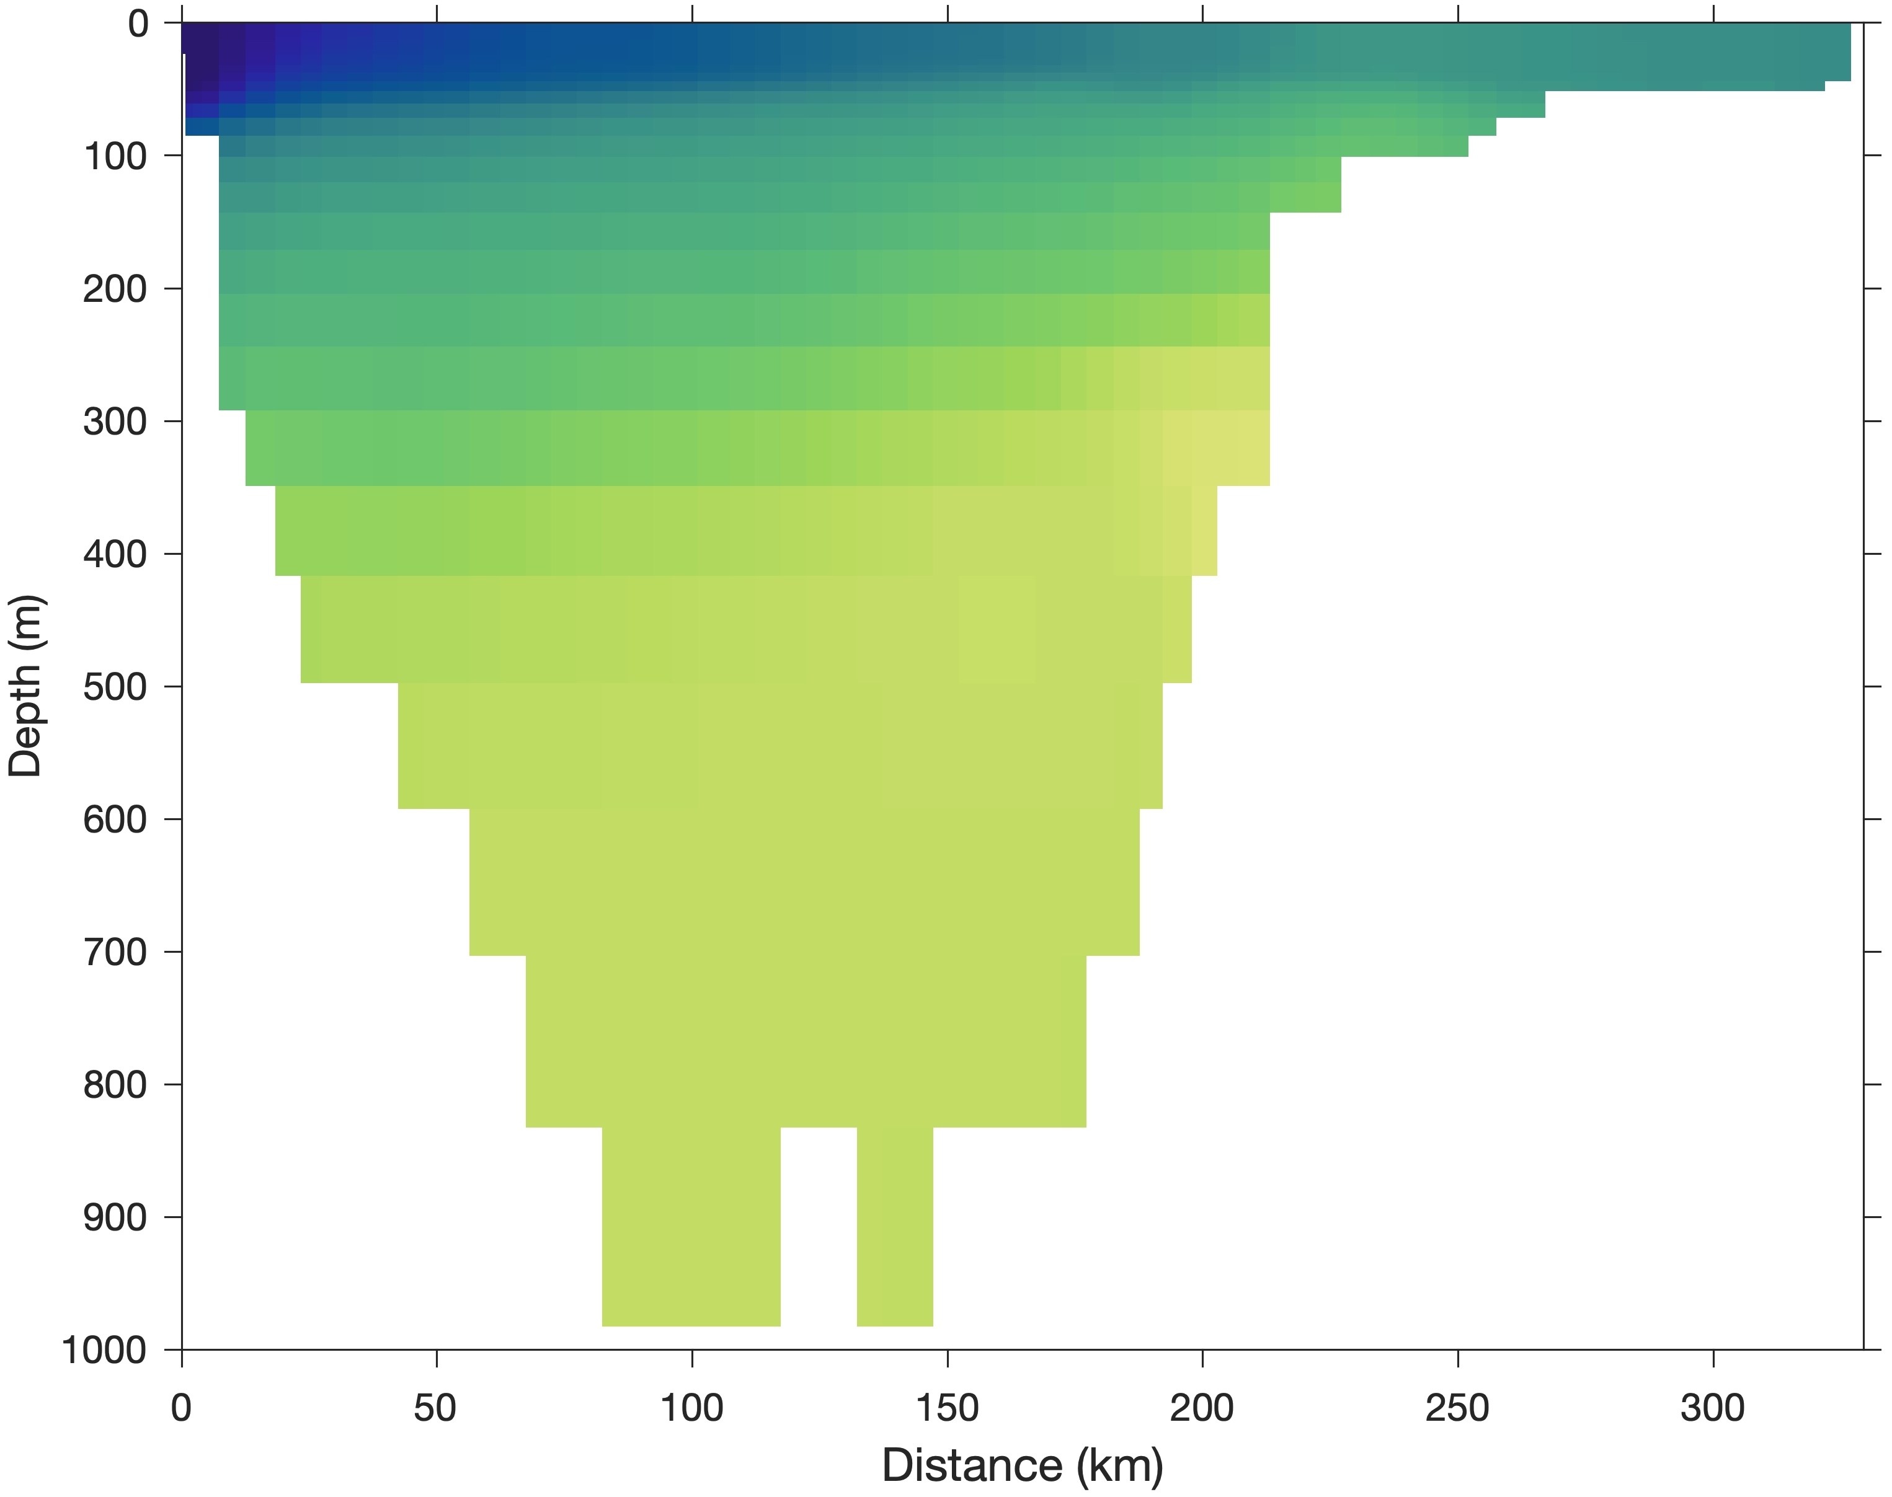
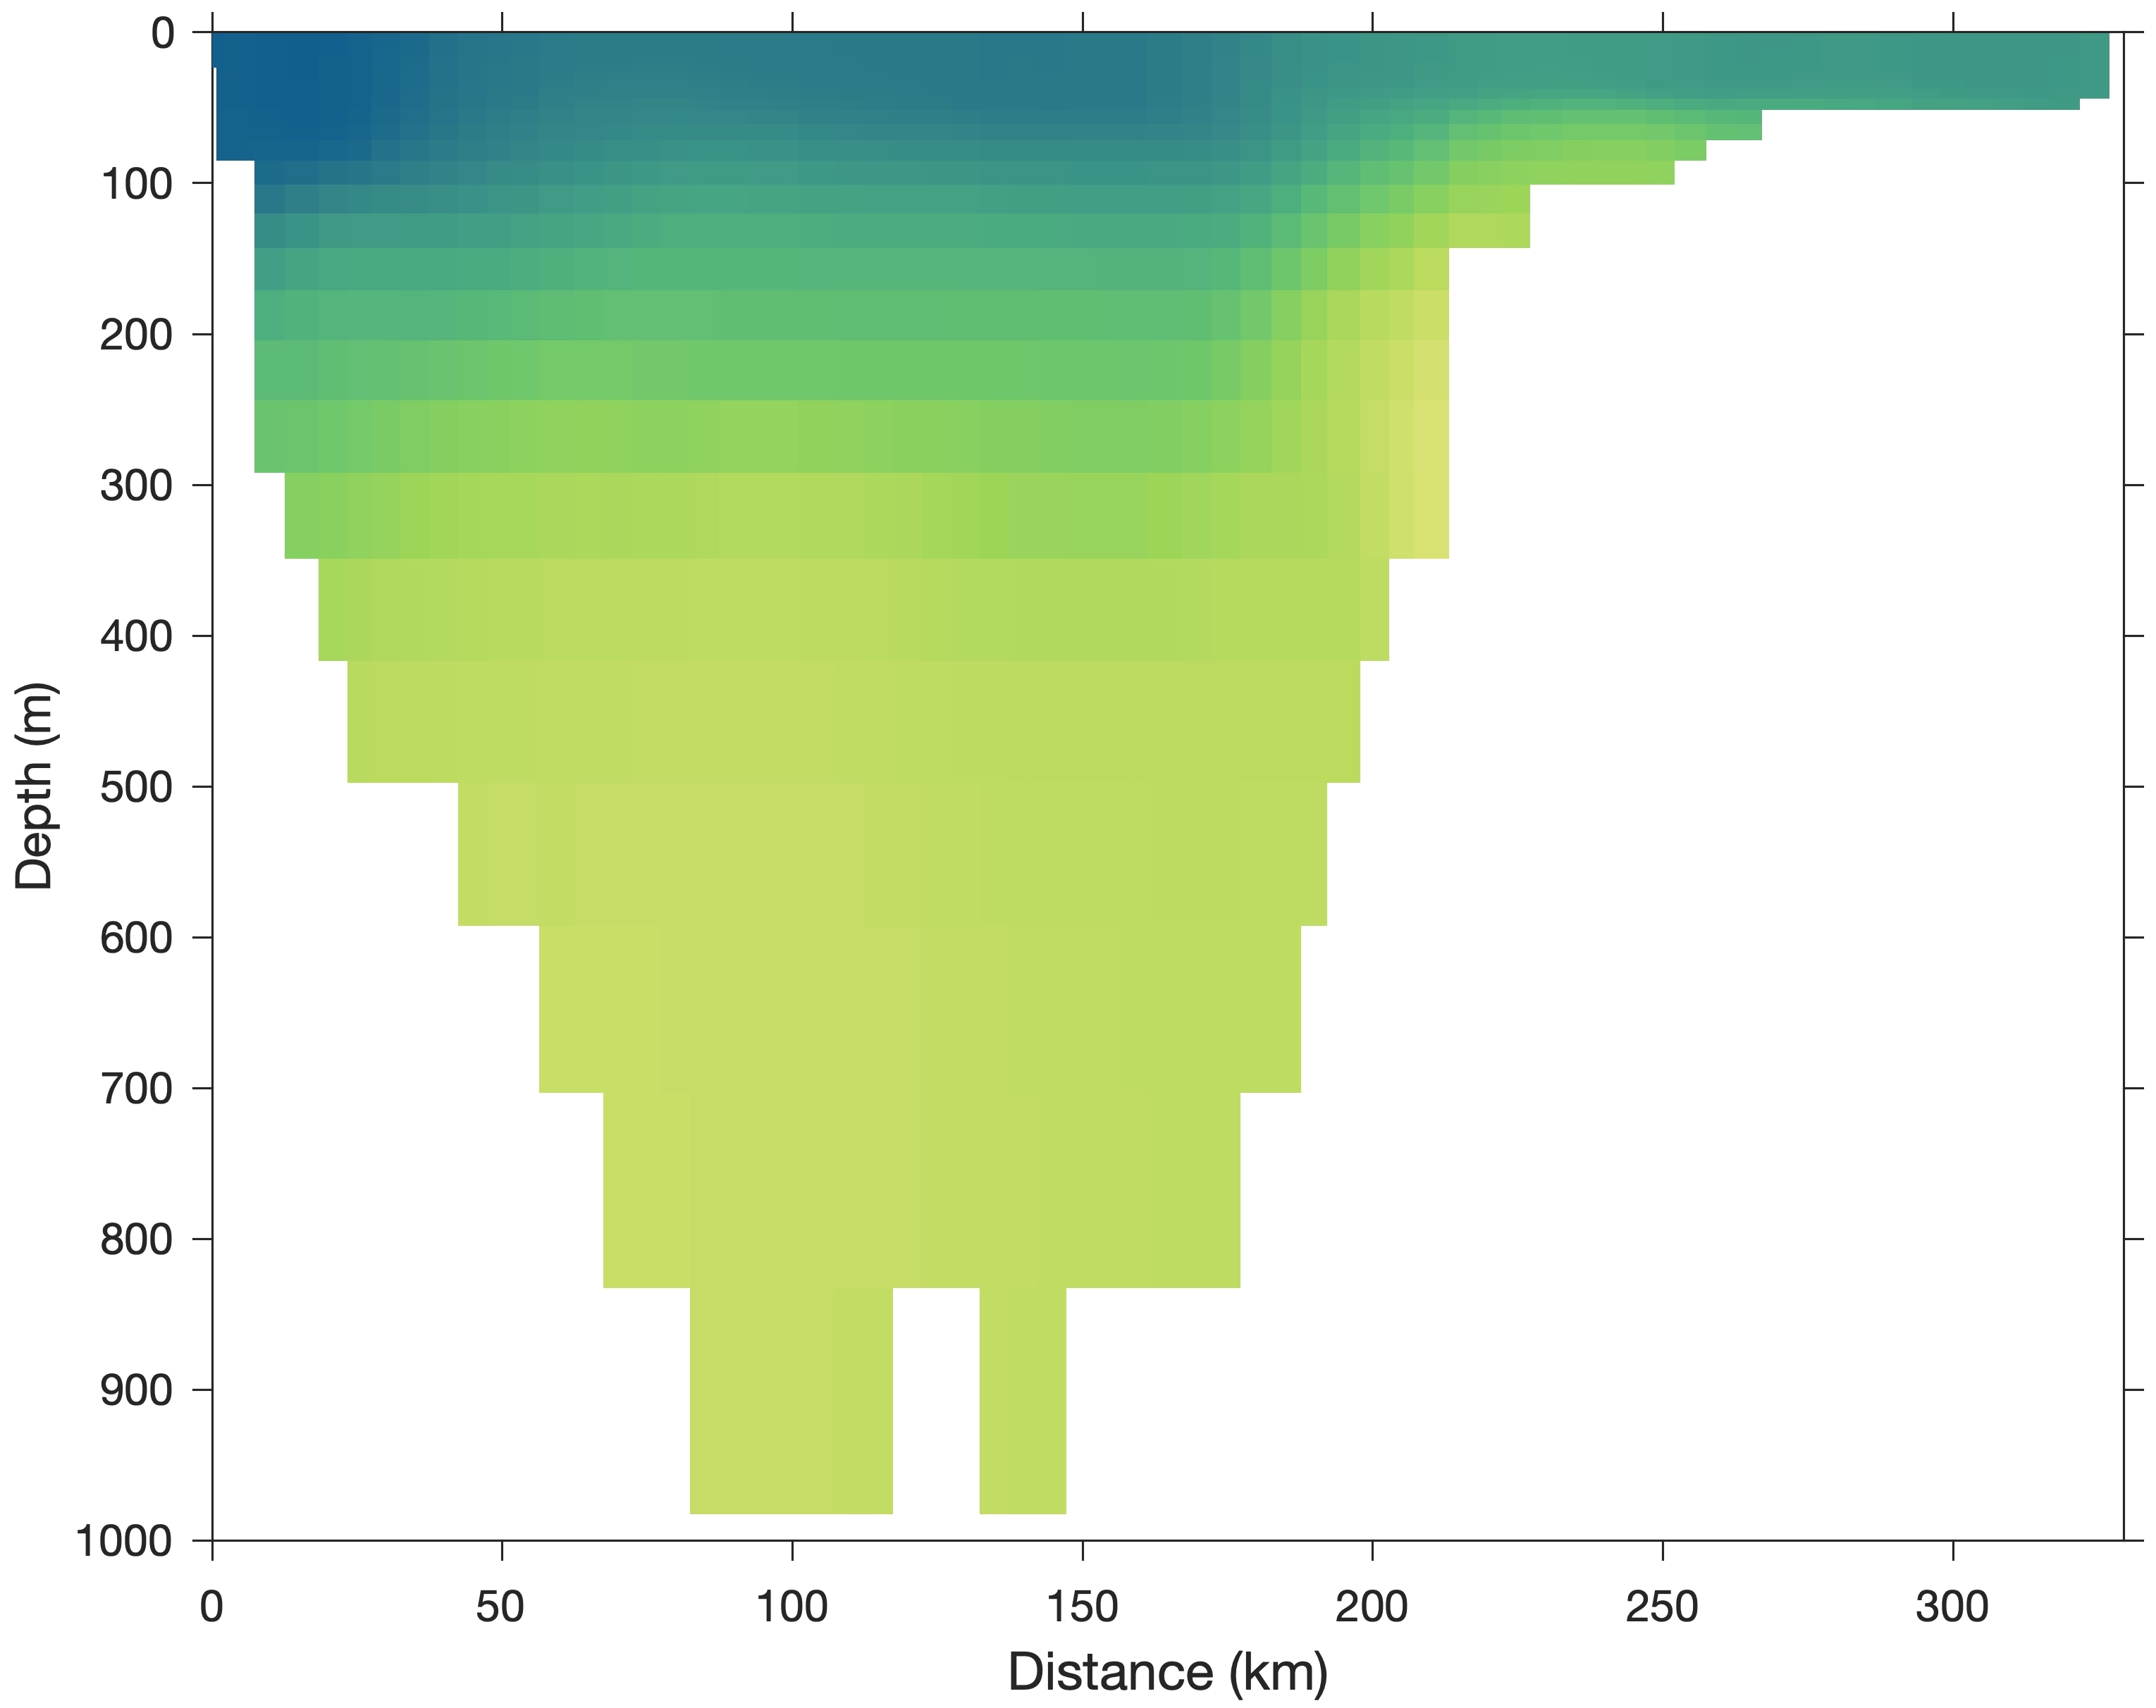
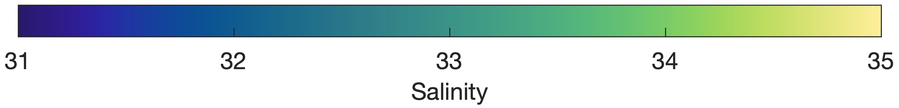
Monthly-mean simulated salinity across Davis Strait
Sep. 2013
Nov. 2013
Jan. 2014
Baffin Island
Greenland
Simulated
(Curry et al., 2014)
Erosion of West Greenland Irminger Water & Arctic Water
Excess mixing?
GLORYS reanalysis

Slide 8
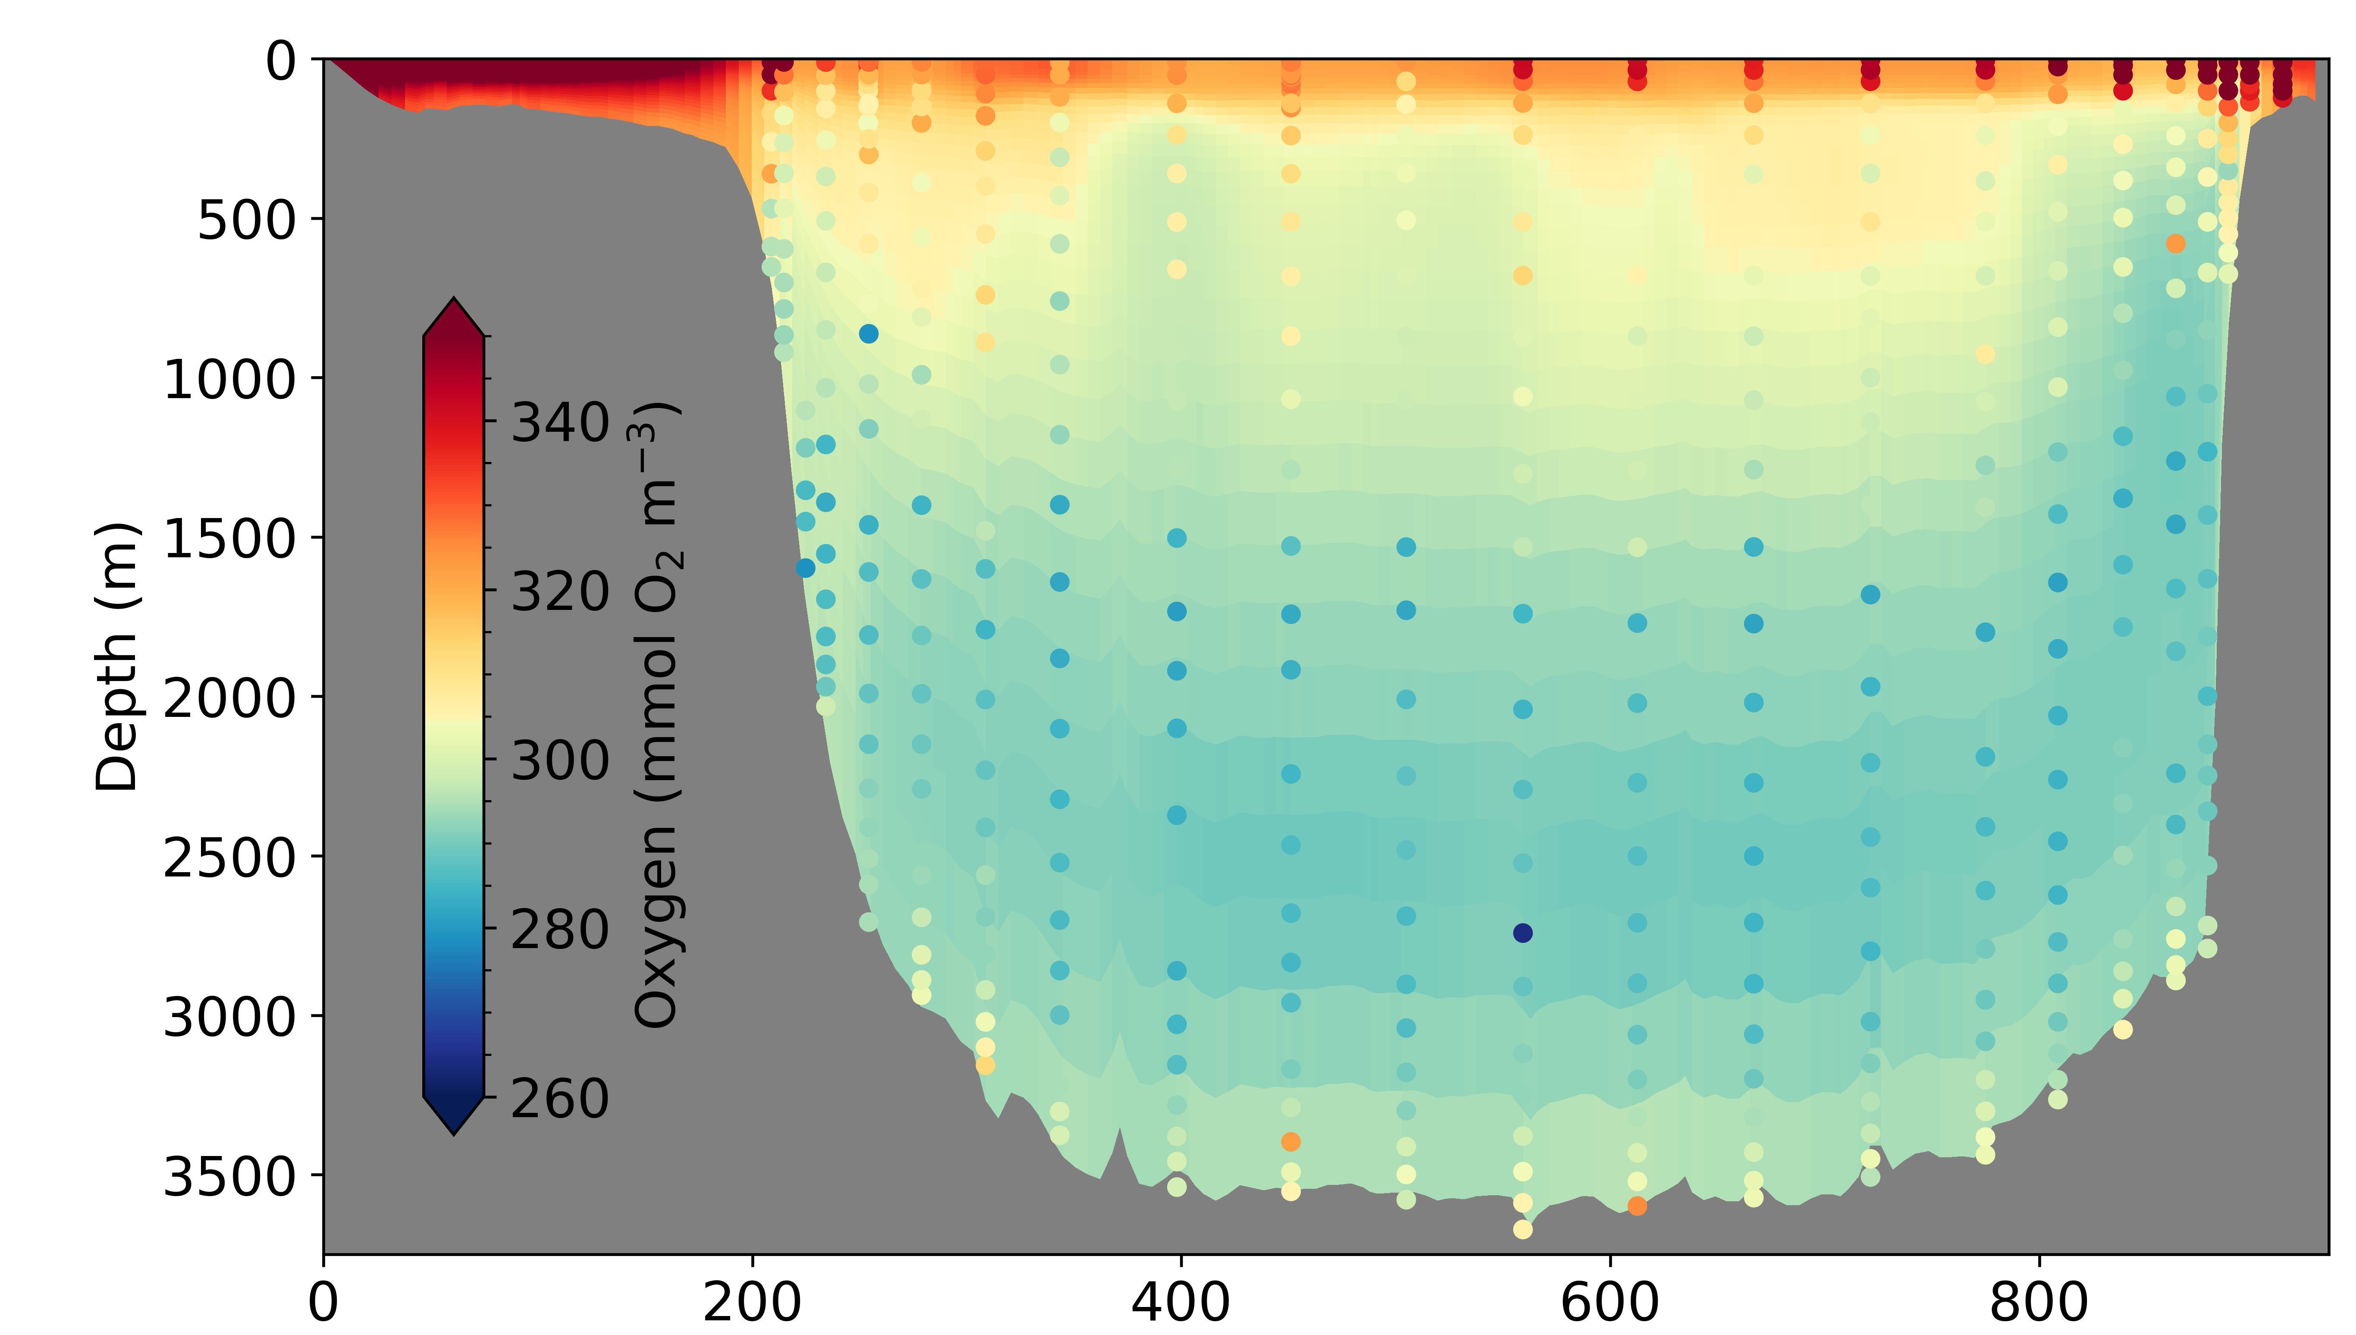
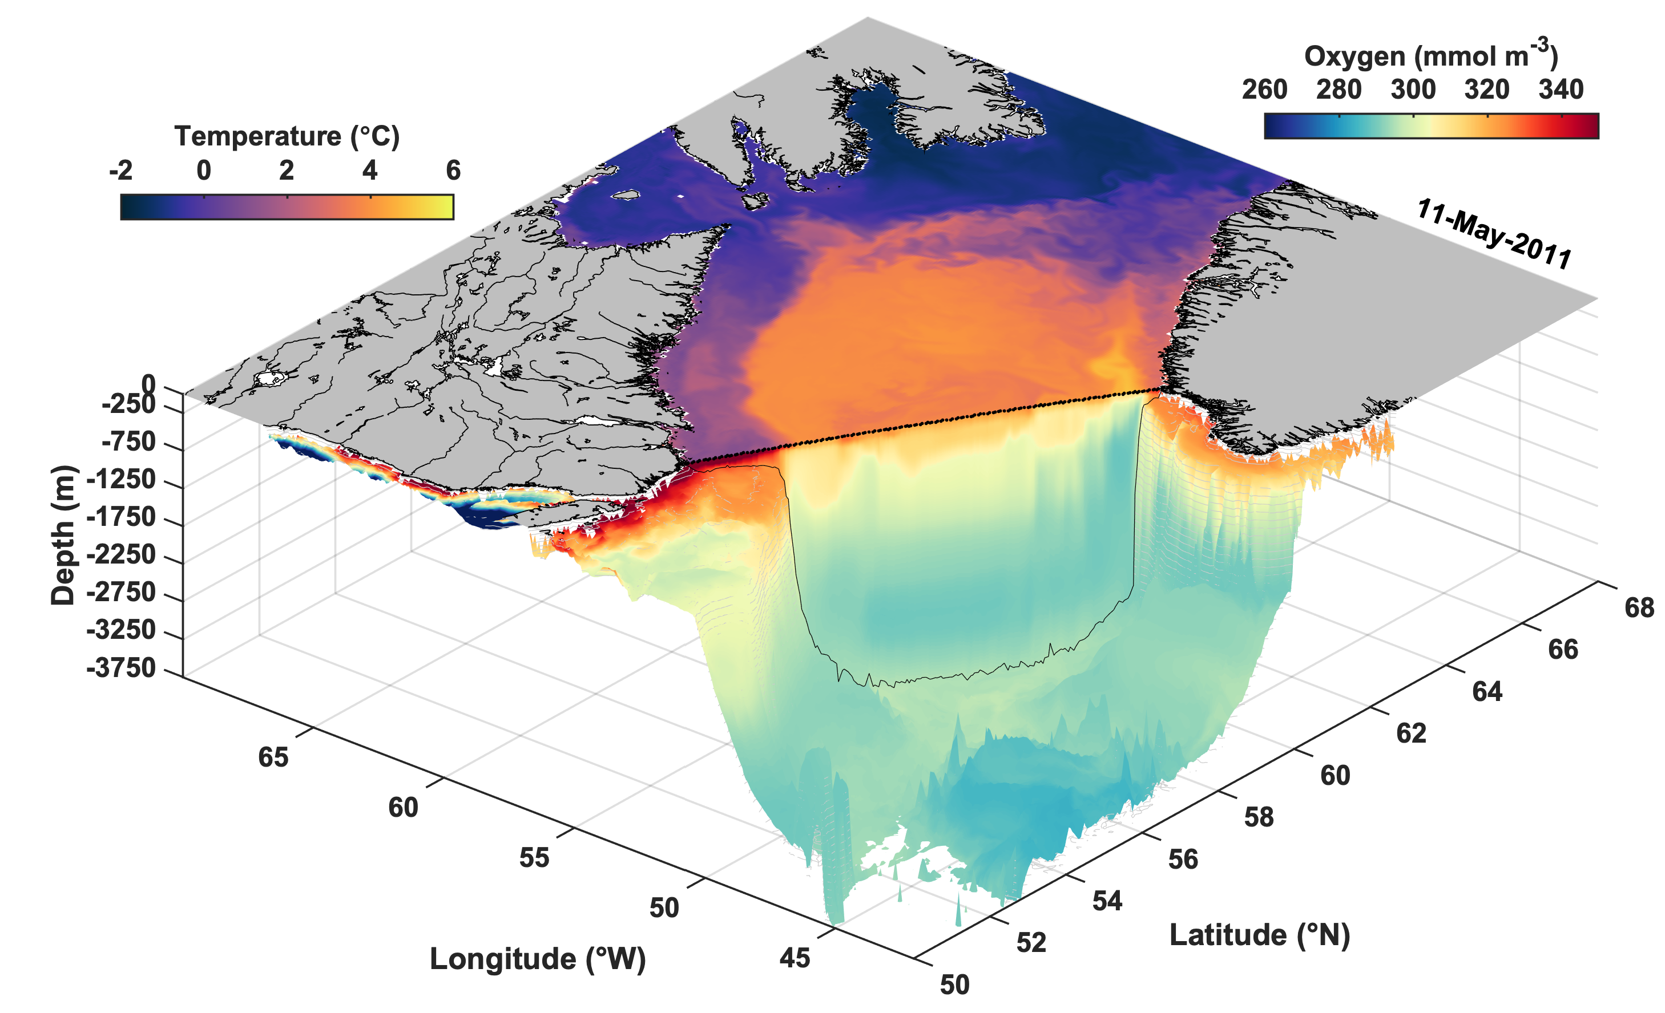
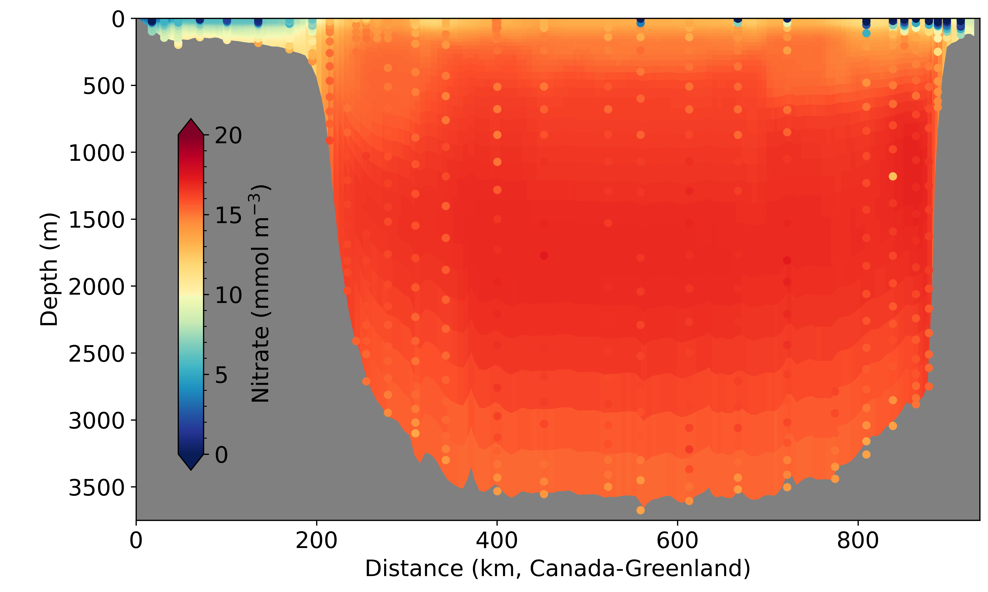
Simulated biogeochemistry
Comparisons with AR7W Transect - May 2011
Simulated surface temperature + oxygen distribution along the AR7W transect and on the bottom, in May 2011.
Labrador Sea Water (100-2000 m)
Northeast Atlantic Deep Water (2000-3000 m)
Denmark Strait Overflow Water (> 3000 m)
Notes:
The left figure shows the surface temperature (purple and orange map), the 2D oxygen distribution along the AR7W transect cross the Labrador Sea, and oxygen concentration at the bottom in May 2011. The simulated nitrate and oxygen concentrations compare reasonably well with observations along the transect (see the right panels; observations are shown as colored dots over the simulated distribution). The model reproduces the biogeochemical characteristics of the main water masses (Lab Sea Water, NE Atlantic Deep Water and Denmark Strait Overflow Water).

Slide 9
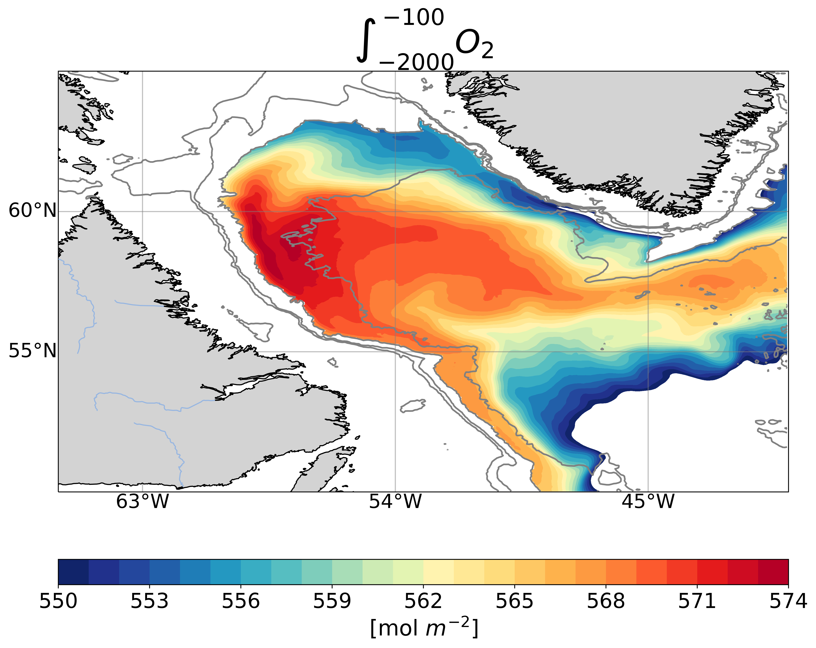
Oxygen Content in Labrador Sea Water
2009-2011 mean vertically integrated oxygen (100-2000 m)
Oxygen-saturated surface waters are mixed with low-oxygen deep waters during wintertime deep convection in the Labrador Sea.
This process critically contributes to ventilation of the deep ocean.
Notes:
The high oxygen content simulated in the central Labrador Sea (100-2000m) is a signature of wintertime convection, during which low-oxygen deep waters are mixed with oxygen-saturated surface waters. This process critically contributes to the ventilation of the deep ocean.

Slide 10
Conclusions
Preliminary results indicate our coupled circulation-sea ice-biogeochemistry modelling system reproduces general spatiotemporal patterns of variables
Future work will include: 1) quantitative model validation; 2) measures to counteract model bias and drift; 3) addition of high-resolution grids nested within existing grid
Application of this model to downscaling of global climate simulations: talk by Christoph Renkl (CL5.3.2, EGU22-10467, 11:14 am on 27 May)

