Slide 1
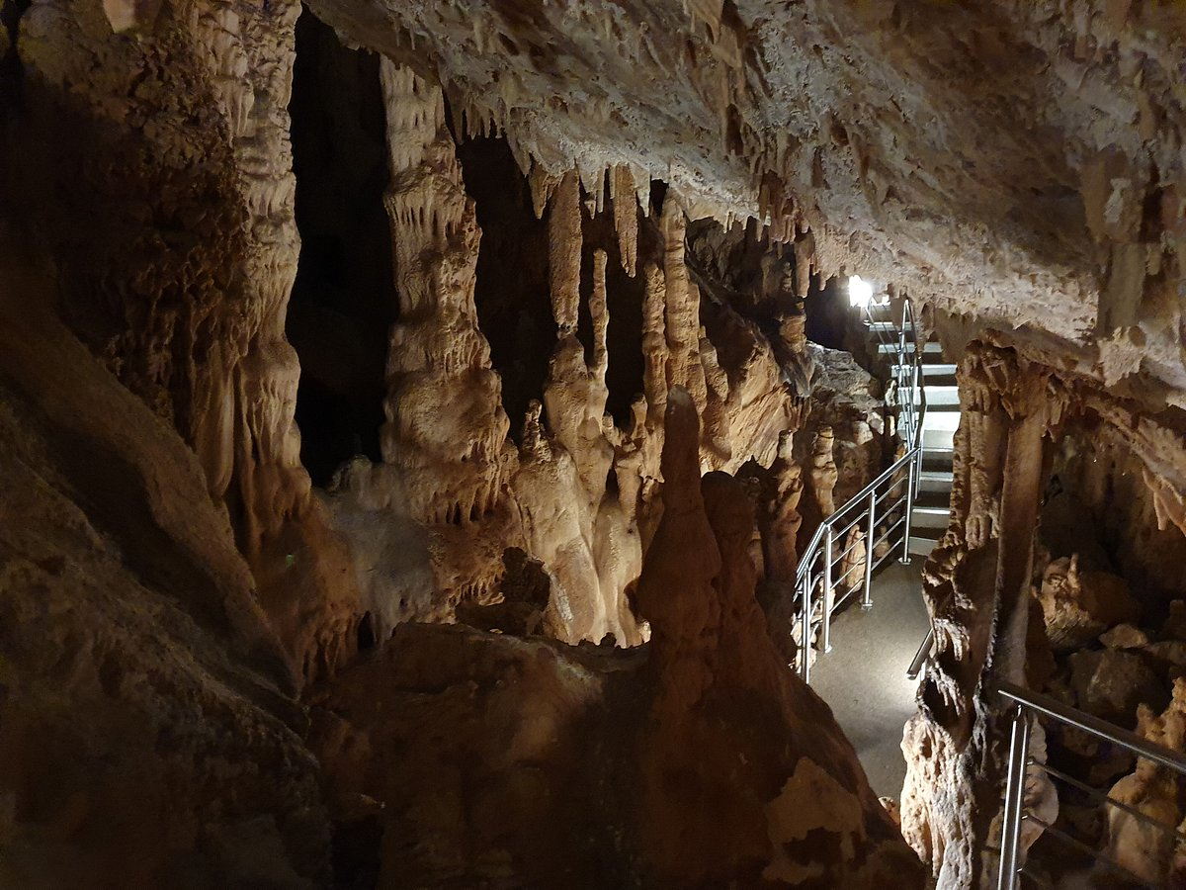

Showcaves: A modern geo-conservation approach utilizing geo-ethics and heritage management principles through sustainable monitoring technology
National & Kapodistrian University of Athens
School of sciences
Department of Geology & Geoenvironment
George Kontostavlos: Geologist MSc / Speleologist, Member of the Hellenic
Speleological Society
Emmanuel Vassilakis: Assoc. Professor, National and Kapodistrian
University of Athens
Maria Triantaphyllou: Professor, National and Kapodistrian
University of Athens
Aliki Konsolaki: Geologist MSc, Phd Candidate, National and Kapodistrian University of Athens
Koutouki Cave, Attica, Greece

Slide 2
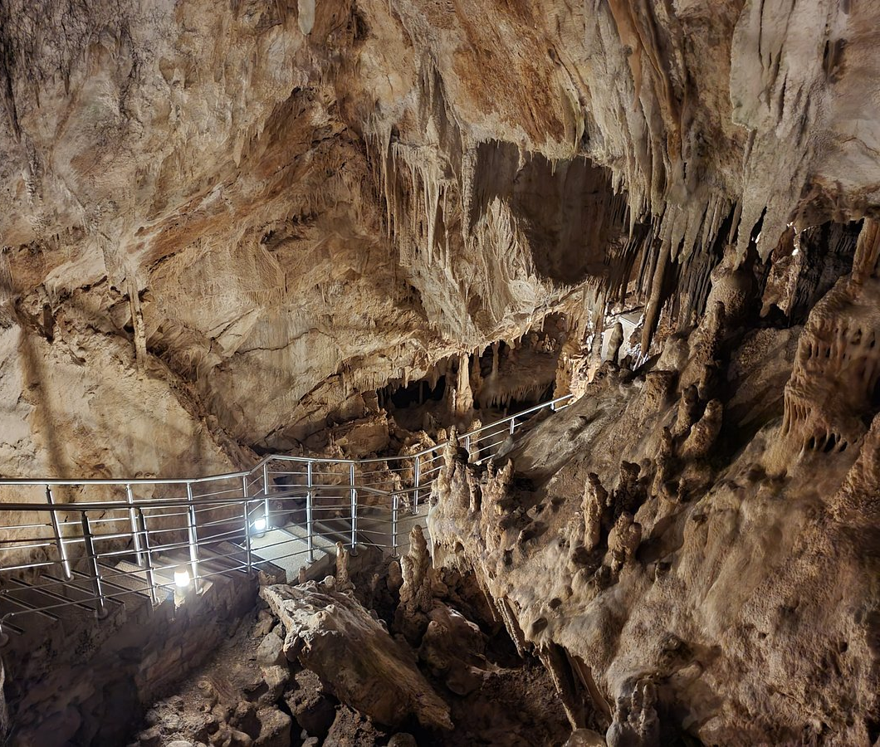
Koutouki Cave, Attica, Greece
Showcaves: Definition & Principles
Showcave is a cave for which the visitor pays a fee to visit and must meet safety and environmental requirements.
Environmental / ecosystem values:
Microclimate conservation, speleothems, air / water pollution, lampenflora
Cultural Values:
Caves related to mythology / history – folklore, aesthetic values and unique formations
Biodiversity:
Ecosystem level, species level / population, fossils, geological formations landscape features
Social:
Leisure, themes, venues, infrastructure outside the cave
Economic:
Tourism, land development, job vacancies in the region
Research and Education:
Places of reference, scientific research for universities / institutes, formal & non-formal education for adults and minors, municipalities
Is it possible to maintain the aesthetic and scientific values of a cave when transforming it into a show cave?
Is it possible to decelerate degradation or manage effectively show caves operating many decades now?

Slide 3
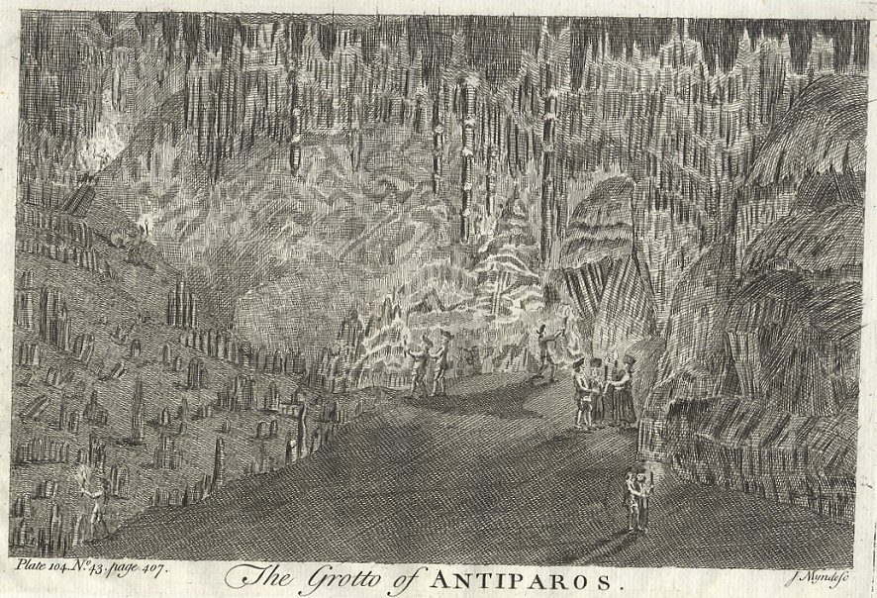
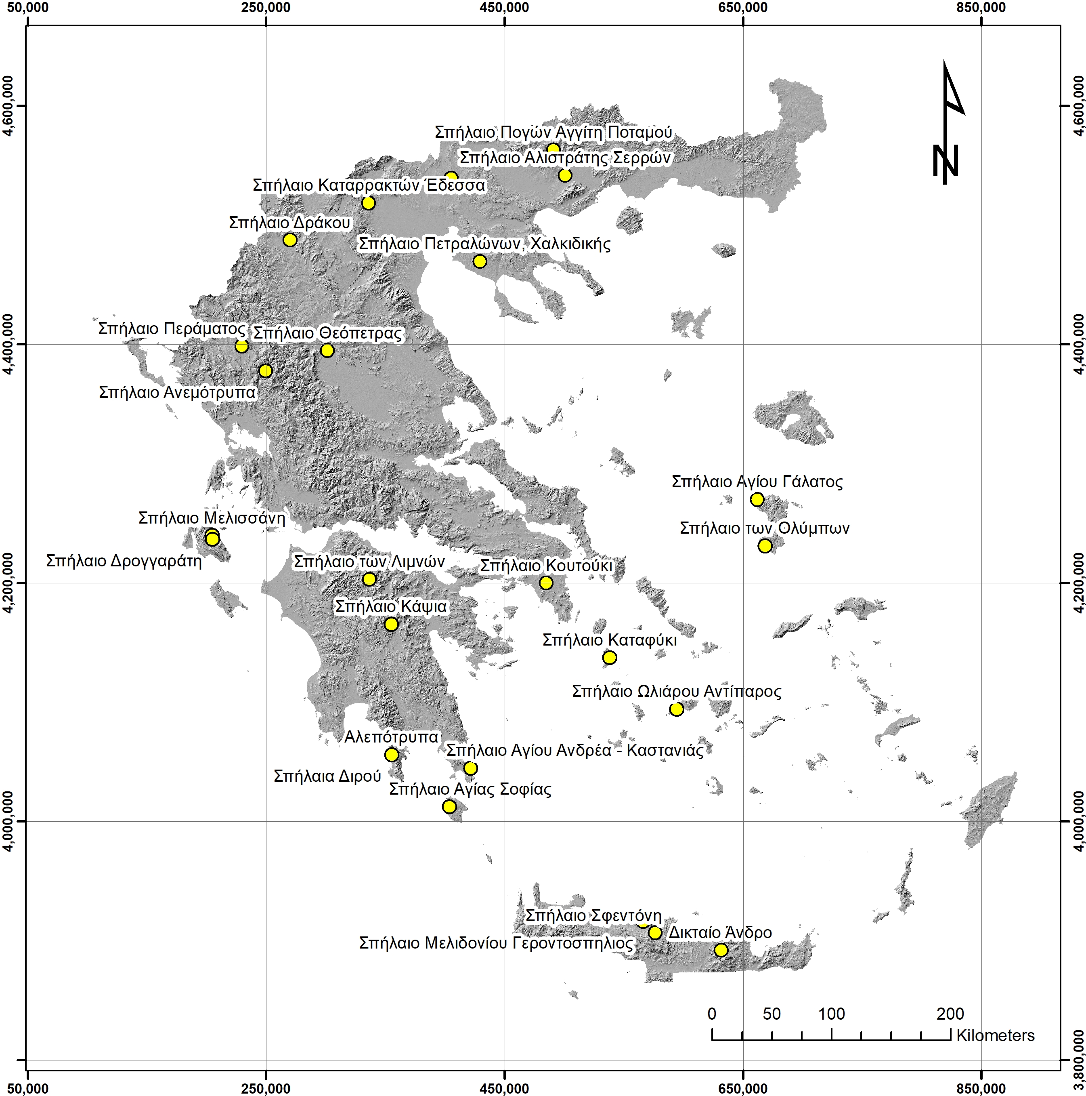
Showcaves in Greece
Cave of Antiparos Island (Travels, Francis Moore, 1770)
How can geosciences serve society in addressing global anthropogenic changes?

Slide 4
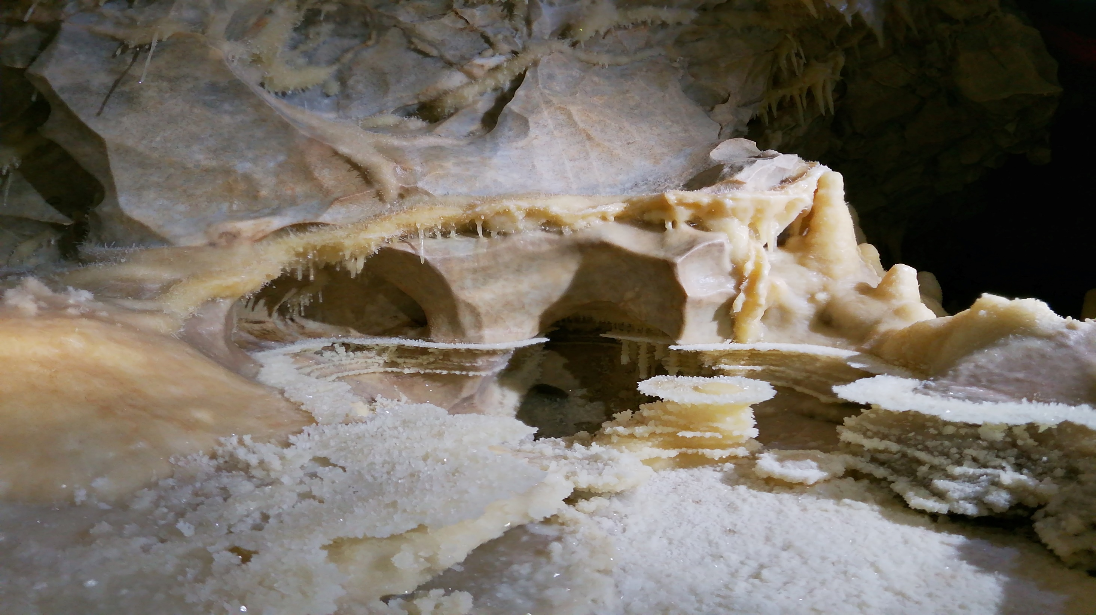
Diros Caves, Mani, Greece
Geo-ethical Thinking
How could geoscientists promote geo-ethical thinking?
Realize complexity / Intersection of different knowledge domains
Identification of each stakeholder’s management method
Adopt common tools nationally and in European perspective
Geosciences
Showcaves
complexity
Humanities
Social sciences
Goals
Managing showcaves as an entity
Synthesizing knowledge methods tools
Protection & Preservation

Slide 5
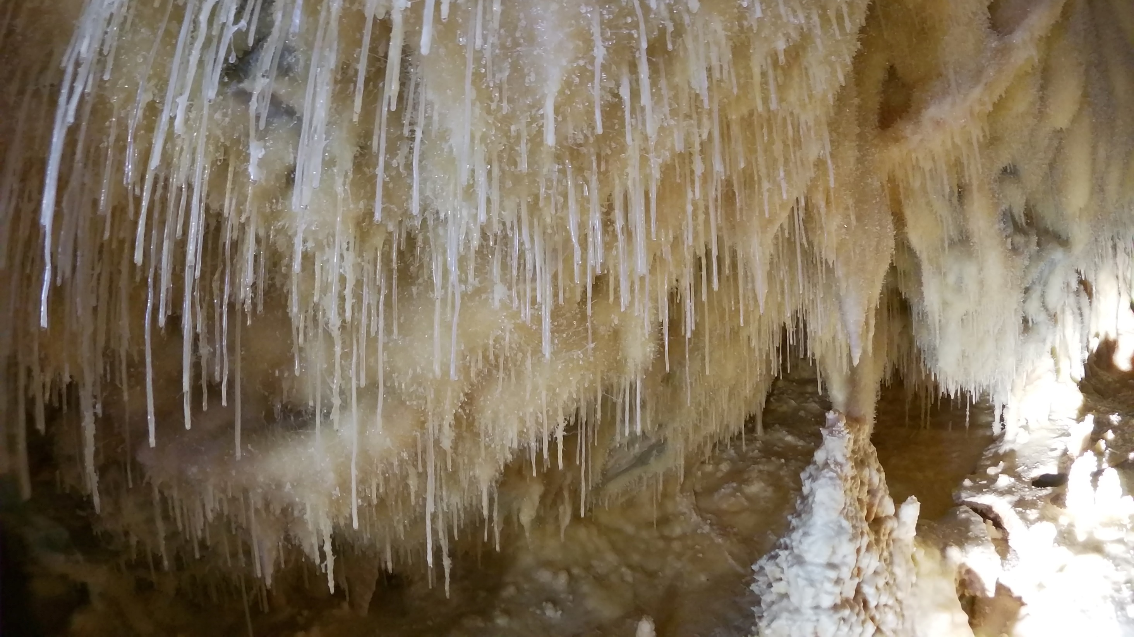
Diros Caves, Mani, Greece
Continuous environmental monitoring is the key for:
Developing an understanding of the spatial and temporal variation in parameters
Developing a baseline of conditions for the identification of the changes affecting the systems
Historical Data – extensive research on variations
Prerequisite is the legal obligation of monitoring
What could be monitored in a showcave?
CAVE METEOROLOGY: temperature, relative humidity, carbon dioxide and airflow
RUNNING WATER PARAMETERS: temperature, conductivity, pH, quality
NUMBER OF VISITORS
FAUNA / FLORA MONITORING
Identify if the changes are: Decide conservation Status:
Result of cave processes Take actions
Human impact Create guidelines / frameworks /
Management Actions vulnerability maps

Slide 6
Define Showcaves Management Bodies & Stakeholders
Implement Specific Monitoring Procedures and Applications
Mandatory implementation of good practices
Mitigation of degradation, good management practices
European and National Legislation alignment
Develop Scientific Methods and Tools, Conduct Evaluations and Assessments
Antonof Cave, Attica, Greece

Slide 7
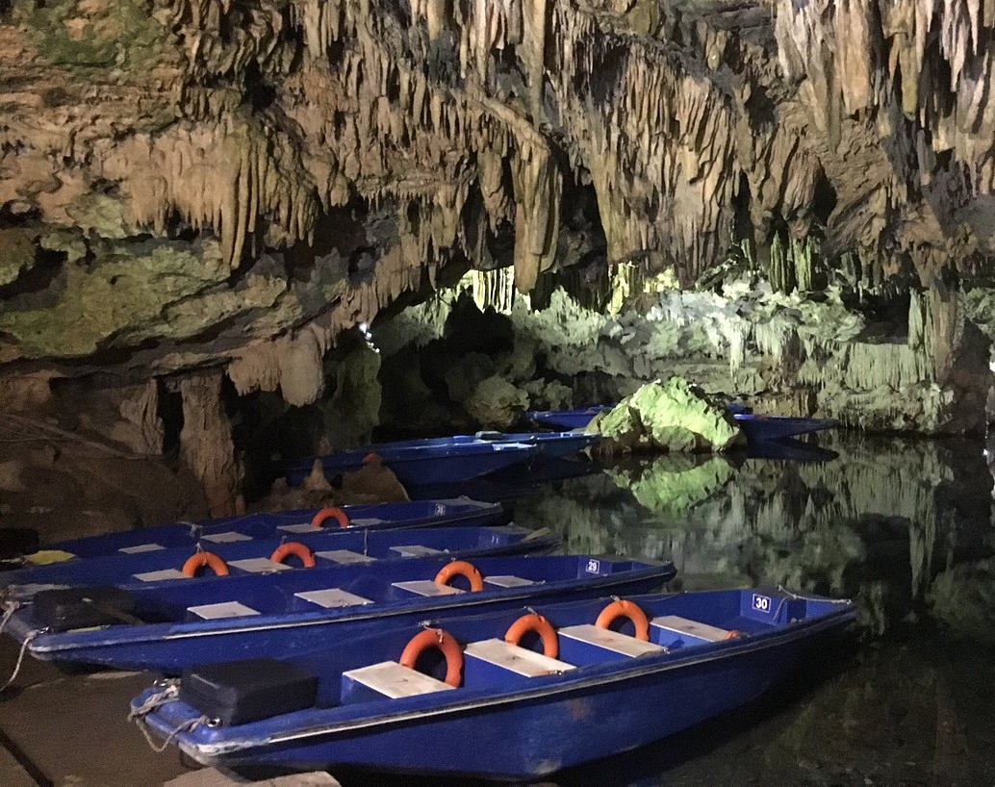
Thank you for your time
Diros Caves, Mani, Greece

