Slide 1





Cropping systems under climate change and adaptation in the Nile basin
Albert Nkwasa¹, Katharina Waha², Ann van Griensven^{1,3}
¹ Hydrology and Hydraulic Engineering Department, Vrije Universiteit Brussel (VUB), 1050 Brussel, Belgium
²CSIRO, Agriculture & Food, 306 Carmody Rd, St Lucia, QLD, Australia
³Water Science & Engineering Department, IHE Delft Institute for Water Education, 2611 AX Delft, The Netherlands

Slide 2
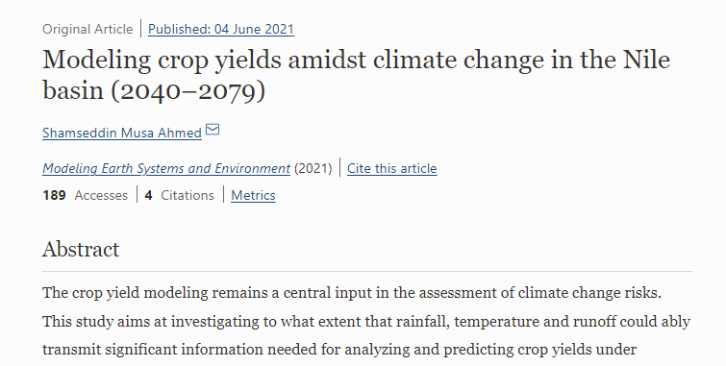
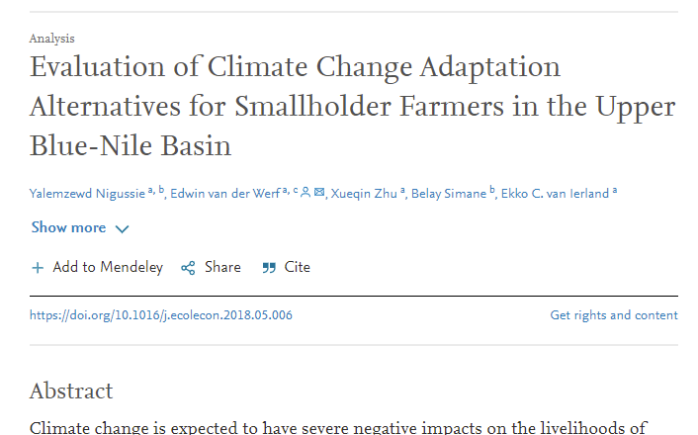
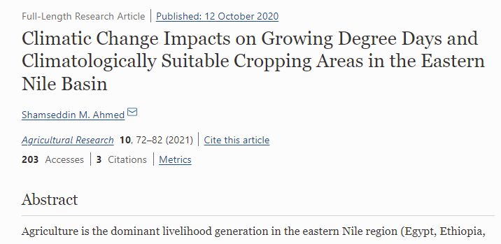
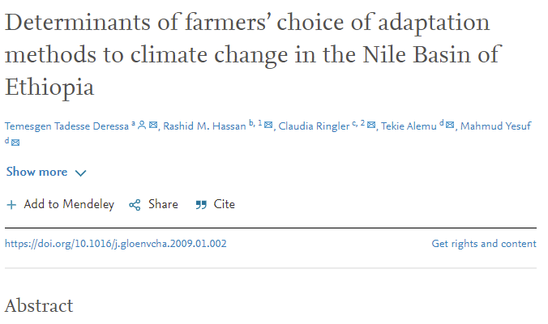
Atlas of agriculture under Climate Change – Nile basin
Overall negative effects on yields of major cereal crops
Notes:
Climate change poses a fundamental threat to agriculture within the Nile basin due to the magnitude of projected impacts and low adaptive capacity. Clearly shown by research!

Slide 3
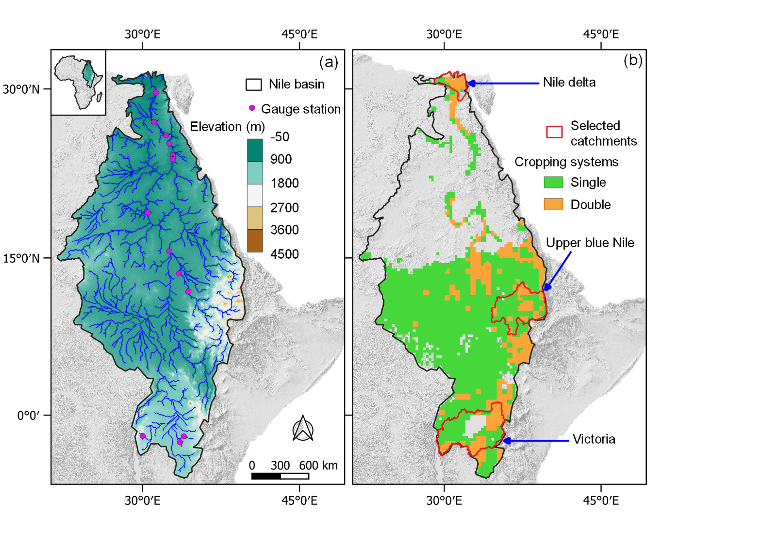
Nile basin at a glance
(a) Study area
(b) Cropping systems
36.3% of the crop area is under double cropping
Notes:
So far, climate change impacts on agriculture for the basin have mostly been assessed for single cropping systems, which may bias the results considering that the basin is dominated by different cropping systems, with about one third of the crop area under double cropping.

Slide 4
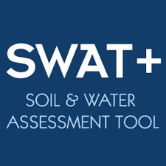




Impact modelling (Single vs Multiple cropping)
Regionally calibrated
(EPIC crop growth model)
No adaptation (Scenario A)
Harmonized Land use
(Hurtt et al. 2020)
Plant/Harvest dates
(Waha et al. 2020)
Climate forcing from 5 GCMs: ISIMIP 3b, CMIP6, SSP5-RCP8.5
Irrigated areas (Siebert et al. 2013)
Cultivar adaptation (Scenario B)
CO2 concentration (Büchner & Reyer, 2020)
Notes:
In this study for the historical and future period, we simulate single and double cropping systems in the Nile basin and assess the climate change impacts on the different cropping systems under two scenarios i.e., ‘no adaptation’ and ‘adaptation to a late maturing cultivar’. We simulate three important crops in the basin i.e wheat, maize and soybean.

Slide 5
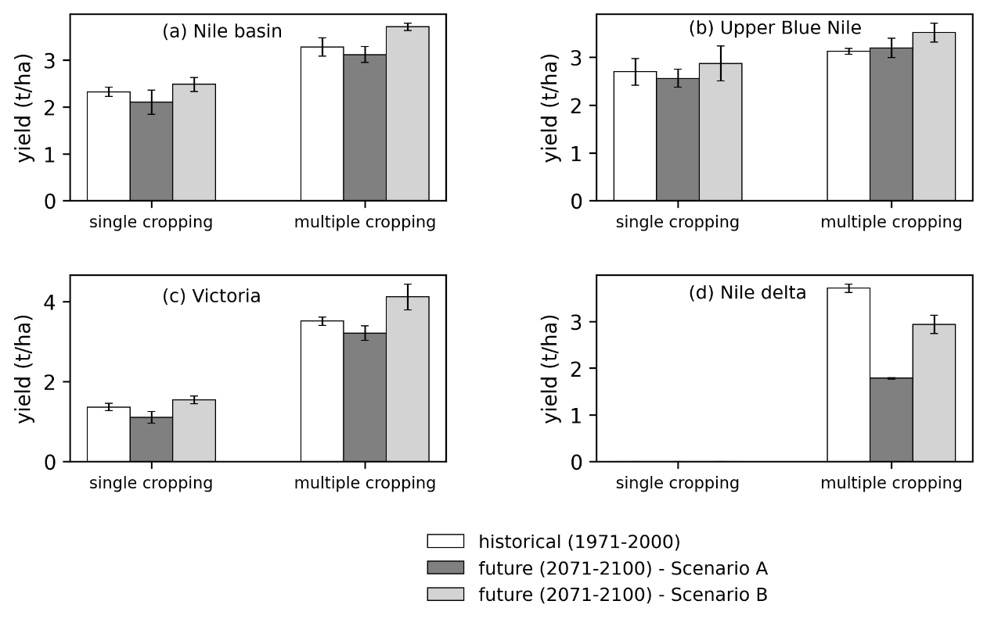
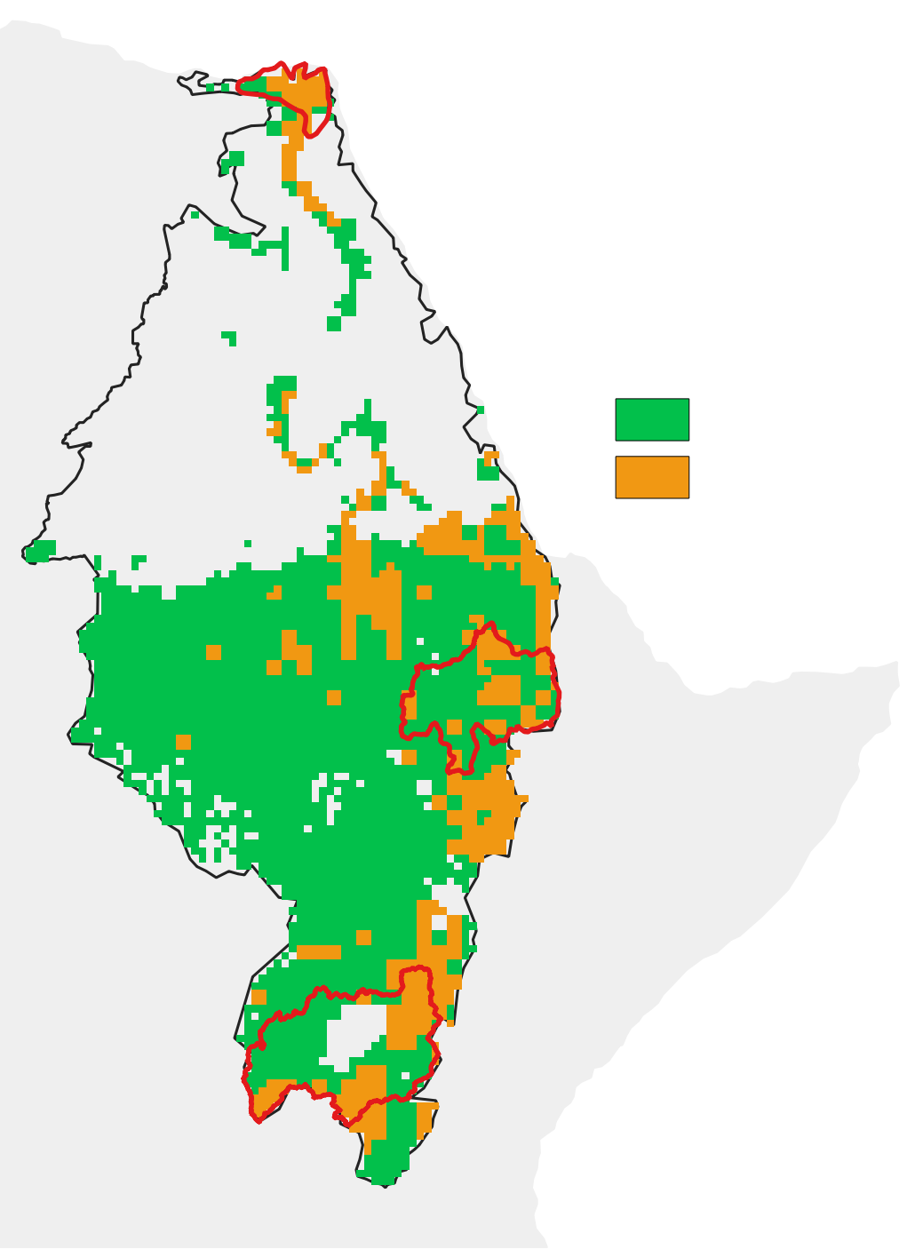

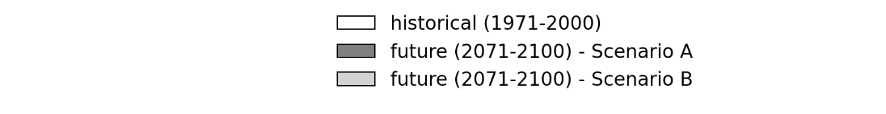
CC impact on crop yields & cropping systems
-19%
-53%
+15%
Cropping systems
-7%
Single
+12%
+6%
Double
+4%
-12%
+6%
-3%
+17%
-10%
+13%
-19%
Historical (1971 – 2000)
Future (2071 – 2100) –Scenario A (no adaptation)
Future (2071 – 2100) –Scenario B (cultivar adaptation)
Notes:
We find that the mean crop yields decrease by 12% and 7% in single and double cropping systems respectively with future warming without cultivar adaptation. We attribute this to the shortening of the growing season due to increased temperature.
Also at local all local scale basins, The decrease signal is stronger in all single cropping systems than in double cropping systems under future warming without cultivar adaptation. The relative magnitude of yield reduction varies spatially with the greatest reduction in the northern part of the basin with strongest warming. In a scenario with cultivar adaptation, the increase signal is stronger in double cropping systems than single cropping systems.

Slide 6
Summary
Different cropping systems respond differently to future warming.
Agricultural assessments should consider different cropping systems.
Farmers could possibly benefit from increasing cropping intensities while adapting to late maturing cultivars.
Notes:
-as different cropping systems respond differently to future warming, agricultural assessments should consider different cropping systems as an integral part of input data used by models to simulate crop yields and other indicators related to agricultural production.
-However, with double cropping systems and late maturing cultivars likely to be more resilient under climate change in the Nile basin, farmers should be aware of a trade-off between crop yields, production risks and resource availability

Slide 7




Cropping systems under climate change and adaptation in the Nile basin
(In review: Regional Environmental Change)
albert.nkwasa@vub.be / nkwasa.albert@gmail.com
Albert Nkwasa
@nkwasa99

