Slide 1
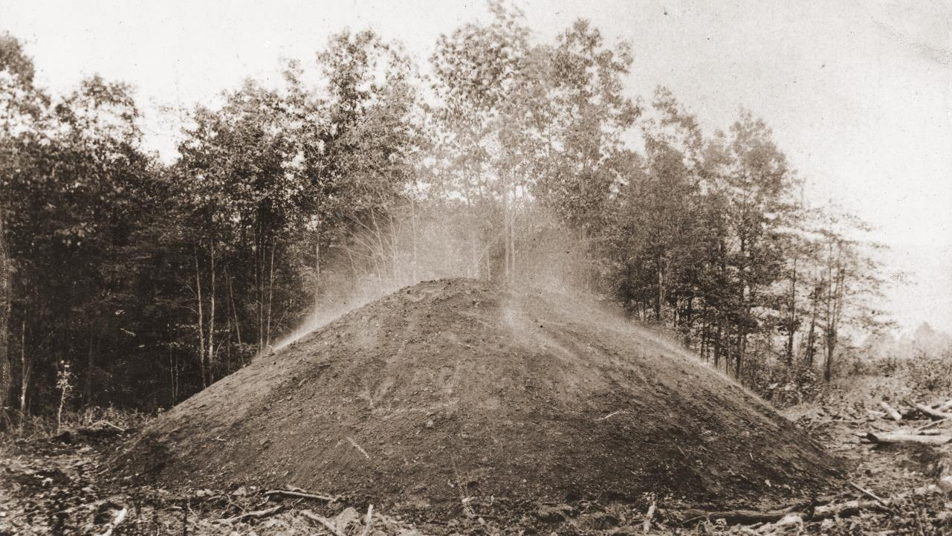



USA Appalachian relict charcoal hearths have complex landscape and pedologic patterns that are unique from surrounding forest ecosystems
Drohan P.J.¹, Bayuzick S.¹, Guarin D.¹, Raab T.², Bonhage A.², Hirsch F.², Diefenbach D.R.^{1,3}, McDill M.¹
1. Department of Ecosystem Science and Management, Pennsylvania State University, University Park, PA 16802, United States
2. Brandenburg University of Technology, Cottbus-Senftenberg, Cottbus, Germany
3. U.S. Geological Survey, Pennsylvania Cooperative Fish and Wildlife Research Unit, Pennsylvania State University, University Park, PA 16802, United States
2 papers in review, Geomorphology Special Issue
This work was supported by the USDA National Institute of Food and Agriculture and McIntire-Stennis Appropriations under Project #PEN04718 and Accession #1020584.
Notes:
Hello Everyone,
Thank you for joining me today. My name is Samuel Bayuzick and I’ll be defending my thesis entitled “Unique Hydrologic, Chemical, and Physical, Properties of Relict Charcoal Hearths”

Slide 2
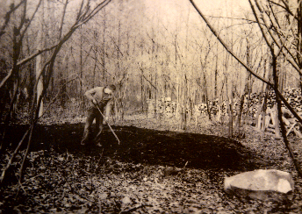
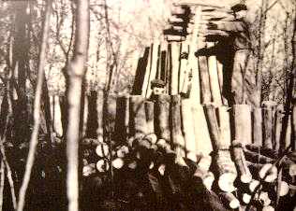
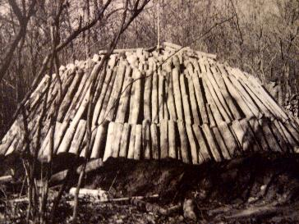
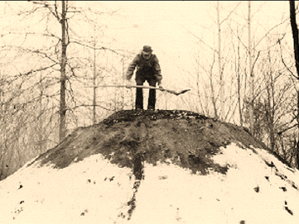
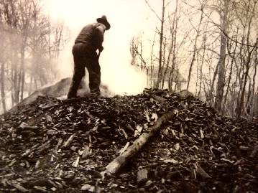
Charcoal Pit Anatomy
Site Clearing
Stacking wood into a charcoal pit
Relict Charcoal Hearths
Uncovered charcoal pit
Tending to a soil covered charcoal pit
Gathering the charcoal
Historic Image Sources: National Park Service,1936
Hopewell Furnace demonstration
Diagram Sources: DNCR, 2019
Notes:
Here is the anatomy of an Appalachian charcoal hearth. To create one, first the site is cleared and a platform is created by removing and transporting material.
Wood is then stacked into a dome shape and is covered by soil. The wood is then smoldered for 1 – 2 weeks. Crack is then removed by raking after first removing the soil cover.

Slide 3
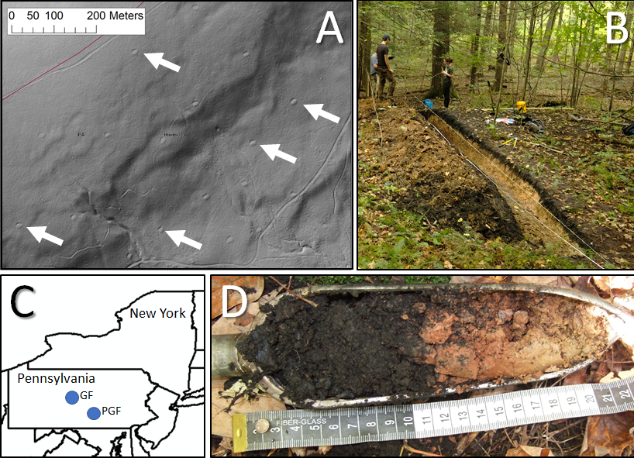
Striking Relief
Study Areas

Slide 4
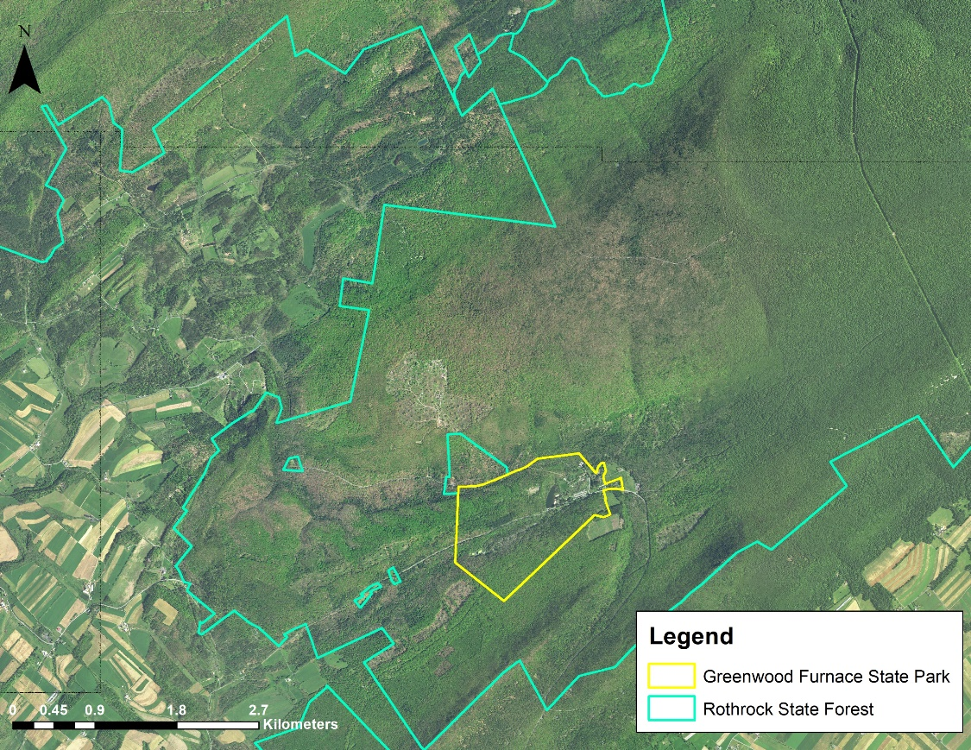
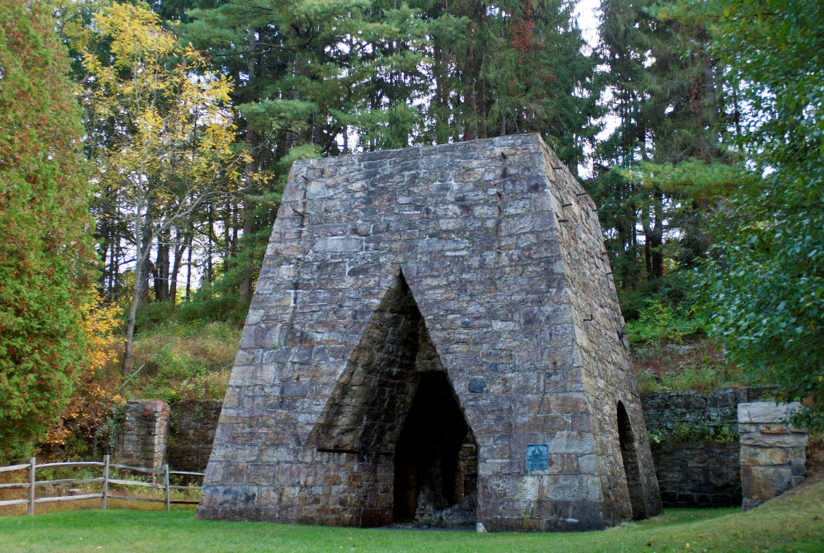
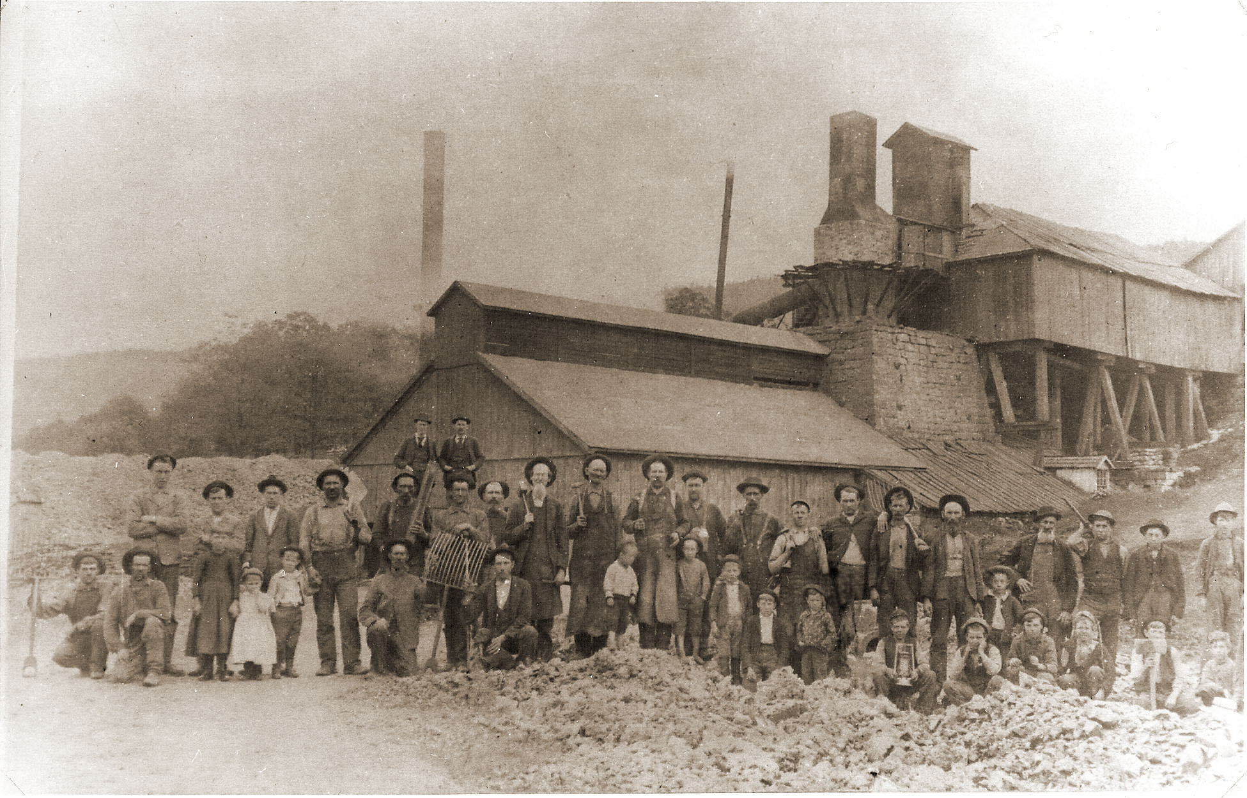
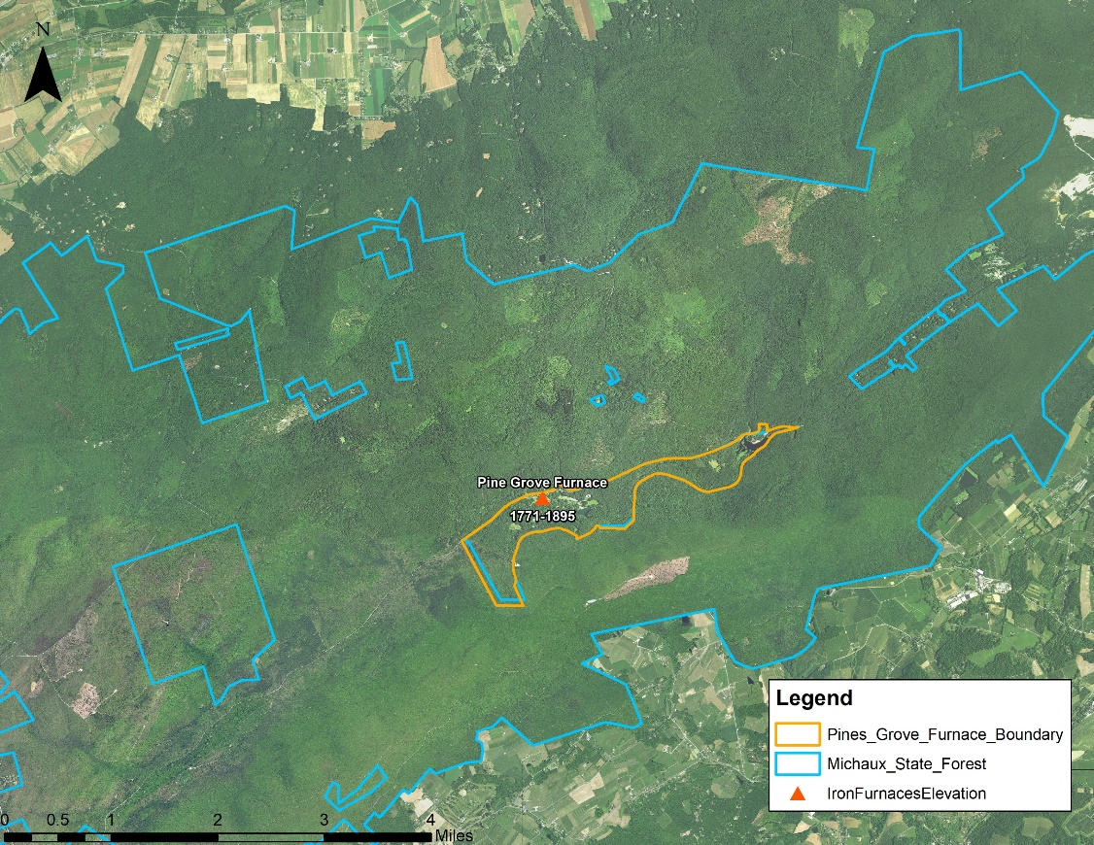
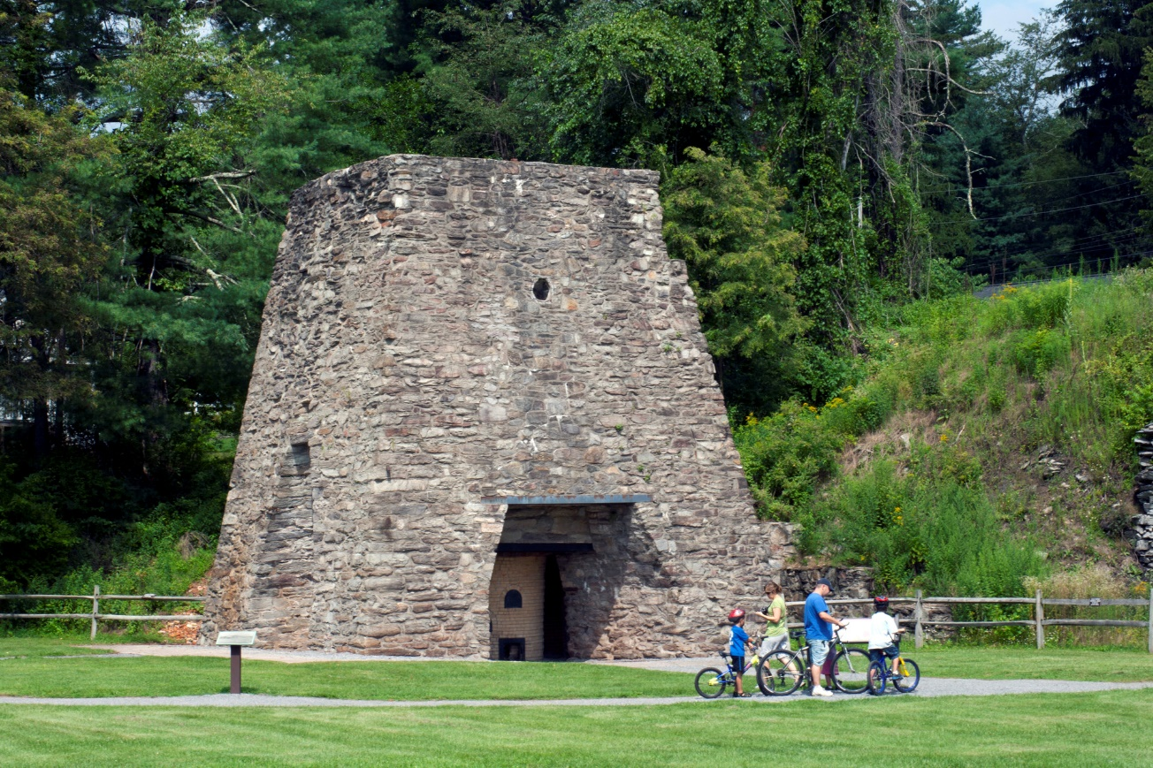
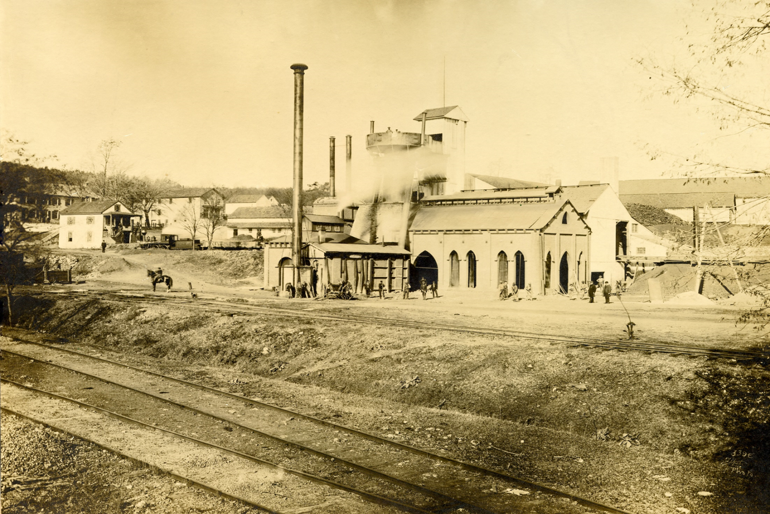
Greenwood Furnace State Park and the surrounding Rothrock State Forest
Geology: Ridges of quartzite, quarzitic sandstone, and shale whereas valleys are comprised of less resistant sandstone, siltstone, shale and limestone
Soils: Typic Hapludults, Typic Fragiudults, Typic Fragiaquults, Aquic Fragiudults, Aquic Fragiudalfs, Typic Dystrudepts, and Entic Haplorthods
Pine Grove Furnace State Park and the surrounding Michaux State Forest
Study Areas
Geology: Ridges of quartzite, quartzose conglomerate with lower elevation hills and valleys of metarhyolite and valleys of dolomite
Soils: Typic Hapludults, Typic Fragiaquults, Aquic Fragiudults, Aquic Fragiudults, Ultic Hapludalfs, and Typic Dystudepts
Notes:
Soils and lithology of the 2 study areas

Slide 5
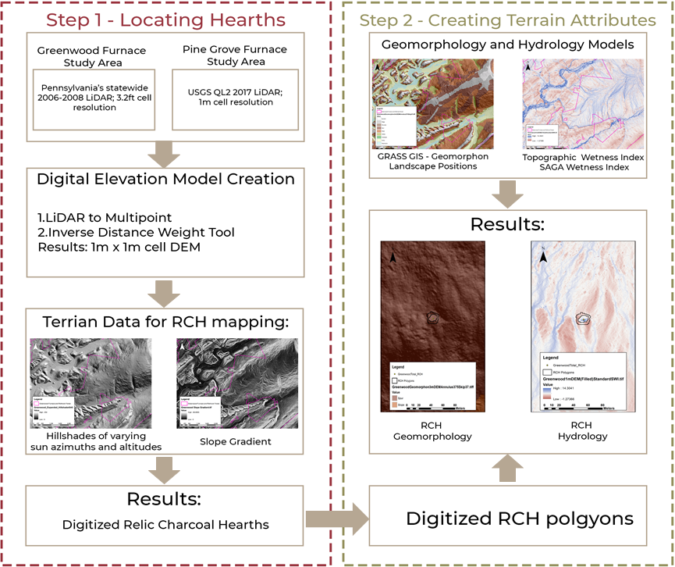
RCH modeling procedure

Slide 6
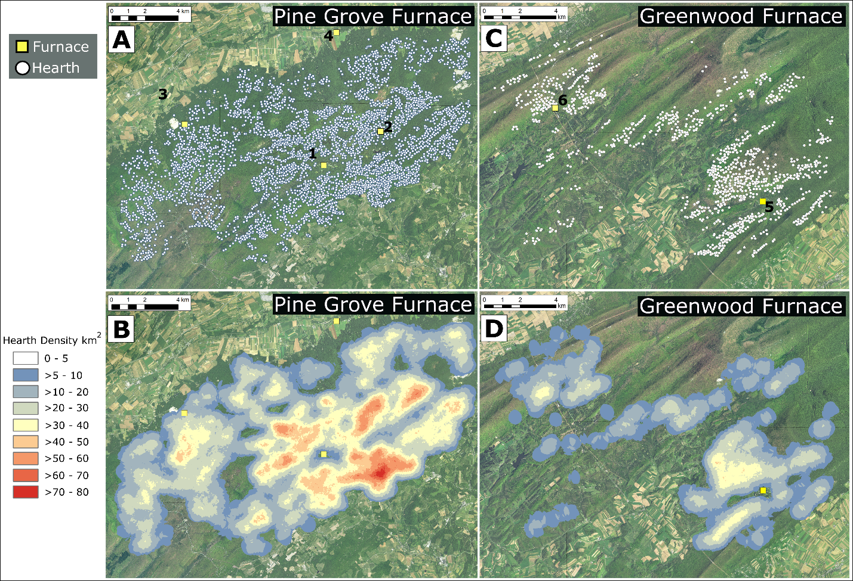
Study Area Hearth Density
4,140 RCHS at an average density of 26.2 km². Within 3 – 4 km of PGF the RCH density >70 per km²
1,200 RCHs, density of 11.8 km². Within 3 - 4 km of GF density increases to over 30 RCH per km²
Notes:
While the occurrence of RCHs in the vicinity of Greenwood Furnace has been known for decades, their number or extent has not been documented. Results from this study suggest there are over 1,200 RCHs in the Greenwood Furnace area and RCHs occur at an average study-wide density of 11.8 km². Within 3 - 4 km of the Greenwood Furnace the density of RCH features increases to over 30 RCH per km². A total of 4,140 RCHS were found in the vicinity of Pine Grove Furnace at an average density of 26.2 km². Within 3 – 4 km of Pine Grove Furnace RCH density can be over 70 per km².

Slide 7
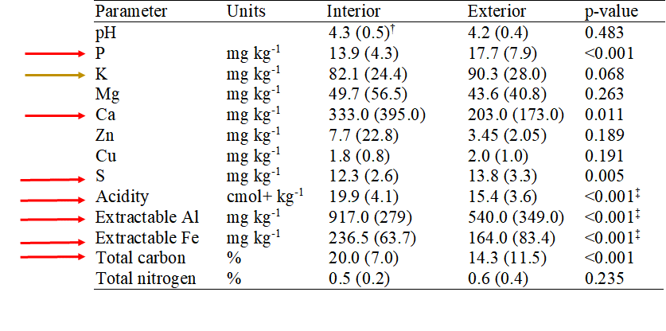
Chemical Differences
Notes:
1.The results of the fertility analysis on the soil samples from the Greenwood field study indicate that RCHs have significantly higher mean % Total Carbon compared to exterior areas. This is due to the increase in carbon content from charcoal enrichment of the soil.
2.Mean Mehlich III extractable Aluminum and Iron in RCH soils is significantly higher than exterior areas.
3. Mehlich III Phosphorus and Sulfur are significantly lower in RCH soils
4. but Mehlich III Calcium is significantly higher.
5. Soil acidity and CEC are significantly higher in RCH soils as compared to exterior areas but the % Potasssium on the exchange complex is significantly lower. The increase in acidity of RCH soils cannot be attributed to hydrogen ions as there is no significant difference in pH between RCH and native soils.
6. This means that the increase in acidity on RCH soils must from an increase of bound Al ions bound to CEC sites. The Mehlich III extractable Al in RCH soils of this study is significantly higher than the surrounding soils further substantiating an increase in active aluminum within the RCH soils from soil acidity results. Aluminum in RCH soils could, if high enough, limit some vegetation production by limiting root growth and inhibiting nutrient uptake

Slide 8
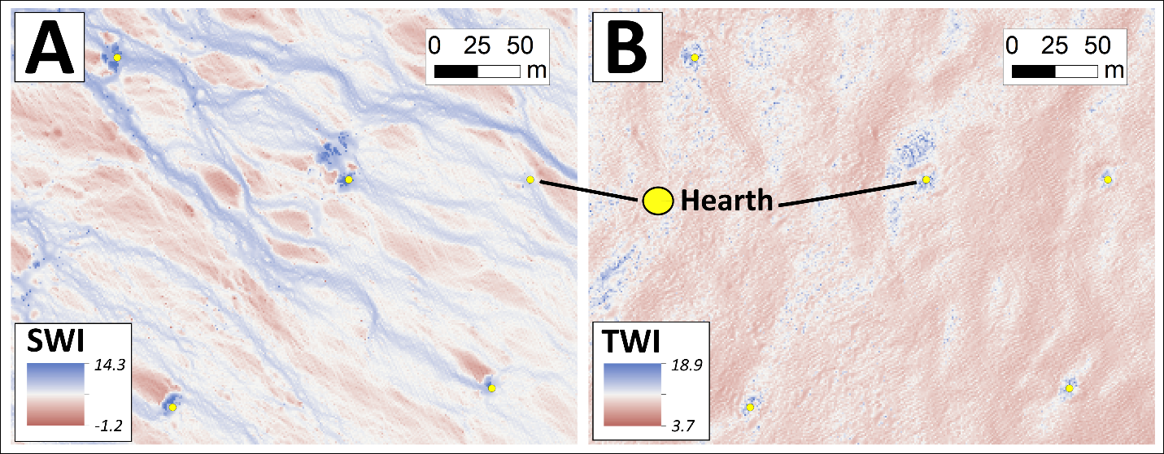
Example wetness index models reflecting how hearth construction may influence immediate RCH location, and surrounding, hydrology. Yellow ovals are center points of hearths. A. SAGA software wetness index; and B. ArcMAP topographic wetness index. Upslope is to southeast and downslope to northwest.
Notes:
Modeled wetness indexes indicate that RCH interiors are significantly wetter than RCH rim areas; RCHs are acting as a landscape moisture sink. Results also indicate that RCHs on slopes result in downslope drier conditions below RCHs. Field measured volumetric water content indicates that as distance from the center of the hearth increases, soil moisture significantly decreases. Geomorphic position was found to not be related to RCH wetness. Soil from RCHs, compared to nearby native soils, has significantly higher total C, a lower Mehlich 3 extractable acidity, higher Ca and P. No trend was evident with RCH soil chemistry and geomorphic position.
The RCHs in this study had interior TWI and SWI values reflecting wetter conditions as compared to outside RCHs. In addition, TWI and SWI values indicate that the RCH rim is drier than the RCH interior. Results from this study highlight the unique hydrologic characteristics of RCHs over a short spatial extent but also point to a broader ecosystem effect given that the construction of RCHs was also shown to be affecting the overall landscape surface hydrology. TWI and SWI ANOVA results of RCHs across geomorphic positions suggests that no matter what landscape position (see Figure 8 to see TWI values in high relief vs low relief landscape positions), RCH interiors are wetter. This trend indicates the stability in RCH construction despite erosional forces on differences in slopes.

Slide 9
Paired t-test results of modeled SWI or TWI values between RCH rim and interior polygons (Interior-Rim). A. Greenwood subset dataset n=84; B: Greenwood field study dataset n=51; C: Pine Grove subset dataset n=374.
wetter
wetter
wetter
Notes:
We infer from the shapes of RCHs found in this study that RCHs influence wetness primarily because of (a) their morphology and (b) substrate properties. Steep RCH rims can quickly shed water into the RCH interior where it infiltrates; percolation may be limited by subsurface horizons with dissimilar particle sizes, or carbon contents, that result in water slowing at boundaries with below native soils. The water holding capacity in RCHs can be be further amplified by the typically higher total carbon contents in hearths (Hirsch et al., 2018a; Hardy et al., 2016, 2017; Kerré et al., 2016; Borchard et al., 2014; Bonhage et al., 2020b; Schneider et al., 2020b), which would further increase the soil’s water holding capacity in comparison to surrounding areas. Results from this study also show that RCH VWC is variable across a lateral gradient of the RCH, and to the area outside the RCH, with soils becoming dryer towards the RCH rim. This difference in VWC between the center of the RCH, the rim, and exterior area further indicate the effects of RCH surface morphology in area hydrology. Previous research has noted that the soil water content of RCHs can be higher than surrounding reference soils but also variable across a singular RCH site or between multiple RCH sites (Schneider et al., 2020b). Hearths, while having different VWCs (this study), have also been shown to drain quickly (Schneider, 2020b), potentially due to large porosity or preferential flow paths (Schneider al., 2020b).

Slide 10
Tukey ANOVA comparisons of field volumetric water content (VWC) by sample position in the Greenwood field study dataset.
 | n | VWC (%/%)
RCH Sample Position
Center | 51 | 24.0 (6.3)†a‡
Halfway | 51 | 22.3 (4.0) ab
Rim | 51 | 20.7 (4.3) b
Outside | 51 | 21.5 (4.3) b
wettest
wetter
driest
drier

Slide 11
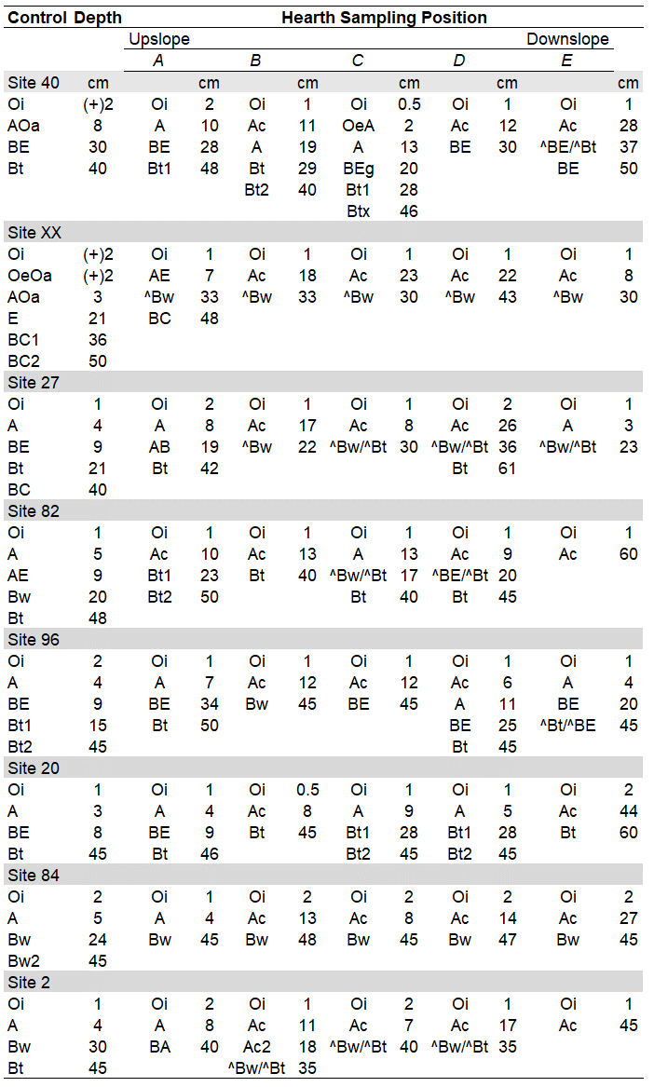
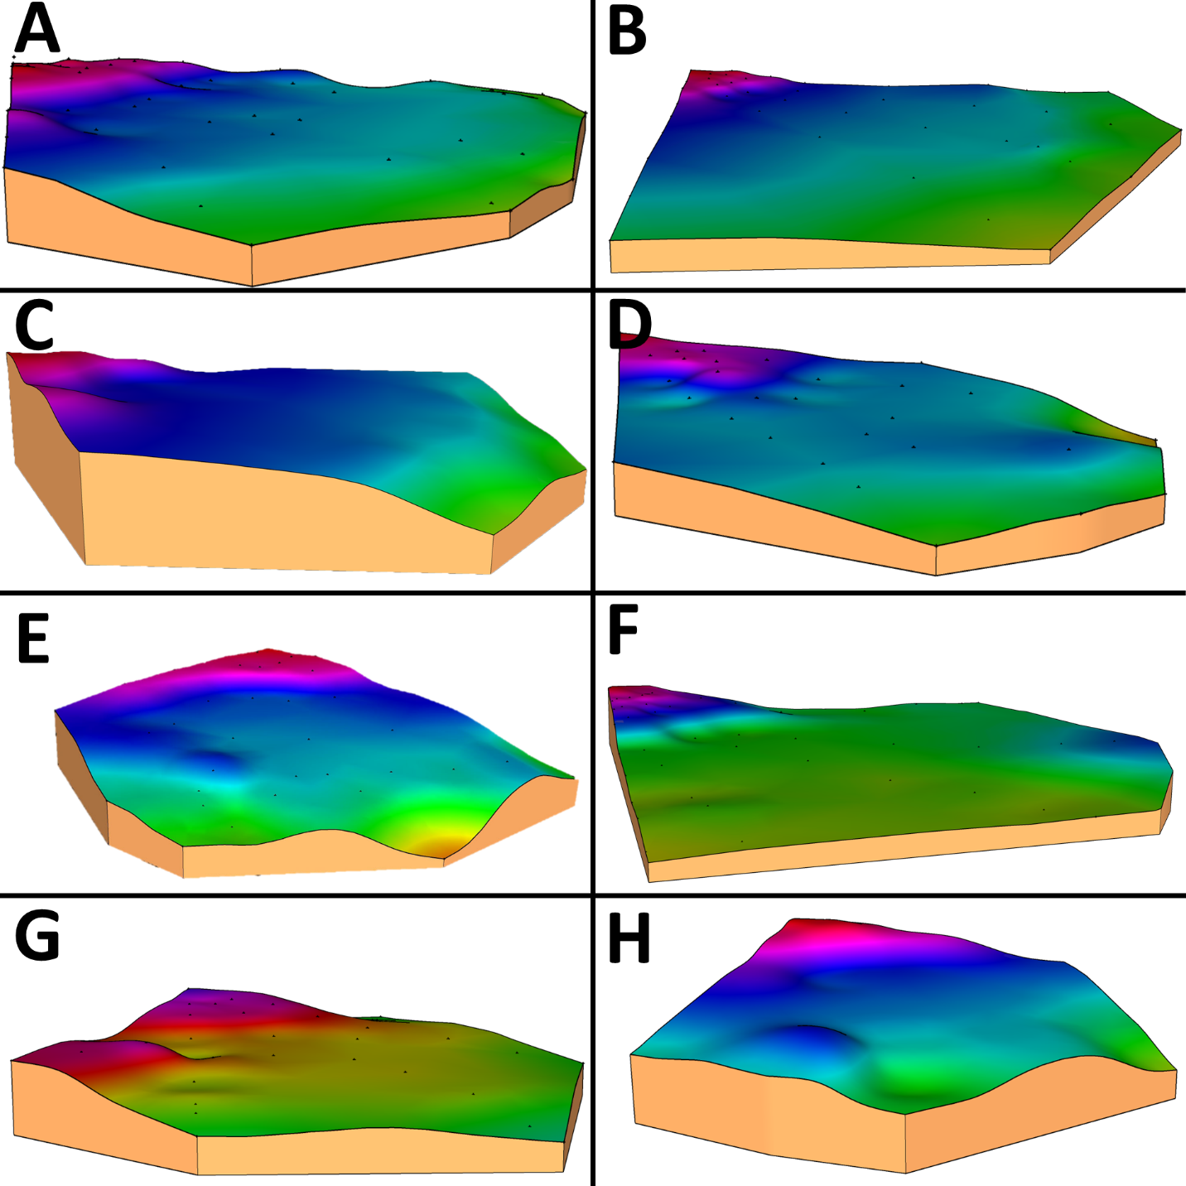
Slope: 18%
6%
27%
8%
10%
23%
14%
44%
Notes:
Example Field surveys with a transit, level and grade rod revealed differences in RCH shape, which we hypothesize is due to inherent landscape geomorphic differences that drove hearth design. We examined soil stratigraphy across 8 hearths (and control soils) on different landforms near Greenwood Furnace. Soils were analyzed for particle size, total and trace elements, and fertility.
Hearth soil morphology at Greenwood Furnace reflects the construction techniques and resulting pedogenic development. Given the steeper landscape positions where RCHs were created on Inceptisols, larger volumes of soil material were moved, compared to Ultisol positions, to create a flat platform for charcoal production. During platform creation on steeper sloped areas, soils from upslope positions were mixed with subsurface materials on the downslope side. In comparison to native soils, Greenwood Furnace RCHs have a mixed matrix of both Bt and Bw horizons (indicated in Table 2 as a Bw/Bt) and shallow Bt horizons (suggesting surface horizon removal). The use of transported materials and mixed matrices soil stratigraphy (symbols ^ and / in Table 2) is often found in RCH soil profiles on steeper slopes (Sites 2, 27, 96, 100). The effect of having transported materials and mixed matrices can also be found on some shallower sloped RCHs in the E sampling position indicating a buildup of the downslope rim to finish the platform creation. The one layered nature of charcoal rich Ac (Auh) horizons supports the idea that Greenwood RCHs were not used more than once for charcoal manufacturing, since, unlike RCHs examined in Connecticut, USA by Bonhage et al. (2020), Raab et al. (2017) and Hirsch et al. (2017), or in Pfälzerwald, south-western Germany (Stolz and Grant, 2010), Greenwood Furnace RCHs lacked multiple charcoal horizons.

Slide 12
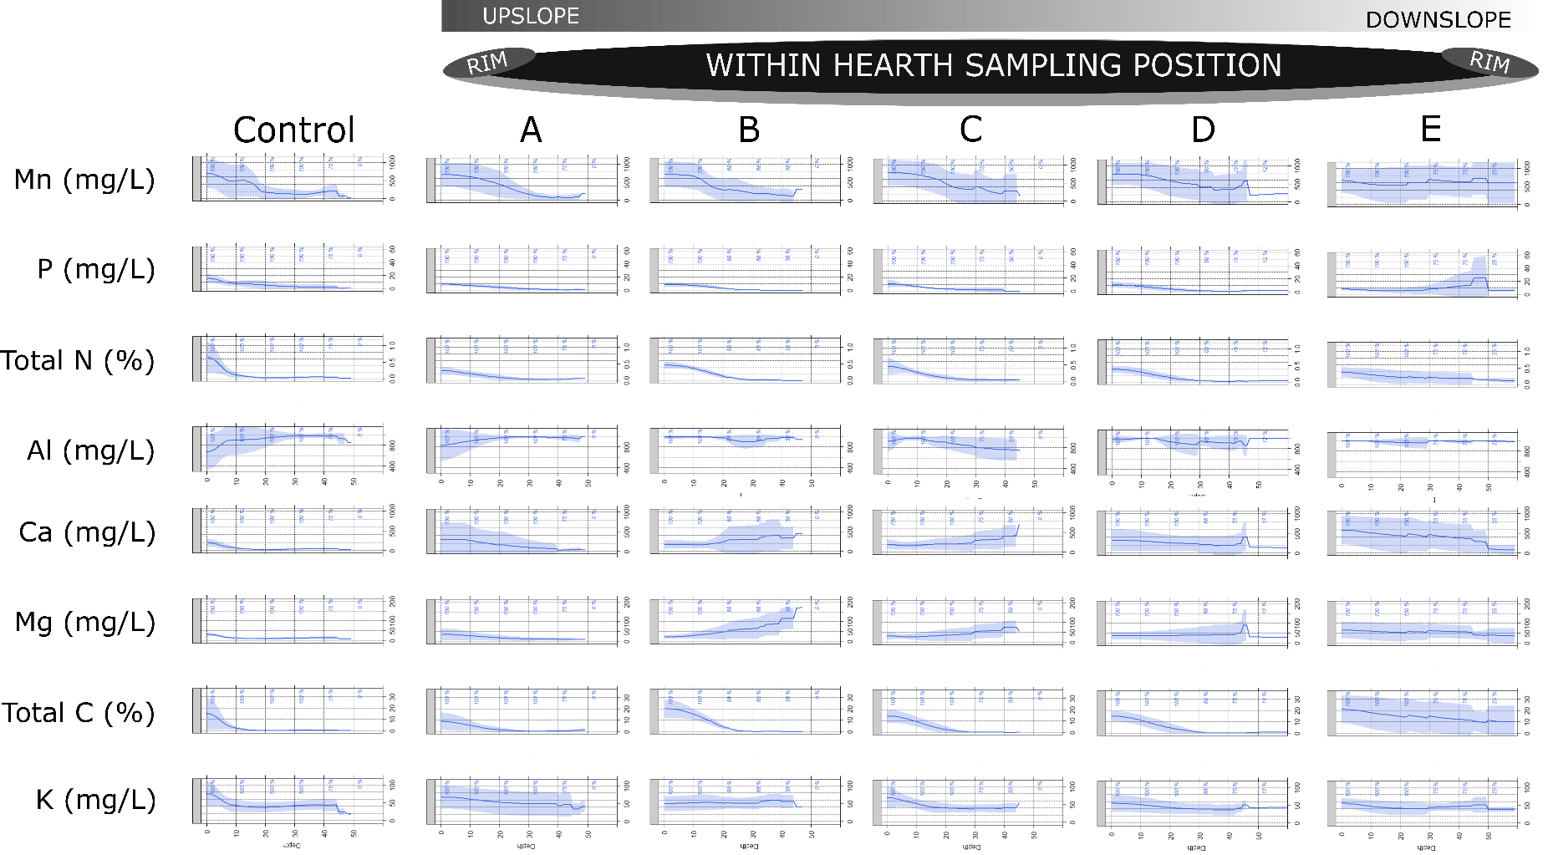
14.
Chapter 2 Results: Soil Chemistry
Notes:
We examined soil stratigraphy across 8 hearths (and control soils) on different landforms near a 19th century furnace complex (Greenwood Furnace, northcentral Appalachians USA). Soils were analyzed for particle size, total and trace elements, and fertility.
Greenwood Furnace RCHs have unique within hearth patterns of chemistry, which could result in unique within RCH niches for flora and fauna. Our results suggest a general pattern where downslope RCH positions had higher concentrations of several soil parameters compared to control soils (total C, Mehlich 3 Mg, and Ca, and Agua Regia digestion Mn) and that higher concentrations graded from the surface downward. Downslope RCH positions, D and E especially, show the largest differences in concentration or variability compared to control soils. However, not all parameters exhibit the same pattern (e.g., Ca or total C, versus P). The increase in RCH surface soil concentrations (A or Ac) especially may indicate enrichment due to the charcoal creation process where nutrients found within the wood of the trees used in the charcoal process were released. Pulling of charcoal across the RCH, and downslope, compounded by long-term shallow water movement within an RCH, could have caused the E sampling position to be the most enriched with Ca and Mg.

Slide 13
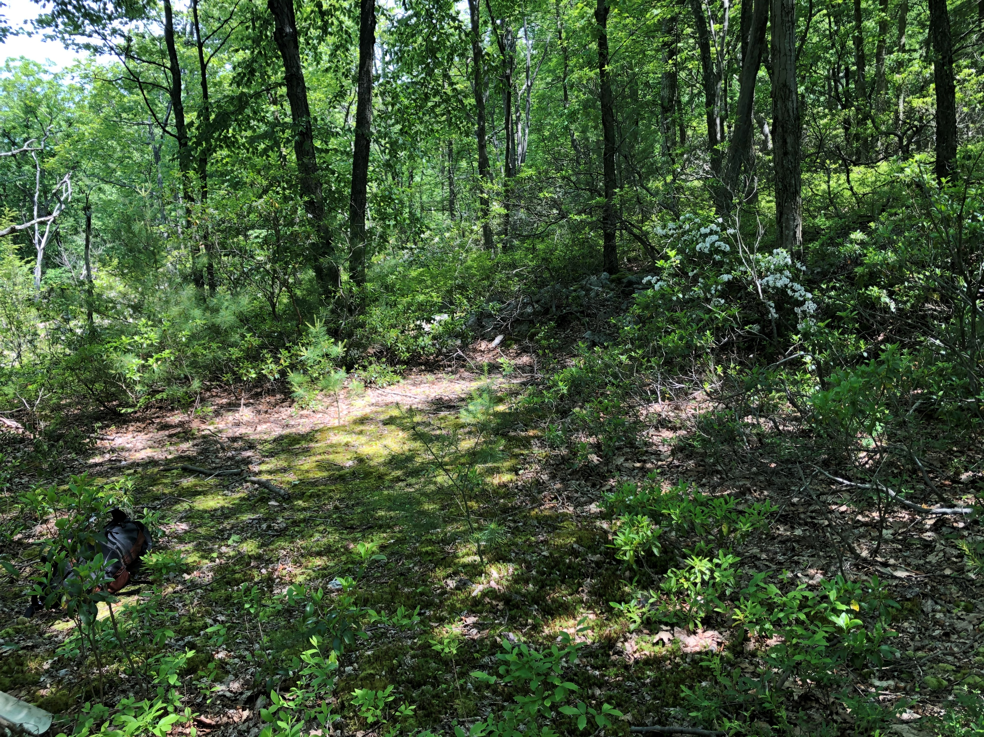
The density of RCHs at both study areas was typically greatest closest to furnaces.
Low SWI and TWI rim values, coupled with high TWI and SWI values within RCH interiors, suggest that RCHs have a unique landscape hydrological footprint and can act as soil moisture sinks.
Field VWC data confirm wetness index modeling results. Modeling SWI and TWI, in and around RCHs, also shows that RCHs could deflect surface water movement.
Conclusions

Slide 14
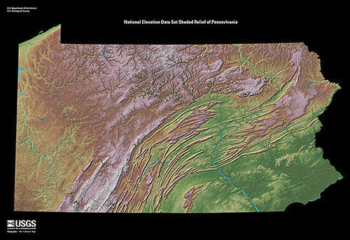
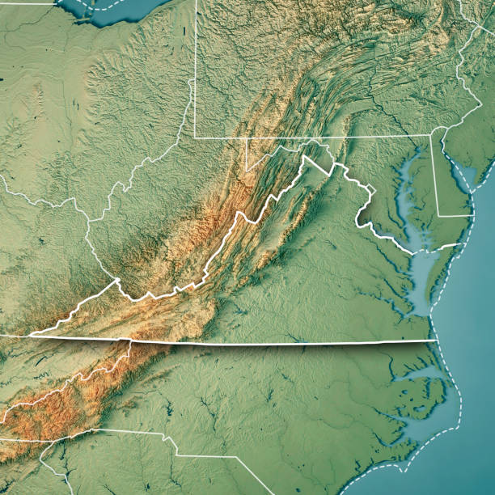
Hearth Characteristics Heavily Influenced by Relief
Conclusions
Notes:
Pennsylvania relief a challenging characteristic to overcome when manipulating landscapes for activities like hearth creation

Slide 15
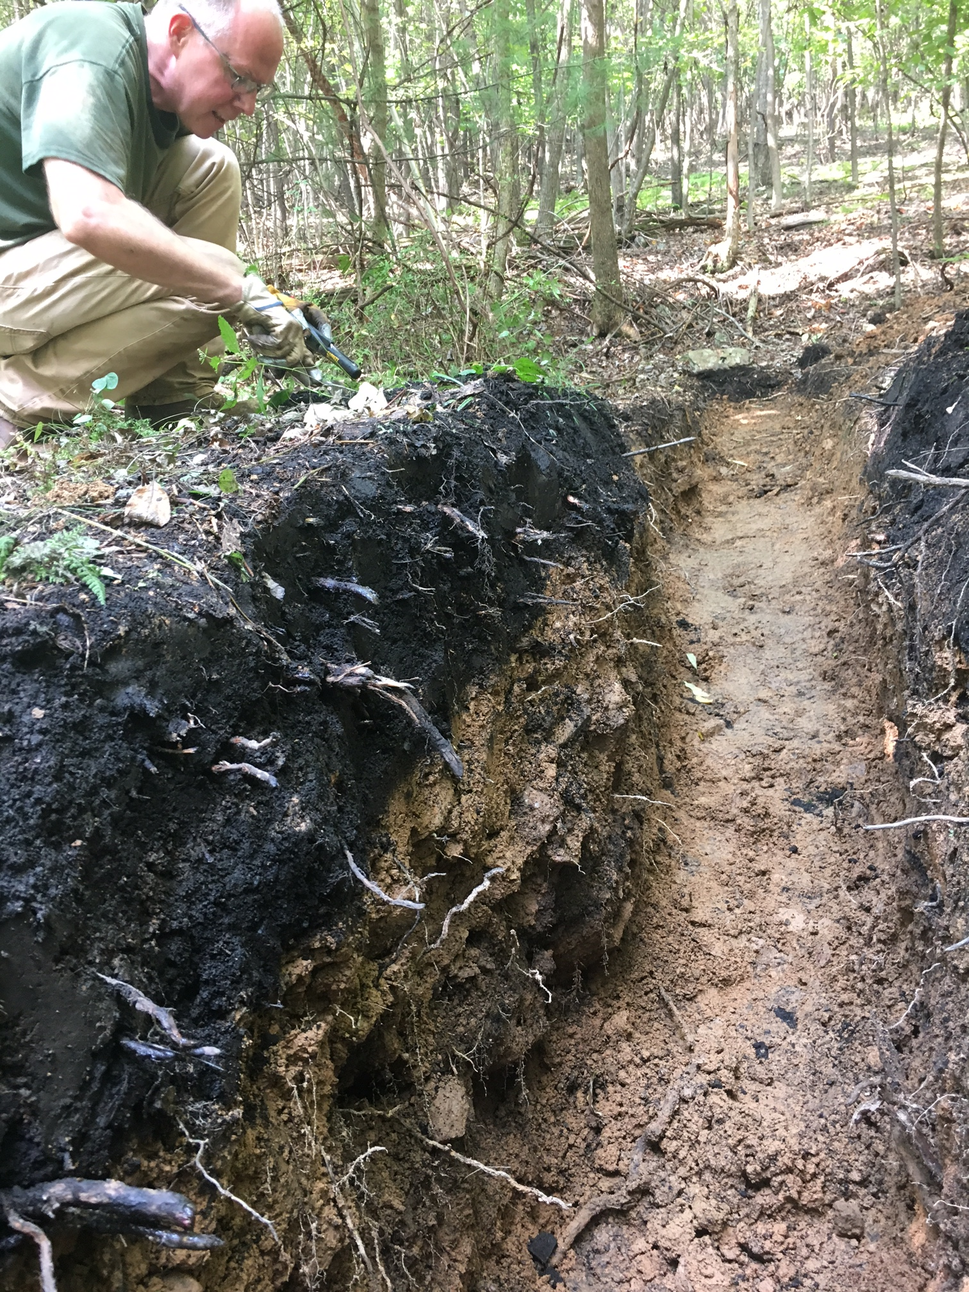
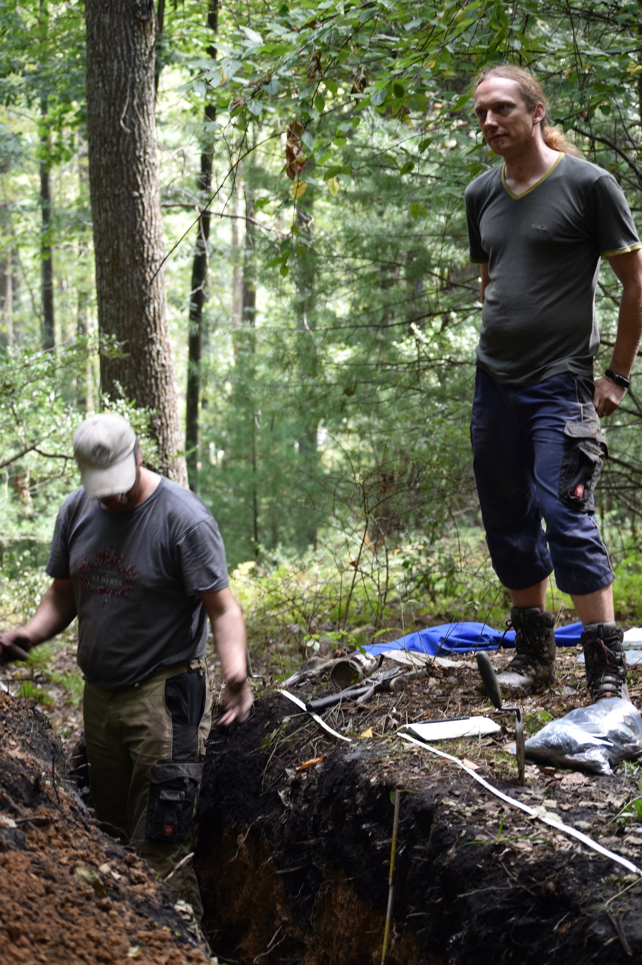
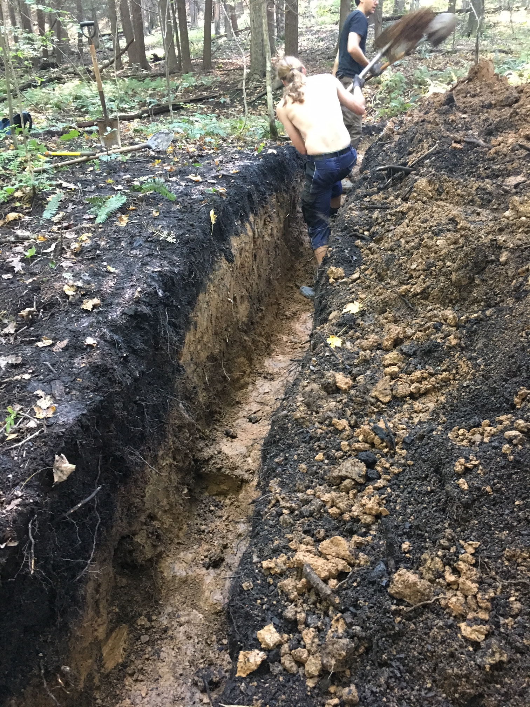
Platform creation resulted in soils from upslope RCH positions mixed with subsurface materials on the downslope side to create a stabilized platform.
The thin, uniform thickness of charcoal surface horizons (Ac) suggests that RCHs were not used more than once for charcoal manufacturing or that charcoal was always removed very efficiently.
Conclusions
Downslope RCH positions are enriched in some parameters compared to control soils and that enrichment often is from the surface downward.
Notes:
We examined soil stratigraphy across 8 hearths (and control soils) on different landforms near a 19th century furnace complex (Greenwood Furnace, northcentral Appalachians USA). Soils were analyzed for particle size, total and trace elements, and fertility.

Slide 16
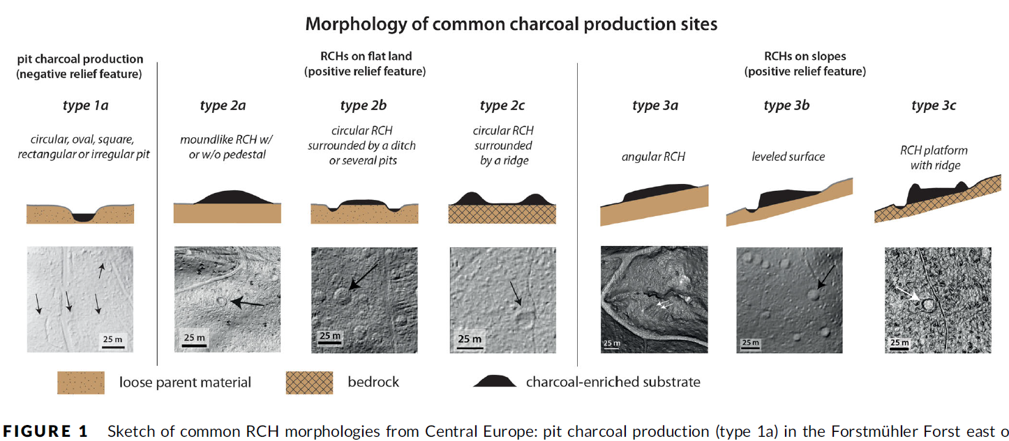
Downslope enrichment within RCH soils may have occurred from:
  charcoal and released ions,
  slope erosion and accumulation, or
  transportation of constructed materials during RCH creation. *Landscape position may accentuate or mute soil chemistry differences.
Hirsch, F., Schneider, A., Bonhage, A., Raab, A., Drohan, P.J. and Raab, T., 2020. An initiative for a morphologic‐genetic catalog of relict charcoal hearths from Central Europe. Geoarchaeology, 35(6), pp.974-983.
Conclusions
Notes:
The RCH morphology found at Greenwood Furnace is most like the “Type 3b” RCH on a slope morphology described in Hirsch et al. (2020). The RCHs at Greenwood Furnace, all on some type of sloped landform, had upslope material pulled downslope to create a flattened platform that wood was stacked upon. Unlike the RCHs described by Hirsch et al. (2020) or seen in Hirsch et al. (2017), Raab et al., (2017), and Donovan et al., (2021), there was no ditch that surrounded the downslope rim.
The lack of a ditch in RCHs at Greenwood Furnace could indicate a cultural difference in the colliers in Pennsylvania, compared to elsewhere, or it is possible that the slopes were steep enough to shed water quickly without extinguishing the charcoal creation process. The RCHs found in the Greenwood Study area were not found to have boulders on the downslope side like those seen in RCHs studied by Raab et al. (2017). Boulders seen on downslope sides of RCHs in Raab et al. (2017) are believed to have been used during a second burn to increase stabilization on the downslope rim. Why boulders were not used in this manner at Greenwood Furnace is not known, but again could be a cultural difference between the colliers, an indication that the RCHs were not used multiple times, or a sign of simple erosional forces burying the boulders used to reinforce the downslope rim

Slide 17
RCH wetness and patterns of chemistry could result in unique niches for flora and fauna.
Future research could more closely investigate whether RCHs support unique species assemblages and how they may play a role in today’s forest biodiversity.
Conclusions
Thank you

