Slide 1

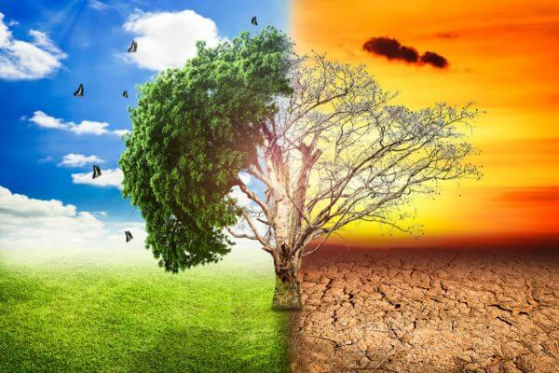

Global analysis of extreme precipitation changes in the Köppen-Geiger climate classification
May 25th
EGU22: HS7.7
Salma Hobbi ,Sofia Nerantzaki, Simon Michael Papalexiou, Chandra Rupa Rajulapati

Slide 2


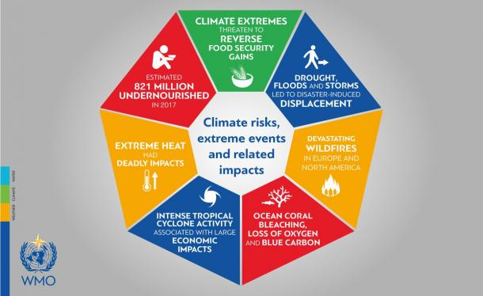
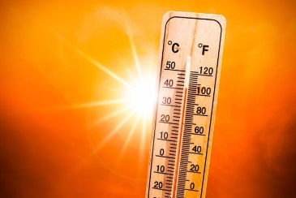
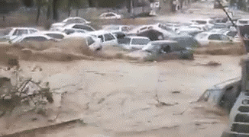
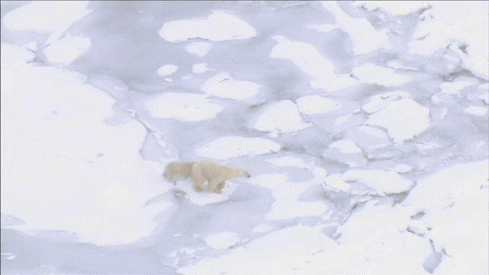
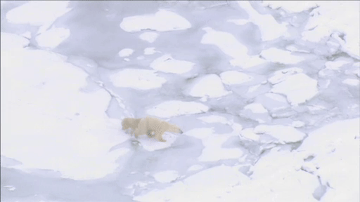
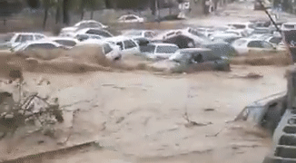
Introduction
‘l
Deadly flash flood struck Shiraz, Iran
March 2019
http://floodlist.com/asia/iran-flash-floods-shiraz-march-2019
Loss of ice pack, Alaska
https://www.pbs.org/wnet/nature/bears-of-the-last-frontier-video-losing-pack-ice/6991/
World Meteorological Organization (WMO)
https://public.wmo.int/en/media/press-release/wmo-addresses-un-security-council-first-time
2

Slide 3
Knowledge Gap
‘l
3

Slide 4
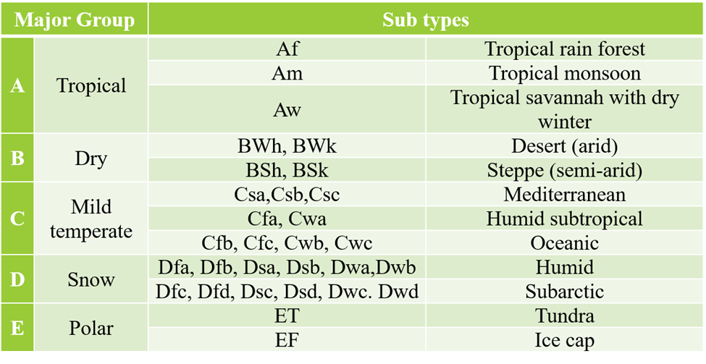

Methodology
Data
GHCN2 daily precipitation station records
1964 to 2013
Koppen-Geiger (KG) Climate classification
Analysis
Extreme precipitation characteristics
Assessment on Annual Maxima Precipitation (AMP)
Trends (slope and significance)
  Magnitude: Sen’s slope estimator
  Significance: Mann-Kendall Test ($α$=0.05)
Heaviness of tail
    Shape parameter of Generalized Extreme Value Distribution ($γ_{GEV}$)
01
03
02
Associate climate type
Koppen-Geiger climate Classification (Beck et al.2018)

Slide 5
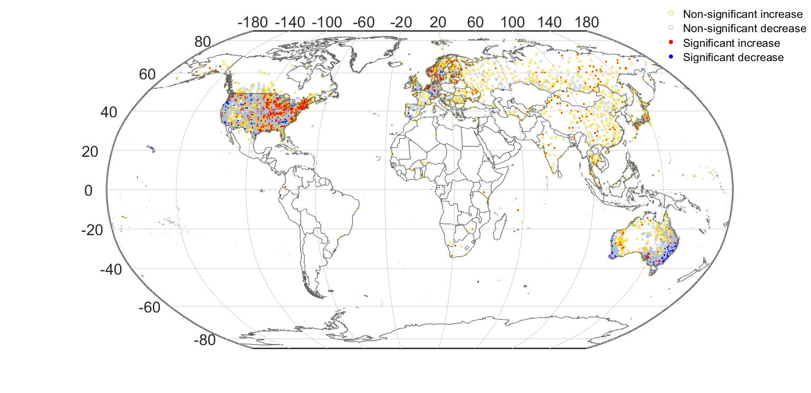
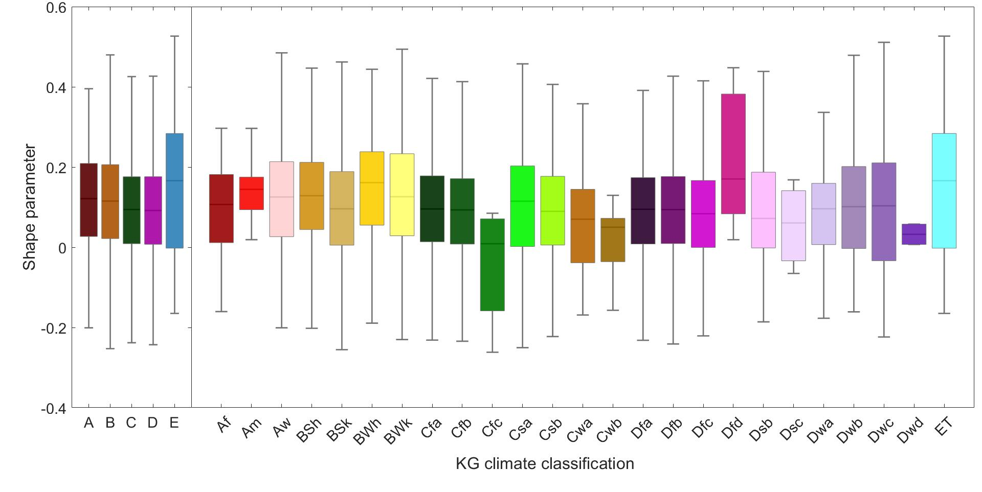
Main Results
  Northern
  Europe
i
Significant trends in extreme precipitation
  Increasing: eastern USA, Asia, and northern Europe
  48%
  Central
  USA
  Eastern
  America
  ET
  Eastern
  Australia
  Decreasing: Eastern Australia and Central USA
  66%
Climate type characteristics:
E: Polar, C: temperate
Cwb: warm-summer temperate winters
Dfd: extremely cold subarctic
Cfc: Subpolar oceanic
Dfd
ii
Heavy-tailed extremes
  Major climate type: largest E, smallest C
  Climate subtype: largest Dfd, smallest Cwb
iii
Frequency and magnitude of extreme precipitation
  Most and largest: Dfd
  Least and smallest: Cfc

Slide 6
References
Beck, H. E., Zimmermann, N. E., McVicar, T. R., Vergopolan, N., Berg, A., & Wood, E. F. (2018). Present and future Köppen-Geiger climate classification maps at 1-km resolution. Scientific data, 5(1), 1-12.
Papalexiou, S. M., & Montanari, A. (2019). Global and regional increase of precipitation extremes under global warming. Water Resources Research, 55(6), 4901-4914. Beck et al. (2018). Present and future Köppen-Geiger climate classification maps at 1-km resolution. Scientific Data, 5(1), 180214.
Rajulapati, C. R., Papalexiou, S. M., Clark, M. P., Razavi, S., Tang, G., & Pomeroy, J. W. (2020). Assessment of extremes in global precipitation products: How reliable are they?. Journal of Hydrometeorology, 21(12), 2855-2873.
Onyutha, C. (2018). Trends and variability in African long-term precipitation. Stochastic Environmental Research and Risk Assessment, 32(9), 2721-2739.
de Oliveira et al. (2020). Köppen-Geiger and Camargo climate classifications for the Midwest of Brasil. Theoretical and Applied Climatology, 142(3–4), 1133–1145.
Evans, J. P. (2009). 21st century climate change in the Middle East. Climatic Change, 92(3–4), 417–432. https://doi.org/10.1007/s10584-008-9438-5
Dore, M. H. I. (2005). Climate change and changes in global precipitation patterns: What do we know? Environment International, 31(8), 1167–1181.
6

Slide 7
THANK YOU !
Global analysis of extreme precipitation changes in the Köppen-Geiger climate classification
salma.hobbi@usask.ca
7

