Slide 1
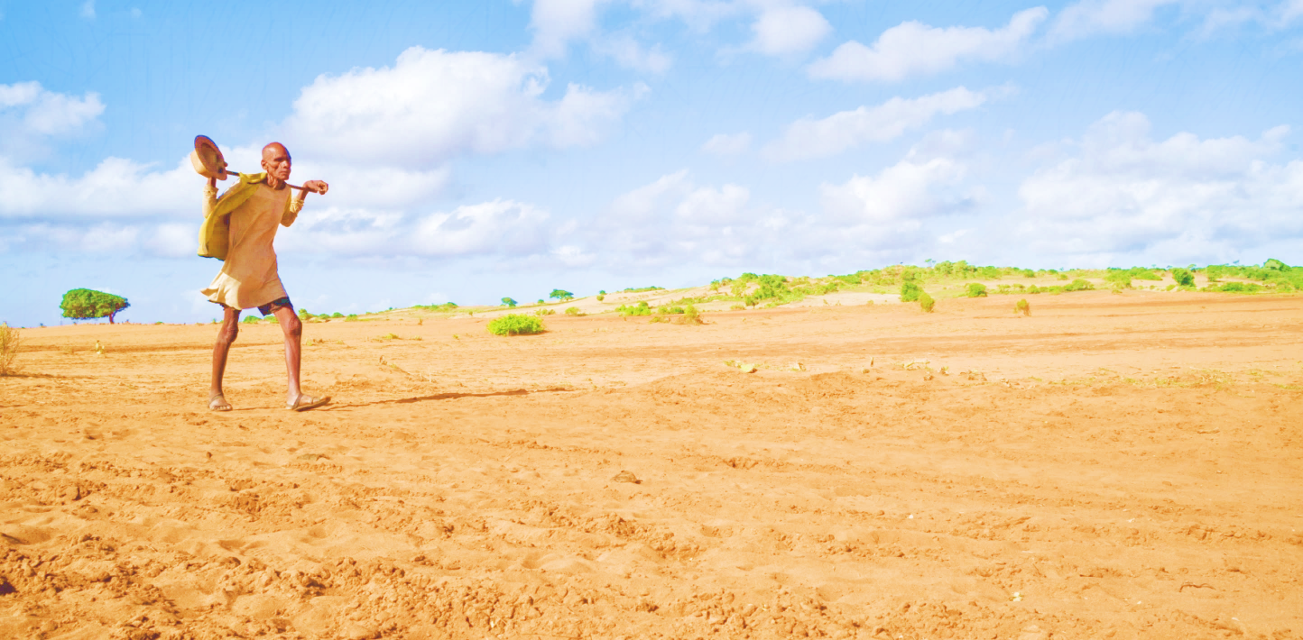



Role of climatic oscillations in causing spatially and temporally compound droughts and heatwaves
Waqar ul hassan¹ and Munir Ahmad Nayak²
¹Department of Civil Engineering, Indian Institute of Technology Indore, Indore, Madhya Pradesh, India-453552 (phd1701204002@iiti.ac.in)
²Department of Civil Engineering, National Institute of Technology, Srinagar, Jammu and Kashmir, India-190006 (munir.nayak@nitsri.net )

Slide 2
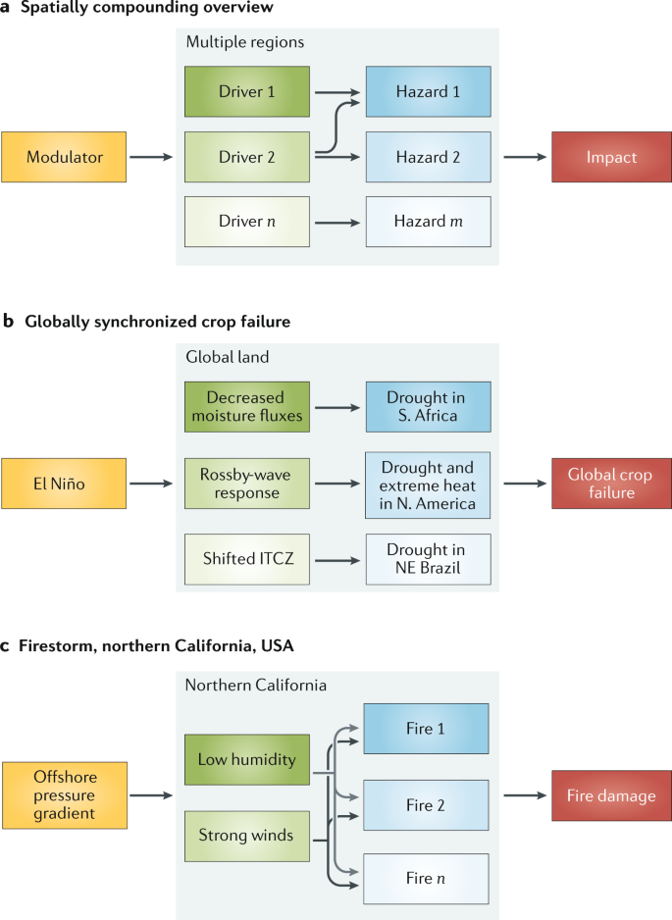
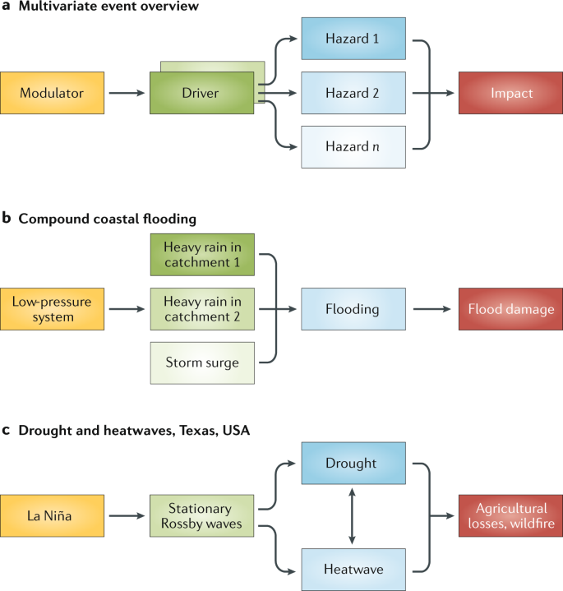
Spatially Compounding Multivariate Extremes (SCME)?
Same region
Spatially compound droughts^{1,2}
concurrent droughts and heatwaves
Spatially compounding of compound droughts and heatwaves?
Figure source: Zscheischler et al 2020

Slide 3
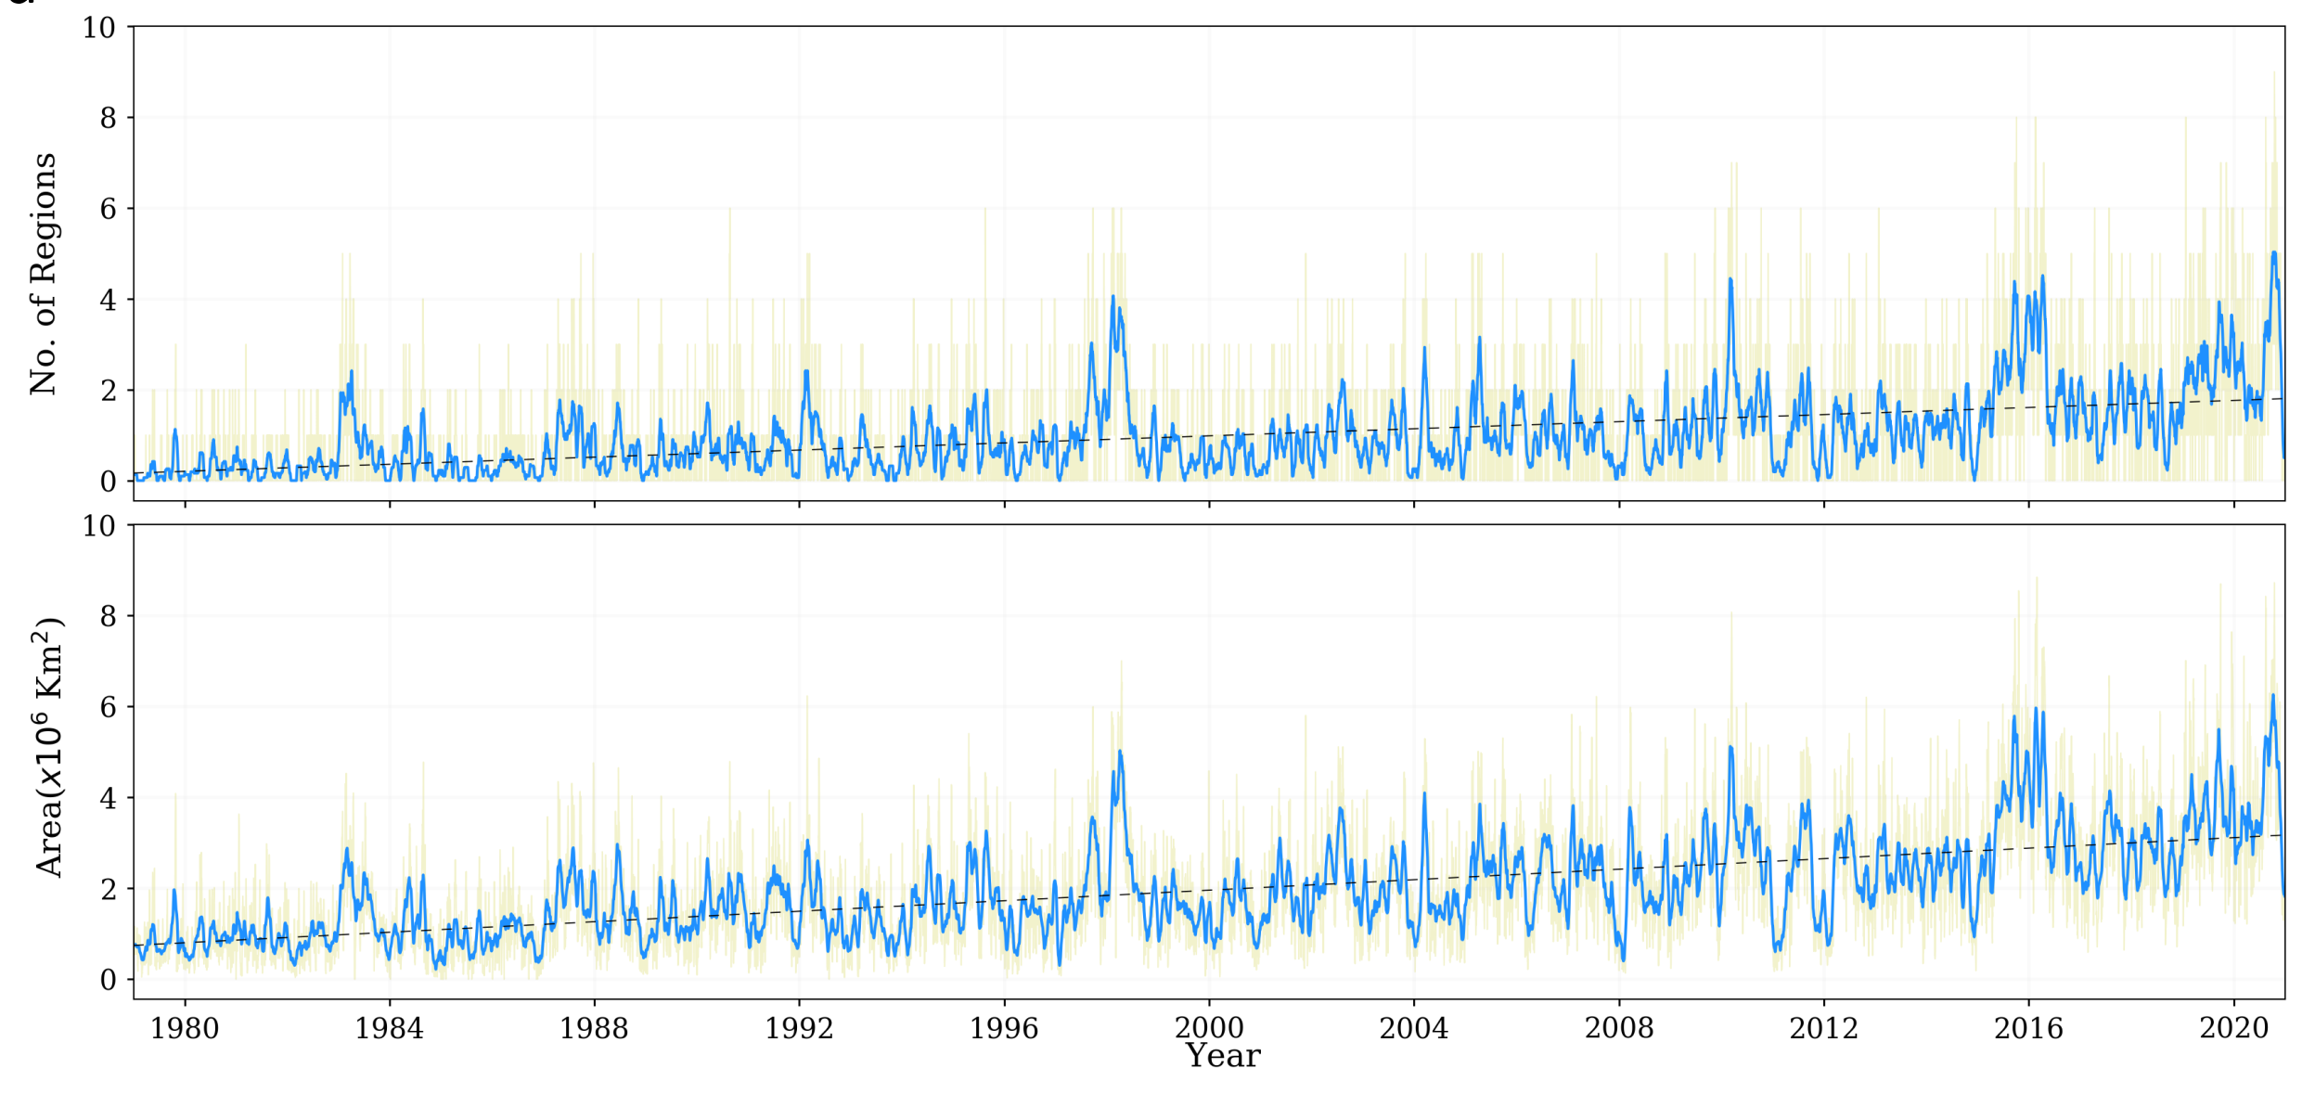
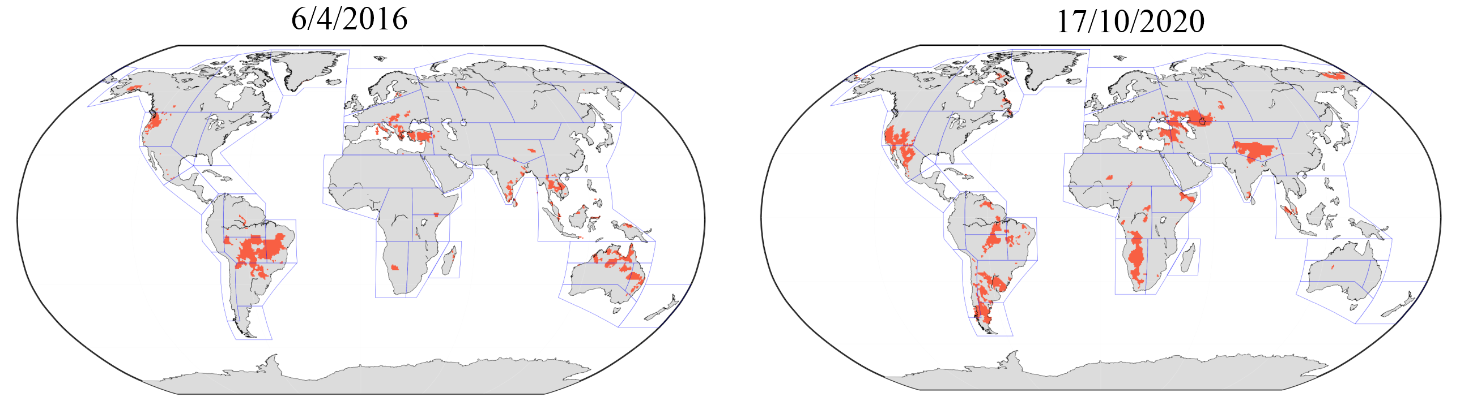
Do SCMEs really happen? If yes; where?
0.4 regions/decade
Region 1 | Region 2 | Distance (km) | Teleconnection
SEA | NSA | 19356 | ✓
SEA | NES | 17485 | ✓
SEA | SWS | 16825 | ✓
SEA | SEAF | 8848 | ✓
SEA | ESAF | 9462 | ✓
NAU | ESAF | 10419 | ✓
NZ | MED | 17623 | ✓
WCE | SCA | 10136 | ✓
WSAF | NWN | 14929 | ✓
ESAF | NWS | 11938 | ✓
WNA | NWN | 2629 | ✗
CNA | WNA | 1603 | ✗
ENA | NEN | 2766 | ✗
ENA | CNA | 1740 | ✗
WCE | MED | 1524 | ✗
0.45% global land/decade
Yes

Slide 4
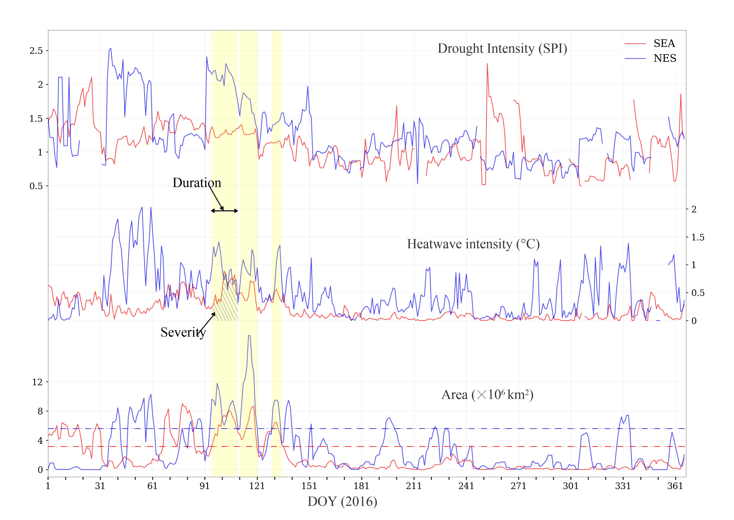
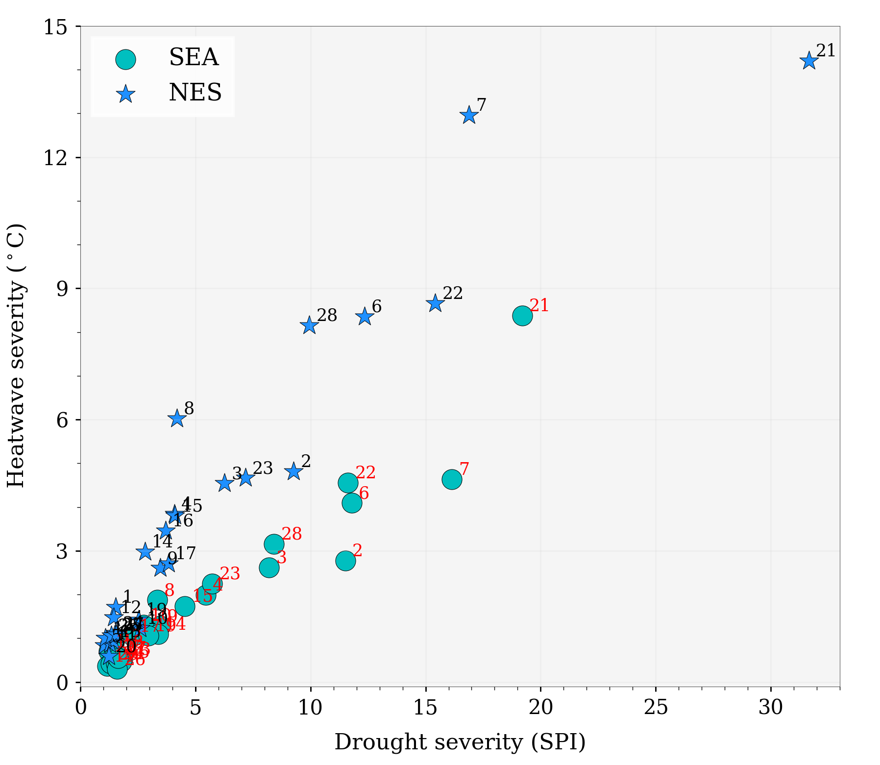
SCME characteristics for SEA$−$NES pair
Regional compound event threshold:
90th percentile of non-zero areas

Slide 5
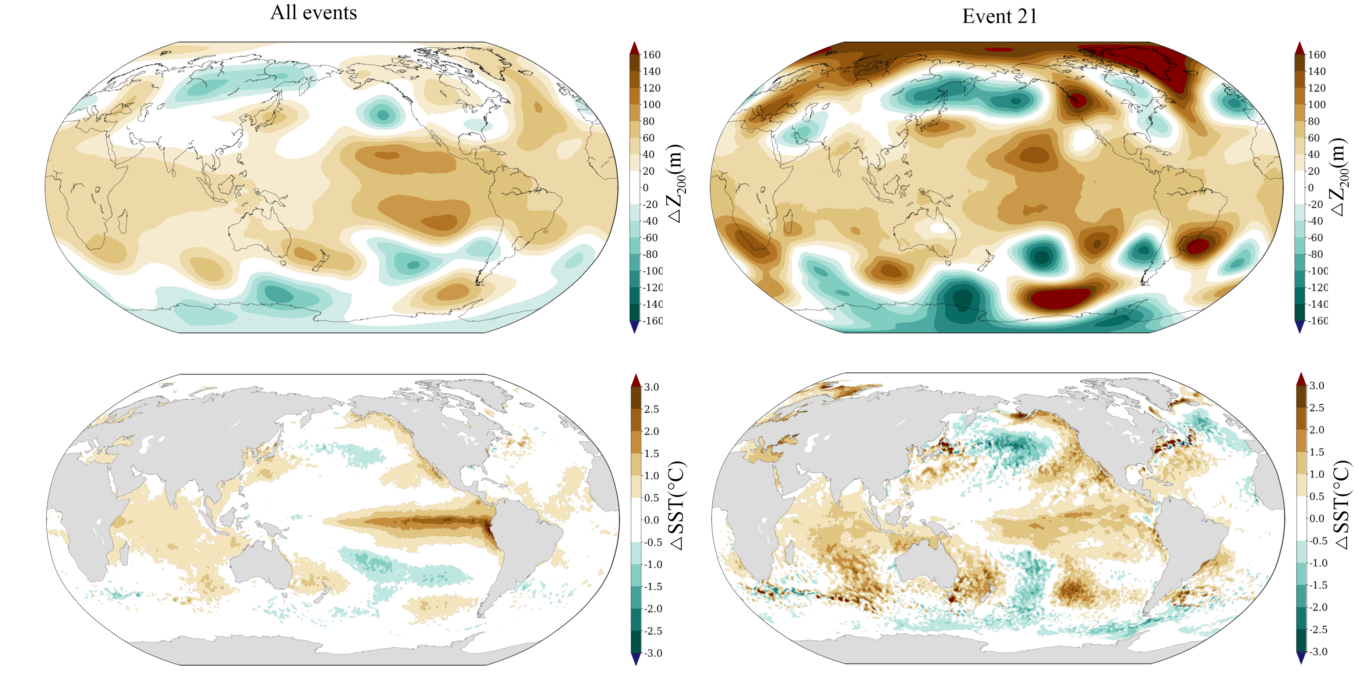
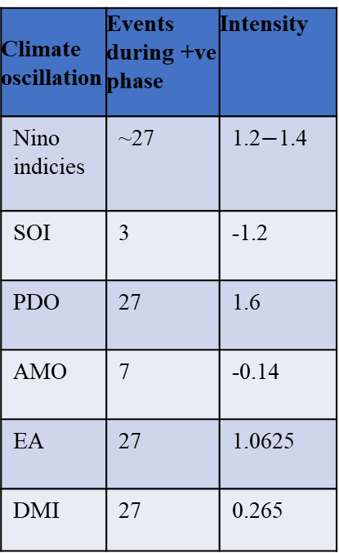
How do SCMEs happen?
Climate oscillation | Events during +ve phase | Intensity
Nino indicies | ~27 | 1.2$−$1.4
SOI | 3 | -1.2
PDO | 27 | 1.6
AMO | 7 | -0.14
EA | 27 | 1.0625
DMI | 27 | 0.265
NAO
El-Niño
PDO
IOD
References
Hassan et al, Environmental Research Letters 16.1 (2020): 014007.
Singh et al, npj Climate and Atmospheric Science (2021) 4(1), 1-14
Zscheischler et al, Nature reviews earth & environment 1.7 (2020): 333-347

Slide 6
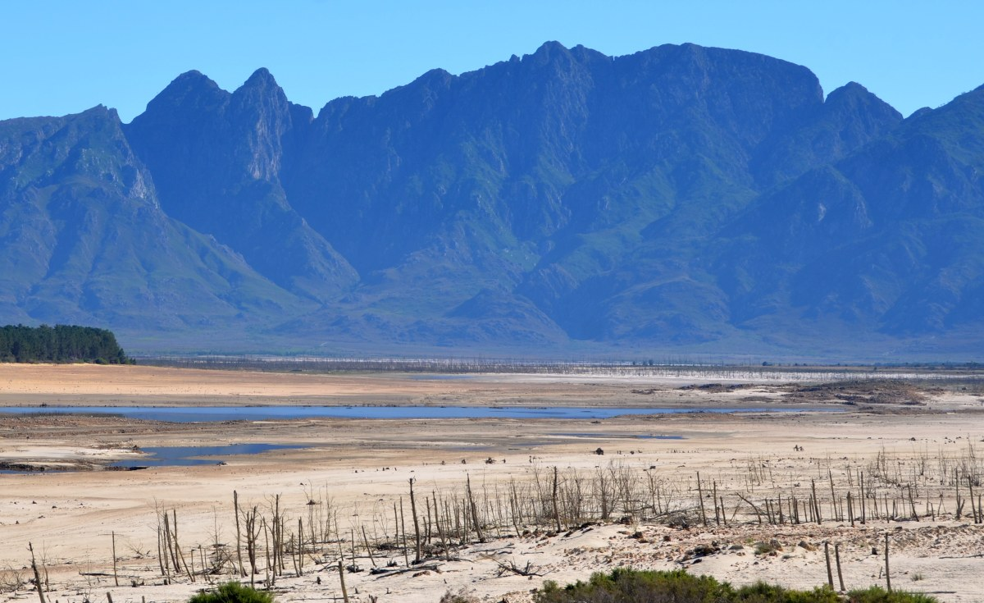
Thank you

