Slide 1
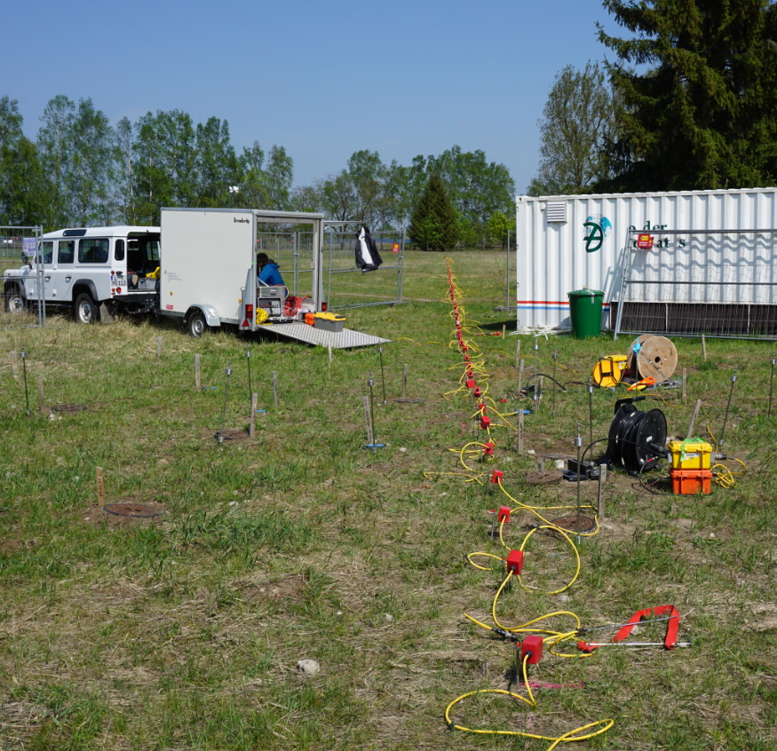
Monitoring of an aquifer thermal storage system in the field scale using crosshole ERT
Susann Birnstengel¹, Thomas Günther², Marco Pohle¹, Uta Koedel¹, Götz Hornbruch³, Johannes Nordbeck³, Sebastian Bauer³, Andreas Dahmke³, Peter Dietrich¹, Ulrike Werban¹
(¹Helmholtz Centre for Environmental Research, Leipzig, Germany
²Leibniz Institute for Applied Geophysics, Hanover, Germany
³Kiel University, Kiel, Germany)
05/2022
EGU General Assembly 2022 HS8.1.6 – Hydrogeophysics: a tool for hydrology, ecology, agronomy and beyond
Surface ERT at testsite „TestUM“ in Wittstock/Dosse (Picture: Marco Pohle)

Slide 2
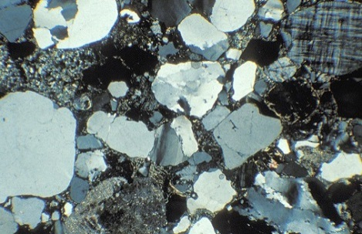
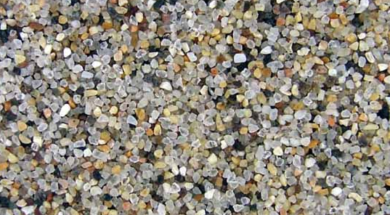
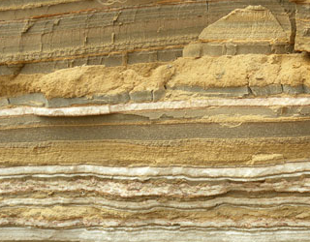
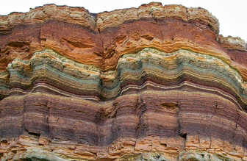

Monitoring of an aquifer thermal storage system
in the field scale using crossole ERT
S. Birnstengel¹, T. Günther², M. Pohle¹, U. Koedel¹, G. Hornbruch³ , J. Nordbeck³, S. Bauer³, A. Dahmke³, P. Dietrich¹, U. Werban¹
Motivation
Geotechnical usage of the near surface impacts groundwater
Dependencies of heat interacting with rock properties are scarcely investigated in the field scale
Experimental methods to identify petrophysical coherencies at the field scale
Impact of cyclic alteration processes on geotechnical stability
µm
cm
m
km
¹ Helmholtz Centre for Environmental Research, UFZ Leipzig
² Leibniz Institut for Applied Geoscience, Hannover
³ Christian Albrecht University of Kiel
Sources: www.cenka.uni-hamburg.de;
www.herfeldt-strahlmittel.de;
www.SAPhoto/Shutterstock.com; Petroleumsys.blogspot.com
© GeoBasis-DE / BKG 2017
References: [1] Cahill et al., 2017, Nature Geosciences
[2] K. Lüders, G. Hornbruch, R. Köber, M. Mahnecke, A. Dahmke (2022): "»Temperaturänderungen im Grundwasser: Ursachen, Prozesse und Auswirkungen", FH-DGGV – 23.-25.03.2022

Slide 3
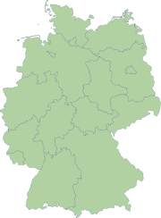
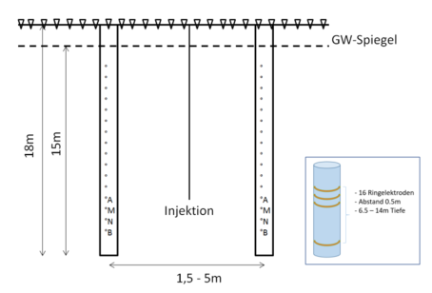
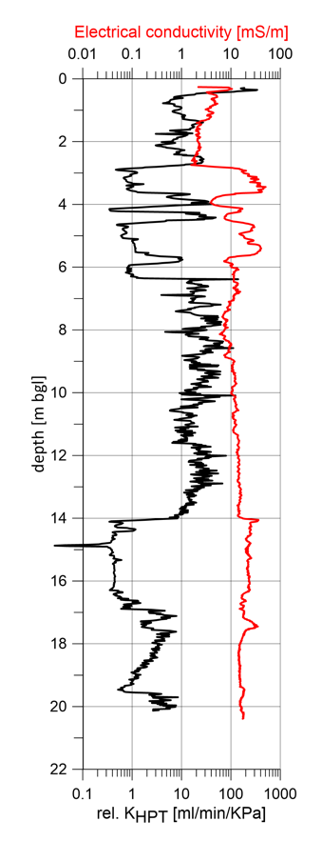
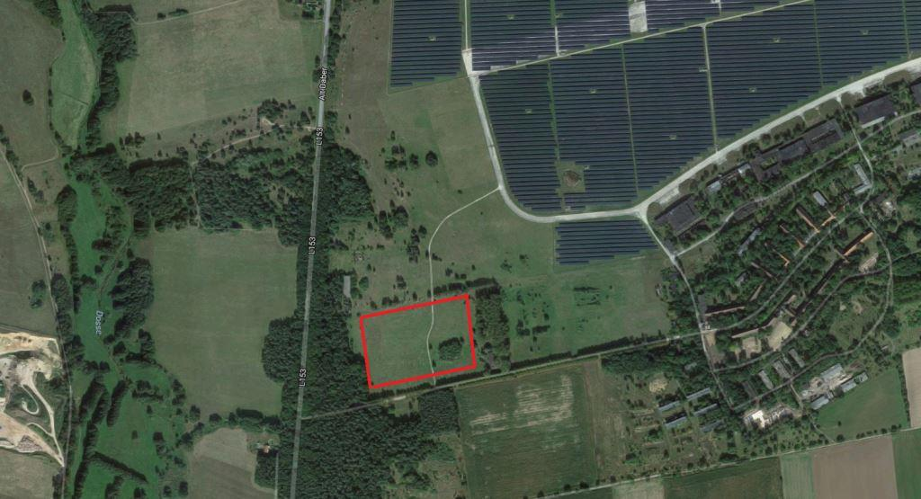
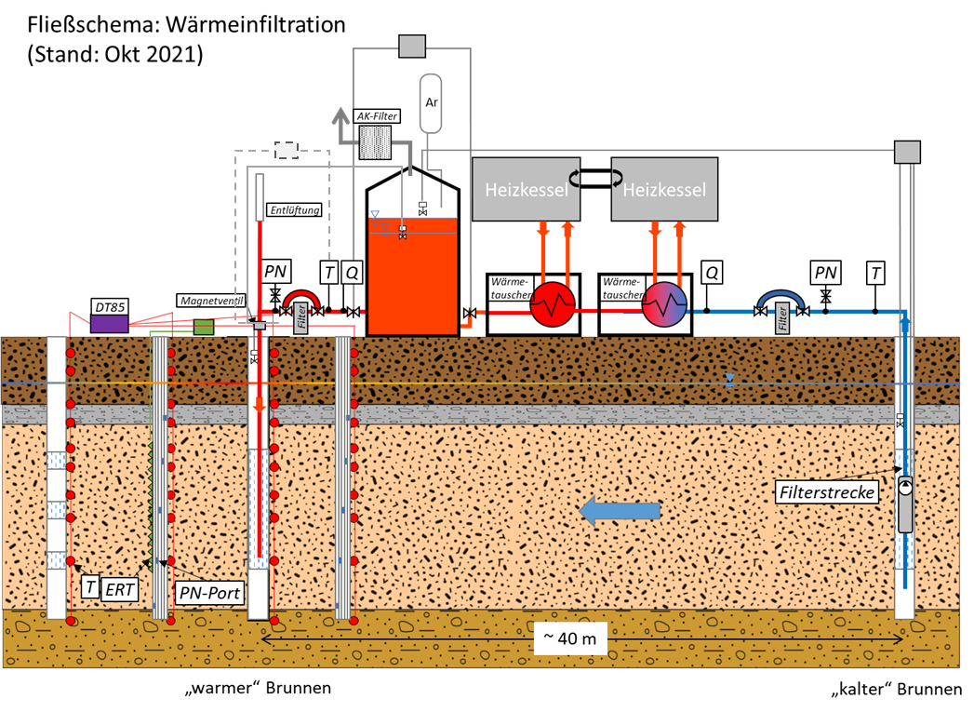
Monitoring of an aquifer thermal storage system
in the field scale using crossole ERT
S. Birnstengel¹, T. Günther², M. Pohle¹, U. Koedel¹, G. Hornbruch³ , J. Nordbeck³, S. Bauer³, A. Dahmke³, P. Dietrich¹, U. Werban¹
Motivation
Location & Experiment
Methods
Geotechnical usage of the near surface impacts groundwater
Dependencies of heat interacting with rock properties are scarcely investigated in the field scale
Need of multidisciplinary monitoring concepts across all scales to describe correlations to conceive the impact on our entire groundwater resource [1]
Testsite „TestUM“
Low permeable
µm
cm
m
km
sandy aquifer,
suitable for
heat injection
Fließschema
© GeoBasis-DE / BKG 2017
Controlled heat injections induce detectable
changes in rock properties (electrical resistivity)
K. Lüders, G. Hornbruch, R. Köber, M. Mahnecke, A. Dahmke (2022): "»Temperaturänderungen im Grundwasser: Ursachen, Prozesse und Auswirkungen", FH-DGGV – 23.-25.03.2022
¹ Helmholtz Centre for Environmental Research, UFZ Leipzig
² Leibniz Institut for Applied Geoscience, Hannover
³ Christian Albrecht University of Kiel
Sources: www.cenka.uni-hamburg.de;
www.herfeldt-strahlmittel.de;
www.SAPhoto/Shutterstock.com; Petroleumsys.blogspot.com
© GeoBasis-DE / BKG 2017
References: [1] Cahill et al., 2017, Nature Geosciences
[2] K. Lüders, G. Hornbruch, R. Köber, M. Mahnecke, A. Dahmke (2022): "»Temperaturänderungen im Grundwasser: Ursachen, Prozesse und Auswirkungen", FH-DGGV – 23.-25.03.2022

Slide 4
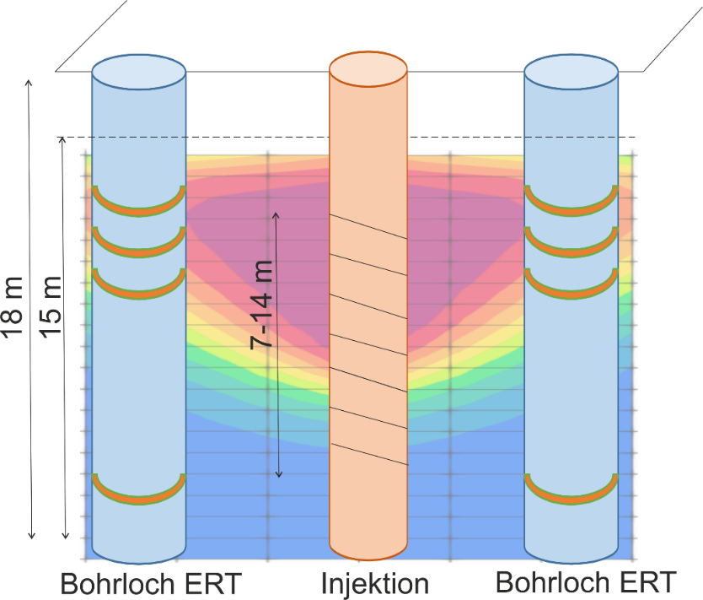

Monitoring of an aquifer thermal storage system
in the field scale using crossole ERT
S. Birnstengel¹, T. Günther², M. Pohle¹, U. Koedel¹, G. Hornbruch³ , J. Nordbeck³, S. Bauer³, A. Dahmke³, P. Dietrich¹, U. Werban¹
Motivation
Methods
Geotechnical usage of the near surface impacts groundwater
Dependencies of heat interacting with rock properties are scarcely investigated in the field scale
Need of multidisciplinary monitoring concepts across all scales to describe correlations to conceive the impact on our entire groundwater resource [1]
Impact of cyclic alteration processes on geotechnical stability
16 ring electrodes
in aquifer (6.5-14m depth)
Spacing 0.5m
Inhole: Wenner-α, DD Crosshole (8 BL): DD, Bipol
µm
cm
m
km
Hypothesis
Controlled heat injections induce detectable changes in rock properties (electrical conductivity)
Detecting variations in the electrical resistivity will infer information about heat distribution
Heat transfer function will enable direct prediction on present temperatures at the near surface
Fließschema
[2]
Borehole ERT Injection Borehole ERT
¹ Helmholtz Centre for Environmental Research, UFZ Leipzig
² Leibniz Institut for Applied Geoscience, Hannover
³ Christian Albrecht University of Kiel
References: LINKS

Slide 5
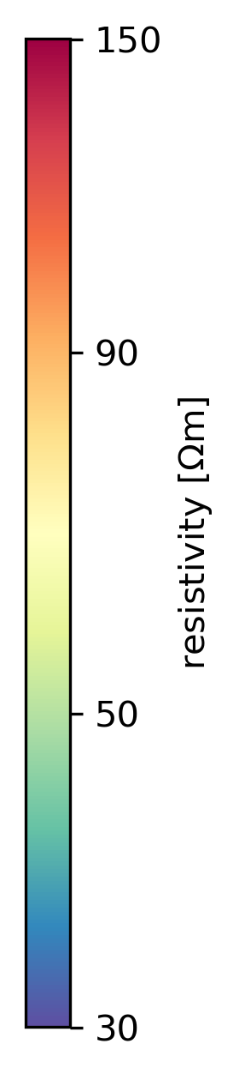
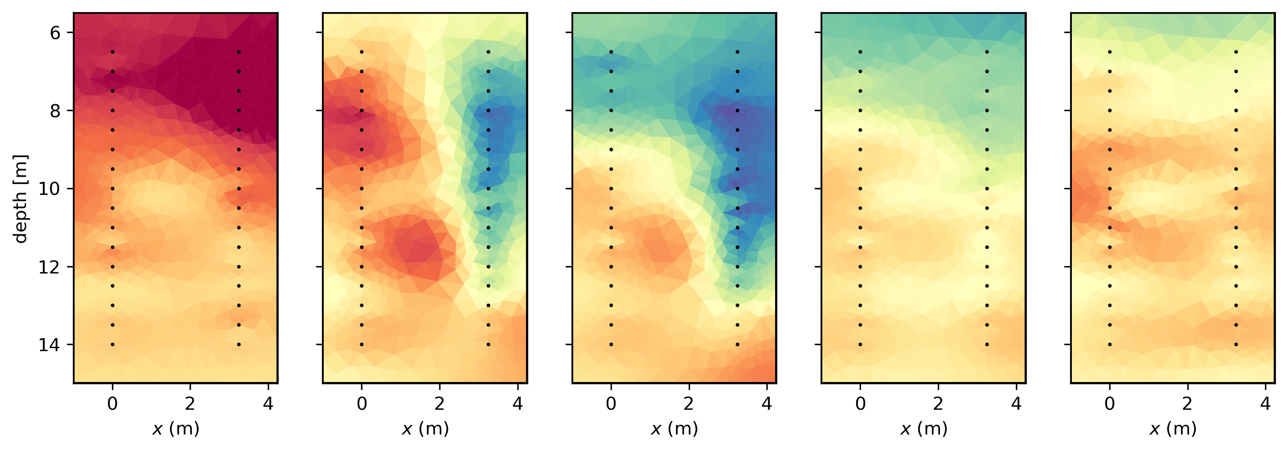
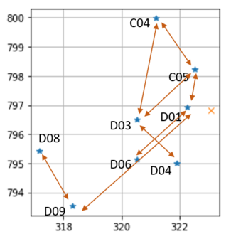
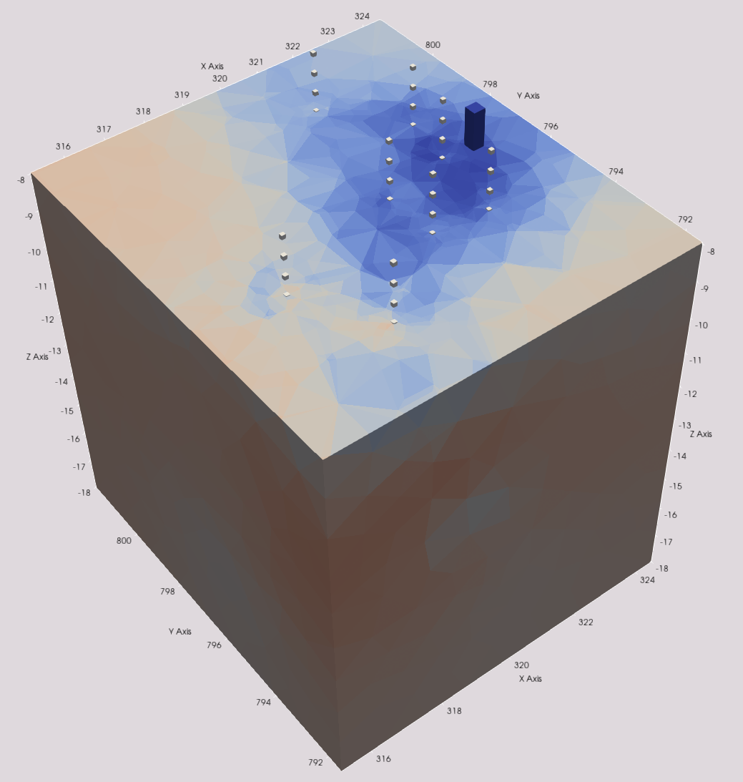
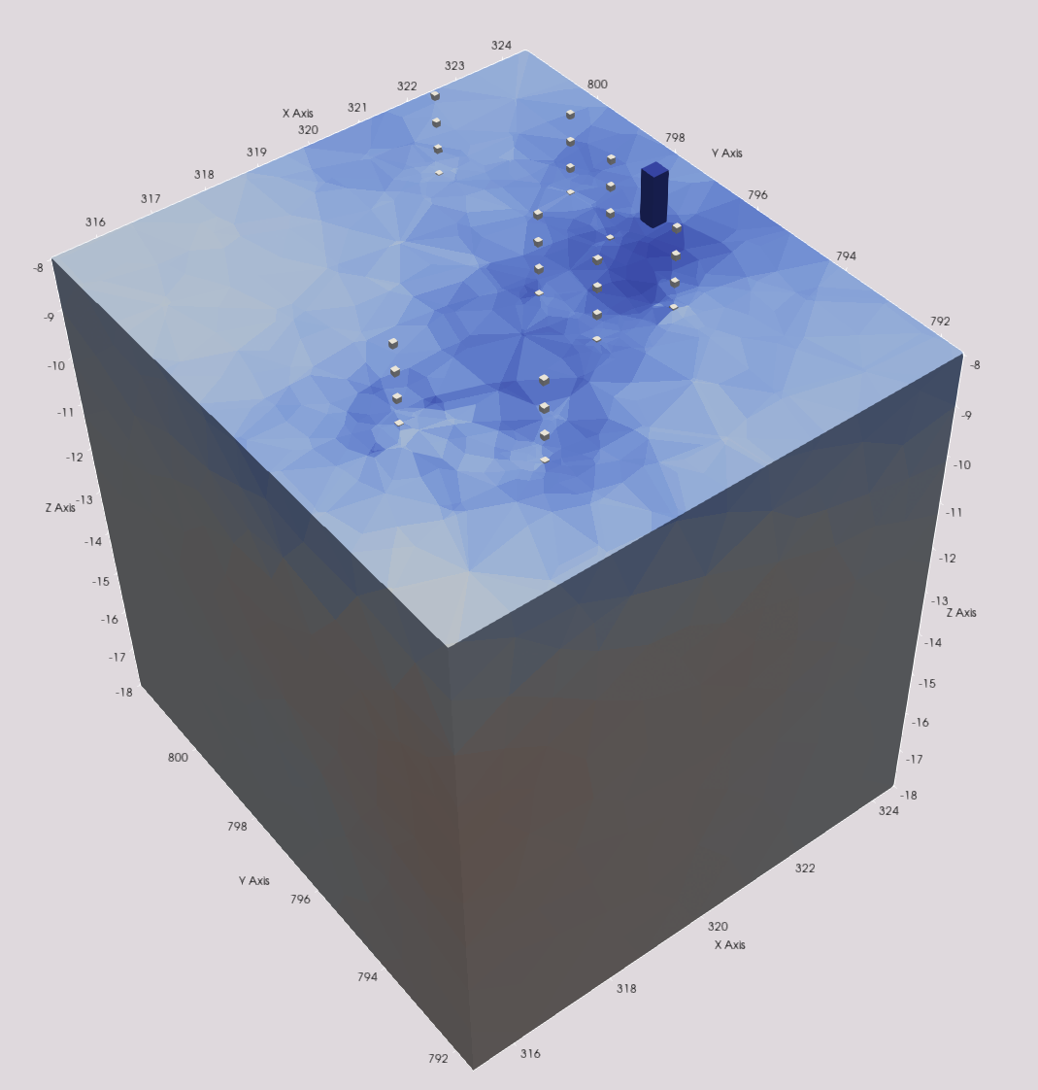
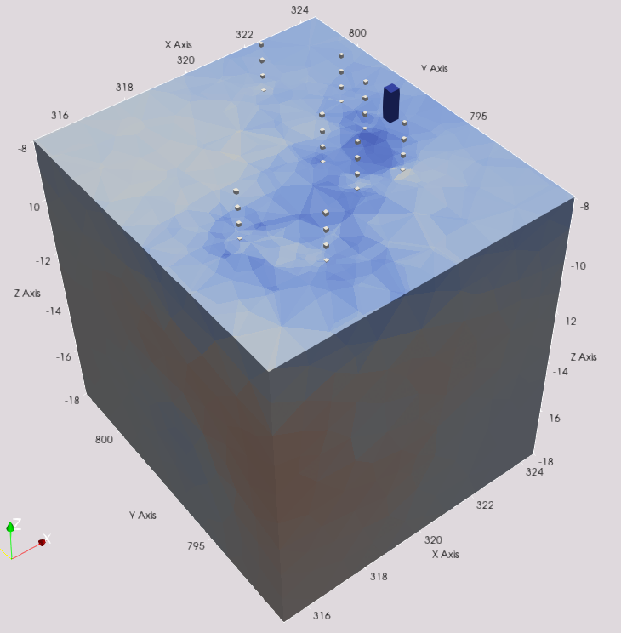
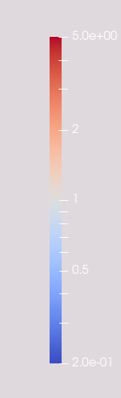
Monitoring of an aquifer thermal storage system
in the field scale using crossole ERT
S. Birnstengel¹, T. Günther², M. Pohle¹, U. Koedel¹, G. Hornbruch³ , J. Nordbeck³, S. Bauer³, A. Dahmke³, P. Dietrich¹, U. Werban¹
Motivation
Methods
Results
Geotechnical usage of the near surface impacts groundwater
Dependencies of heat interacting with rock properties are scarcely investigated in the field scale
Need of multidisciplinary monitoring concepts across all scales to describe correlations to conceive the impact on our entire groundwater resource [1]
Impact of cyclic alteration processes on geotechnical stability
16 ring electrodes in aquifer (6.5-14m depth)
Spacing 0.5m
Inhole: Wenner-α, DD
Crosshole (8 BL): DD, Bipol
Baseline Start Heat Injection End Heat Injection Extraction Standby C04 D01 2 days 14days 28 days 36 days
µm
cm
m
km
Borehole ERT Injection Borehole ERT
Hypothesis
Test Site „TestUM“
Controlled heat injections induce detectable changes in rock properties (electrical conductivity)
Detecting variations in the electrical resistivity will infer information about heat distribution
Heat transfer function will enable direct prediction on present temperatures at the near surface
Fließschema
2D inverted |k| > 30000 | 25 < Rhoa < 200 Ωm | Est. Error > 30 % | Relative Error 3% | absolute Error 100μV | Lambda: 100
[2]
Start Heat Injection Standby Extraction
6 days 26 days 33 days
3D inverted
¹ Helmholtz Centre for Environmental Research, UFZ Leipzig
² Leibniz Institut for Applied Geoscience, Hannover
³ Christian Albrecht University of Kiel
Sources: www.cenka.uni-hamburg.de;
www.herfeldt-strahlmittel.de;
www.SAPhoto/Shutterstock.com; Petroleumsys.blogspot.com
© GeoBasis-DE / BKG 2017
References: [1] Cahill et al., 2017, Nature Geosciences
[2] K. Lüders, G. Hornbruch, R. Köber, M. Mahnecke, A. Dahmke (2022): "»Temperaturänderungen im Grundwasser: Ursachen, Prozesse und Auswirkungen", FH-DGGV – 23.-25.03.2022

Slide 6

Monitoring of an aquifer thermal storage system
in the field scale using crossole ERT
S. Birnstengel¹, T. Günther², M. Pohle¹, U. Koedel¹, G. Hornbruch³ , J. Nordbeck³, S. Bauer³, A. Dahmke³, P. Dietrich¹, U. Werban¹
Motivation
Methods
Results
Geotechnical usage of the near surface impacts groundwater
Dependencies of heat interacting with rock properties are scarcely investigated in the field scale
Need of multidisciplinary monitoring concepts across all scales to describe correlations to conceive the impact on our entire groundwater resource [1]
Impact of cyclic alteration processes on geotechnical stability
16 ring electrodes in aquifer (6.5-14m depth)
Spacing 0.5m
Inhole: Wenner-α, DD
Crosshole (8 BL): DD, Bipol
Baseline Start Heat Injection End Heat Injection Extraction Standby C04 D01 2 days 14days 28 days 36 days
µm
cm
m
km
Borehole ERT Injection Borehole ERT
Hypothesis
Test Site „TestUM“
Controlled heat injections induce detectable changes in rock properties (electrical conductivity)
Detecting variations in the electrical resistivity will infer information about heat distribution
Heat transfer function will enable direct prediction on present temperatures at the near surface
Fließschema
© GeoBasis-DE / BKG 2017
2D inverted |k| > 3000 | 20 < Rhoa < 200 Ωm | Est. Error > 30 % | Relative Error 3% | absolute Error 100μV | Lambda: 100 |
[2]
Start Heat Injection Standby Extraction
6 days 26 days 33 days
Conclusion and Outlook
Wittstock/Germany
Quaternary Sediments
Aquiclude
Aquifer
Injection horizon
Wide and detailed data set of subsurface heat injection experiment
Single injection phases are detectable
Qualitatively/quantitatively comparable
Validation of temperature simulation
Variation of cycles to assess influence on petropysical relation
→ geotechnical stability
3D inverted
¹ Helmholtz Centre for Environmental Research, UFZ Leipzig
² Leibniz Institut for Applied Geoscience, Hannover
³ Christian Albrecht University of Kiel
Sources: www.cenka.uni-hamburg.de;
www.herfeldt-strahlmittel.de;
www.SAPhoto/Shutterstock.com; Petroleumsys.blogspot.com
© GeoBasis-DE / BKG 2017
References: [1] Cahill et al., 2017, Nature Geosciences
[2] K. Lüders, G. Hornbruch, R. Köber, M. Mahnecke, A. Dahmke (2022): "»Temperaturänderungen im Grundwasser: Ursachen, Prozesse und Auswirkungen", FH-DGGV – 23.-25.03.2022

