Slide 1




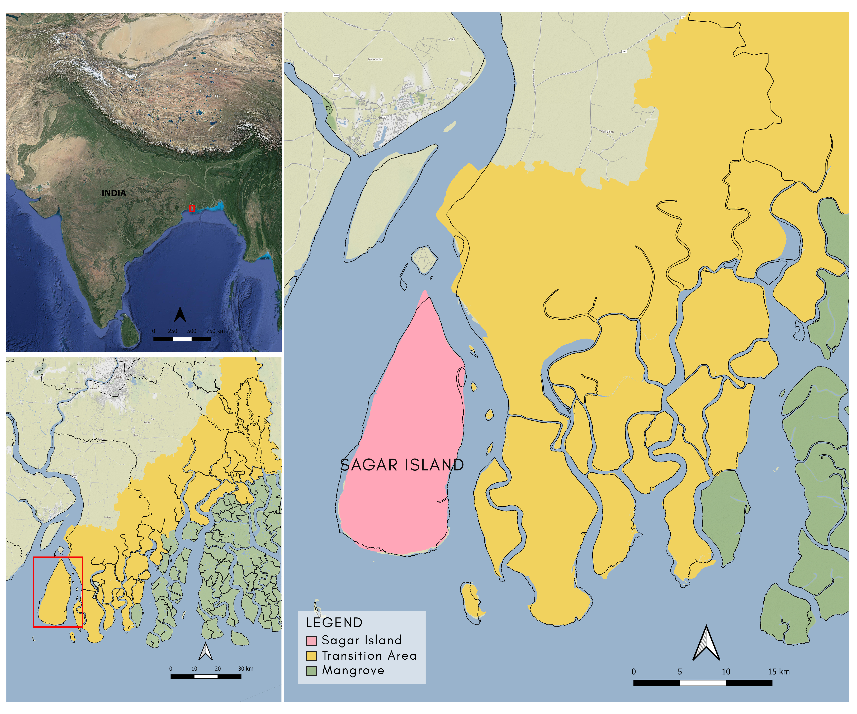
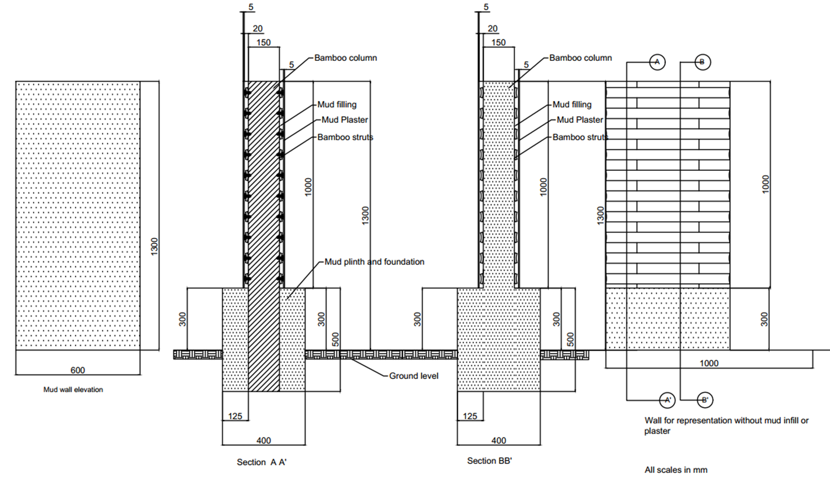
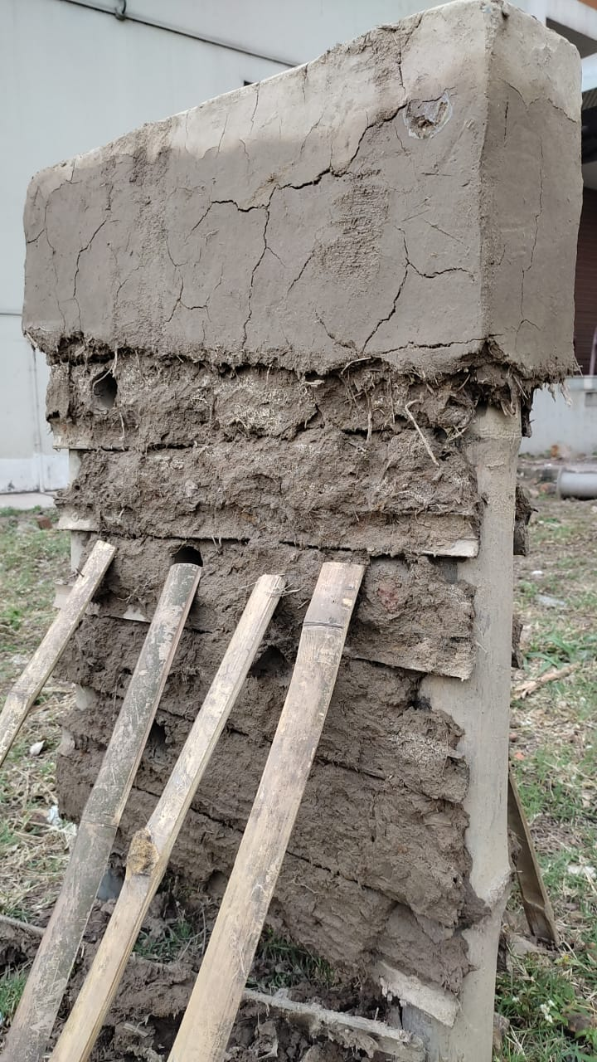
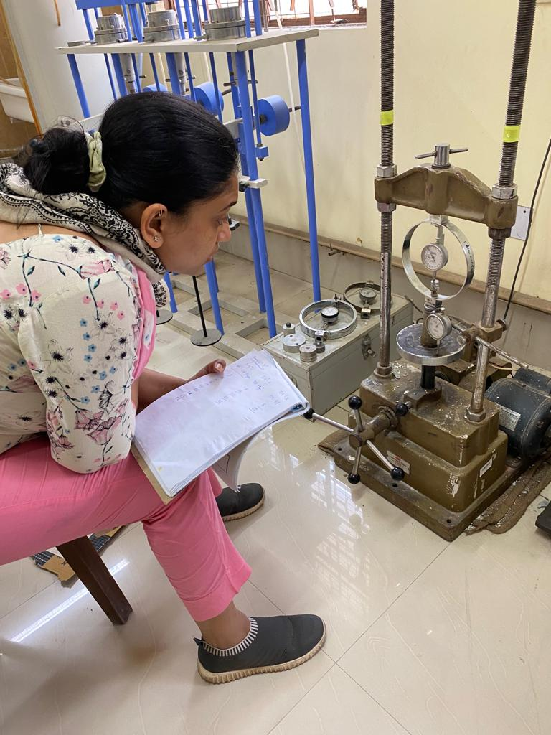
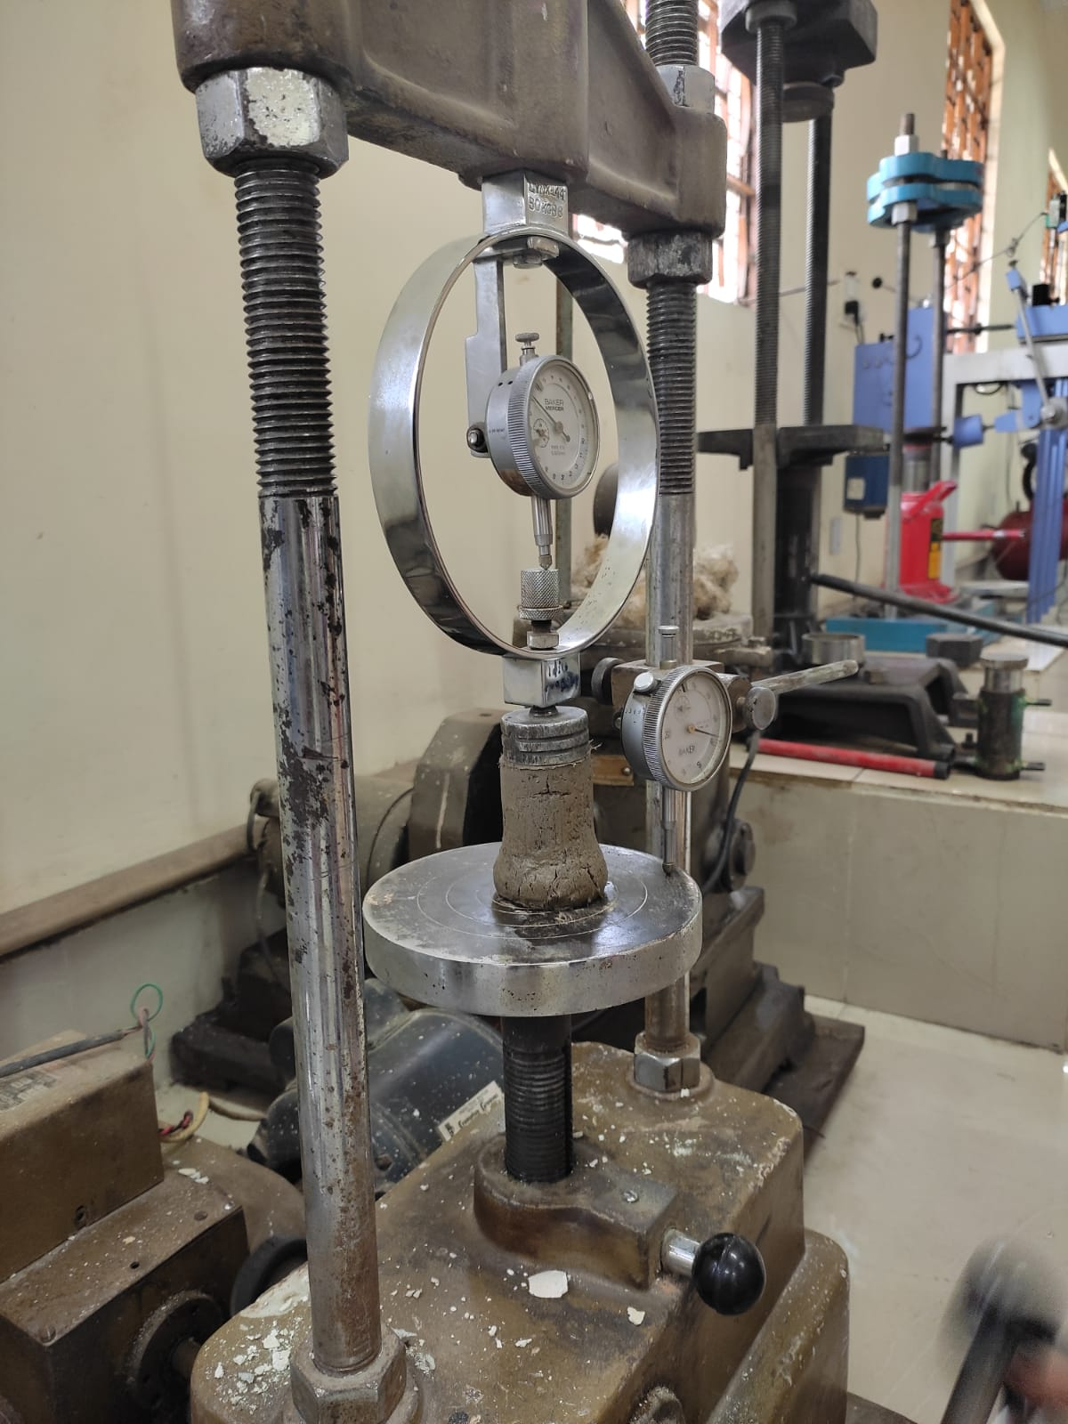
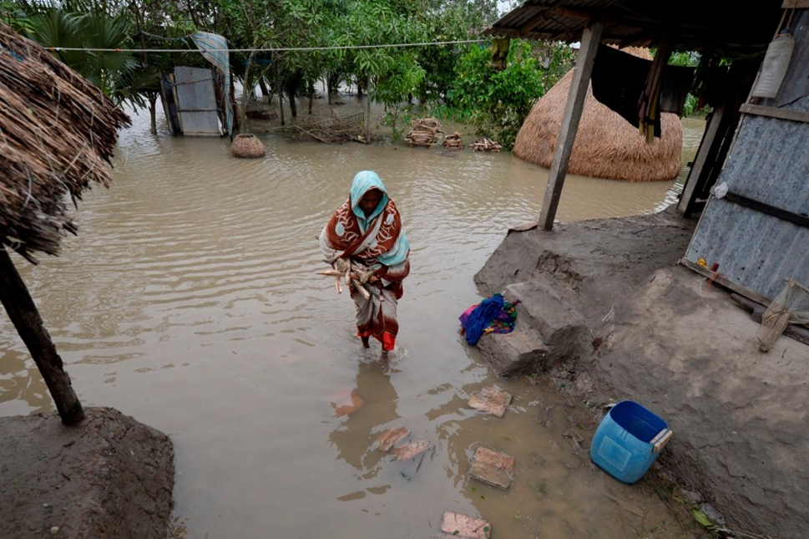
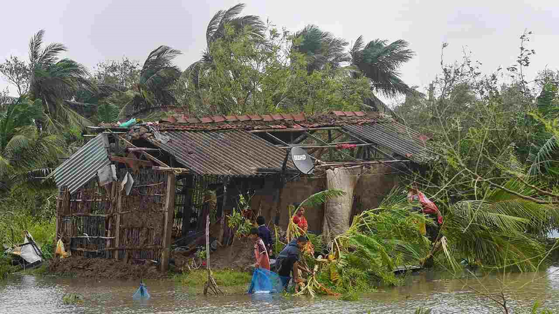
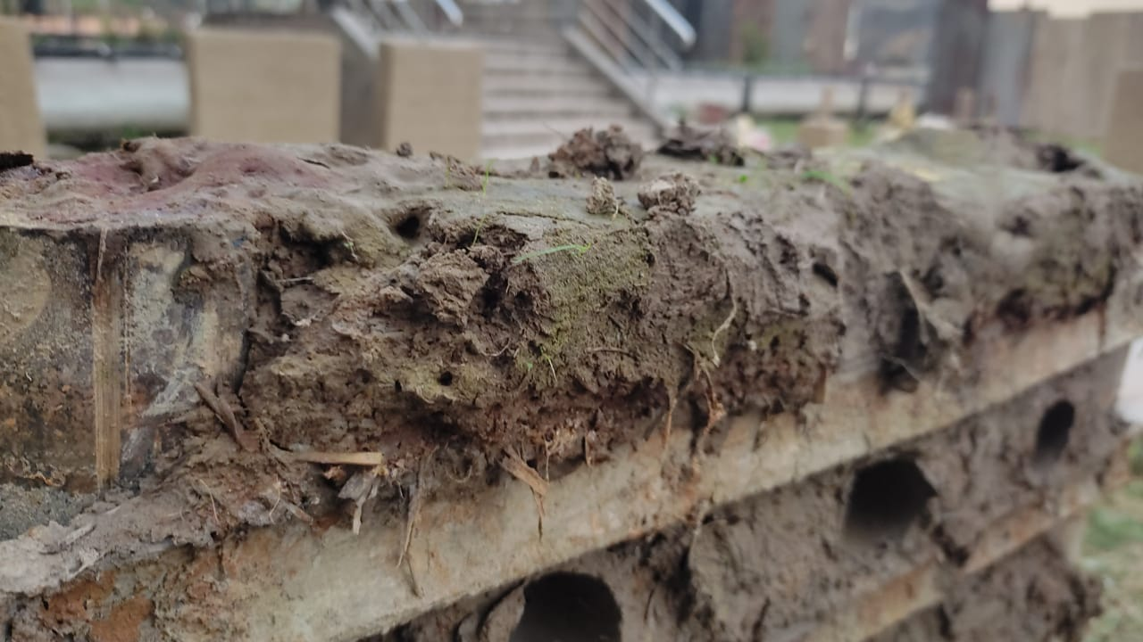
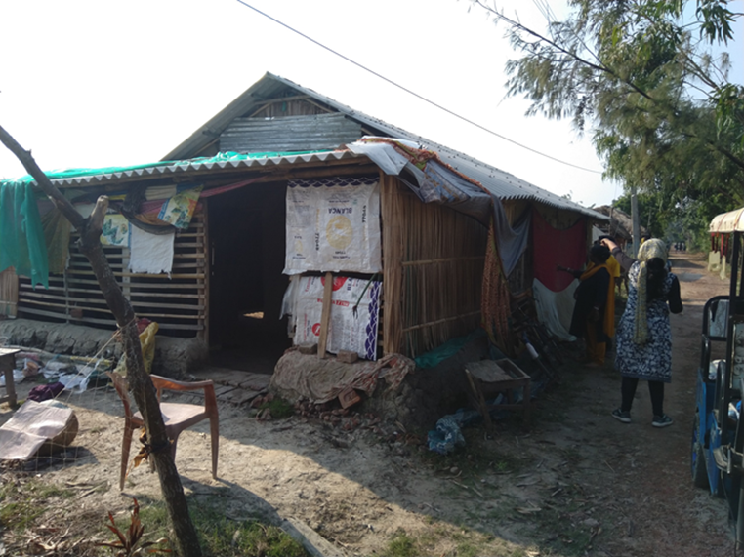


An experimental approach for developing a building damage matrix for the flood-affected vernacular housing typology
European Geophysical Union 2022, May 2022
Housing –in Indian Sundarbans
Step 3 : Results
Load Carrying Capacity of the wall
Mud buildings have accommodated 50% of global population,
Step 2: To design a method to assess the impact of flooding on the building typology
Duration (Hr) | Compressive strength (kPa) | Compressive strength (kg)
0 | 12.488 | 6055.12
36 | 11.57 | 1391.27
72 | 9.84 | 1003.63
102 | 9.21 | 930.52
144 | 7.99 | 815.46
75% of the building in Sagar Island are made of vernacular design
Destructive tests: Unconfined compressive strength test
Motivation of the study:
Limited literature on assessment of flood impact on vernacular buildings
Moment developed due to the weight of the roof
Depth (mm) | Compressive stress due to roof (MPa) | Moment (kN-m)
525 (25%) | 0.00955 | 1.48
1050 (50%) | 0.00955 | 0.65
1575 (75%) | 0.00955 | 0.164
Limited literature on damage curves for mud building
Building damage assessment
Building damage matrix
To understand the direct tangible impact on buildings
Walls were immersed for 36 hours, 72 hours, 102 hours, and 144 hours, respectively. The water depth is kept at 25 %, 50 %, 75 %, and 100 % of the height of the mud wall for each duration.
Duration (h) | Depth of the water level (% w.r.t wall height)
 | 0 | 25% | 50% | 75% | 100%
0 | 3.44,12.488 (NF,NF) | 3.44,12.488 (NF,NF) | 3.44,12.488 (NF,NF) | 3.44,12.488 (NF,NF) | 3.44,12.488 (NF,NF)
18 | 3.44,11.908 (NF,NF) | 1.8463,11.908 (NF,NF) | 0.821,11.908 (NF,NF) | 0.2043,11.908 (NF,NF) | 0.11.908 (F,NF)
36 | 3.44,11.57 (NF,NF) | 1.79,11.57 (NF,NF) | 0.797,11.57 (NF,NF) | 0.199,11.57 (NF,NF) | 0,11.57 (F,NF)
54 | 3.44,10.75 (NF,NF) | 1.6663,10.75 (NF,NF) | 0.7418,10.75 (NF,NF) | 0.1827,10.75 (NF,NF) | 0,10.75 (F,NF)
72 | 3.44,9.84 (NF,NF) | 1.52,9.84 (NF,NF) | 0.6780,9.84 (NF,NF) | 0.1695,9.84 (NF,NF) | 0,9.84 (F,NF)
92 | 3.44,9.52 (NF,F) | 1.4763,9.52 (F,F) | 0.6582,9.52 (F,F) | 0.1599,9.52 (F,F) | 0,9.52 (F,F)
102 | 3.44,9.12 (NF,F) | 1.414,9.12 (F,F) | 0.6268,9.12 (F,F) | 0.1571,9.12 (F,F) | 0,9.12 (F,F)
123 | 3.44,8.527 (NF,F) | 1.32.13,8.527 (F,F) | 0.59,8.527 (F,F) | 0.1413,8.527 (F,F) | 0,8.527 (F,F)
144 | 3.44,7.99 (NF,F) | 1.239,7.99 (F,F) | 0.5506,7.99 (F,F) | 0.1376,7.99 (F,F) | 0,7.99 (F,F)
To understand the effect of damage parameters – resistance and impact parameter
To understand the effect of flooding through experimental finding in absence of empirical data/ observation
Carrying capacity of the walls based on
Compressive strength at a given duration
Moment of resistance at a given depth and duration
Step 1 : Identifying the housing (construction) typology
At zero duration the load carrying capacity of the wall is 6055 kg which is sufficiently larger than the weight of the roof.
The matrix comprises of moment of resistance and compressive strength values
A wall may fail when –Moment generated by the roof load exceed the moment of resistance and compressive load by the roof succeeds the compressive strength of the wall (after an immersion period)
Reference – Islam (1997); Shah et al., 2013; Mohd et al., 2016; Mohd et al., 2016 ; Malgwi et al., 2021
Indian Institute of Technology Kharagpur, India
EGU |Aishwarya Narendr| Shantanu Anand | Dr. Bharath H. Aithal |Dr Sutapa Das

