Slide 1




Developing a soil moisture Decision Support Tool to quantify the occurrence of flash droughts and saturated soil conditions for pasture grasses in the southeast of the United States
Authors: Sara Maktabi, Ioannis Gallios, Pam Knox, Sunaab Kukal, and George Vellidis.
Reporter: Sara Maktabi
Date: 26/05/2022
Notes:
HELLO room, today I want to present part of our research project, aiming at providing a decision support tool

Slide 2
Motivation of the study
Flash droughts have dire consequences on agricultural commodities.
Flash droughts can cause extensive damage to agriculture, economies, and ecosystems if they are not predicted and discovered early (Drought.gov).
The frequency of flash drought in the Southeast region generally peaked in May. (Christian et al 2019).
BUT…
  Is it possible to quantify their occurrence by modeling soil moisture ?

Slide 3
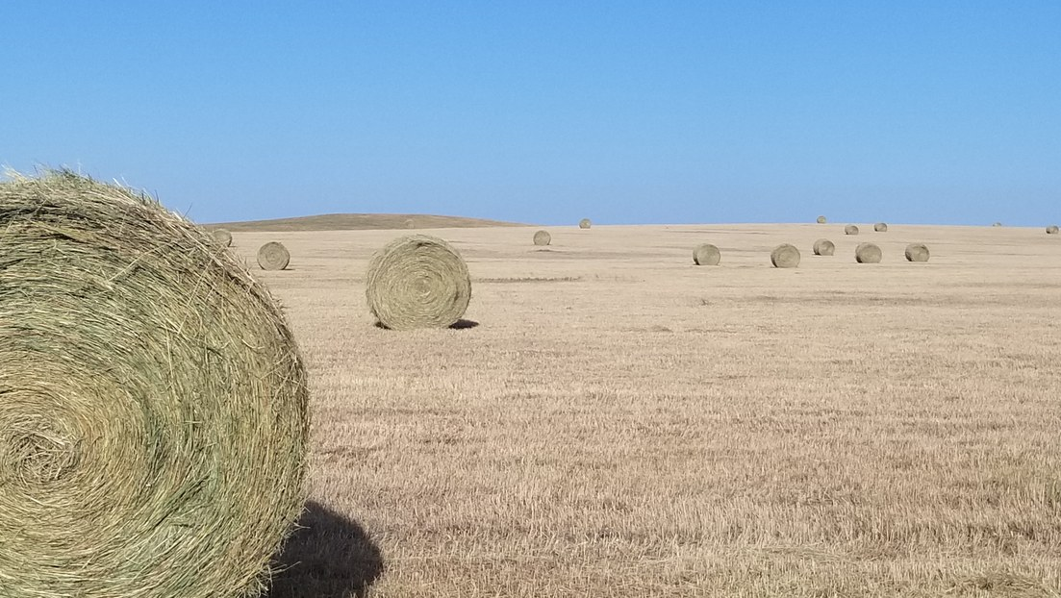
Objectives:
Development of Smart Irrigation Forage Application
Observing magnitude of the soil moisture and vegetative stress
Creating a database for further scientific goals
This Photo by Unknown Author is licensed under CC BY-SA-NC

Slide 4
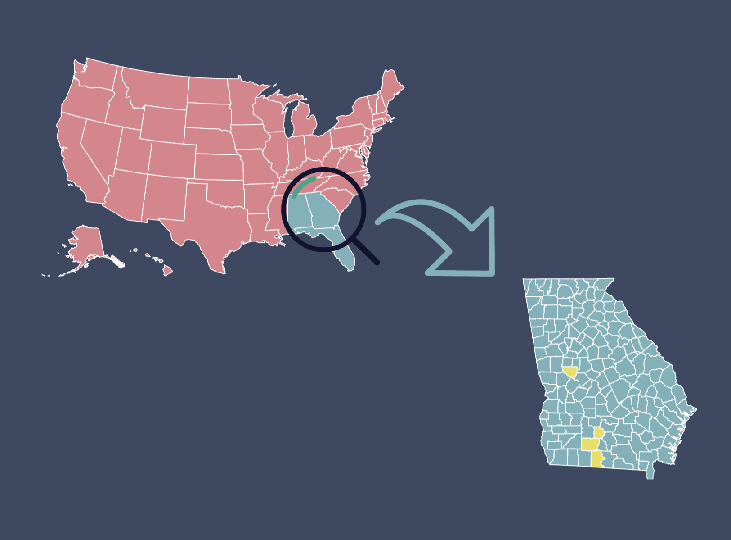
Study Area
Five sites in Georgia, the U.S.
Grassed with common pasture grasses
  Bermudagrass
  Bahia grass
  Tall fescue

Slide 5
Basics of the modeling:
ET_{O}
K_{C}
ET_{C}
(Penman-Monteith Evapotranspiration equation, FAO 56, 1998)

Slide 6
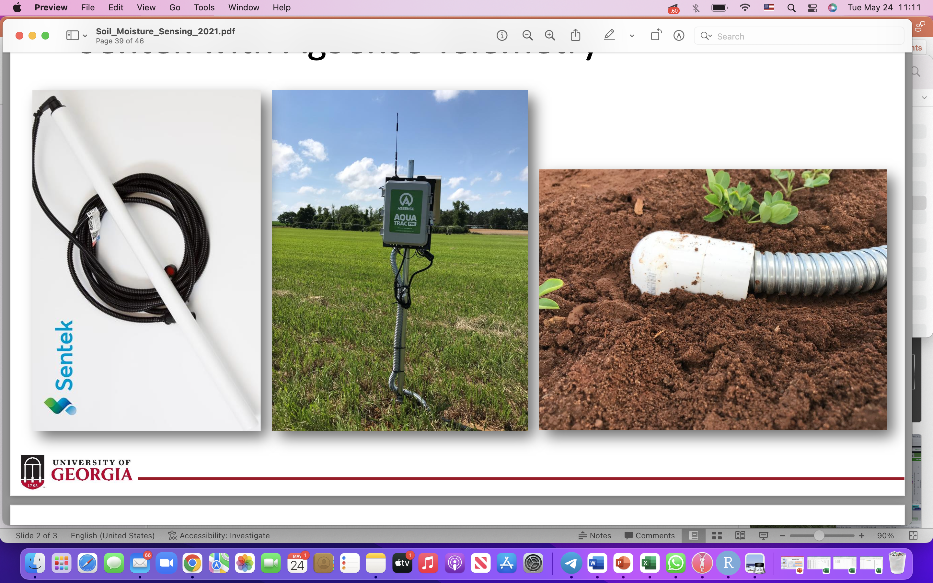
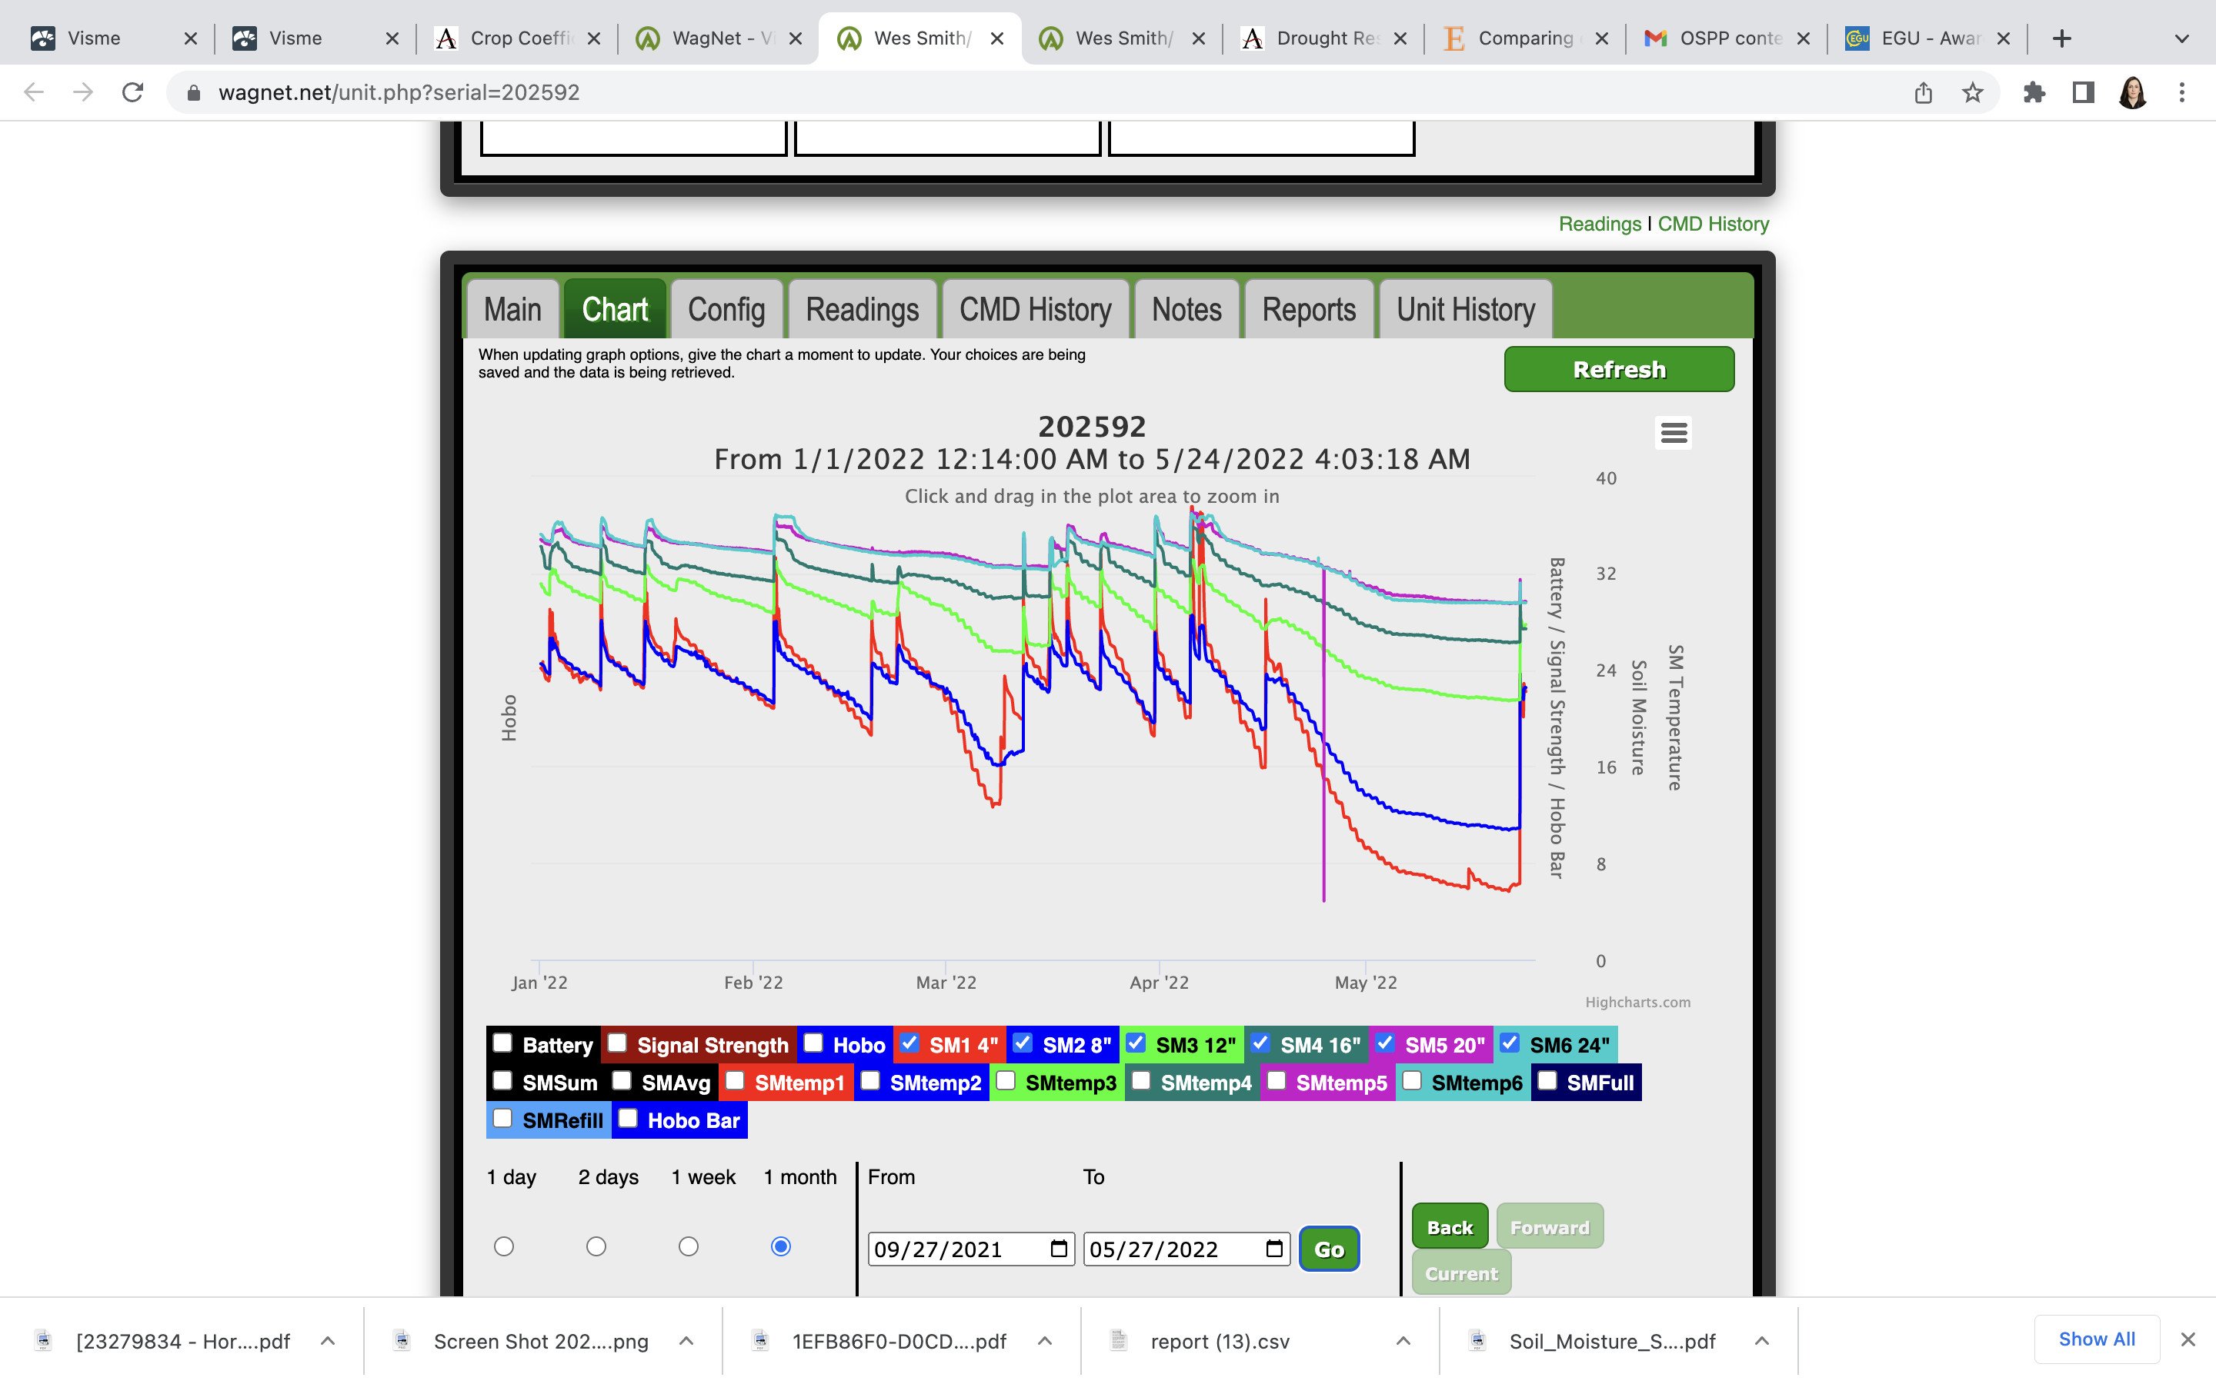
Soil moisture sensing to calculate
ET_{c} values

Slide 7
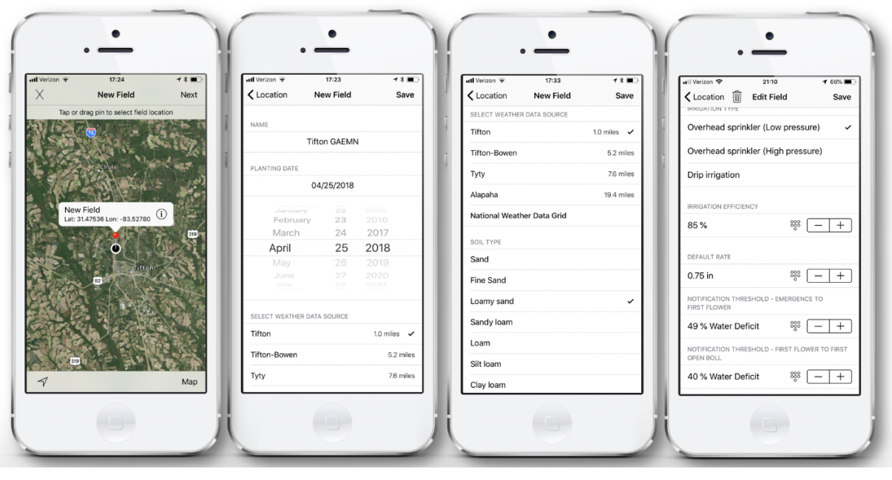
Using ET_{o} values from the previous Smart Irrigation Application
(https://smartirrigationapps.org/)

Slide 8
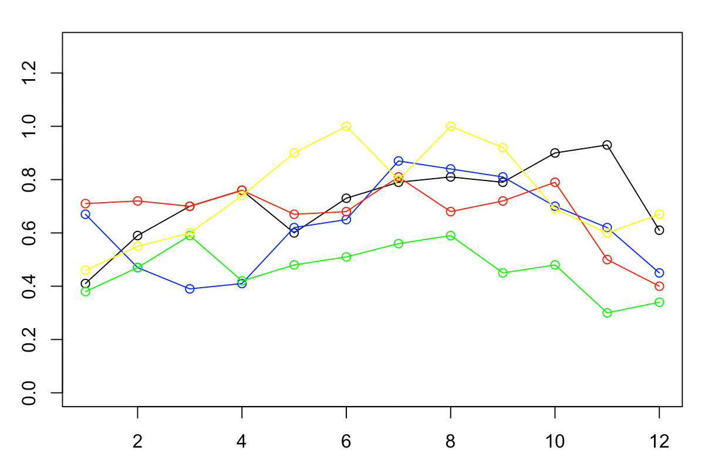
Developing Crop Coefficient Curves
K_{C} Values
Early Results:
BERMUDAGRASS-SITE1 in Black
BERMUDAGRASS-SITE2 in Blue
TALL FESCUE in Red
BAHIA GRASS-SITE1 in Green
BAHIAGRASS-SITE2 in Yellow
Months

Slide 9
Refining the results:
(Example of Bahia grass)
Steps to refine the data points:
Soil moisture graphs
Solar radiation data
Minimum and Maximum temperatures
Considering Growing Degree Days

Slide 10
Highlights:
Using Volumetric Water Content for soil moisture measurements
Socio-economic implications of the new Smart Irrigation App.
Avoiding vegetative stress periods
Quantify the duration and frequency of flash droughts

Slide 11

THANK YOU!

