Slide 1

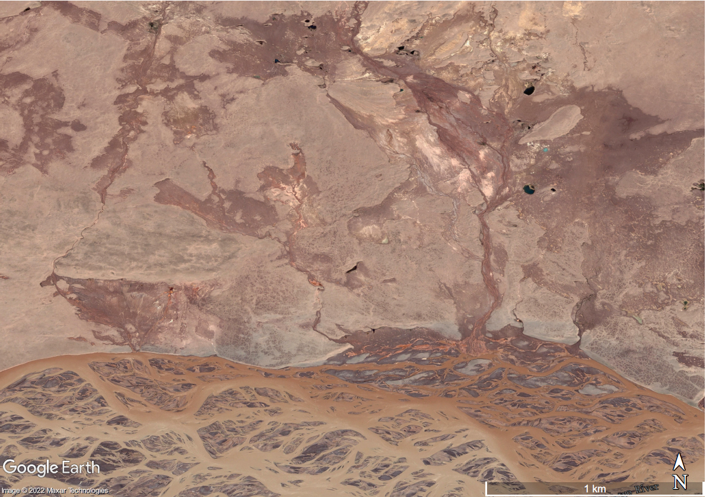
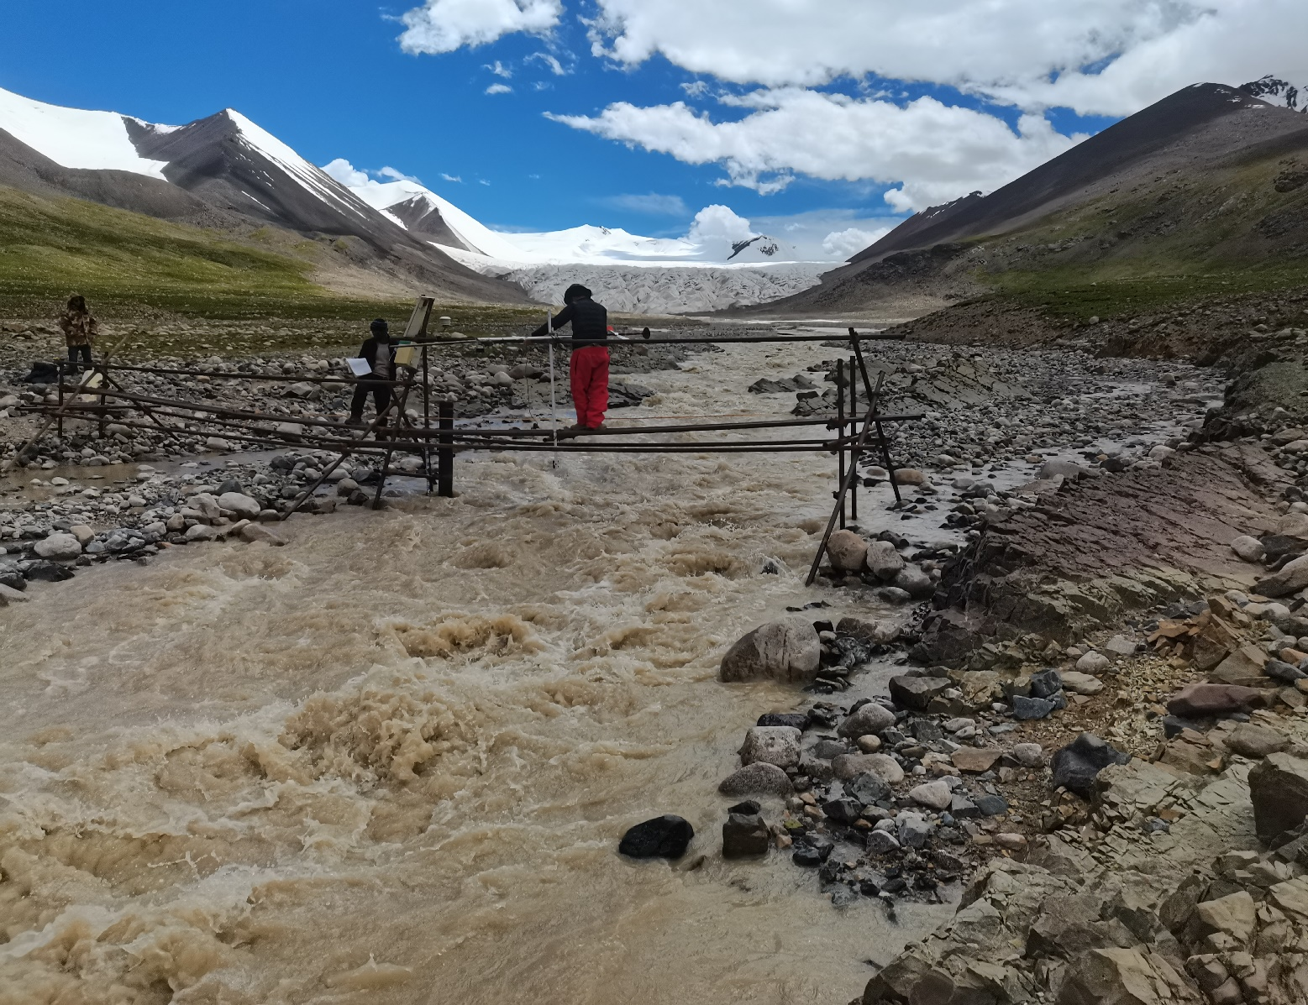
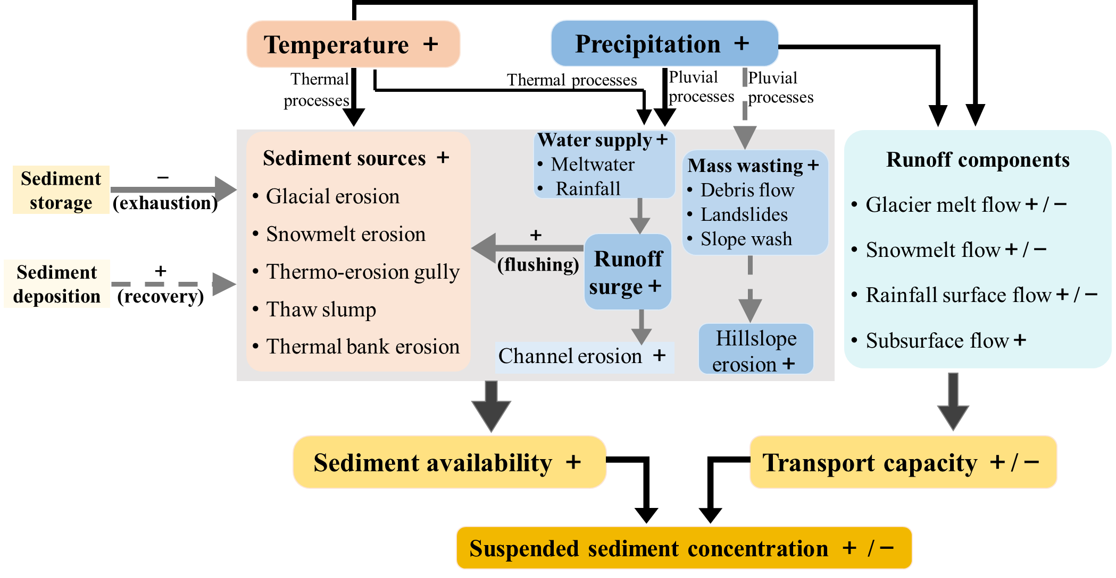

EGU2022-1038
Basin-scale sediment transport and modeling in a permafrost-dominated basin: SAT-model
Ting Zhang¹, Dongfeng Li¹, Albert J. Kettner², Xixi Lu¹
¹Department of Geography, National University of Singapore, Kent Ridge 117570, Singapore; ²CSDMS, Institute of Arctic and Alpine Research, University of Colorado Boulder, Boulder, CO 80309, USA

Slide 2
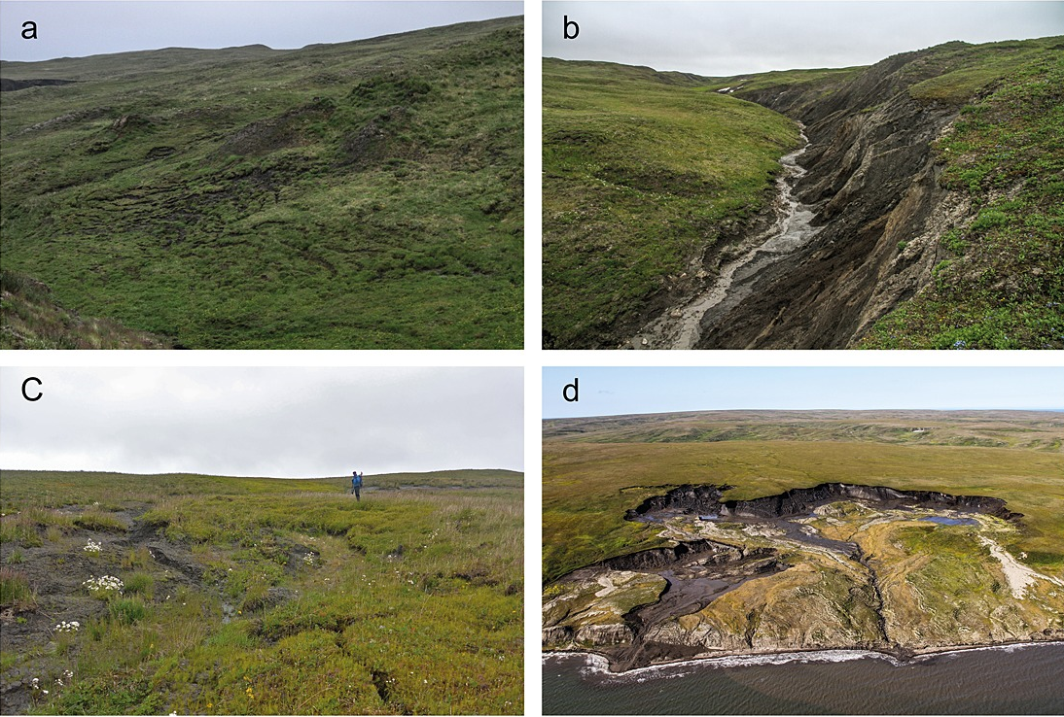
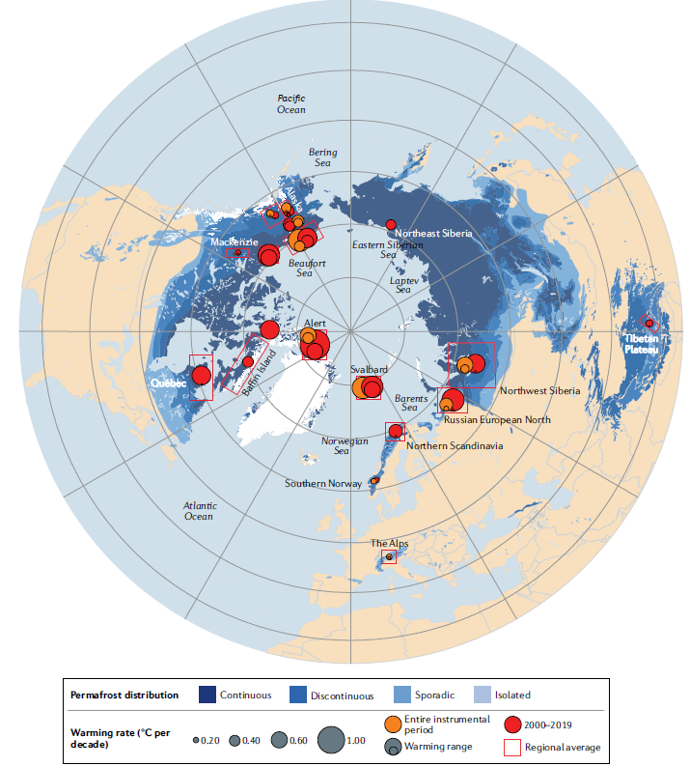
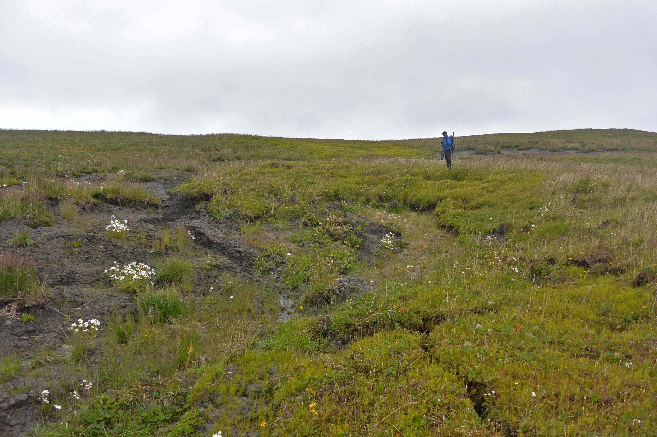
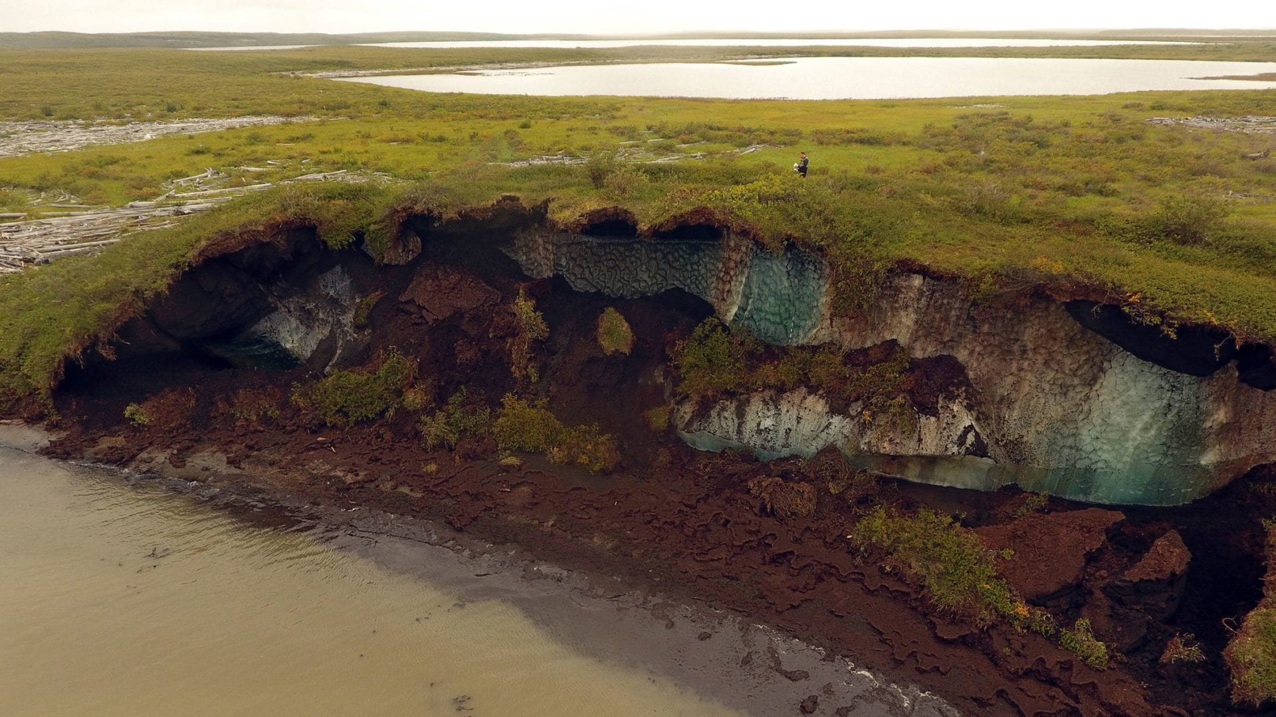
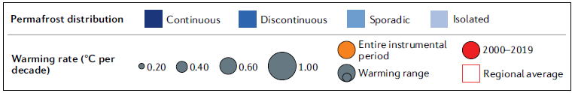
Sediment transport
1
Permafrost thaw & Thermokarst landscapes
1
(Smith et al., 2022)
(Rowland et al., 2010)
(Obu et al., 2017)
1
2
4
2
(Obu et al., 2017)
5
3
3
6
(Obu et al., 2017)
4
Main sediment sources
Negative feedback
Thaw slump
Active layer detachment
Thermal erosion gully
Thermal bank erosion
Thermokarst lake
Infiltration of surface flow
Landscape stabilization
2/9
Smith, S.L., O’Neill, H.B., Isaksen, K., Noetzli, J., Romanovsky, V.E., 2022. The changing thermal state of permafrost. Nature Reviews Earth & Environment, 3(1): 10-23.
Obu, J. et al., 2017. Effect of Terrain Characteristics on Soil Organic Carbon and Total Nitrogen Stocks in Soils of Herschel Island, Western Canadian Arctic. Permafrost and Periglacial Processes, 28(1): 92-107.
Rowland, J.C. et al., 2010. Arctic Landscapes in Transition: Responses to Thawing Permafrost. Eos, Transactions American Geophysical Union, 91(26): 229-230.

Slide 3
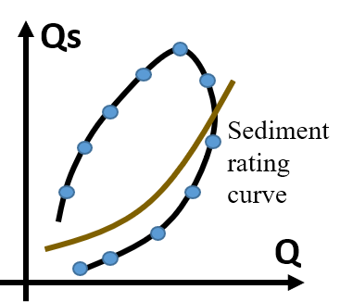
Model framework
2
Sediment-Availability-Transport model
Suspended sediment concentration
Discharge
a-coefficient: erosion severity.
b-coefficient: new available sediment sources
Sediment-Availability-Transport (SAT) model:
Thermally-activated erosion processes due to cryosphere melting
Pluvial erosion processes enhanced by runoff surge
Sediment availability regulated by exhaustion and recovery of sediment storage
Parameterize?
Determine formula?
Thermal term
Pluvial term
Fluvial term (baseflow)
3/9
Zhang, T., Li, D., Kettner, A.J., Zhou, Y., Lu, X., 2021. Constraining Dynamic Sediment‐Discharge Relationships in Cold Environments: the Sediment‐Availability‐Transport (SAT) Model. Water Resources Research.

Slide 4
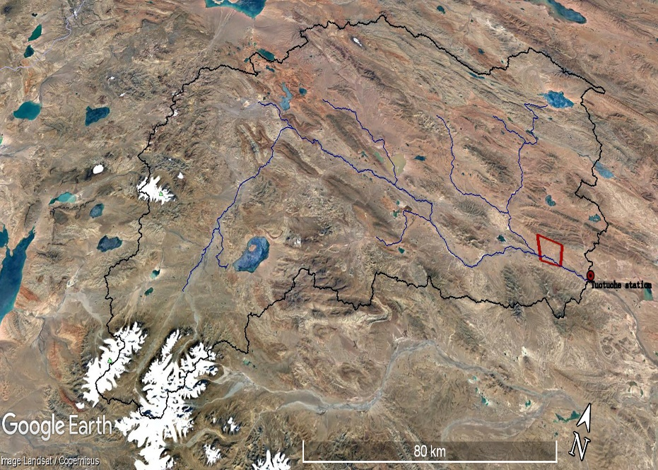
Model application
3
Permafrost dominated basin: Tuotuohe
4/9
Zhang, T., Li, D., Kettner, A.J., Zhou, Y., Lu, X., 2021. Constraining Dynamic Sediment‐Discharge Relationships in Cold Environments: the Sediment‐Availability‐Transport (SAT) Model. Water Resources Research.
Li, D., Overeem, I., Kettner, A.J., Zhou, Y., Lu, X., 2021. Air Temperature Regulates Erodible Landscape, Water, and Sediment Fluxes in the Permafrost-Dominated Catchment on the Tibetan Plateau. Water Resources Research.

Slide 5
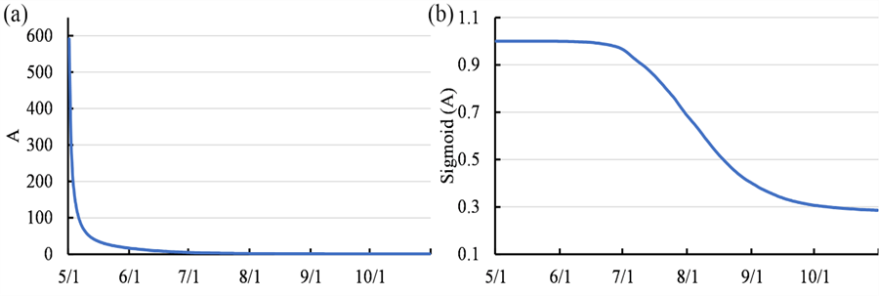
Model application
3
Parameter in SAT-model
Parameterization at a daily scale:
Magnitude of temperature :
Pluvial processes: Strengthening sediment erosion and flushing with runoff increase
Temperature antecedent: L-day
Runoff increase:
Thermal processes: Increasing sediment sources with cryosphere loss
Channel erosion by baseflow
For a given day i:
Q_{i}: discharge
T_{i}: L-day average temperature
QI_{i}: L-day discharge increase
E_{i}: dimensionless geomorphic exhaustion index
a_{n}, b_{n} : parameters need to be calibrated
Parameterization
Effective increase in water supply, with L-day time lag
Sediment exhaustion index:
Previous storage is assumed to be continuously depleted within a hydrological year
5/9
Zhang, T., Li, D., Kettner, A.J., Zhou, Y., Lu, X., 2021. Constraining Dynamic Sediment‐Discharge Relationships in Cold Environments: the Sediment‐Availability‐Transport (SAT) Model. Water Resources Research.

Slide 6
Event scale: 2002 with the largest SSC
3
Model performance
Decadal scale
Seasonal scale
6/9
Zhang, T., Li, D., Kettner, A.J., Zhou, Y., Lu, X., 2021. Constraining Dynamic Sediment‐Discharge Relationships in Cold Environments: the Sediment‐Availability‐Transport (SAT) Model. Water Resources Research.

Slide 7
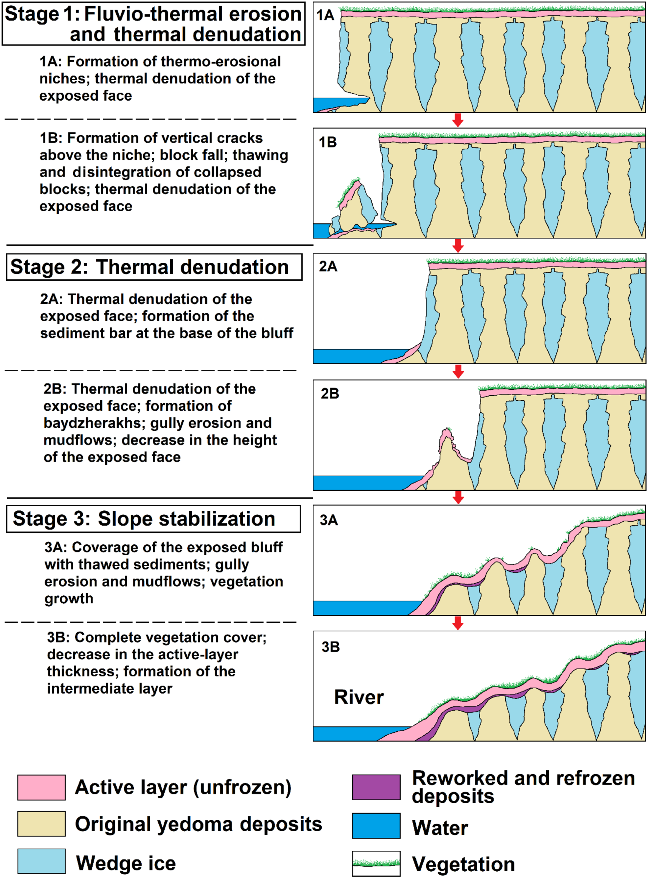
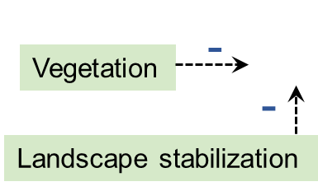
Take home message
Merits over sediment rating curve
having robust capability to reproduce long-term and short-term SSC-Q relationships by incorporating thermally activated erosion and fluvial erosion;
possessing a straightforward function with clear physical meaning, driven by easily obtained data;
providing a ready-to-use model framework that can be applied to other cold basins and continuously developed to incorporate more processes explicitly.
Next step…
Consider negative effects introduced by landscape stabilization, vegetation, and surface flow infiltration
Incorporate recovery and depletion of sediment supply between peak events
Estimate model parameters for ungauged basins by investigating their relationships with basin characteristics.
Recovery
(Shur et al., 2021)
Depletion
Depletion
7/9
Shur, Y. et al., 2021. Fluvio‐thermal erosion and thermal denudation in the yedoma region of northern Alaska: Revisiting the Itkillik River exposure. Permafrost and Periglacial Processes, 32(2): 277-298.

Slide 8

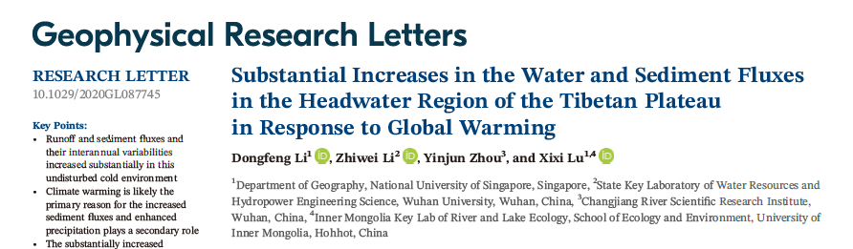
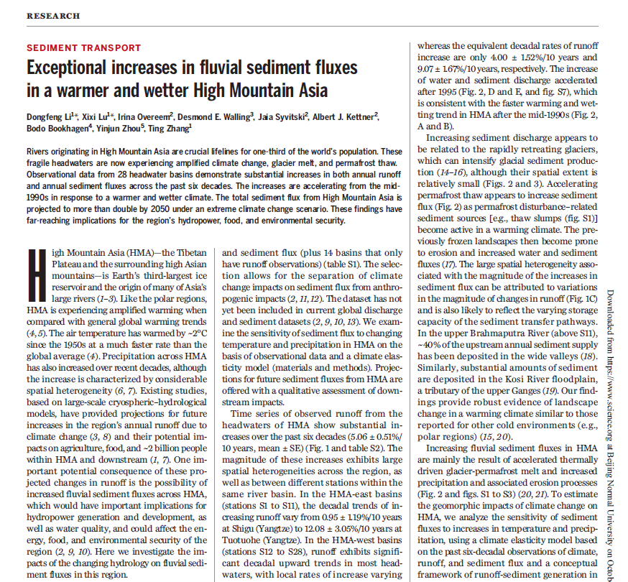
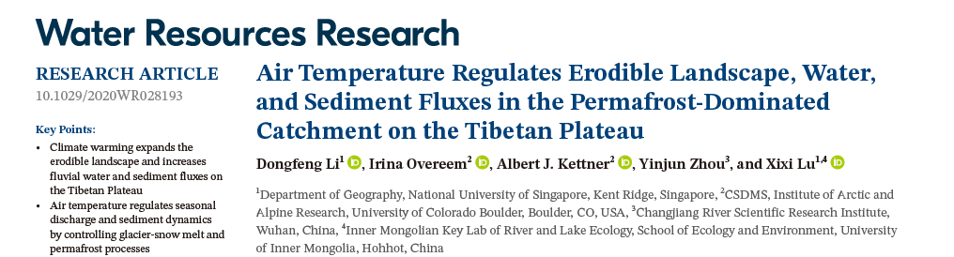
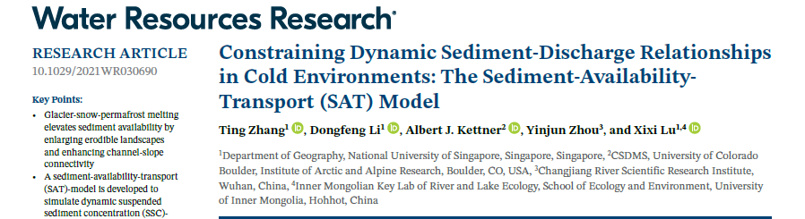
Thank You
Ting Zhang
(zhang_ting@u.nus.edu)

Slide 9
Simulating results
S
Amplified Sediment Availability
Pluvial processes dominated by baseflow:
sediment transported by baseflow in the low-flow period (e.g. channel erosion by baseflow) when erosion processes are not amplified by changes of temperature and discharge due to relatively low temperature and runoff and fewer rainfall.
9/9
Zhang, T., et al., 2021. Constraining Dynamic Sediment‐Discharge Relationships in Cold Environments: the Sediment‐Availability‐Transport (SAT) Model. Water Resources Research.

Slide 10
Simulating results
S
Dynamic SSC-Q Relationship
Time-lag in QI | 1 | 2 | 3 | 4 | 5 | 6 | 7
R² of M_{F} | 0.705 | 0.698 | 0.683 | 0.676 | 0.668 | 0.663 | 0.656
Time-lag in T | 0 | 7 | 14 | 21 | 28
R² of M_{T} | 0.654 | 0.678 | 0.669 | 0.664 | 0.662
10/9
Zhang, T., et al., 2021. Constraining Dynamic Sediment‐Discharge Relationships in Cold Environments: the Sediment‐Availability‐Transport (SAT) Model. Water Resources Research.

Slide 11
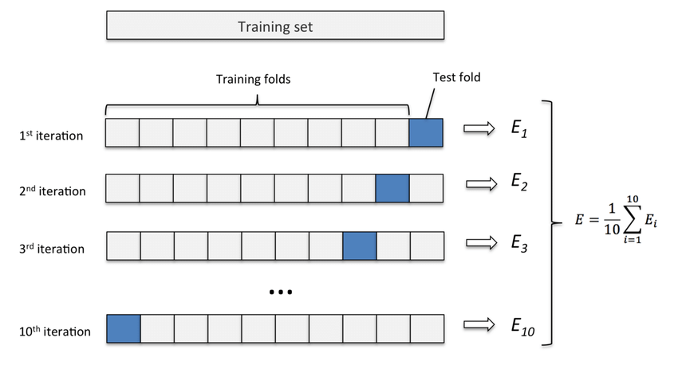
Validation
S
Cross-Validation of the SAT-Model
Randomly pick 10 years from 1985-2017 to calibrate the model and use the rest data as validation:
SAT model | Cali |  |  | Veri
Scheme1 | Nse | RE | R2 | Nse | RE | R2
G1 | 0.76 | 0.02 | 0.76 | 0.74 | -0.01 | 0.75
G2 | 0.75 | 0.02 | 0.75 | 0.74 | 0.10 | 0.75
G3 | 0.71 | 0.02 | 0.71 | 0.76 | 0.11 | 0.77
G4 | 0.76 | 0.00 | 0.76 | 0.72 | -0.02 | 0.73
G5 | 0.79 | 0.01 | 0.79 | 0.72 | 0.00 | 0.72
G6 | 0.78 | 0.03 | 0.78 | 0.62 | 0.20 | 0.71
G7 | 0.72 | 0.01 | 0.72 | 0.75 | 0.05 | 0.76
G8 | 0.77 | 0.01 | 0.77 | 0.72 | -0.06 | 0.73
G9 | 0.82 | 0.01 | 0.82 | 0.71 | 0.01 | 0.71
G10 | 0.78 | 0.01 | 0.78 | 0.72 | 0.01 | 0.73
year | G1 | G2 | G3 | G4 | G5 | G6 | G7 | G8 | G9 | G10
1 | 1988 | 1989 | 1985 | 1985 | 1988 | 1985 | 1987 | 1987 | 1985 | 1985
2 | 1990 | 1994 | 1989 | 1986 | 1989 | 1986 | 1991 | 1989 | 1987 | 1989
3 | 1993 | 1998 | 1994 | 1987 | 1994 | 1989 | 1999 | 1999 | 1989 | 1990
4 | 1995 | 1999 | 1998 | 1988 | 1998 | 1990 | 2003 | 2001 | 1992 | 1992
5 | 1997 | 2001 | 1999 | 1989 | 2002 | 1991 | 2004 | 2008 | 1999 | 1996
6 | 2000 | 2007 | 2001 | 1999 | 2008 | 1992 | 2006 | 2009 | 2000 | 1997
7 | 2003 | 2011 | 2004 | 2001 | 2012 | 1996 | 2007 | 2012 | 2001 | 1999
8 | 2005 | 2013 | 2006 | 2002 | 2013 | 1998 | 2012 | 2014 | 2002 | 2002
9 | 2010 | 2015 | 2009 | 2012 | 2014 | 2005 | 2013 | 2015 | 2007 | 2011
10 | 2017 | 2016 | 2011 | 2017 | 2016 | 2013 | 2015 | 2016 | 2010 | 2015
Rating Curve | Cali |  |  | Veri
Rating Curve | Nse | RE | R2 | Nse | RE | R2
G1 | 0.58 | -0.02 | 0.58 | 0.53 | -0.04 | 0.54
G2 | 0.57 | -0.02 | 0.57 | 0.53 | 0.05 | 0.54
G3 | 0.50 | -0.04 | 0.51 | 0.56 | 0.00 | 0.57
G4 | 0.56 | -0.06 | 0.56 | 0.53 | -0.11 | 0.54
G5 | 0.53 | -0.03 | 0.53 | 0.56 | -0.04 | 0.56
G6 | 0.58 | 0.00 | 0.58 | 0.50 | 0.16 | 0.54
G7 | 0.51 | 0.02 | 0.51 | 0.55 | 0.08 | 0.55
G8 | 0.58 | -0.07 | 0.58 | 0.51 | -0.20 | 0.54
G9 | 0.61 | -0.05 | 0.61 | 0.51 | -0.05 | 0.52
G10 | 0.57 | -0.05 | 0.57 | 0.53 | -0.07 | 0.54
Model performance in ten-time cross-validation
Metrics | SAT-model |  | Sediment rating curve
 | Calibration | Verification | Calibration | Verification
NSE | 0.76±0.010 | 0.72±0.012 | 0.56±0.010 | 0.53±0.006
RE (%) | 1.43±0.266 | 3.84±2.292 | -3.34±0.784 | -2.18±3.050
R² | 0.76±0.010 | 0.74±0.006 | 0.56±0.010 | 0.54±0.004
stable performance
outperforming the rating curve by 0.2
11/9
Zhang, T., et al., 2021. Constraining Dynamic Sediment‐Discharge Relationships in Cold Environments: the Sediment‐Availability‐Transport (SAT) Model. Water Resources Research.

