Slide 1
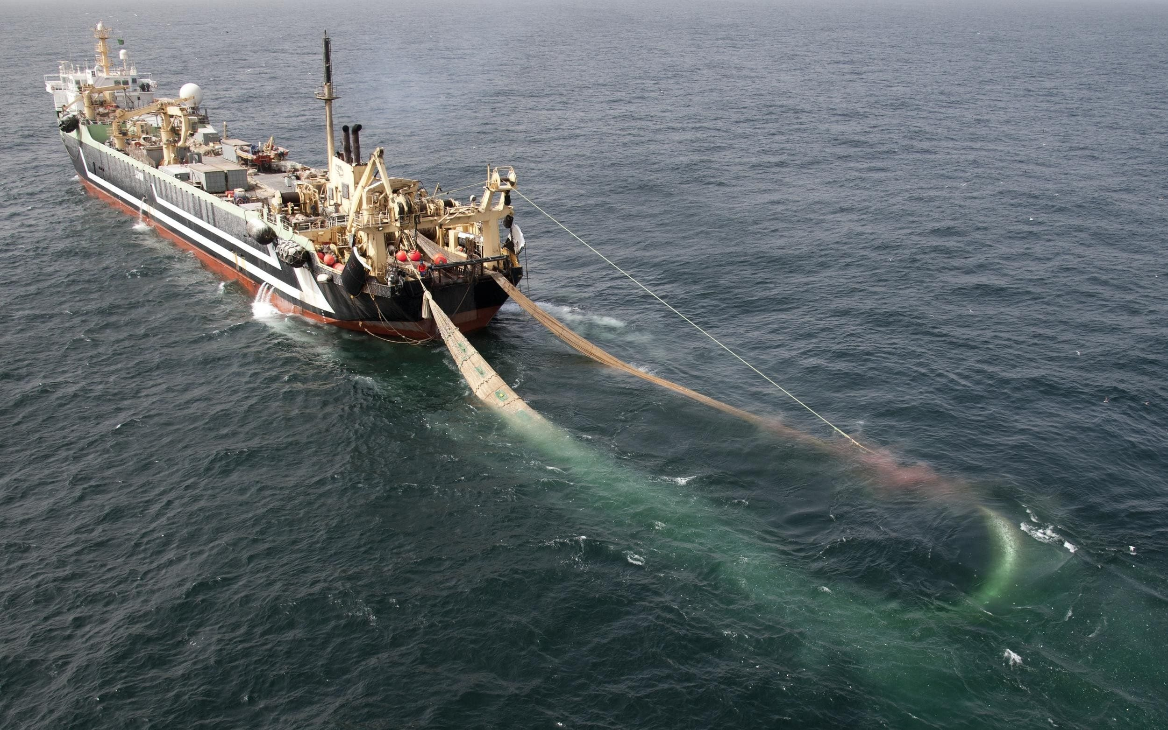



Assessing the Potential Vulnerability of Sedimentary Carbon Stores to Benthic Trawling within the UK EEZ
Kirsty Black*, Dr. Craig Smeaton, Dr. William Turrell, and Professor. William Austin
*kb99@st-andrews.ac.uk

Slide 2
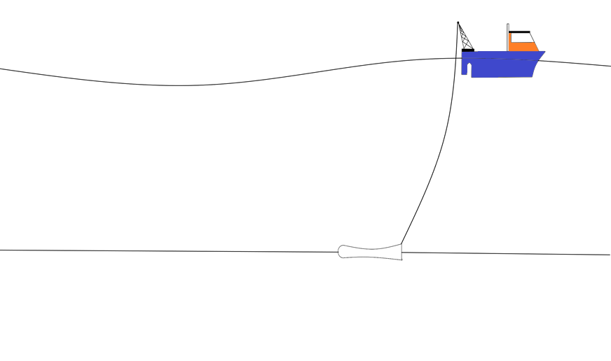




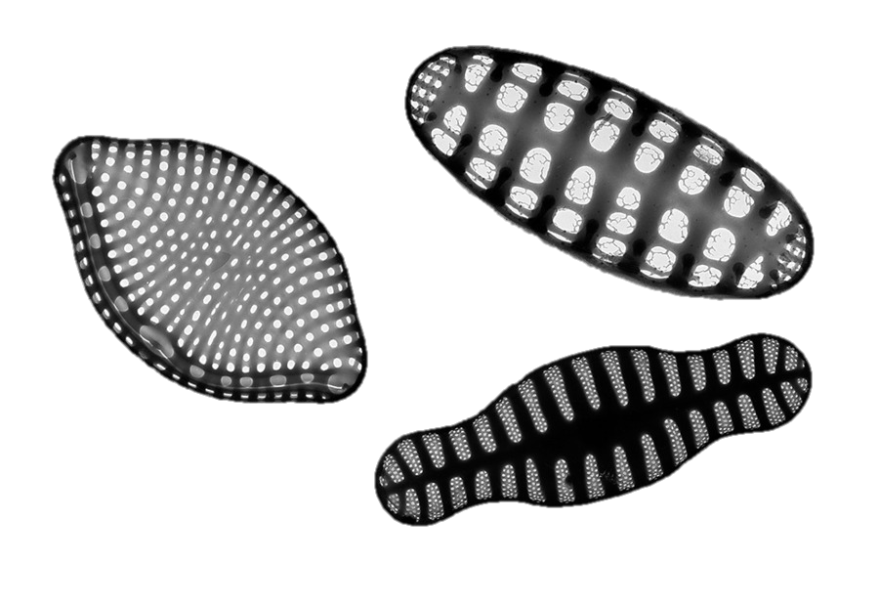




How does benthic trawling effect burial?
1
3
C lost back to the atmosphere?
CO₂ gas exchange
Consumption of org C
Consumed?
Transported by currents?
Remineralisation?
Water
Downward movement of remaining org C matter
2
Natural disturbance
Resuspension
Bioturbation
C burial and long-term storage
Sediment

Slide 3
Carbon Vulnerability Mapping Objectives
To improve the current understanding of the influence of benthic trawling on sedimentary carbon stores within the UK EEZ, it was first necessary to compile the currently available data sources. With these data sources, the following criteria were assessed:
Where is fishing activity occurring in the UK EEZ and what bottom trawling gear type is being used?
What is the sediment type in these highly fished areas?
How fast will sediment resettle based on sediment type?
How labile are the sediments?
How much organic carbon is stored in these sediments?

Slide 4
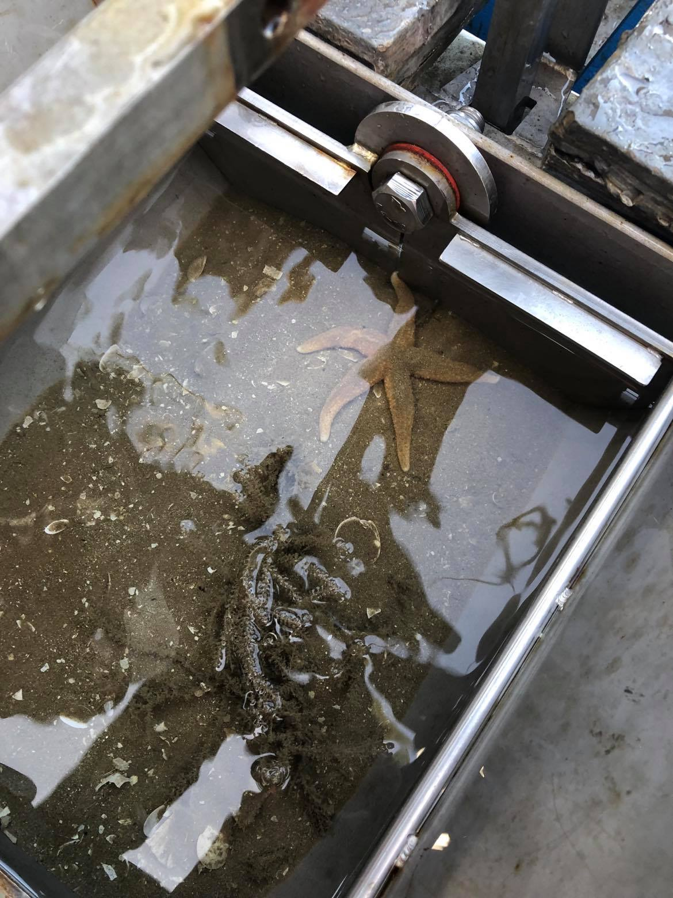
Carbon Vulnerability Ranking
By combining the 5 key variables with the addition of several external constant parameters such as the sediment penetration depth of the towed gear, it is possible to generate a carbon vulnerability ranking for the UK EEZ.
The carbon vulnerability ranking identifies areas where sedimentary organic carbon is potentially most vulnerable to bottom trawling activity.
While this model doesn’t estimate the fate of organic carbon (e.g. lateral transport, remineralisation, multiple-year effects etc.) it considers spatially where organic carbon is potentially most vulnerable and may be used as a tool to identify where further study efforts should be prioritised.

Slide 5
Carbon Vulnerability Ranking
The west coast of Scotland represents one of the key areas where sedimentary carbon is potentially most vulnerable to bottom trawling activity.
  This is largely due to the high lability of the sediments as a function of the elevated organic carbon content of these sediments as well as their cohesive muddy nature.
Unlike other threats to sedimentary carbon stores (e.g. increased storminess, ocean acidification, temperature changes etc), anthropogenic disturbance is something which can be monitored.
  The outputs of this study may be used as a tool to identify where further study efforts should be prioritised.
  This is of particular interest due to the potential of marine sediment stores to be included within national inventories and natural capital accounting.

Slide 6
Contact Info: kb99@st-andrews.ac.uk

