Slide 1
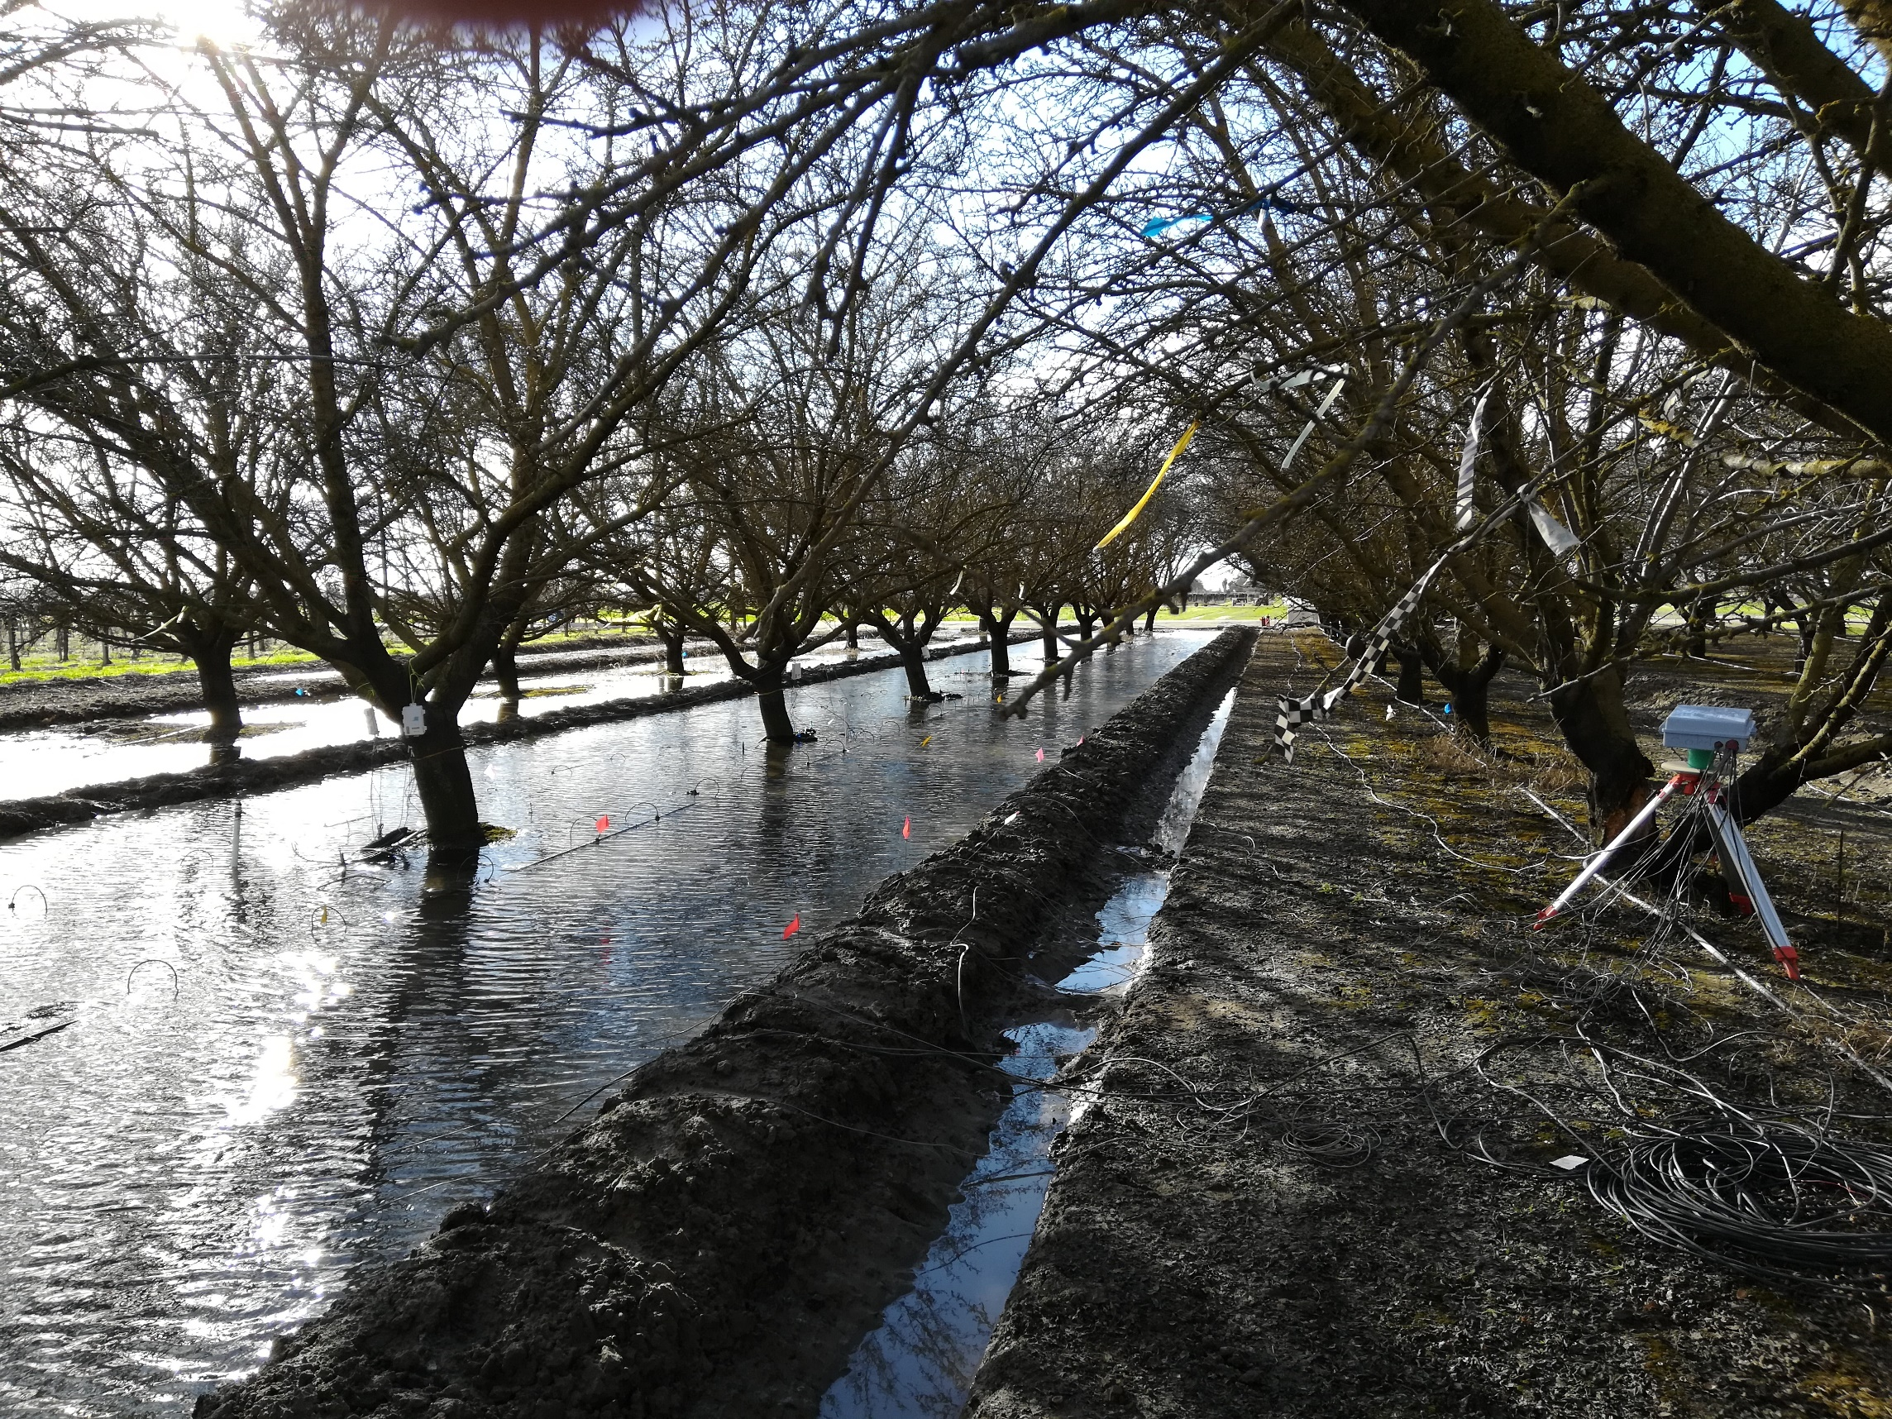


Natural and forced soil aeration during agricultural managed aquifer recharge (Ag-MAR)
Yonatan Ganot and Helen Dahlke
(ganotyo@biu.ac.il)
Acknowledgment: Cristina Prieto Garcia, Dale Pattigan, Rudy Gonzales, Vincent Silva, Franz Niederholzer, Stan Cutter, Luis A Loza Reyes

Slide 2
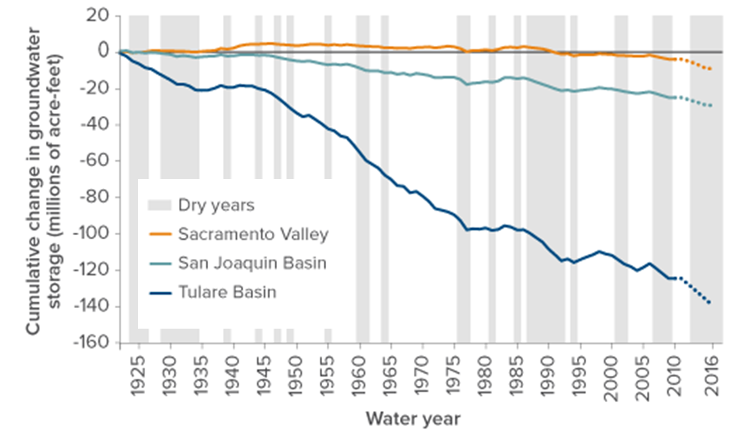
Background
California groundwater overdraft has dramatically increased in the past 100 years due to: (1) drought, (2) over pumping and (3) expansions of water intensive crops acreage
[1 acre-feet = 1233 cubic meter]

Slide 3
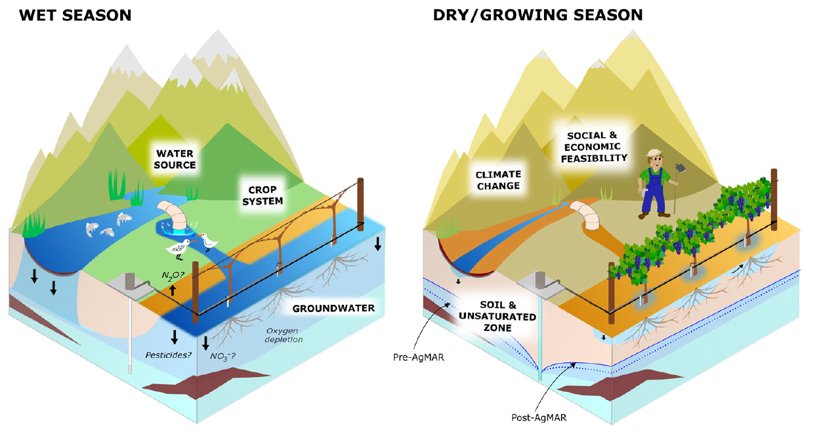
Towards sustainable groundwater use?
An integrated water resources management approach is needed to prevent future unsustainable groundwater use –
Ag-MAR is (part of) the solution
Can we guarantee “clean recharge” without yield loss and groundwater contamination?
Agricultural managed aquifer recharge (Ag-MAR)—a method for sustainable groundwater management: A review (Levintal et al., 2022)

Slide 4
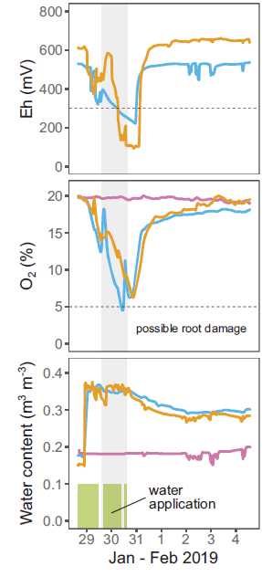
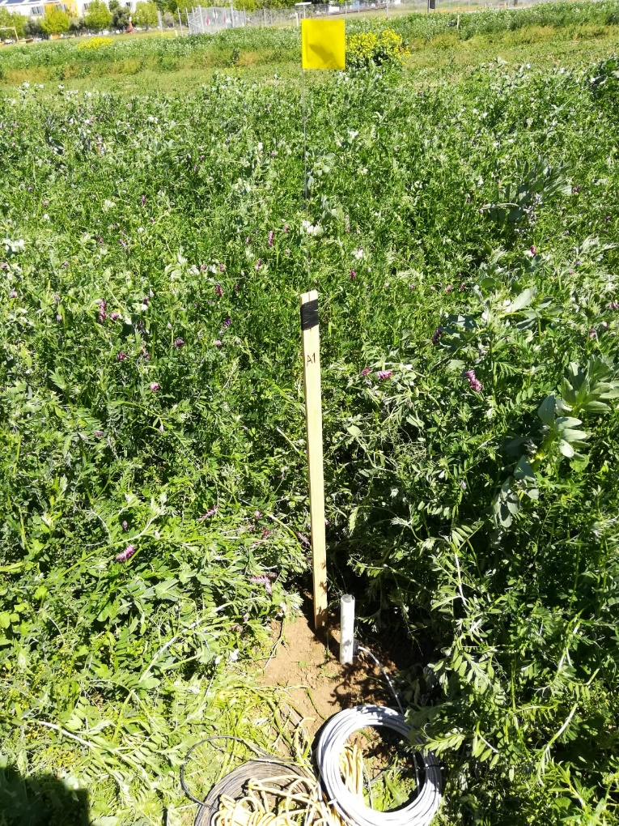
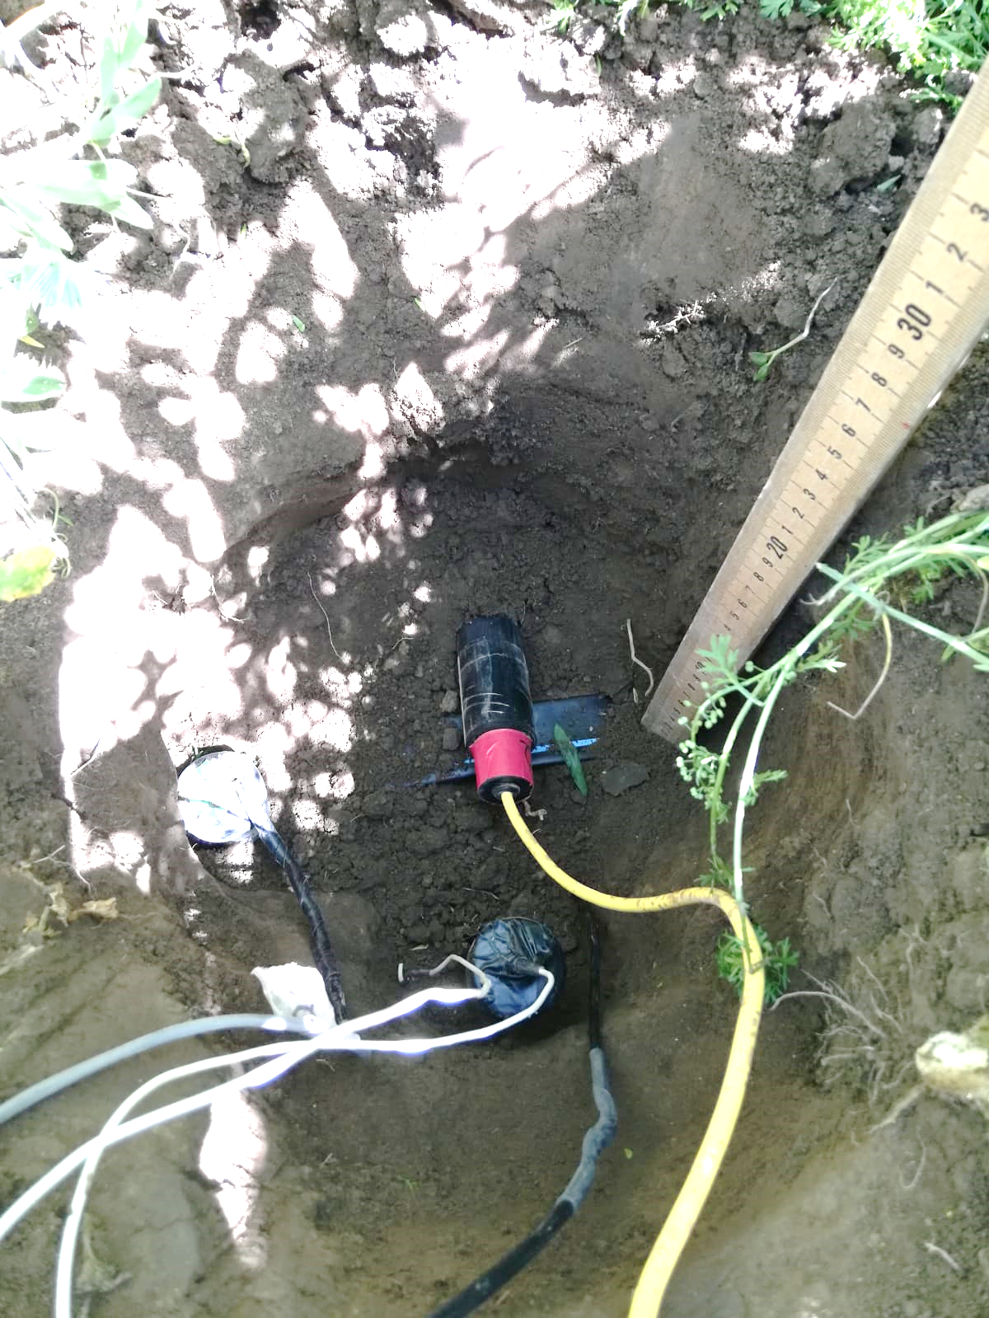
Measuring the soil aeration status
vwc
O₂
Eh
Ganot and Dahlke, (2021a)

Slide 5
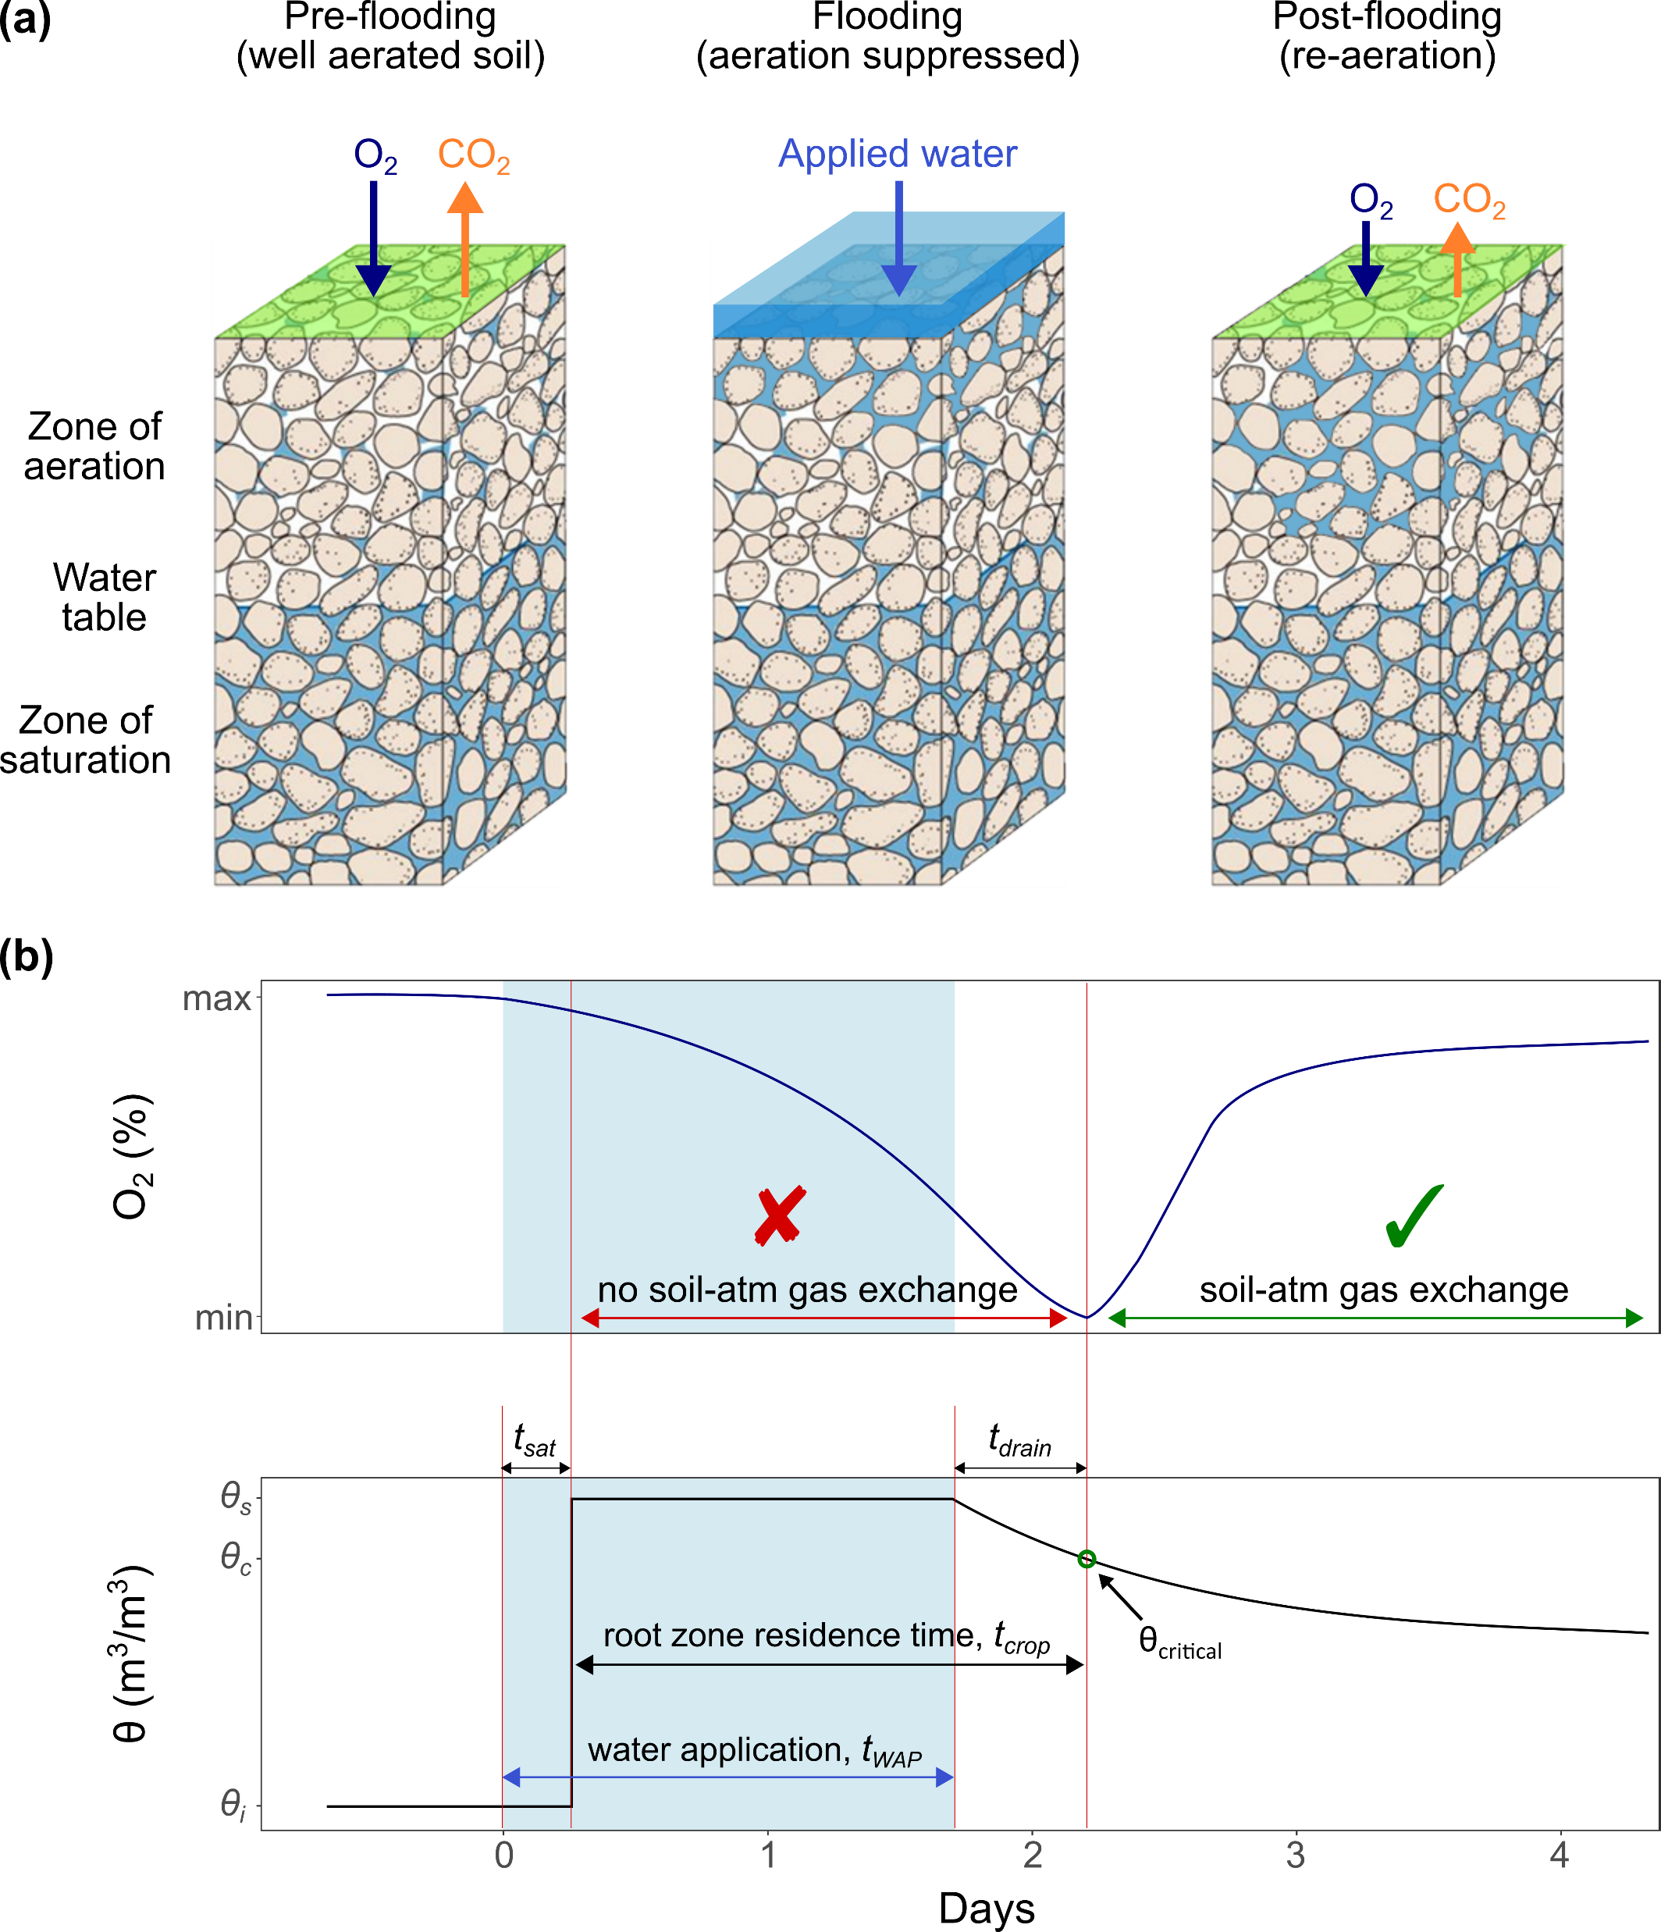
Soil aeration during Ag-MAR
Natural aeration - preventing crop yield loss by controlling flood duration
Ag-MAR water application can be estimated by simplified model based on crop tolerance, root depth, and soil texture data:
t_{wap} = t_{sat} + t_{crop} - t_{drain}
Flow model
Agronomic knowledge
Flow model
Ganot and Dahlke, (2021b)
Agricultural managed aquifer recharge (Ag-MAR)—a method for sustainable groundwater management: A review (Levintal et al., 2022)

Slide 6
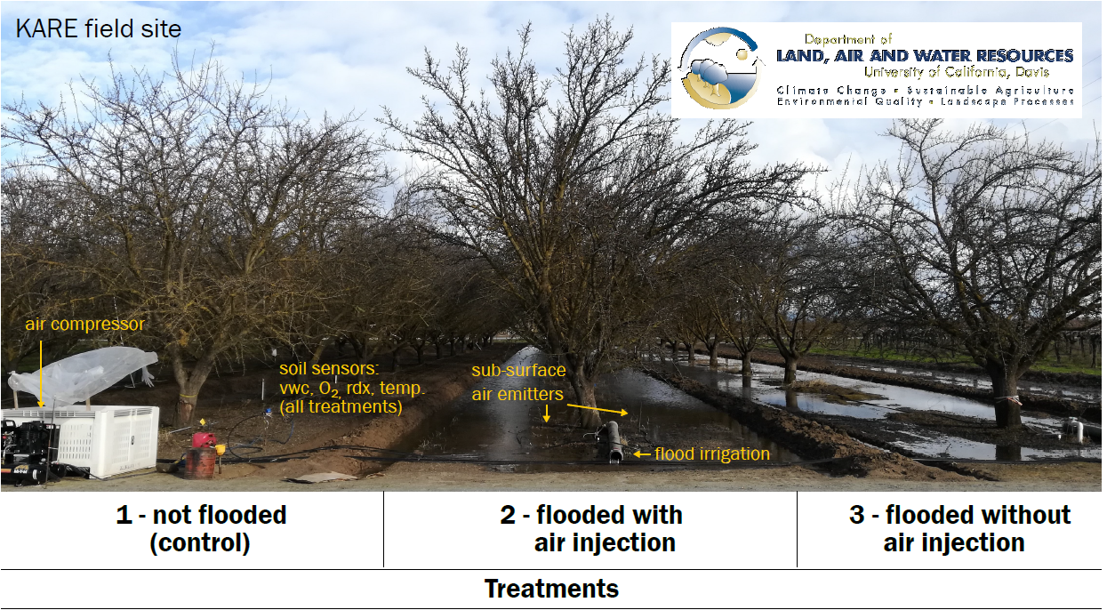
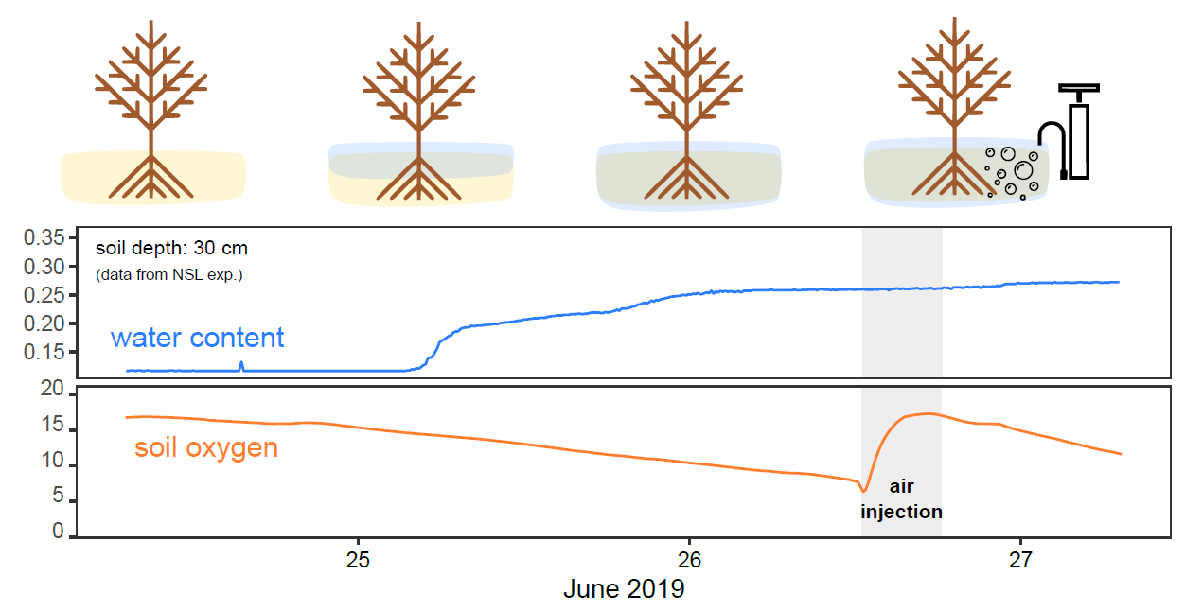
Soil aeration during Ag-MAR
Forced aeration - preventing crop yield loss by supplying oxygen
By air injection throw subsurface drip irrigation

Slide 7
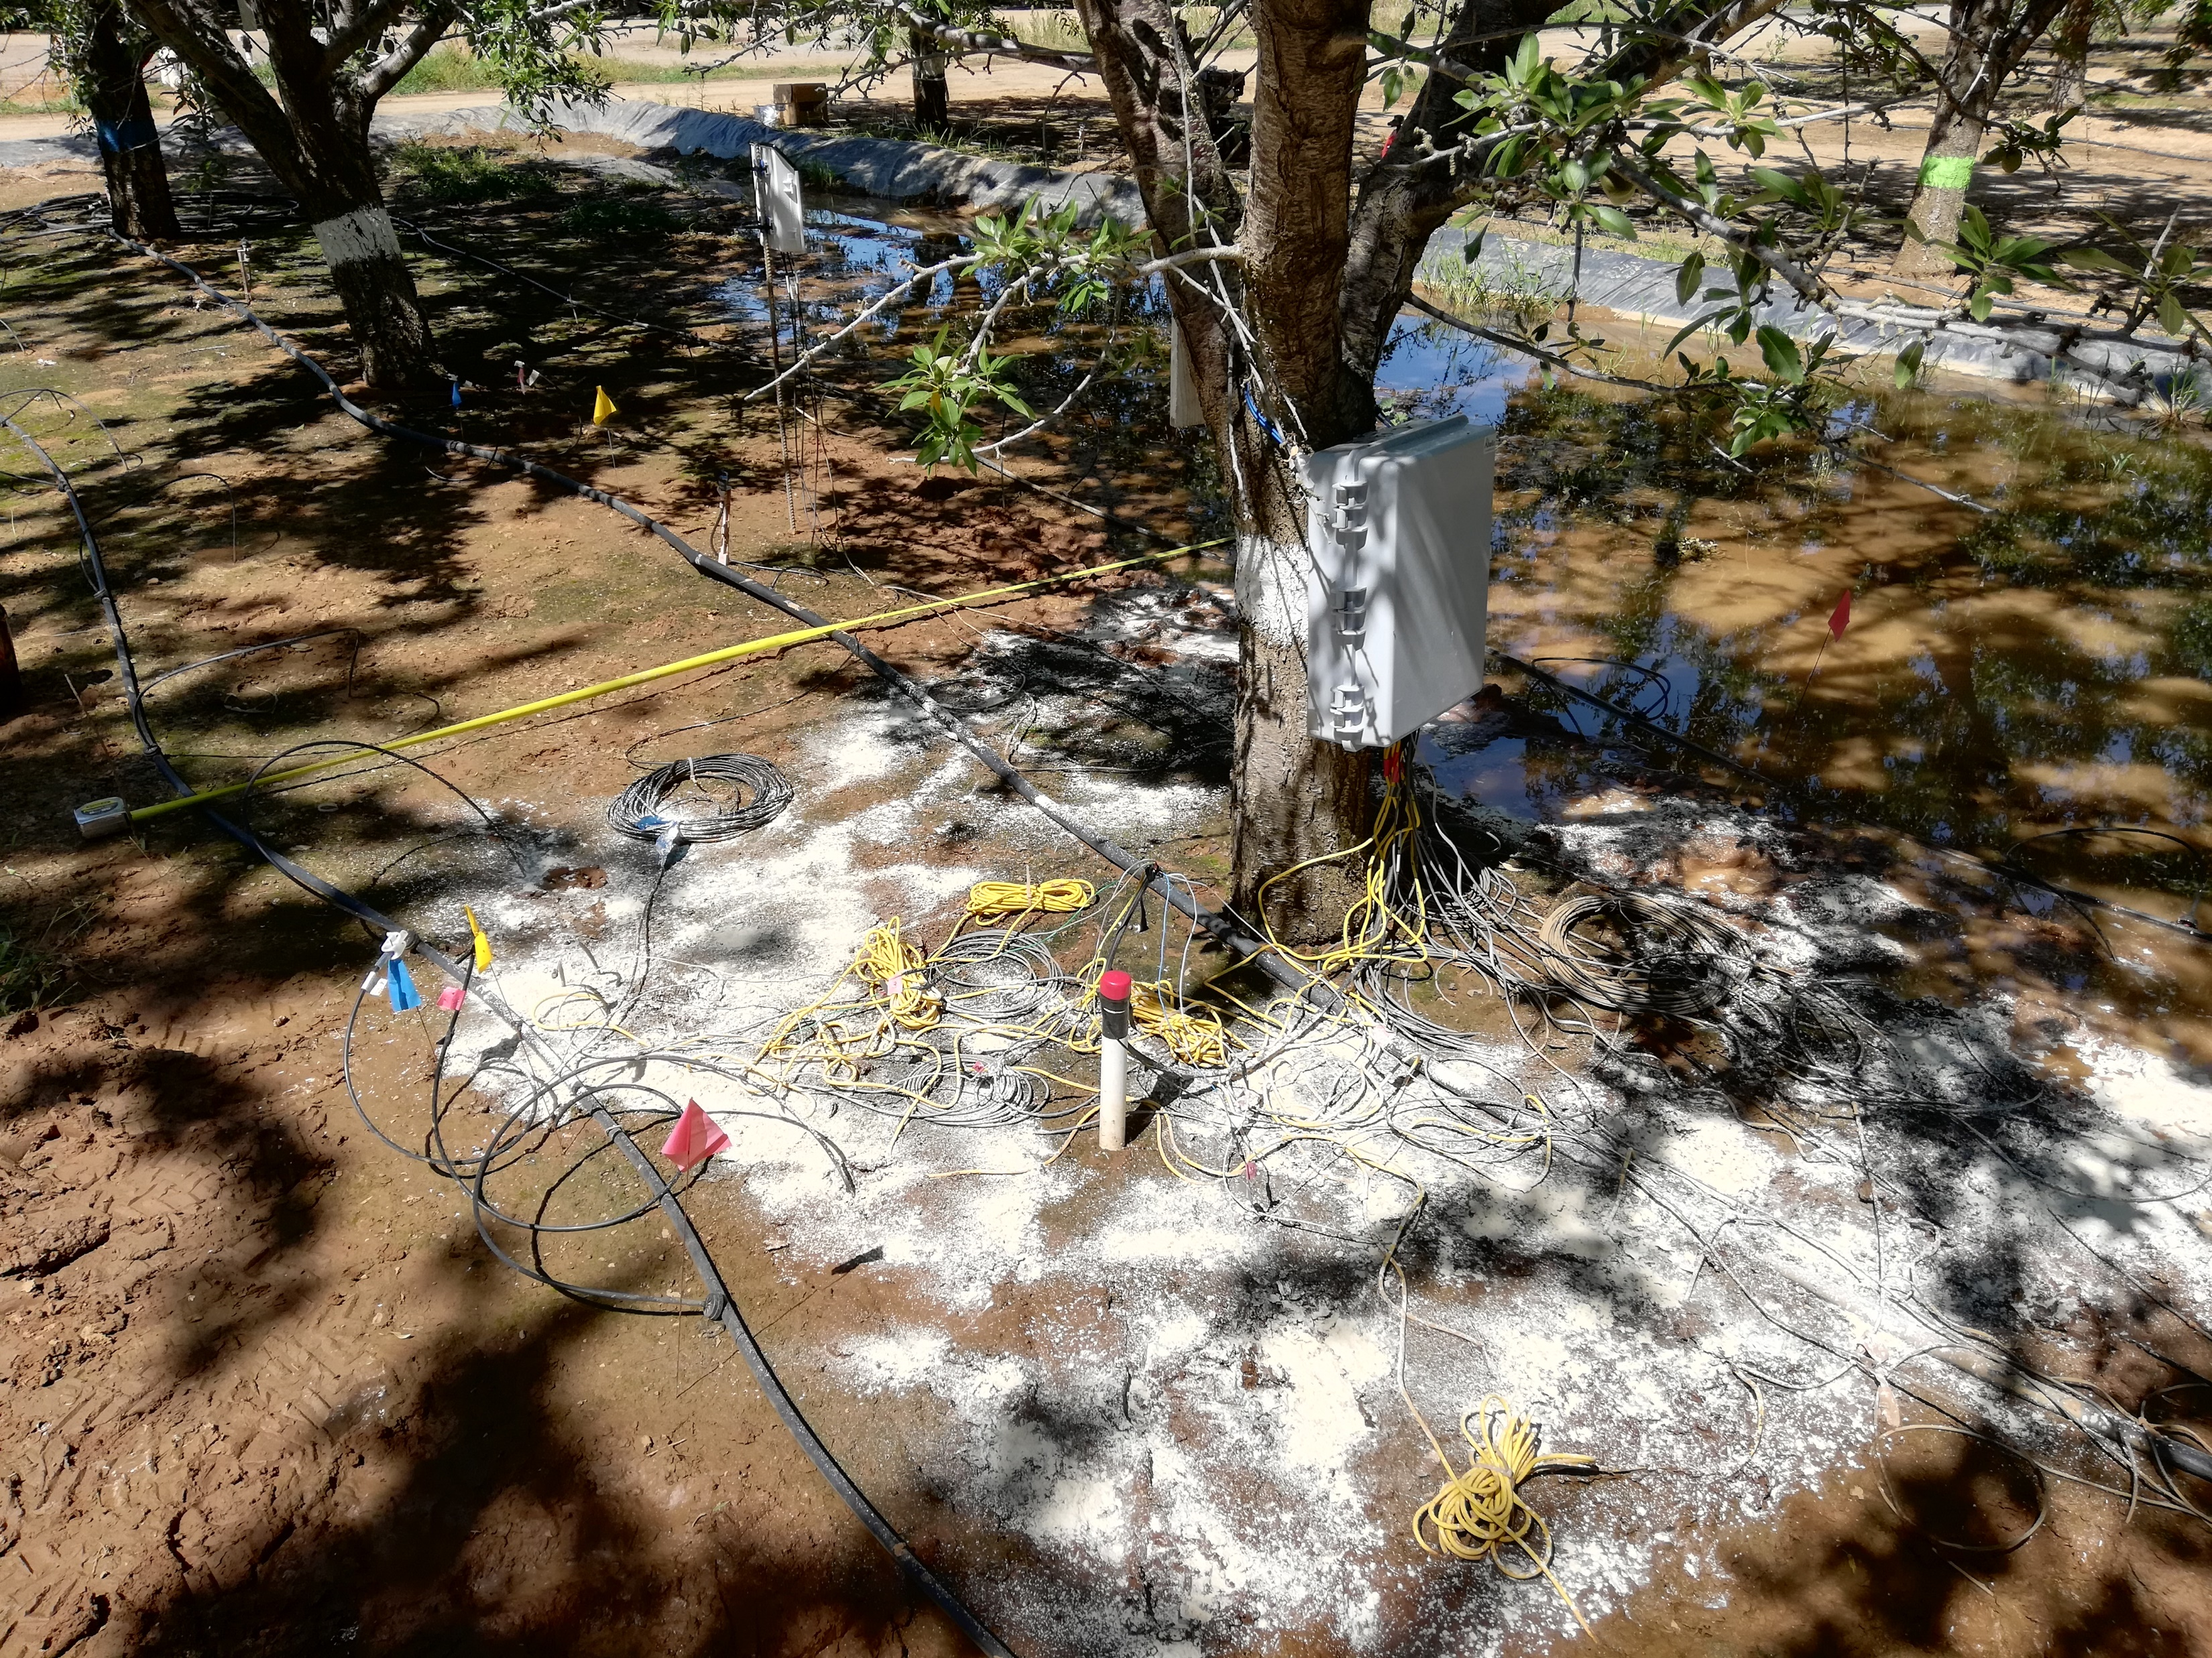
Soil aeration during Ag-MAR
Forced aeration - preventing crop yield loss by supplying oxygen
By adding peroxide compounds to the soil
(solid Ca-peroxide in our case)
Agricultural managed aquifer recharge (Ag-MAR)—a method for sustainable groundwater management: A review (Levintal et al., 2022)

Slide 8
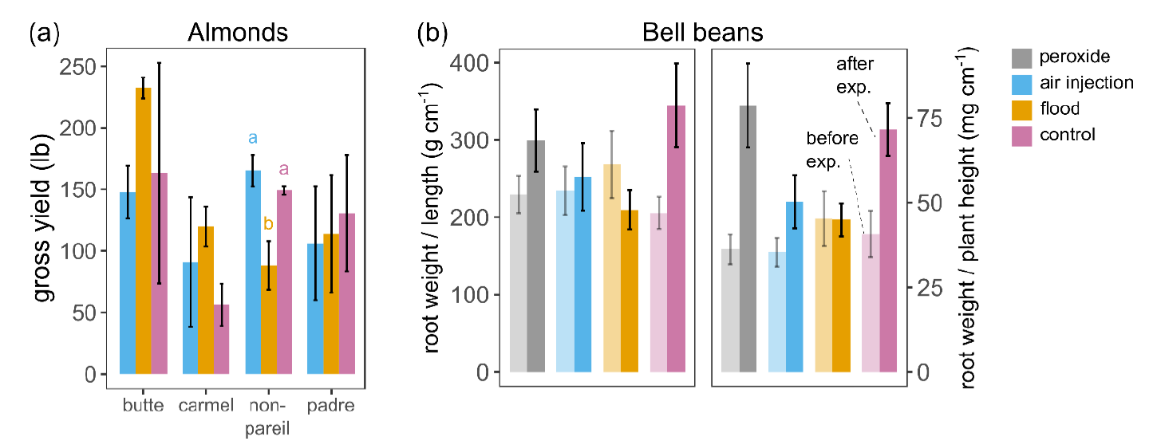
What about plant response?
Flood
+
Forced aeration
Flood
Control

Slide 9
Thank you, questions?
Ganot, Y., & Dahlke, H. E. (2021a). Natural and forced soil aeration during agricultural managed aquifer recharge. Vadose Zone Journal, 20(3), e20128. https://doi.org/10.1002/vzj2.20128
Ganot, Y., & Dahlke, H. E. (2021b). A model for estimating Ag-MAR flooding duration based on crop tolerance, root depth, and soil texture data. Agricultural Water Management, 255, 107031. https://doi.org/10.1016/j.agwat.2021.107031
Levintal, E., Kniffin, M. L., Ganot, Y., Marwaha, N., Murphy, N. P., & Dahlke, H. E. (2022). Agricultural managed aquifer recharge (Ag-MAR)—a method for sustainable groundwater management: A review. Critical Reviews in Environmental Science and Technology, 0(0), 1–24. https://doi.org/10.1080/10643389.2022.2050160

