Slide 1
Attribution of 2021 Weather Extreme Events in British Columbia
Elizaveta Malininaª, Nathan P. Gillettª, Megan Kirchmeier-Youngª, Xuebin Zhangª , Faron Anslow^{b}, Francis Zwiers^{b}
ªClimate Research Division, Environment and Climate Change Canada, Canada.
^{b}Pacific Climate Impacts Consortium, University of Victoria, Victoria, BC, Canada.
EGU22 display material:
https://doi.org/10.5194/egusphere-egu22-10422

Slide 2
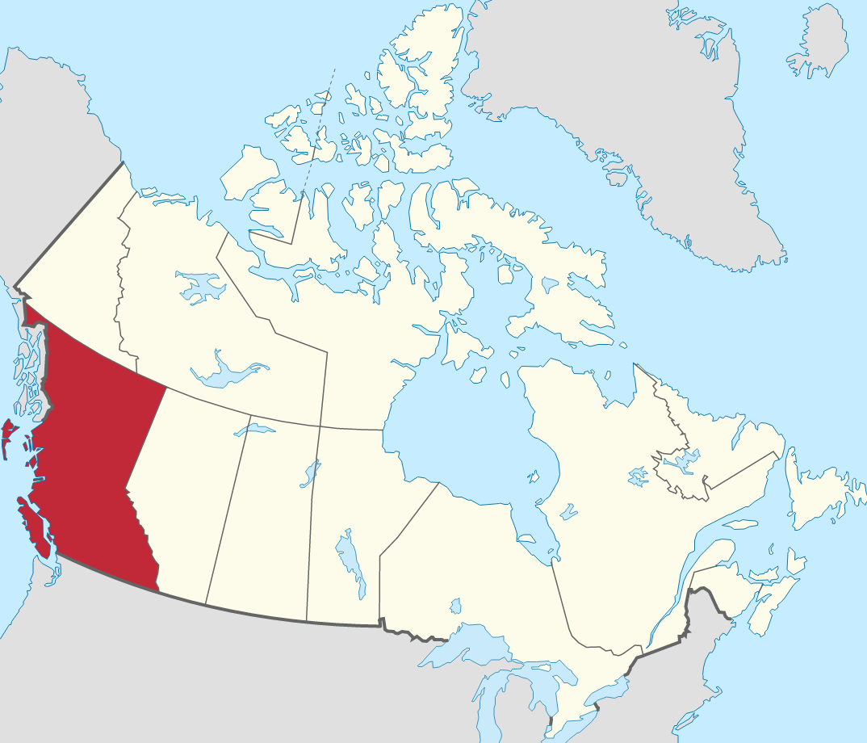
introduction
In 2021 BC was struck by two major weather extreme events
Heat wave in late June:
Temperature records broken in multiple locations by several degrees
600+ lives lost
Extreme precipitation in mid-November:
Brought by a westerly oriented atmospheric river
The resulting flooding estimated to be the costliest natural disaster in BC
5 fatalities, over 450 million CAD insured losses
Scientific questions:
What was the scale of the events? How unusual were they?
What is the contribution of human induced climate change?
What to expect in the future?
British Columbia (BC) Source: Wikipedia
https://doi.org/10.5194/egusphere-egu22-10422

Slide 3
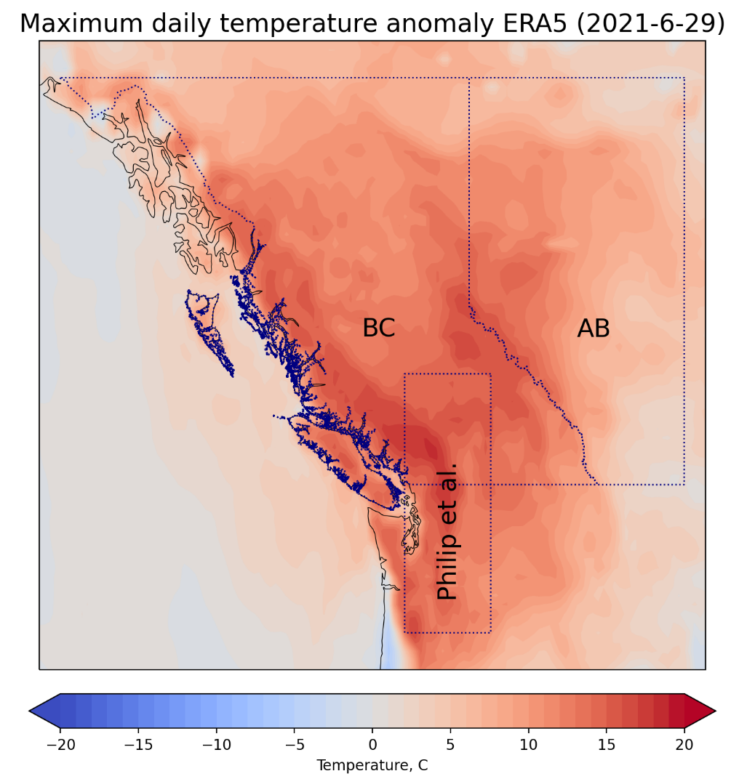
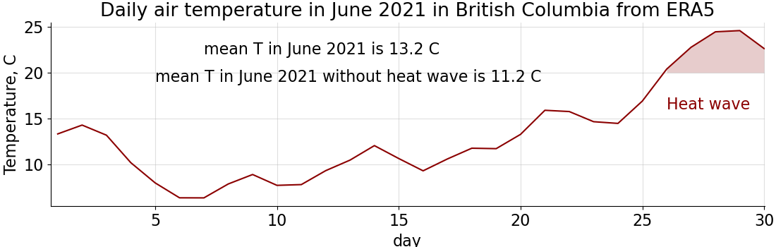
Region and PERIOD choice
Unlike previous studies, Philip et al. (2021) & Thompson et al. (2022), looking at British Columbia as a province
Temperatures were high for several days
Considering not only maximum temperatures during one day, but also longer periods

Slide 4
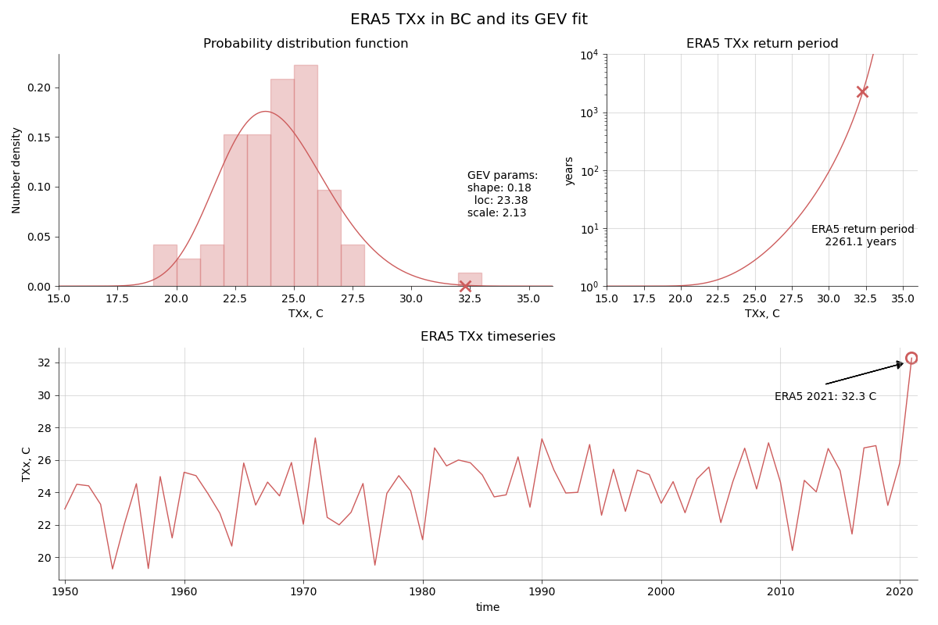
Extremely Rare Daily maximum temperature in BC
TXx is a maximum of daily maximum temperature
2021 TXx anomaly is 8.9°C relative to 1950-1969
Return period is 2261 years (CI:1296-3352)
Results comparable to Philip et al. (2021) & Thompson et al. (2022)
https://doi.org/10.5194/egusphere-egu22-10422
Notes:
2144.2

Slide 5
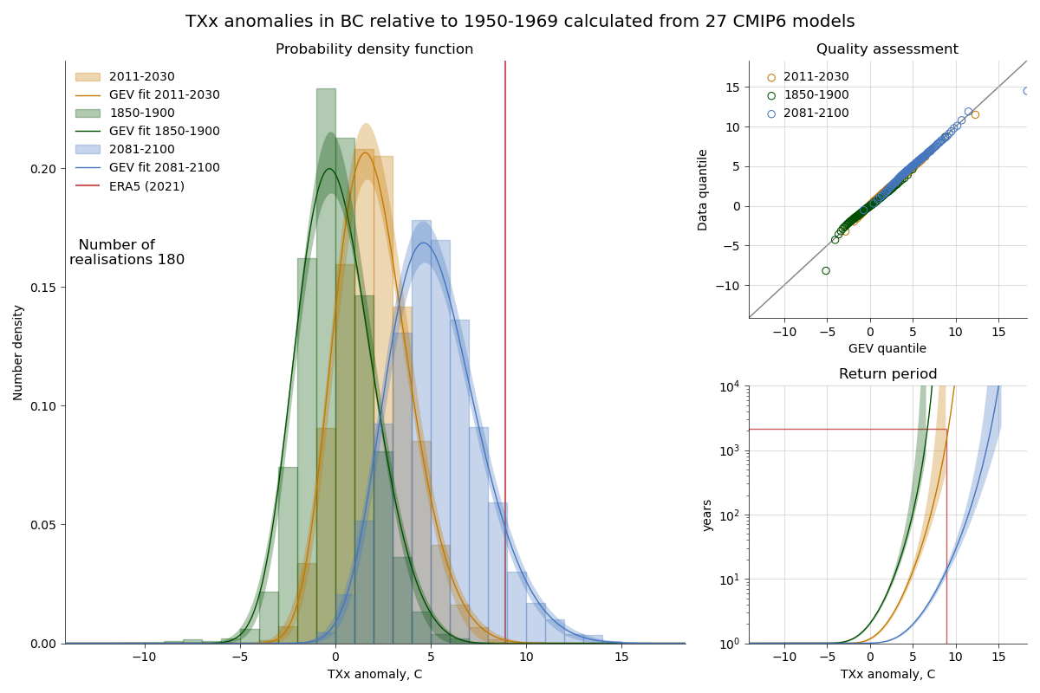
2021 event was Virtually impossible in the preindustrial climate
Analysis of TXx from 27 CMIP6 models
Fitting all three parameters of GEV
In the preindustrial climate (1850-1900) the 2021 event was virtually impossible
In the current climate (2011-2030) 1 in 1347 years event (CI:501-inf)
In 2081-2100 under SSP245 scenario (2.7°C warming) 2021 event is 1 in 13 years (CI:11-17)
Models do reproduce 2021 event!
https://doi.org/10.5194/egusphere-egu22-10422

Slide 6
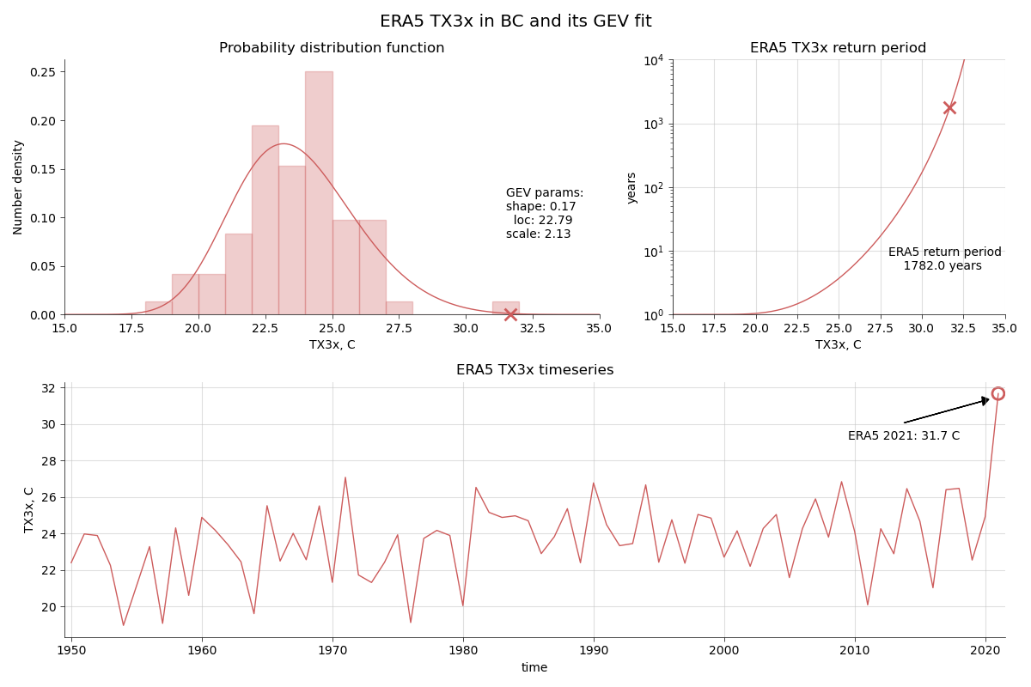
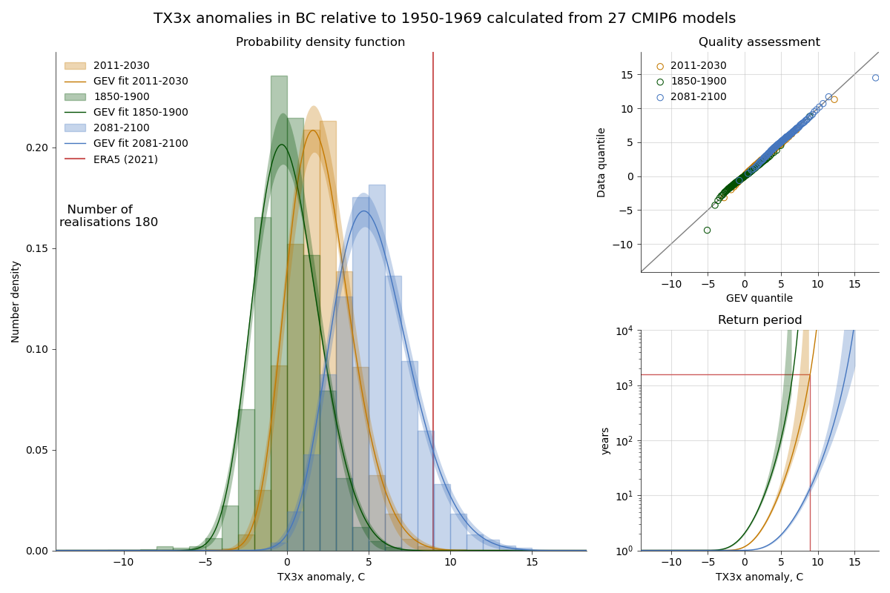
Temperature over three days was as Extreme
TX3x is maximum 3-day average daily maximum surface air temperature
In ERA5, TX3x is 1 in 1782 (CI:962-2716) year event
CMIP6 results similar to TXx
https://doi.org/10.5194/egusphere-egu22-10422

Slide 7
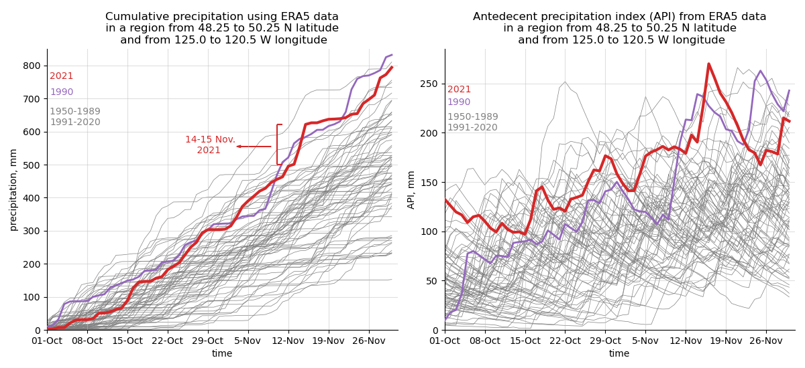
Extreme precipitation in BC in November 2021
Atmospheric river (14-15th of November 2021)
Heavy Precipitation
Flooding
Destruction
https://doi.org/10.5194/egusphere-egu22-10422

Slide 8
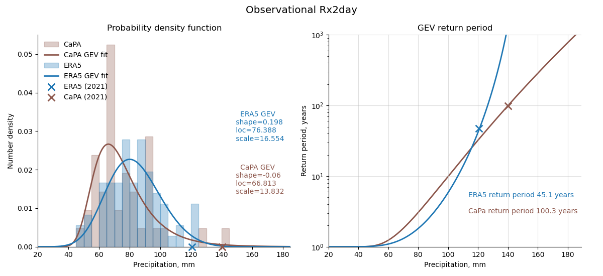
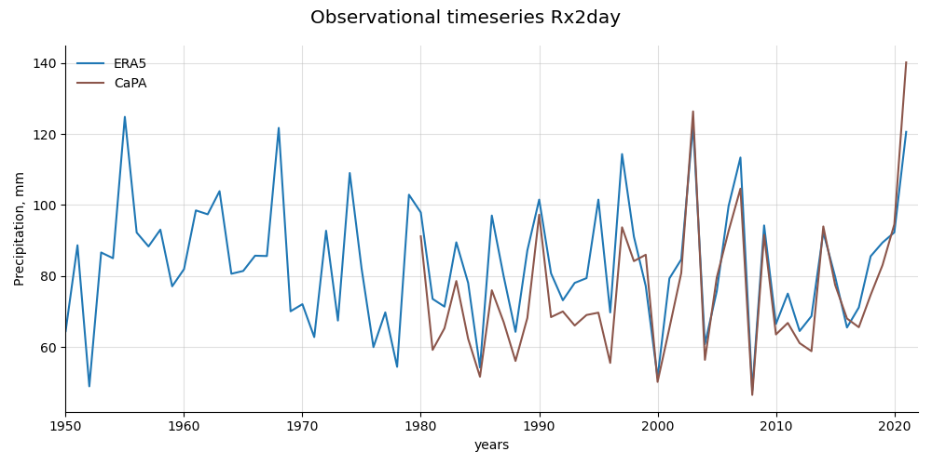
TWO day precipitation was extreme
Analysis of RX2day (maximum consecutive 2-day precipitation) in south-western BC
2021 RX2day in ERA5 is 1 in 45 (CI:18-120) year event
In CaPA (Canadian reanalysis), 2021 RX2day is 1 in 100 (CI41-311) year event
In CaPA, 2021 Rx2day is the largest
Part of the rapid attribution study (Gillett et al., 2022)
https://doi.org/10.5194/egusphere-egu22-10422

Slide 9
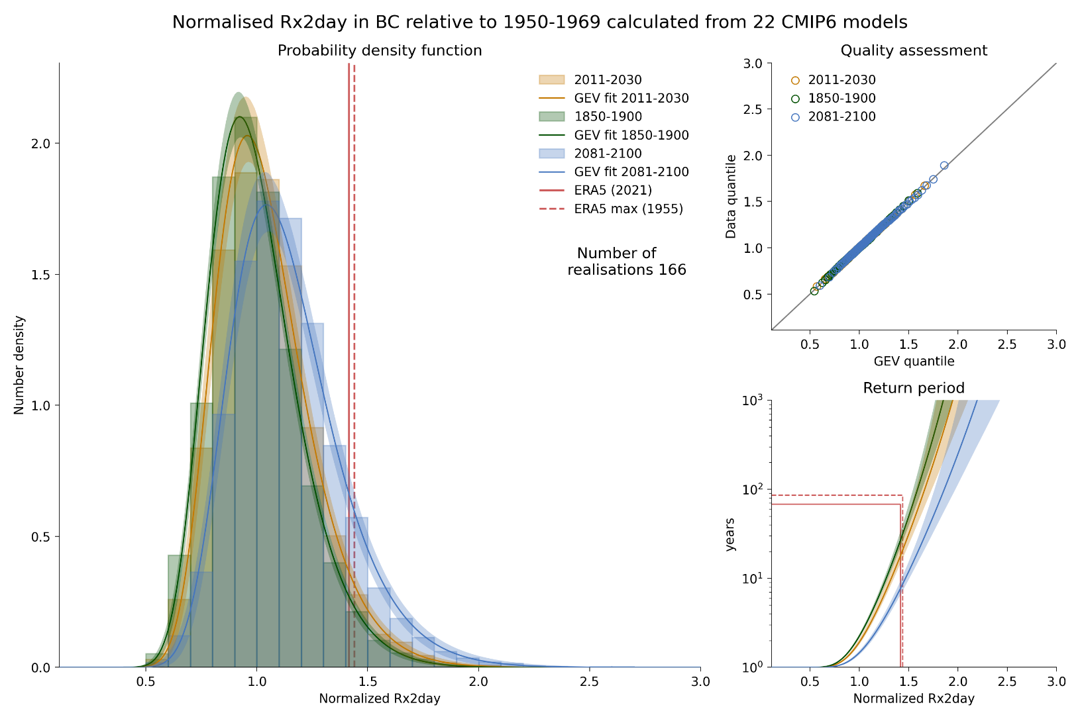
Significant human influence on 2021 precipitation event in BC
In the pre-industrial climate (1850-1900), the return period of 2021 event is 1 in 19 (CI:16-23) years
In the current climate (2011-2030), the return period is 13 years (CI:11-18); probability increase 45% (CI: 1-84%)
In the SSP245 (2081-2100), the return period is 6.1 years (CI:5.3-7.3); probability increase relative to current climate 218% (CI: 173-309%)
https://doi.org/10.5194/egusphere-egu22-10422

Slide 10
Summary
Heat wave:
TXx and TX3x in BC is 1 in 2000 year event based on ERA5 data
Based on CMIP6 results, 2021 TXx was virtually impossible in the pre-industrial climate, will be 1 in 13 years event by the end of the century under SSP245 scenario
CMIP6 models do reproduce 2021 event
Two-day precipitation:
1 in 50-100 year event
Human induced climate increased the probability of an RX2day event at least as rare as 2021 by 45% and will increase it by 200% by the end of the century under SSP245 scenario
The details on the precipitation are published in Gillett et al. (2022) https://doi.org/10.1016/j.wace.2022.100441
https://doi.org/10.5194/egusphere-egu22-10422

