Slide 1

Juno Plasma Wave Observations at Ganymede
10441
W. S. Kurth¹, A. H. Sulaiman¹, G. B. Hospodarsky¹, J. D. Menietti¹, B. H. Mauk², G. Clark², F. Allegrini^{3,4}, P. Valek³,
J. E. P. Connerney⁵, J. H. Waite³, S. J. Bolton³, M. Imai⁶, O. Santolik^{7,8}, W. Li⁹, S. Duling¹⁰, J. Saur¹⁰, C. Louis¹¹
¹Department of Physics and Astronomy, University of Iowa, Iowa City, IA USA.
²The Johns Hopkins University Applied Physics Laboratory, Laurel, MD, USA.
³Southwest Research Institute, San Antonio, TX, USA.
⁴Department of Physics and Astronomy, University of Texas at San Antonio, San Antonio, Texas, USA
⁵Goddard Space Flight Center, Greenbelt, MD, USA.
⁶Department of Electrical Engineering and Information Science, National Institute of Technology (KOSEN), Niihama College, Niihama, Ehime, Japan
⁷Department of Space Physics, Institute of Atmospheric Physics of the Czech Academy of Sciences, Prague, Czechia.
⁸Faculty of Mathematics and Physics, Charles University, Prague, Czechia.
⁹Center for Space Physics, Boston University, Boston, Massachusetts, USA.,
¹⁰Institute of Geophysics and Meteorology, University of Cologne, Cologne, Germany.
¹¹School of Cosmic Physics, DIAS Dunsink Observatory, Dublin Institute for Advanced Studies, Dublin, Ireland.
Presented at the 2022 EGU Meeting, Vienna

Slide 2
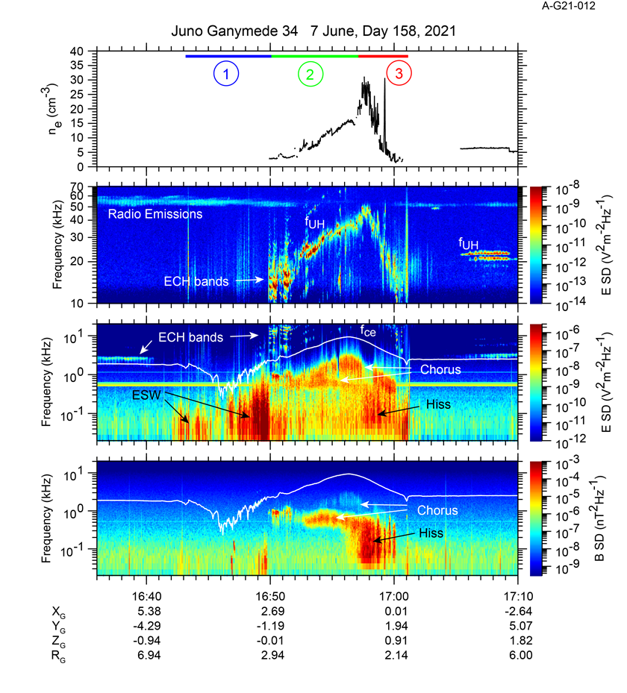
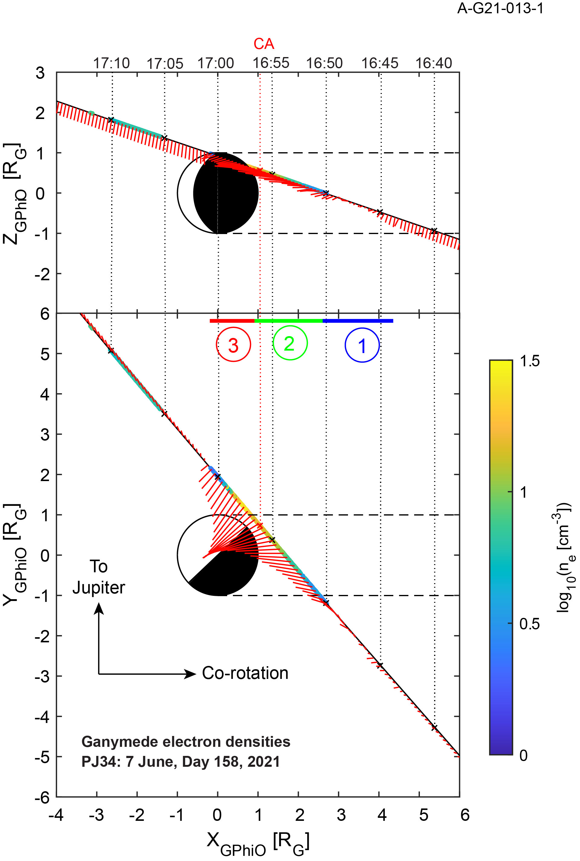
Waves Observations at Ganymede 34

Slide 3
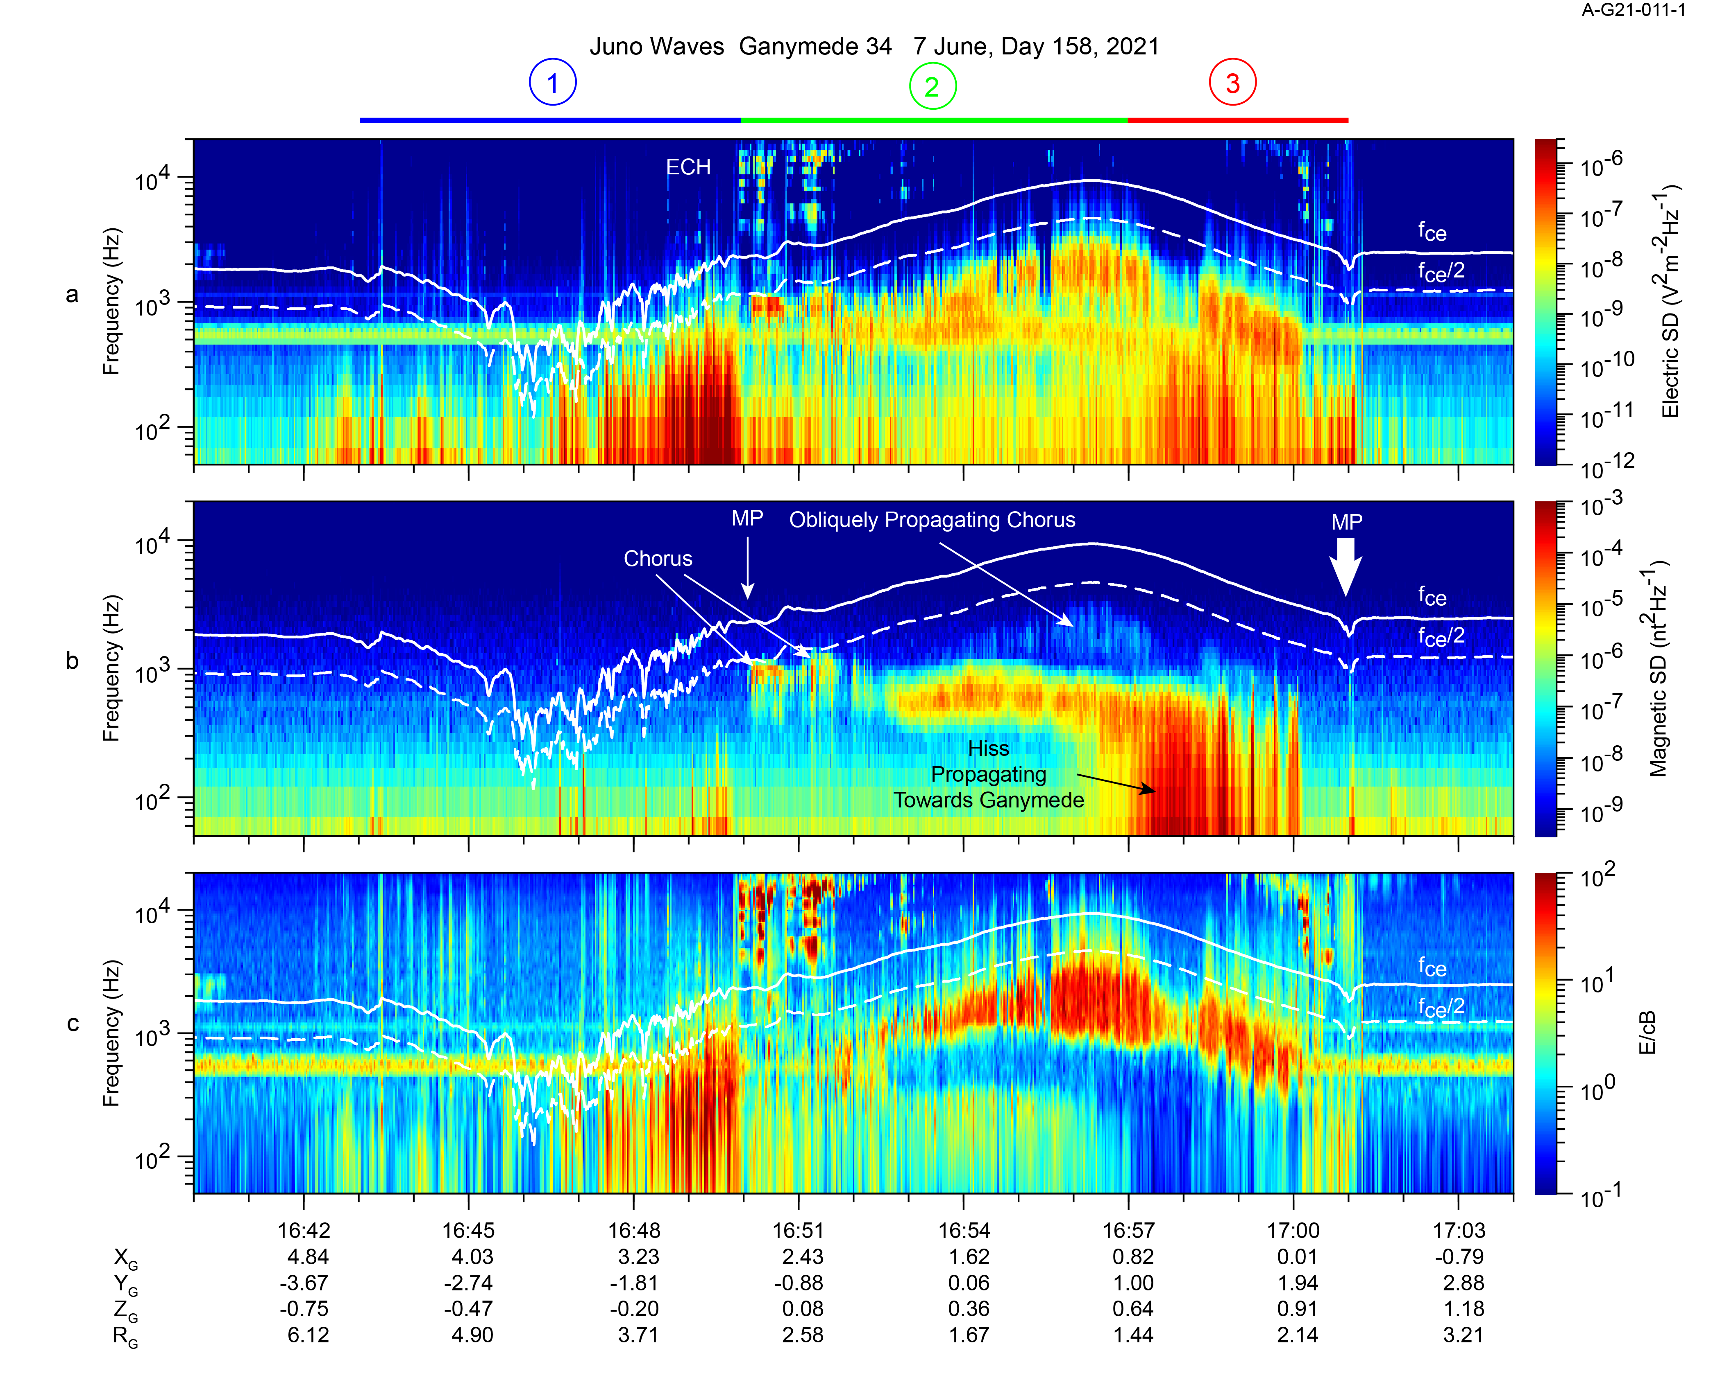
Whistler-mode emissions in Ganymede’s magnetosphere
Whistler-mode emissions dominate the spectrum below f_{ce} in Ganymede’s magnetosphere
These can be driven by anisotropic e⁻ distributions and can accelerate and scatter electrons
Two chorus bands in the magnetosphere.
  A higher frequency band is quasi-electrostatic, implying propagation near the resonance cone
  A lower frequency component is more electromagnetic
Hiss, with component of Poynting vector towards Ganymede in region 3
The spectrum changes ~ 16:57 at the boundary between regions 2 and 3.
Difficult to identify rising/falling tones expected for chorus, due to burst mode duty cycle

Slide 4

Summary
The Waves instrument observed plasma wave features common to planetary magnetospheres at Ganymede
  ECH bands including one at f_{UH} provides electron densities
  Whistler-mode chorus and hiss likely accelerate and/or scatter electrons
  Broadband wave spectrum at/near magnetopause identified as Electrostatic Solitary Waves (ESW) and consistent with reconnection.
  Radio emissions
Three distinct regions in magnetosphere
  Magnetotail (or wake)
  Open, nightside magnetosphere with smoothly-varying density
  Open, dayside magnetosphere with higher, more variable densities
Magnetotail/wake characterized by broadband, bursty emissions, likely ESW’s.
Magnetosphere dominated by whistler-mode emissions
  Obliquely-propagating chorus (WNA near resonance cone)
  Parallel-propagating chorus (WNA ~ parallel to B)
  Broadband hiss with WNA ~ parallel to B

