Slide 1









Monitoring vegetation responses to heatwaves using novel remote sensing techniques
Qian Zhang on behalf of all of the coworkers
05.2022

Slide 2
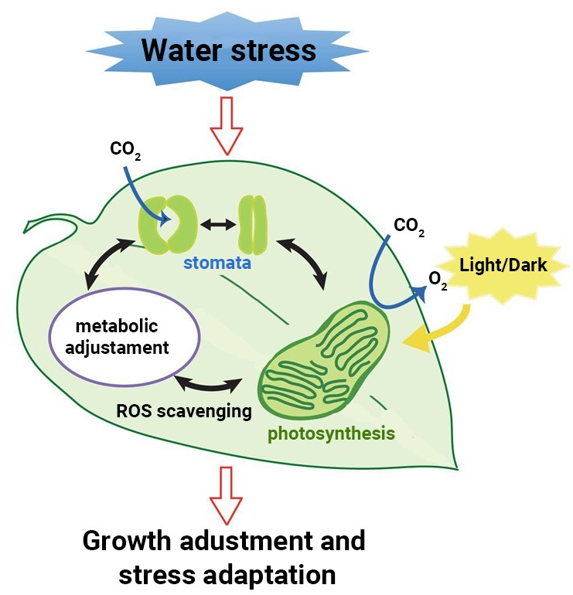
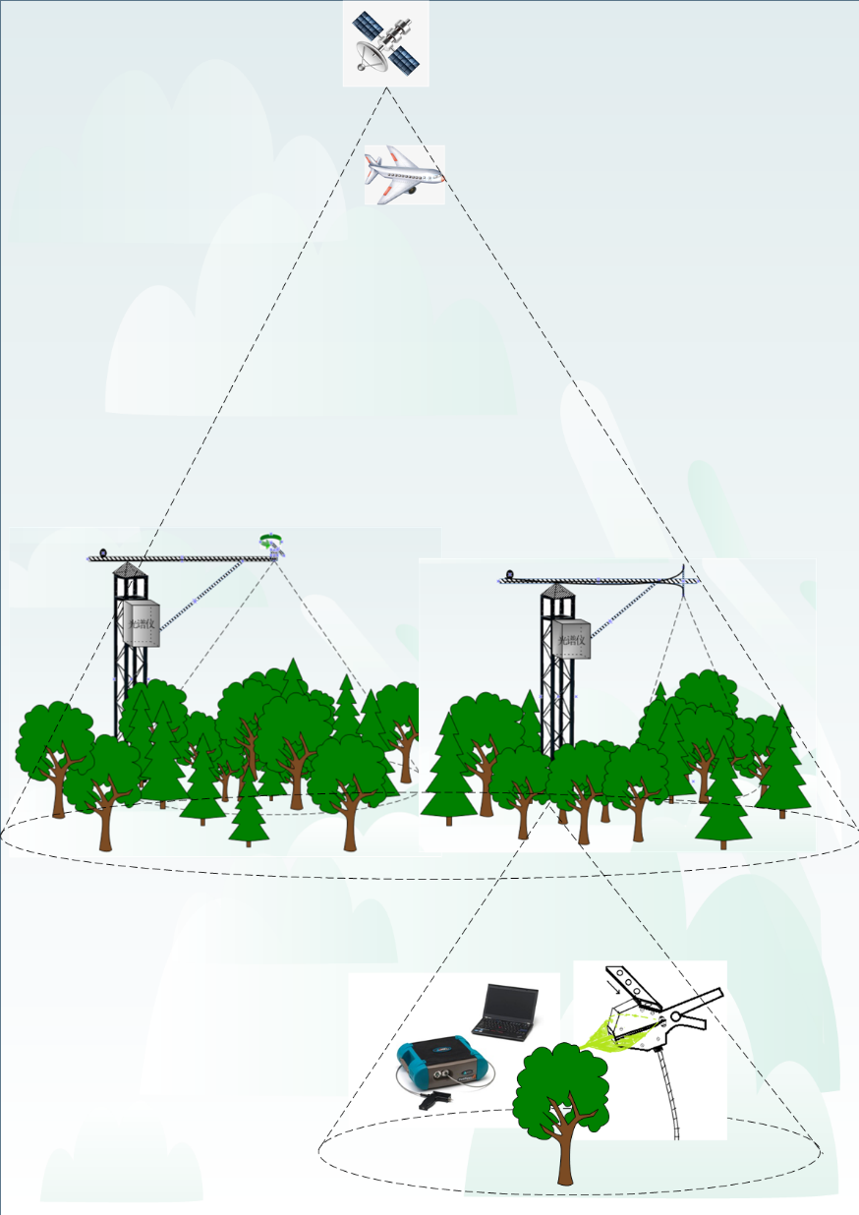

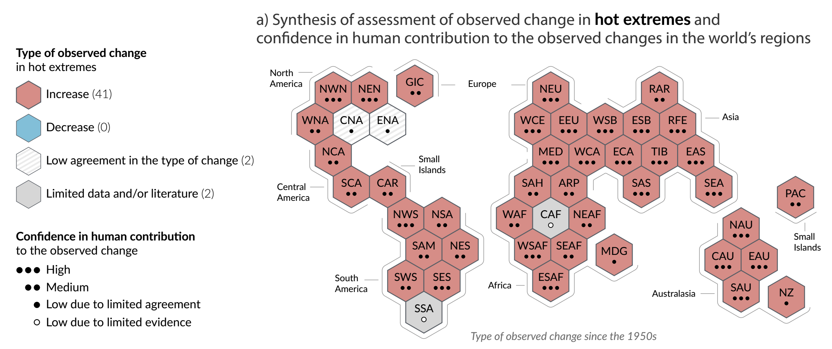
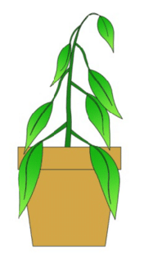
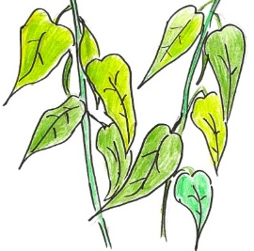
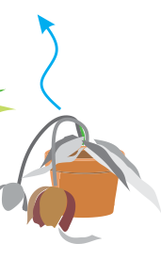
1. Motivation
Response
Monitoring
Heatwave
www.toppr.com/
Time
Scale
Near-surface
Physiology
Copyright @IPCC 6
Function
Structure
Mortality
Remote sensing

Slide 3
2. Heat wave synthesis across different ecosystems
Schematic figure of field configurations for spectral measurements, and (b) map of the locations of sites, and the legend shows the name of each site (14 flash heatwave events from 8 sites).
Flash heatwave: at least a duration of 3 consecutive days of abrupt increase of temperature
Variety: ecosystems, climatic regions, stress intensity, phenological phases

Slide 4
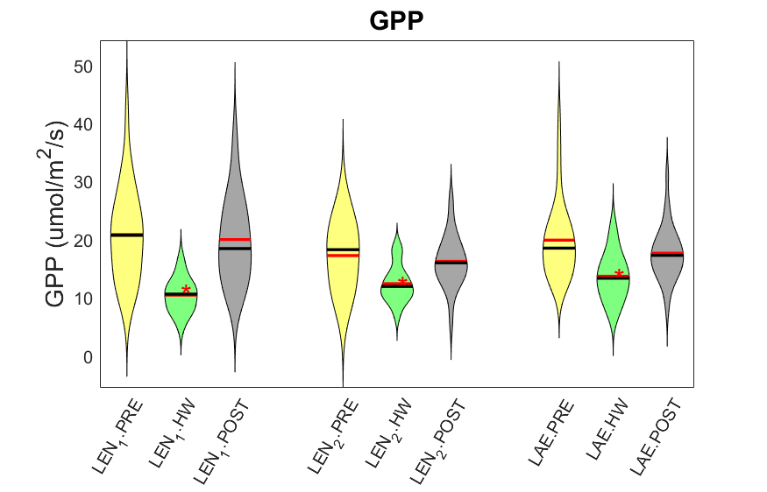
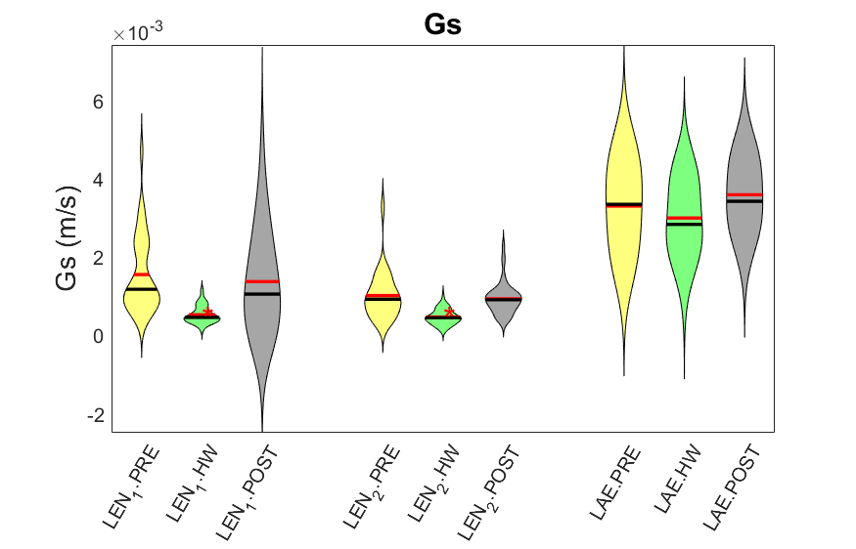
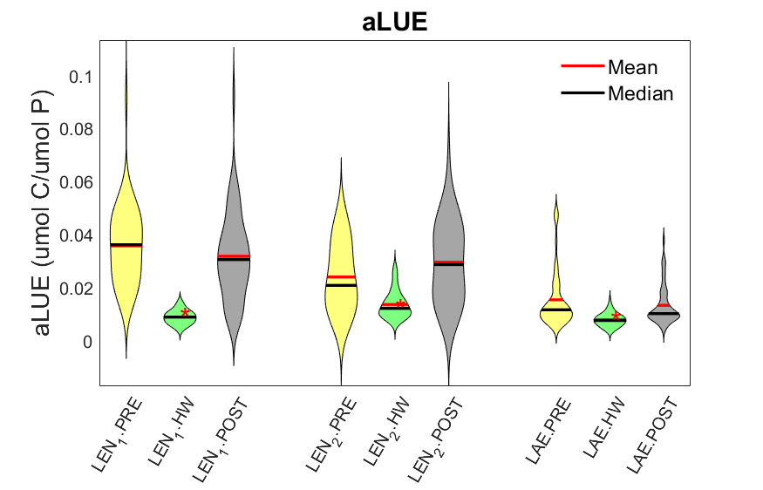
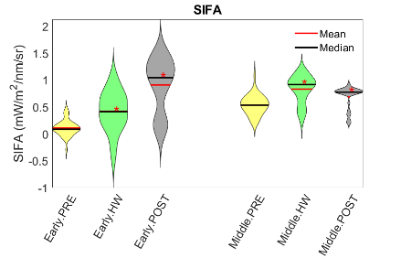
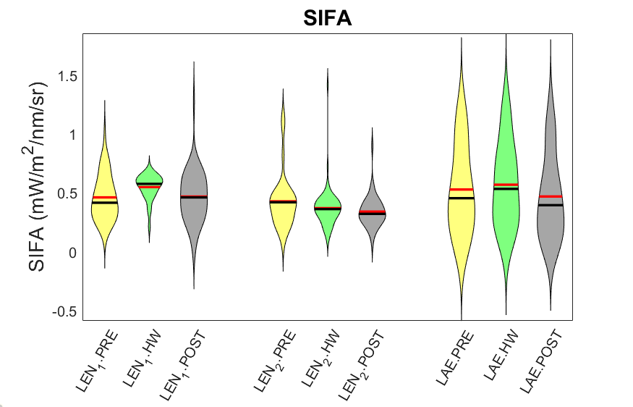
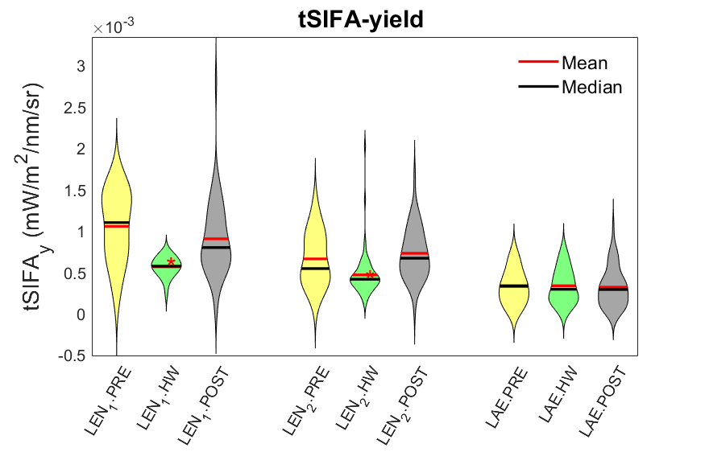
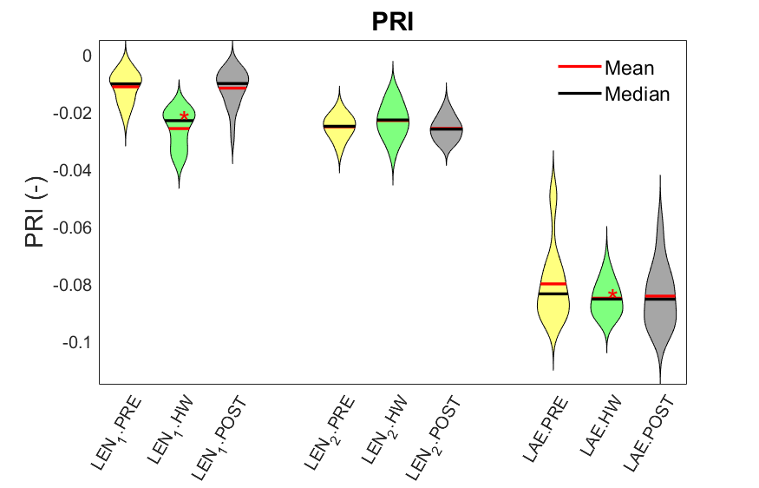
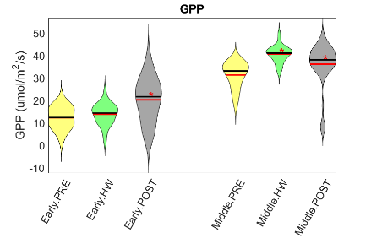
3. Changes of variables
Step 1: to identify heatwave and clarify the behavior of each meteorological, physiological and spectral variable during heatwave
Rice
Beech forest
Step 2: to quantify changes of each variable during heatwave
*: significant changes (Tukey HSD test)
SIFA: far-red SIF, SIFB: red SIF, PRI: photochemical reflectance index, GPP: productivity, Gs: surface conductance, LUE: light use efficiency

Slide 5
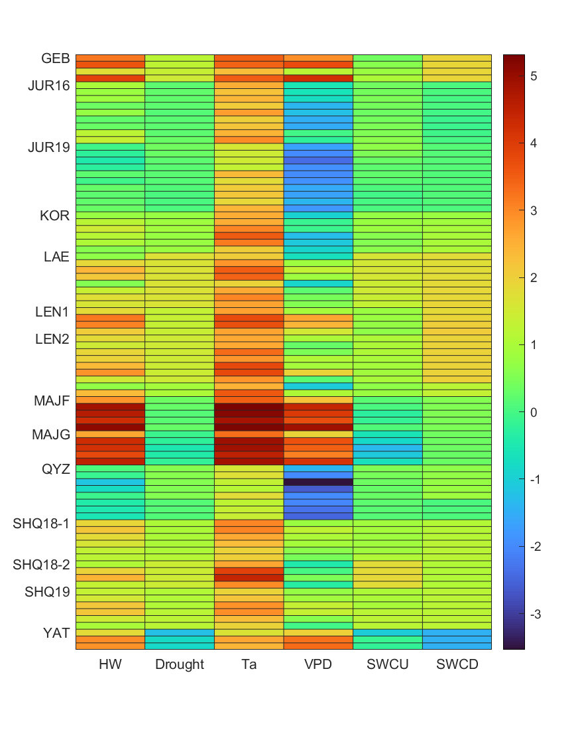
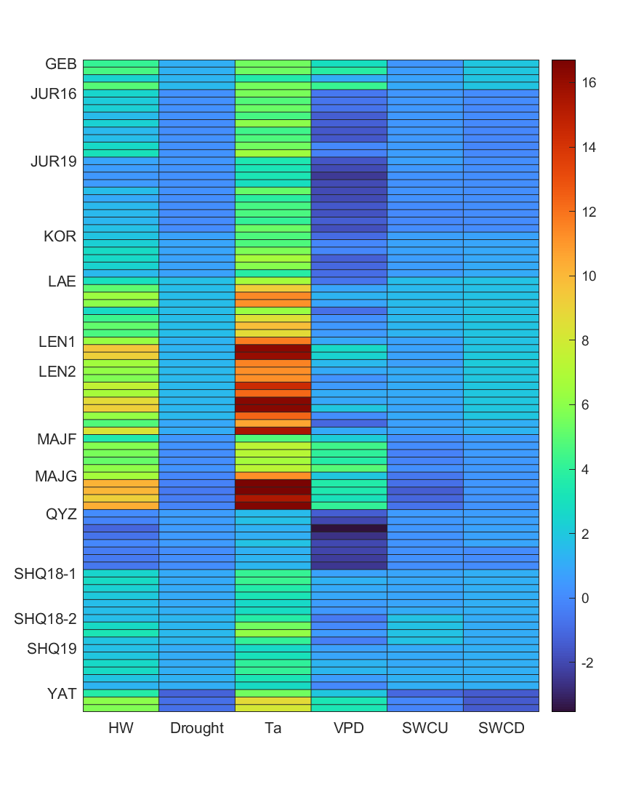
4. Stress intensity
Intensity = (DM_hw – DM_era5)/STD_era5 (higher values mean stronger stress)
Changing point of VPD when Gs getting flat or to be zero.
Sensitivity = (CP_site – 5)/(70 – CP_site)
wheat rice paddy rice paddy rice paddy beech (mixed) beech beech broadleaf C4 grass needle leaf C4 maize C4 maize C4 maize needle leaf
Ta intense uncorrected and corrected

Slide 6
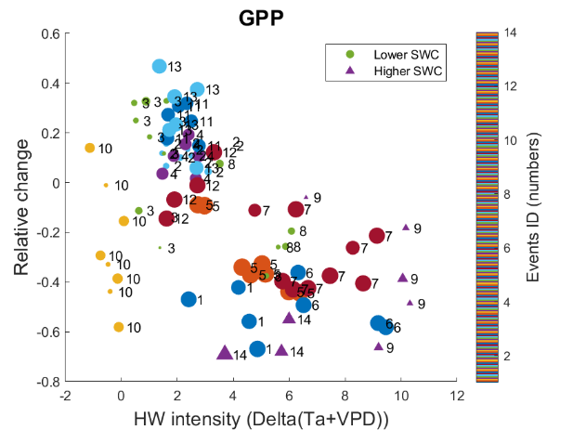
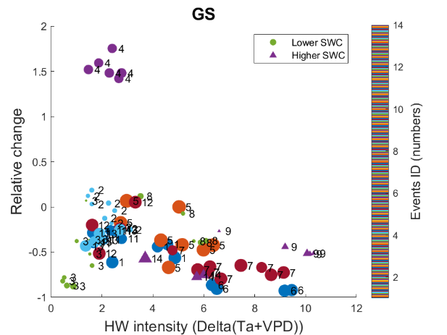
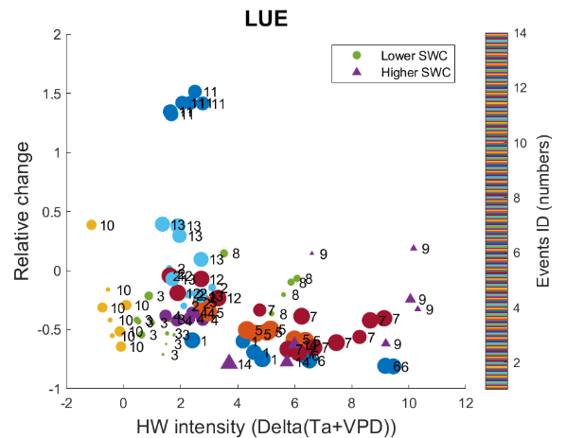
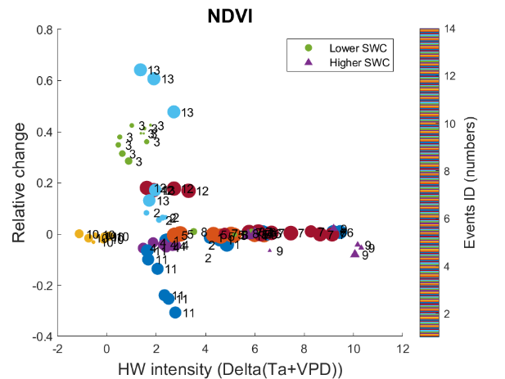
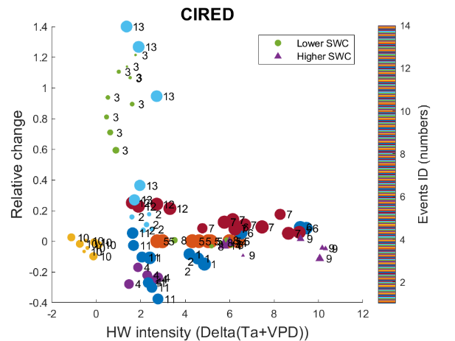
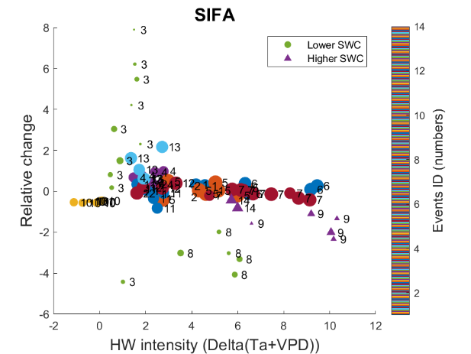
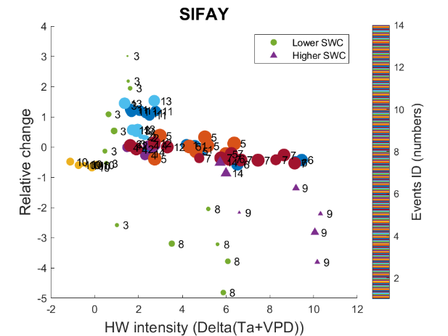
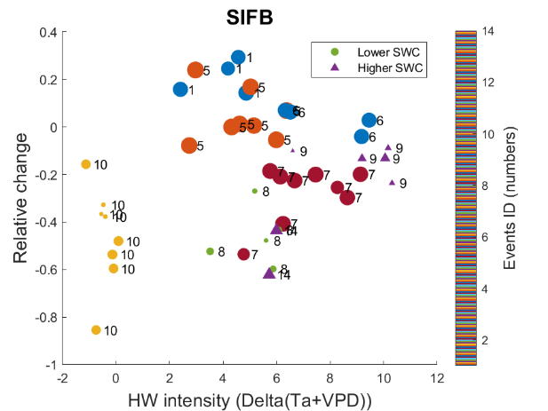
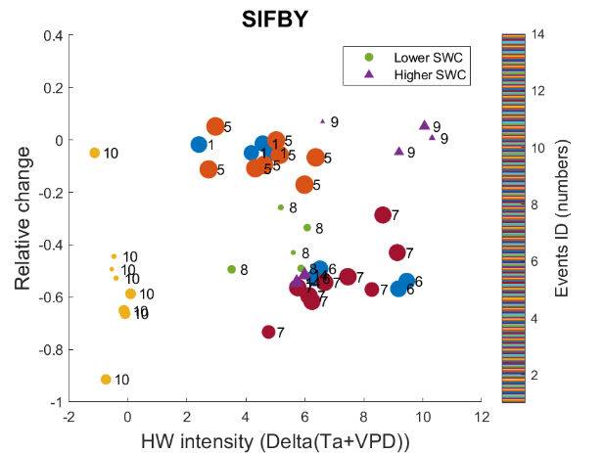
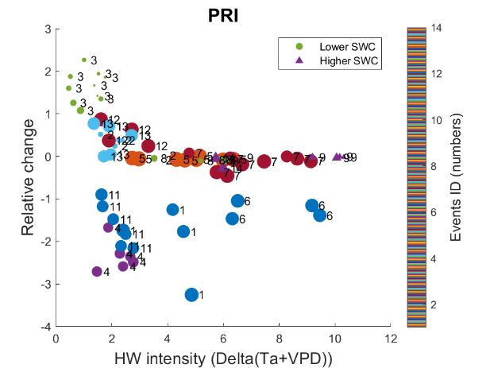
5. Daily relative changes over daily HW stress intensity
ALL
Relative changes = (X_hw– X_prehw) /(X_prehw)
Size of points represents drought intensity: ‘Lower SWC’ indicating water stress, ‘Higher SWC’ indicating more water availability
Color and numbers represent different sites
Variance: SIFA > SIFAY > PRI > GS > LUE > CIred > GPP > SIFB > SIFBY > NDVI (SIFA: far-red SIF, SIFB: red SIF, SIF*Y: SIF yield)
: rice paddy or maize, phenology-related increase

Slide 7
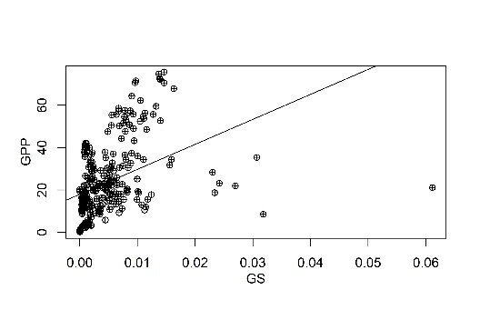
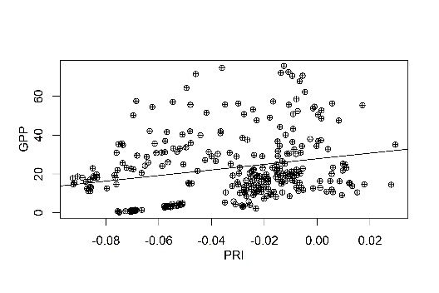
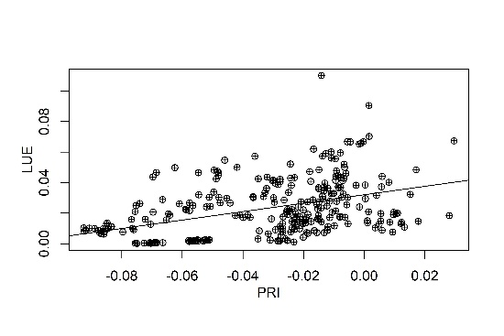
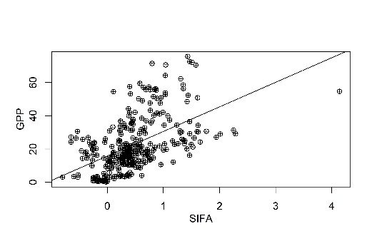
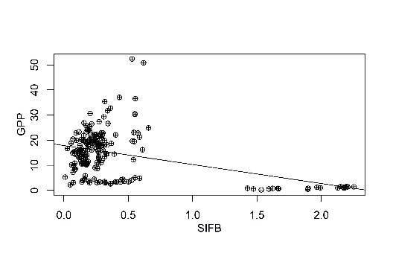
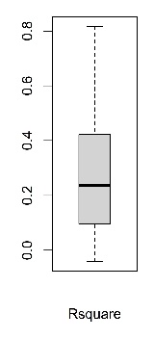
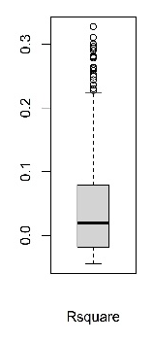
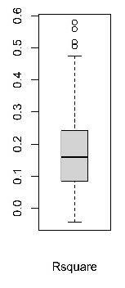
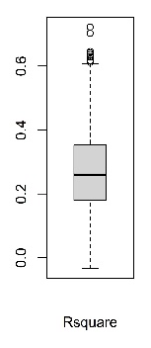
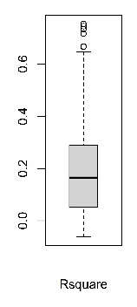
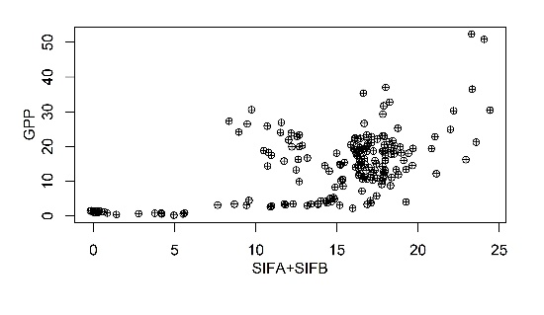
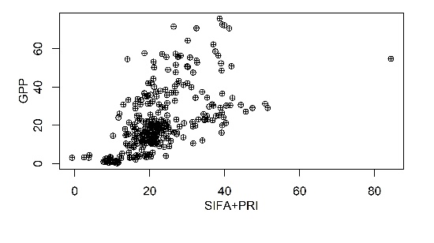
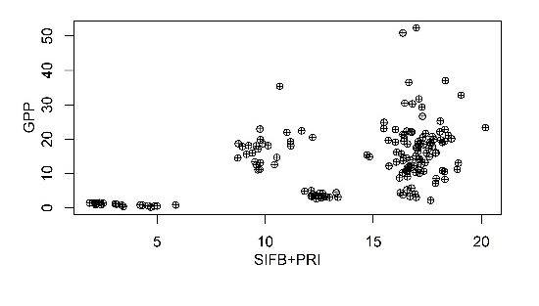
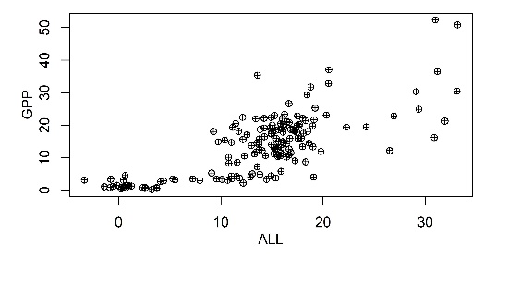
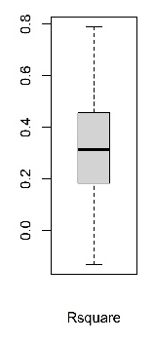
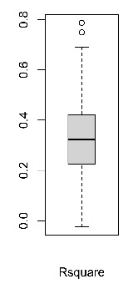
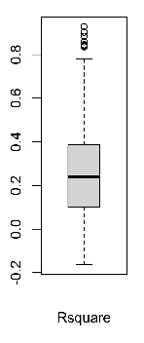
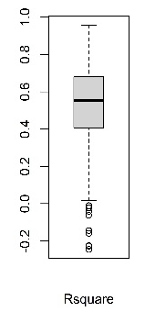
6. Scatter plots around HW
ALL bootstrap
Polynomial regression:
SIFA, SIFB, PRI provide complementary information even across different ecosystems

Slide 8
Summary
From steps 1 and 2: the ability of spectral variables to track GPP and responding to stress has been identified
Flux and spectral variables may have different responses to stress , but SIFA shows a better ability to track GPP (i.e. better correlation)
Combining SIFA, SIFB, PRI could better monitor or predict GPP variations across different ecosystems
For next steps: two directions depends on the spatial scale
Precision real-time monitoring at local scale based on deep understanding of the ability of each spectral variable to monitor the response to stress for single or cluster of similar ecosystems
Evaluation or prediction carbon assimilation under stress at regional to global scale trying to find a way to combine spectral variables with meteorological variables for tracking or indicating GPP changes

Slide 9

Call for data sharing and collaborations!
The end! Thanks!

Slide 10
Backups: Flowchart of the quantitative assessment
Bio-climate
Physiology
Remote sensing
Ta, SWC
VPD
Gs
GPP, LUE
SIF, SIFy, PRI, CIred
ERA5 (20yrs)
HW
Change point of Gs with VPD
(to be flat or zero )
Stomatal response
(VPD vs. Log (Gs))
Seasonal patterns
Pre-HW
and HW
STD of
daily mean
Daily mean
Heat and drought intensity
Inter-comparison
Normalized site-independent heat intensity,
and site-level drought intensity
Relative changes of HW with respect to Pre-HW

Slide 11
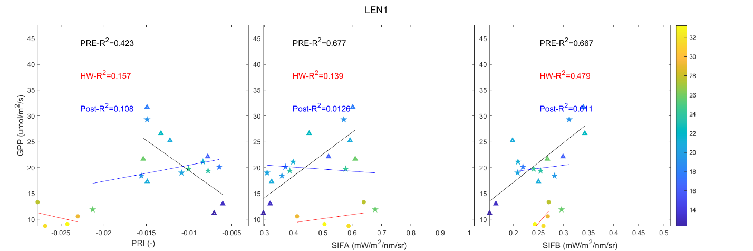
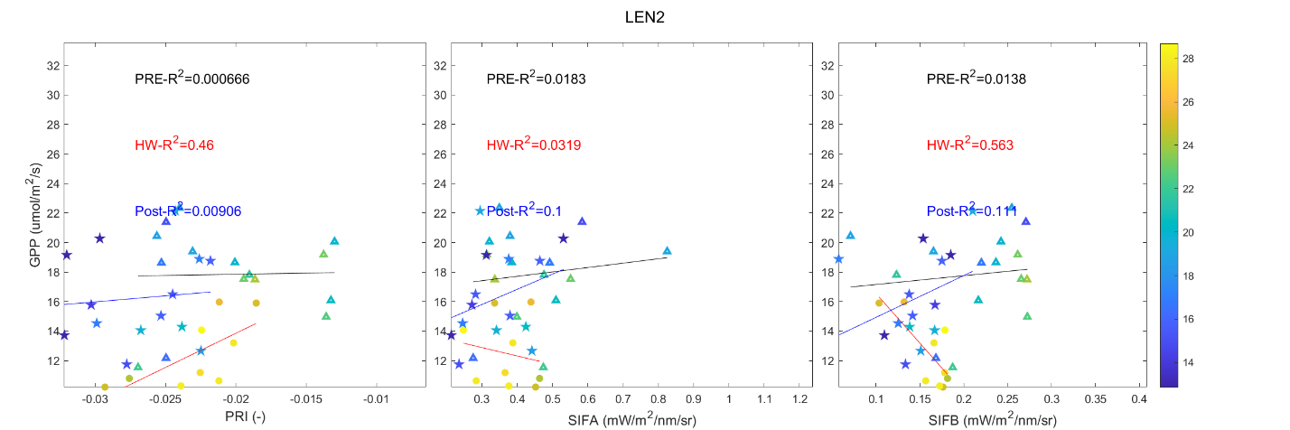

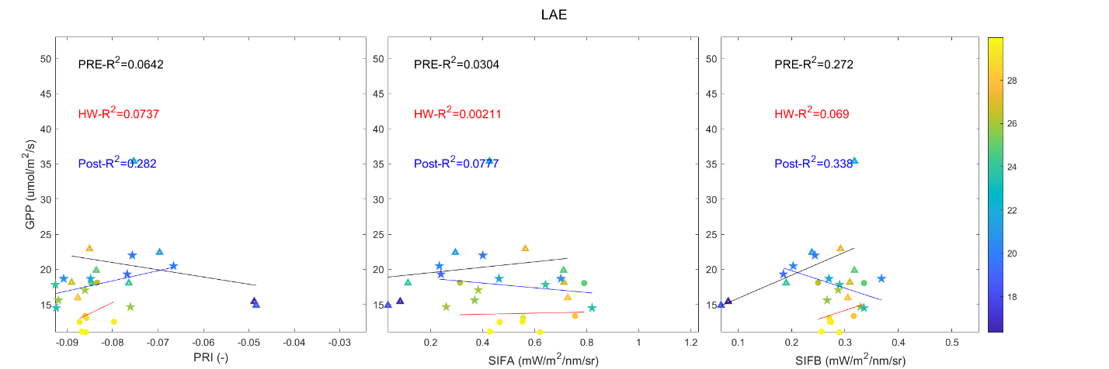
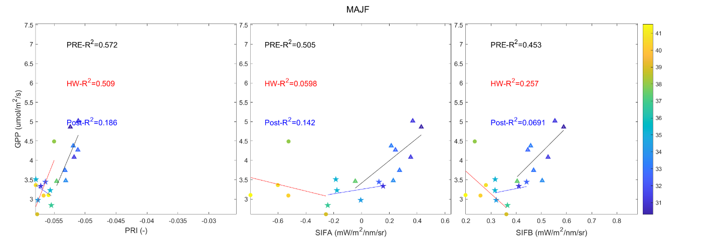
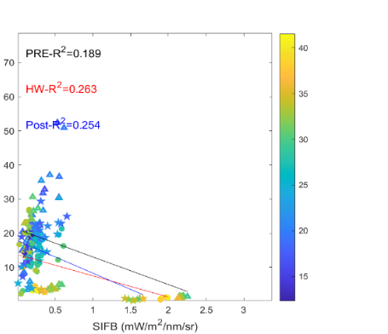
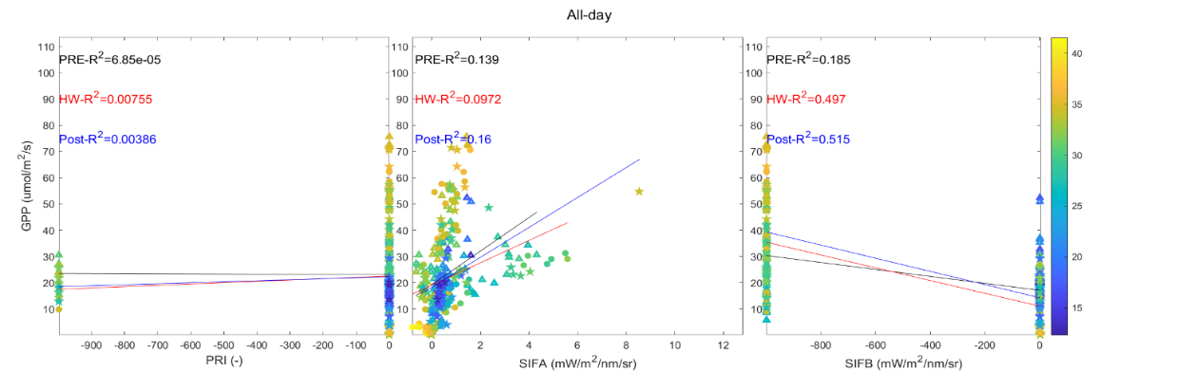



Backups: Scatter plots around HW
C3 FOREST and all
No data
Various behaviors, even for the same ecosystem.

