Slide 1


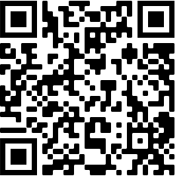

Attributing Recent Variability in the AMOC to Surface Buoyancy-Forcing
Charlotte Marris and Robert Marsh
University of Southampton
cmm1e20@southamptonalumni.ac.uk
Notes:
View my pre-recorded presentation with closed captions at: https://youtu.be/U-Hy3rn5MRQ
For additional material, please visit: https://youtu.be/oT_AaU9r6KM

Slide 2
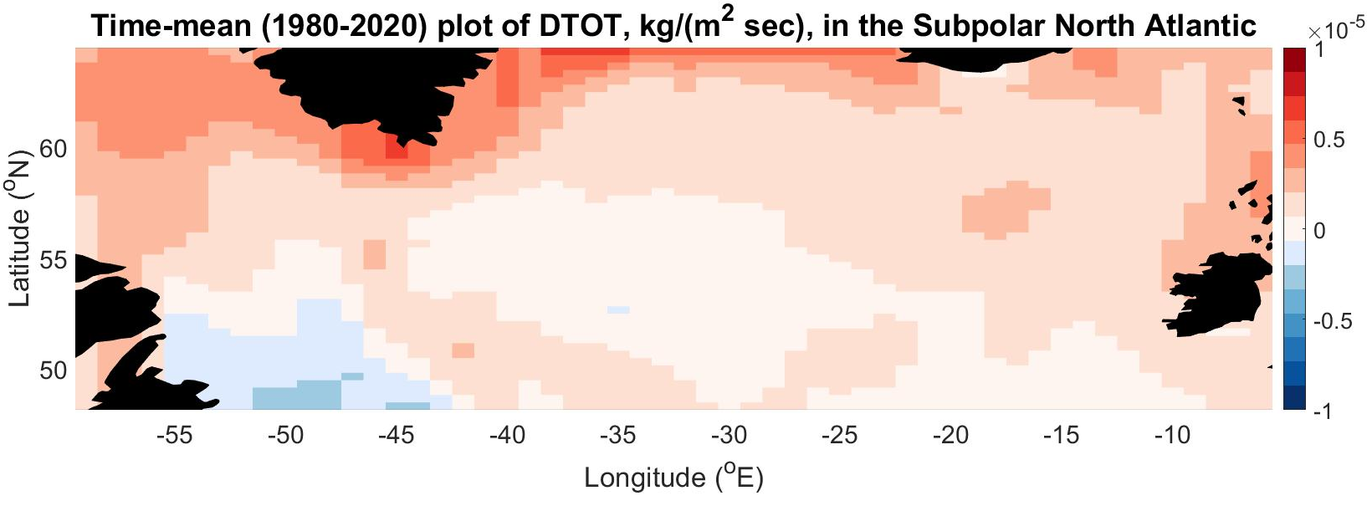
Methods
Aim: To reconstruct the Surface-Forced Overturning Circulation (SFOC) in the Subpolar North Atlantic from 1980-2020
OSNAP EAST
OSNAP WEST
WEST SPG
60-43 °W
EAST SPG
43-5°W

Slide 3
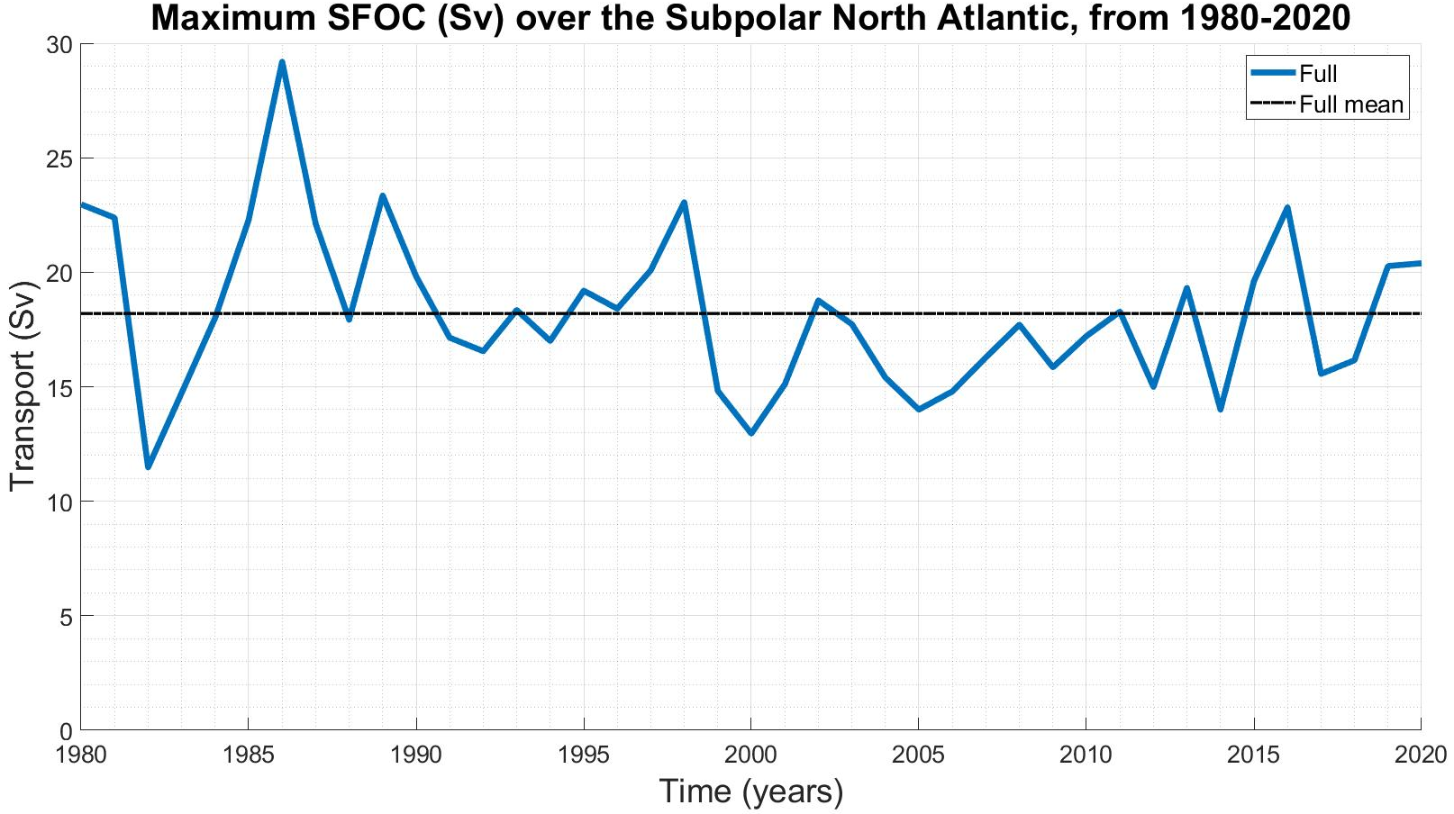
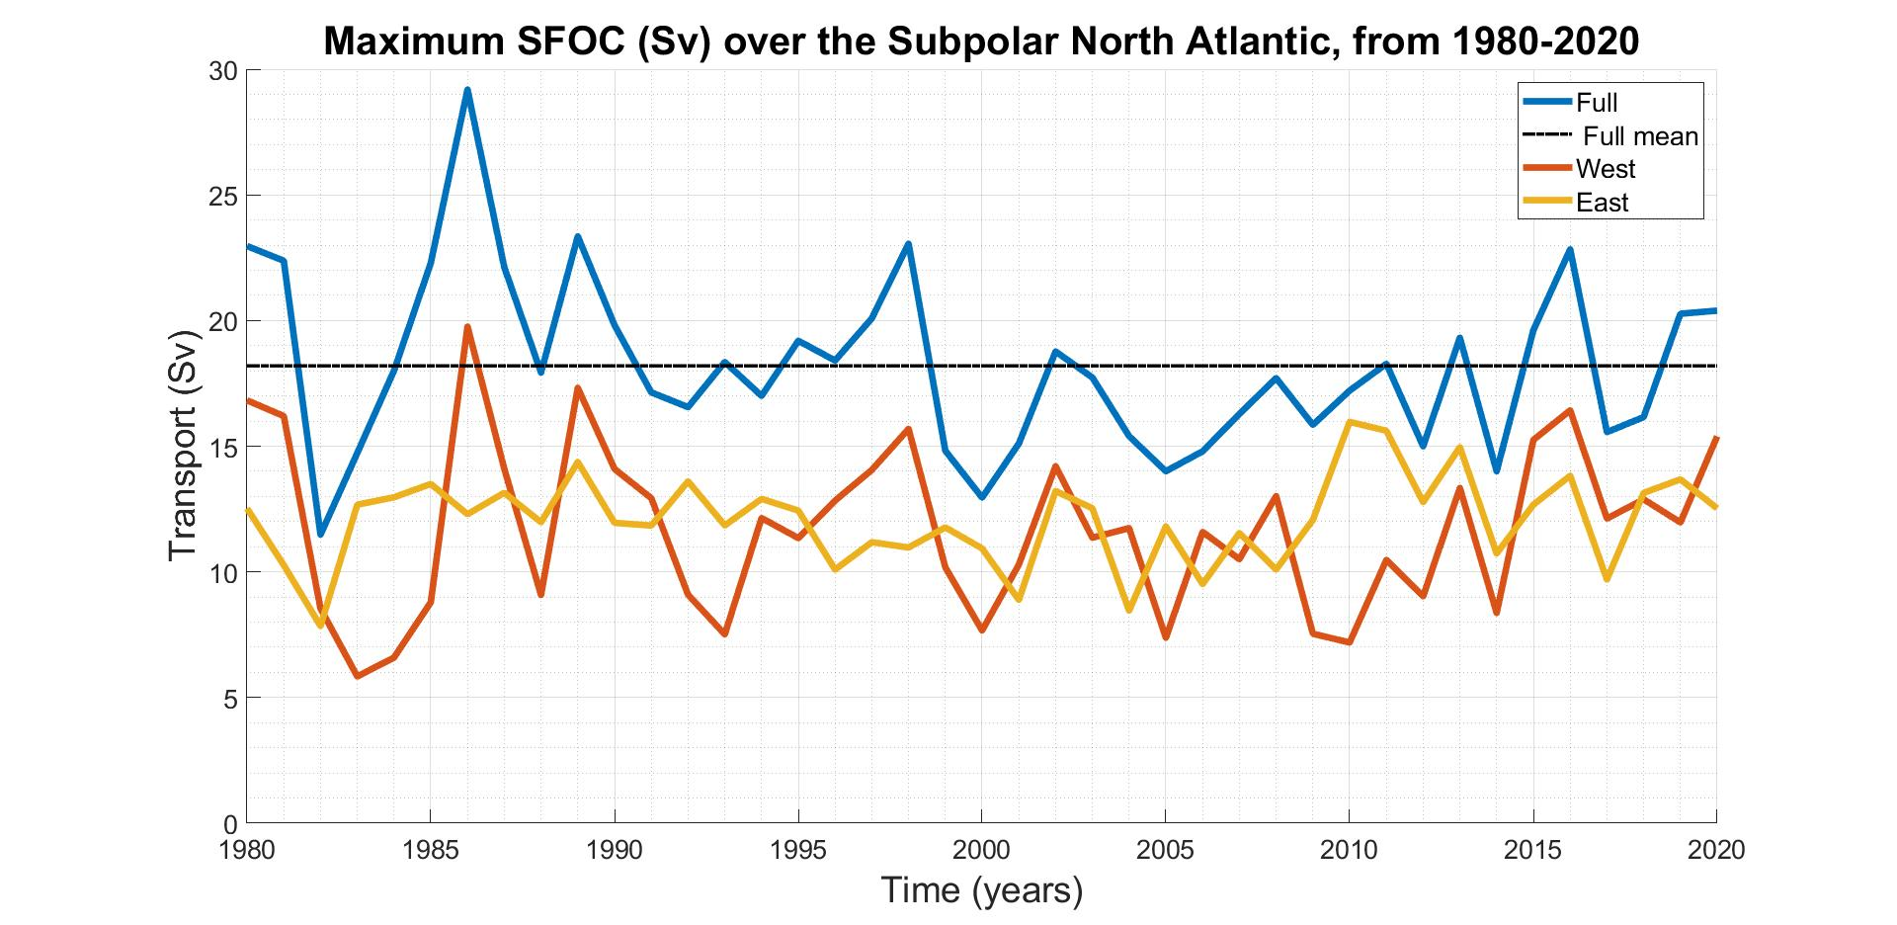
Key Results
18.2 Sv

Slide 4
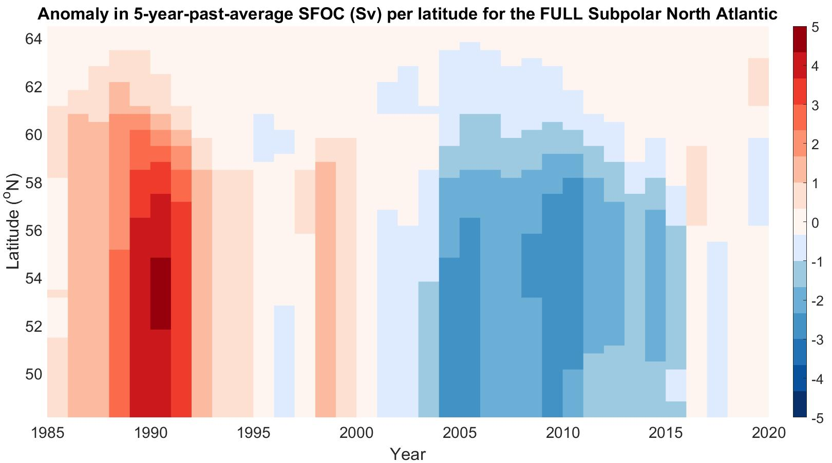
Key Results
Coincided with increased MHT and positive NAO
Coincided with decreased MHT and negative NAO
Strong overturning
Weak overturning

Slide 5
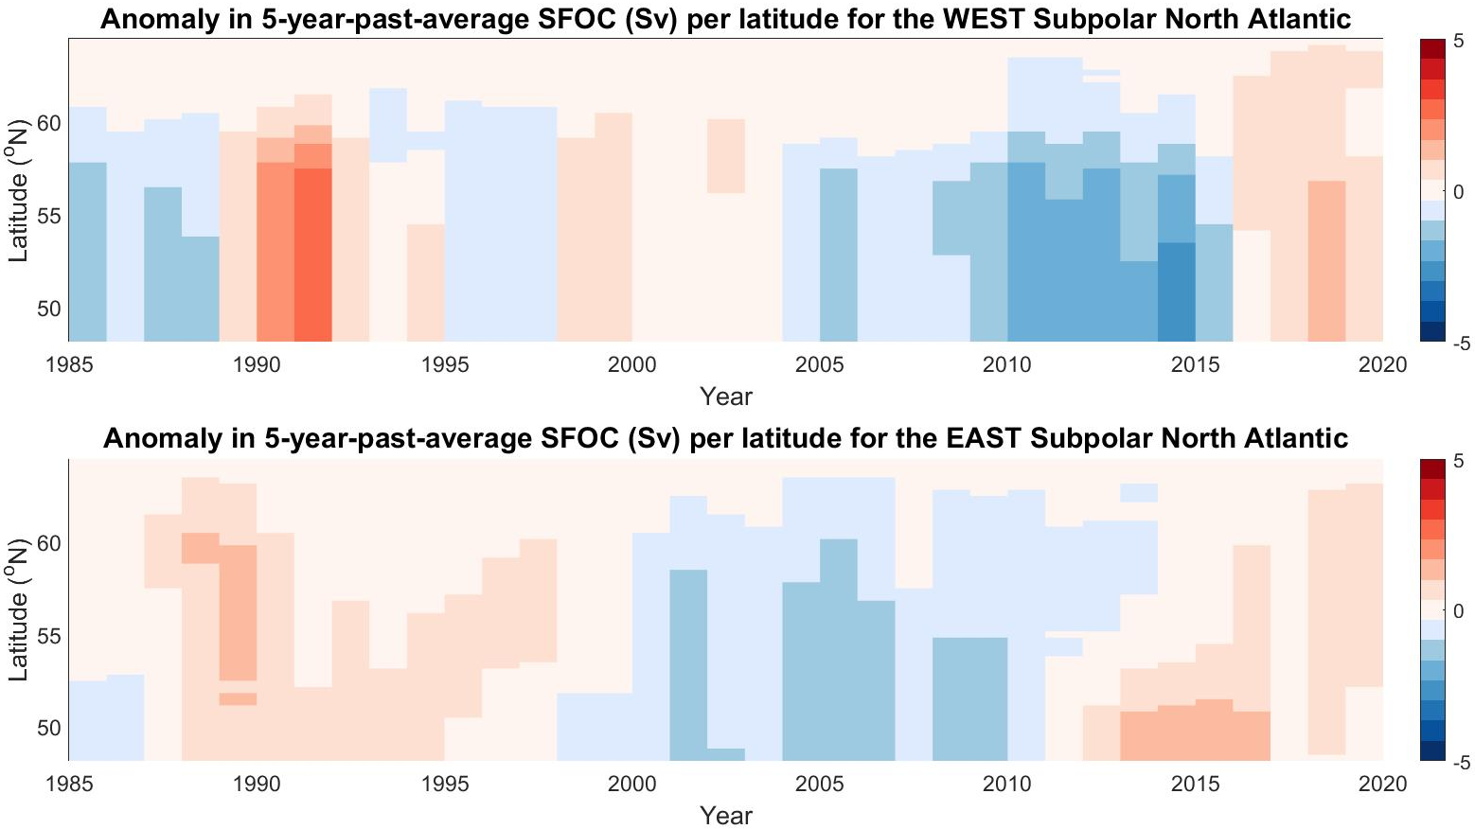
Key Results
Weak
Strong

Slide 6
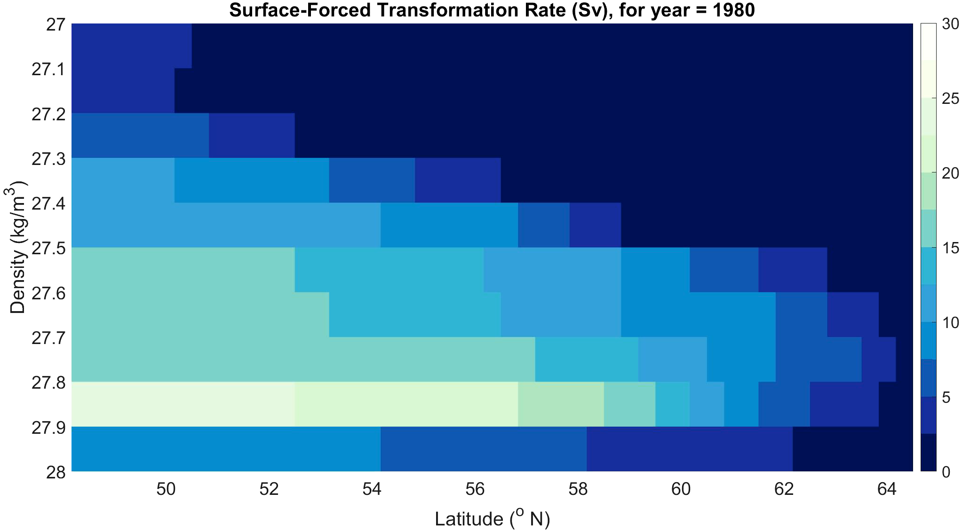
Key Results
SPMW
LSW

Slide 7
Conclusions
Reconstruction of the Surface-Forced Overturning Circulation (SFOC) in the Subpolar North Atlantic from 1980-2020 elucidates interannual to multidecadal variability
Greater long-term SFOC variability in the West SPG than in the East SPG
Contribution from the West SPG to total SFOC variability over 1980-2020 is more substantial than that of the East SPG
Maximum surface-forcing in the Subpolar North Atlantic typically occurs at densities >27.8 kg/m³ and at latitudes 48-56 °N
Questions?
Email: cmm1e20@southamptonalumni.ac.uk
Twitter: @char_marris

Slide 8
Additional Material –
SFOC Streamfunction Movies
Charlotte Marris and Robert Marsh
University of Southampton
cmm1e20@southamptonalumni.ac.uk
Notes:
Please visit https://youtu.be/oT_AaU9r6KM for a pre-recorded video of my additional material with closed-captions.

Slide 9
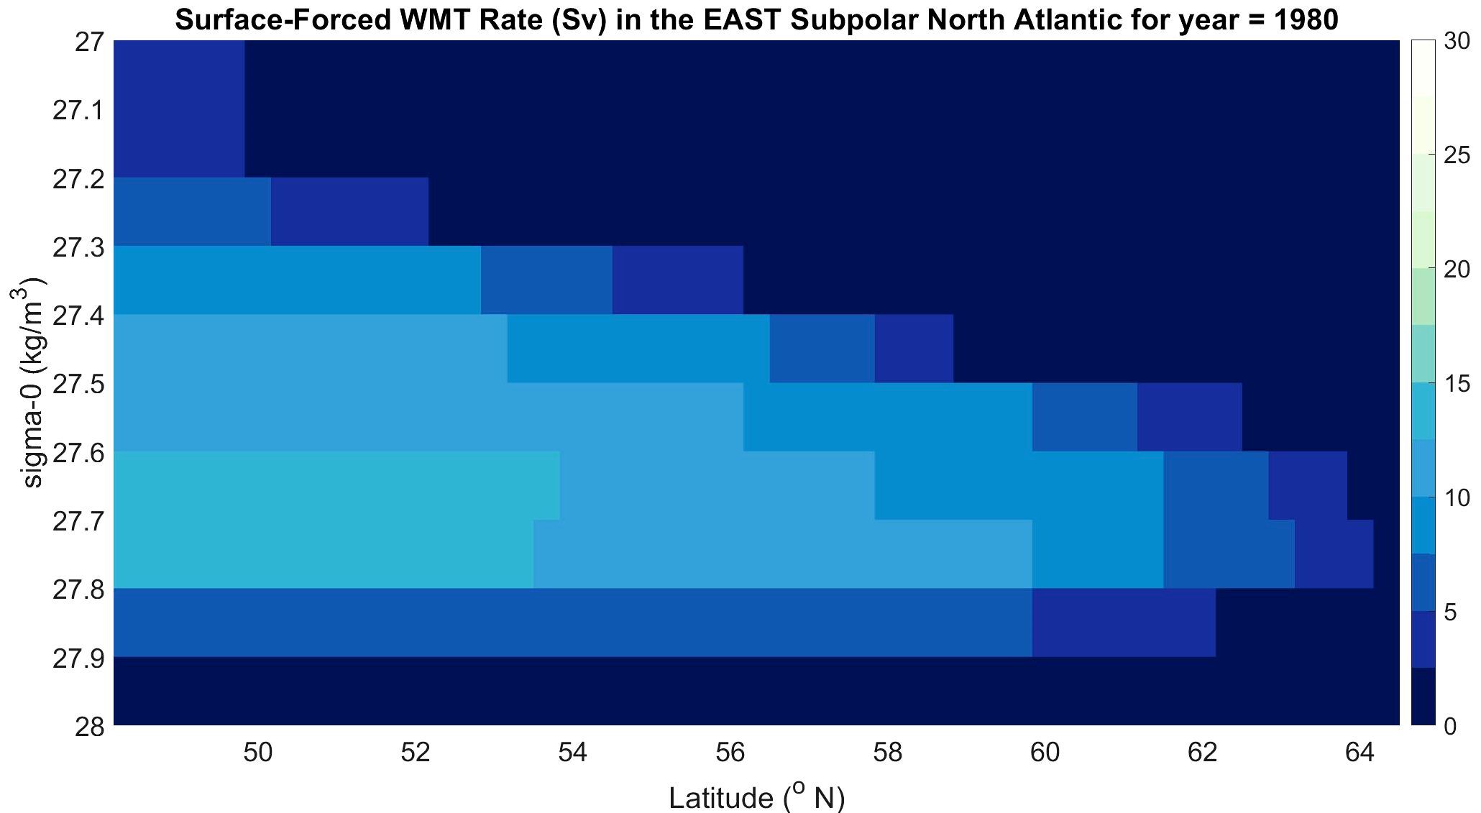
SPMW
LSW

Slide 10
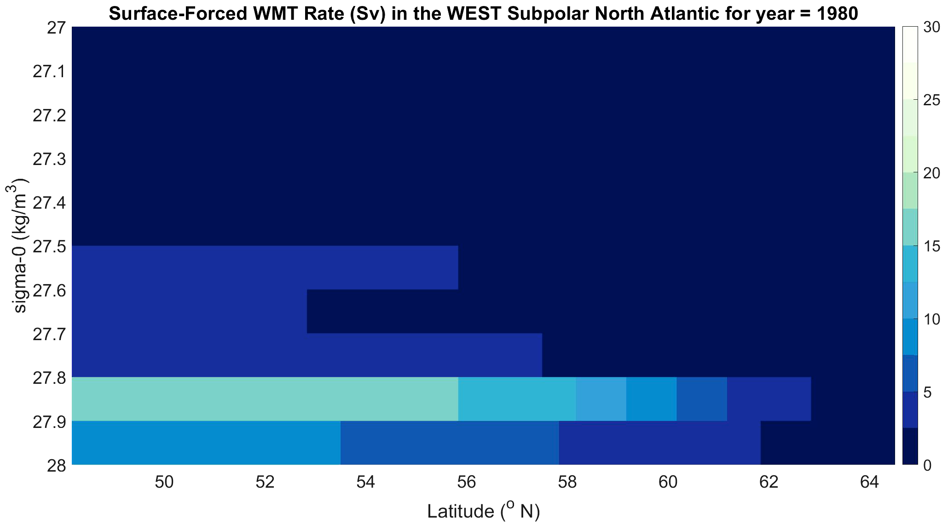
SPMW
LSW

Slide 11
Key Points
Maximum surface-forced overturning in the East SPG typically occurs at intermediate densities of 27.3-27.7 kg/m³
Maximum surface-forced overturning in the West SPG typically occurs at higher densities >27.8 kg/m³
Surface-forcing in the West SPG is likely to be the main contributor to SFOC variability across the Full Subpolar North Atlantic from 1980-2020
Questions?
Email: cmm1e20@southamptonalumni.ac.uk
Twitter: @char_marris

