Slide 1
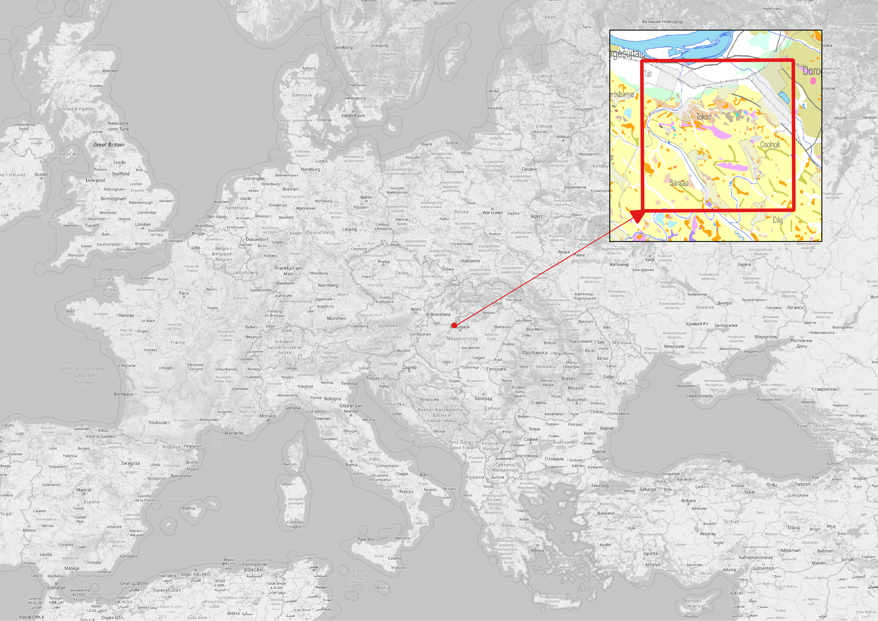
The Dorog-basin as study area
Automatic detection of rock outcrops on vegetated and moderately cultivated areas
Réka Pogácsás
and Gáspár Albert
Eötvös Loránd University, Department of Cartography and Geoinformatics, Budapest, Hungary
The Dorog-basin is located in the northern central part of Hungary
Outcropping Mesosoic carbonates, Paleogene limestones and limnic coal sequences is Quaternary sediments form the diversity of the surfacel
Previous mining activities

Slide 2
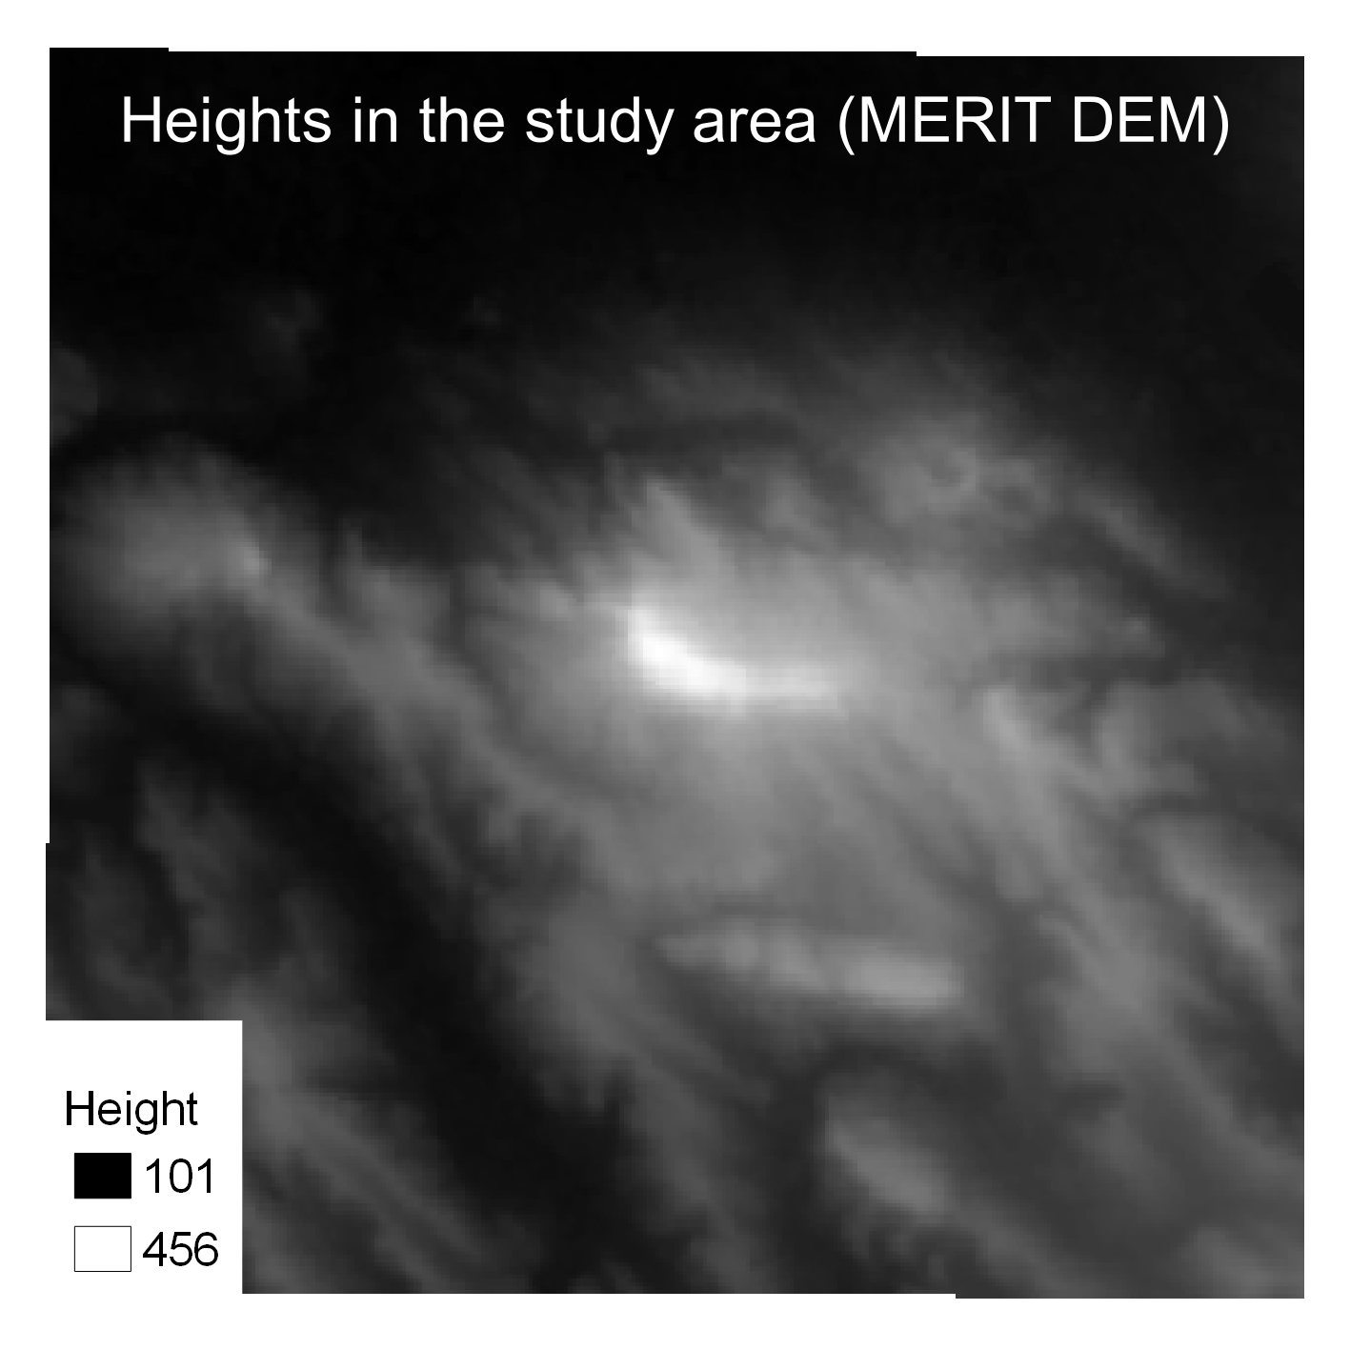
Input data of the modelling
14 morphometrical raster layers were generated from SRTM-1 (aspect, curvature, flow-line curvature, geomorphon, height, mid-slope position, normalized height, plan curvature, slope, texture, TPI, TRI, TWI)
6 raster layer of mineral indices were derived from Sentinel II. (ferric iron, feric oxides, ferrous iron, ferrous oxides, ferrous silicates, soil composition index)
1 ecosystem layer (Ecosystem Map of Hungary.)[1]
Data for the training area was derived from the former geological map of the Dorog-basin[2]
[1] Ecosystem Map of Hungary. DOI: 10.34811/osz.alapterkep
[2] Gidai, L., Nagy, G., & Sipass, S. (1981). Geological map of the Dorog Basin 1: 25 000. [in Hungarian] Geological Institute of Hungary, Budapest.

Slide 3
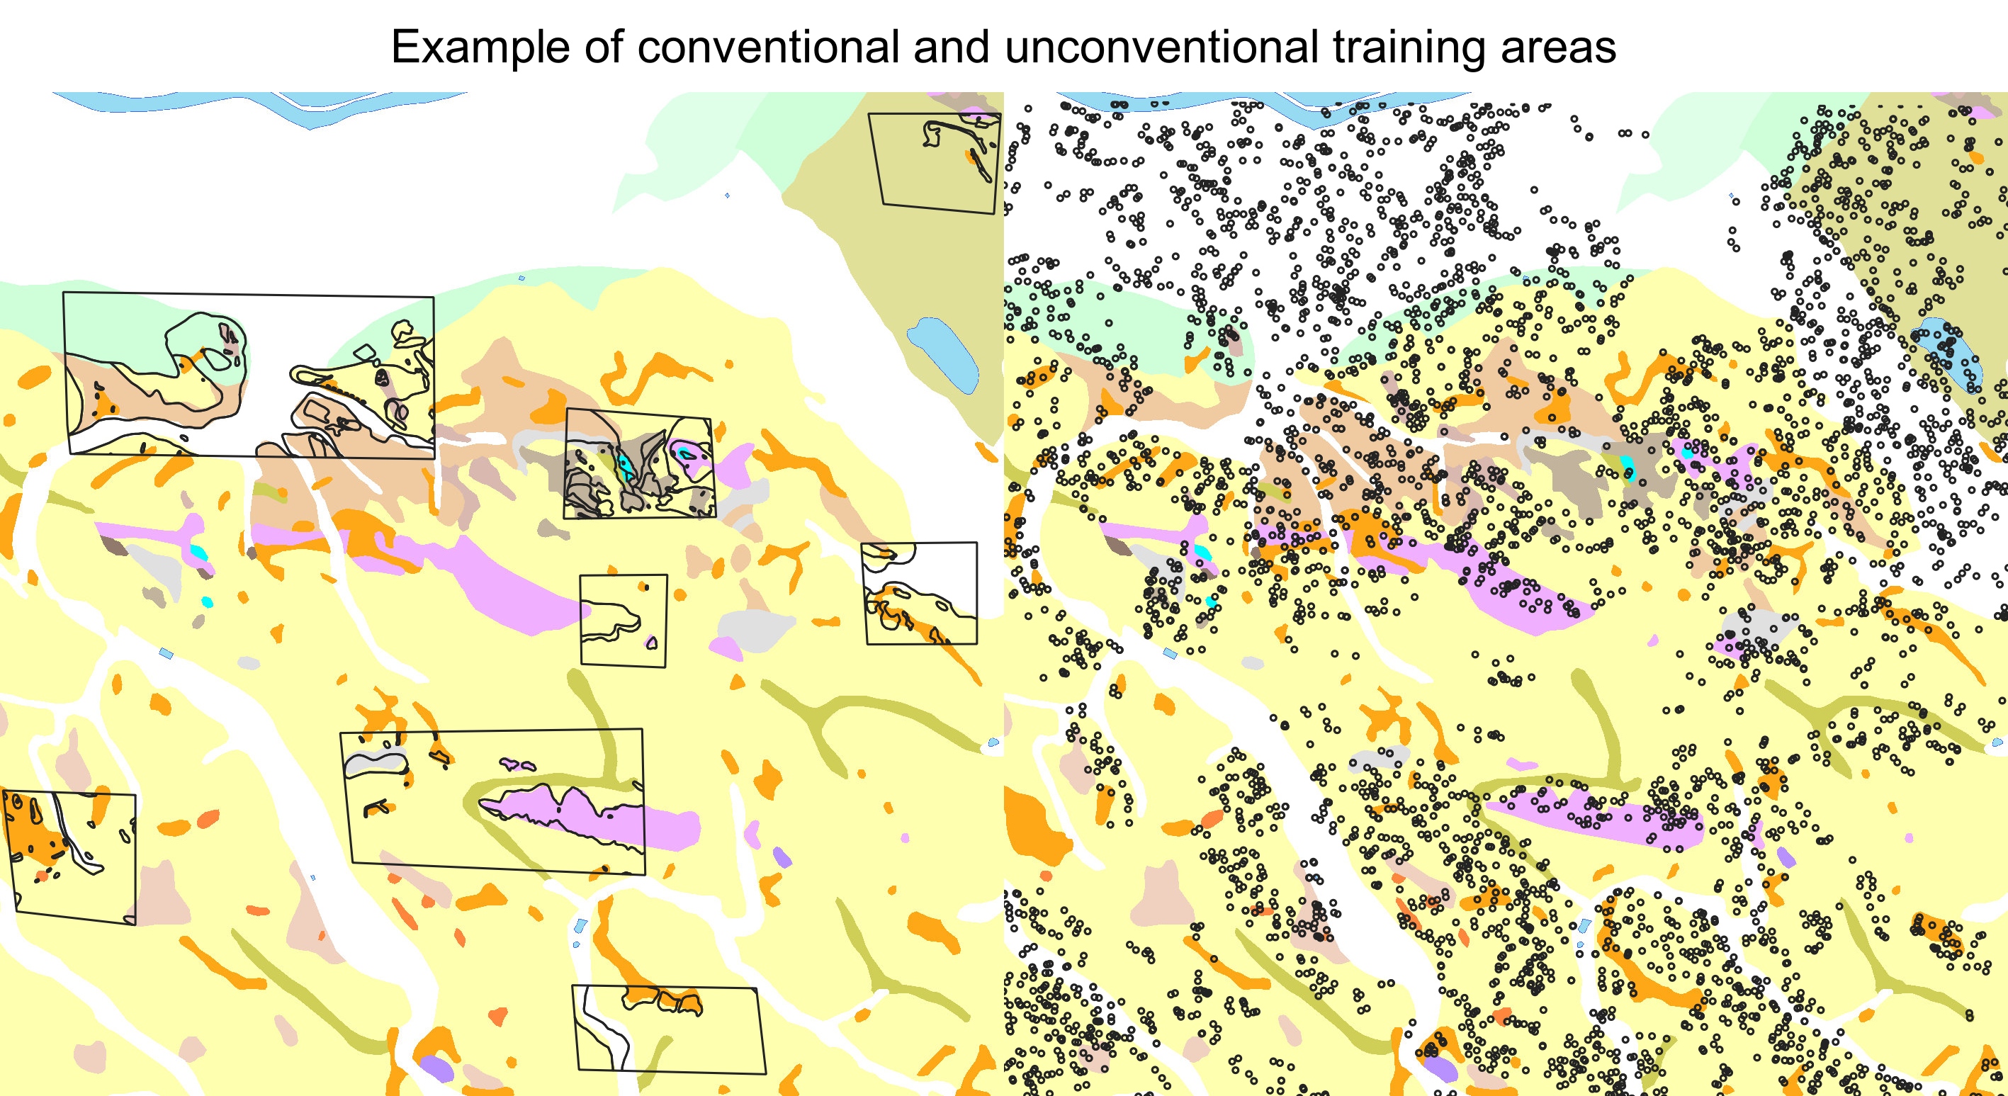
Training areas
Conventional: well placed polygons over the study area representing each and equal amounts of the formations (picture 1)
Randomly selected points, covering 1-2 px sizes (picture 2).
  NDVI calculation used to find less vegetated area
  Randomly generated points within

Slide 4
Methodology and results
Two models on physical characteristics, and two models on sorting Quaternary and pre- Quaternary formations using conventional training areas
Two models on physical characteristics, and two models on sorting Quaternary and pre- Quaternary formations using random point-based training areas
Run in SAGA GIS with 32 trees with sample replacement

Slide 5
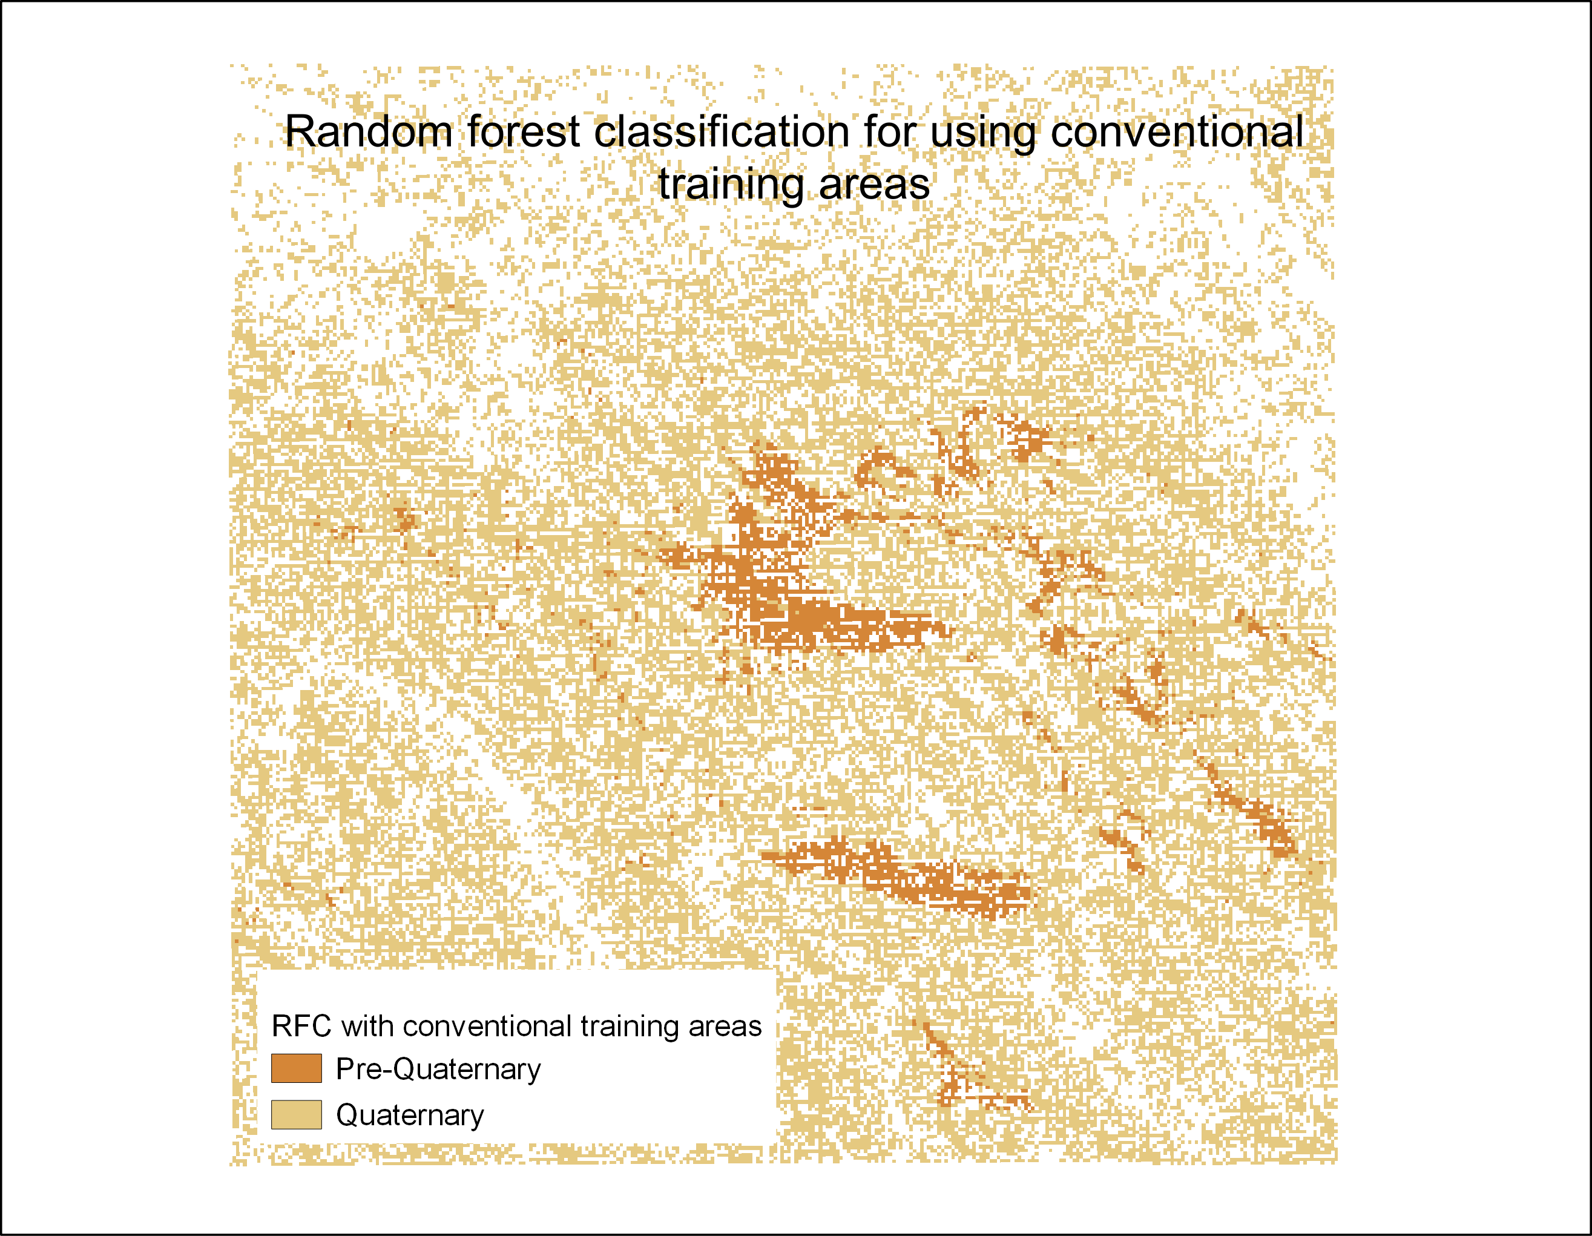
Classification of pre-Quaternary outcrops using conventional training area
Gete
Pre-Quaternary formations describe the Gete and the Magos-hegy correctly
Further outrcops are less compact therefore the accurcy is lower (81-82%)
Magos- hegy

Slide 6
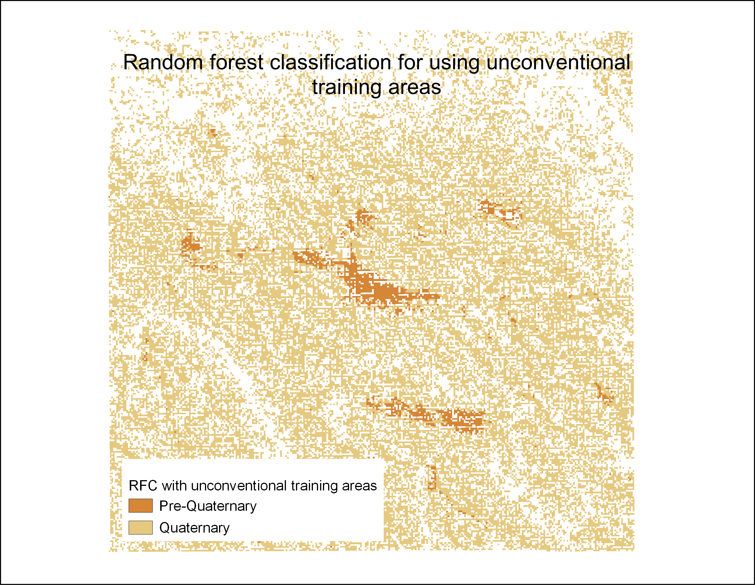
Classification of pre-Quaternary outcrops using conventional training area
Gete
Pre-Quaternary formations also describe the Gete and the Magos hegy correctly
All outcrops seem to be more compact, however some outcrops appear to be missing compared to the former geological map.
Magos- hegy

Slide 7
Feature importances
FI_quart_conventional |  | FI_quart_unconventional |  | FI_character_conventional |  | FI_character_unconventional
Feature | Gini Decrease | Feature | Gini Decrease | Feature | Gini Decrease | Feature | Gini Decrease
texture | 629,74 | texture | 276,75 | texture | 647,45 | texture | 302,60
height | 307,48 | height | 166,80 | height | 336,64 | height | 222,65
ecosystem | 197,42 | ecosystem | 98,56 | ecosystem | 198,61 | ecosystem | 94,03
ferrous silicates | 150,63 | Ferric iron3+ | 60,56 | Ferrous silicates | 167,79 | vrm | 84,89
aspect | 122,41 | vrm | 59,81 | aspect | 132,67 | ferric_iron3+ | 66,76

Slide 8
Validation and Conclusions
Six-fold cross validation resulted 80%+ accuracy (to former geological map of the area). These results still need to be confimed via fieldwork
Promising results meaning the possibility of using the method in geological mapping
Input feature importances showed a massive significance of texture and height, however their prominent importance decreased using unconventional sample areas
Feature importances still need to be reviewed, as more precise input rasters might increase the overall accuracy
Thank you for your attention

