Slide 1





Extending ML impact-based forecasting model for typhoons in the Philippines with a rainfall threshold for consecutive landslide events
Renske Free, Marc van den Homberg, Frederiek Sperna Weiland, Aklilu Teklesadik, Massimo Melillo, and Thom Bogaard
EGU 2022
Notes:
Italian National Research Council

Slide 2






Impact-based forecasting for typhoons
Trigger level
Disaster
Preparedness
Early Actions
Response and Recovery
€ € €
We need a trigger to release humanitarian funding & execute early actions 72 hours before a typhoon makes landfall.
Can we FORECAST which municipalities in the Philippines will be most impacted?

Slide 3

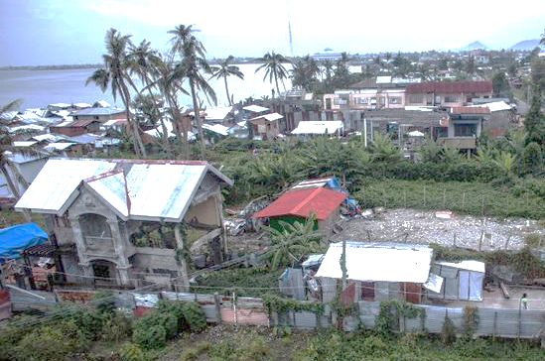
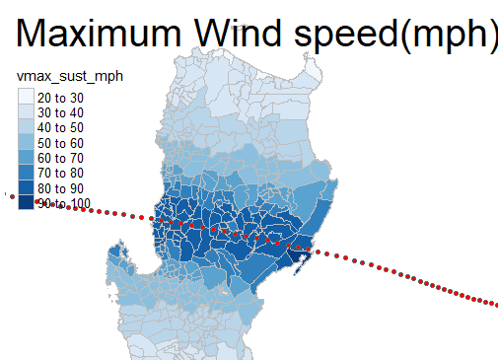


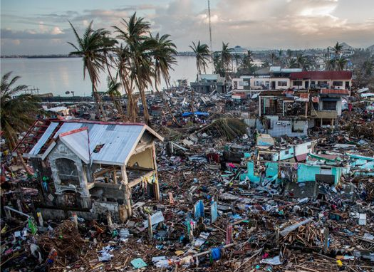
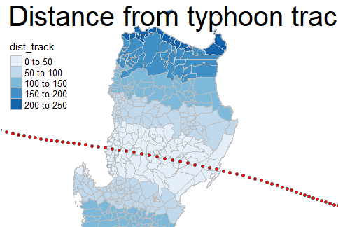
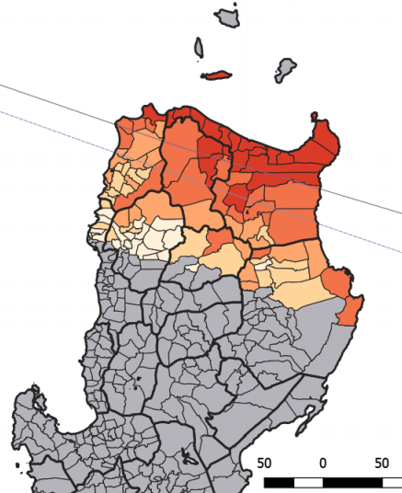
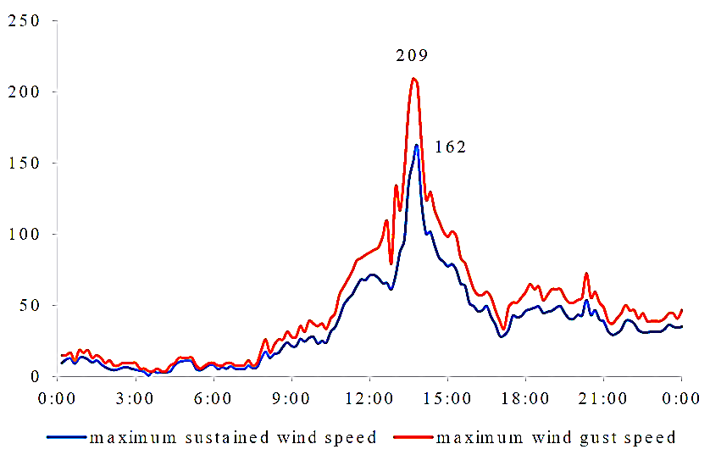
Impact-based forecasting <> Machine Learning
Predictors Predictand
Exposure & vulnerability Hazard Impact
Physical vulnerability Typhoon Storm surge Landslide House damage
Social vulnerability:
Poverty
Population <5 & > 60 years
Exposure: Exposure time to gust wind (>30mph)
Population density
Ruggedness
Coastal length
Elevation Maximum rainfall (mm/day)

Slide 4
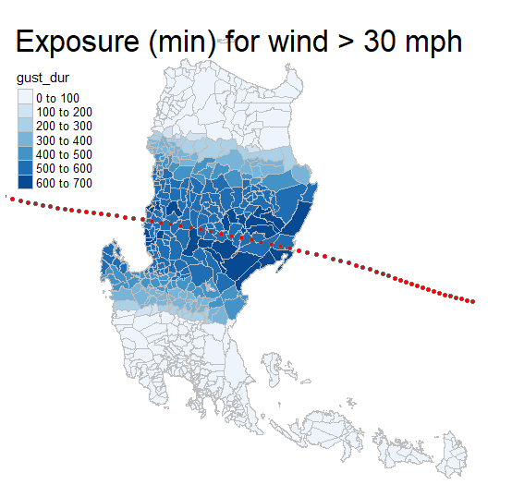
ML impact-based forecasting model
Predictors Predictand
Exposure & vulnerability Hazard Impact
Physical vulnerability Typhoon Storm surge Landslide House damage
Social vulnerability:
Poverty
Population density
Exposure:
Ruggedness
Coastal length
Elevation
Dynamic predictor
For each historical typhoon separately obtained using observations/
calculations
Static predictor
Same values (per municipality) used when training the model with 42 historical typhoons

Slide 5
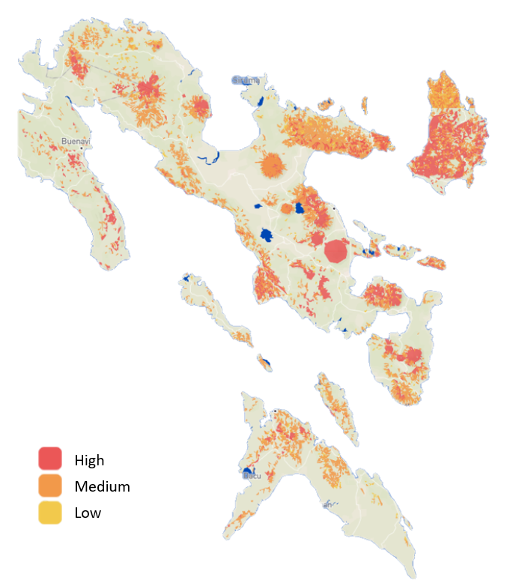
ML impact-based forecasting model:
Static predictor on landslides
Landslide susceptibility map (3 classes of vulnerability), source NOAH project Philippines
% of buildings in landslide prone areas
Low feature importance
Notes:
The NOAH project includes three landslide susceptibility maps (NOAH, 2021). The first
map is called the ‘Landslide Hazard Map’ and identifies the unstable slopes and landslide
extent of shallow landslides and is a combination of two maps: the ‘Landslide Hazard
Map’ and the ‘Unstable Slopes Map’. In this research, the combination of these two maps
are referred to as the Landslide susceptibility map (LSM). It is created by defining
potential rock slide zones as high susceptibility zones. These zones are overlain with a
stability index map resulting in the source areas of landslides presented in the ‘Unstable
Slopes’ map. This map is overlain with a runout map, of which the runout zones are
classified as high susceptible. This results in the creation of the final landslide
susceptibility map: the Landslide Hazard Map

Slide 6
Research objective: towards a hybrid model
How can we create a dynamic landslide hazard model to replace the static predictor?
Will the performance of the ML model improve by adding this dynamic rainfall threshold model?
Case study for the Bicol region

Slide 7
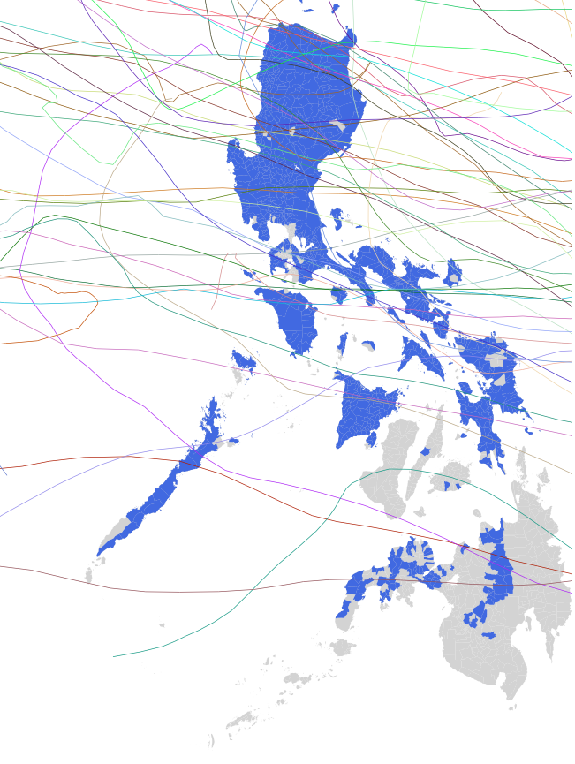

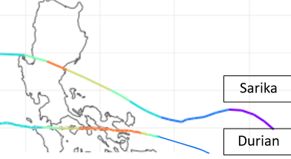

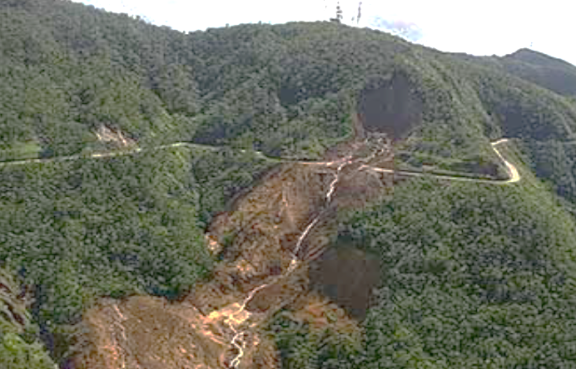

Data: typhoon train & test set and landslide inventory
 | Train and test set ML model | Landslide inventory
 | National level | Bicol region
 | 42 | Durian (2006) Sarika (2016)
 | Landslide susceptibility map | Durian: 4 Sarika: 5 59 landslides in total (90% of landslides are caused by typhoons)
 | 2006-2020 | 2006 2016 Usually December -February
Spatial coverage
Typhoons
Landslides
Period
Notes:
Cooperative Open Online Landslide Repository’ (COOLR)

Slide 8

Method: Event Duration (ED) threshold
CTRL-T Calculation of Thresholds for Rainfall-induced Landslides–Tool
Melillo, M., Brunetti, M. T., Peruccacci, S., Gariano, S. L., Roccati, A., and Guzzetti, F. (2018). A tool for the automatic calculation of rainfall thresholds for landslide occurrence.” Environmental Modelling and Software 105
Input
CTRL – T
Rain gauges
Rainfall timeseries per rain gauge
Landslides
$$E=α D^{ (γ)}$$
Notes:
The tool of CTRL-T, which was created by mister Melillo from the Italian Geohydrology Institute, and relates event rainfall to the initiation of landslides. The tool requires input from three files: rain gauges, rainfall time series and landslides. The output is a powerlaw curve where the accumulated rainfall E is assessed over a time range or duration D. CTRL-T determines the region-specific parameters of alpha and gamma of the event duration curve
Once we have a reliable event duration threshold, .

Slide 9
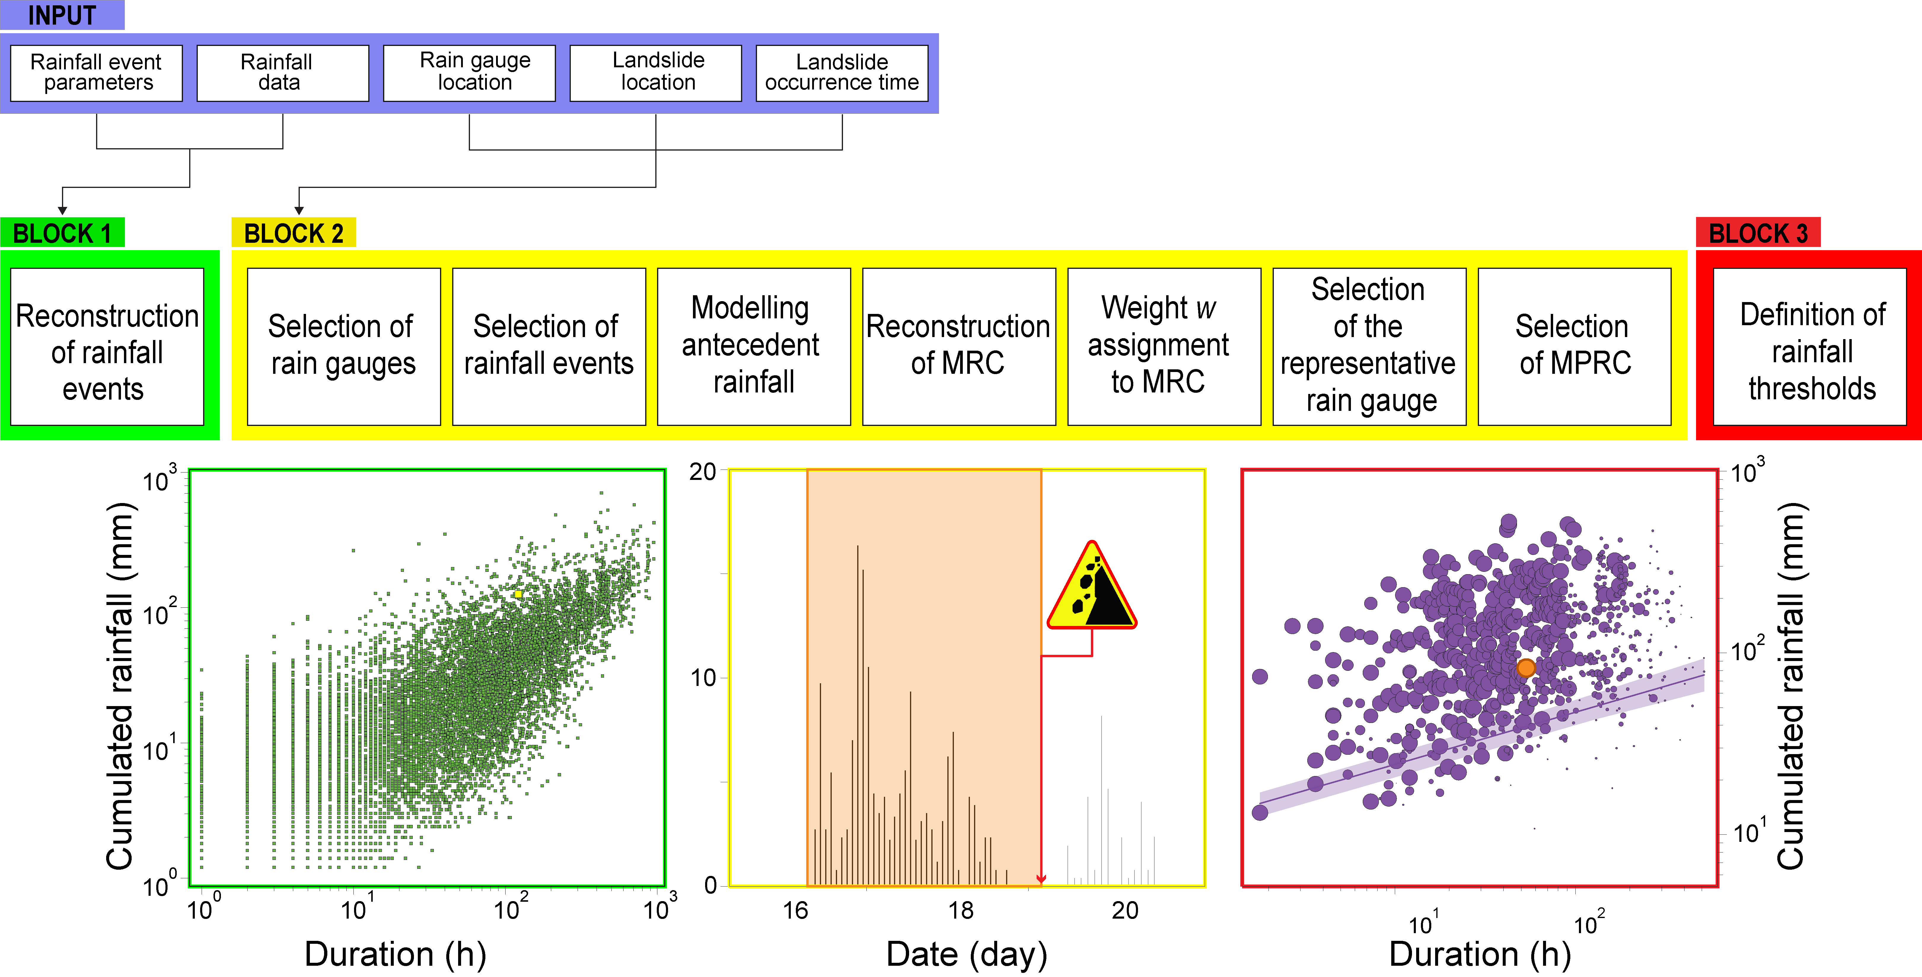
Method: event duration (ED) threshold
CTRL-T Calculation of Thresholds for Rainfall-induced Landslides–Tool

Slide 10
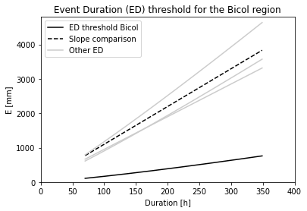

Results: determine Event Duration treshold in Bicol
2006-2018
59 landslides from NASA Cooperative Open Online Landslide Repository (COOLR), DROMIC reports + online search
3 rain gauges in Bicol region, buffer 60km
$$E=0.6D^{ 1.22}$$
Notes:
A first result is an ED threshold for the Bicol region. In this graph accumulated rainfall in mm is displayed over a duration in hours. The bottom black curve is the ED for Bicol. Compared to similar research, the slope alike, yet the curve is lowered. This implies that less accumulted rainfall is required for the exceedance of the threshold. The low ED curve and its uncertainty will influence the reliability of the landslide hazard forecast.

Slide 11
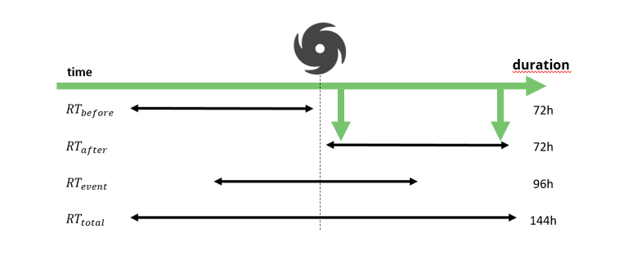
Method: use Event Duration threshold to determine landslide hazard YES or NO per municipality
Landslide hazard = rainfall total (RT) > ED threshold
Notes:
We go to step 2 of the method: hazard and impact forecasting. The landslide hazard forecast is calculated by the exceedance of the ED threshold by accumulated rainfall, or rainfall total. Four RTs with different time ranges in relation to typhoon landfall are defined. Of these four, RT before and event can be applied for forecasting and RT after and RT total are used as quality checks.
Then, landslide impact is calculated by coupling the hazard to vulnerability and exposure, via the IBF formula (this one). The LSM is used as indicator for vulnerability and the % of houses as quantitative measure of exposure.
Two scenarios were defined based on the three zones: All classes considers high, medium and low zones and High classes include only the high and medium vulnerable zones.
Together the hazard and impact form the landlsie IBF model.

Slide 12
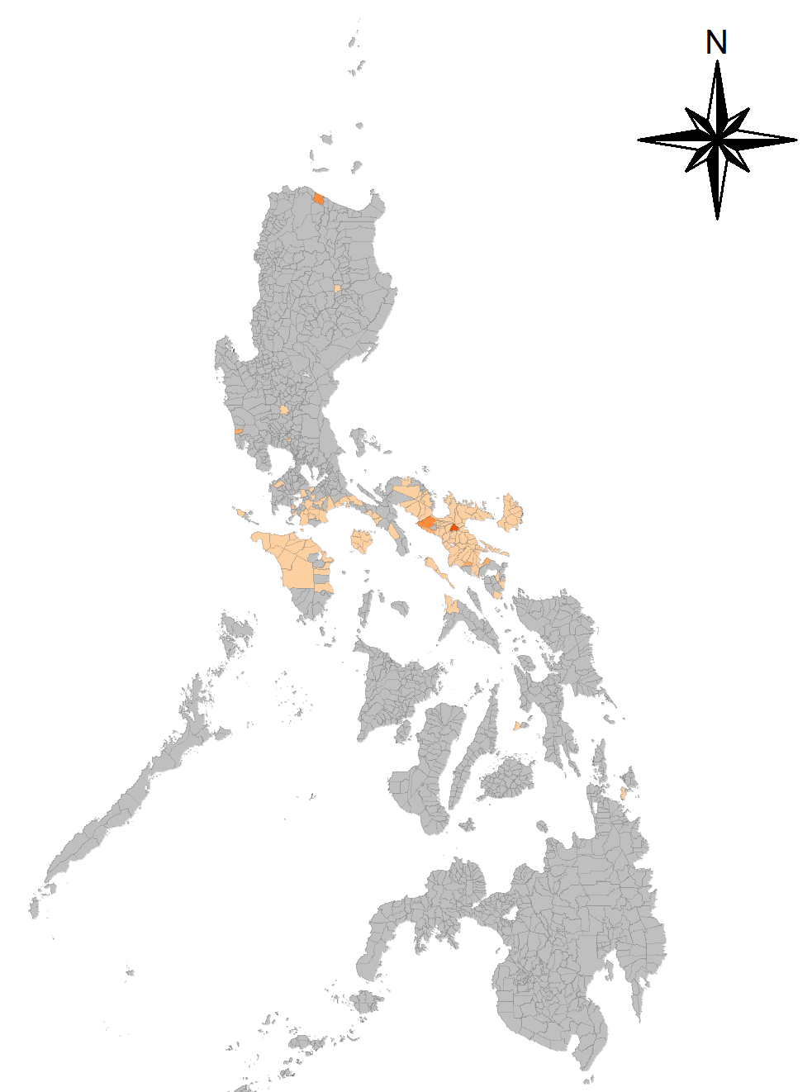
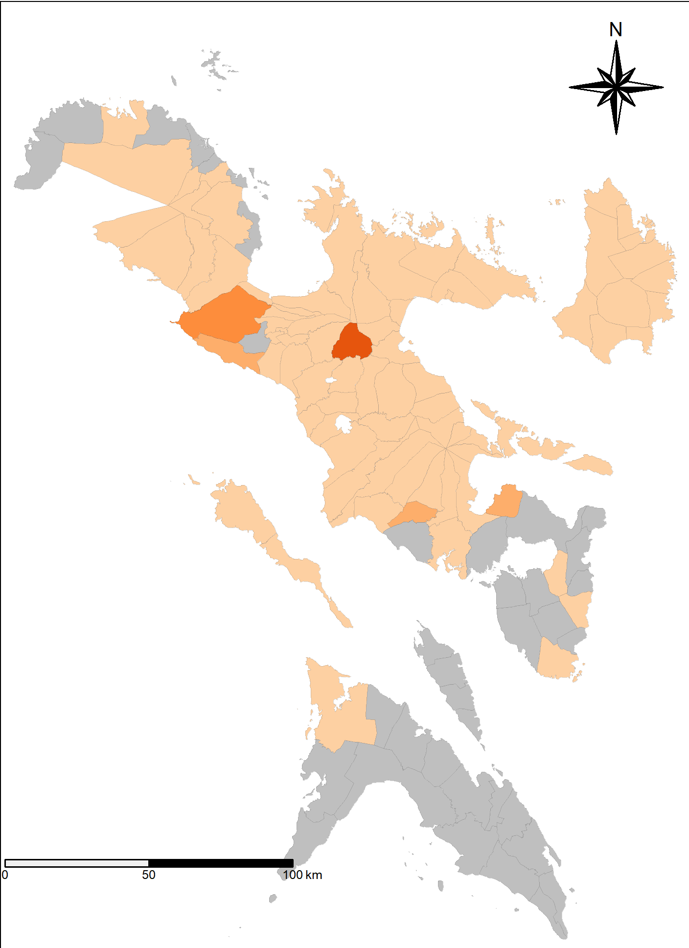
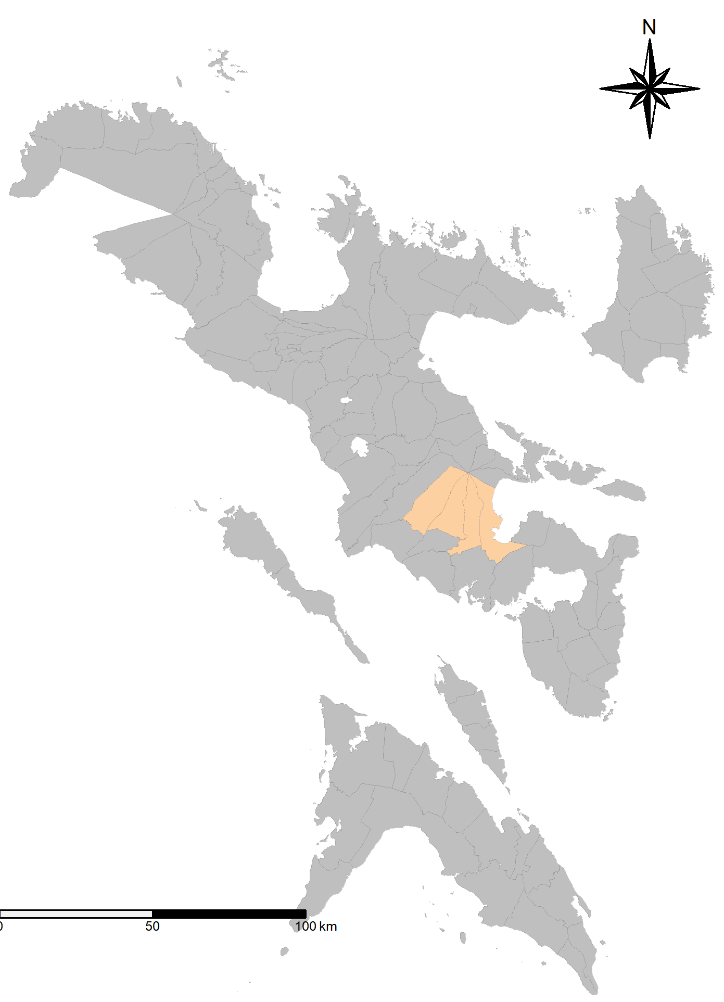
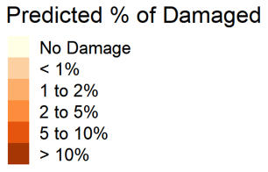
Method to go from landslide hazard (YES or NO) to landslide exposure
If rainfall total (RT) > ED threshold, then select:
High exposure: all 3 classes of Landslide Susceptibility maps (NOAH) + % of buildings in landslide prone areas
Medium exposure: only high and medium classes
Example typhoon Durian:
Observed housing damage impact: 76 municipalities
Observed landslides: 4 municipalities
Notes:
Two case study typhoons in the Bicol region were assessed and today, we will look into typhoon Durian. The typhoon travelled right over the Bicol region, causing impact in almost all municipalities. Indicated by the colors, which represent the percentage of buildings completely damaged in a municipality. Landslides, of which we know, occurred in 4 municipalities around the slope of a volcano.

Slide 13
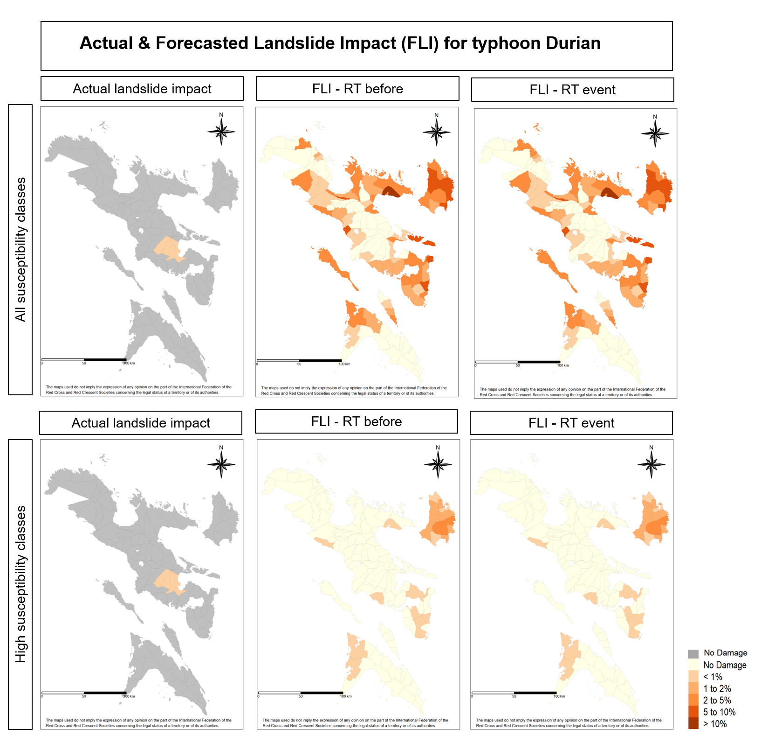
Results
Notes:
It should be noted that the magnitude of the impact is not considered in the reliability assessment. On the left we see again the actual landslide impact and on the right the 4 forecasted landslide impact (FLI) from the landslide IBF model.

Slide 14
Results
Notes:
Looking at the predictions for high classes, the impact is less spread out in location extent but reliability regarding the accuracy is low as no correct landslide impact forecasts were obtained.

Slide 15
Results
Notes:
For all susceptibility classes, the location of the municipalities which were affected is overestimated. 1 out of the four actual landslide events, so 25%, were correctly forecastsed, yet het the F1 score was still low due to the overestimation of the impact. Out of all RTs, RT before and event were defined as the least incorrect forecasts for both case studies.

Slide 16
Conclusions
It is important for a typhoon impact-based forecasting model to include consecutive events preferably through a real-time/dynamic predictor instead of a static one
Doing do this for landslides is possible by constructing a rainfall threshold model
  Rainfall total event would be the best, but cannot be achieved in forecast mode
  Also, typhoons that do not make landfall (but that are accompanied by heavy rainfall) can cause landslides
  A sufficiently wide area around the typhoon track should be included to cover landslides that occur further away from the high windspeed areas

Slide 17
Future research
Improve landslide inventory
  Use satellite data?
  For all typhoons that had associated landslides
Extend landslide model
  Add debris flow?
Implement in ML impact-based forecasting model
  Retrain with the landslide model

Slide 18
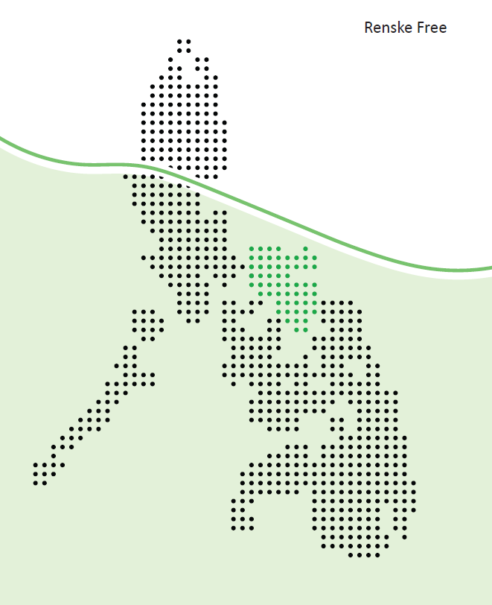

Contact information
mvandenhomberg@redcross.nl
renskefree@gmail.com

Slide 19


