Slide 1
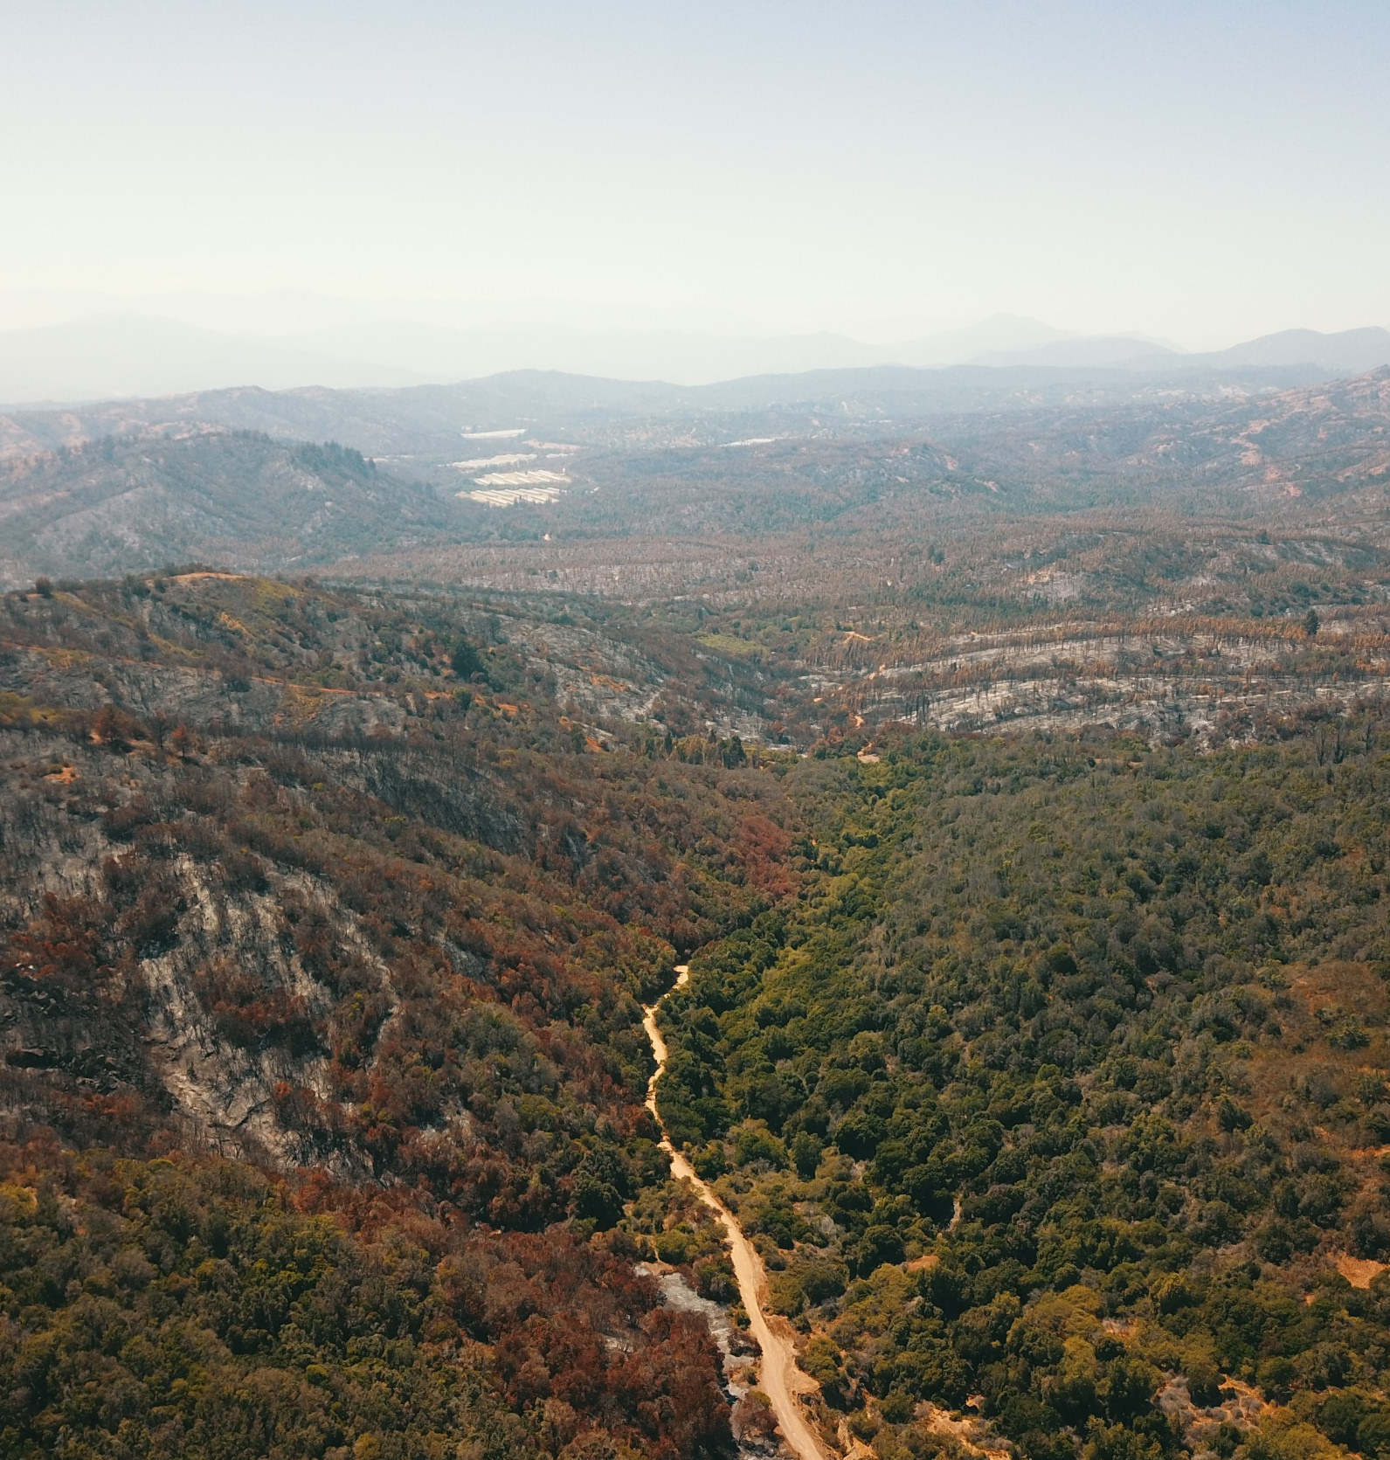






Interaction between disturbances and their effects on the recovery OF A HETEROGENEOUS Mediterranean landscape in south America
Ana Hernández-Duarte, Freddy Saavedra
May 23, 2022
Notes:
Hi everyone,
I am glad to present today.
This is Ana Hernández speaking. I am a PhD student at the University of Playa Ancha in Chile.

Slide 2
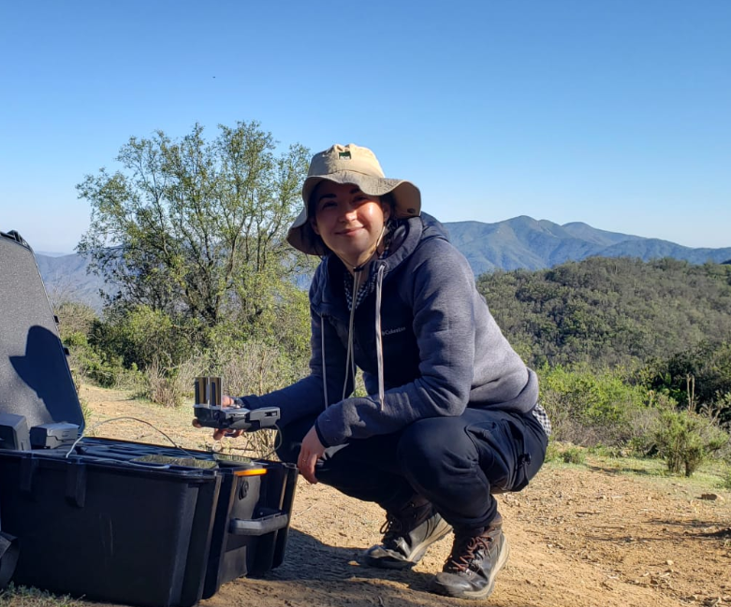


ANA HERNÁNDEZ-DUARTE
PhD. Student
Doctorado Interdisciplinario en Ciencias Ambientales

Slide 3
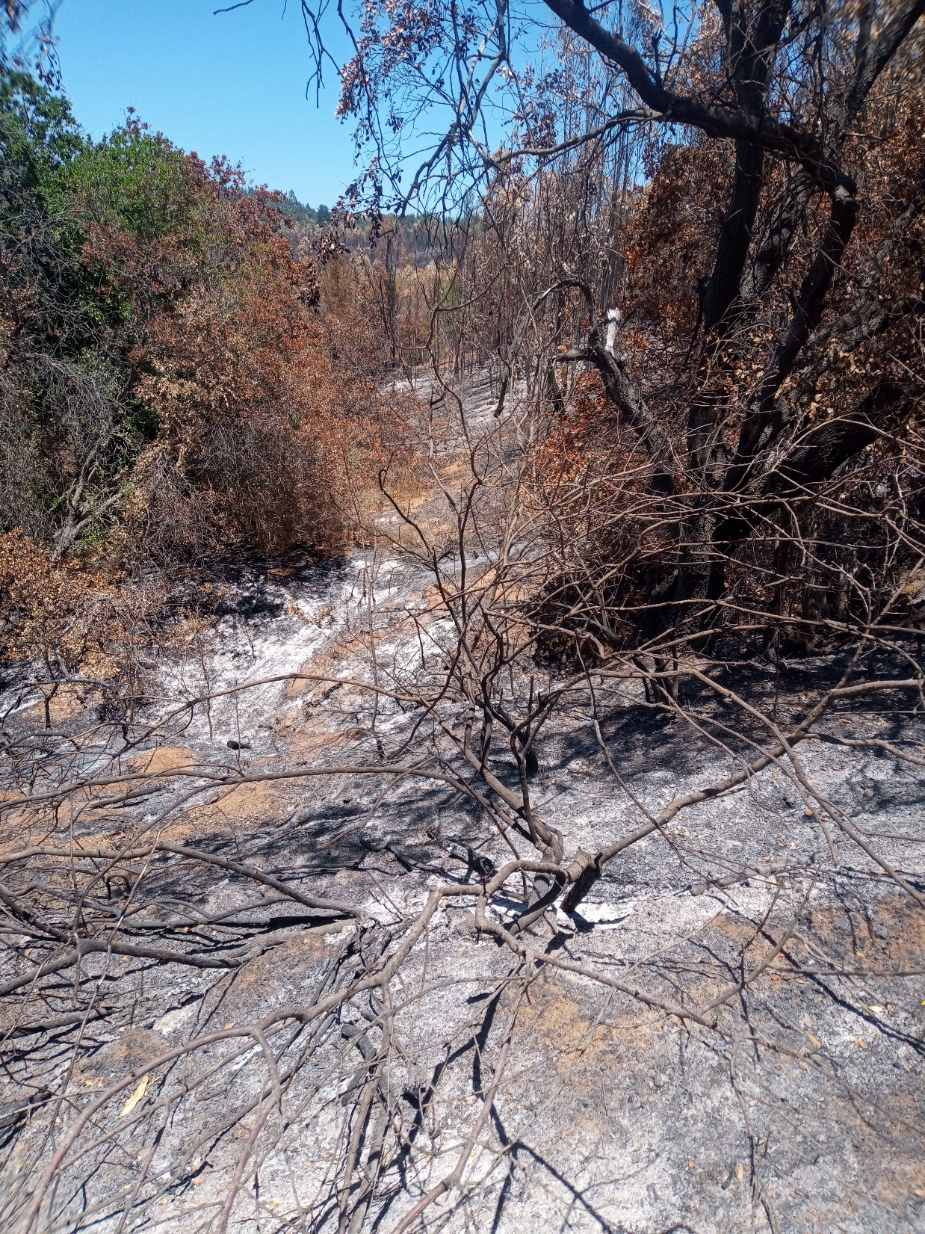
DISTURBANCE IN GLOBAL CLIMATE CHANGE
The world is changing rapidly. Warming world.
The most abrupt changes are likely to be modulated by ecological disturbances (Gill et al., 2017; Turner, 2010).
Disturbances alters an ecosystem's structure and compositions limiting the availability of resources (White and Pickett, 1985).
Several disturbance regimes are also changing (Seidl, et al., 2017).
It is necessary to study disturbances in a wide range the dynamics of ecosystems (Turner, 2010).

Slide 4
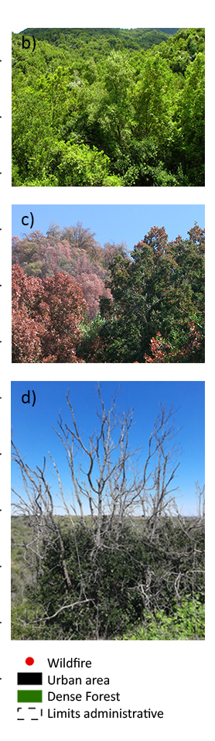
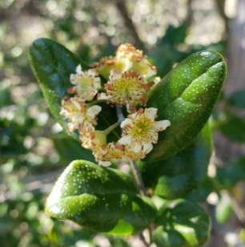
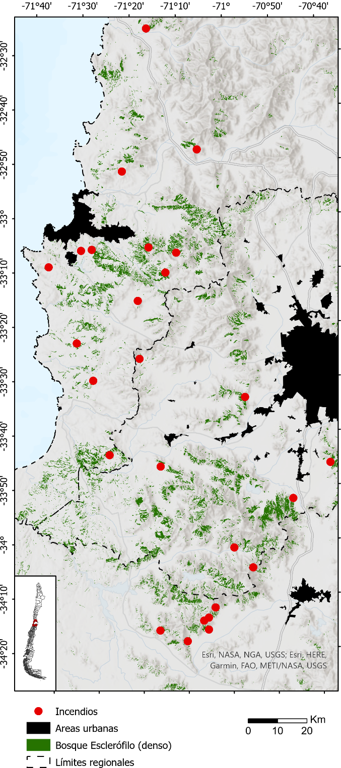

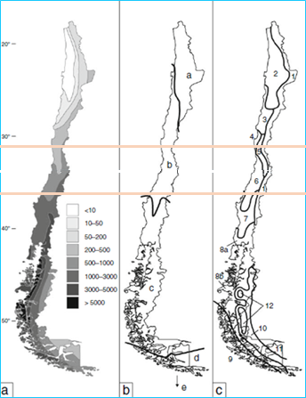
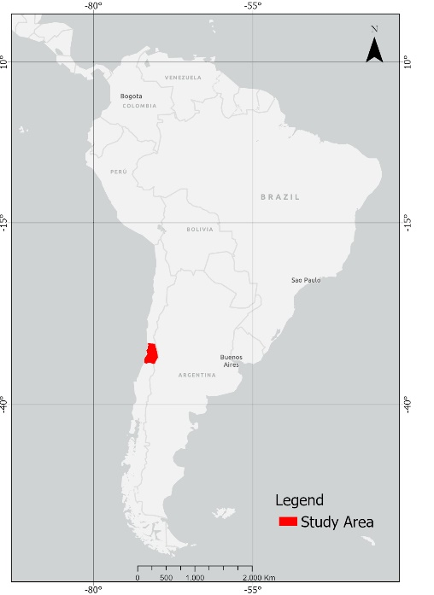
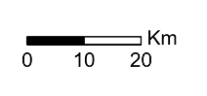
STUDY AREA
Sclerophyllous forest
Central Chile
Annual precipitation
Chilean macro-bioclimates b= Mediterranean
Distribution of vegetation formations 5= woody savanna; 6= sclerophyllous matorral. Adapted from Moreira-Muñoz (2011).

Slide 5
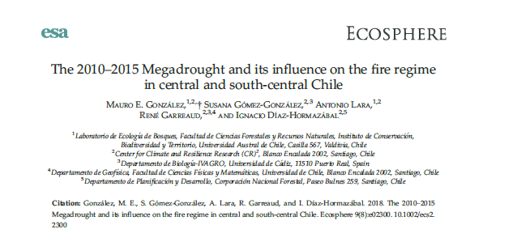
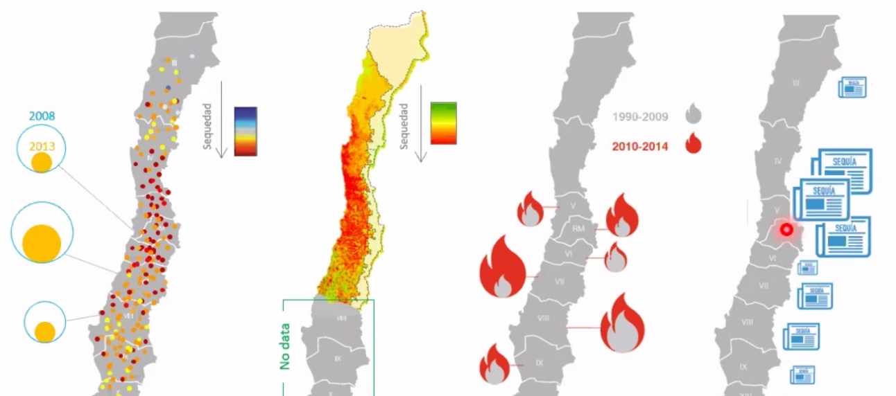
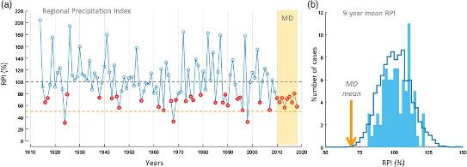
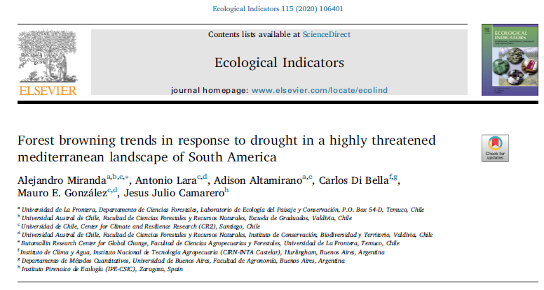
MEGADROUGHT
Since 2010, there has been a rainfall deficit that ranges between 25% and 45%, reaching a peak in latitudes between 31° and 33° S (Garreaud et al. 2019).
Vegetation deterioration (August 2010-2015)
Rainfall Deficit (2010-2014)
Intense forest fires
News in written press (2014)
(Garreaud et al., 2020).
©GdG
Drought
Fires

Slide 6
goals
?
What is the interaction between drought and wildfires and their effects in recovery patterns in the Mediterranean sclerophyllous forests
Quantify interaction effects between drought and wildfires in sclerophyllous forests.
Analyze the spatial location, the direction of the trend, and the timing of the forest's spectral change.
Determine the relationship between spectral change and vegetation productivity after fire and drought, taking into account influences on climate and topography.
Notes:
Now, the question I ask myself is
What is the interaction between drought and wildfires and their effects in recovery patterns in the Mediterranean forests?
For this, I propose 2 specific goals:
1. Analyze the spatial location, the direction of the trend, and the timing of the forest's spectral change.
And 2. Determine the relationship between spectral change and vegetation productivity after fire and drought, taking into account influences on climate and topography.

Slide 7
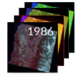
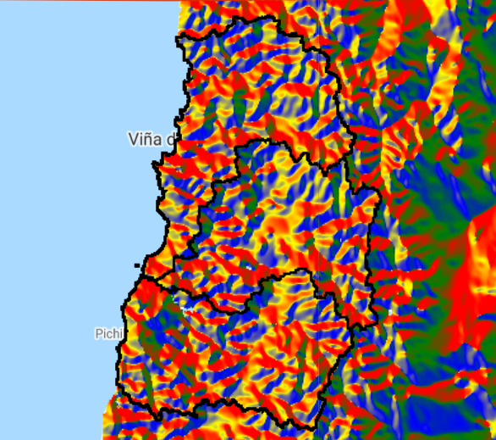
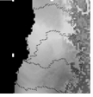
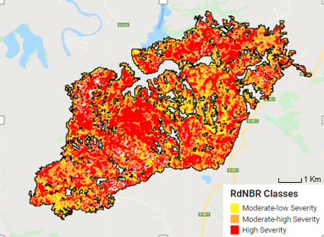
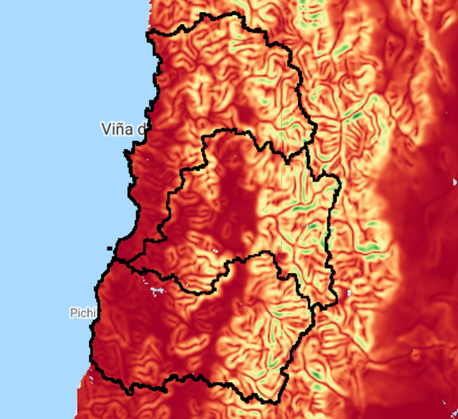

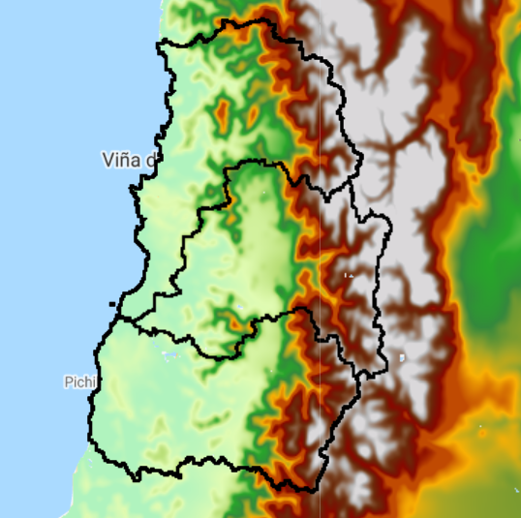
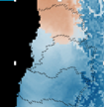
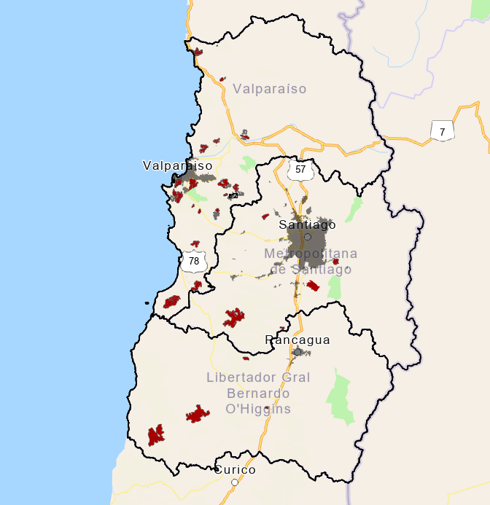
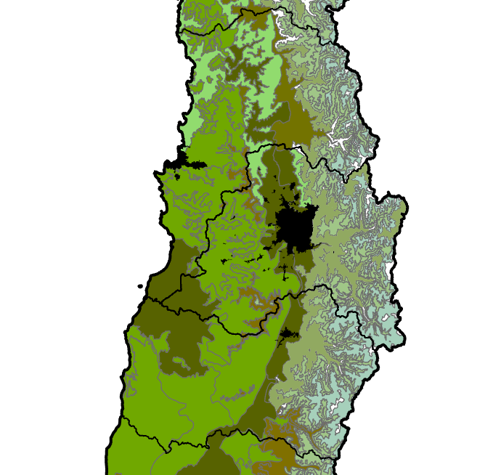
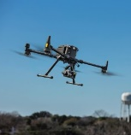


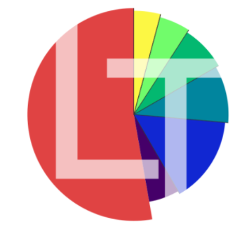

MATERIAL & METHODS
Landsat images
(30 m)
DEM
(NASA STRM)
(30 m)
Climate
data set
(2.5 arc min)
Fire polygons (CONAF
1988-2020)
Severity class
(dNBR
30 m)
Vegetation cover class
(CIREN-CONAF 2013)
Satellite and climate data
Field data
Trend analysis
Driver analysis (model)
Drone data
PDSI (TerraClimate)
Precipitation
Temperature
monthly
NDVI
NDMI
TC
NBR
(30 m)
Severity
Hight
Medium
Low
(30 m)
Slope
Aspect
Elevation
TPI
(30 m)
Sclerophyllous forest
dense cover
dVIs
(30 m)
Joined by date
Notes:
This research based on multiple data as you can see. The analysis was mainly done using Google Earth Engine. PAUSE For the detection of changes I will use the detection algorithm LANDTREND.
PAUSE
More information in the extended video of my research

Slide 8
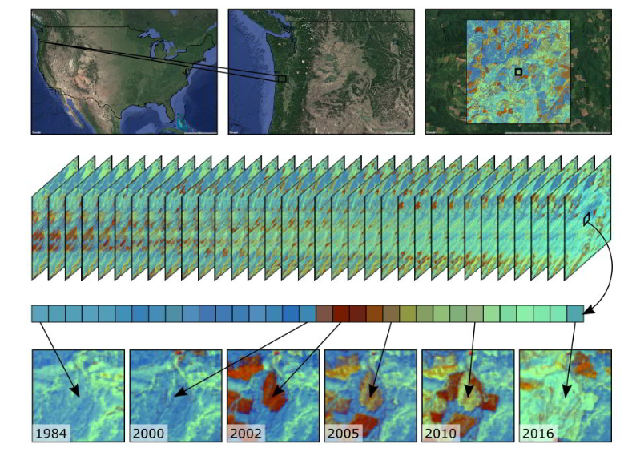
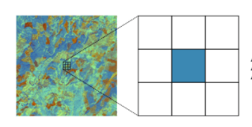
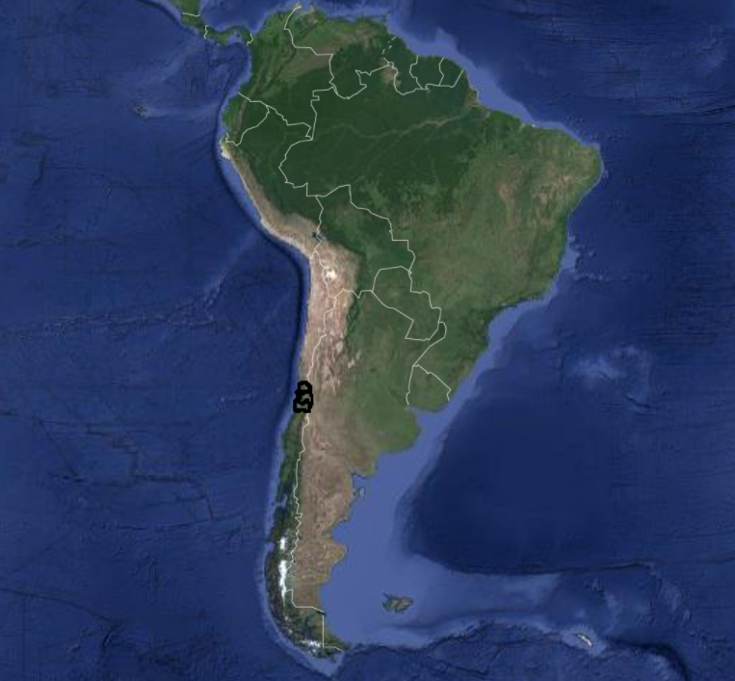
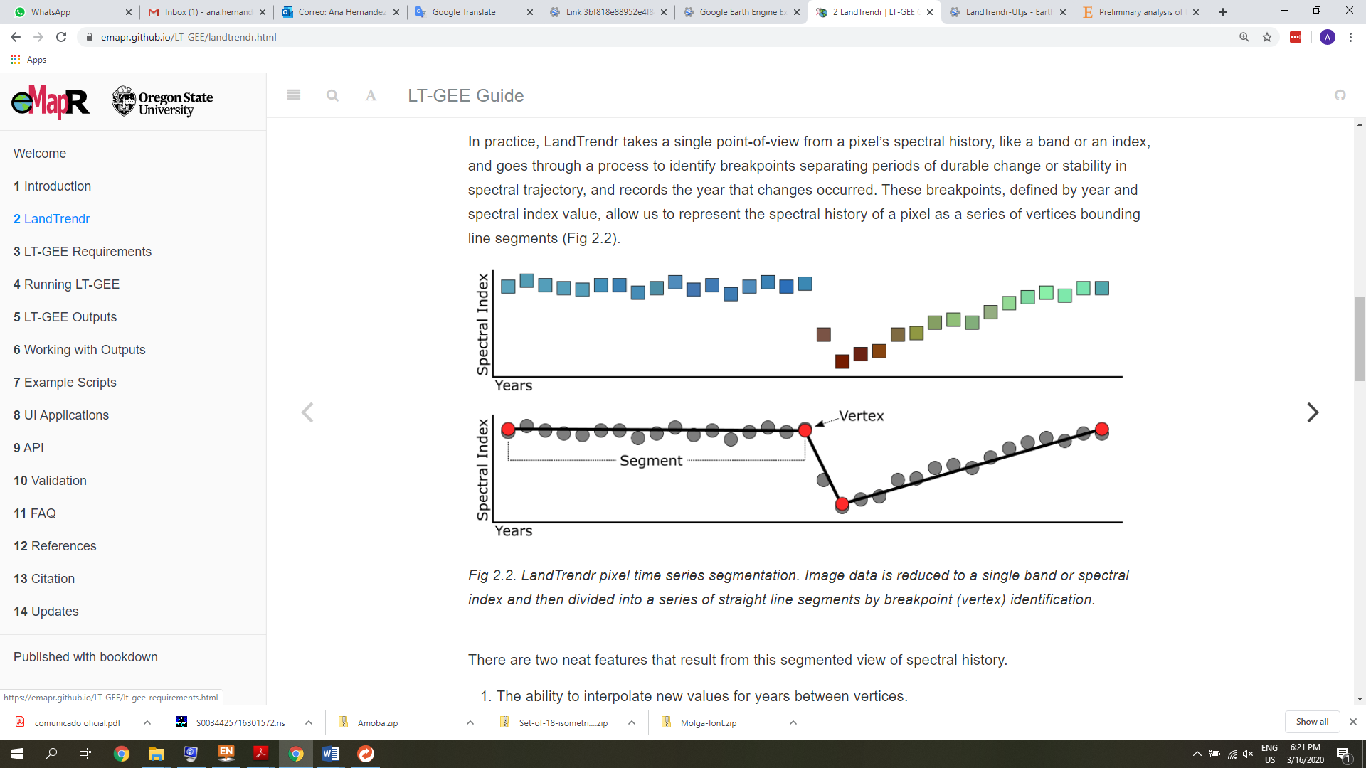
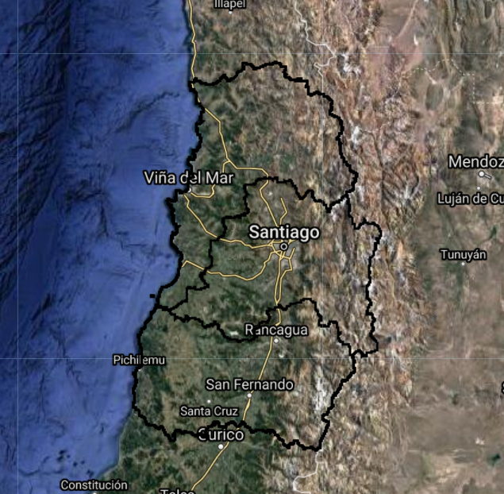
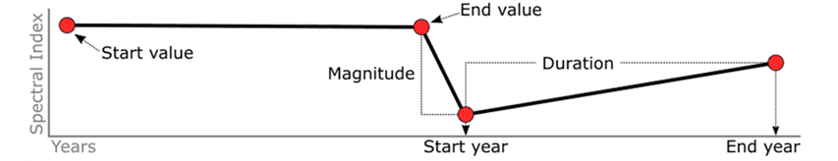
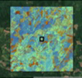
METHODS
LT-GEE
(Kennedy et al., 2018)
https://emapr.github.io/LT-GEE/landtrendr.html

Slide 9
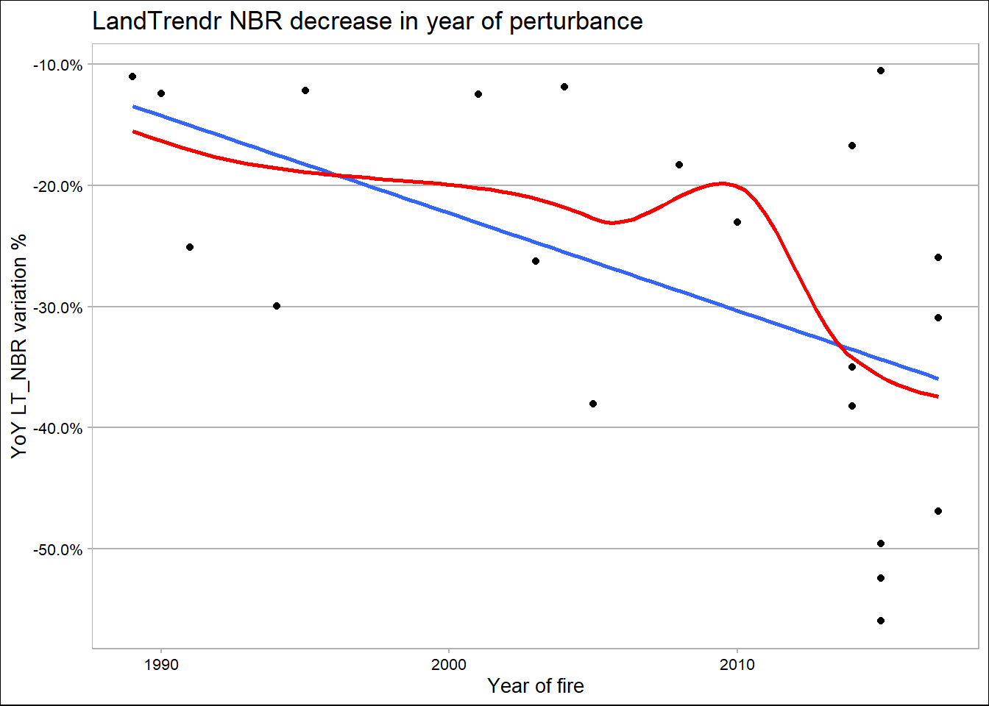
Early RESULTs
Fires LT-NBR
NBR value dropped as a percentage in the year the fire occurred compared to its previous value
Linear trend
Polynomial regression
The loess regression, it seems that the drop in NBR values were grater or more severe in the years with drought, after 2010.
Notes:
I want to quickly show you some data that we have worked on.
As a result of the spectral history between a period of drought and non-drought.
We selected twenty fires from sites that share similar biogeographic conditions either as dense forest cover or high severity patches so we can evaluate the recovery after a fire with non-drought and recovery from a fire with drought.
We took multiple samples from each site and we summarized all the samples into one mean value per year per site.
In this chart we can see how much the Normalized Burn Ratio (NBR) value dropped as a percentage in the year the fire occurred compared to its previous value
Following the Loess regression, it seems that the drop in NBR values were grater or more severe in the years with drought.
We did the same analysis using NDVI

Slide 10
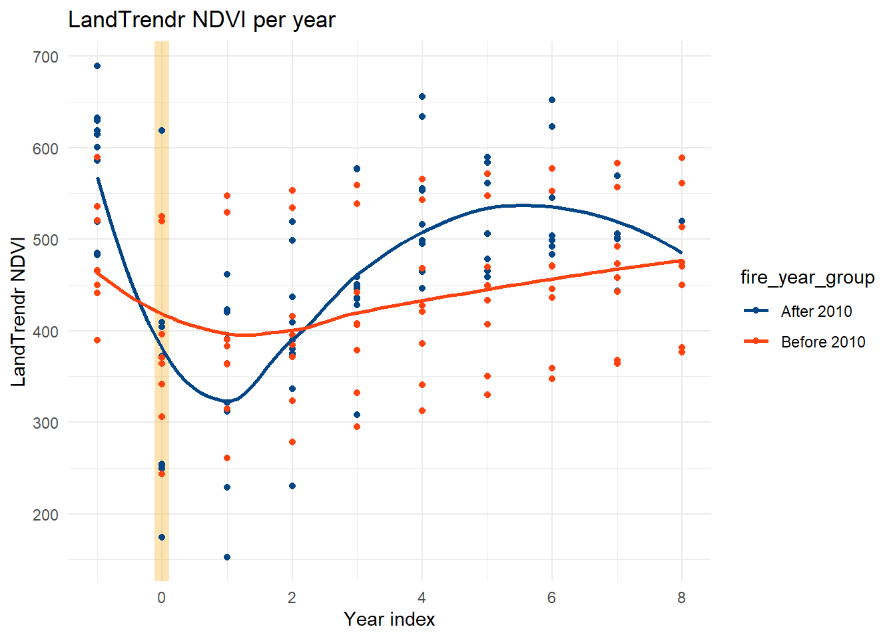
Early RESULTs
DROUGHT
The level of recovery doesn’t completely reach the NDVI levels from before the disturbance, it even seems to decrease in the last years as the drought became more severe.
NON DROUGHT
Show more extended periods to recovery but they reach a point where the value of the NDVI returns to the levels prior to the fire.
NDVI
Recovery
Aligned every disturbance, in this case fires, to the same year scale from -1 to 8.
Fire year groups
Drought (after 2010)
Non drought (before 2010)
Notes:
To evaluate the recovery, we aligned every wildfires, to the same year scale from -1 to 8.
• Year 0 is the year in which the fire occurred
• Years 1-8 are the years after the fire
Here we see some interesting things…
For sites with fires in drought period, we see that the level of recovery doesn’t completely reach the NDVI levels from before the disturbance, it even seems to decrease in the last years as the drought became more severe.

Slide 11
what comes next?
Modeling...
Limitations
Spatial resolution
Greennest ~ mortality
Demographyc framework
NDVI(+4&8 Yfire) ~ Dvi + Slope + Aspect + Elevation + TPI + PDSIpre + PDSI post + mean air temperature + mean precipitation + NDVI(preDr)
Future analyses should evaluate multiple processes of forest resistance and resilience including growth, rerouting, mortality, regeneration, and shifts in species compositions.
Notes:
OK, what comes next?
We will take a deeper look into the samples
We will include more variables to the model like spectral indices associated with humidity, topographic and climate variables. With this, the idea is to test each fire and between fires.
I still have to validate some points in the field, which were delayed due to the pandemic, but that are also important and missing.

Slide 12
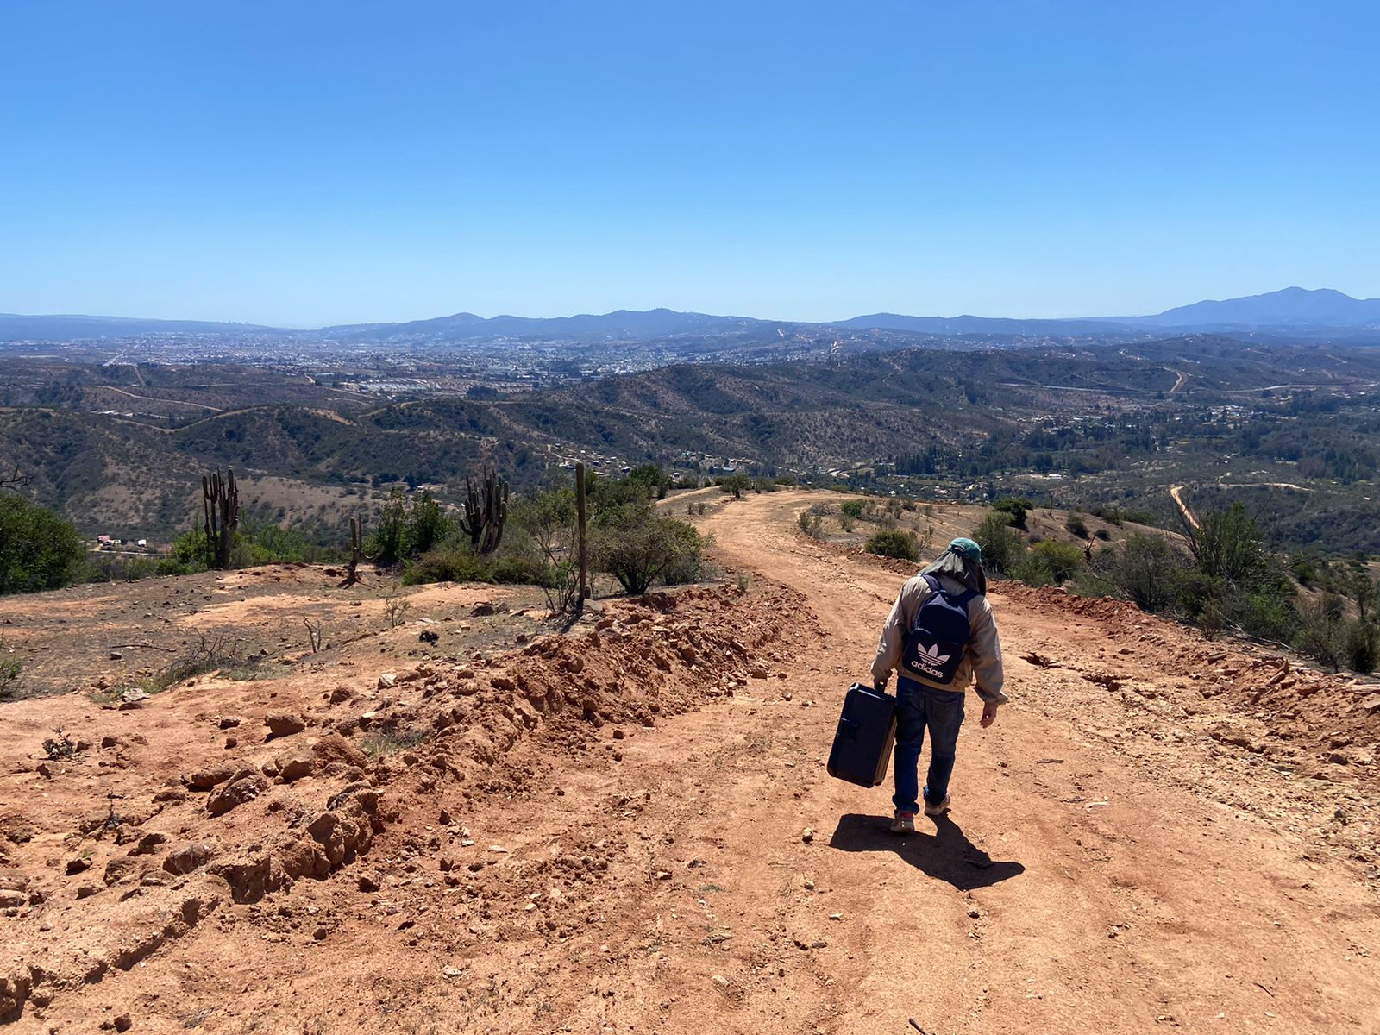




Acknowledgements
Thanks ANID, Fomento a la vinculación Internacional para Instituciones de Investigación Regionales, FOVI210026 Project, IDeA I+D 2020 FONDEF ID20i10058 Project, CLIMAT-AMSUD 21-CLIMAT-02, PhD Program Interdisciplinary Enviromental Sciences Universidad de Playa Ancha.
Thank you!
Ana Hernández-Duarte
PhD. Student
Universidad de Playa Ancha
Chile
ana.hernandez@upla.cl
https://doi.org/10.5194/egusphere-egu22-10480
Notes:
Thank you!
I remain available for questions or comments

