Slide 1



Using Nudging for Aerosol Radiative Adjustment Mechanism-Denial Experiments
Max R. Coleman, Bill J. Collins, Keith P. Shine, Nicolas Bellouin, Fiona M. O’Connor

Slide 2
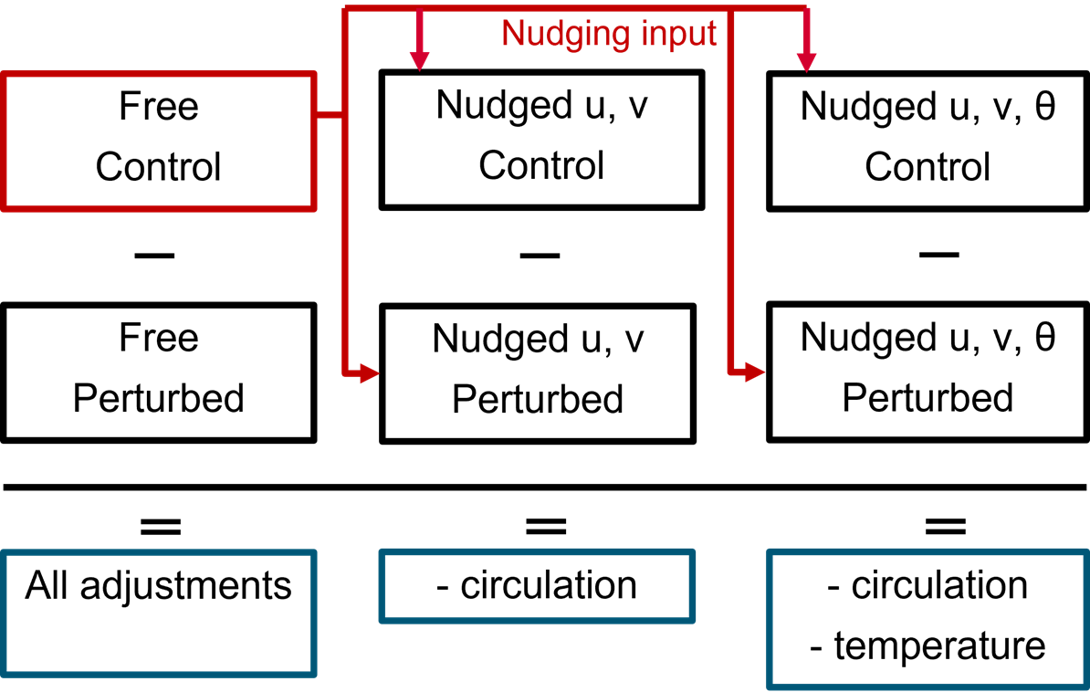
Method

Slide 3
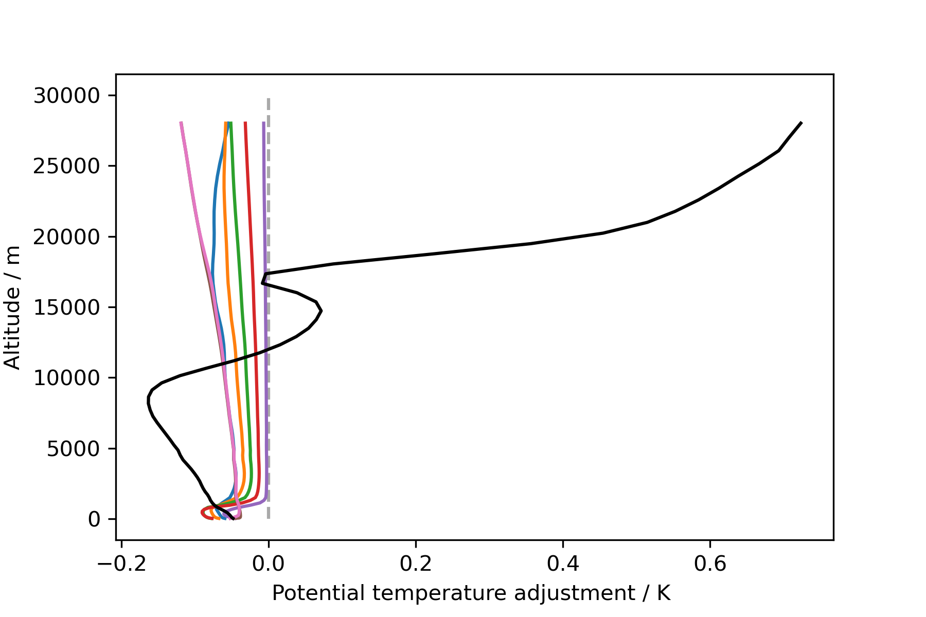
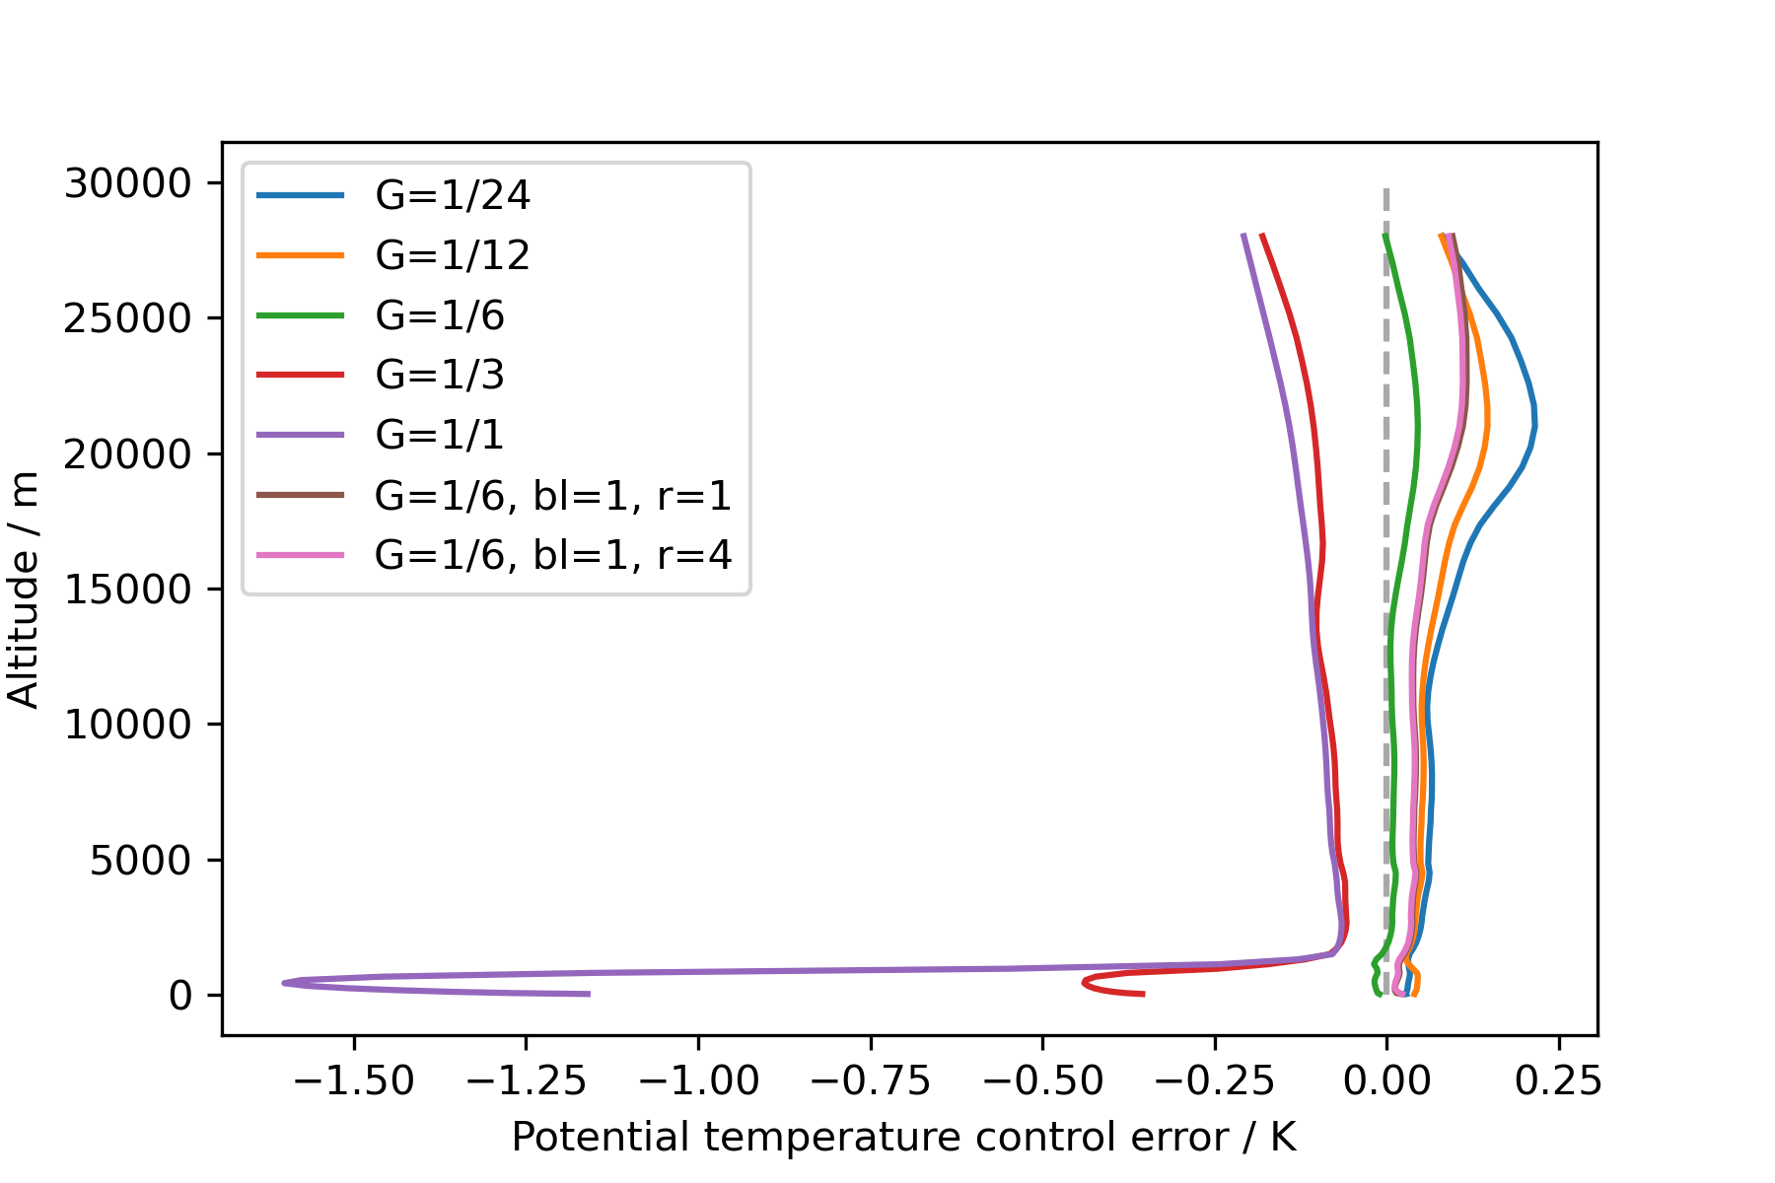
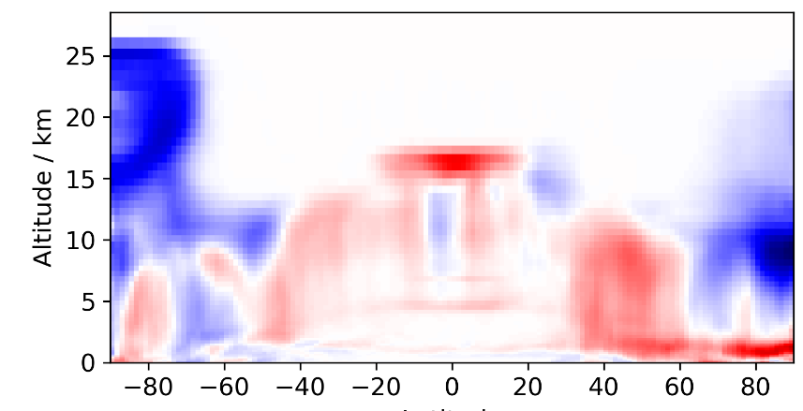
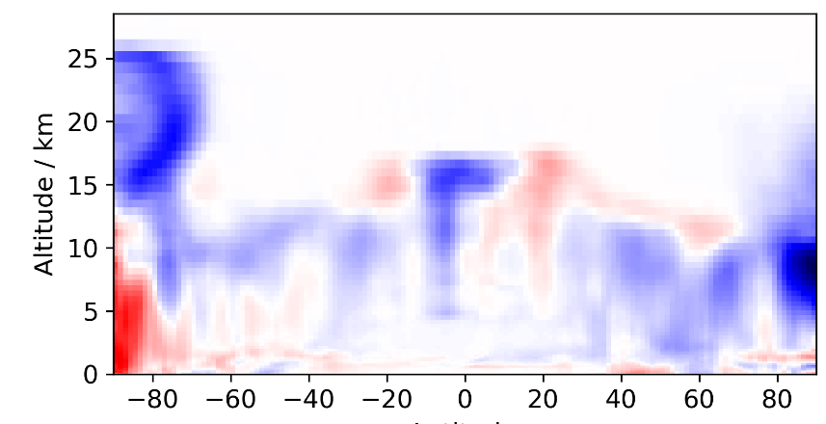
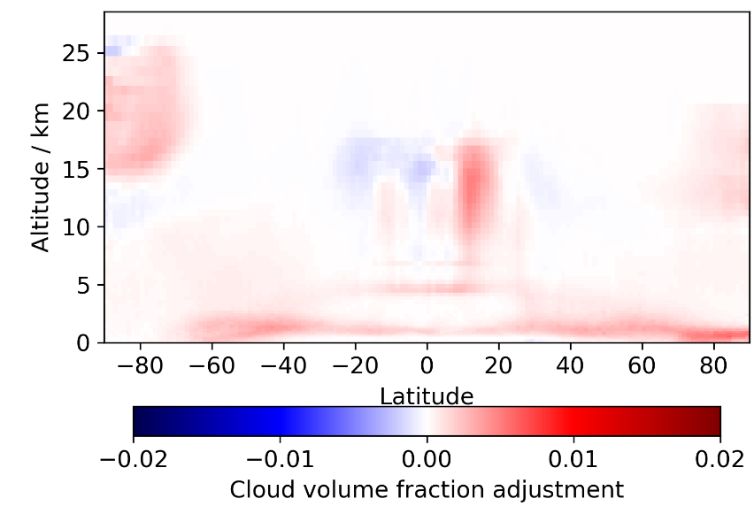
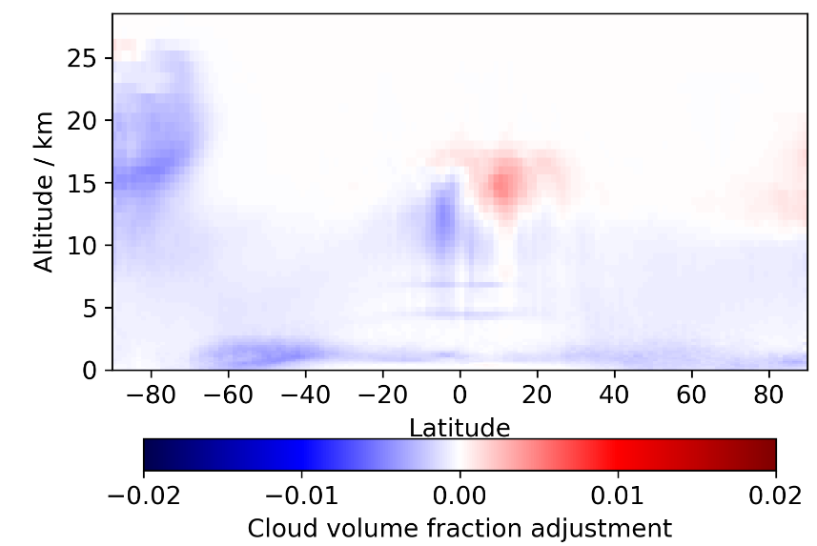
Uvθ-nudging
SU
BC
Free
Nudged

Slide 4
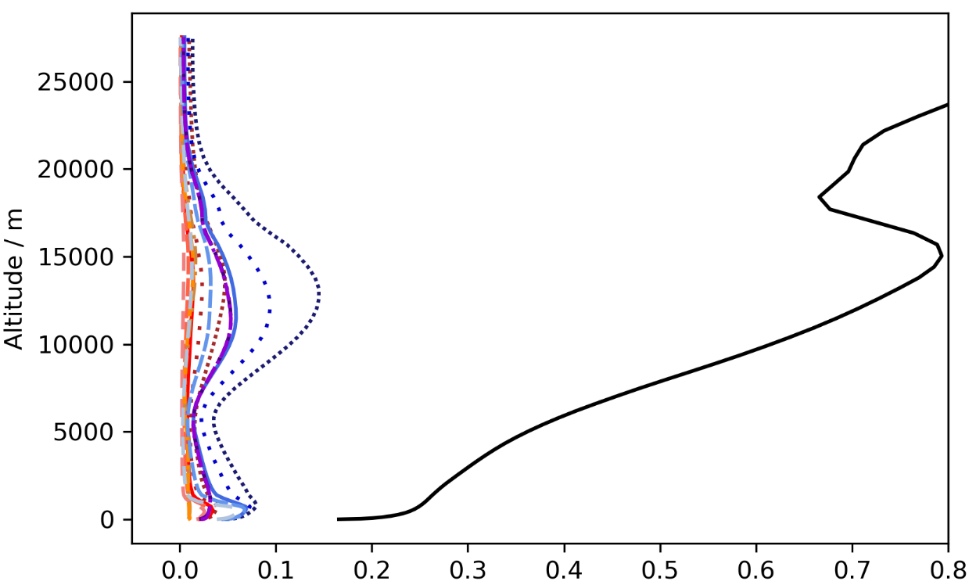
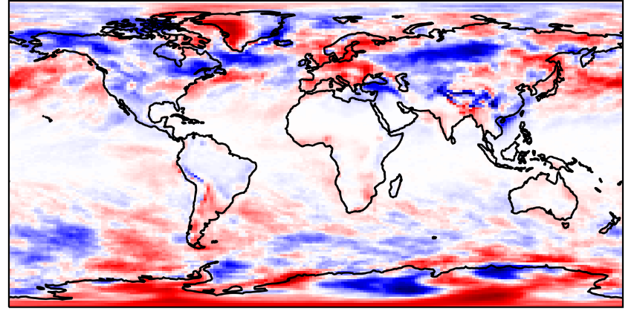
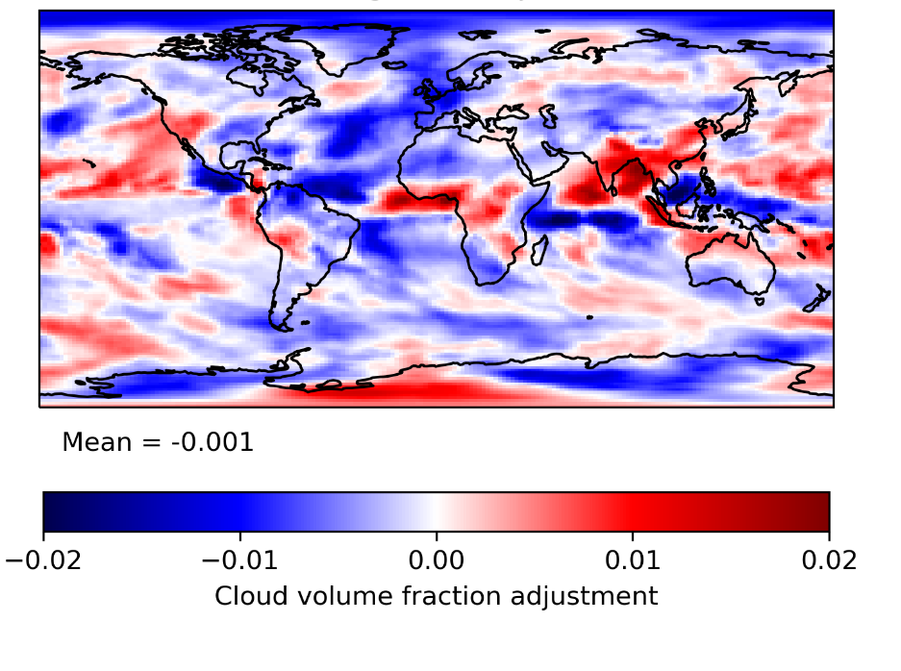
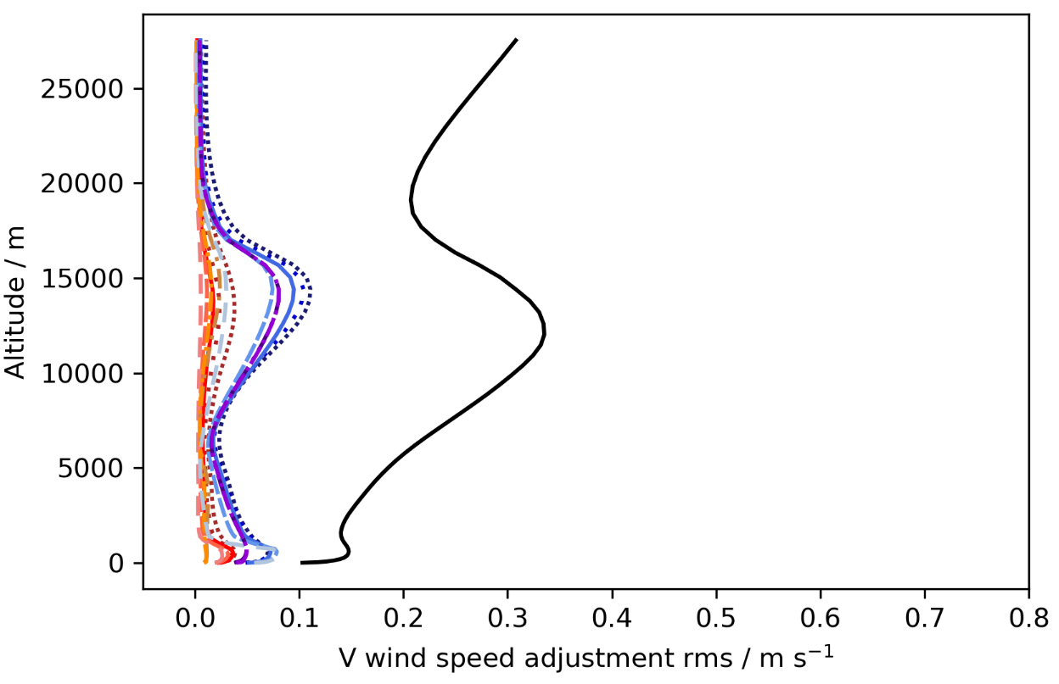
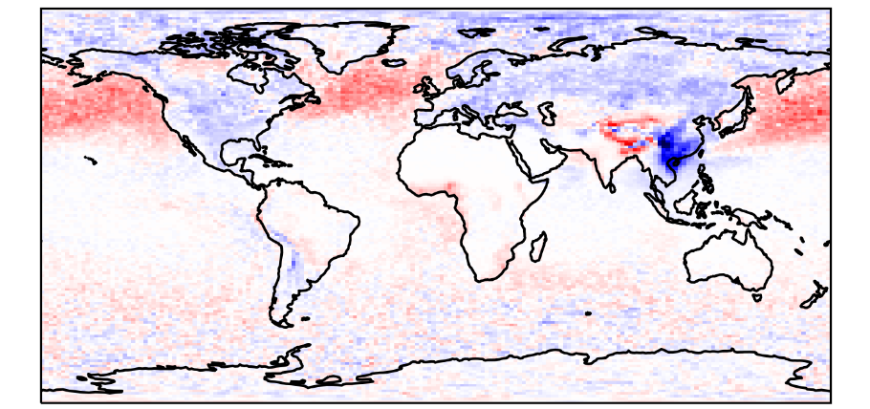
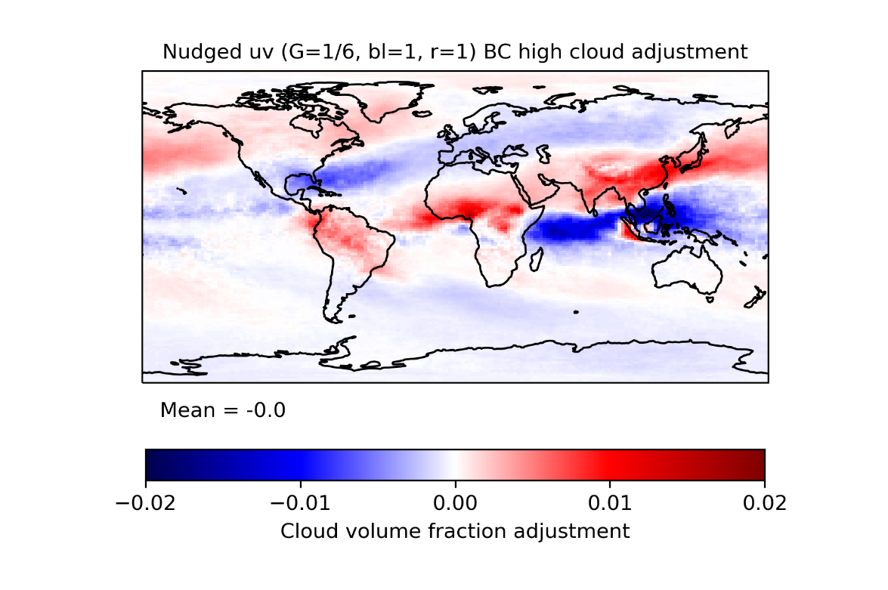
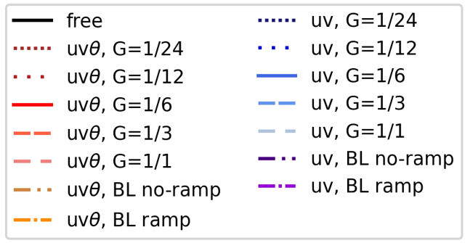
Uv-nudging
Low Cloud
High Cloud
Free
Free
Nudged

Slide 5
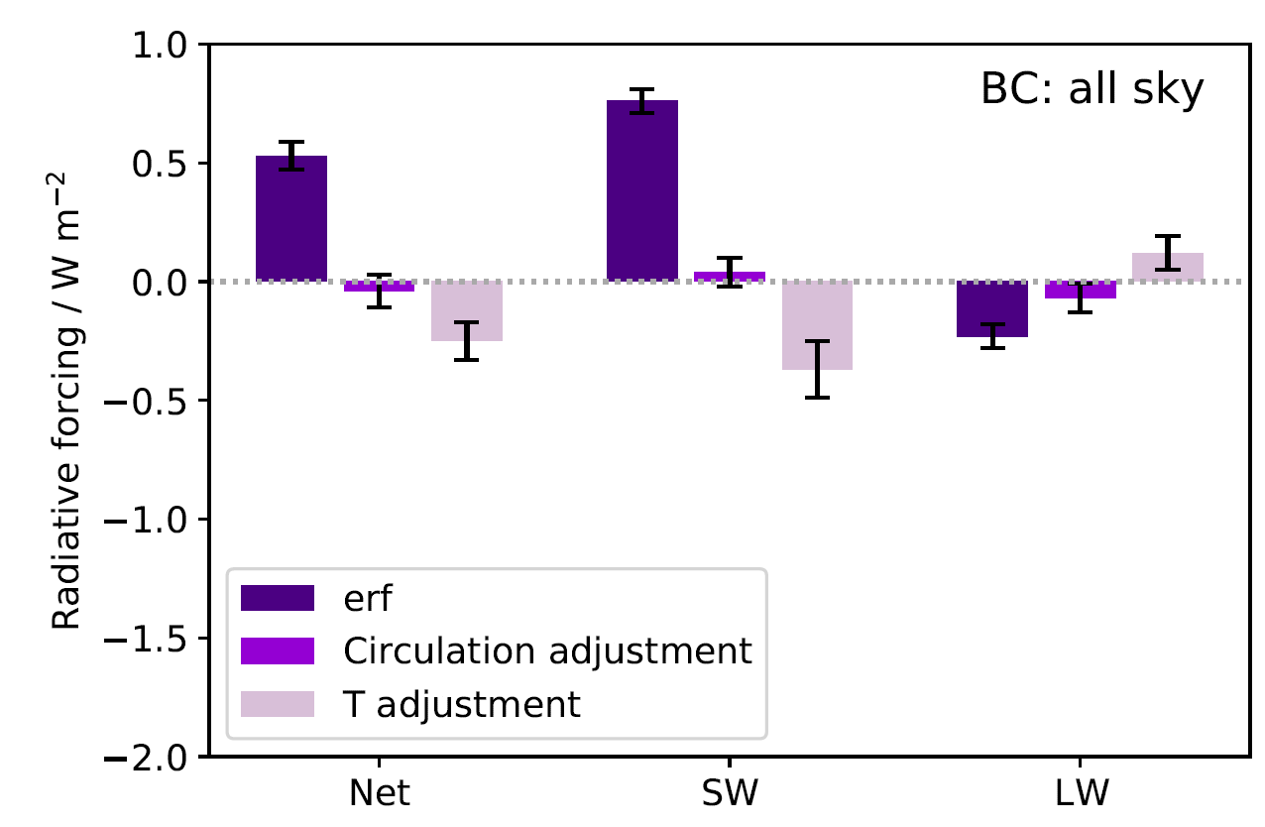
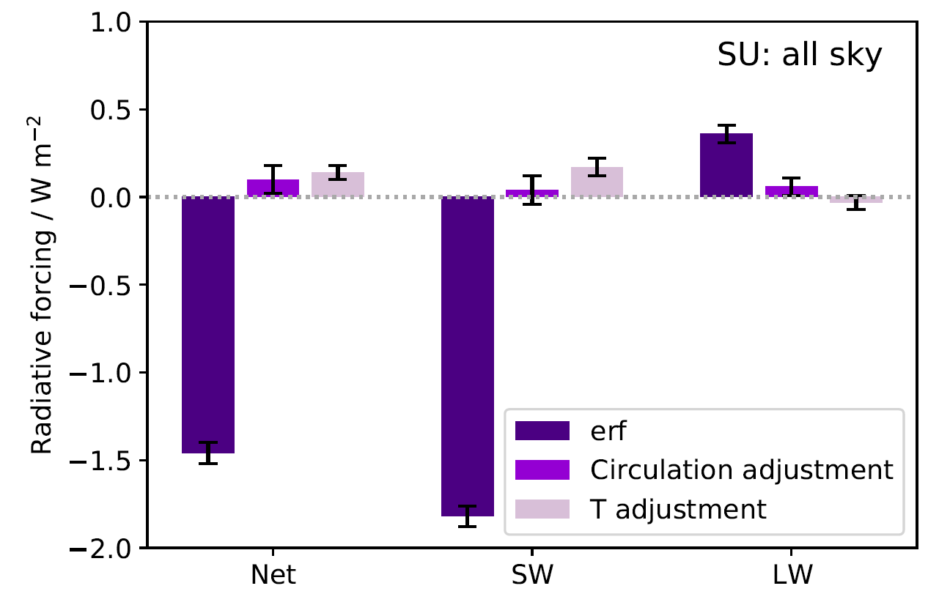
ERF and adjustment forcing

Slide 6
Summary
Difficult to suppress adjustment in both u,v and θ
Suppressing u,v adjustment better – still some uncertainties introduced by nudging
Stronger net forcing for T-mediated adjustments than circulation-mediated for both species – but needs more confidence!!!

Slide 7
Extra slides

Slide 8
Simulation Details
Based off AerChemMIP UKESM1 PiClim experiments (but PD atmosphere)
UKESM1 atmos-only
Global domain
N96 resolution (Lat 1.25°; Lon = 1.875°)
35 yrs (free), 5 yrs (nudged); 1yr spin-up
Nudging horizontal winds (u, v) and potential temperature (θ)

Slide 9
Theta nudging control error

Slide 10
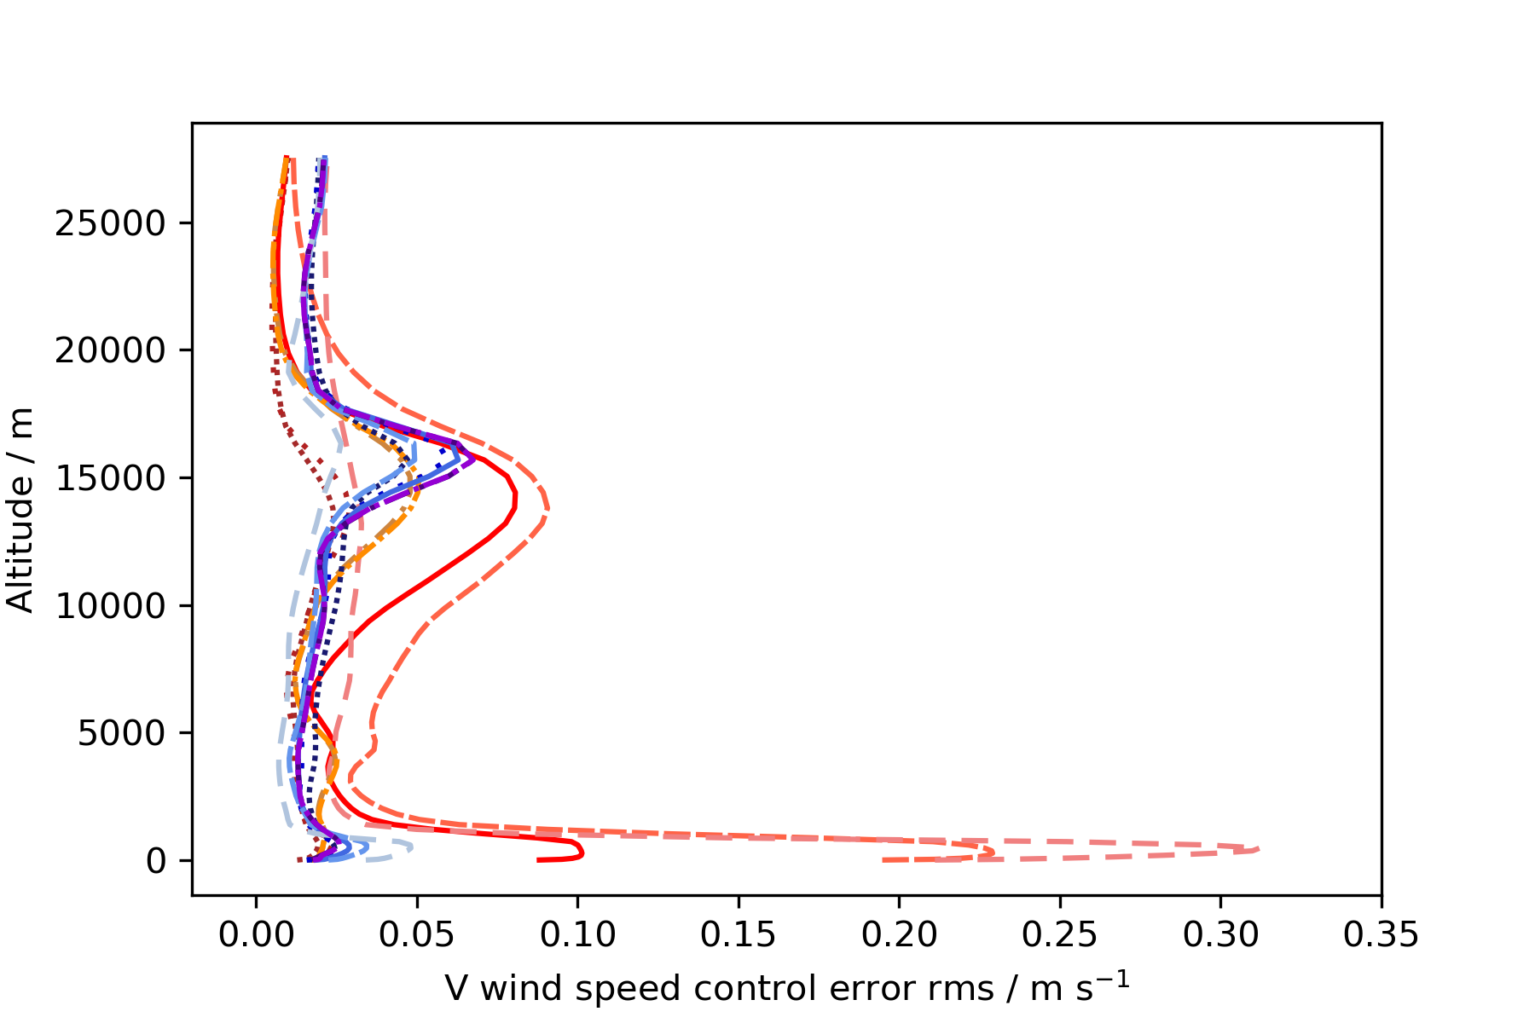
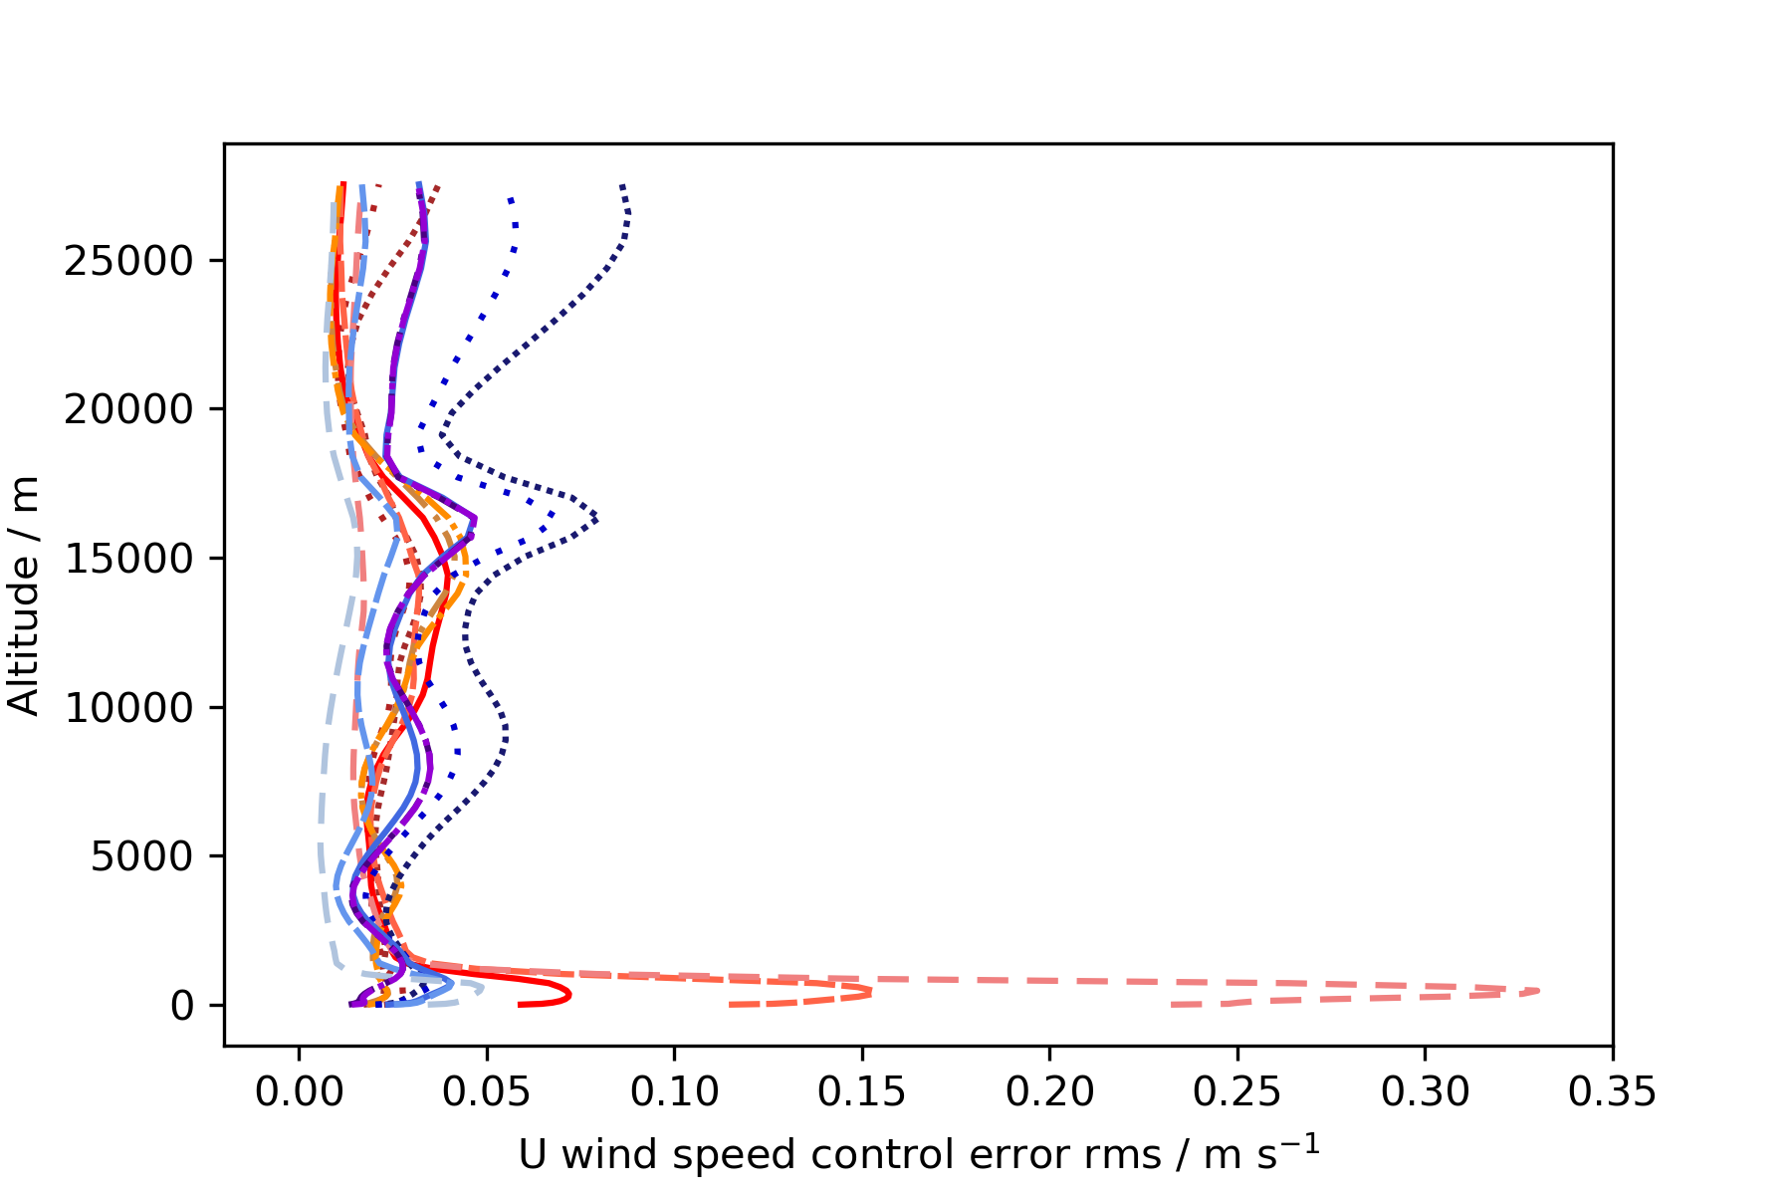
UV-nudging control error

