Slide 1
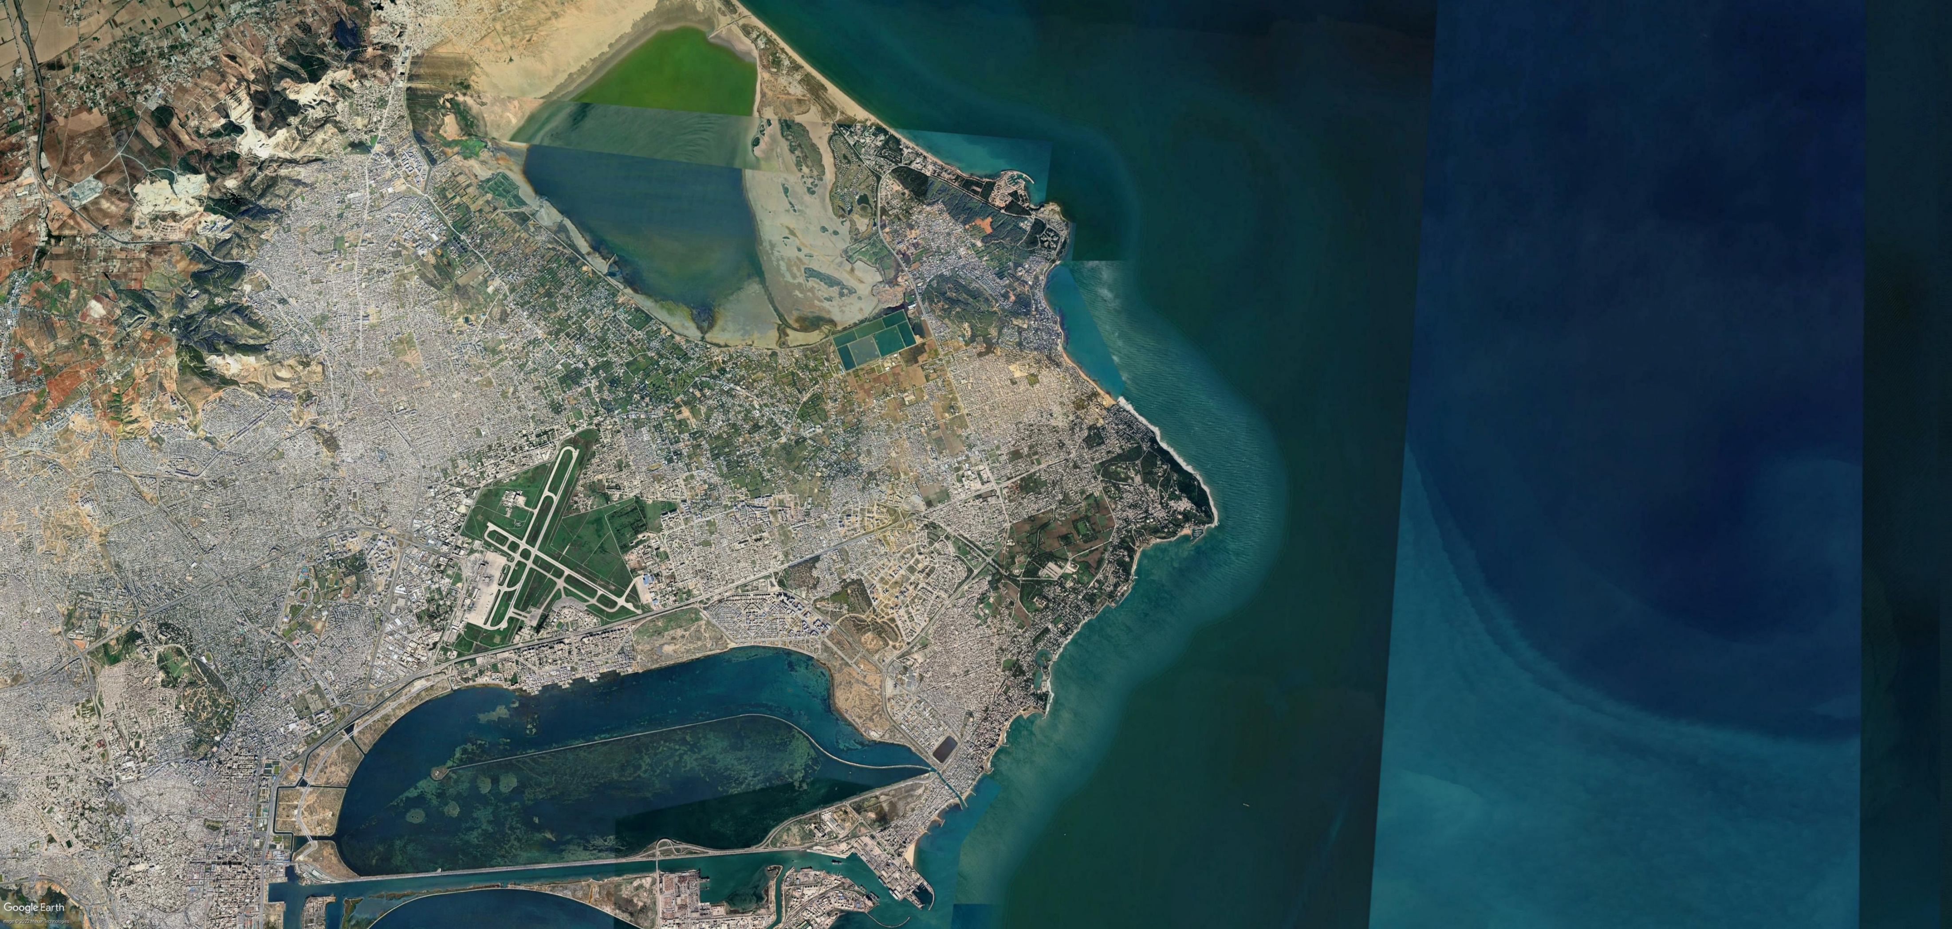




The societal impacts of volcanically induced climate forcing on Carthaginian (pre-Roman) northwestern Africa (396-146 BCE)
Andrew M. Hill, Rhonda McGovern, Francis Ludlow, Conor Kostick, Selga Medenieks
CL 3.2.6: Climate extremes, biosphere and society: impacts, cascades, feedbacks and resilience
hillan@tcd.ie
27/05/22

Slide 2
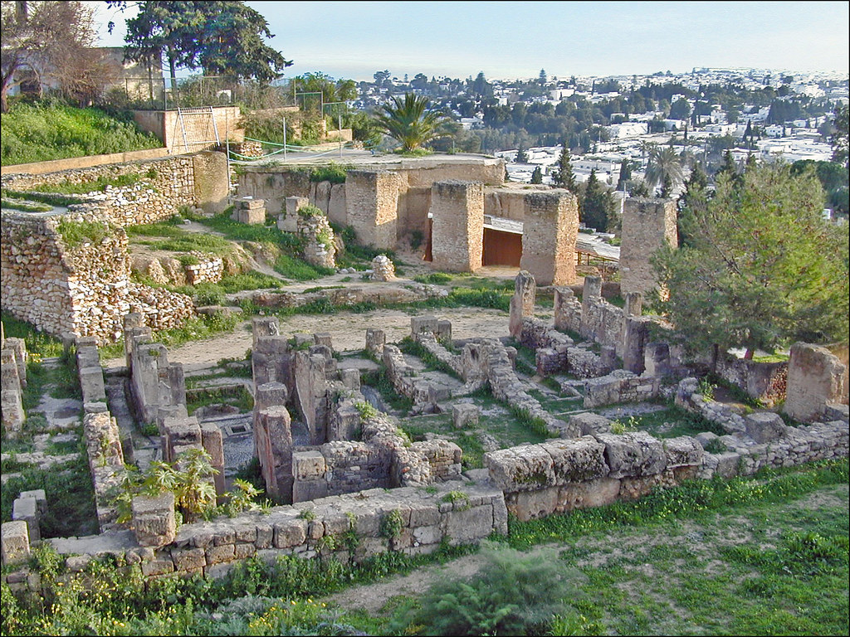
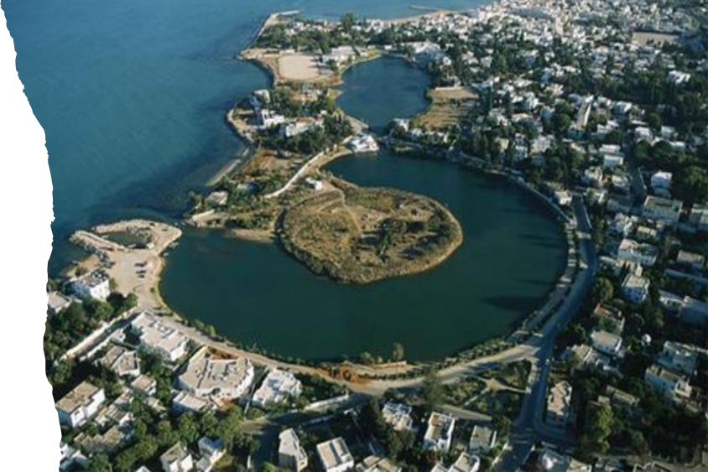
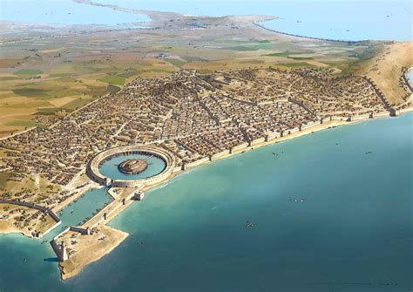
Carthage in history
Foundation by Dido in 814.
Hanno the Navigator 5th century.
First Punic War (264-241).
Second Punic (Hannibalic) War (218-201).
Third Punic War (149-146).
Urban centre
Perhaps 200,000 dependents ca. 400.
700,000 ca. 150 (Strab. 17.3.15).
Empire encompassing parts of Sicily, Sardinia, Libya, Tunisia, Algeria, Morocco, Spain.
Punic ruins on the acropolis of Byrsa
Carthage’s cothon (military harbour)
Image: Rocío Espín Piñar
Notes:
Famously founded by Dido, the love sick princess of Virgil’s Aeneid; yet boasting of its other denizens… Hanno the Navigator, best known for Wars with Rome, Hannibal, Second Punic War; legacy of relationship with Rome cemented by Rome’s eclipsing and destruction of Carthage in 146.
Yet great urban centre in its day.
Population density
Largest city in the Mediterranean for a period (700,000 combined with its hinterland province)
Seat of a large empire, yet a large part of the city’s individual prosperity came from its large hinterland province, worked by Libyans…

Slide 3
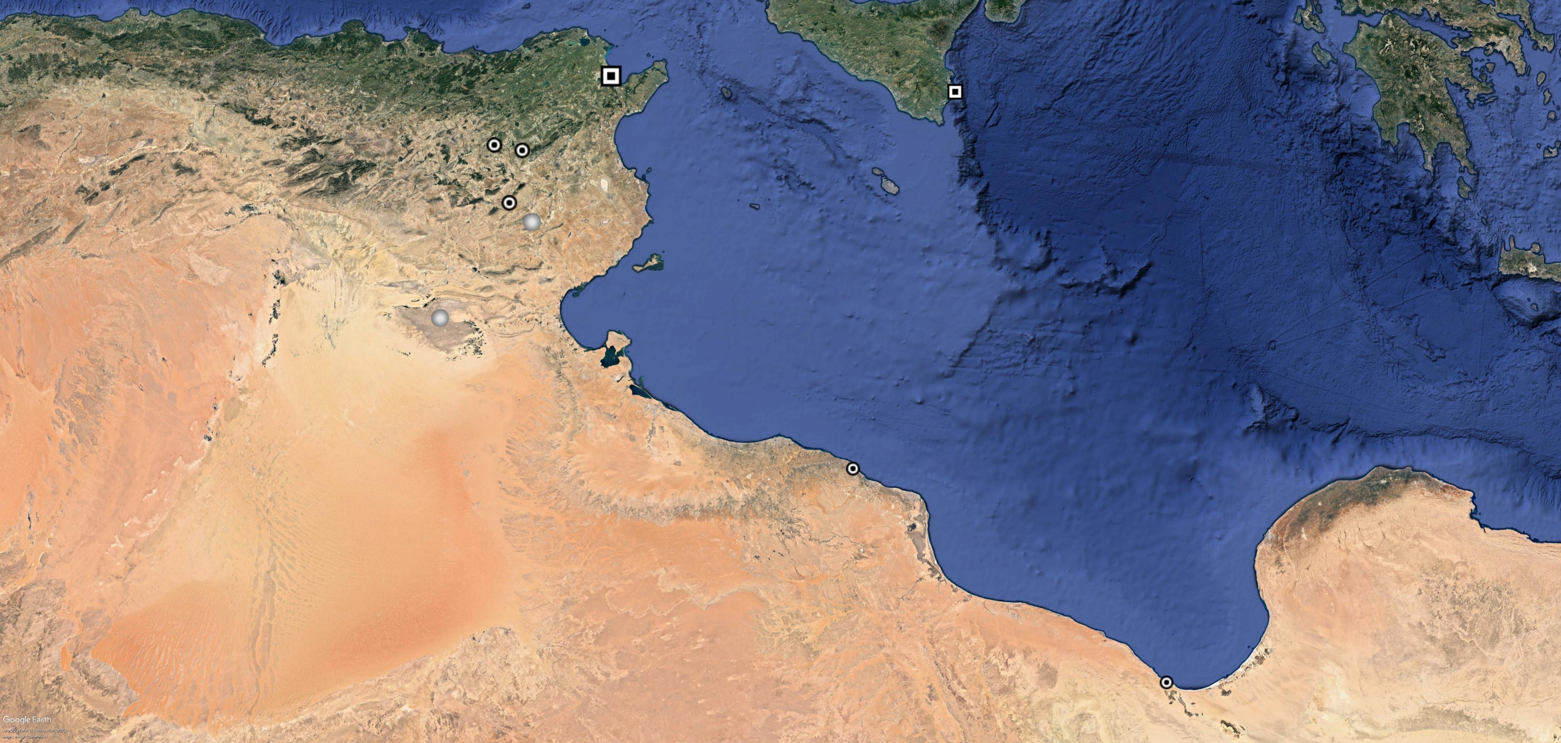


































Numidians
Carthage
Syracuse
Althiburos
Maktar
Numidians
Sufetula
Sidi Bouzid
Lesser Syrtis
Mediterranean Sea
Chott el Djerid
Lepcis Magna
Syrtic (Libyan) symmachoi
Greater Syrtis
200km
Altars Philaeni

Slide 4
Numidians
Carthage
African Revolts
Libyan
1. The First Libyan War (396-392) (Diod. Sic. 14.76-77)
2. The Second Libyan War (377-368) (Diod. Sic. 15.24; 15.73)
3. Hanno’s coup (inciting African participation) (ca. 346) (Just. Epit. 21.4)
4. Invasion of Agathocles (310) (Diod. Sic. 20.55; Just. Epit. 22.6-7)
5. Invasion of Regulus (255) (App. Lib. 3)
6. Hekatompylos Revolt (ca. 247) (Polyb. 1.73.1; Diod. Sic. 24.10.2)
7. The Third Libyan (‘Mercenary’) War (241-237) (Polyb. 1.66-88; Diod. Sic. 24.13-14, 25.1-9; App. Sik. 3; His. 4-5; Hann. 2; Lib. 5; Nep. Ham. 2; Cas. Dio. 16-17; Front. Strat. 3.16.2-4)
Numidian
8. Numidian rebellion (ca. 235-229 (unknown length)) (Diod. Sic. 25.10.3; Coel. Ant. fr. 3, 4 = Peter (1883) 100; Front. 4.7.18)
9. Revolt of the Micatani (ca. 212-207 (unknown length)) (Diod. Sic. 26.23)
Syracuse
Althiburos
Maktar
Numidians
Sufetula
Sidi Bouzid
Lesser Syrtis
Mediterranean Sea
Chott el Djerid
Lepcis Magna
Syrtic (Libyan) symmachoi
Greater Syrtis
200km
Altars Philaeni

Slide 5
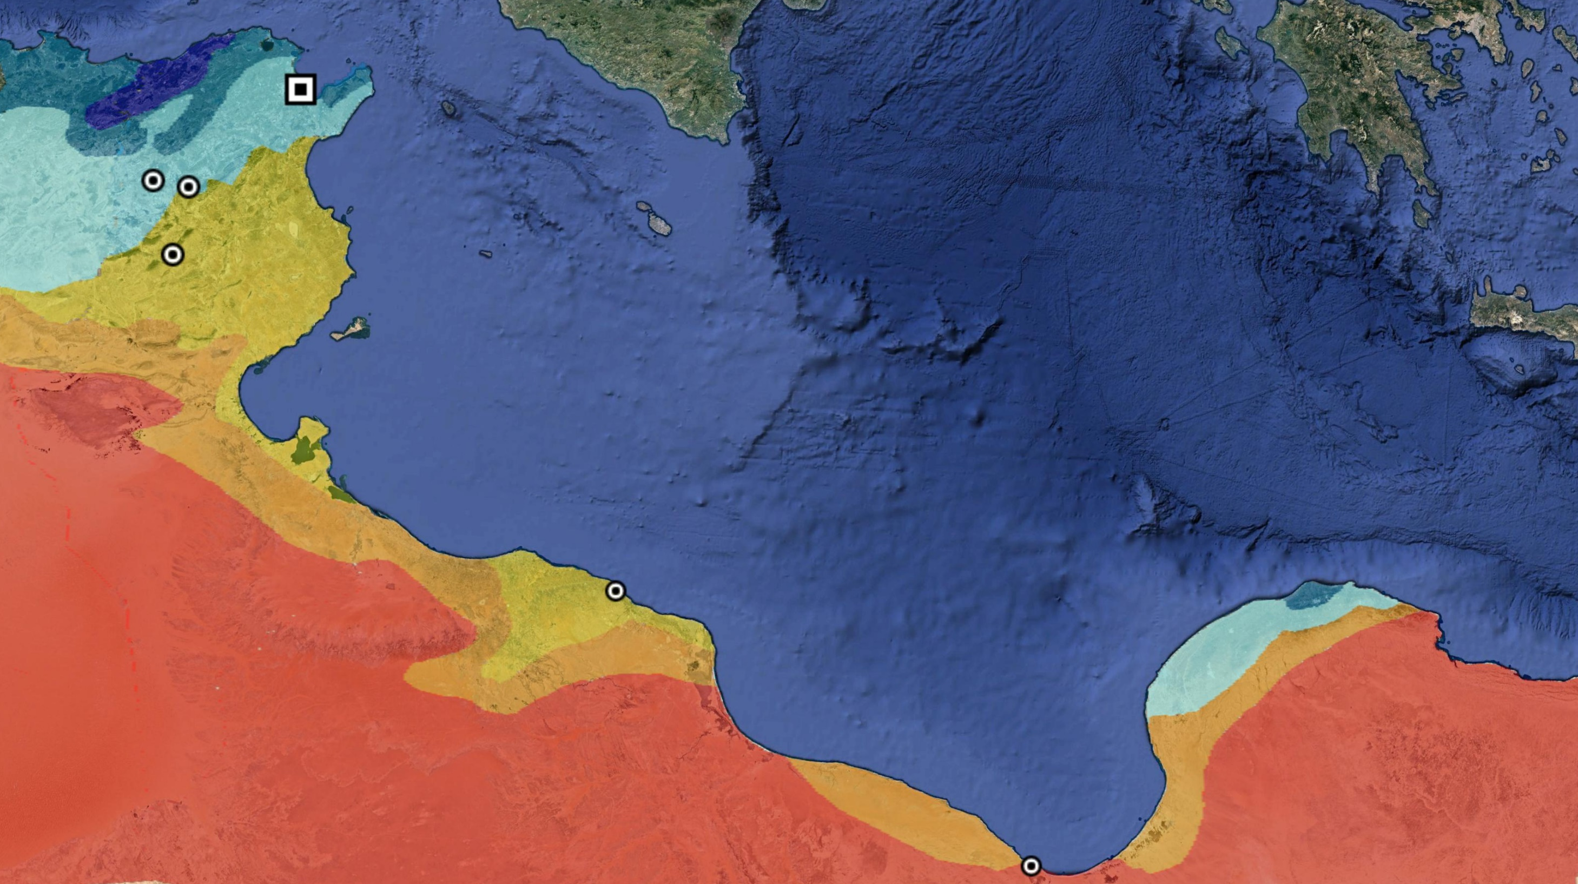
Semi-humid
Carthage: 600 mm p/a
Legend:
Dark blue: Humid
Blue:
Semi-humid
Light blue:
Semi-arid
Yellow:
Arid
Orange:
Pre-desert
Red:
Desert
Humid
Nabeul: 483 mm
Semi-arid
Arid
Gabes: 189 mm
Pre-desert
Desert
Additional data:
World Bank Group Data, mean annual precipitation between 1991-2020)
Mansour, M. and M. Hachicha (2014) ‘Chapter 21’, in P. Ahmad and S. Rasool (eds) (London) 485-500
> 100 mm
Adapted from maps in:
Allen, C. et al. (2010) ‘A global overview of drought and heat-induced tree mortality reveals emerging climate change risks for forests’, Forest Ecology and Management 259, 660-84
http://www.hydriaproject.info/en/tunisia-kerkouane-punic-city/setting20/
https://water.fanack.com/libya/
Notes:
Climatological profile of Carthage’s core territory in Africa. Mention of Vesco?

Slide 6
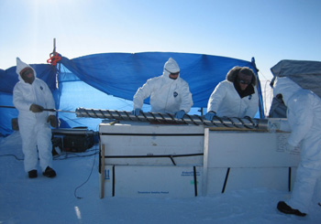
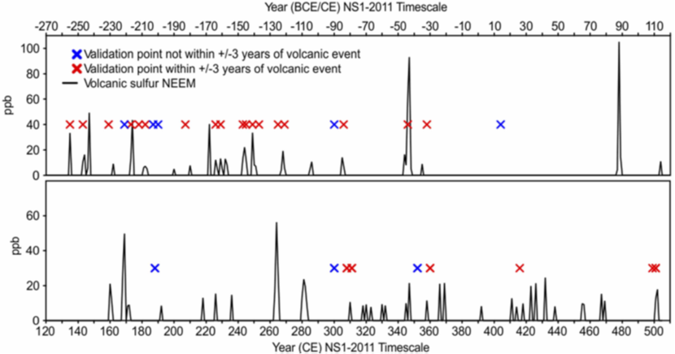
Dating volcanic events
Landmark 2015 study by M. Sigl and colleagues accurately dates historic eruptions to within less than five years for the past 2,500 years.
Matching high-resolution detailed information from historical sources can inform us about the links between volcanic activity and the adaptive capacity of societies in times of climatic change.
Patterns with historical processes emerging; hypothesised links with societal change and crisis in Ptolemaic Egypt, the Roman state, and dynastic China.
Image: icecores.org
Sigl, M. et al. (2015) ‘Timing and climate forcing of volcanic eruptions for the past 2,500 years’, Nature 523, 543-49
Ludlow, F., J. G. Manning et al. (2017) ‘Volcanic suppression of Nile summer flooding triggers revolt and constrains interstate conflict in ancient Egypt’, Nature Communications 8, 900
McConnell, J. R. et al. (2020) ‘Extreme climate after massive eruption of Alaska’s Okmok volcano in 43 BCE and effects on the late Roman Republic and Ptolemaic Kingdom’, Proceedings of the National Academy of Sciences 117 (27), 15443-49
Gao, C., F. Ludlow, J. A. Matthews et al. (2021) ‘Volcanic climate impacts can act as ultimate and proximate causes of Chinese dynastic collapse’, Commun Earth Environ 2, 234
Graph: Sigl et al. (2015)

Slide 7
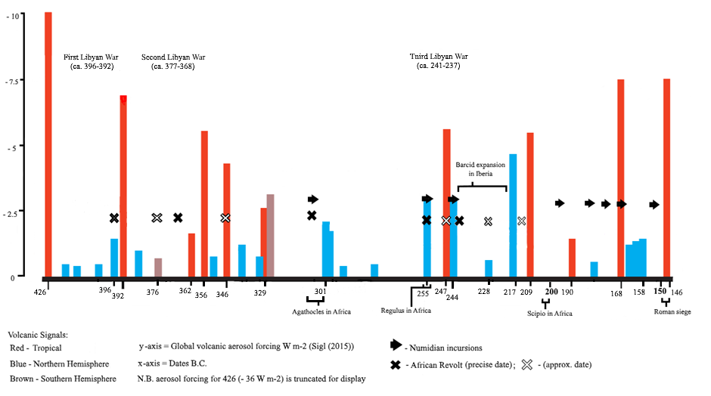
African revolts and volcanic forcing events

Slide 8
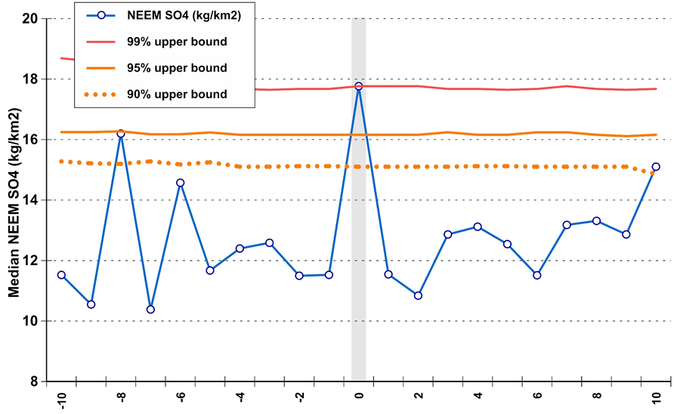

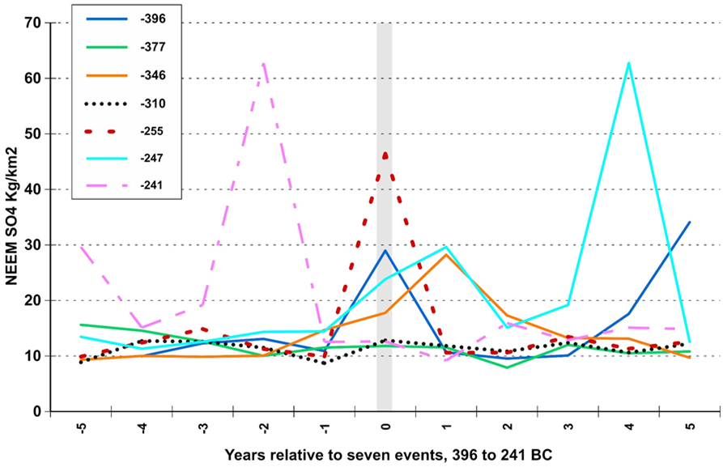
Statistical testing (superposed epoch analysis)
Fig. a
Fig. b
Graphs: Francis Ludlow

Slide 9



Thank you for listening.
This research is made possible by the support of the Irish Research Council, and Trinity College Dublin.
hillan@tcd.ie
27/05/22

