Slide 1
Assessment of the Recent Tendencies of the Winter Precipitations and the Snow Cover in Bulgaria
Dimitar nikolov
National Institute of Meteorology and Hydrology, Sofia, Bulgaria

Slide 2
Assessment of the Recent Tendencies in Winter Precipitations and Snow Cover in Bulgaria
The main goal of this study is to assess the recent tendencies in the winter precipitations and in the snow cover characteristics in Bulgaria
Data from 20 stations with altitudes ranging from 50 up to 2925 m a. s. l. for the period 1961-2020 have been used for testing of the following winter characteristics: mean monthly air temperatures, days with different snow cover depth (all, greater than 15, 30 and 50 cm), days with snowfalls, days with rains and days with mixed precipitation as well as the corresponding monthly precipitation amounts.

Slide 3
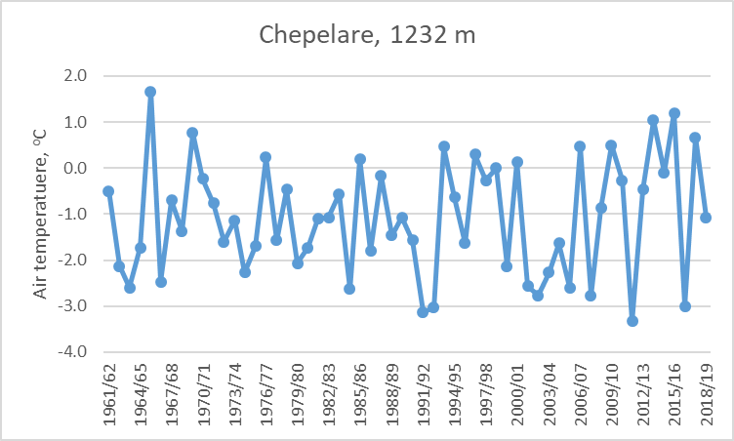
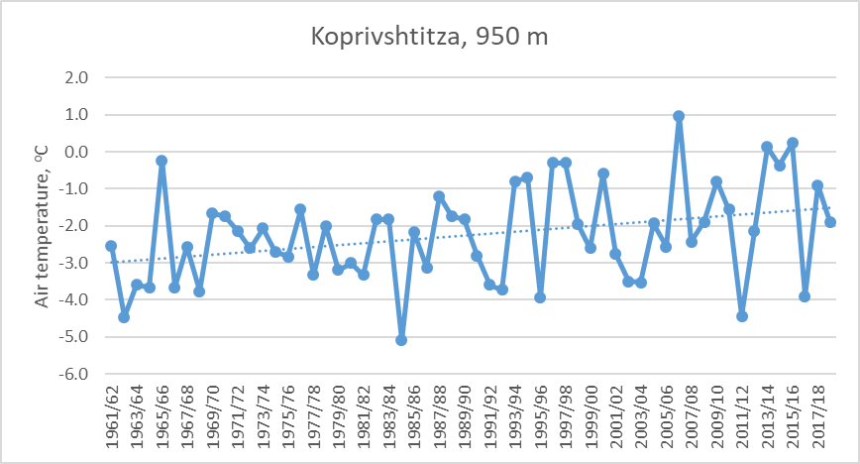
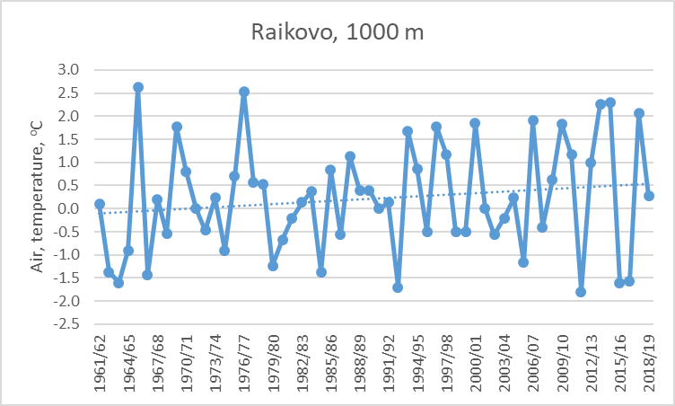
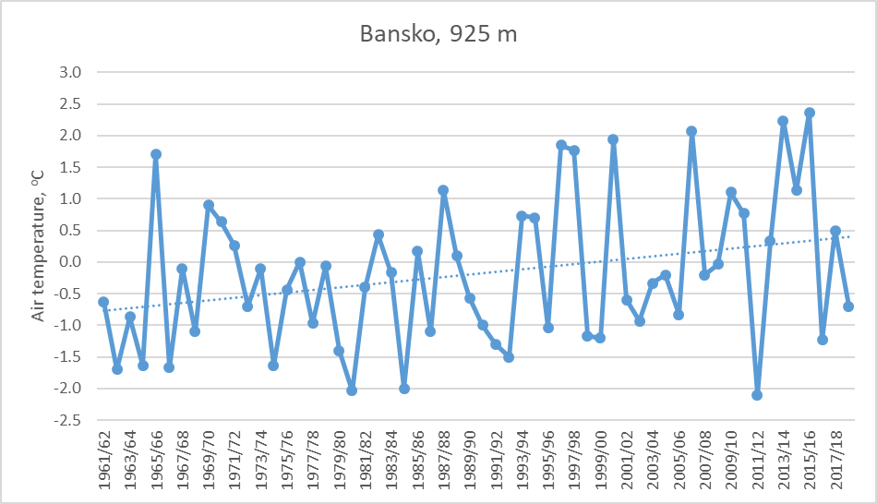
Mean air temperature December - February

Slide 4
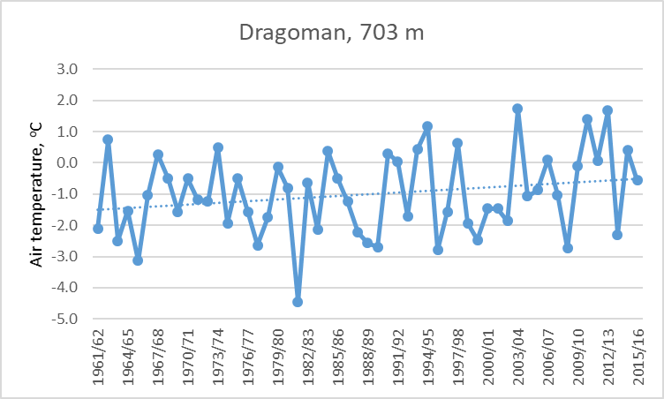
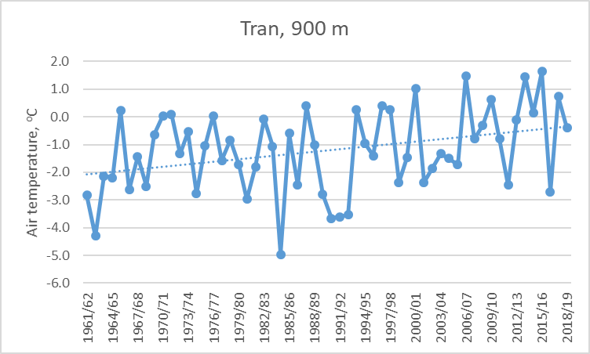
Mean air temperature December - February

Slide 5
Table 1. Comparison of the number of days with snow cover (all) for two periods
North
Bulgaria
Coastal line

Slide 6
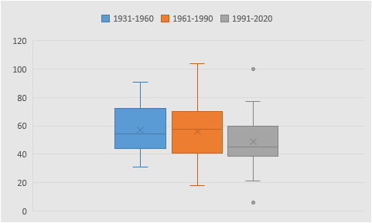
Number of days with snow cover (all)

Slide 7
Table 2. Comparison of the mean seasonal snow cover maxima for two periods

Slide 8
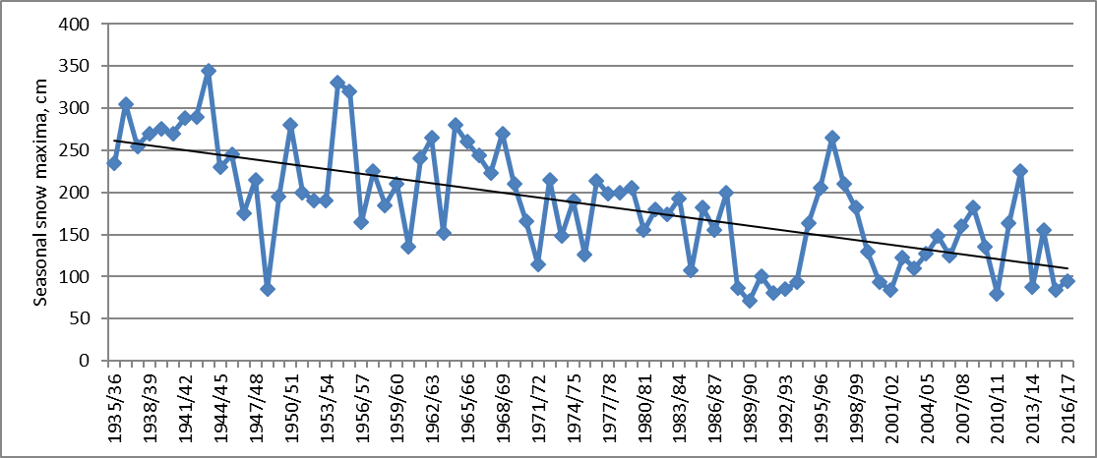
Seasonal snow cover maxima
Significant decreasing trends of the seasonal snow cover maxima have been found only in the highest mountain regions and this is determined by the declination of the winter precipitation here – as example station Cherni vrah (2290 m) is depicted below.

Slide 9
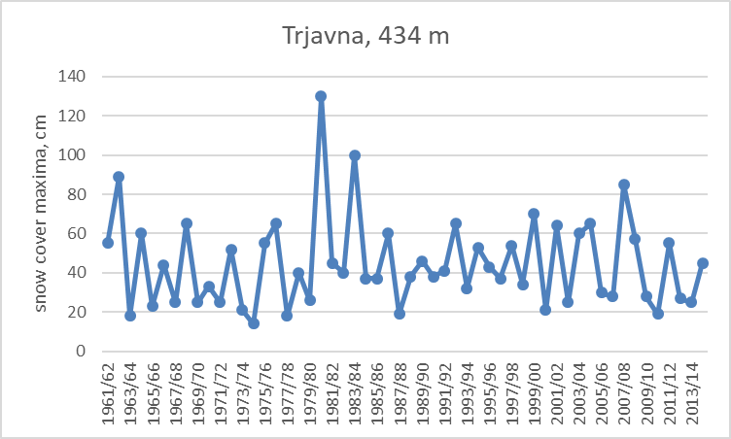
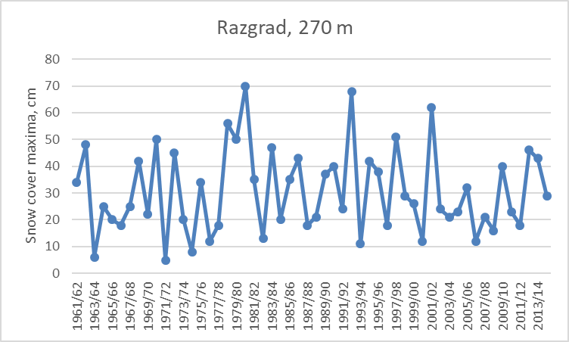
Seasonal snow cover maxima
In the low part of the country no trend can be detected usually – seasonal maxima here are determined mostly by one or two consequtive snow fall events and there is no significant change in these precipitation amounts – stations Trjavna and Razgrad as example.

Slide 10
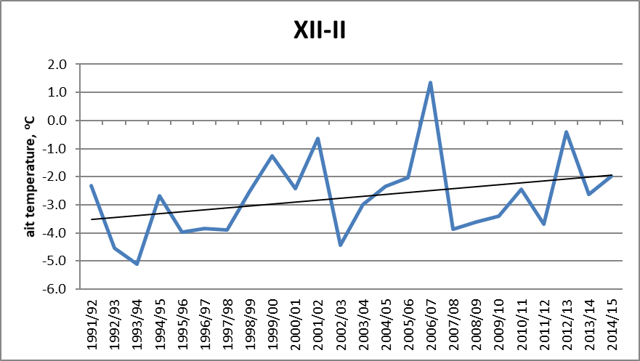
Air temperature during snowfalls
Air temperature during snowfalls at station Vratza in NW Bulgaria

Slide 11
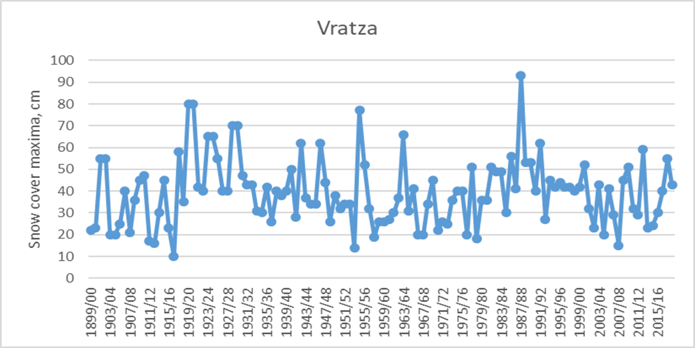
Long term variability
Seasonal snow cover maximums in Vratza 1910 – 2019

Slide 12
Conclusions
Significant increasing trends in the mean air temperature for the majority of the used stations have been encountered;
Same applies for the air temperature during snowfalls;
Decreasing tendency in days with the snow cover have been detected, mostly for the stations from North Bulgaria;
The number of days with snow falls are not so well pronounced;
No trends are found for the seasonal maxima except for the highest mountain station. The decreasing here is due to the declining of the winter precipitations predominantly;
We will continue the study searching not only for linear trends. We will include other methods such as quantile as well as spline regression for the stations with the longest period of observations.

