Slide 1

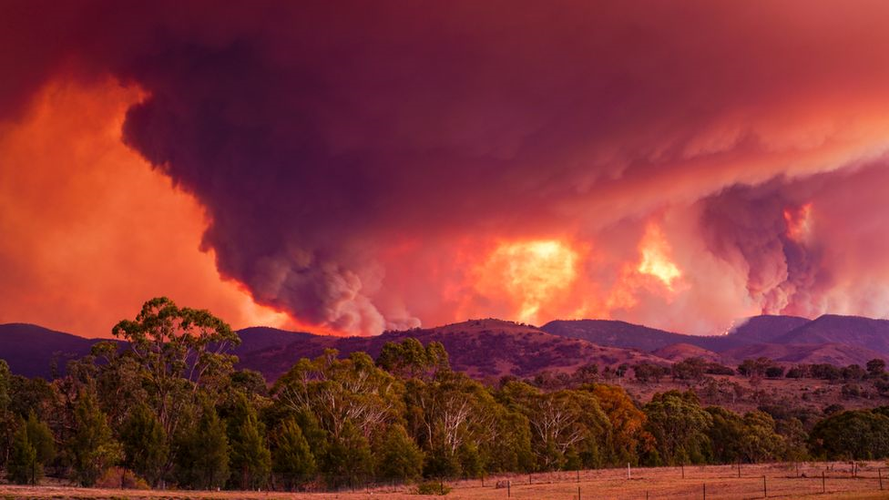

EGU General Assembly 2022
Observing the climate impact of large wildfires on stratospheric temperature
Matthias Stocker, Florian Ladstädter and Andrea K. Steiner
matthias.stocker@uni-graz.at
May 25, 2022

Slide 2
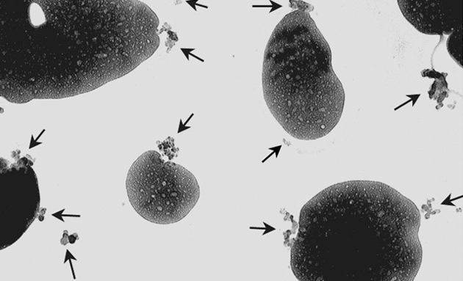

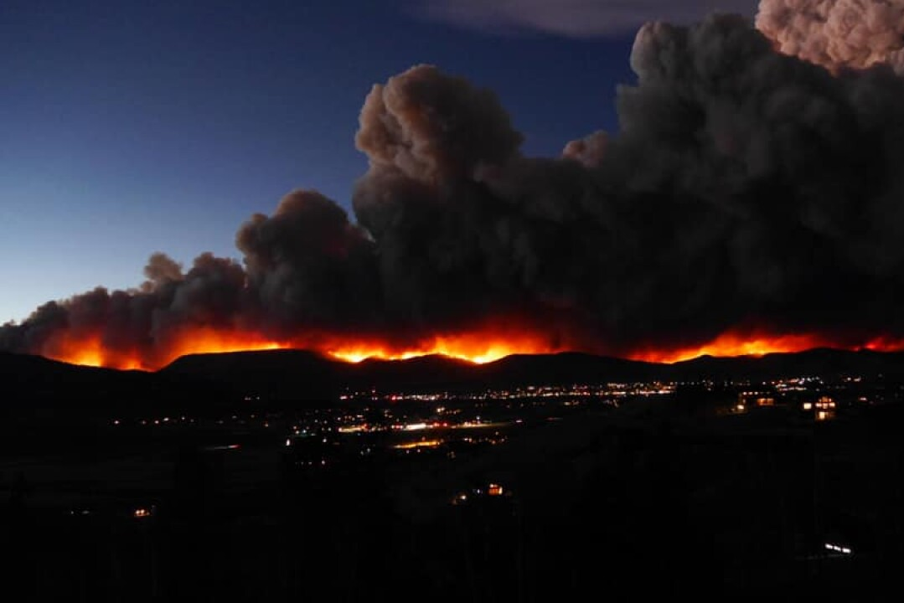
Motivation
WHY ARE WE INTERESTED IN THE CLIMATE EFFECTS OF WILDFIRES?
Wildfire aerosols have a stronger heating potential compared to volcanic aerosols (black carbon vs. sulfate aerosols)
Wildfires are an underestimated source for stratospheric aerosols and little is known about their climate impact
Climate change increases probability for intense wildfires reaching the stratosphere
Stratospheric Aerosol Layer
BC
SO4

Slide 3
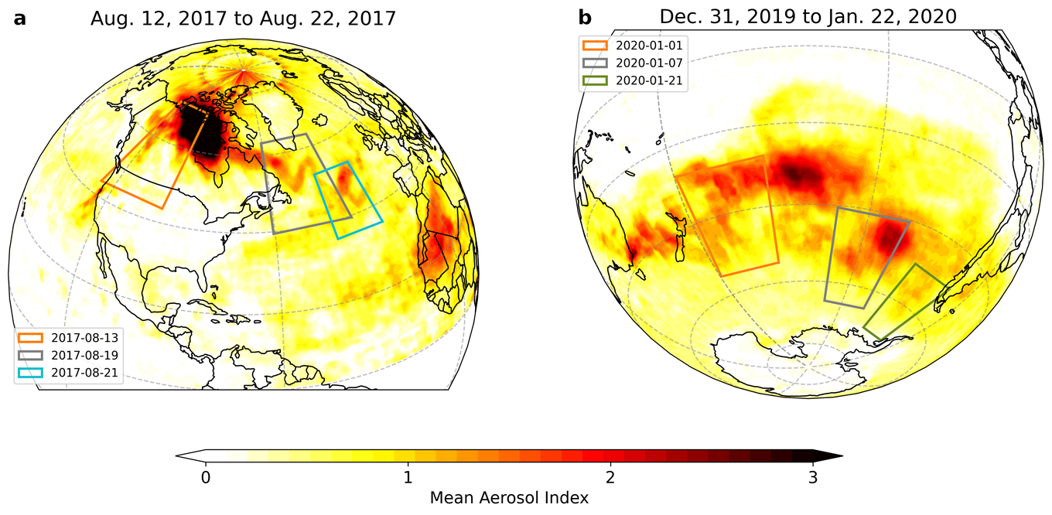
CASE STUDIES
TWO OF THE LARGEST WILDFIRE EVENTS DURING THE LAST YEARS WITH AEROSOL EMISSIONS COMPARABLE TO MODERATE VOLCANIC ERUPTIONS
North American wildfires 2017
Australian wildfires 2019/20

Slide 4
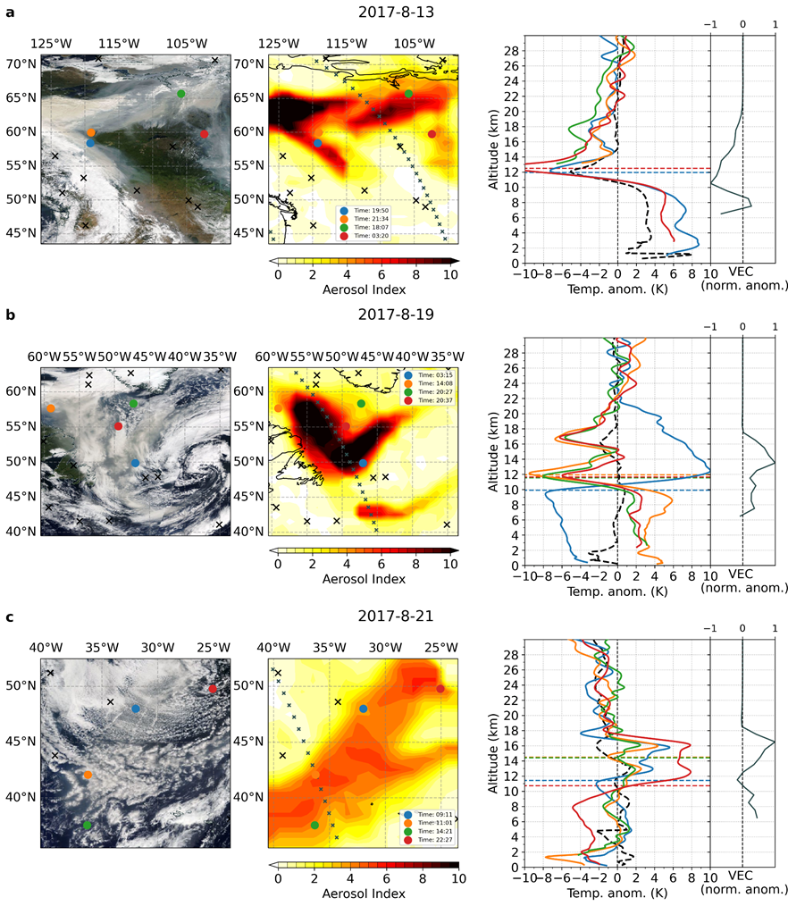
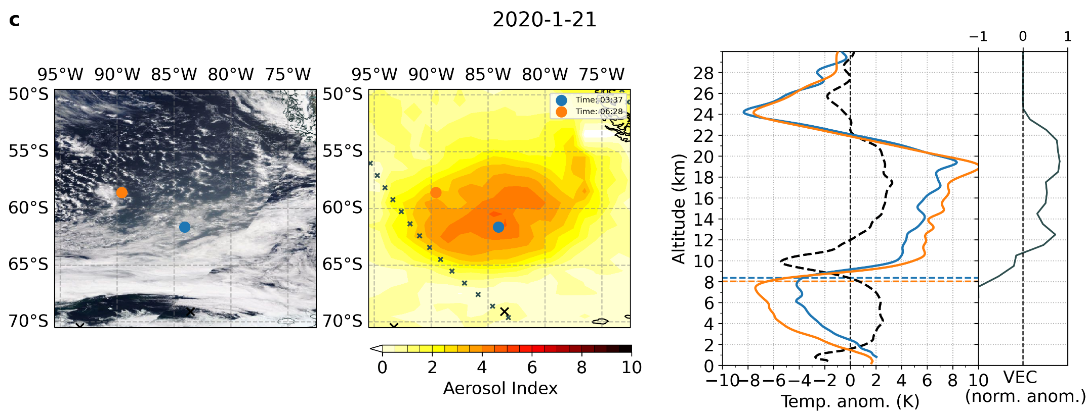
IMMEDIATE TEMPERATURE IMPRINTS
THE NORTH AMERICAN WILDFIRES CAUSED A DISTINCT WARMING SIGNATURE AS THE AEROSOL PLUME REACHED THE ATLANTIC OCEAN
Warming of more than 8 K in individual temperature profiles!
THE AUSTRALIAN WILDFIRES 2019/20 CAUSED AEROSOL “VORTICES” WHICH LOCALLY HEATED THE WHOLE LOWER STRATOSPHERIC AIR COLUMN
Peak warming of more than 10 K, with cooling above the maximum warming.

Slide 5
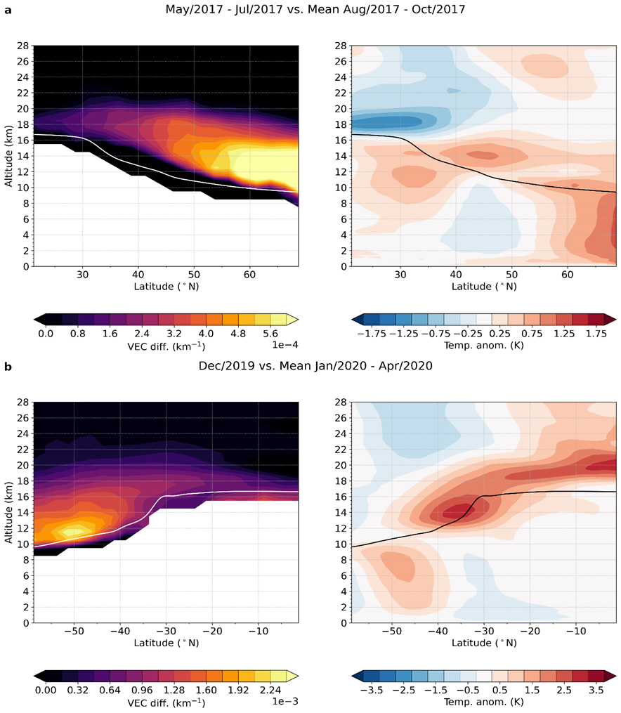
SHORT-TERM CLIMATE SIGNALS
THE NORTH AMERICAN WILDFIRES RESULTED IN A WARMING OF 1 K IN THE LOWER STRATOSPHERE AT MID-LATITUDES
Strong warming due to high solar illumination at low to mid latitudes
Aerosol entry from dense aerosol plume over northern Canada

Slide 6
SHORT-TERM CLIMATE SIGNALS
THE AUSTRALIAN WILDFIRES CAUSED A STRATOSPHERIC WARMING LARGER THAN ANY SIGNAL FROM RECENT VOLCANIC ERUPTIONS
Aerosol signal not in line with the maximum warming
Meridional aerosol transport / insolation
Maximum warming of more than 3 K!

Slide 7
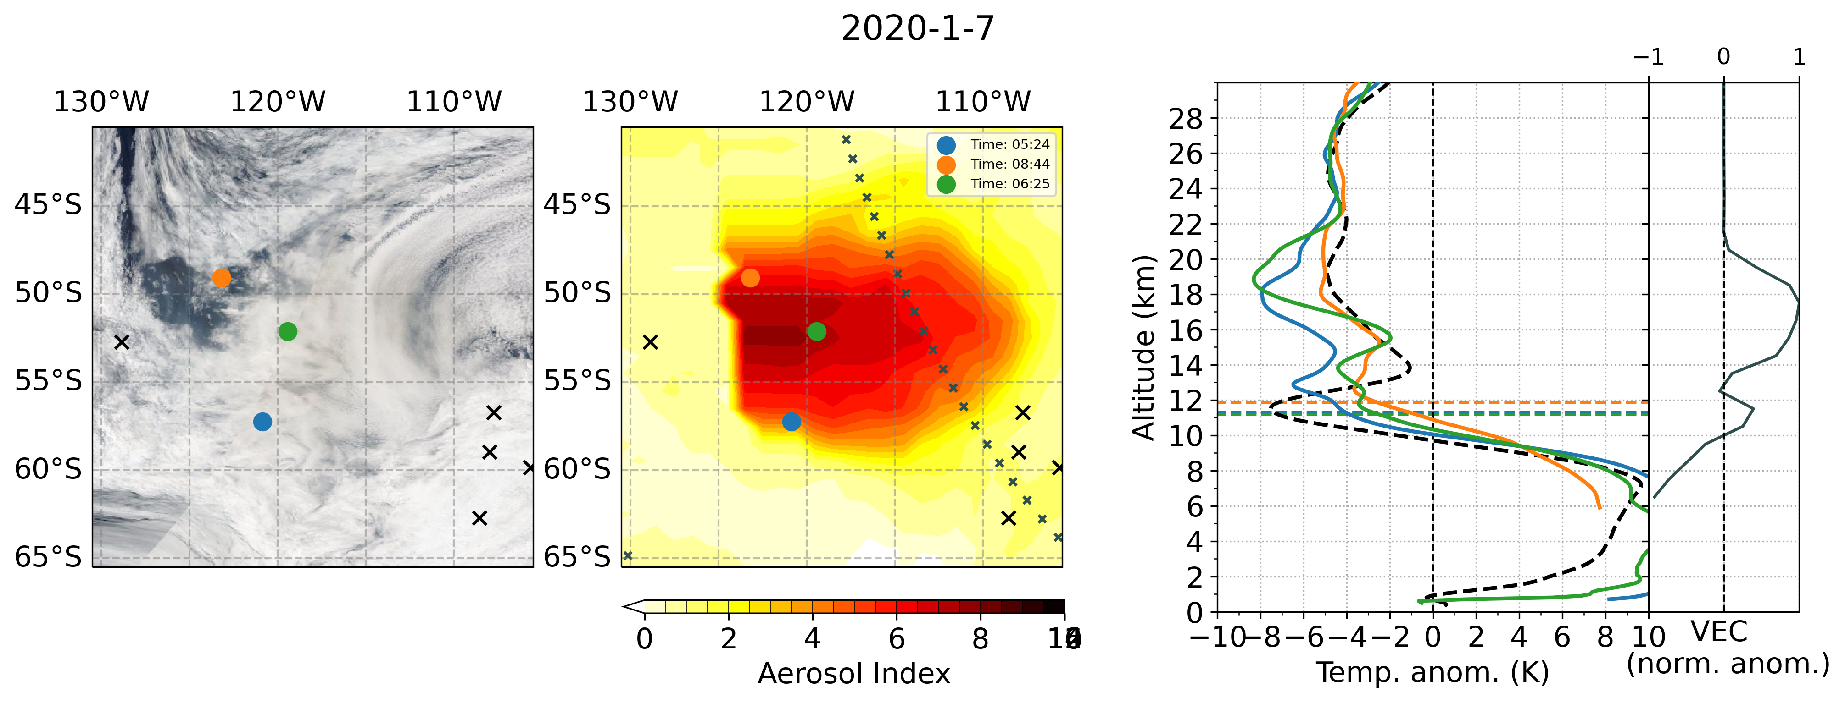
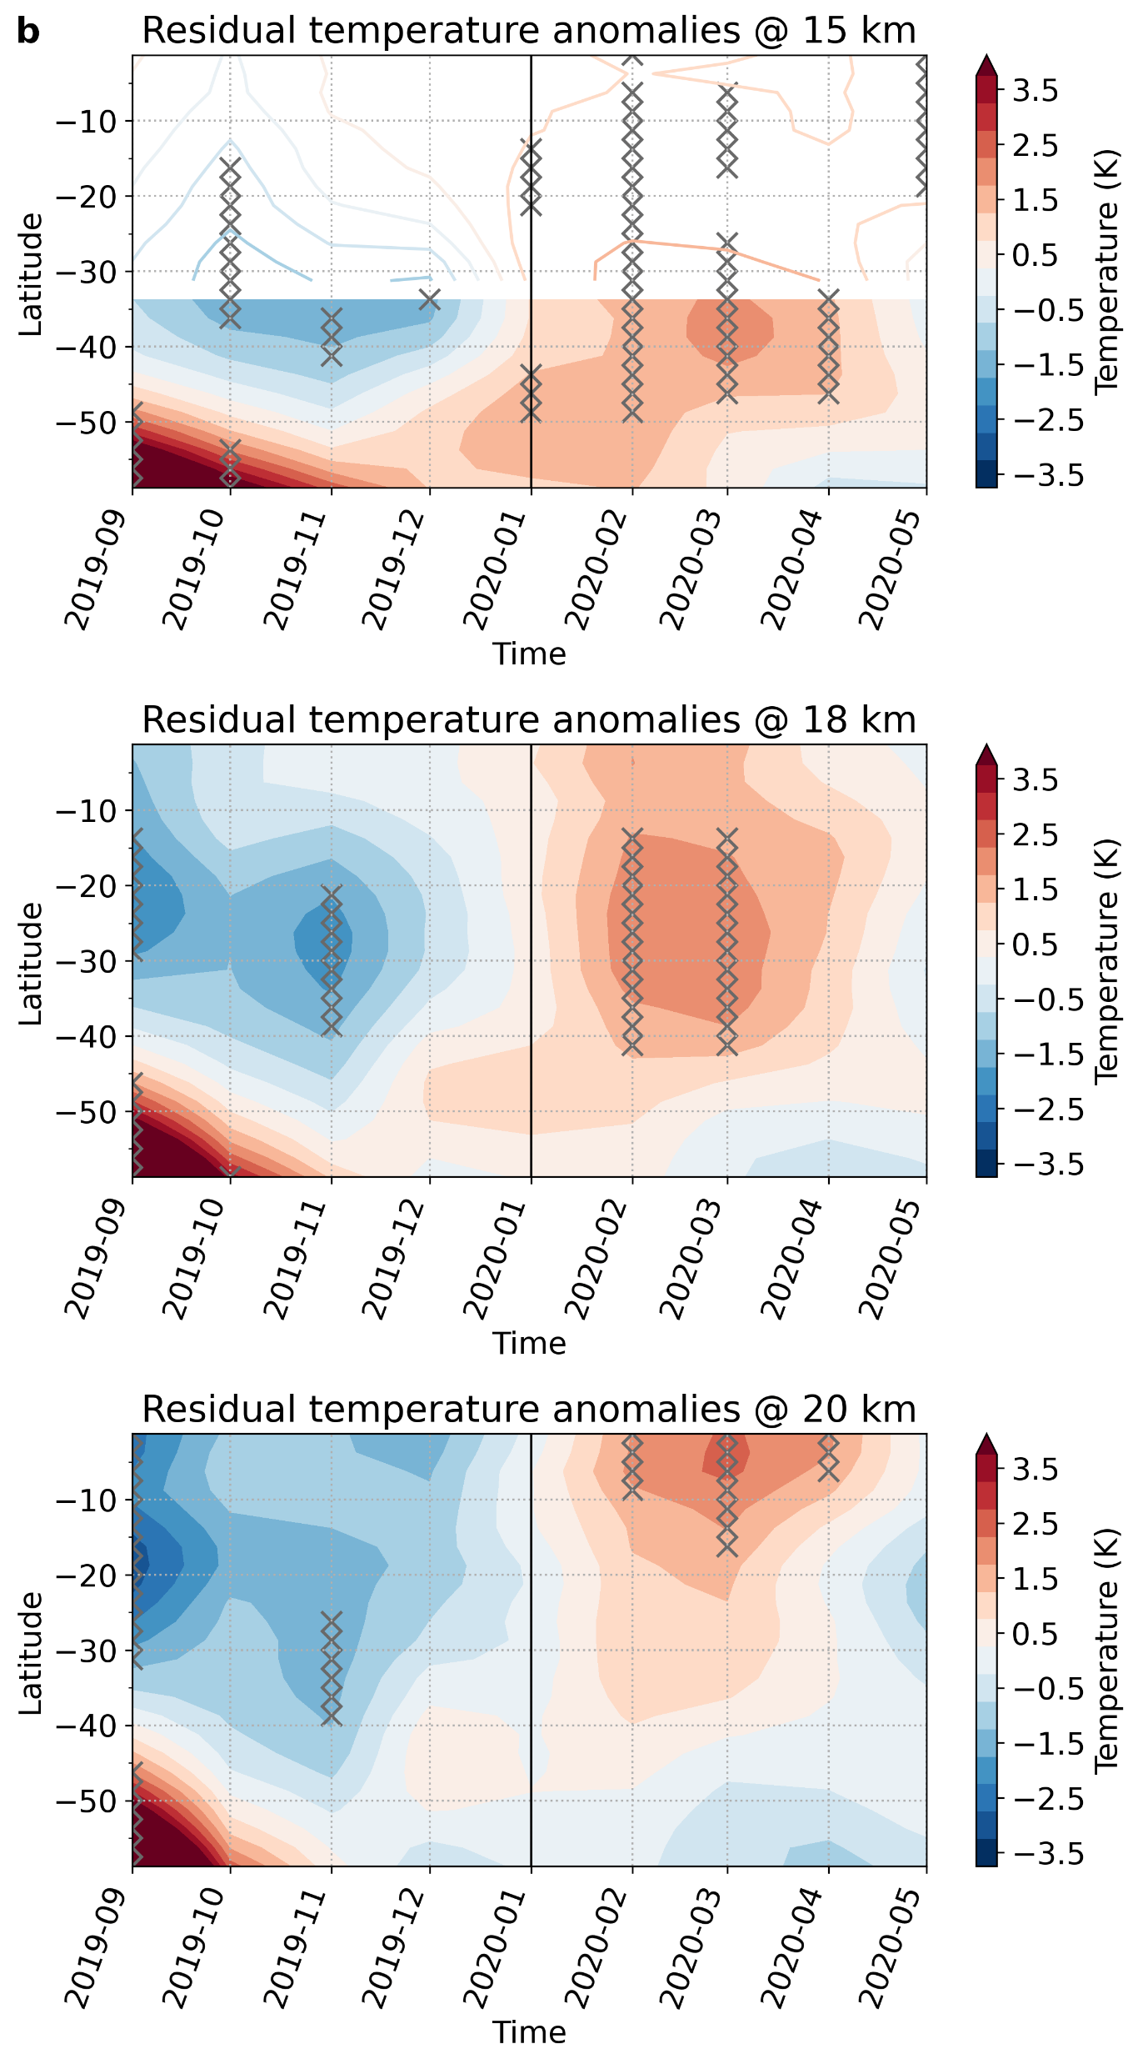
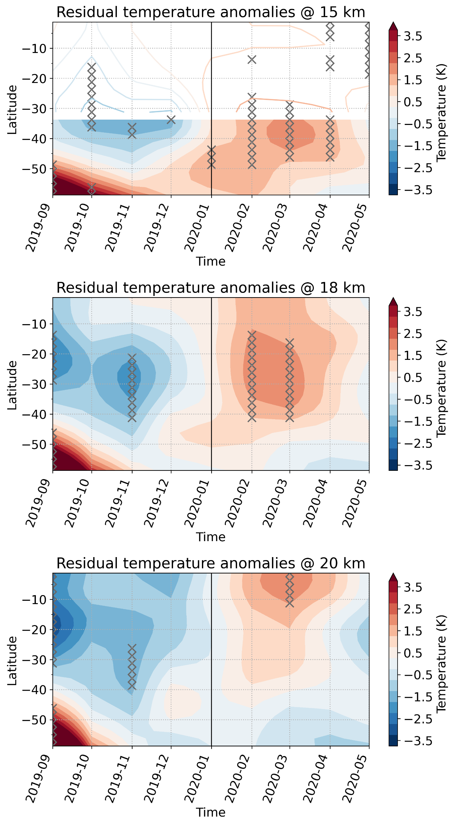

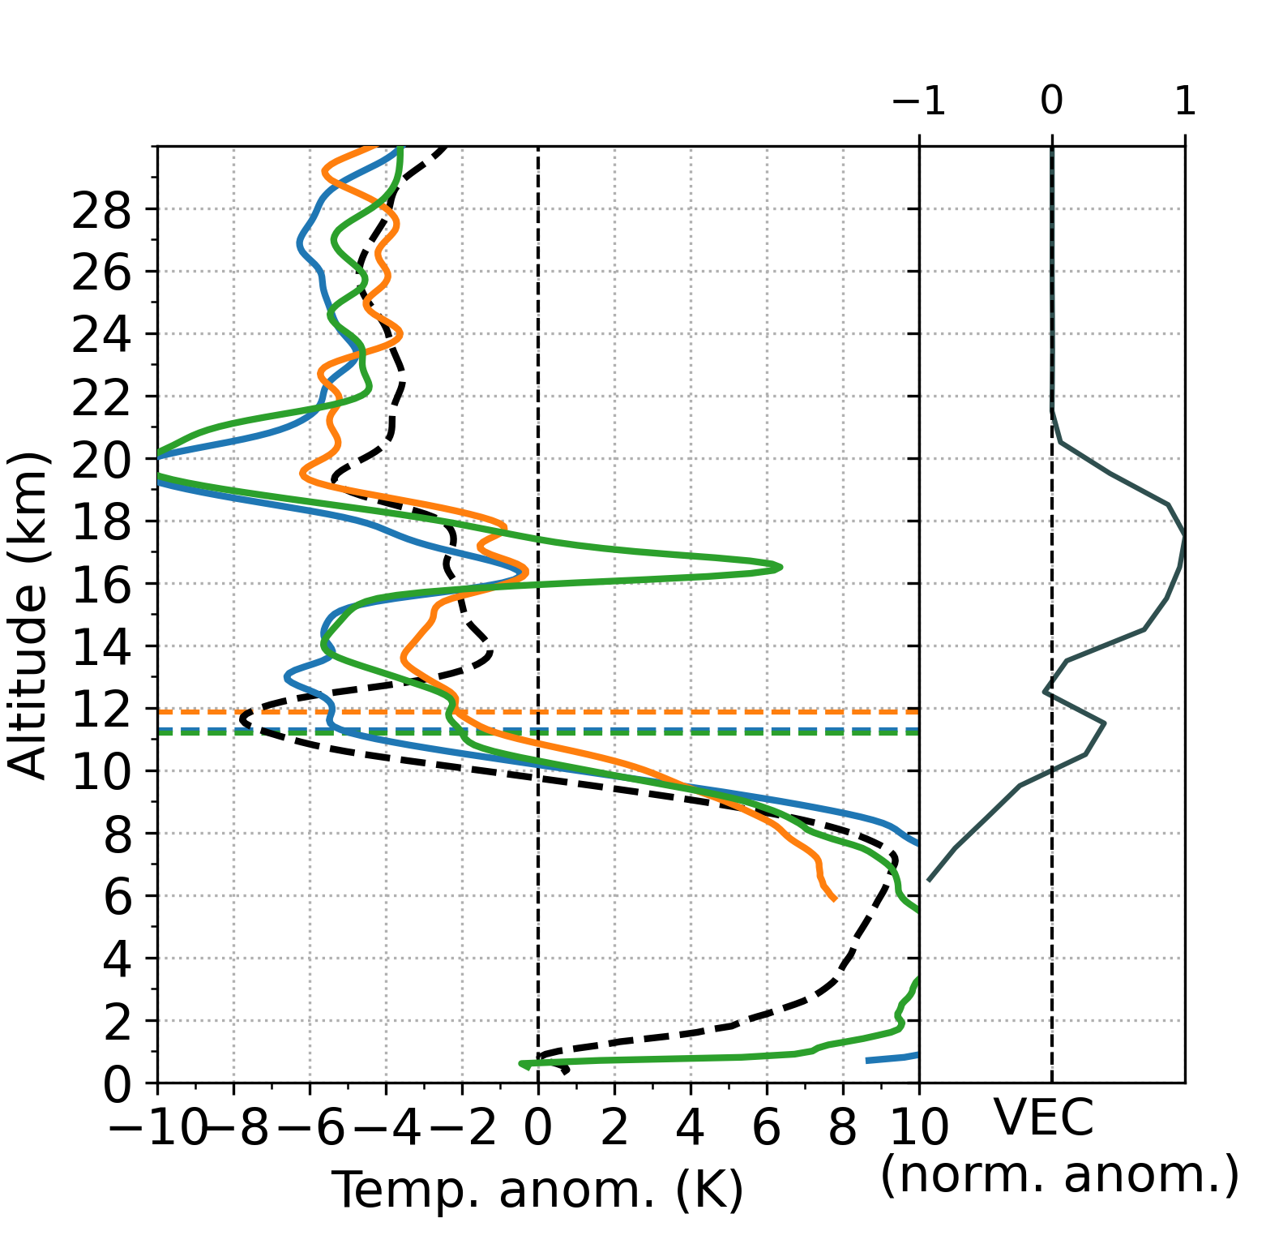
RO-DATA FOR SIGNAL DETECTION
RO PROFILES ALLOW A DETAILED VIEW OF THE WILDFIRE PLUME SIGNALS ESPECIALLY ON SHORT TIMESCALES
ERA5
RO
IFS forecast
Reanalysis
RO profiles

Slide 8

CONCLUSION
THE TEMPERATURE SIGNATURES OF LARGE WILDFIRES IMPACT STRATOSPHERIC CLIMATE VARIABILITY AND POTENTIALLY AFFECT CLIMATE TRENDS!
Stocker et al., (2021)
doi: 10.1038/s41598-021-02335-7
matthias.stocker@uni-graz.at
Short-term climate signals lasting serval months
Immediate impacts on the local, vertical temperature structure
THANK YOU!

