Slide 1





What control hydrothermal dolomitization?
Experimental replacement with time-step monitoring by X-ray microtomography
B. Lefeuvre, N.E. Beaudoin, S. Centrella
E2S project supported by « Disturb » chair
Co-funded by CCLO & INSU projects
25/05/2022
benjamin.lefeuvre@univ-pau.fr

Slide 2
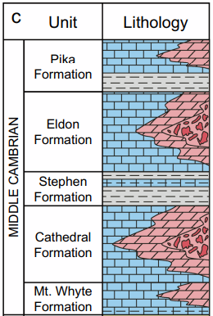
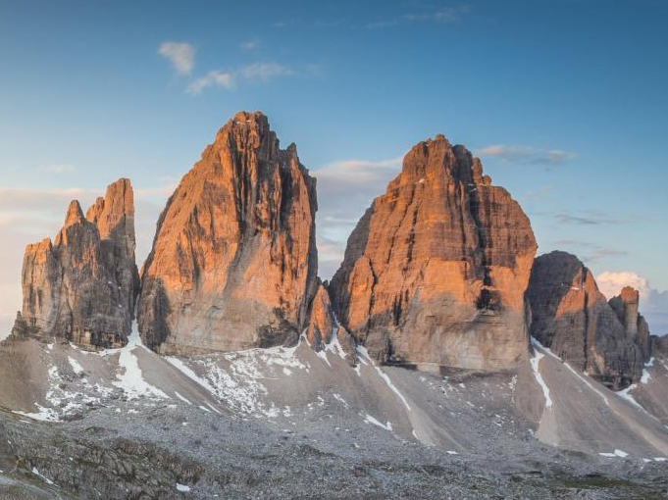
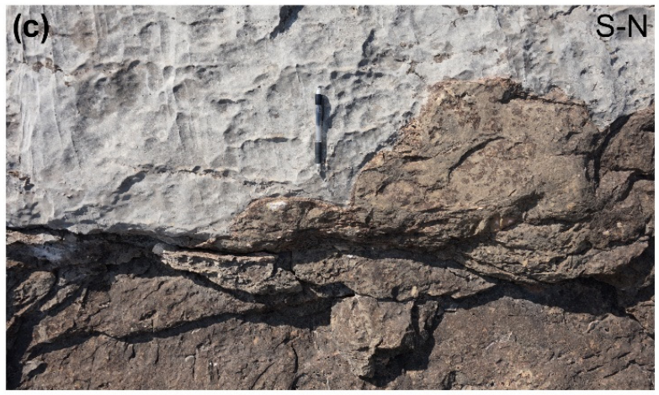
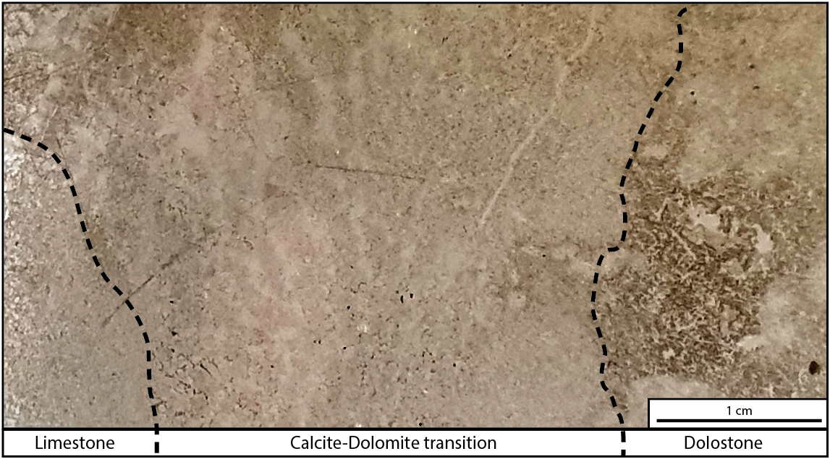



Introduction
1
Replacement of calcite by dolomite
2CaCO₃ + Mg²⁺ = (Ca,Mg)(CO₃)₂ + Ca²⁺
calcite
fluid
dolomite
fluid
Density = 2,71
Density = 2,84
Mc Cormick et al., 2021
→ Apparition of 16% of porosity
m to km
µm
Cc
Cc
Dol
Dol
Dolomites mountains, Italy
Gomez-Rivas et al., 2021
Centrella et al., 2020

Slide 3
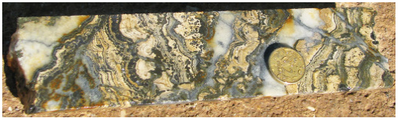
Introduction
1
Replacement of calcite by dolomite
2CaCO₃ + Mg²⁺ = (Ca,Mg)(CO₃)₂ + Ca²⁺
calcite
fluid
dolomite
fluid
Density = 2,71
Density = 2,84
Mc Cormick et al., 2021
→ Apparition of 16% of porosity
MVT
Very good reservoir properties (high porosity)
- Hydrocarbons, CO₂ storage, geothermy, groundwater
Often associated with MVT deposits (Zn, Pb, Ag, Sulfides)
Results of the transformation of two carbonate phases…
- Impact on CO₂ cycle?
DOLOSTONE
Haldar, 2020

Slide 4
Introduction
1
Replacement of calcite by dolomite
2CaCO₃ + Mg²⁺ = (Ca,Mg)(CO₃)₂ + Ca²⁺
calcite
fluid
dolomite
fluid
Density = 2,71
Density = 2,84
Mc Cormick et al., 2021
→ Apparition of 16% of porosity
How can we reconciliate scales of observations?
What can we learn from the replacement front morphology?
Does the creation of porosity help propagating the replacement front?
→ Need of experimental petrology to recreate dolomitization

Slide 5
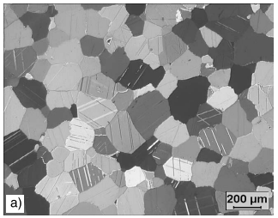
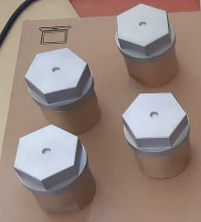
Experimental setup
2
Homogeneous
No porosity
1 cm
HYDROTHERMAL
REACTOR
Reactive Mg-enriched
fluid
(H₂O , CaCl₂ , MgCl₂ , ZnCl)
Carrara Marble
SAMPLE
Confinement
pressure
(16 bars)
Vandeginste et al., 2019
Reactive fluid
De Bresser et al., 2005
Sealed and hermetic
Teflon holds up to ≈ 287°C
Suited to hydrothermal conditions !
Fluid-rock interactions
→ CLOSED SYSTEM !!!
De Bresser et al., 2005
Hydrothermal reactors

Slide 6
Experimental setup
2
HYDROTHERMAL
REACTOR
Reactive Mg-enriched
fluid
(H₂O , CaCl₂ , MgCl₂ , ZnCl)
Confinement
pressure
(16 bars)
Vandeginste et al., 2019
Reactive fluid
STEAMROOM (200°C)
Incubation
(1, 2, 3 weeks)

Slide 7
Experimental setup
2
HYDROTHERMAL
REACTOR
Reactive Mg-enriched
fluid
(H₂O , CaCl₂ , MgCl₂ , ZnCl)
Confinement
pressure
(16 bars)
Vandeginste et al., 2019
Reactive fluid
X-RAY
MICROTOMOGRAPHY
STEAMROOM (200°C)
Incubation
(1, 2, 3 weeks)
3D
(x,y,z)

Slide 8
Experimental setup
2
HYDROTHERMAL
REACTOR
Reactive Mg-enriched
fluid
(H₂O , CaCl₂ , MgCl₂ , ZnCl)
4D
(x,y,z,t)
Confinement
pressure
(16 bars)
Vandeginste et al., 2019
Reactive fluid
X-RAY
MICROTOMOGRAPHY
STEAMROOM (200°C)
Incubation
(1, 2, 3 weeks)
3D
(x,y,z)

Slide 9
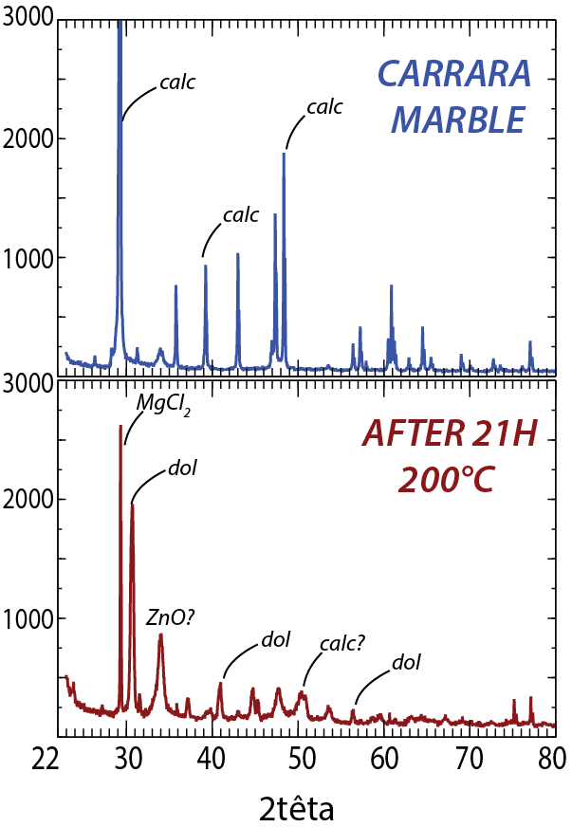
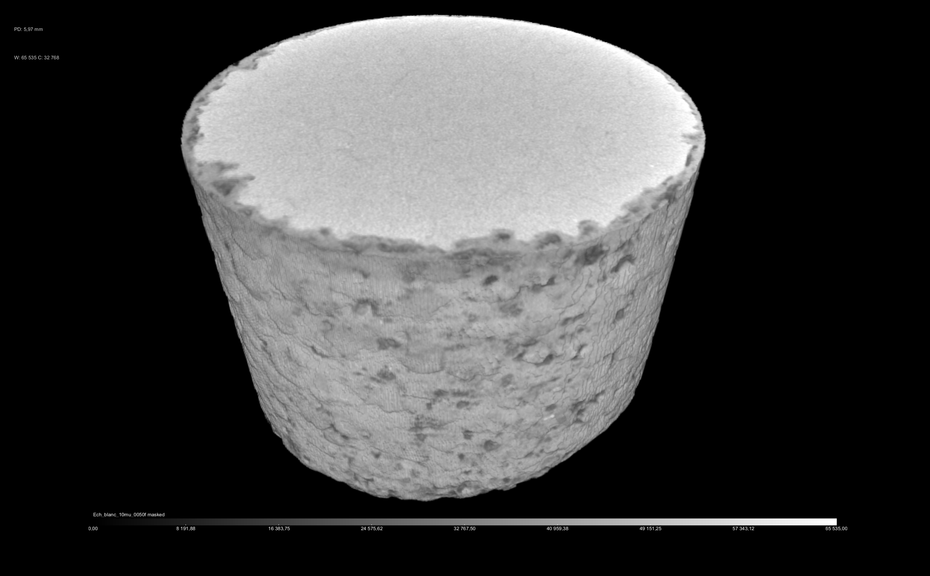

Experimental setup
3
t_{2wks}
Unreacted
calcite core
Dolomite
ᴓ
4mm
Experimental setup

Slide 10
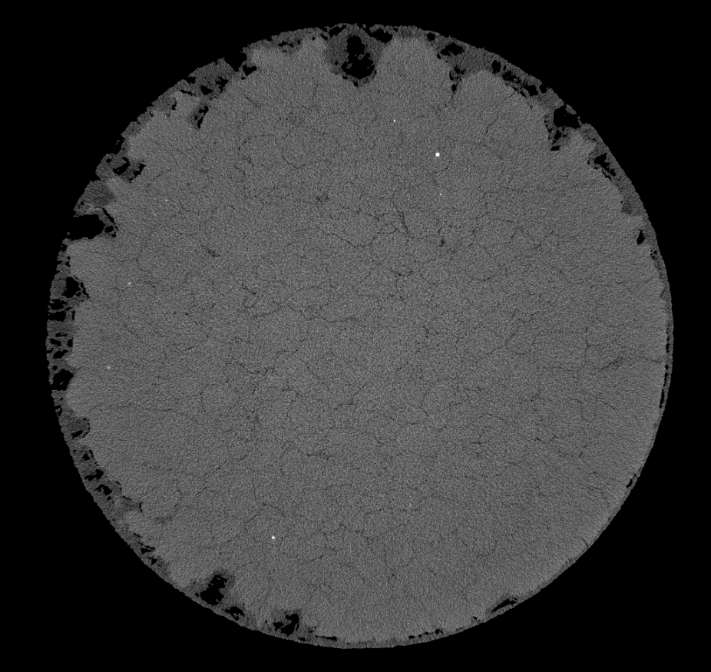
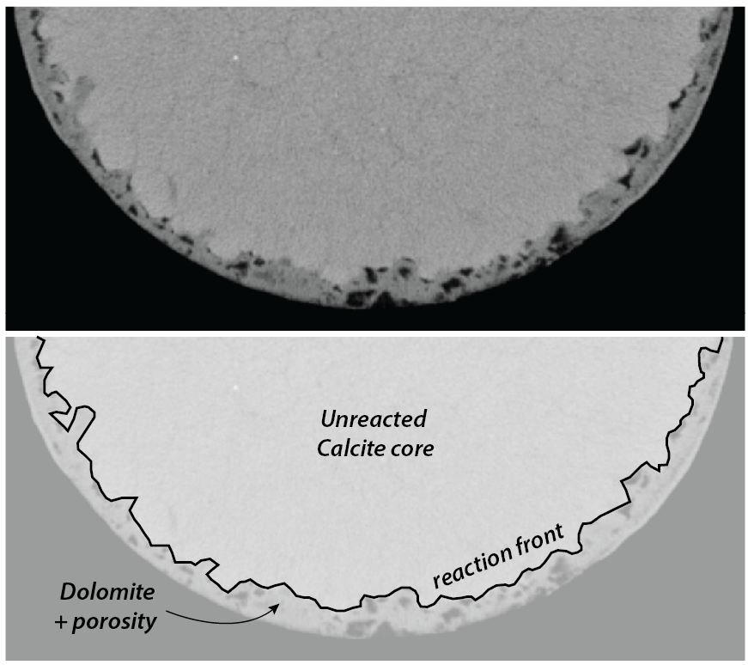
Results
4
(voxel = 4,25µm)
t_{1wk}
x, y
Heterogeneous replacement front:
Propagating along grain boundaries
Developping macro pores or not…
1mm

Slide 11
Results
5

Slide 12
Results
5
Cc
Two-steps reaction
Cc to Protodol
Protodol to Dol
Different porosities between the three minerals at stake in this reaction
How do they connect?
What are the impacts of pores sizes??
ProtoDol
Dol

Slide 13
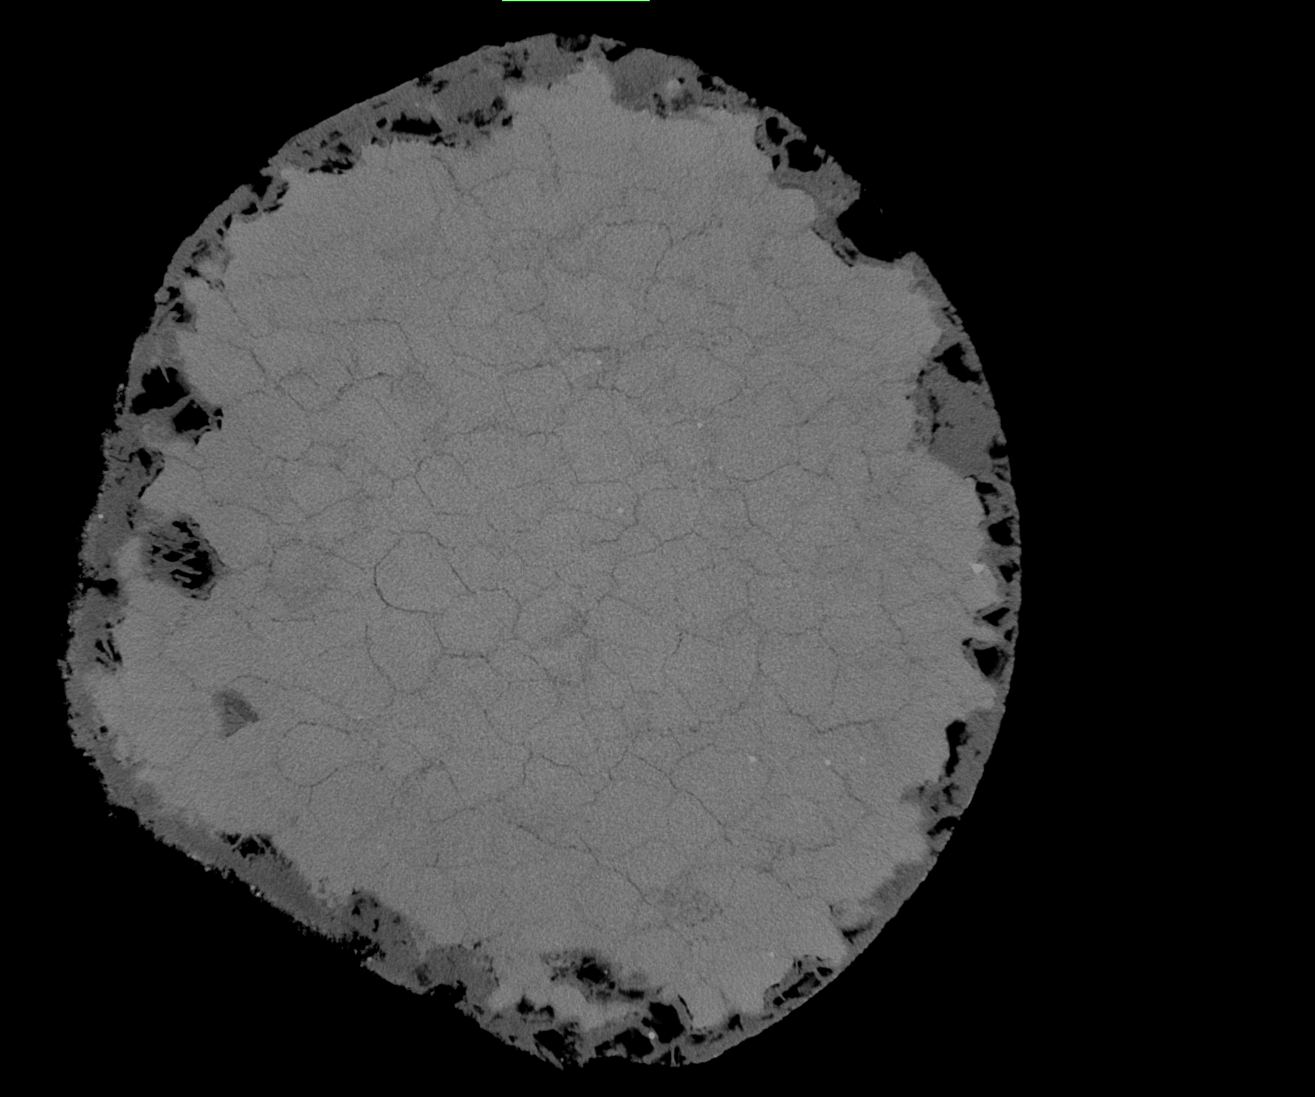
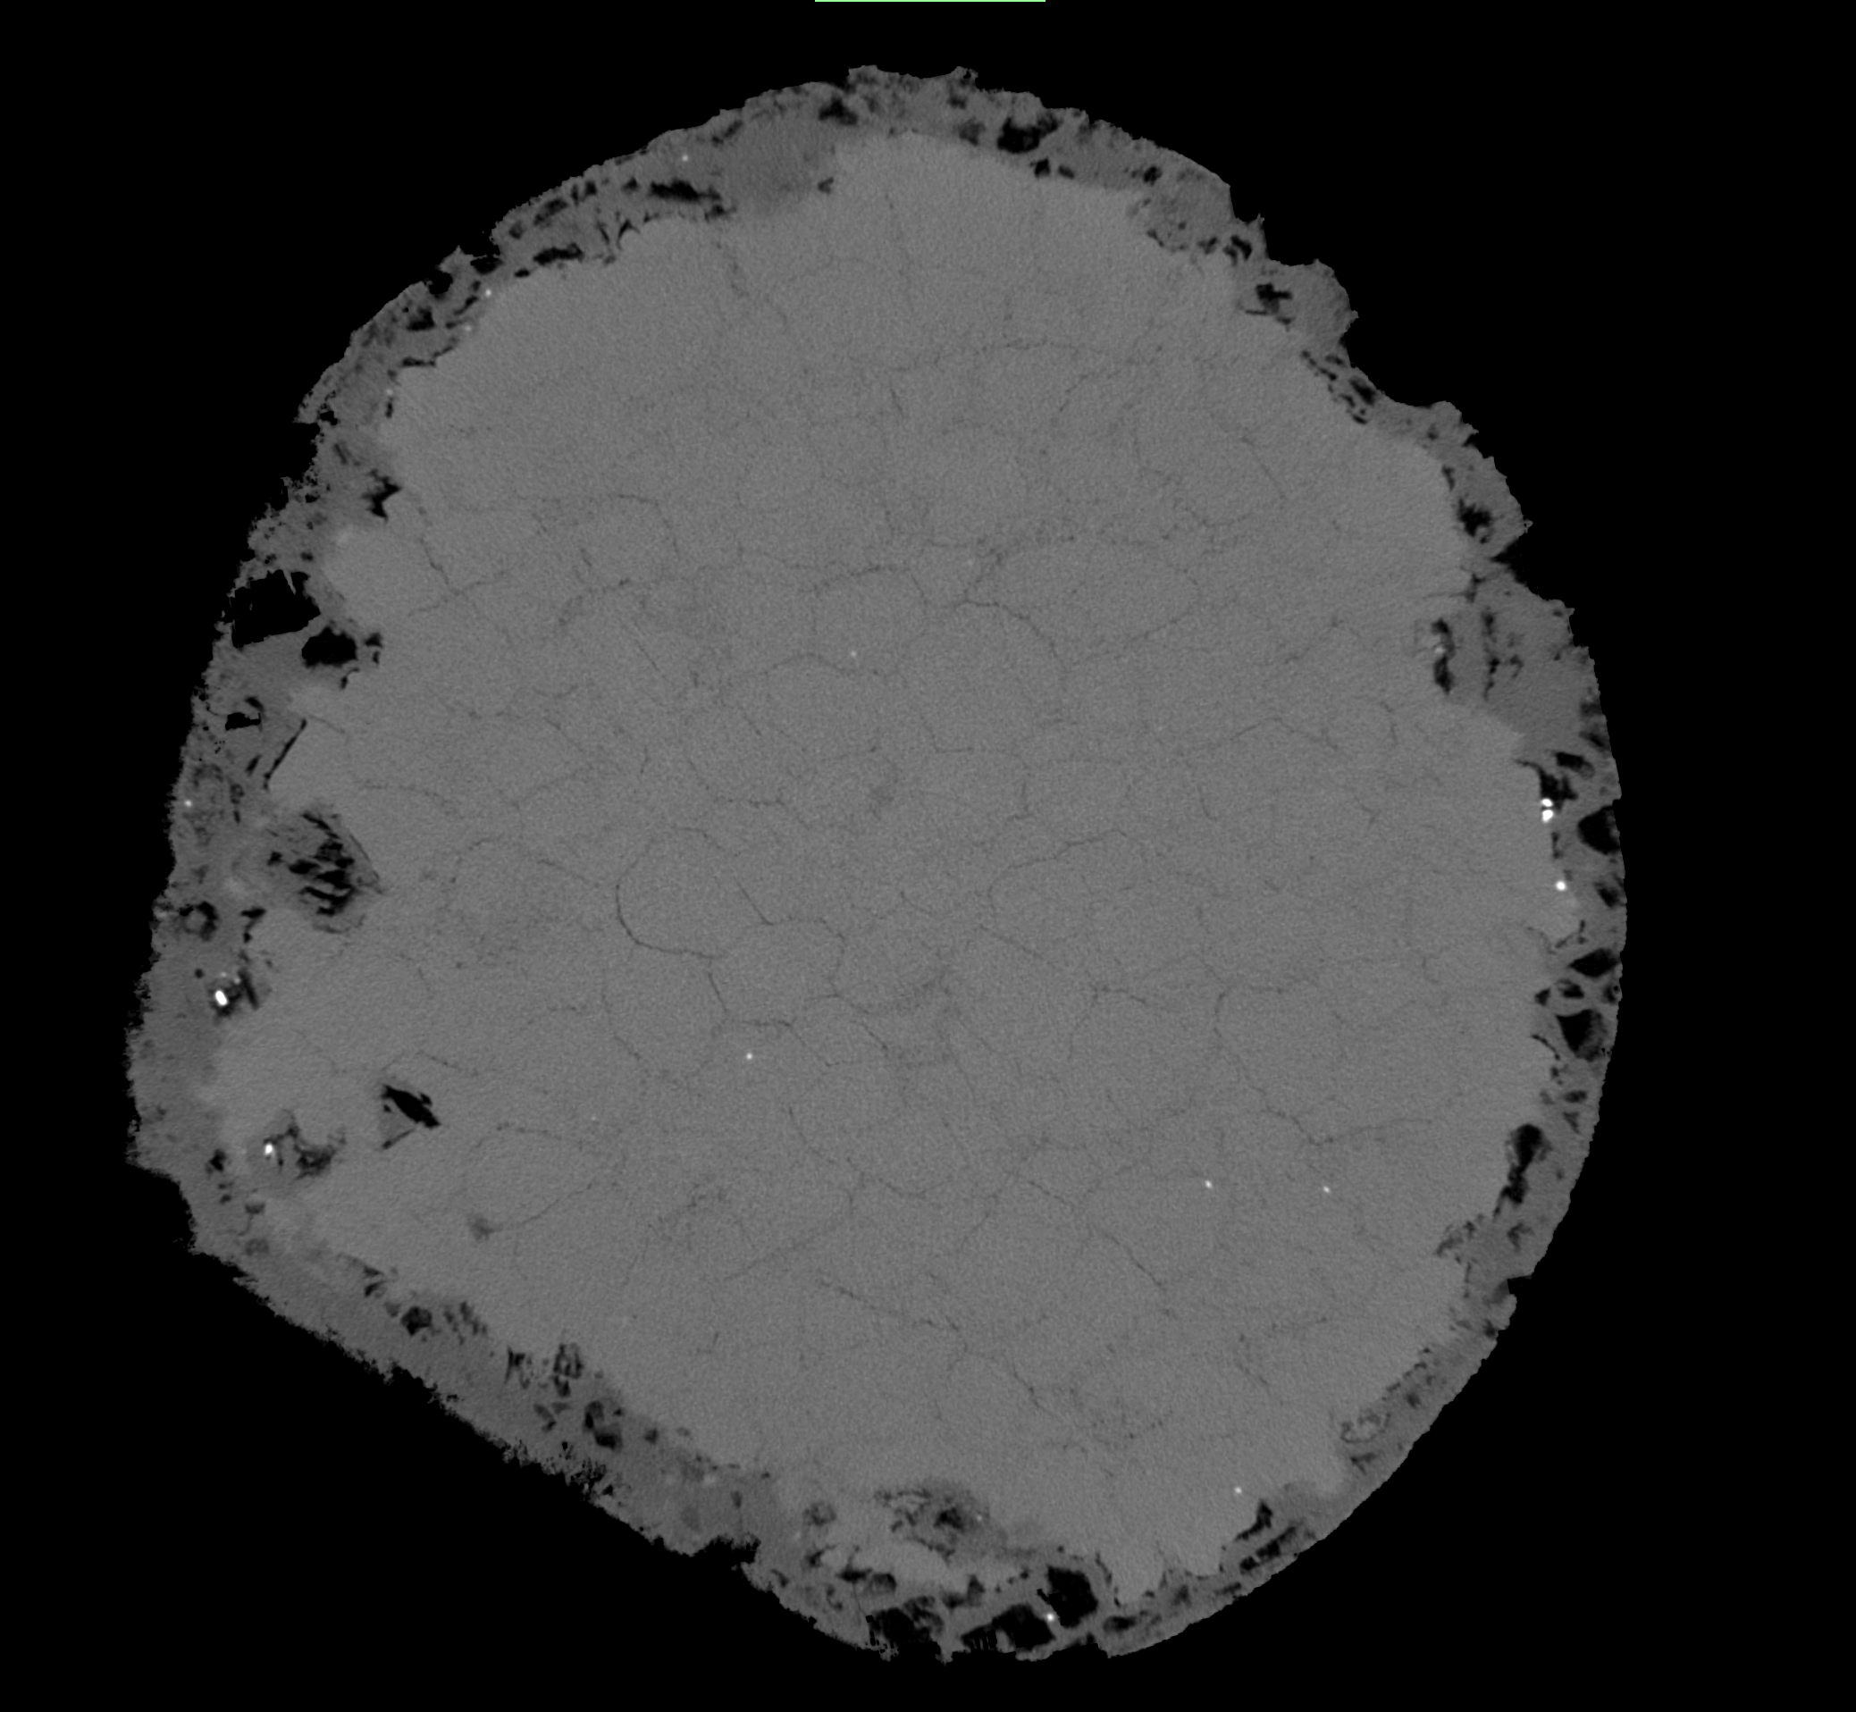
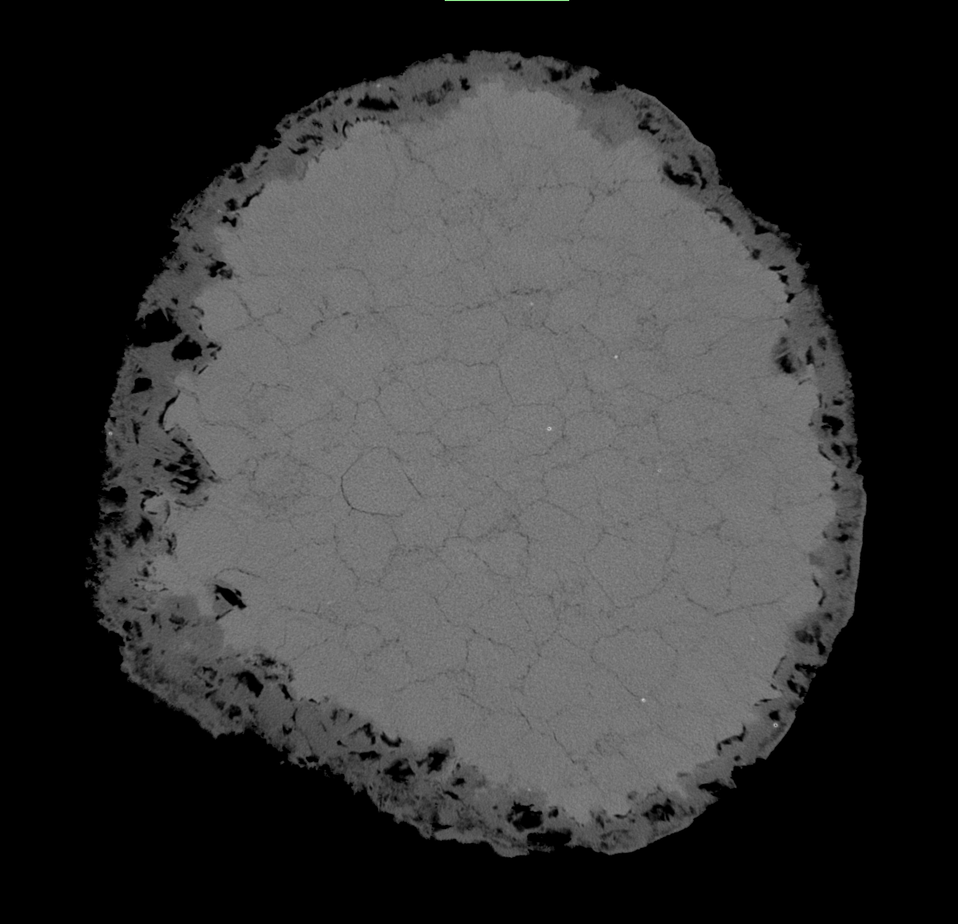
Results
6
Same sample, same (x,y) slice, different time!
t_{1wk}
t_{2wks}
t_{3wks}
x, y
x, y
x, y
ᴓ
≈ 3,43mm
ᴓ
≈ 3,36mm
ᴓ
≈ 3,26mm
Reduction of diameter with time implies dolomite dissolution in the reactive fluid
- Need of ICP-MS concentrations of the different fluids collected after the experiments to constrain fluid/rock equilibrium

Slide 14
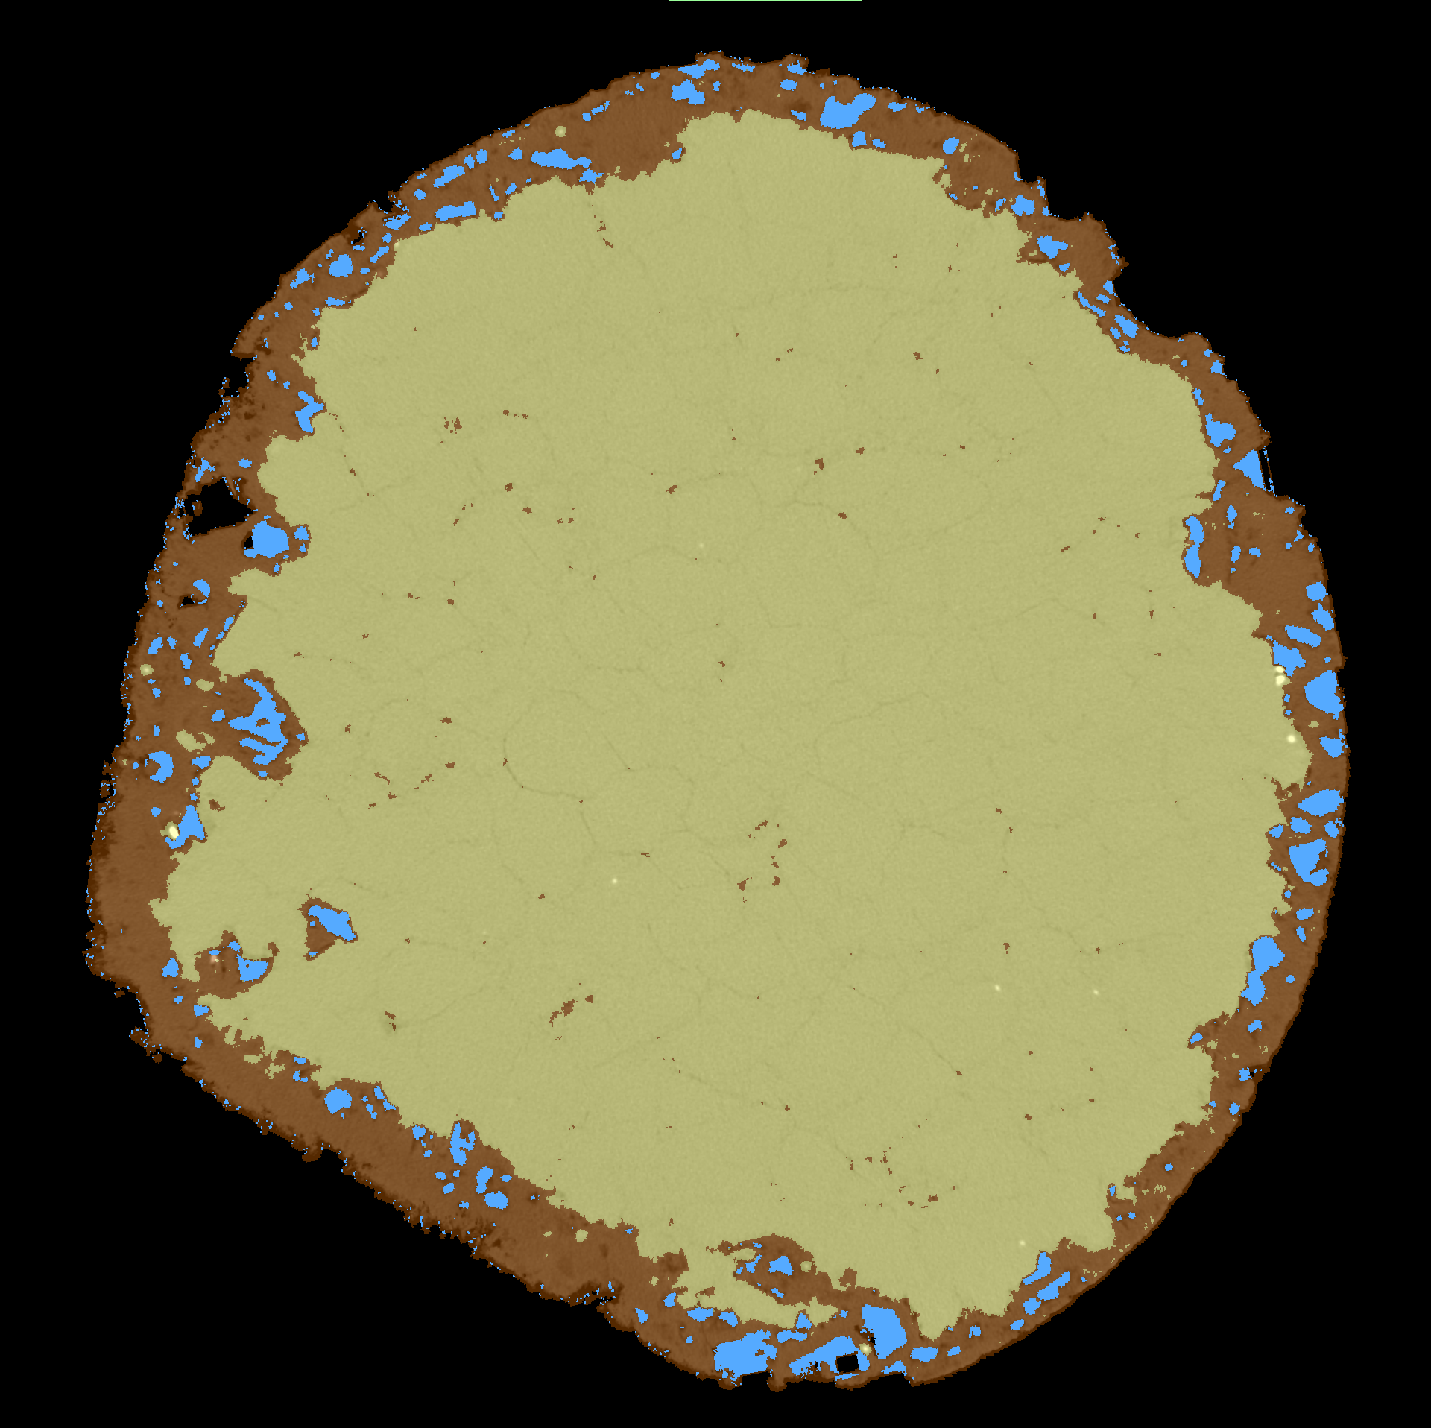
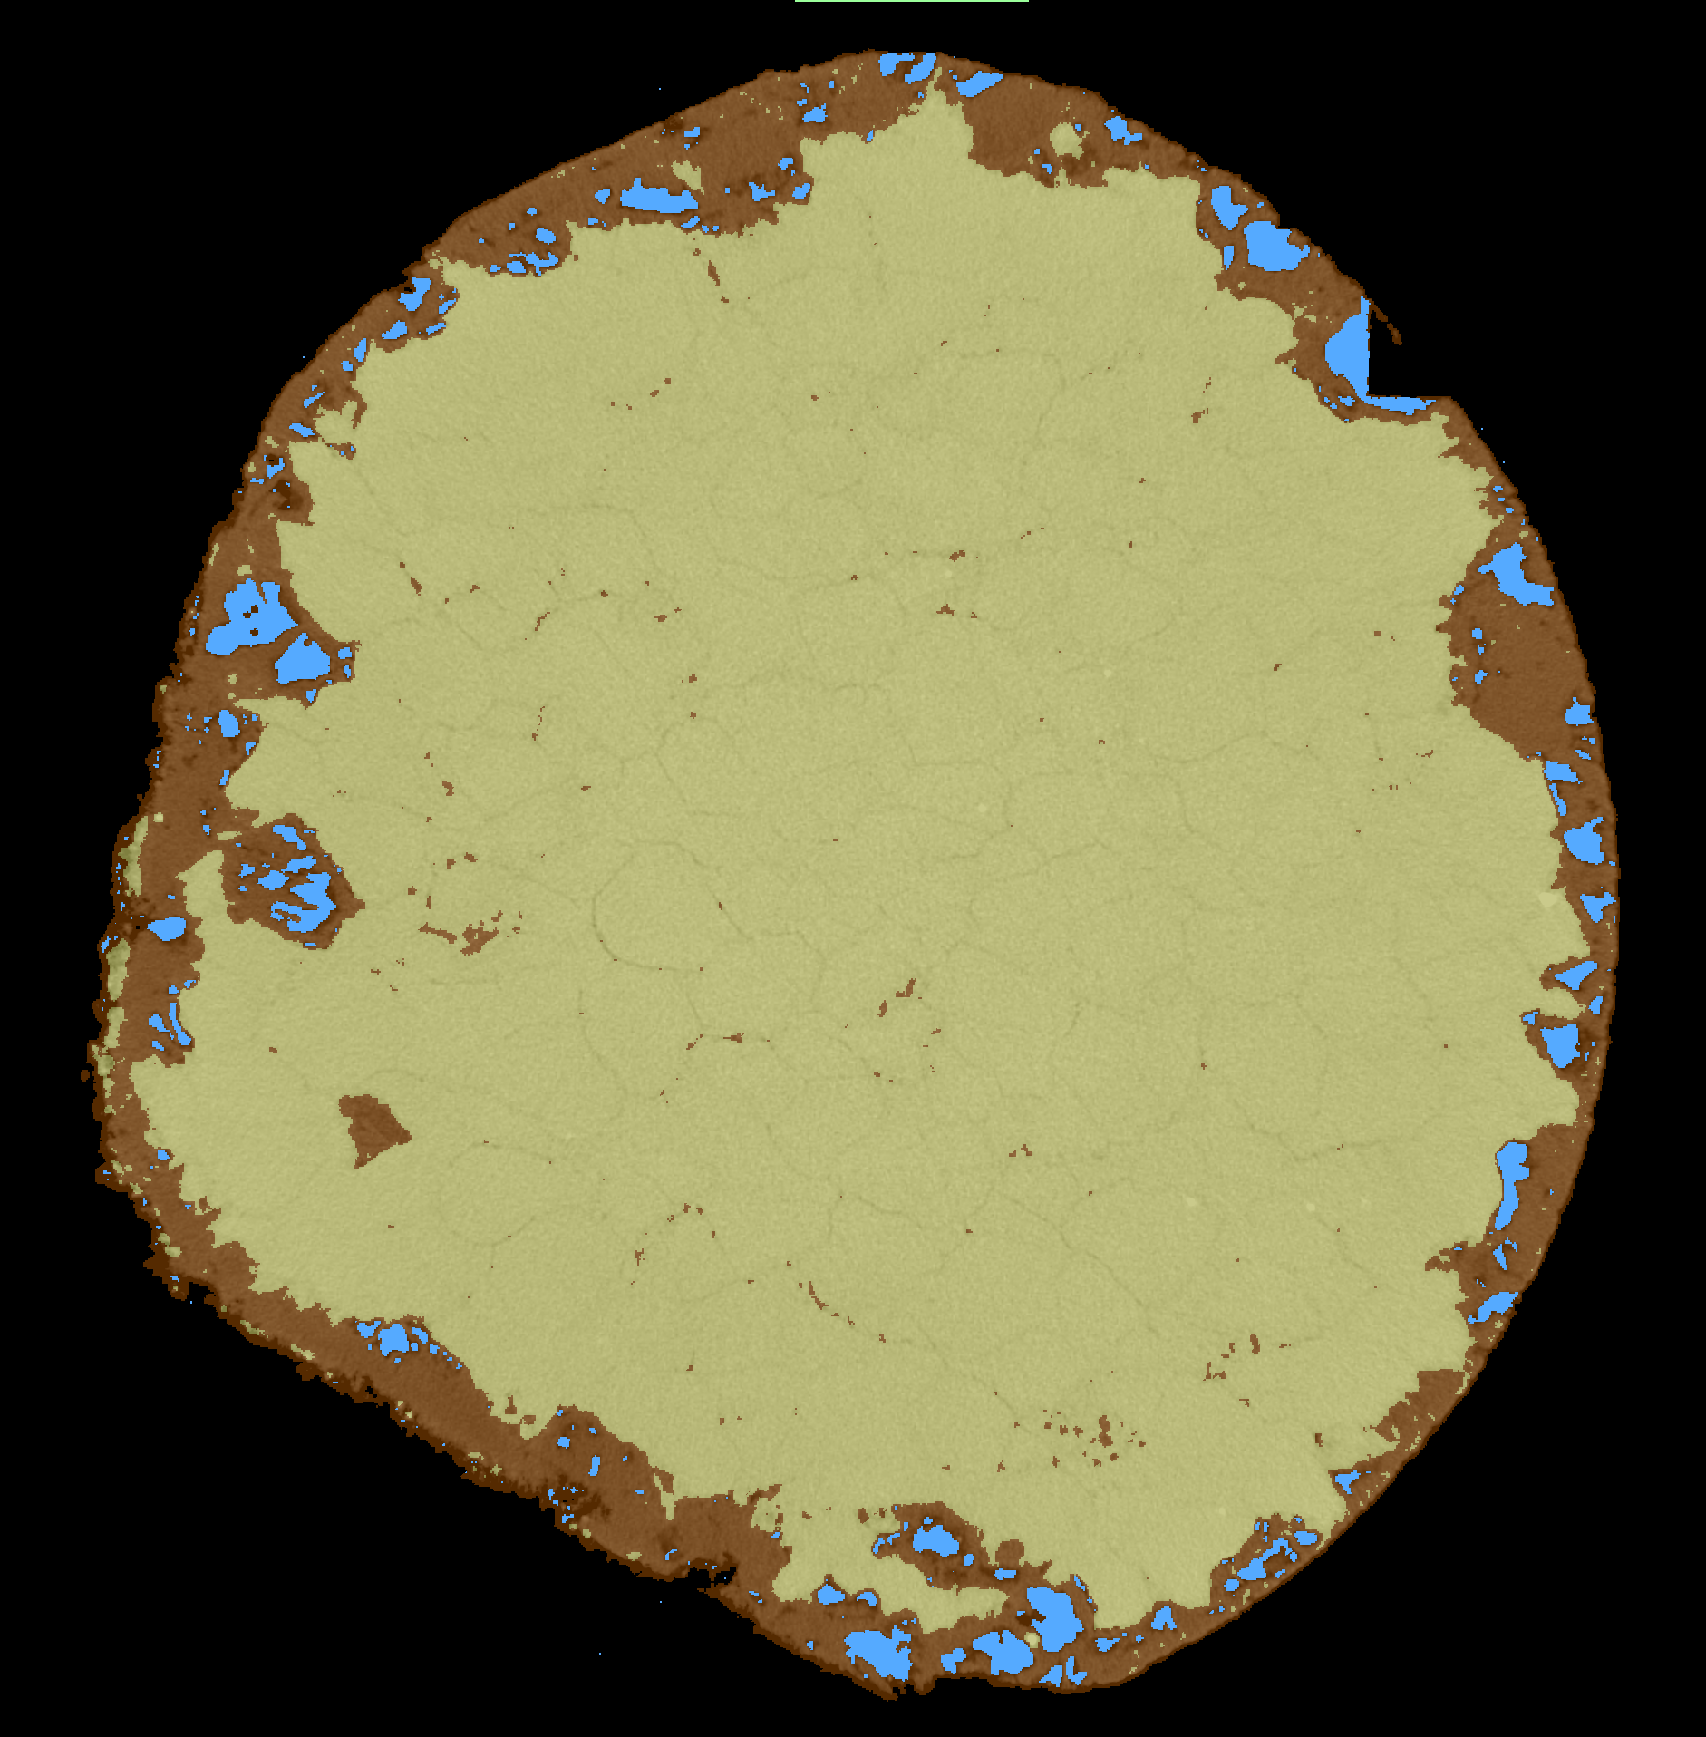
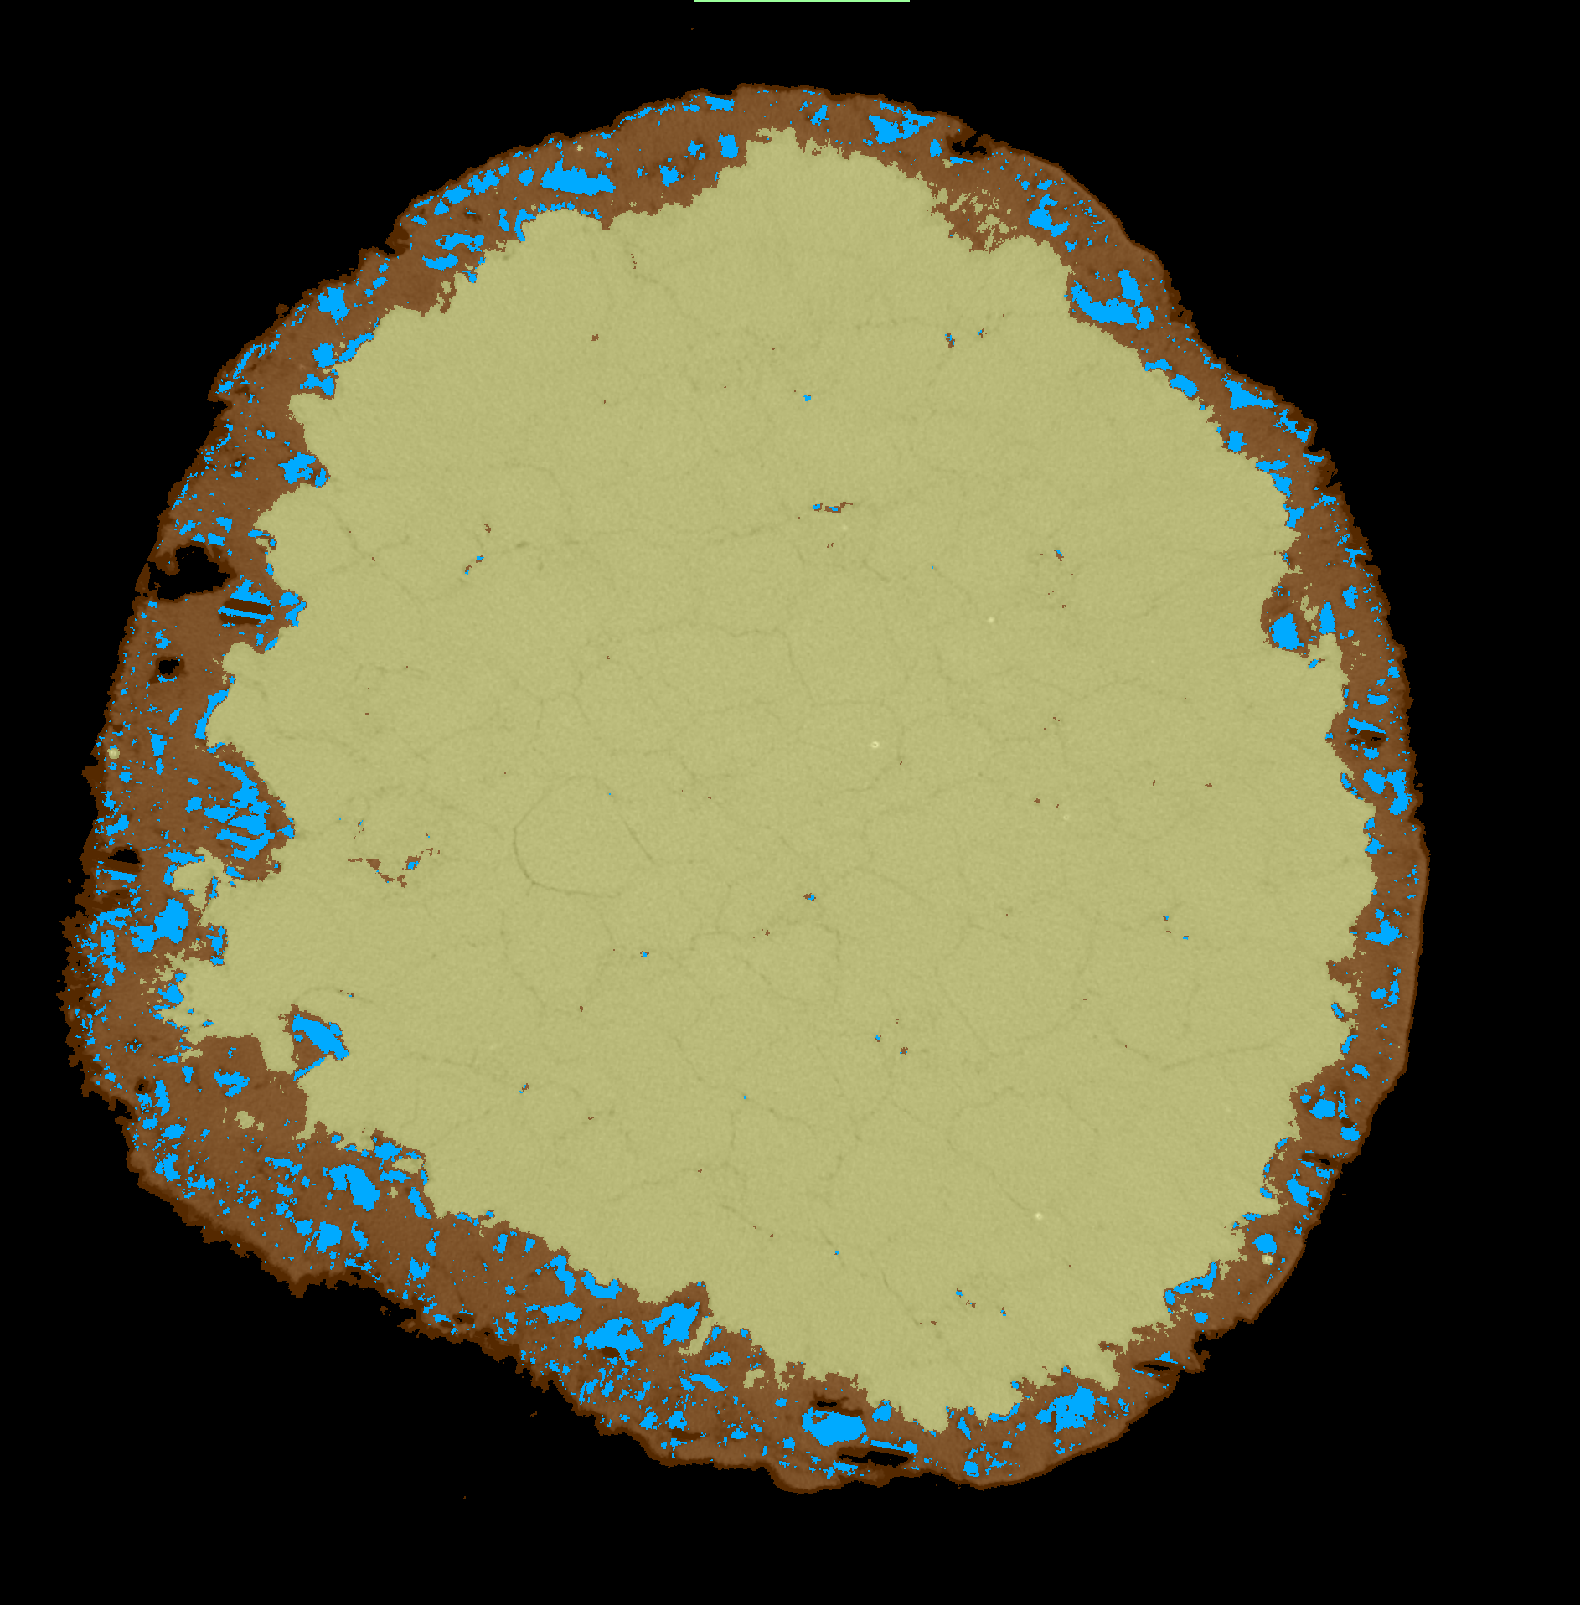

Results
6
Same sample, same (x,y) slice, different time!
t_{1wk}
t_{2wks}
t_{3wks}
x, y
x, y
x, y
% | t1 | t2 | t3
Dol | 10,27 | 15,27 | 17,63
Cc | 87,04 | 81,09 | 78,61
Pores | 2,69 | 3,64 | 3,76
Cc
Dol & Pores
Usefull to constrain kinetics

Slide 15
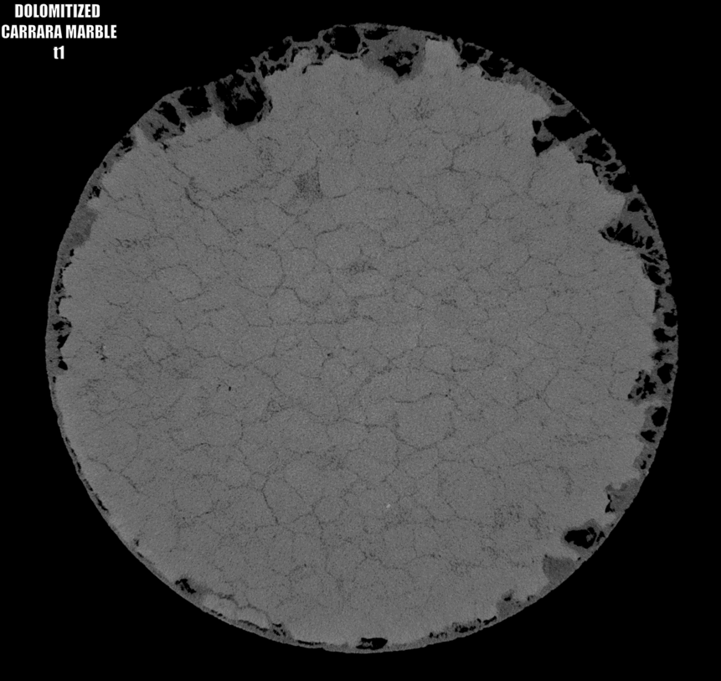
Conclusions and perspectives
7
Experimental setup
Fluid chemistry (Vandeginste et al., 2019 recipee)
Selected samples (Carrare marble)
Suitable experimental conditions (hydrothermal reactors)
Imaging the dolomitization front
3D morphology
Pores repartition
Quantification
Protodolomite
Evolution of the porosity
Coupled dissolution-precipitation between Cc and Protodolomite
Coupled dissolution-precipitation between Protodolomite and dolomite??
Diffusion of Mg?

Slide 16
Thanks for your attention!
benjamin.lefeuvre@univ-pau.fr

