Slide 1


Morphological evolution and sedimentological study of the Essaouira bay and the mouth of Oued Ksob (Essaouira, Morocco)
Ezzahzi Salma1, Abdellah Algouti1, Ahmed Algouti1
1 Cadi Ayyad University / Geoscience Geotourism Natural Hazards and Remote Sensing Laboratory(2GRNT) / Department of Geology, Faculty of Sciences Semlalia/ Marrakech, Morocco

Slide 2
PLAN
Objectives and methodologies
general context of the study area
Study of the evolution of Essaouira Bay and the mouth of Oued Ksob by processing satellite imagery (1985-2021)
Sedimentological study of the sands of the Essaouira coastline
Conclusion

Slide 3
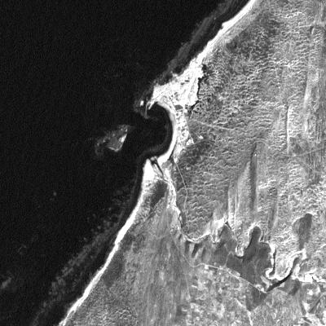
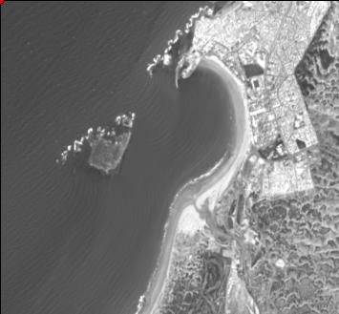
Objectives and methodologies
1985
2021

Slide 4
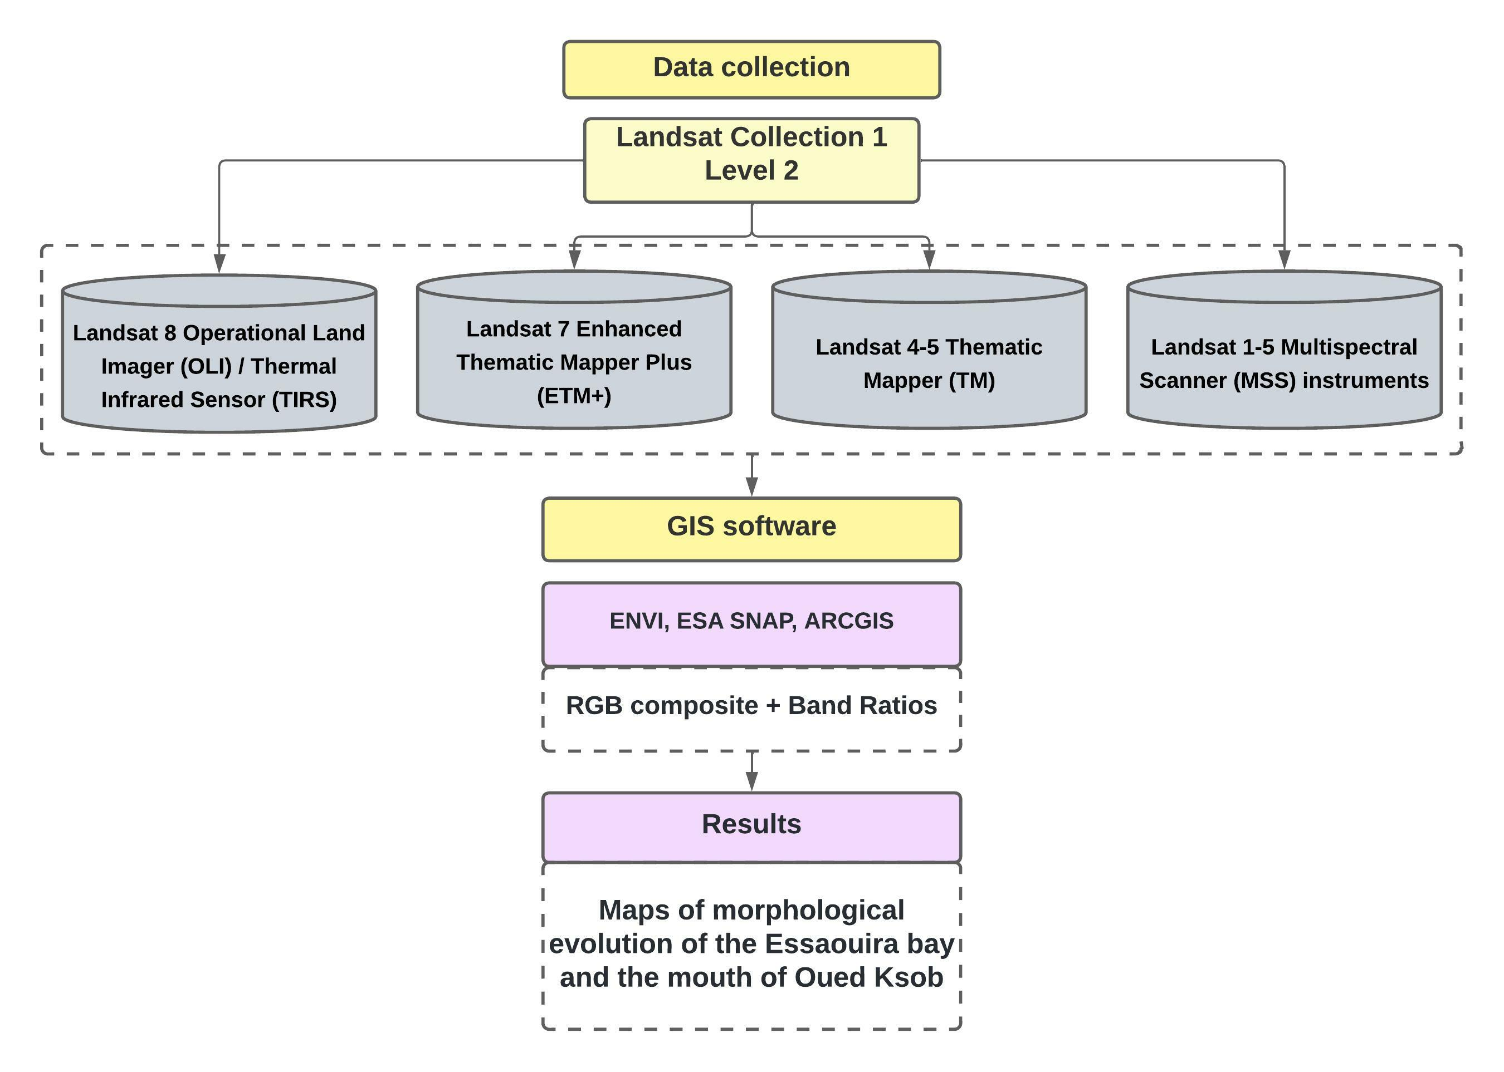

Slide 5
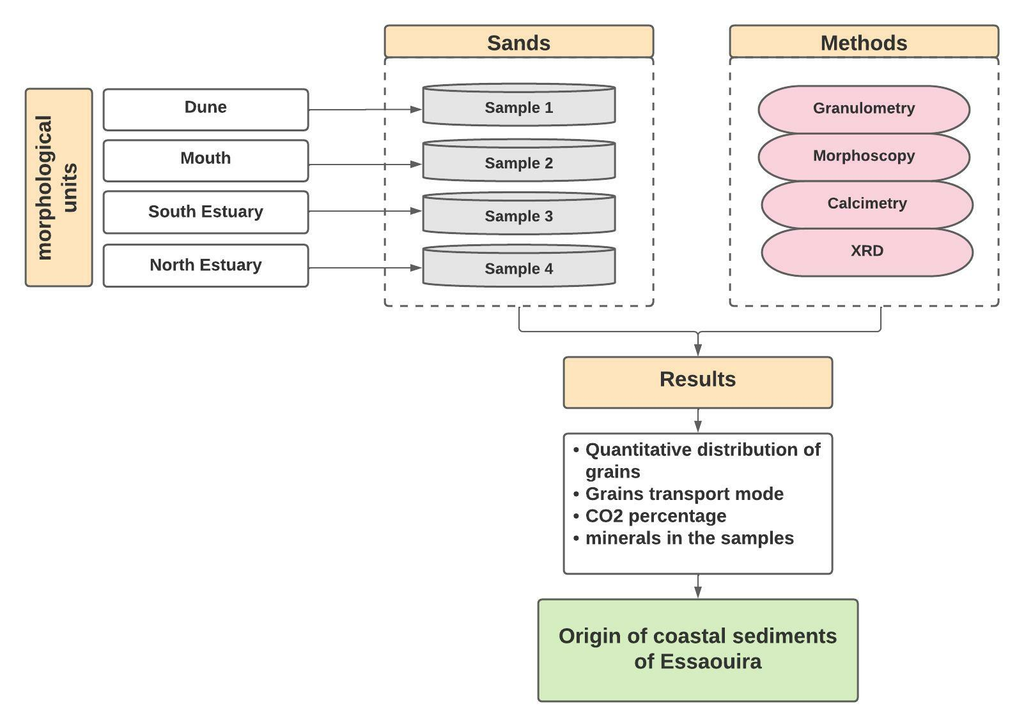

Slide 6
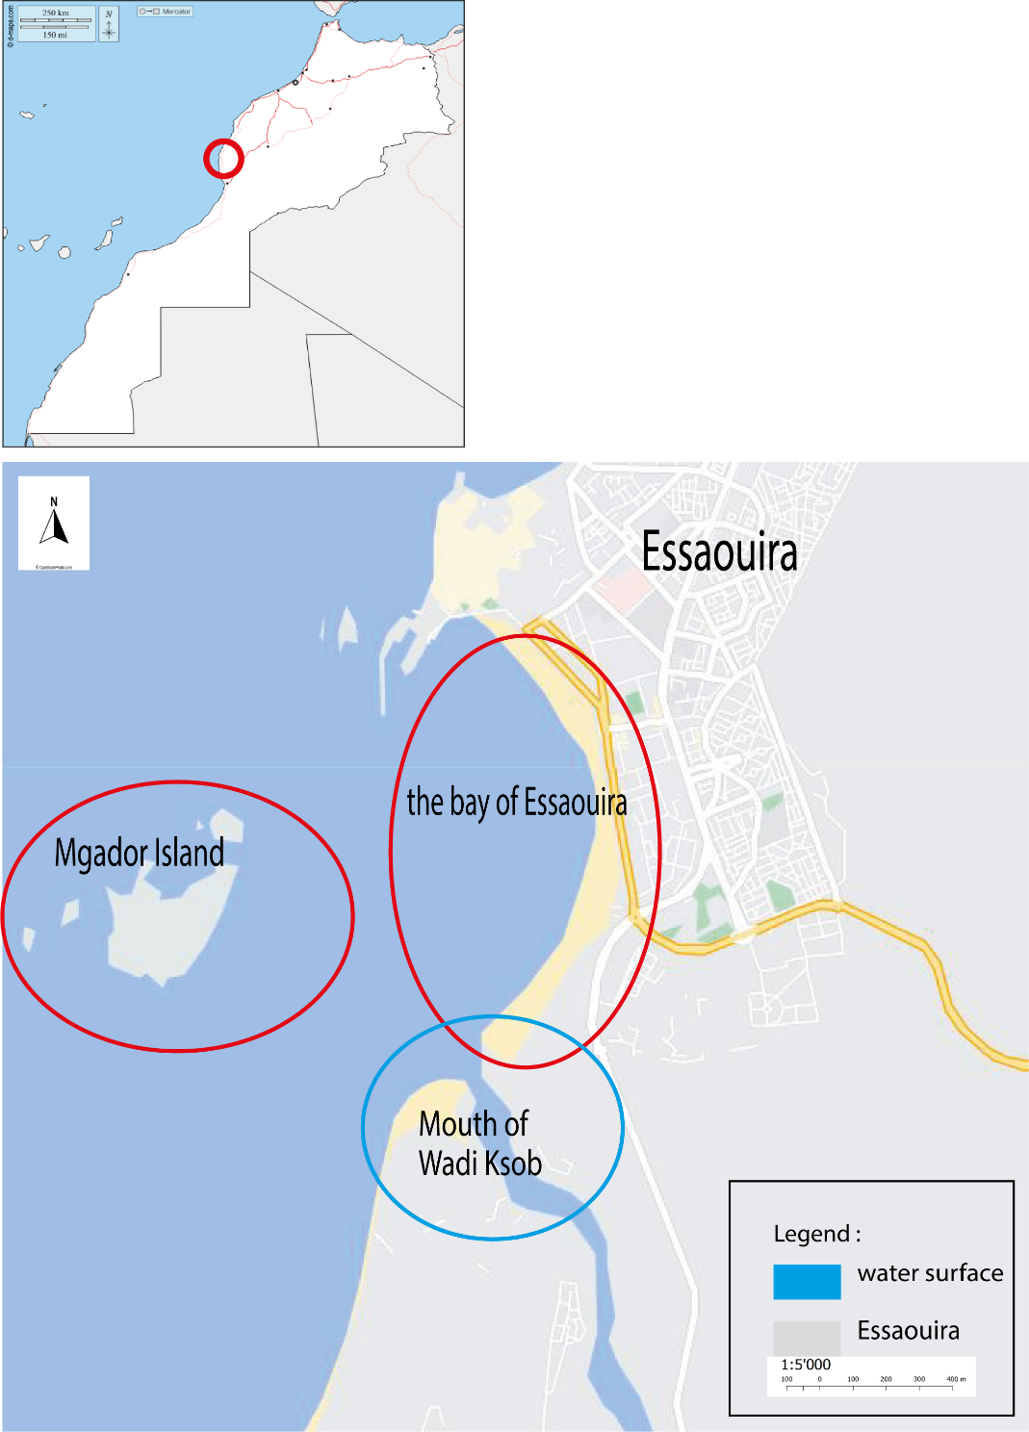
general context of the study area

Slide 7
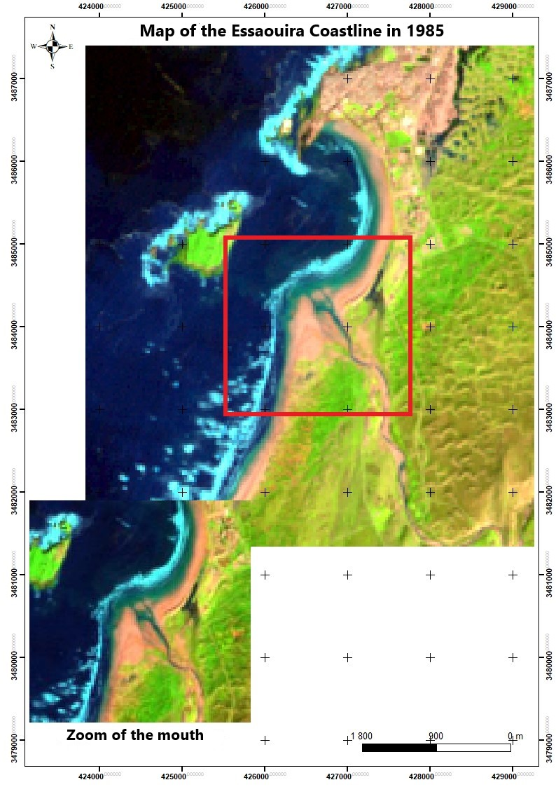
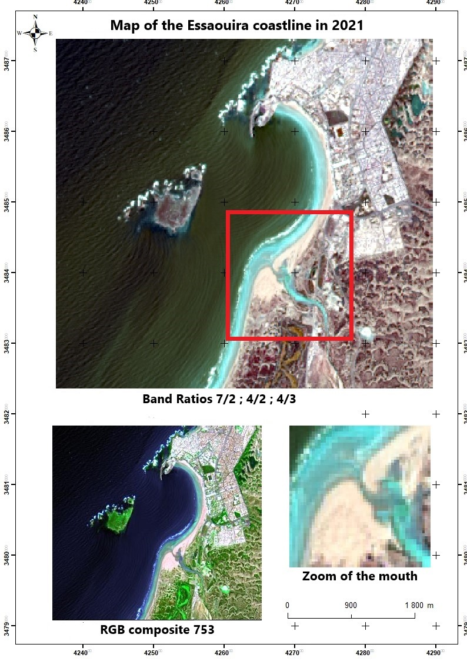
Study of the evolution of Essaouira Bay and the mouth of Oued Ksob by processing satellite imagery (1985-2021)

Slide 8
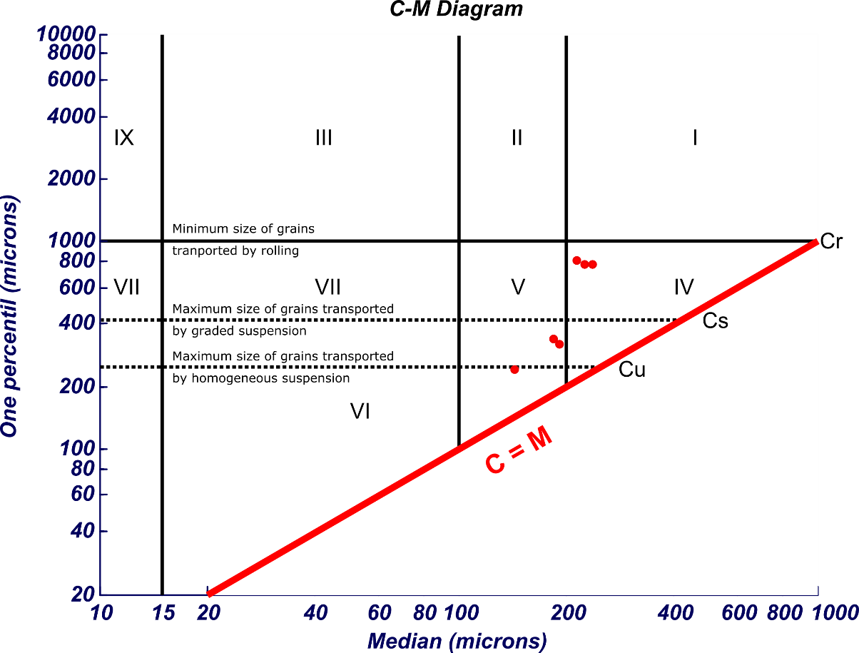
Particle size analysis

Slide 9
Calcimetric analysis

Slide 10
Morphoscopic analysis
the Dune sample
the Mouth sample

Slide 11
the North estuary sample
the South estuary sample

Slide 12
X-ray diffraction analysis

Slide 13
Conclusion

Slide 14
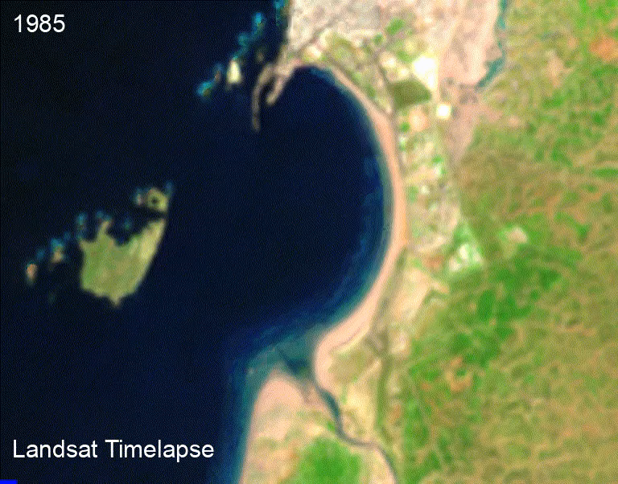

Slide 15
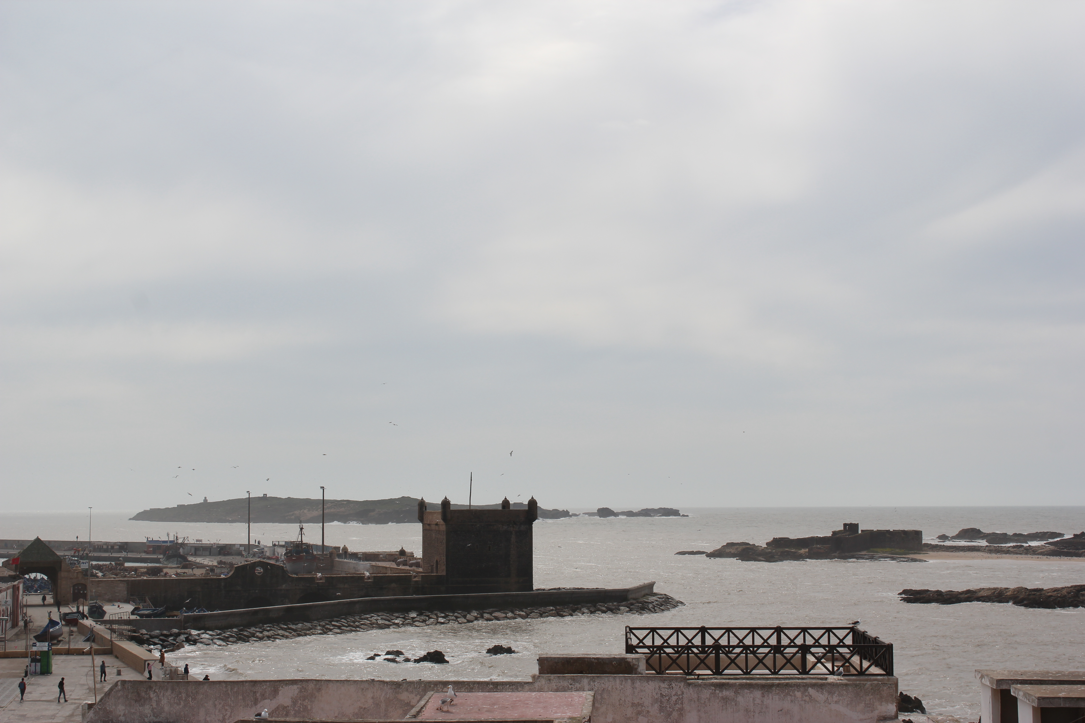
THANK YOU FOR YOUR ATTENTION

