Slide 1






LINKS BETWEEN LAND USE AND CLIMATE IN THE HORN OF AFRICA
MD ABDUL MUKTADIR, AKASH KOPPA, JEROEN CLAESSEN, DAVID A MACLEOD, MICHAEL SINGER, DIEGO G. MIRALLES
VIENNA | AUSTRIA | 23–27 May 2022

Slide 2
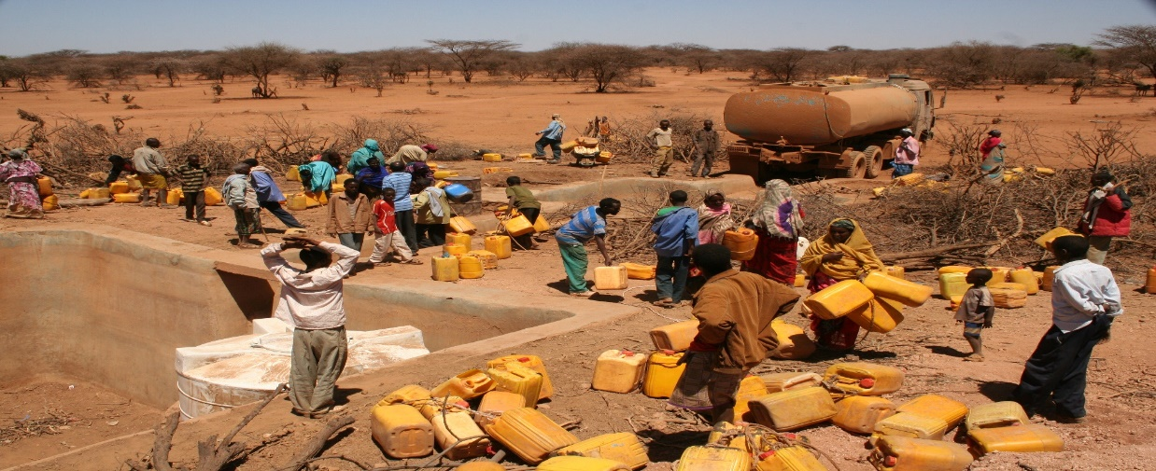
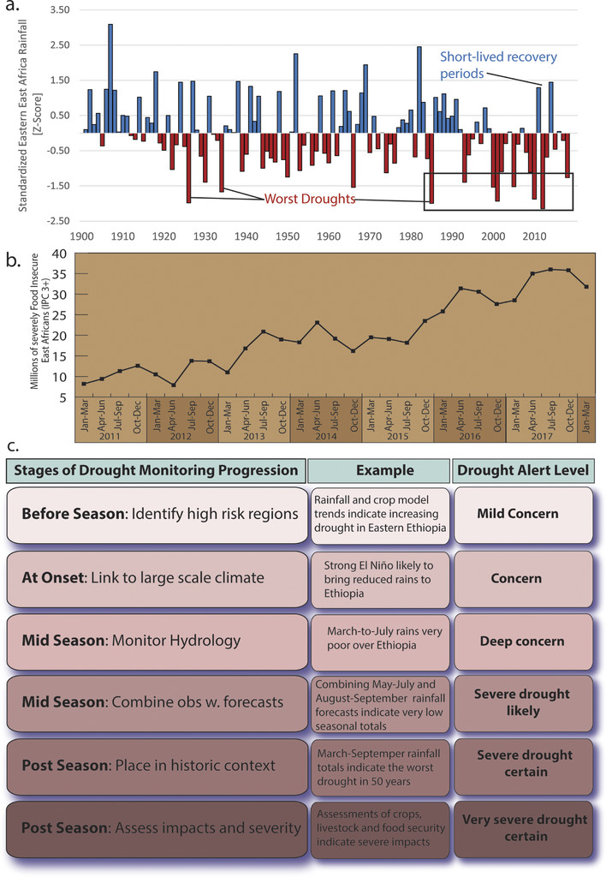
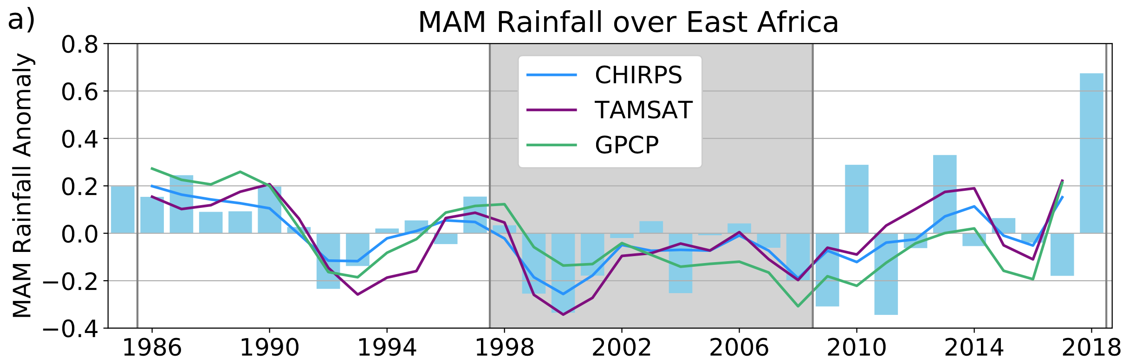
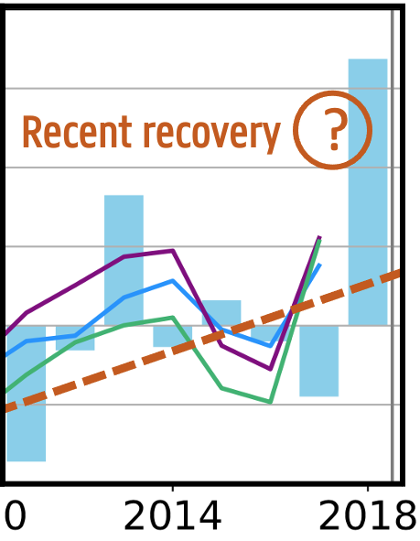

BACKGROUND
Funk et al. (2019)
Prolonged decrease in long rains (MAM)
Drying trend is missed by climate models: East African Paradox
Despite partial recovery in recent years: drought since 2020
Prolonged decrease
Recent recovery
?
Wainwrigth et al. (2019)
2

Slide 3

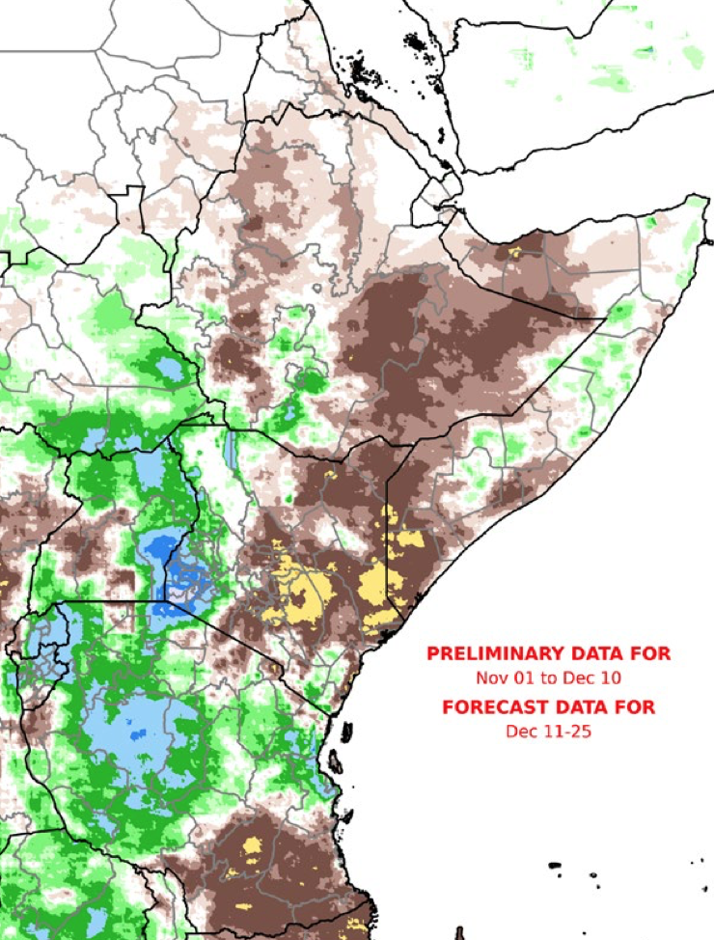
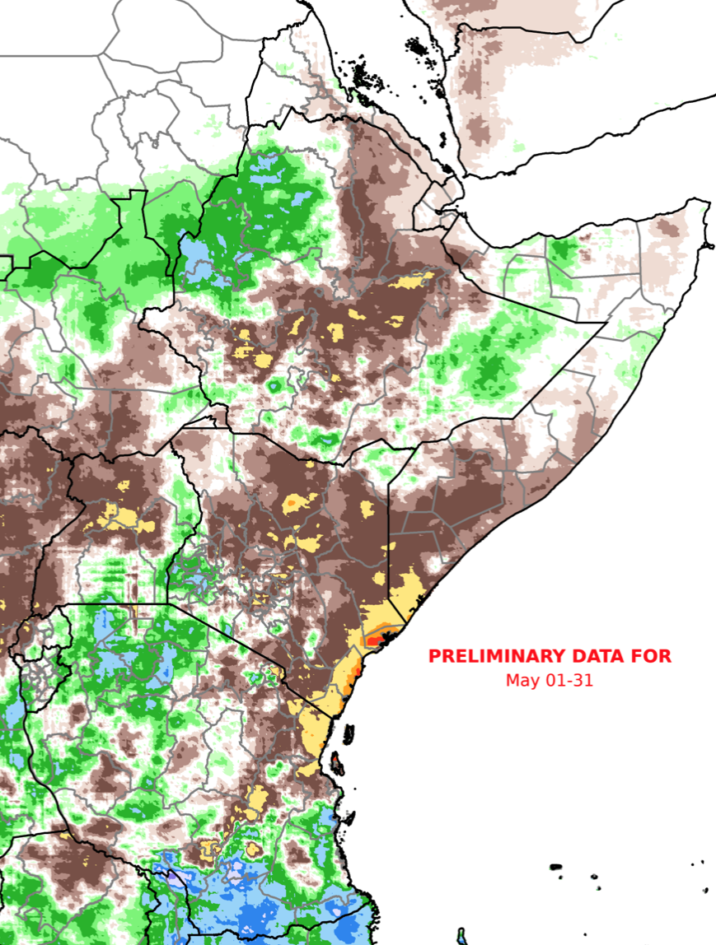
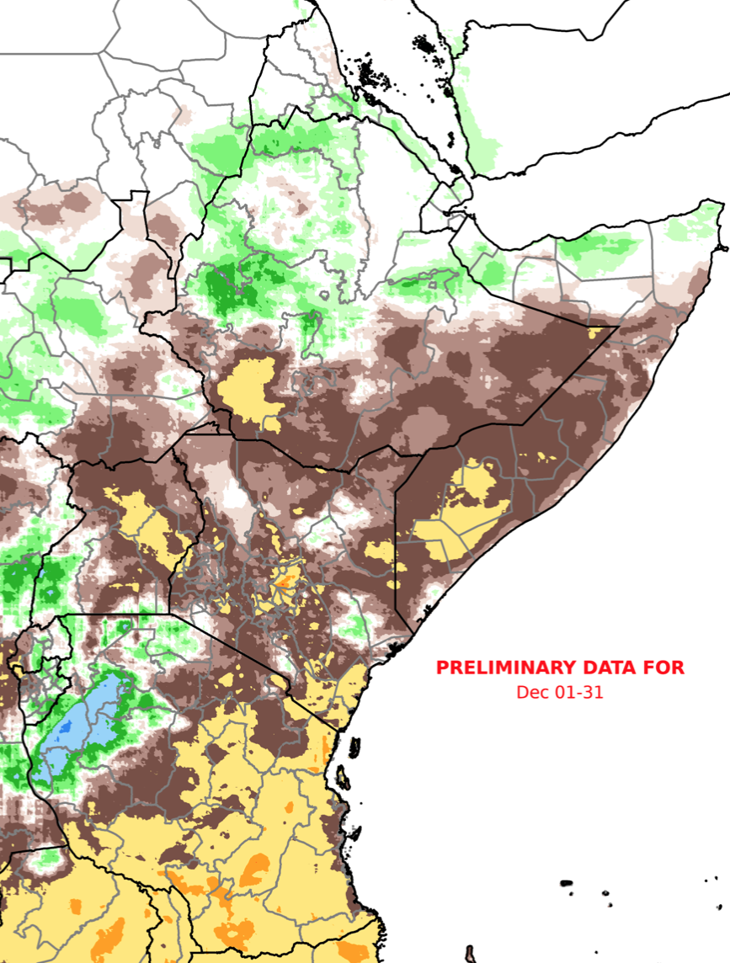
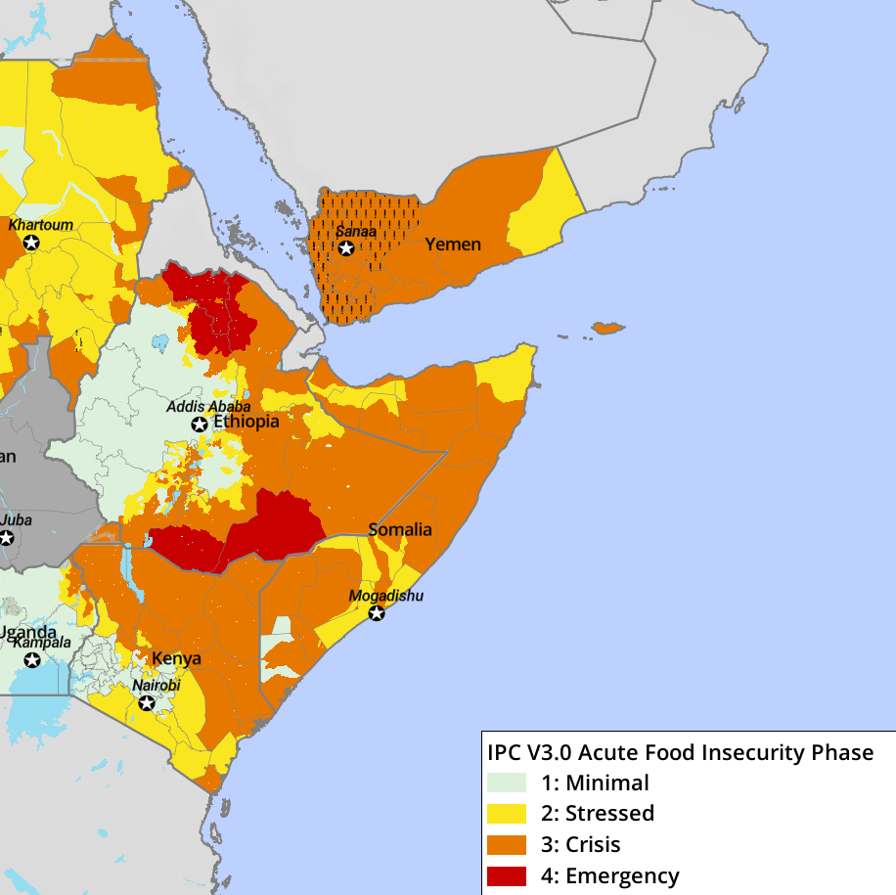
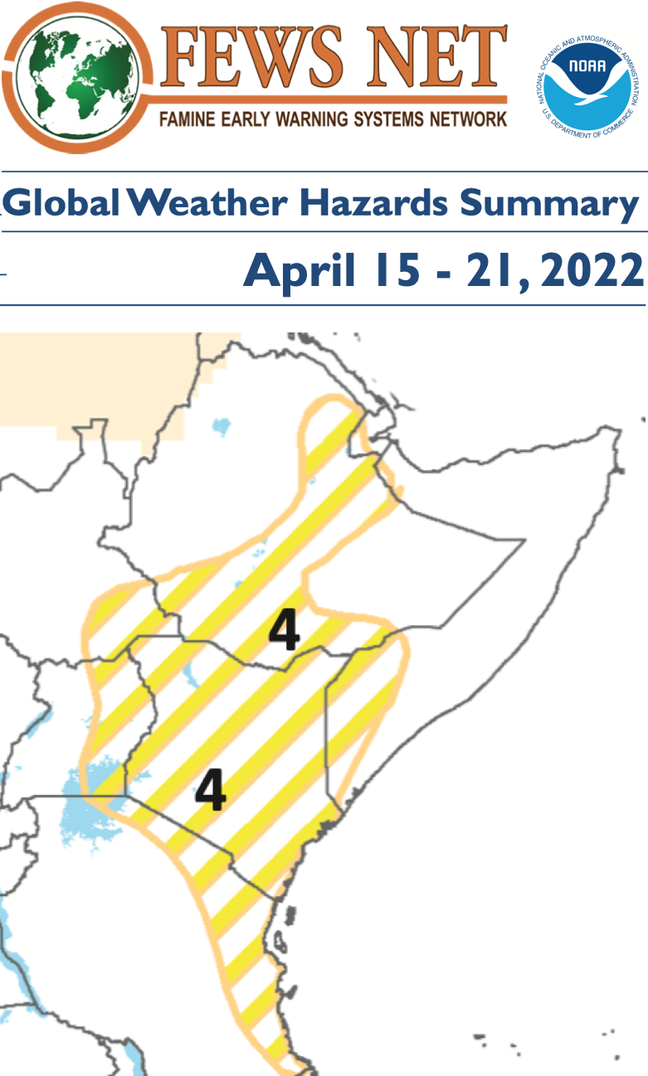

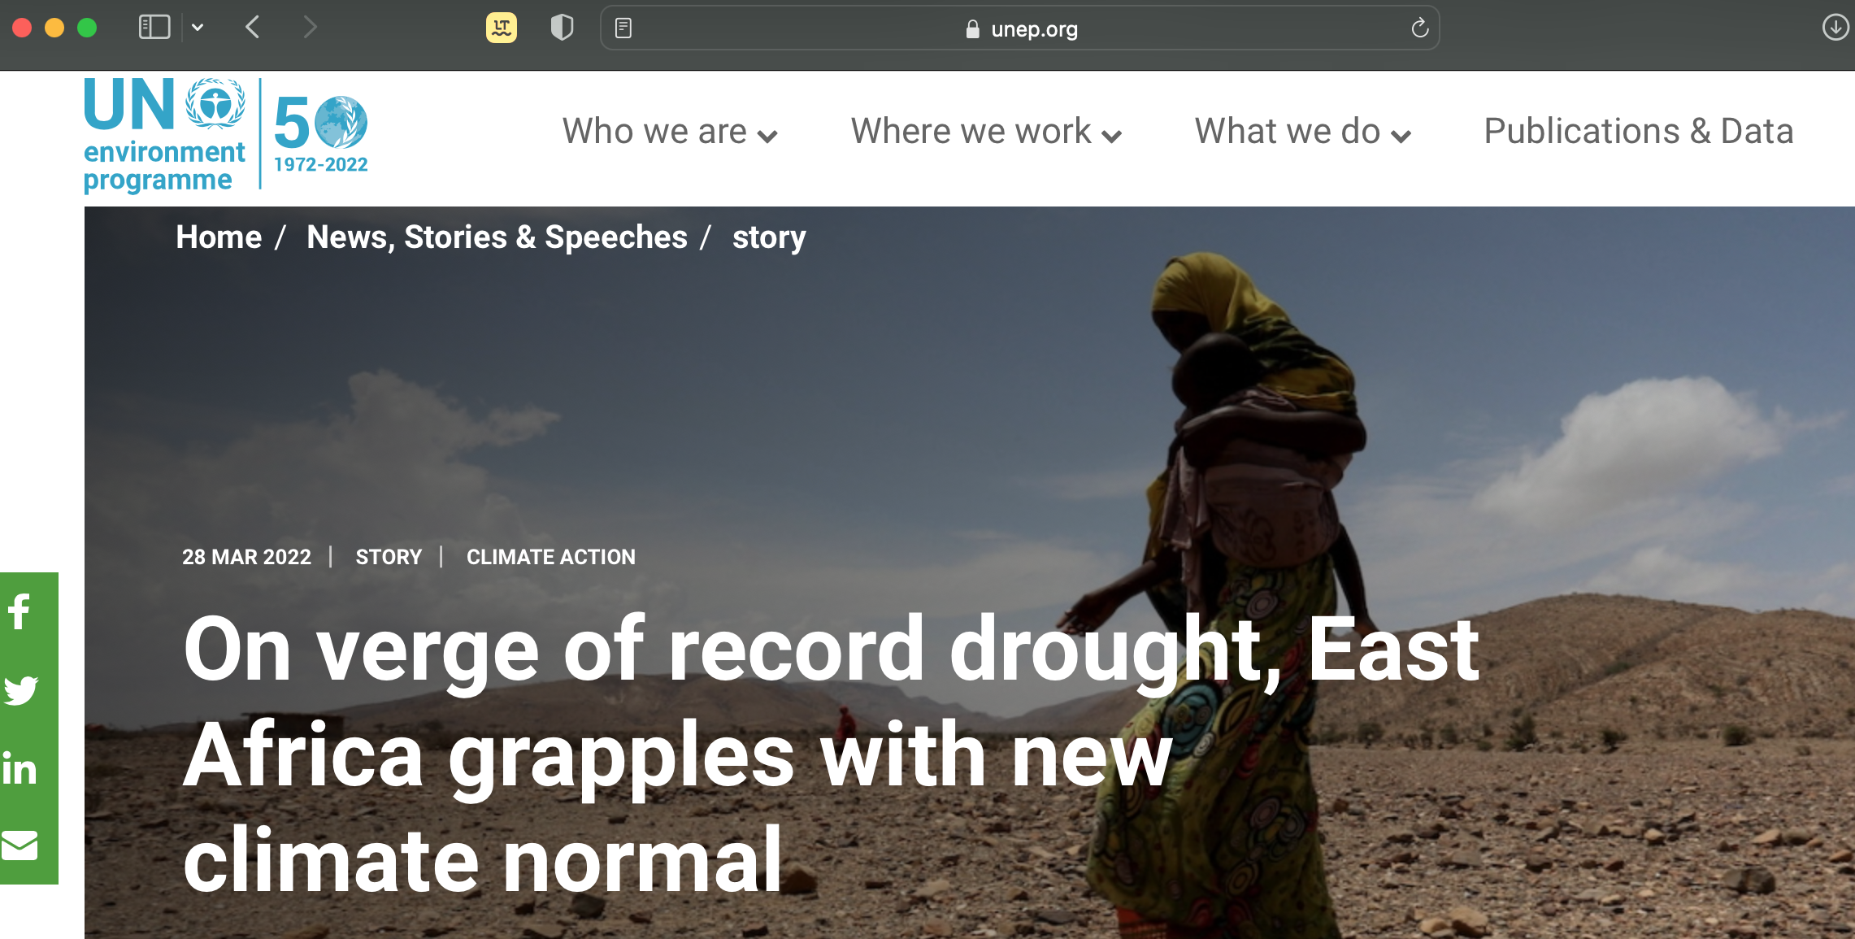

BACKGROUND
RAIN ANOMALY
April 2022
OND 2020
MAM 2021
OND 2021
high
low
'Communities in the Horn of Africa are experiencing one of the most severe droughts in their memory following three poor rainy seasons '
high
low
Projected Food Security May 2022

Slide 4
OBJECTIVE
To analyse changes in land use and their relation to climate
DATA APPROACH
MODIS
Global Dataset of Historical Yield (GDHY, Iizumi and Sakai, 2020)
Standardized Precipitation Evapotranspiration Index (SPEI) (Vicente-Serrano et al., 2010)
self-calibrating Palmer Drought Severity Index (PDSI) (Alley, 1984)
Standard Evapotranspiration Deficit Index (SEDI) (Vicente-Serrano et al.,2018)
To evaluate land use and land cover trends
To analyse the main climate drivers of those changes
To identify trends in the two main food crops (maize and wheat) and relation to climate
To explore if frequently-used drought indices can explain the interannual variability in yield
4

Slide 5
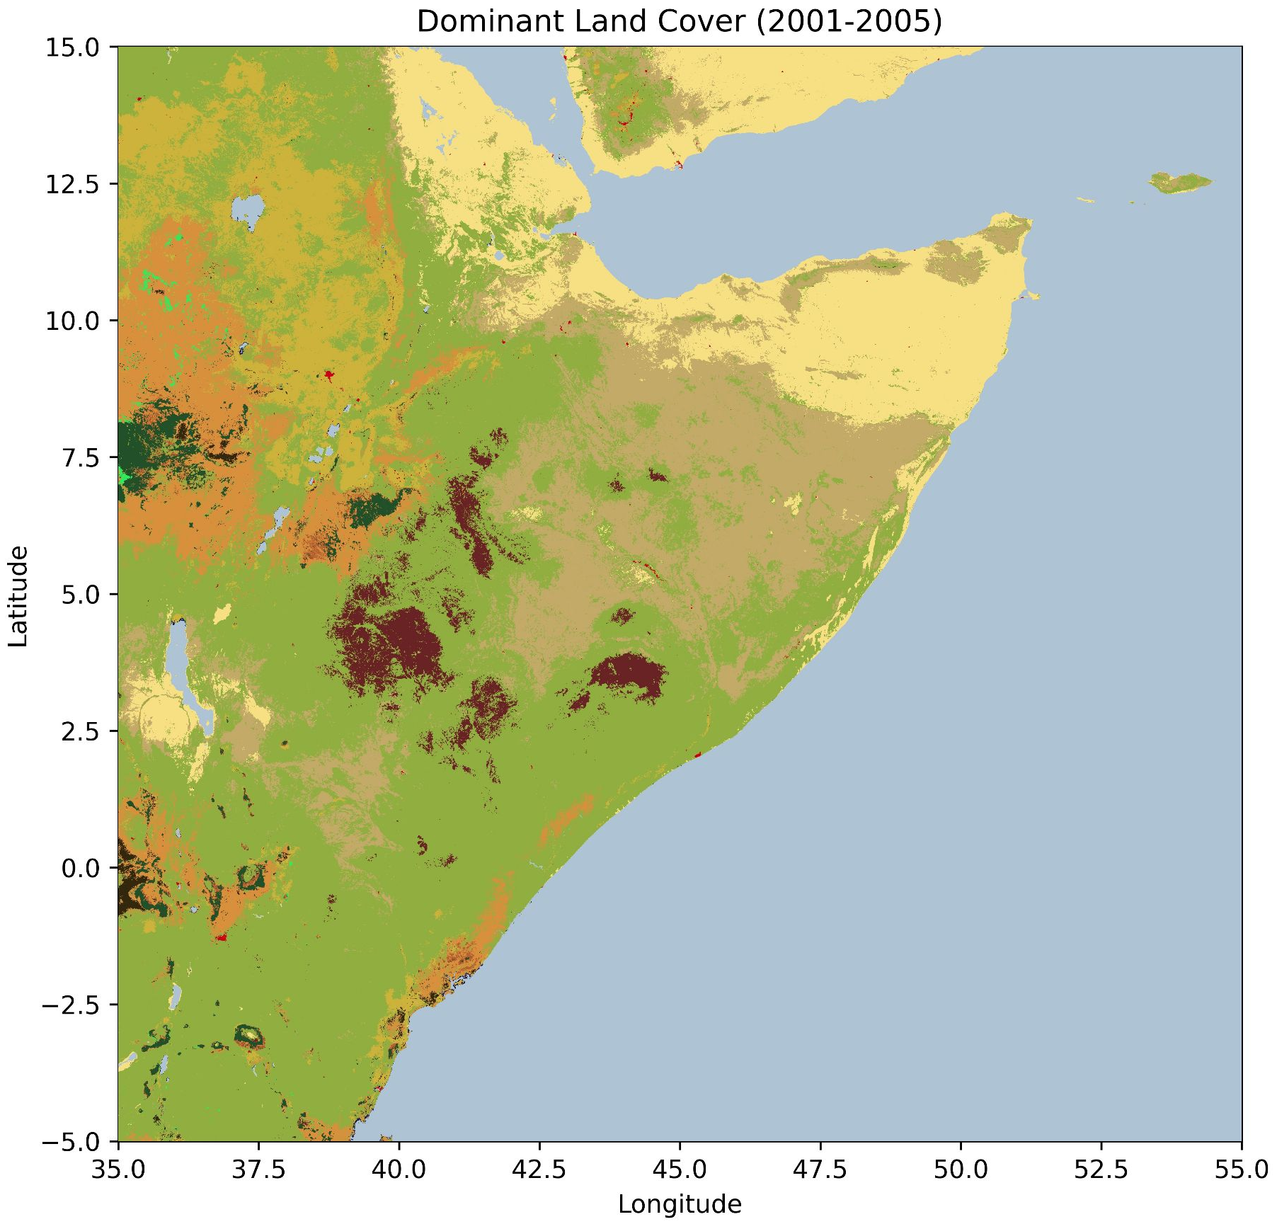
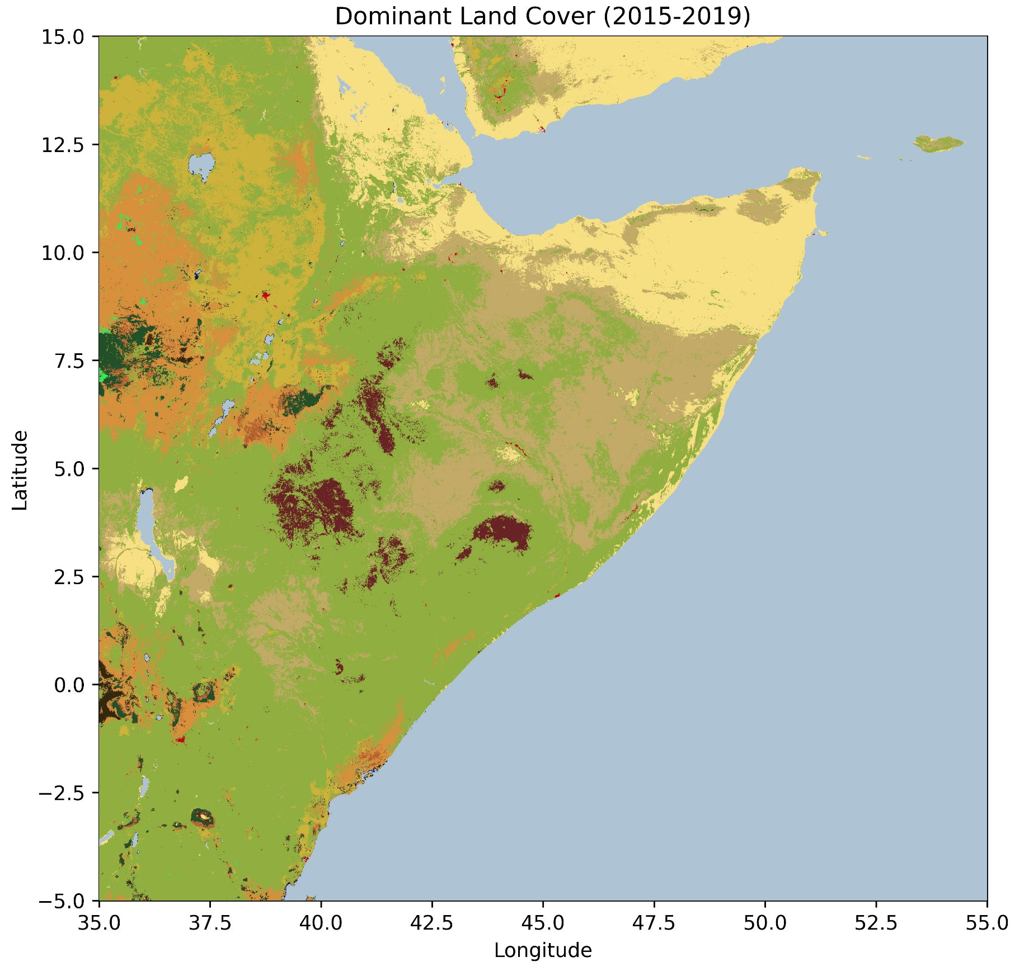
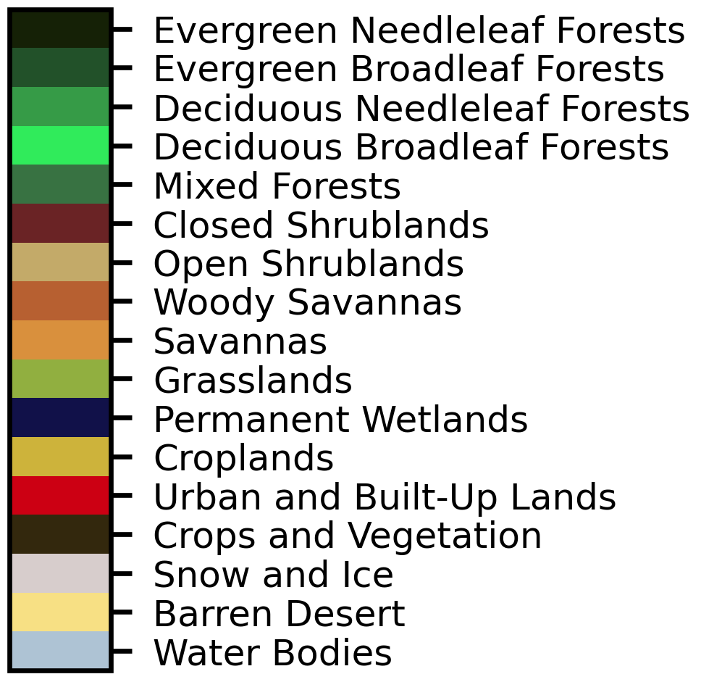
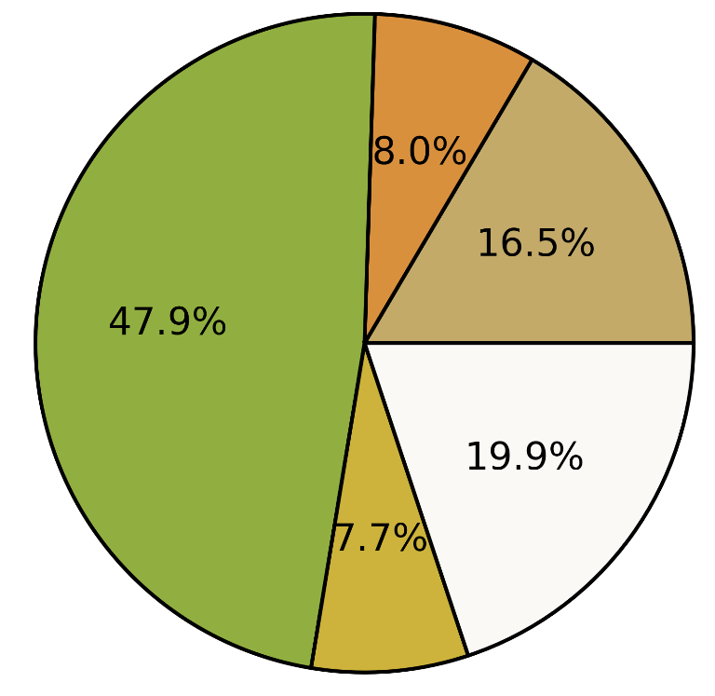

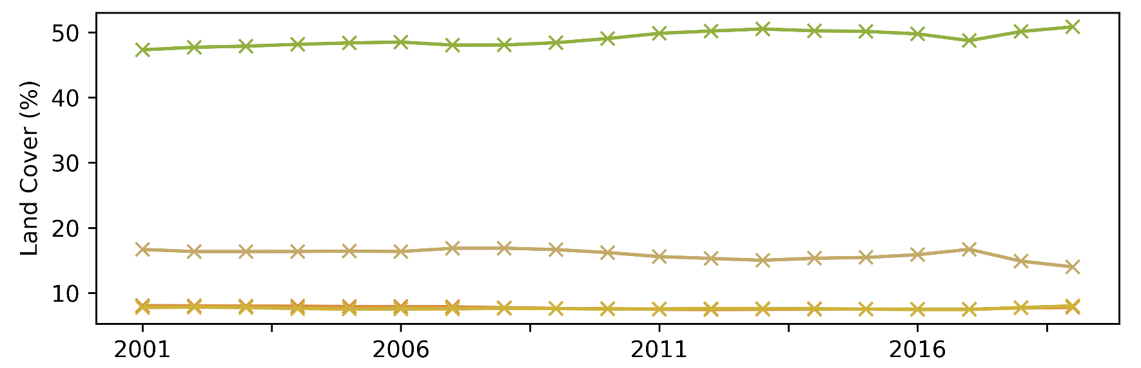
RESULTS
1. Land cover trends
Dominant Land Cover (2001-2005))
Dominant Land Cover (2015-2019))
a
b
c
Increase in grasslands, decrease in shrublands
Croplands widespread throughout the landscape
5

Slide 6
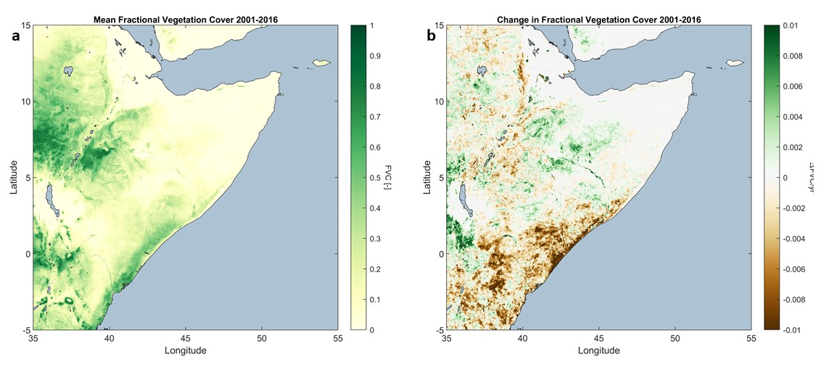
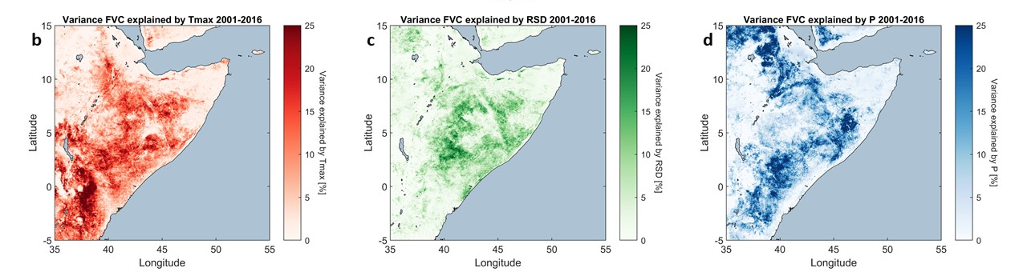
RESULTS
Mean FVC 2001-2016)
Change in FVC 2001-2016)
2. Main climate drivers
Fractional Vegetation Cover (FVC) as target variable
Based on Conditional Spectral Granger Causality (Claessen et al., 2019)
Signs of deforestation
Water availability determining vegetation dynamics
Increasing influence of temperature
Variance FVC explained by Tmax 2001-2016)
Variance FVC explained by RSD 2001-2016)
Variance FVC explained by P 2001-2016)
6

Slide 7
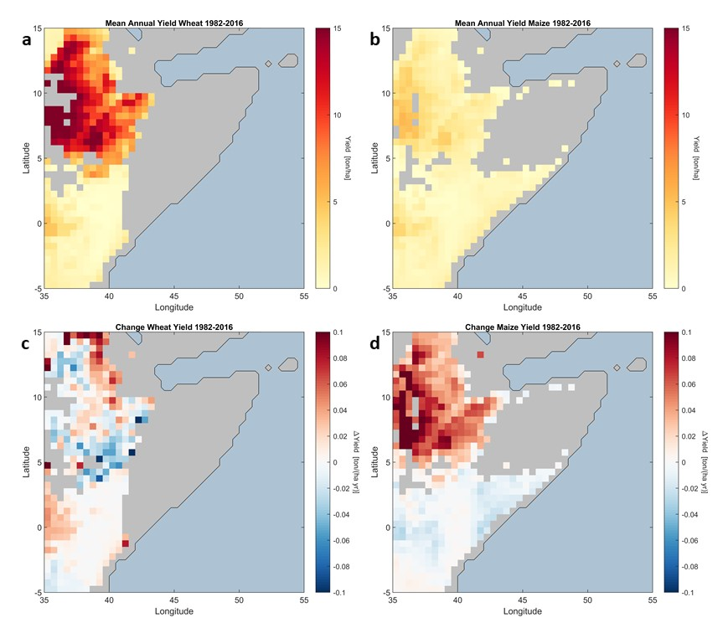


RESULTS
Mean Annual Yield Wheat 1982-2016)
Mean Annual Yield Maize 1982-2016)
3. Trends in crop yield
Increase of Maize yield in Ethiopia and decrease in wheat production
Yield (ton/ha)
Yield (ton/ha)
Change Wheat Yield 1982-2016)
Change Maize Yield 1982-2016)
$∆\text{Yield}\text{ (}\text{ton}\text{/}\text{ha}\text{)}$/yr
$∆\text{Yield}\text{ (}\text{ton}\text{/}\text{ha}\text{)}$/yr
7

Slide 8
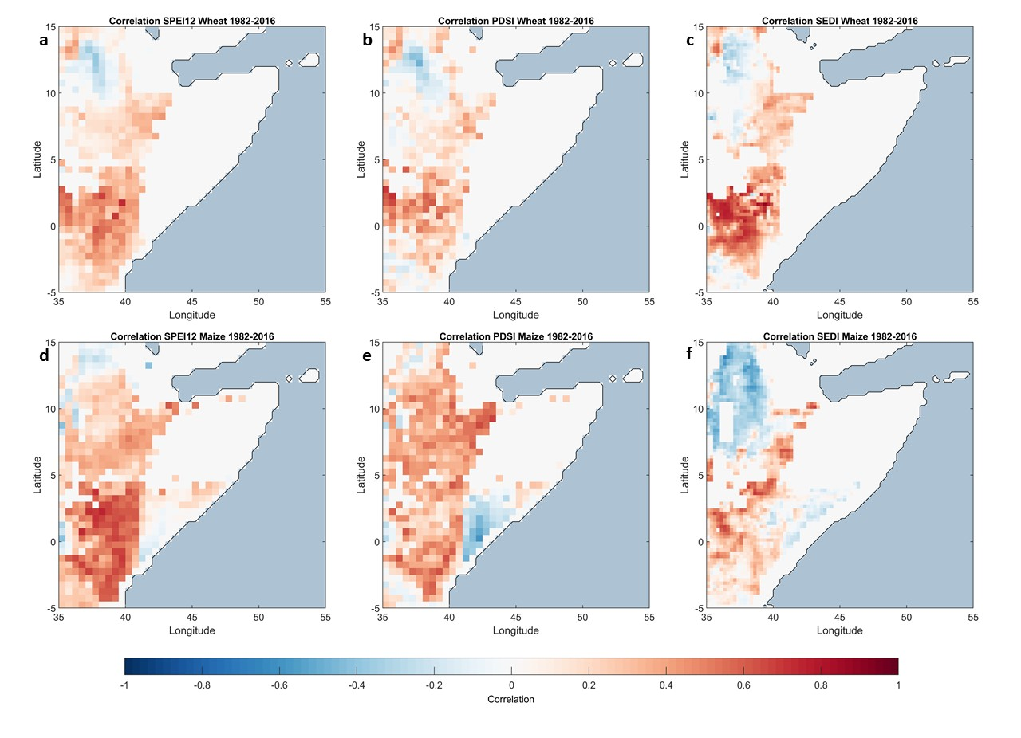
RESULTS
Correlation SPEI12 Wheat 1982-2016)
Correlation PDSI Wheat 1982-2016)
Correlation SEDI Wheat 1982-2016)
4. Drought and yield
SPEI12 seems the drought index that can better predict the inter-annual variance in yield
Kenya shows higher correlation
Correlation SPEI12 Maize 1982-2016
Correlation PDSI Maize 1982-2016)
Correlation SEDI Maize 1982-2016
8

Slide 9
CONCLUSIONS
Steady expansion of grasslands and evidence of deforestation
Rainfall and temperature playing vital role in vegetation dynamics
SPEI12 is the drought index that can better predict the inter-annual variance in yield in the region
9

Slide 10
REFERENCES
Funk, C., Shukla, S., Thiaw, W. M., Rowland, J., Hoell, A., McNally, A., Husak, G., Novella, N., Budde, M., Peters-Lidard, C., Adoum, A., Galu, G., Korecha, D., Magadzire, T., Rodriguez, M., Robjhon, M., Bekele, E., Arsenault, K., Peterson, P., … Verdin, J. (2019). Recognizing the Famine Early Warning Systems Network: Over 30 Years of Drought Early Warning Science Advances and Partnerships Promoting Global Food Security. Bulletin of the American Meteorological Society, 100(6), 1011–1027. https://doi.org/10.1175/BAMS-D-17-0233.1
Wainwright, C. M., Marsham, J. H., Keane, R. J., Rowell, D. P., Finney, D. L., Black, E., & Allan, R. P. (2019). ‘Eastern
African Paradox’ rainfall decline due to shorter not less intense Long Rains. Npj Climate and Atmospheric Science,
2(1), 1–9. https://doi.org/10.1038/s41612-019-0091-7
10

