Slide 1
Mapping subsidence in Lagos, Nigeria with Sentinel-1A/B Satellite Radar
Joel Johnson, Kristy Tiampo, Mike Willis, Eduard Heijkoop, Steve Nerem
Cooperative Institute for Research in Environmental Sciences at the University of Colorado Boulder

Slide 2
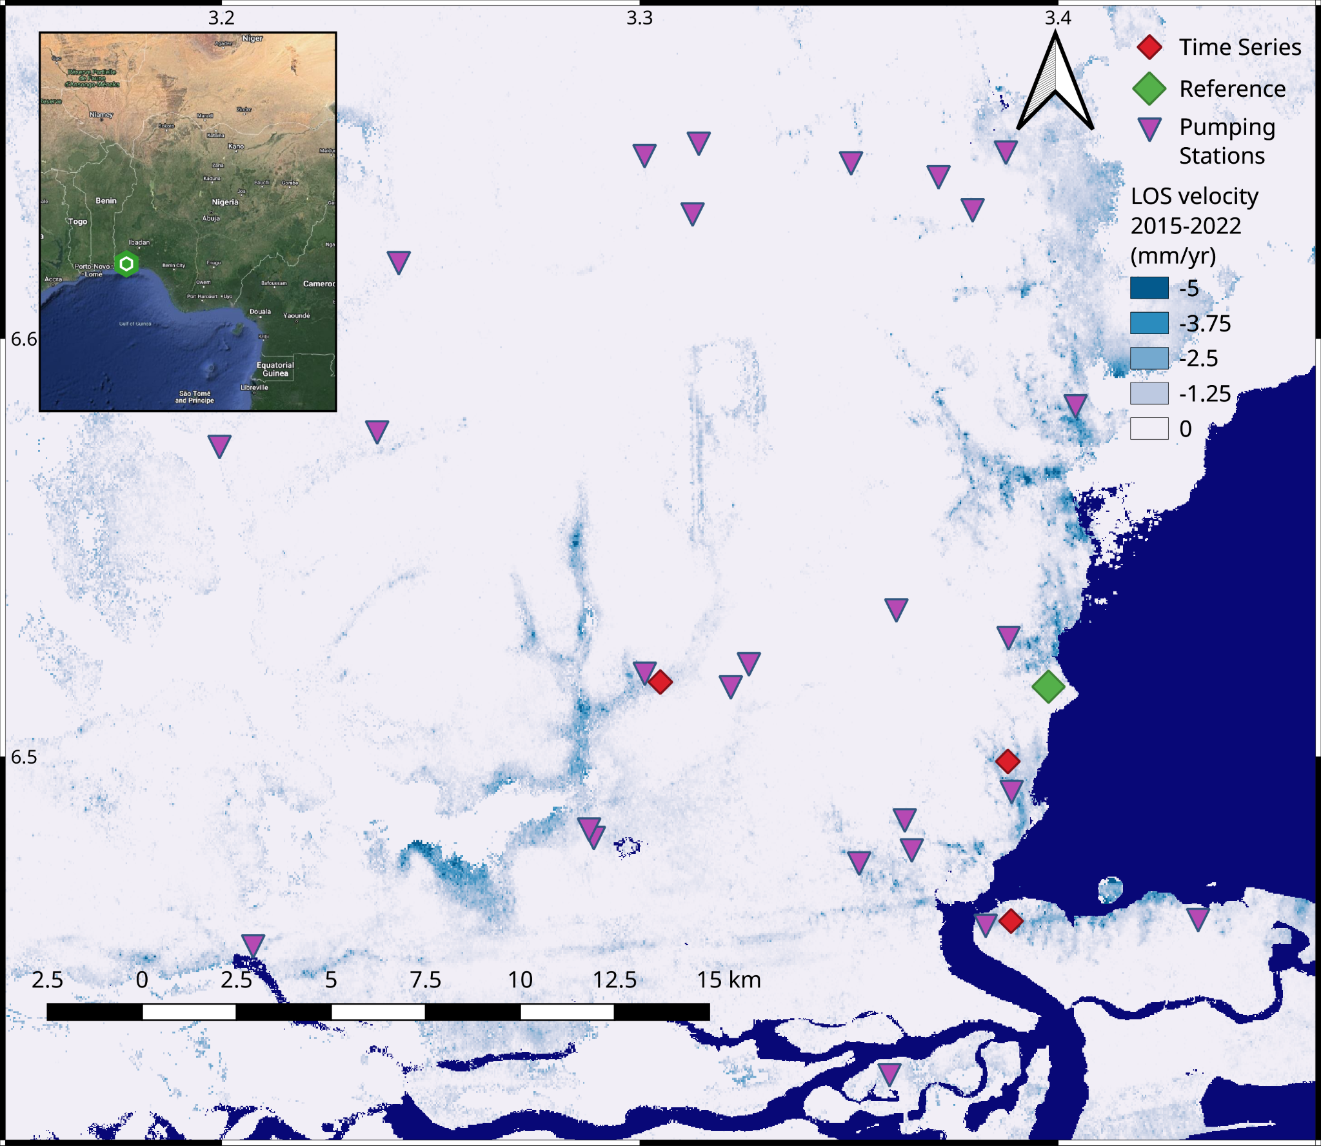
Methodology and initial velocity results:
ISCE topsStack Processor and MintPy software.
Processed with 9 by 3 multilooks in range and azimuth.
Maximum scene LOS value is 1.7 mm/yr
Minimum is -10.2 mm/yr.
Current pixel spacing 40x49 meters
Notes:
Line of Sight motion in mm/yr from April 2015 – April 2022 in Lagos, Nigeria. Motion was calculated using Sentinel 1A, Path 1, Tracks 16 and 1200. The map’s reference point is displayed by the green diamond. Pumping station locations are from Balogun et al. 2016, displayed in purple triangles.

Slide 3
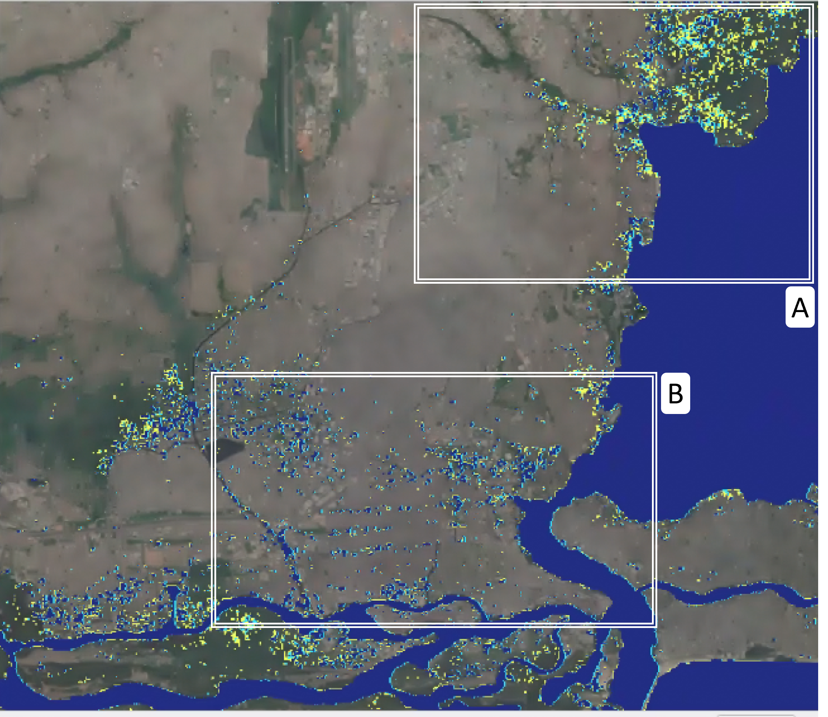
Initial Subsidence Inundation estimates
Subsidence Inundation
Does NOT include
IPCC SLR change rates:
Year 2055
RCP 2.6: 0.26(0.18-0.34)
RCP 4.5: 0.27 (0.19-0.36)
RCP 8.5: 0.33 (0.24-0.43)
Year 2055
Year 2090
Notes:
The subsidence rates are projected forward in time and resampled on a high-resolution topographic model. We then model the inundated area due to increasing sea levels, various storm surge heights, and land subsidence

Slide 4
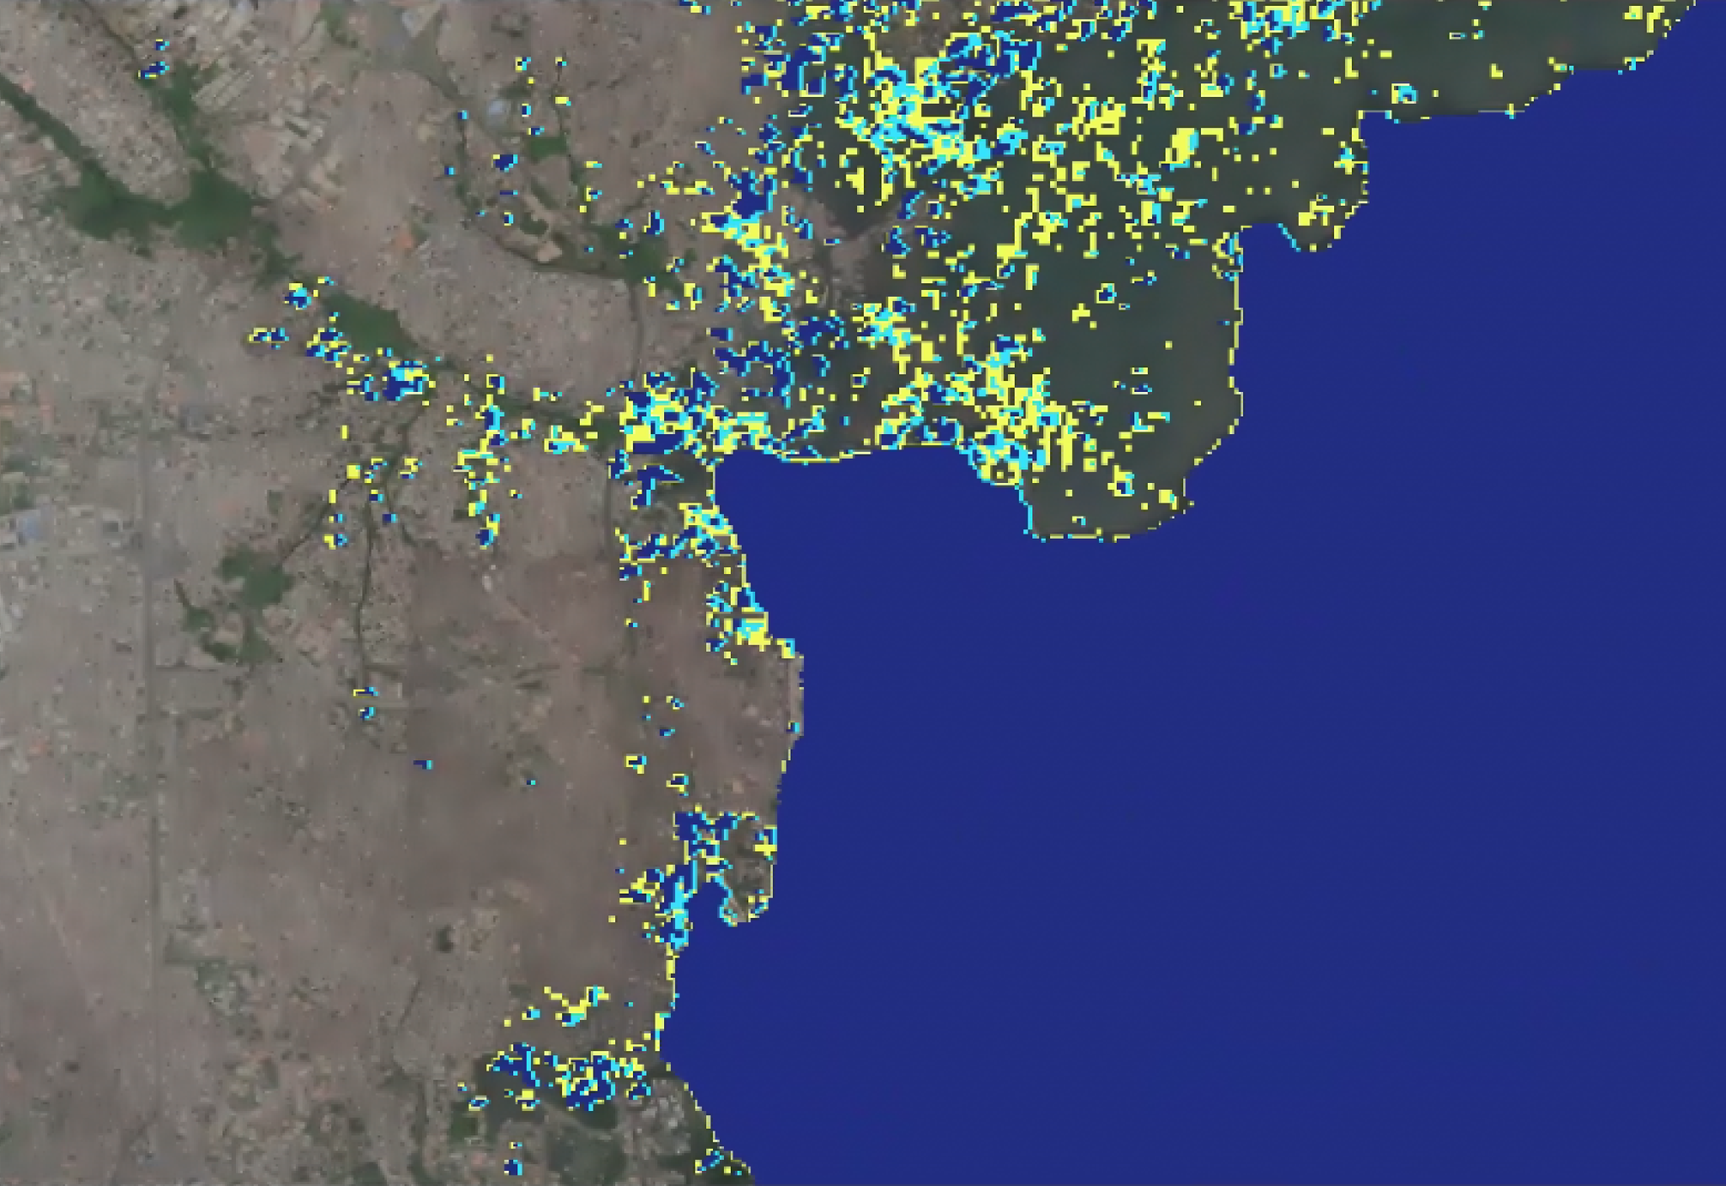
Initial Subsidence Inundation estimates
A
Subsidence Inundation
Year 2055
Year 2090

Slide 5
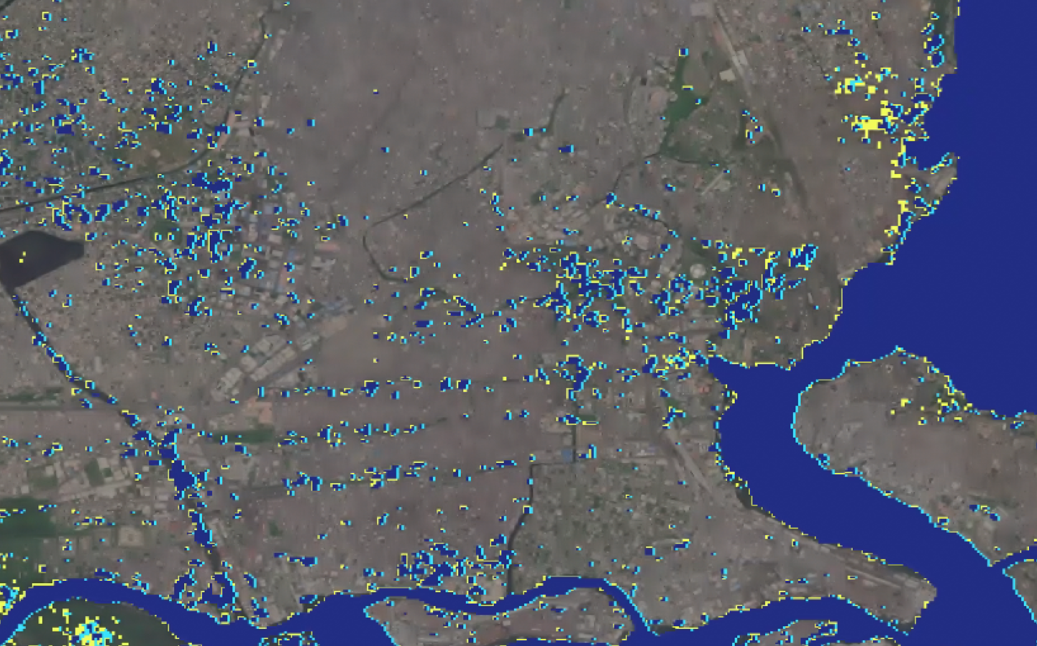
Initial Subsidence Inundation estimates
B
Subsidence Inundation
Year 2055
Year 2090

Slide 6
For questions: email joel.johnson@colorado.edu
Thank you!

