Slide 1

Effects of injection parameters on fault response under spatially homogenous and heterogenous pore-fluid conditions
Riddhi Mandal¹, Semechah Lui¹
¹University of Toronto

Slide 2
Introduction
Fluid injection can perturb the stress state in continental interiors enough to cause earthquakes
Fluid injection causes variety of effects on fault slip, such as advancing and delaying earthquakes, causing aseismic slip and triggering earthquakes during the injection activity.
Energy released due to injection is predominantly aseismic and aseismic transients can mediate future earthquakes.
Our current work is to advance the rate and state based fault slip model to incorporate spatially variable pore pressure

Slide 3
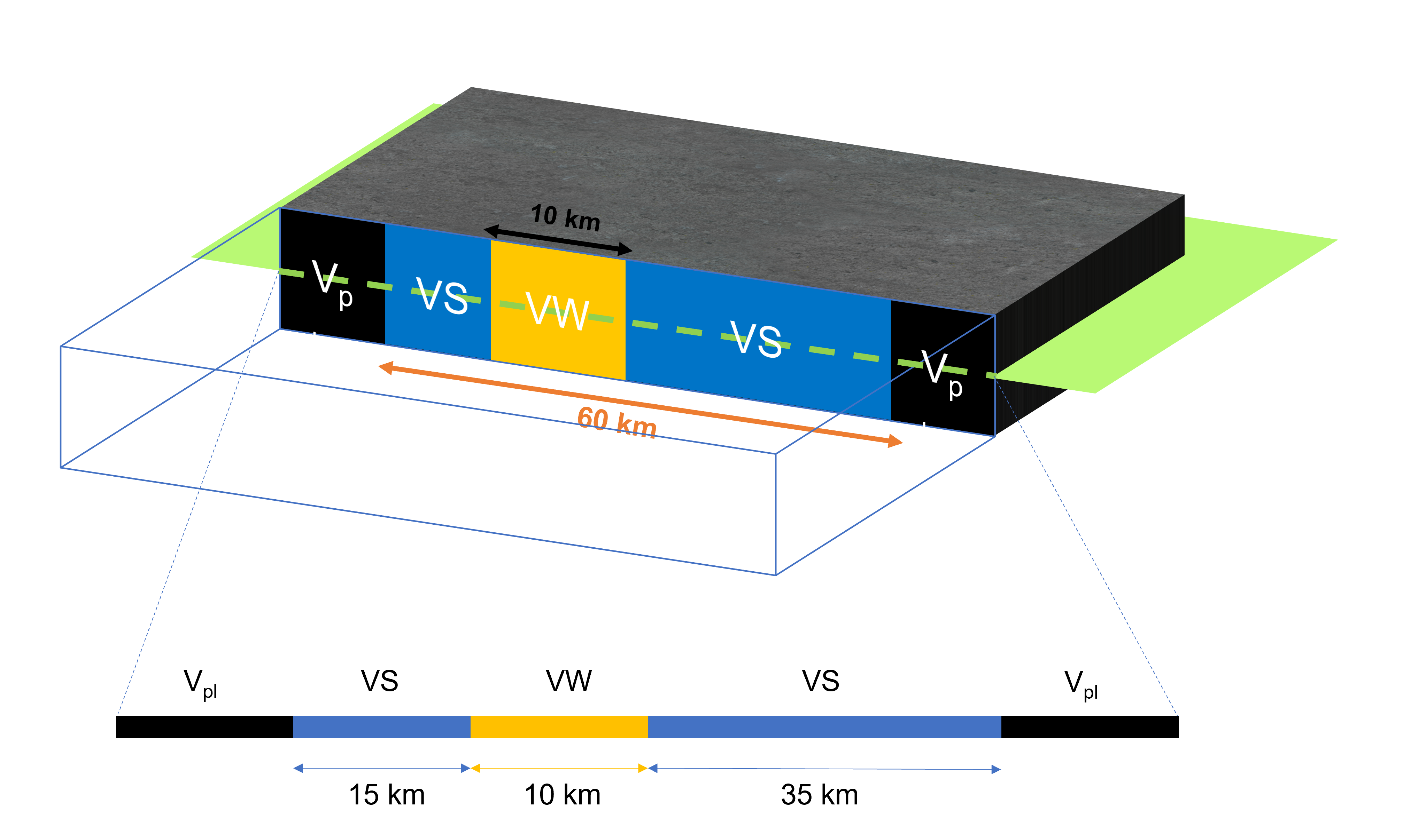

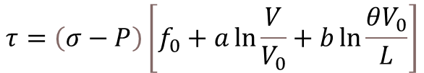
Model
Boundary Integral Method
Stress equation:
Rate-and-state law:
$$τ=τ_{0}+F\left(δ\right)−\frac{μ}{2c}V$$
$$τ=\left(σ−P\right)\left[f_{0}+a\ln{\frac{V}{V_{0}}}+b\ln{\frac{θV_{0}}{L}}\right]$$

Slide 4
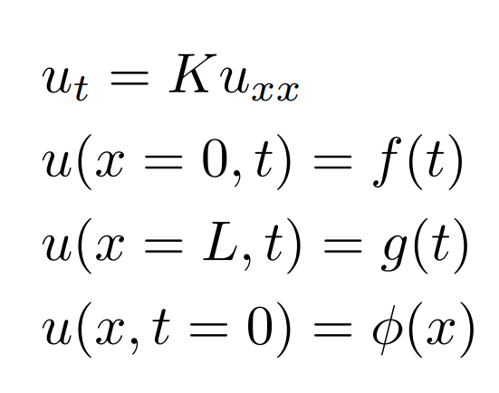
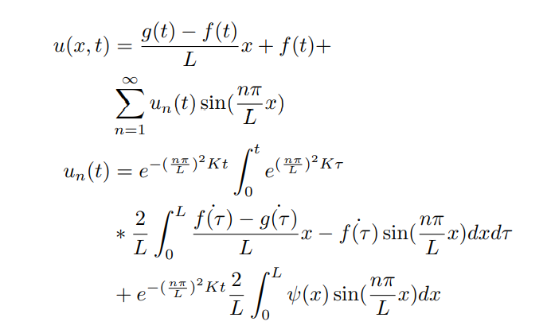
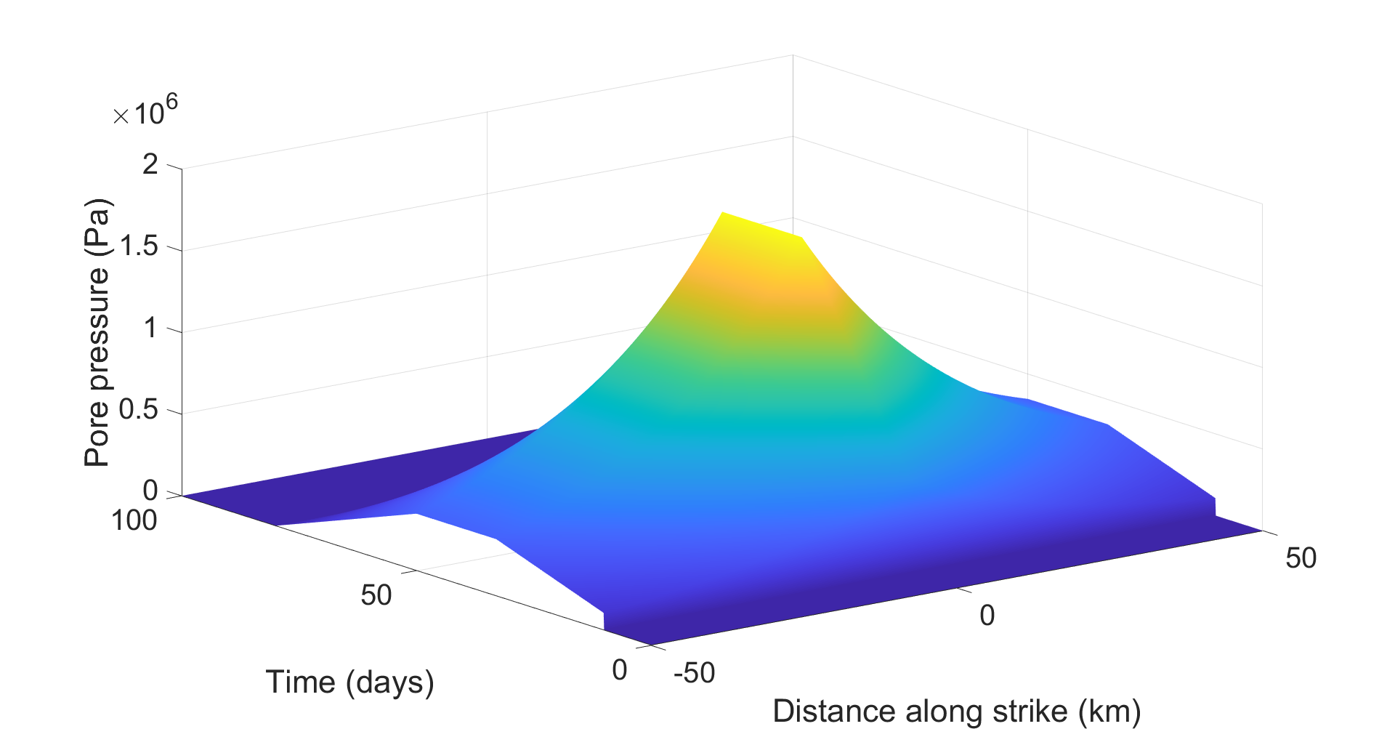


Pore pressure diffusion
P=u
Initial and boundary conditions set up
Solutions
Best fit function
$$u\left(x,t\right)=X\left(x\right)T(t)$$
$$τ=\left(σ−P\right)\left[ε_{0}+a\ln{\frac{V}{V_{0}}}+b\ln{\frac{θV_{0}}{L}}\right]$$
Spatially and temporally varying pore pressure

Slide 5
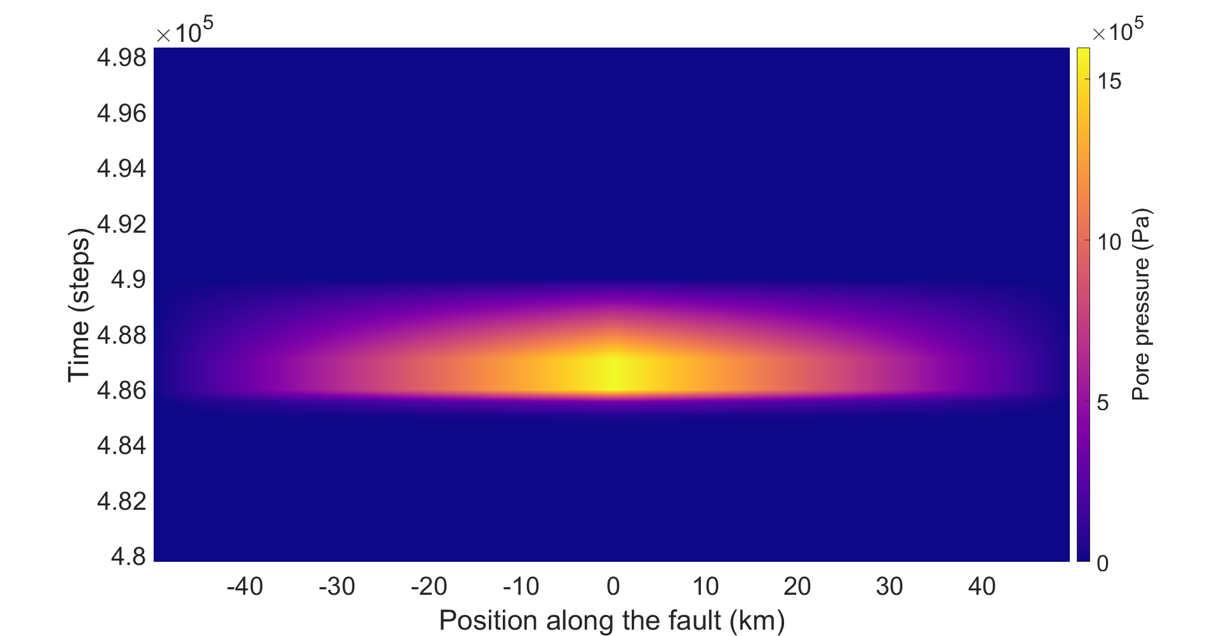
Pore pressure evolution (P_{max}=1.6 MPa)
VS
VW
VS
VS
VW
VS
VS
VW
VS

Slide 6
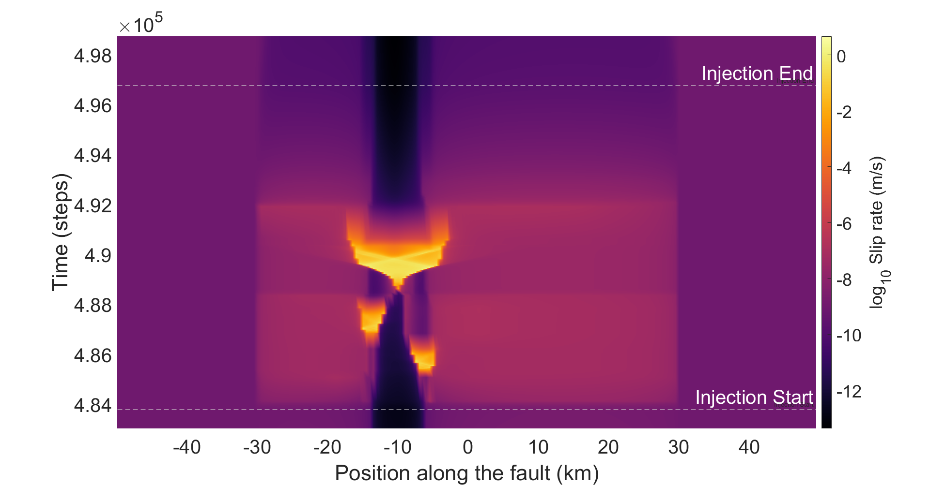
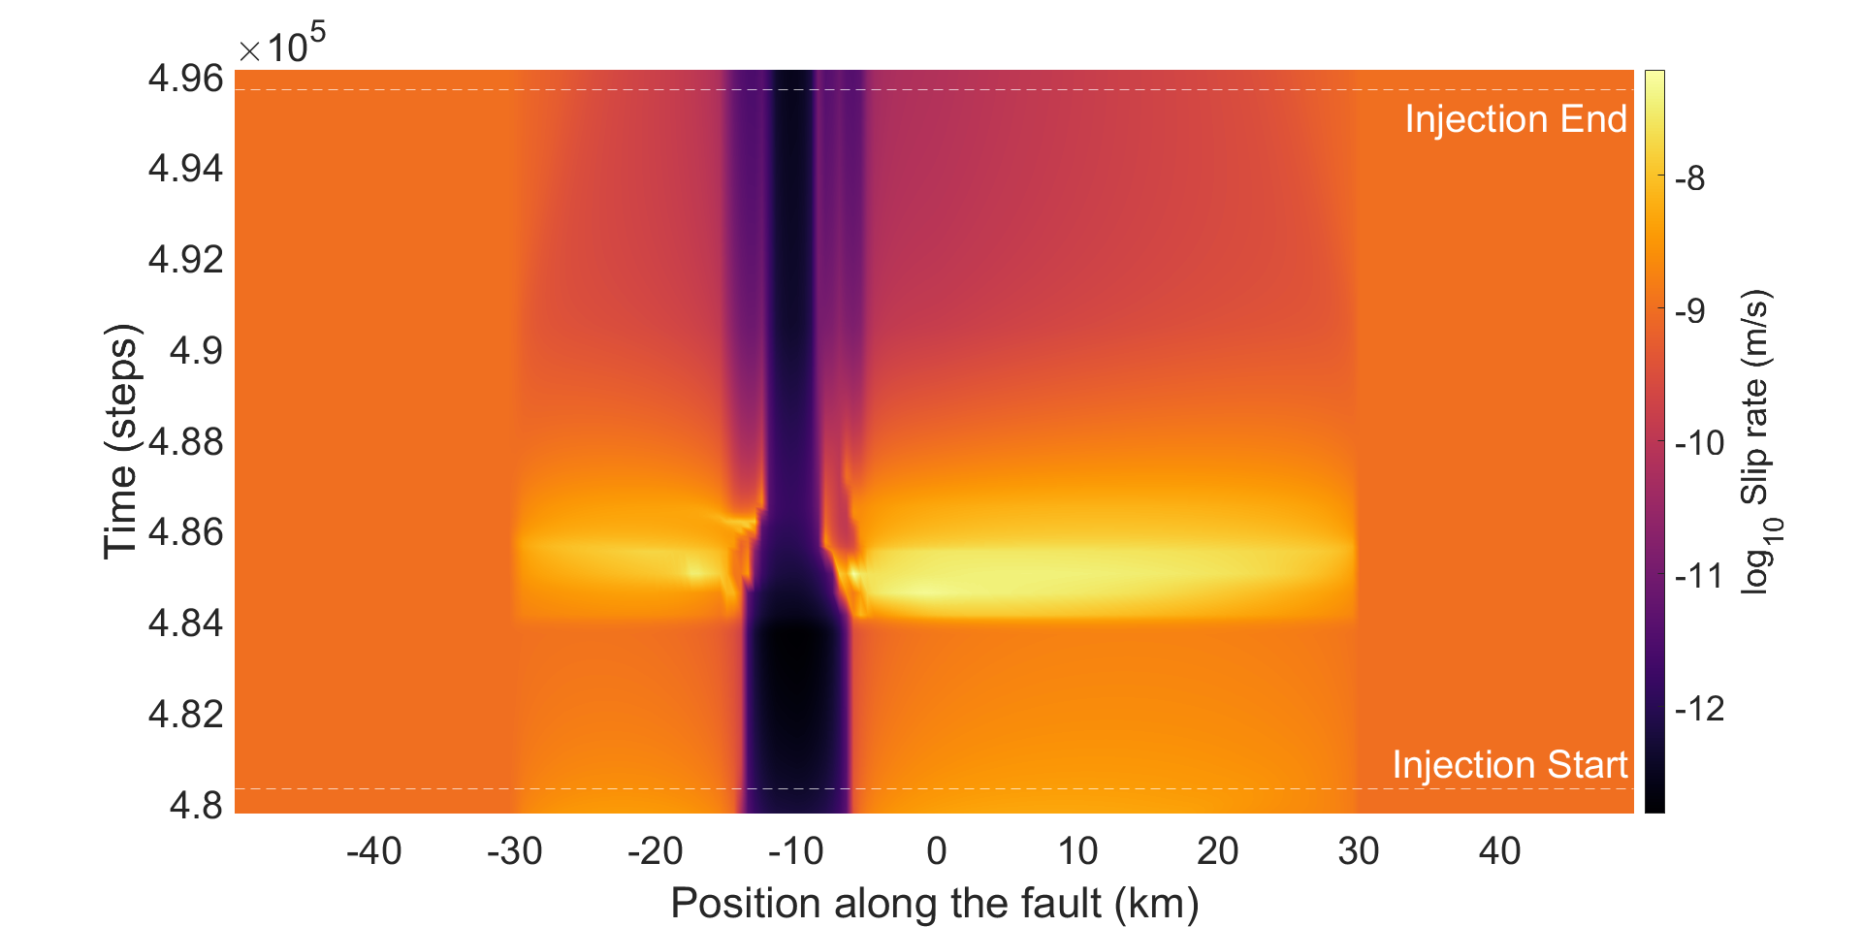
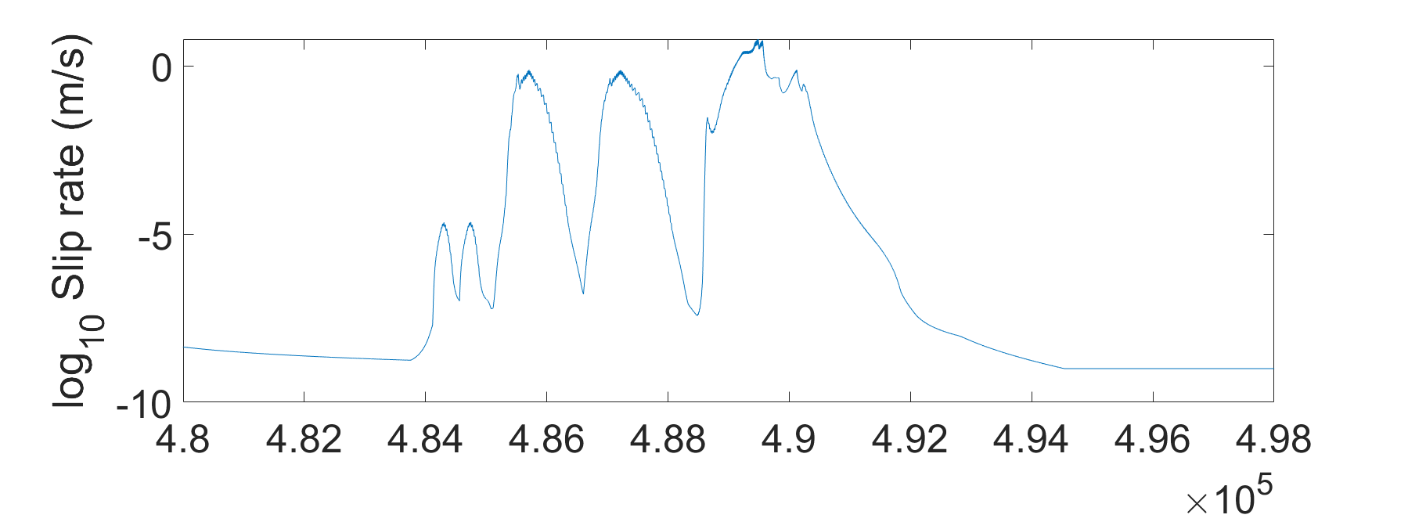
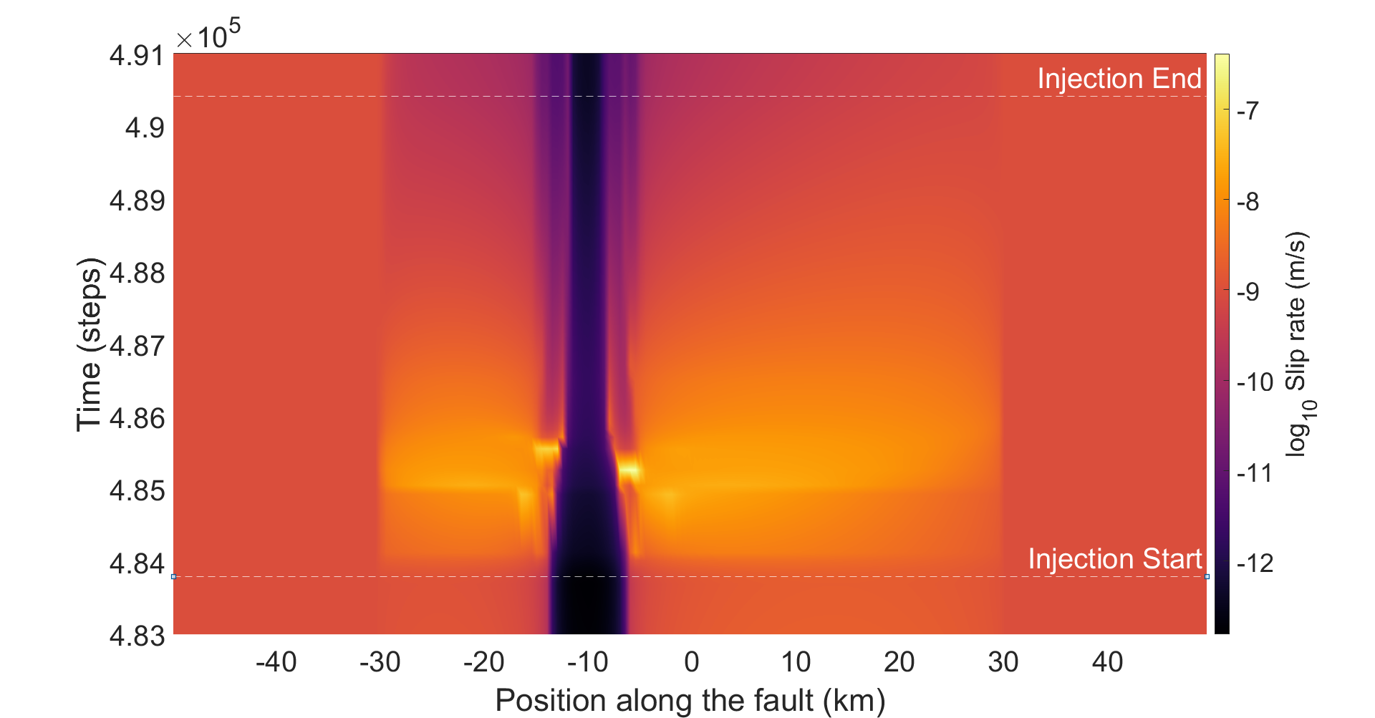
Slip rate (P_{max}=1.6 MPa)
VS
VW
VS
VS
VW
VS
VS
VW
VS

Slide 7
Summary & Future work
We have implemented a spatiotemporally variable pore pressure diffusion over a fault at different injection locations
Slip pattern is sensitive to the location and amount of pore pressure perturbation at every point. Earthquake triggering depends highly on the triggering threshold of the fault.
Apart from triggering mechanisms such as direct pore pressure change, triggering through aseismic stress change, we also observe a cascading effect where triggering of one earthquake triggers subsequent earthquakes
Our ongoing work is focusing on quantifying these different triggering mechanisms and how injection parameters like injection rate and volume affect the triggering conditions.

