Slide 1
Novel methane emission estimation method for ground based remote sensing networks
Dr. rer. nat. Friedrich Klappenbach

Slide 2
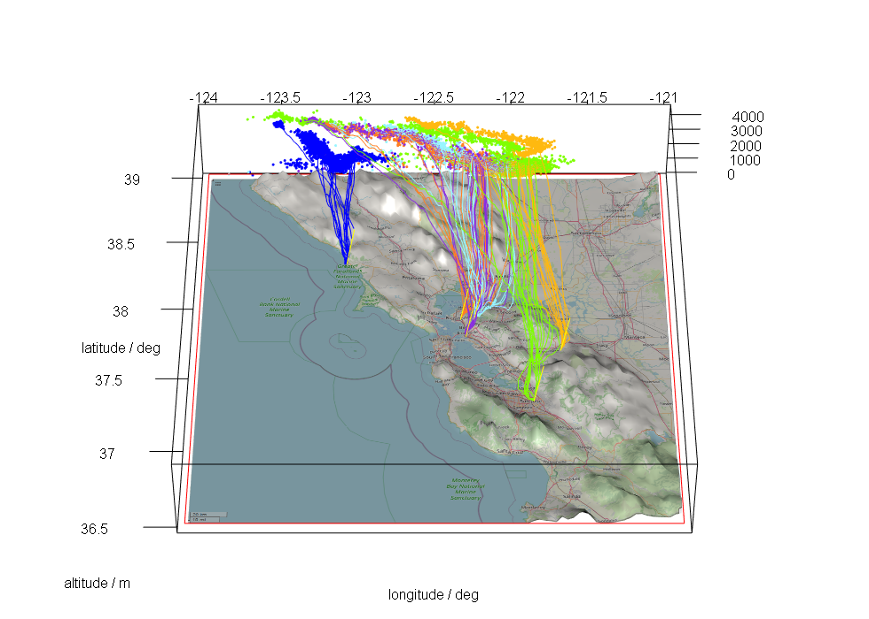






Novel methane emission estimation method for ground based remote sensing networks
EGU22-10604
$$y=b+e$$
Notes:
Not present in person – hungry for your thoughts, email
This work collaboration of KIT, University of Berkley, Berkley lab, Caltech and our collogues from Harvard
Data from campaign in 2016 SFBA
You see 6 sites and the STILT calculated trajectories here
Typical assessments to infer emissions from observations
Several ways to do this – observed background

Slide 3
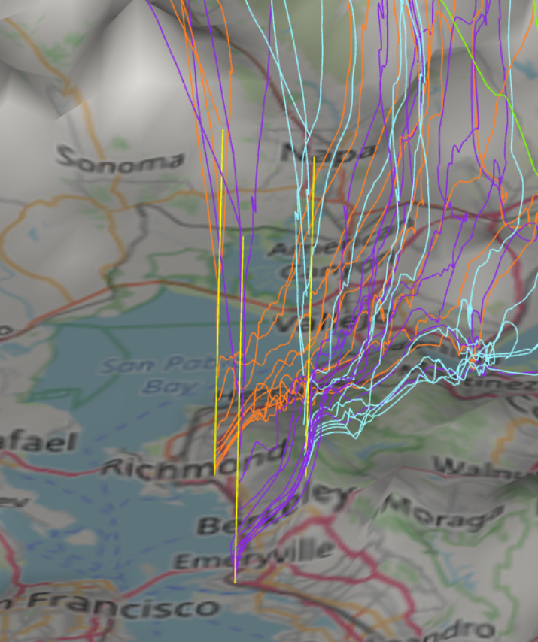
Novel methane emission estimation method for ground based remote sensing networks
EGU22-10604
$$y=b+e$$
Notes:
You see the close up of 3 sites
Line of sight in yellow
Trajectories pass by

Slide 4
wind
STILT [2] trajectory
line of sight
receptor point [1]
Exapmples of mass balance approaches:
Chen et al. 2016: “Differential column measurements using compact solar-tracking spectrometers”
Makarova et al. 2020: “Emission Monitoring Mobile Experiment (EMME): an overview and first results of the St. Petersburg megacity campaign-2019”
EM27/SUN FTS instrument
Downwind site (dw)
Upwind site (uw)
[1] T.S. Jones et al. 2021: “Assessing Urban Methane Emissions Using Column-Observing Portable Fourier Transform Infrared (ftir) Spectrometers and a Novel Bayesian Inversion Framework”
[2] B.Fasoli et al. 2018: “Simulating atmospheric tracer concentrations for spatially distributed receptors: updates to the Stochastic Time-Inverted Lagrangian Transport model's R interface (STILT-R version 2)”

Slide 5
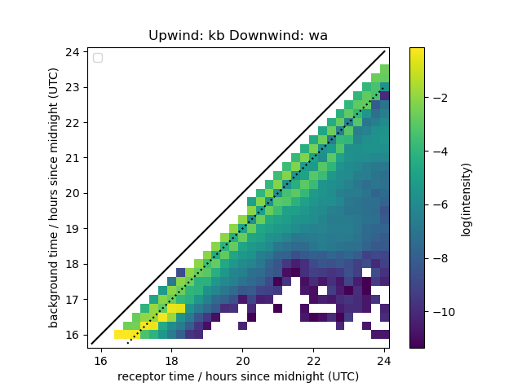
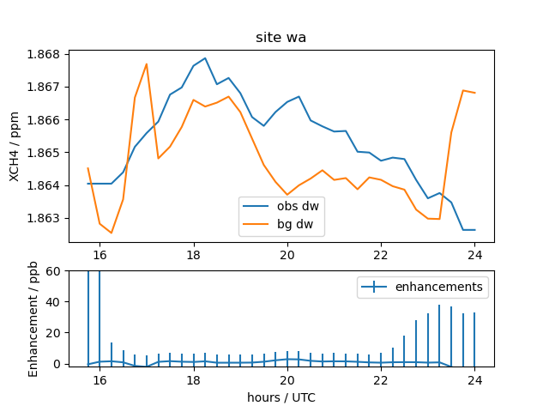


Upwind Influence Matrix UIM
uw – upwind
dw – downwind
$$y_{dw}=My_{uw}+e_{dw}+ε$$
$${e_{dw}=y}_{dw}−My_{uw}+ε$$
See: Background Influence Matrix in
T.S. Jones et al. 2021: “Assessing Urban Methane Emissions Using Column-Observing Portable Fourier Transform Infrared (ftir) Spectrometers and a Novel Bayesian Inversion Framework”

Slide 6

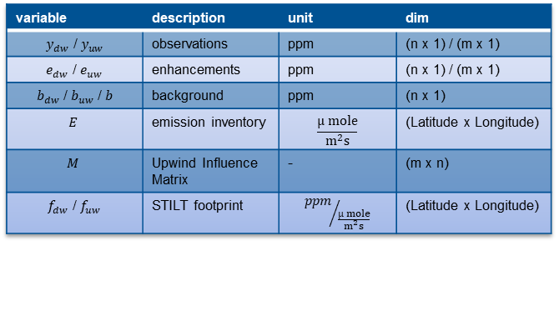

Which emission area the enhancements should be attributed to?
$$y_{dw}=b_{dw}+e_{dw}= b_{dw}+Ef_{dw}$$
dw
$$f_{dw}$$
variable | description | unit | dim
$y_{dw}$ / $y_{uw}$ | observations | ppm | (n x 1) / (m x 1)
$e_{dw}$ / $e_{uw}$ | enhancements | ppm | (n x 1) / (m x 1)
$b_{dw}$ / $b_{uw}$ / $b$ | background | ppm | (n x 1)
$$E$$ | emission inventory | $$\frac{µ mole}{m^{2}s}$$ | (Latitude x Longitude)
$$M$$ | Upwind Influence Matrix | - | (m x n)
$f_{dw}$ / $f_{uw}$ | STILT footprint | $${ppm}/{\frac{µ mole}{m^{2}s}}$$ | (Latitude x Longitude)
Notes:
STILT calculates footprints – surface interaction
Multiplication with an LAT-LON inventory → Enhancements

Slide 7




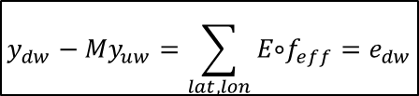
Which emission area the enhancements should be attributed to?
$$y_{dw}=b_{dw}+e_{dw}= b_{dw}+Ef_{dw}$$
$$y_{uw}=b_{uw}+e_{uw}= b_{uw}+Ef_{uw}$$
dw
uw
$$b_{dw}=b_{uw}=b$$
$$f_{dw}$$
$$f_{uw}$$
variable | description | unit | dim
$y_{dw}$ / $y_{uw}$ | observations | ppm | (n x 1) / (m x 1)
$e_{dw}$ / $e_{uw}$ | enhancements | ppm | (n x 1) / (m x 1)
$b_{dw}$ / $b_{uw}$ / $b$ | background | ppm | (n x 1)
$$E$$ | emission inventory | $$\frac{µ mole}{m^{2}s}$$ | (Latitude x Longitude)
$$M$$ | Upwind Influence Matrix | - | (m x n)
$f_{dw}$ / $f_{uw}$ | STILT footprint | $${ppm}/{\frac{µ mole}{m^{2}s}}$$ | (Latitude x Longitude)
$$y_{dw}−{My}_{uw}=\sum_{lat,lon}{E\text{∘}f_{eff}}=e_{dw}$$
$$f_{eff}=\left\{\begin{matrix}f_{dw}−f_{uw} | \left(f_{dw}−f_{uw}\right)>0 \\ 0 \end{matrix}\right.$$
Notes:
Upwind footprint has similar conditions and shape
It is assumed, that they are roughly the same in the far-field.
Analog to the observations I substract the upwind footprot from the dw-fp
Negatieve Footprints are non-physical (negative interaction) and set 0
Remains the positive fraction as effective footprint – the source region of the enhancements

Slide 8
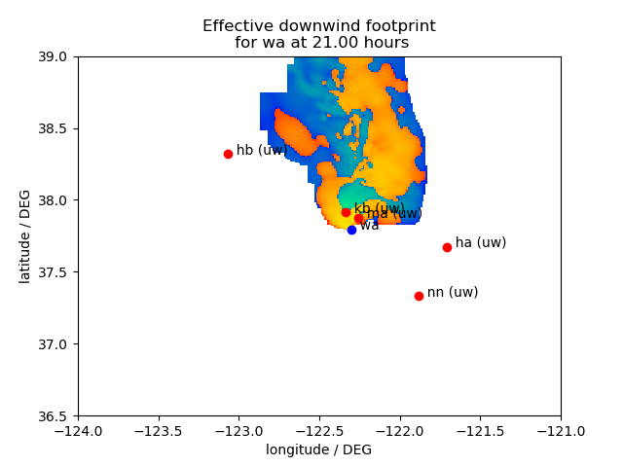
Notes:
Example of such a footprint – note, log-plot
DW site in blue
Upwind sites of network
Negative footprint in cold colors
Positive in warm.

Slide 9
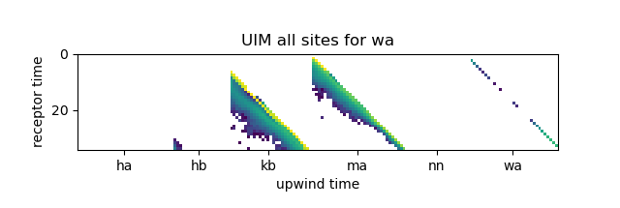
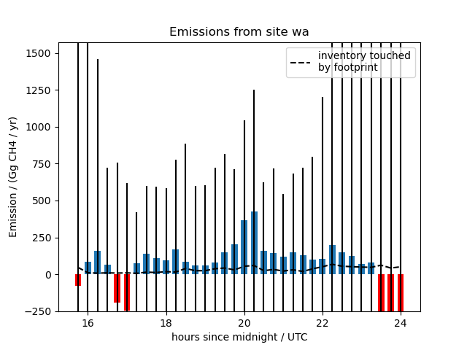
First results from San Francisco Campaign 2016
BAAQMD [3]
[3] Fischer, M. L. et al. 2016: “Evaluating the Bay Area methane emission inventory, BAAQMD Report (2014-108)”. Available at http://www.baaqmd.gov/~/media/files/planning-and-research/emission-inventory/baaqmd-2014-108-sfba-ch4-emissions_20160330pdf.pdf?la=en
Notes:
Full upwind influence matrix with two major upwind contributors
Enhancements with the uncertainteies
Emissions with uncertainties
Negative emissions indicate where the method has difficulties, because methane has no known surface sink
Overall the results look promising

Slide 10

Conclusion
This method is novel in three aspects:
Upwind signal is advected to downwind site with best estimate on transport using STILT calculated trajectories in multiple altitudes
Source region attributed using STILT footprints solely (no definition of modeling domain)
Uncertainty estimate based on meteorological upwind-downwind conditions
Observation downwind
observations of entire network
$$e_{dw}=y_{dw}−My_{uw}+ε$$
quantified
uncertainty
Upwind Influence Matrix
enhancements
Friedrich.Klappenbach@tum.de

