Slide 1



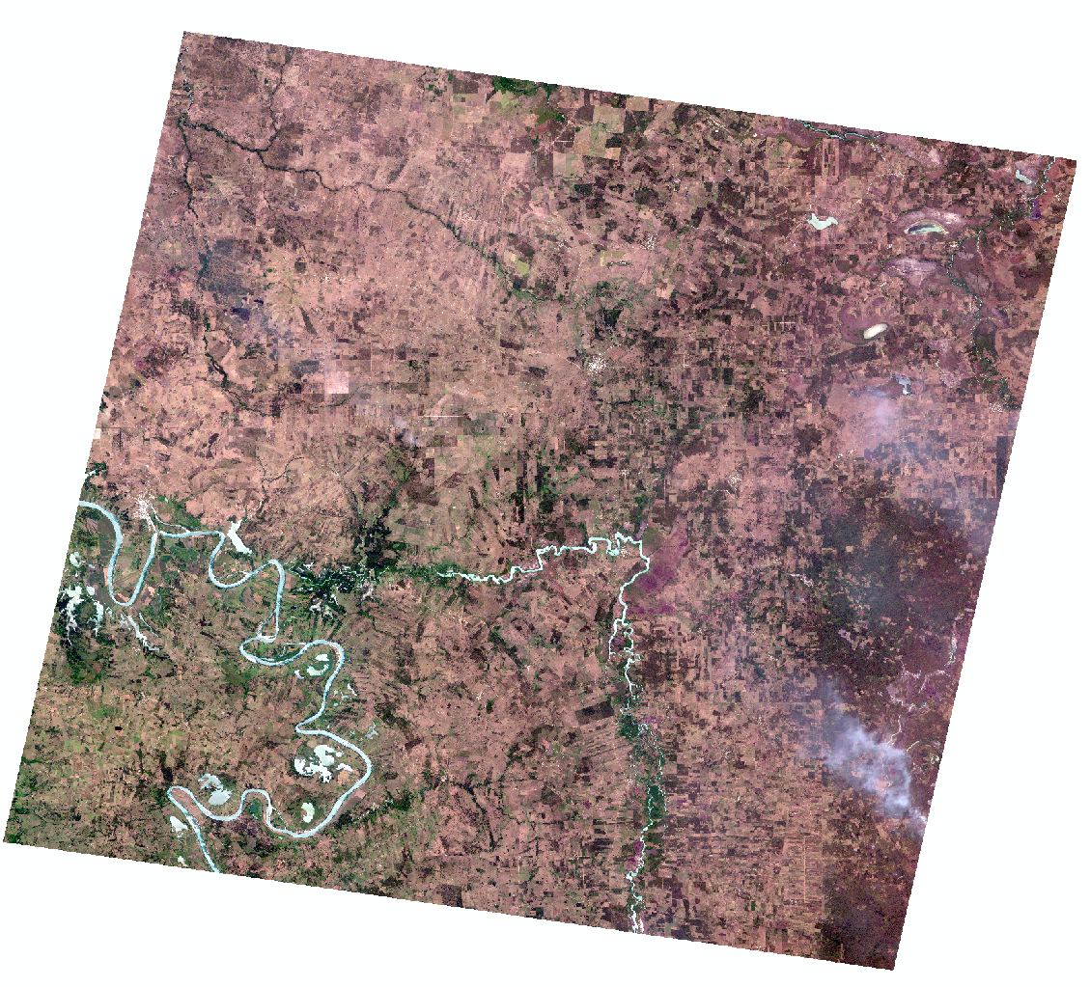
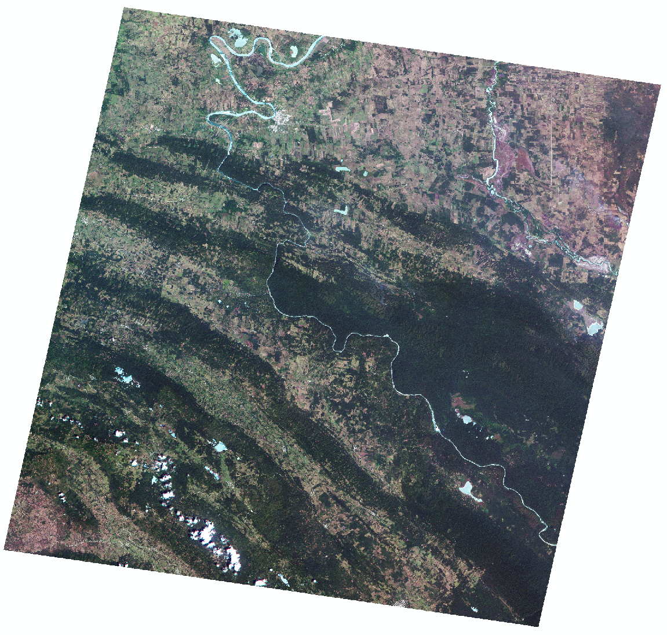

Use of Rapideye images from the planet platform to update vegetation cover studies in Tenosique, Tabasco, Mexico.
Nieto J. J.¹, Ramírez, N. L. ¹, Jácome M. P. ¹, Ruiz T. X. ², Núñez J. M. ³
Geophysics Institute-UNAM ¹, Independet Consultor², University Iberoamericana ³
1
3
2
4
Planet Team (2017). Planet Application Program Interface: In Space for Life on Earth. San Francisco, CA. https://api.planet.com.
jacob.nieto@ingenieria.unam.edu

Slide 2


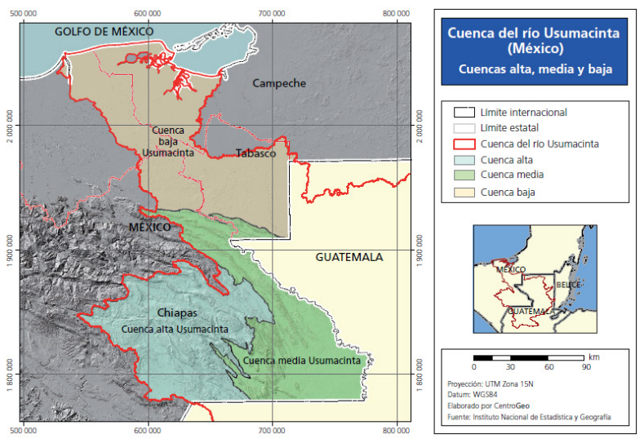
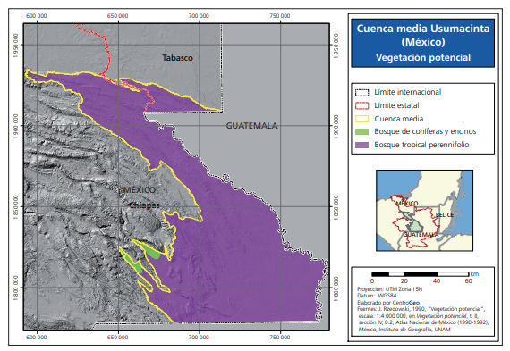
A long time ago... [1]
The Usumacinta River Basin (CRU), was one with a great diversity of flora and fauna.
Its three main ecosystems are: aquatic vegetation, tropical forest and cloud forest and coniferous forest.
Over time, various events caused the area to lose its splendor.
Now that it is a protected area (14 years ago), it is time to specifically observe the Tenosique area, how it has evolved.
1
3
2
4
Study zone
Notes:
BENNI: pTLS steht für „permanent TLS“…das vllt explizit erwähnen – wär cool, wenn sich dieser Begriff etablieren könnte

Slide 3
A little history... [2]
Due to various activities, decisions and events, Tenosique has lost a large part of its forest cover.
Tenosique has lost a lot of his vegetation, forest, animals like howler monkey, jaguar among other.
Some of these activities were:
  Agrarian Reform in 1917 and in 1954.
  Livestock and agricultural activities.
  Food crisis in 1965.
  Discovery of Cantarel (oil well).
  Economic crisis in 1982
The area entered as a protection area for Flora and Fauna by the (CONANP), in 2008.
1
3
2
4
Study zone

Slide 4
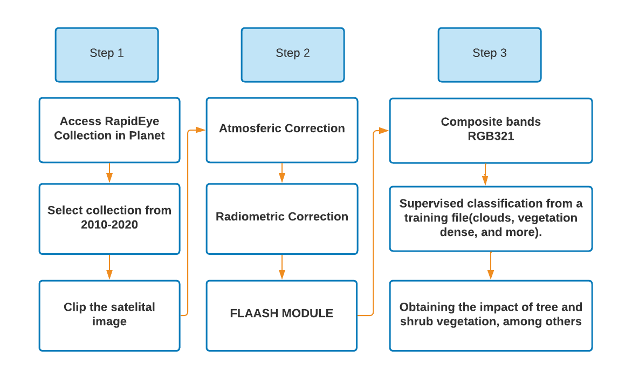
Methodology ... [3]
Our methodology are:
1
3
2
4
Notes:
[BENNI: point pairs sind so kleine Reflektorscheiben außerhalb der Rutschung, die mit dem Tachy eingemessen wurden)

Slide 5
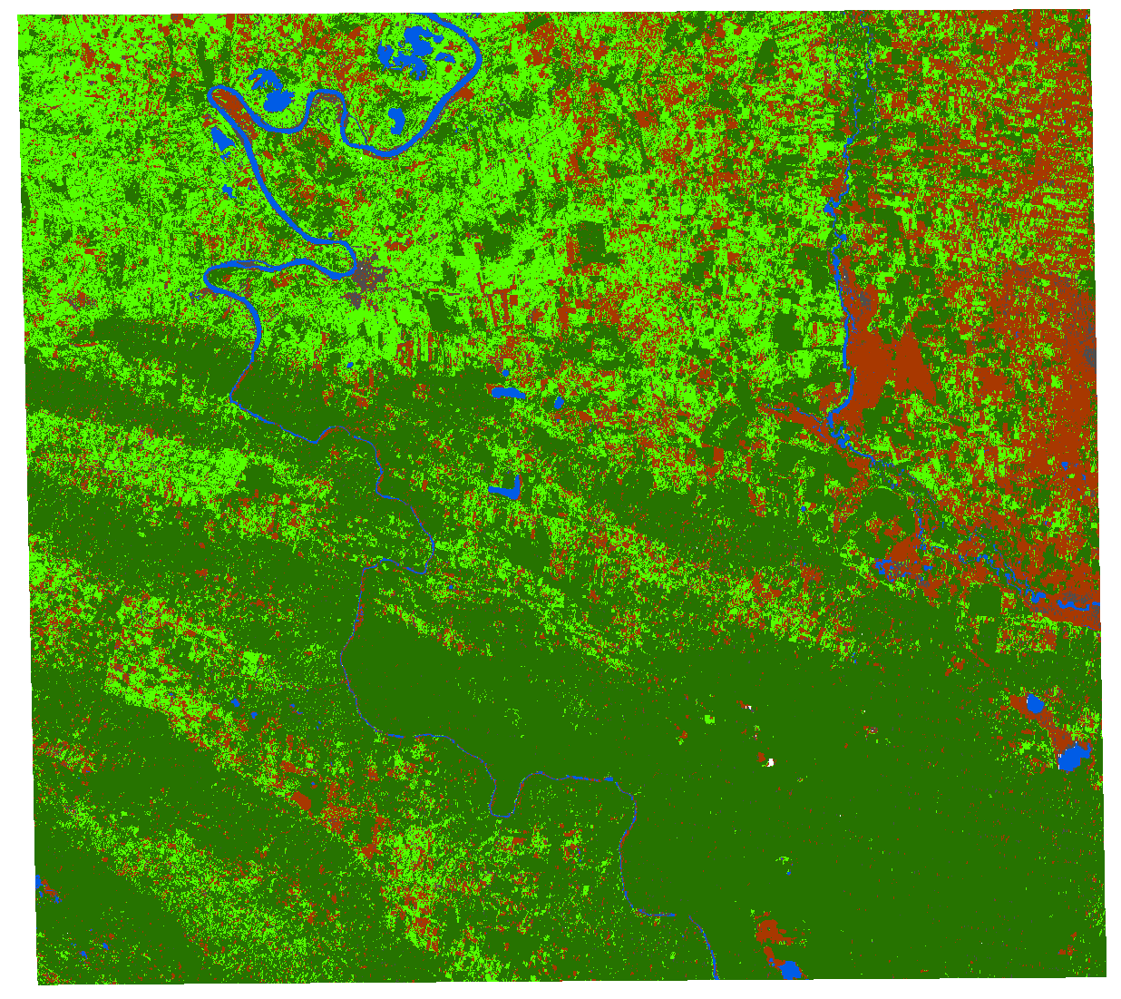
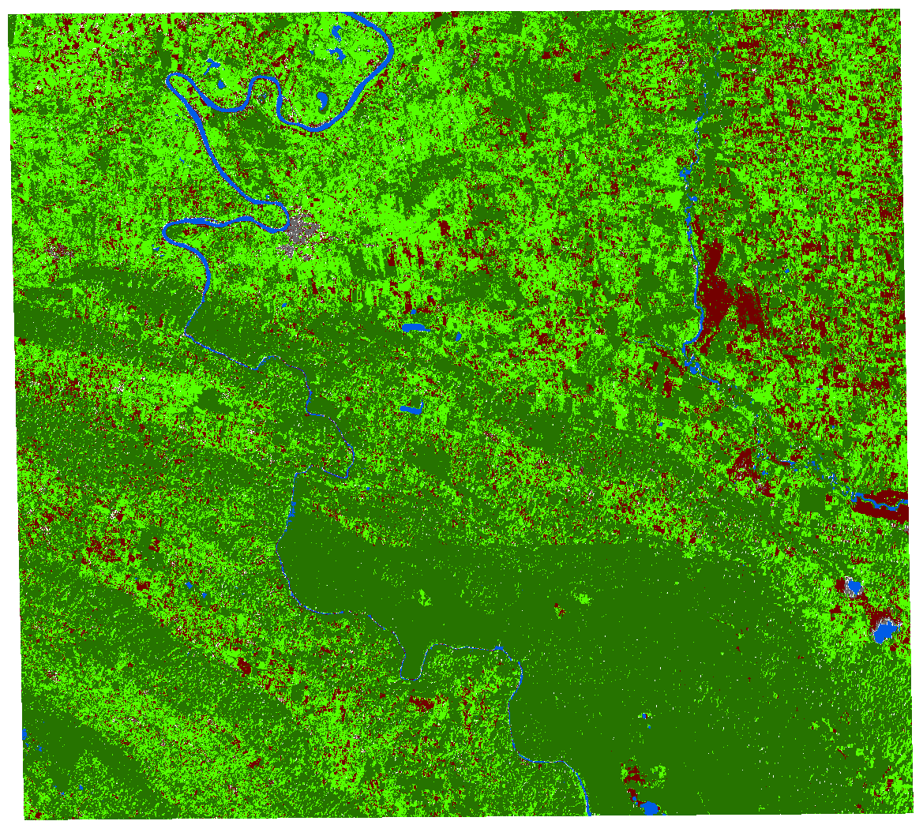

Preliminary Results... [4]
In the dense vegetation cover there is a very pronounced change, it decreases until 2018 and increases to 2020. It is due to a time lag.
In the case of shrubby vegetation, it is very likely that most of it is temporary, it presents an inverse proportion, the more soil, the less shrubby vegetation.
In the federal protection area there is a decrease in forest cover, it is necessary to implement programs to care for and preserve the area even more.
1
3
2
4
2010
2020
jacob.nieto@ingenieria.unam.edu

Slide 6

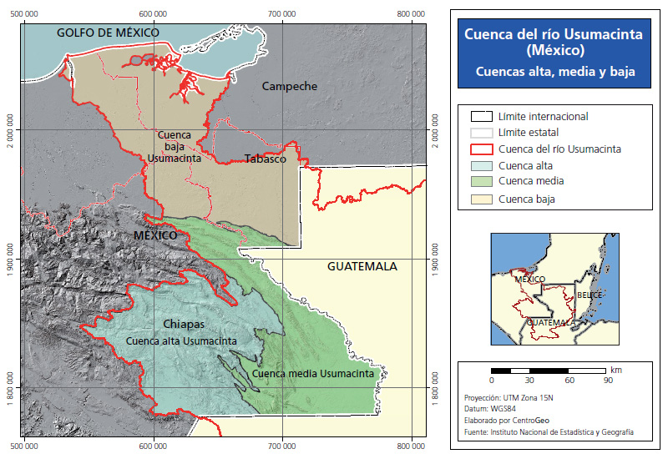



[close]
Figura 1. Map of the Usumacinta River Basin. Taken from CentroGeo

Slide 7

[close]
Figura 1. Vegetation of the Middle Basin of the Usumacinta River (Arístides, 2020).

Slide 8
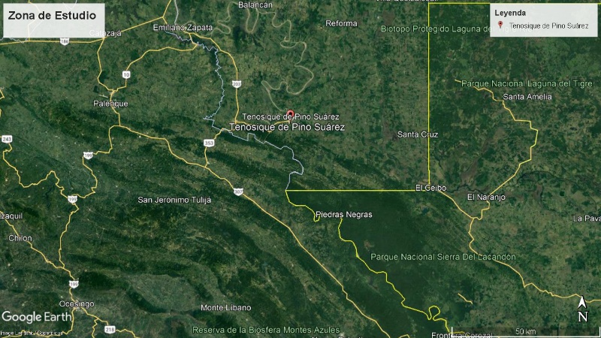
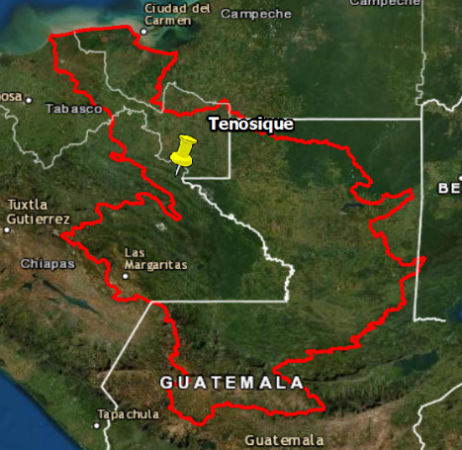
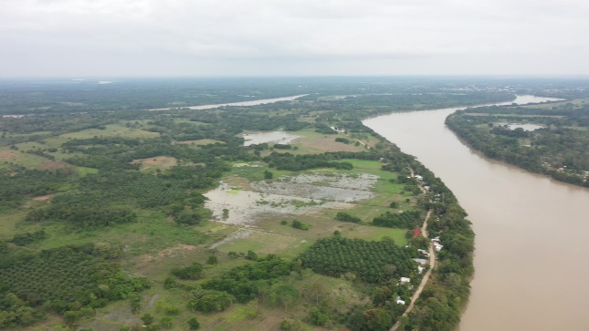
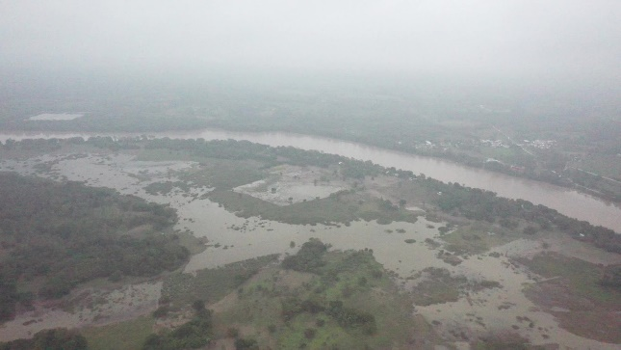
Use of Rapideye images from the planet platform to update vegetation cover studies in Tenosique, Tabasco, Mexico.
Study Zone
Tenosique, Tabasco, México(Usumacinta River Middle Basin)
1
3
2
4
Tenosique is located on the borders of Mexico and Guatemala.
It is located in the Middle Basin, therefore it has tropical-type vegetation.
Its Mayan words Ta-na-tsiic, mean "House of the un raveler or spinner".
It has a great flora such as the mangroves found in the Usumacinta River.

Slide 9


[close]

