Slide 1



Session HS10.2/BG4/OS2 "From the source to the sea – rivers, estuaries, deltas, marshlands, and coastal seas under global change"
Modelling of sediment transport pattern in the mouth of the Piave River
Antonia Menzione, Marco Mancini

Slide 2
RESEARCH OVERVIEW AND OBJECTIVE
RESEARCH OVERVIEW
Sedimentary processes play a fundamental role in the dynamics of coastal environments (Thorne et al., 1994; Holdaway et al., 1999; Gartner, 2004), such as lagoons and estuaries under present and future climate scenarios.
Numerical models being one of the major tools for sediment dynamic studies (in complex coastal waters and estuarine areas) and are now benefitting from remote sensing images that are easily available and mainly free.
RESEARCH OBJECTIVE
Investigate the capability of remote sensing images of suspended sediment for hydrodynamic coastal modelling calibration
Antonia Menzione

Slide 3
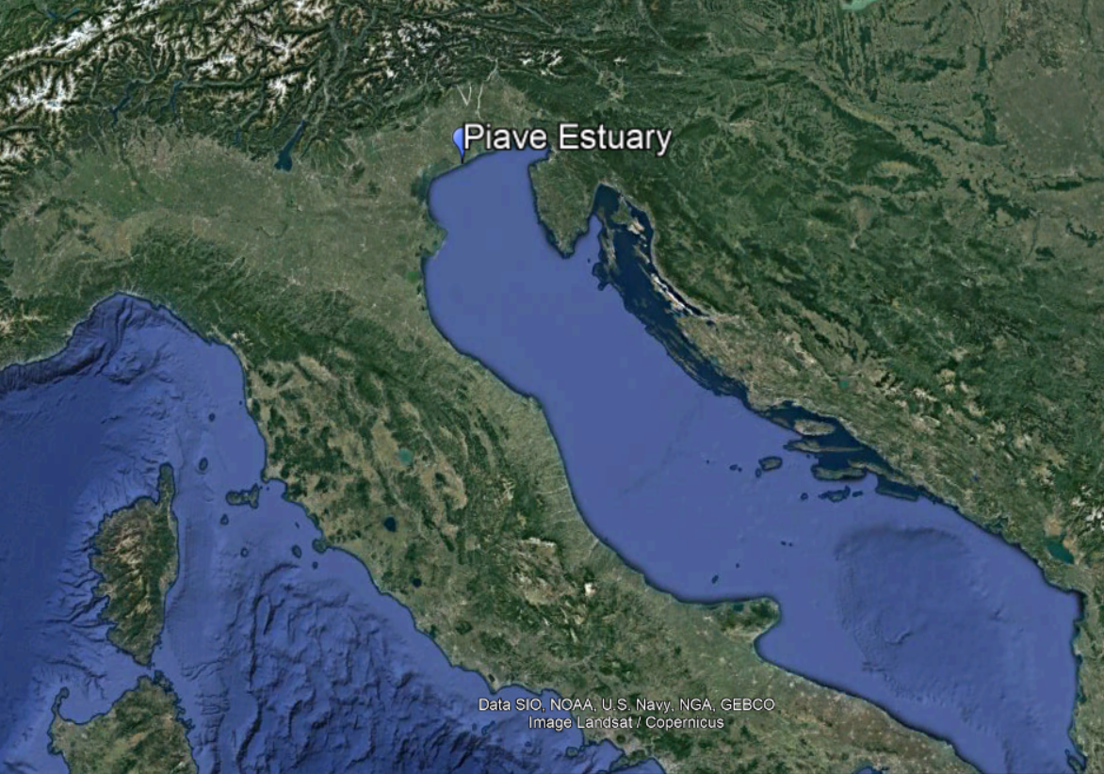
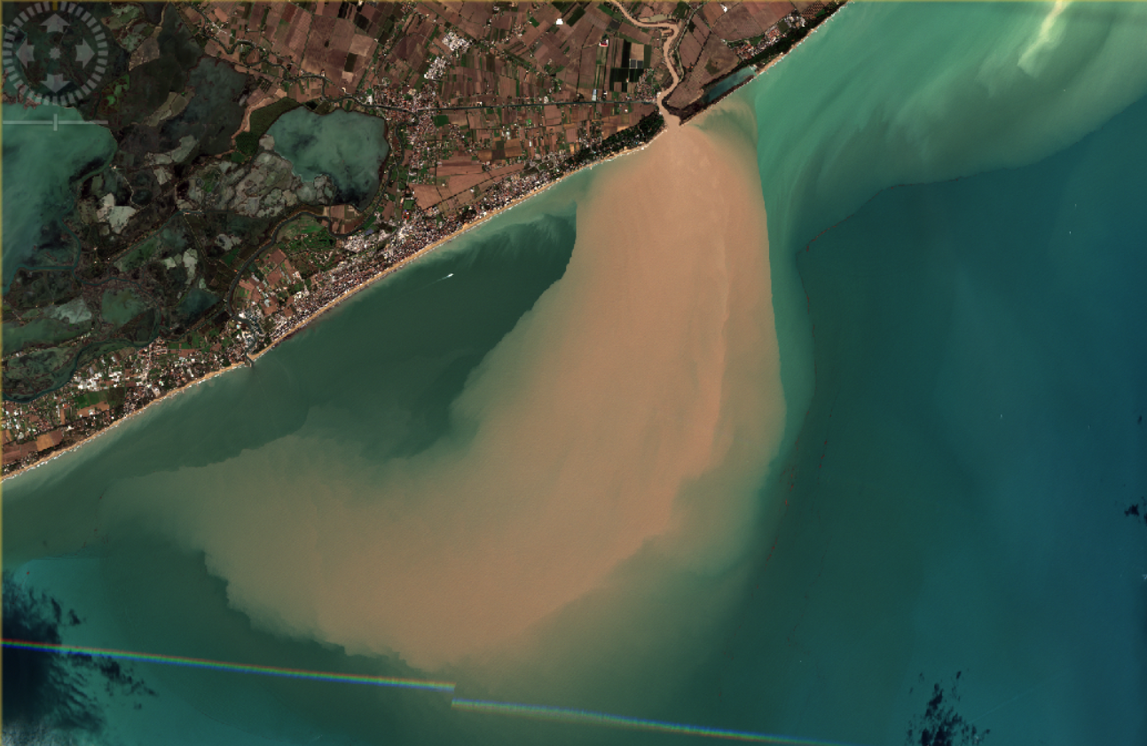
METHODOLOGY AND CASE STUDY
Piave Estuary
Flood Event
Telemac 2D
Sisyphe
Remote sensing images
TELEMAC
Image Credit: Google Earth
Antonia Menzione

Slide 4
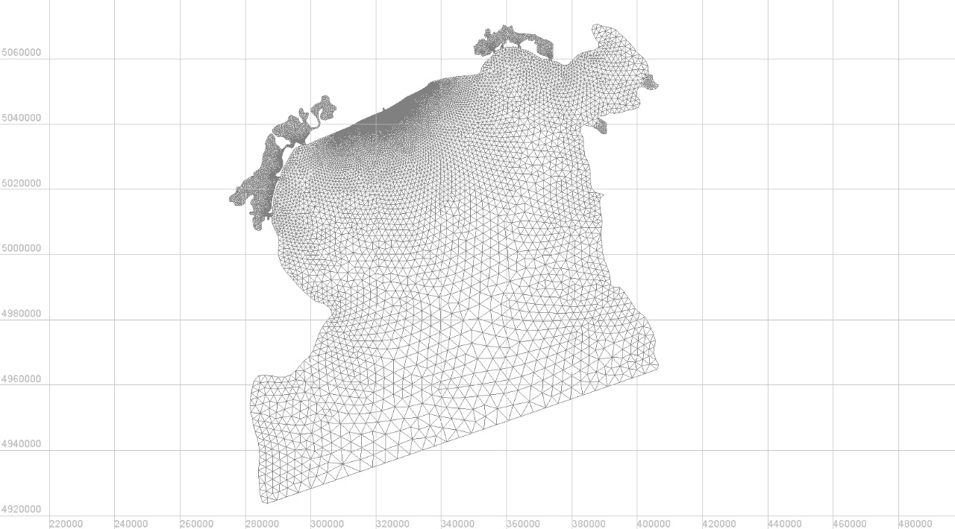
HYDRODYNAMIC MODEL SET UP
BOUNDARY CONDITIONS
Regional domain
Water level at boundary condition
Piave Estuary
ADRIATIC SEA
Credit: ISPRA Istituto Superiore per la Protezione e la Ricerca Ambientale - R.M.N. Rete Mareografica Nazionale
Ravenna
Antonia Menzione

Slide 5
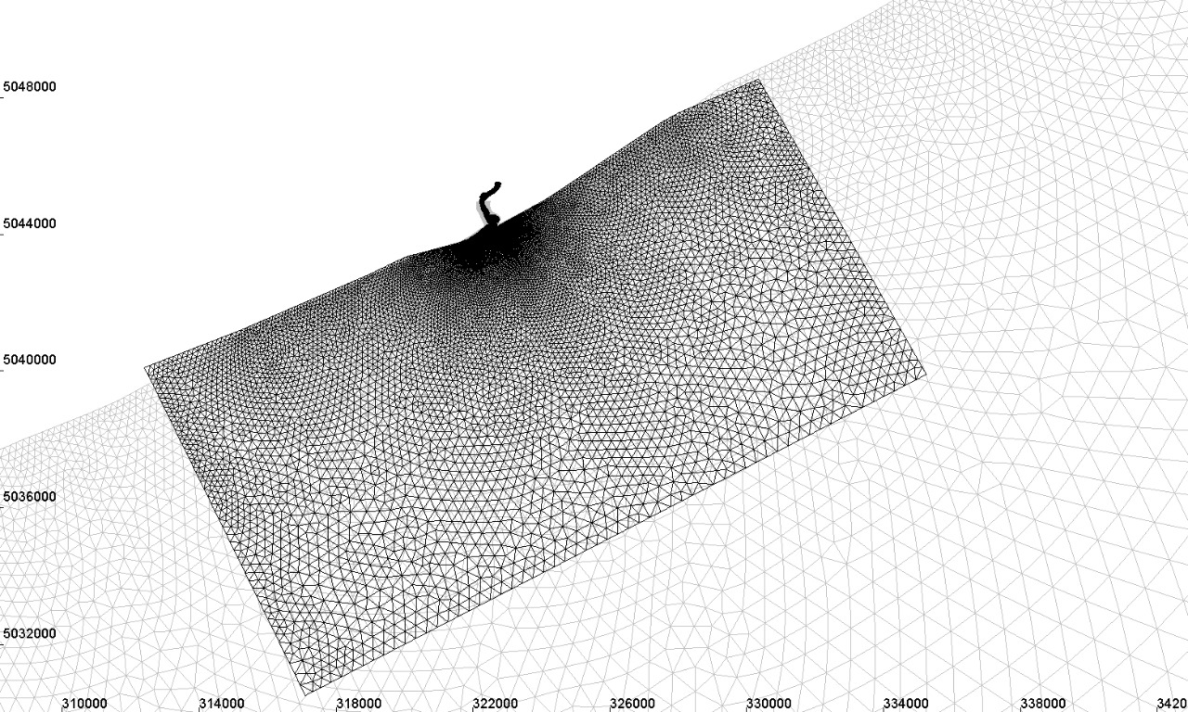
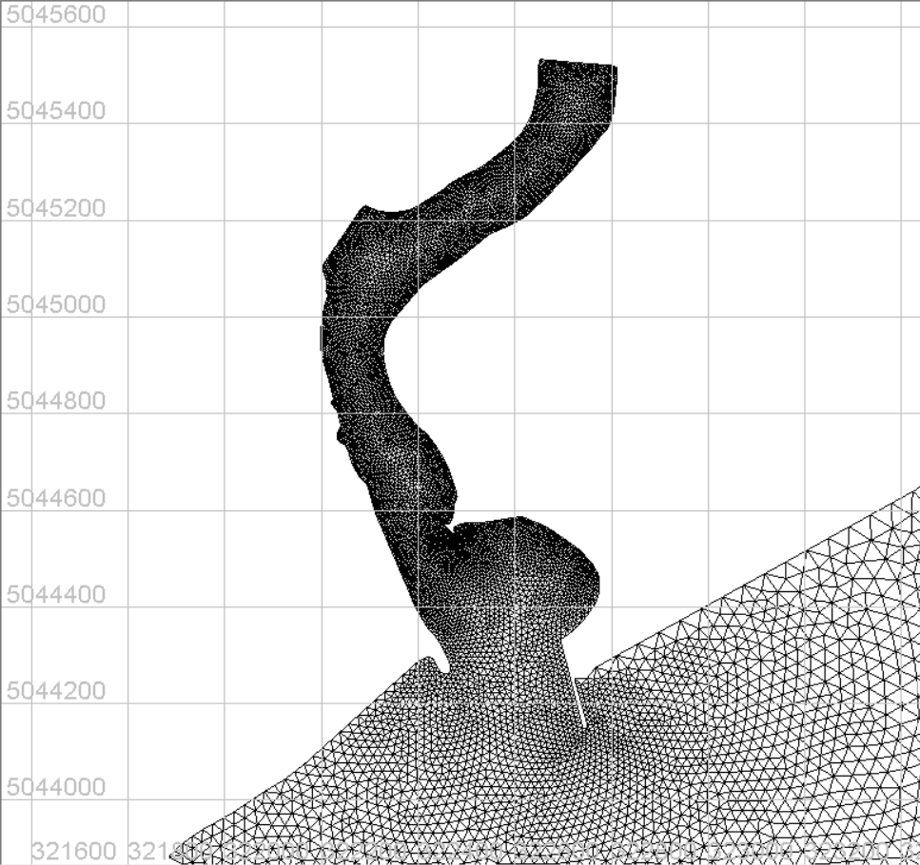
HYDRODYNAMIC MODEL SET UP
BOUNDARY CONDITIONS
Piave estuary domain
Water discharge
Water levels
Velocity
Antonia Menzione

Slide 6
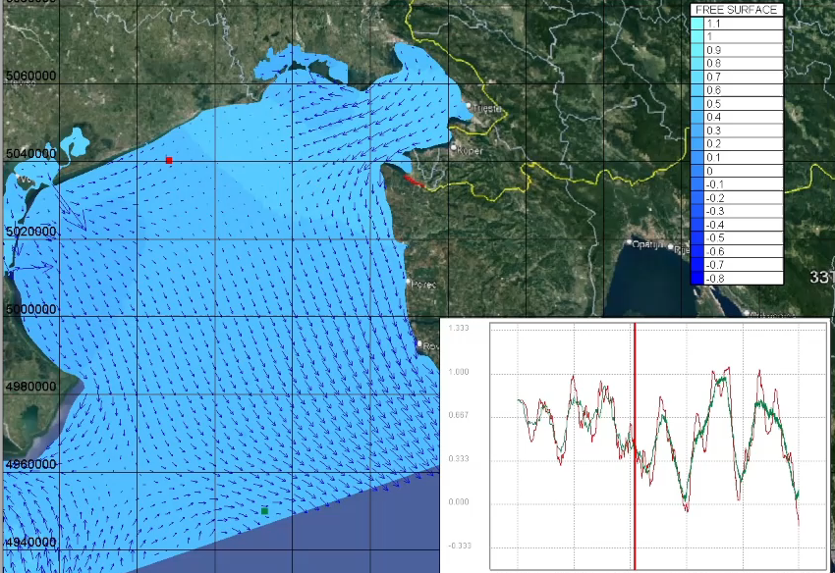
HYDRODYNAMIC MODEL RESULTS
Antonia Menzione

Slide 7
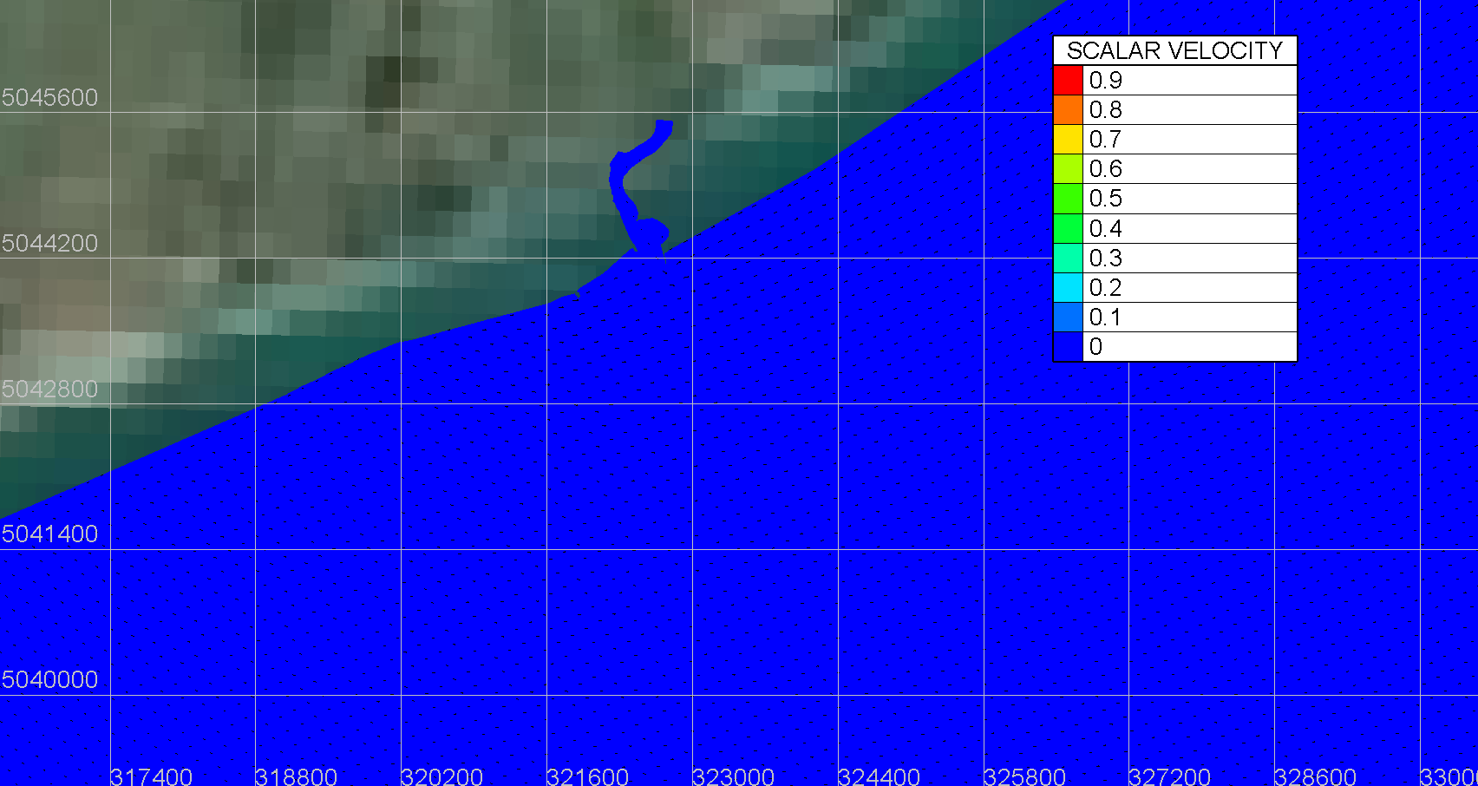
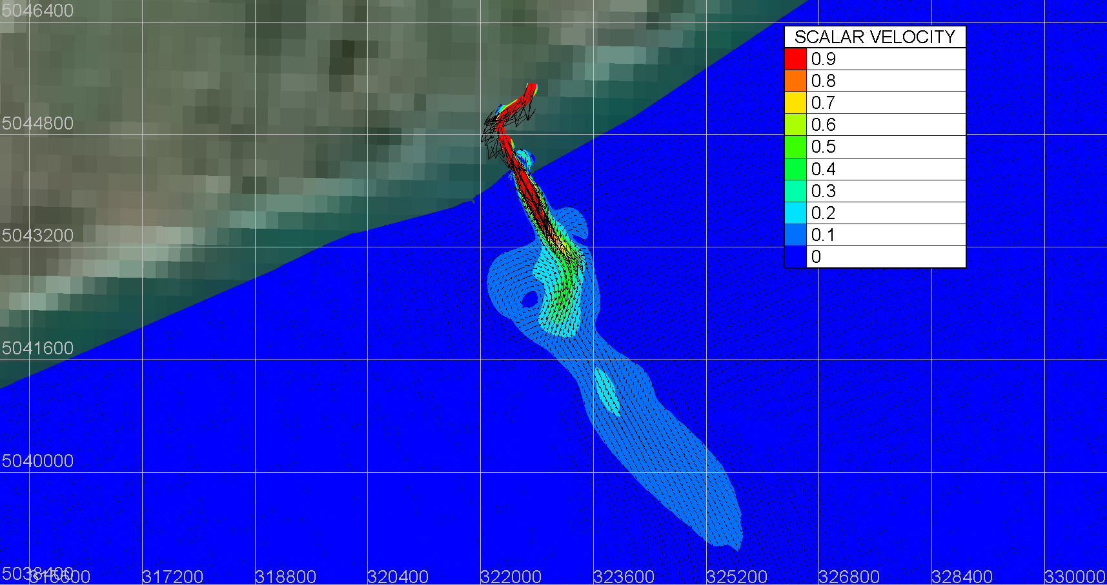
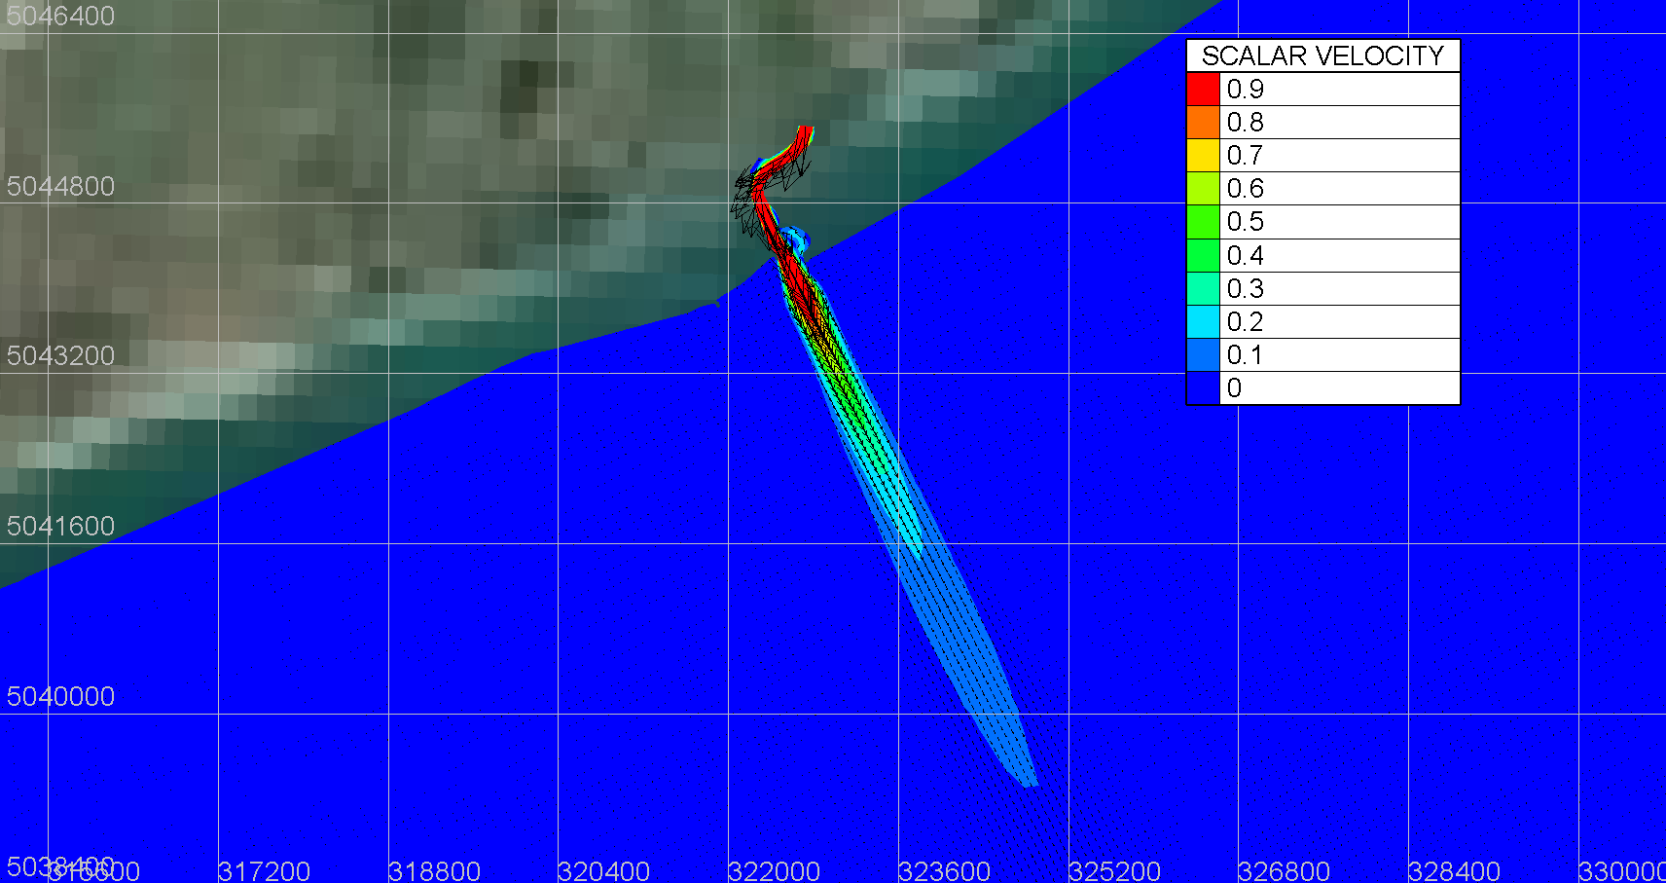
HYDRODYNAMIC MODEL RESULTS
Water level and velocity conditions
Water level and velocity + river discharge conditions
Foto tide
Foto river
River discharge conditions
Interaction
Antonia Menzione

Slide 8
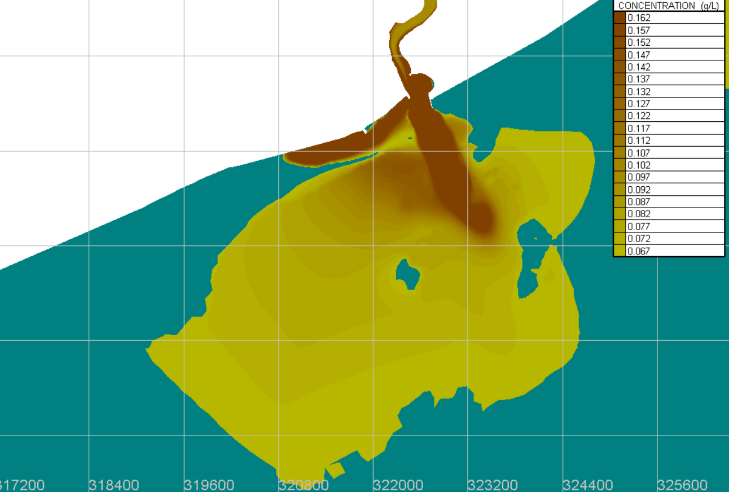
SEDIMENT TRANSPORT
SYSIPHE MODEL RESULTS
Sysiphe simulation results for the flood event
Image Credit: Sentinel -2 Images
Antonia Menzione

Slide 9
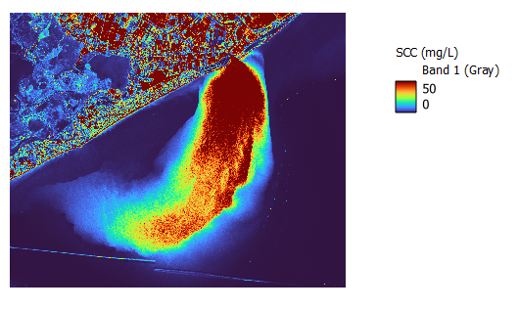
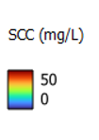
SEDIMENT TRANSPORT
IMAGE ANALYSIS
$$SSC=0.0242∙exp(6.3466∙Rss(645)/Rss(555)$$
Credit: Peng Zhang 1,2, Onyx W.H. Wai 2, Xiaoling Chen 1, Jianzhong Lu 1,* and Liqiao Tian 1
SSC suspended sediment concentration (mg/L)
Rss(645) water reflectance on bands 645 nm
Rss(555) water reflectance on bands 555nm
Antonia Menzione

Slide 10
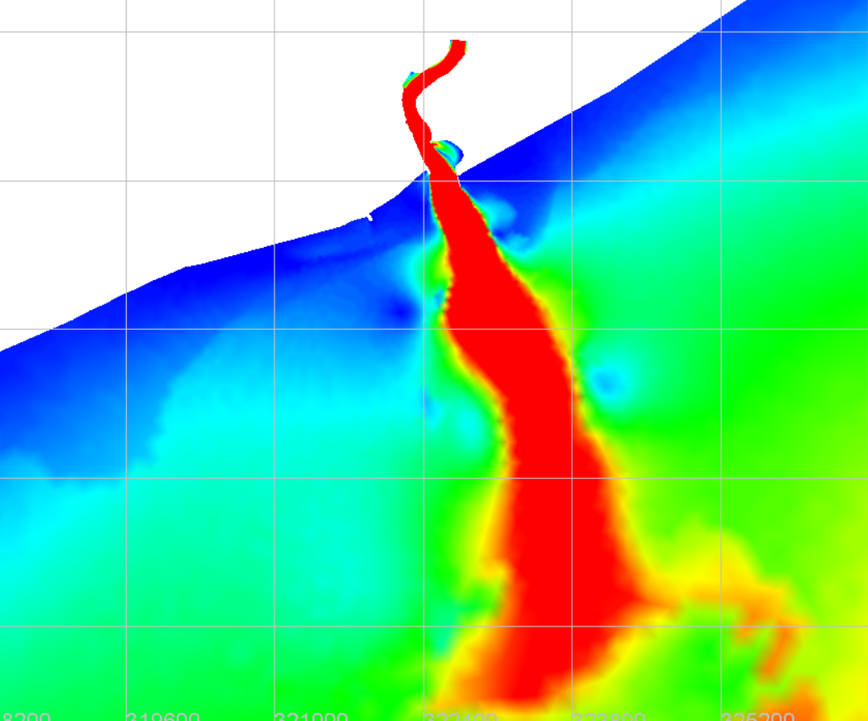
OUTPUT IMAGES ANALYSIS
SSC (mg/L)
50
0
QS (m3/s)
0.3
0
Date 31/10/2018
Time 10.11 am
Antonia Menzione

Slide 11
CONCLUSIONS AND FUTURE DEVELOPMENTS
CONCLUSIONS
First results seems to be promising in reproducing the pattern of the sediment plume;
For a better calibration in quantitative terms, measurements campaigns and / or laboratory studies should be performed;
The model was implemented with open - source data (low-cost model)
  Numerical model: Telemac (open- source)
  The bathymetry: GEBCO data set
  The water level and water discharge data: ISPRA data set
4. Even if the case study is specific to the estuary of the Piave river, the methodology can also be applied to other case studies
FUTURE DEVELOPMENTS
Measurement campaigns
Additional events, other sites simulation and implementation of more detailed data
Expand the domain to capture the influence of nearby rivers
Antonia Menzione

Slide 12
THANK YOU FOR YOUR ATTENTION
Antonia Menzione
antonia.menzione@polimi.it

