Slide 1
GNSS-Reflectometry for Ocean Remote Sensing
Matthew Hammond, Giuseppe Foti, Christine Gommenginger, Meric Srokosz, and Nicolas Floury
EGU 2022

Slide 2
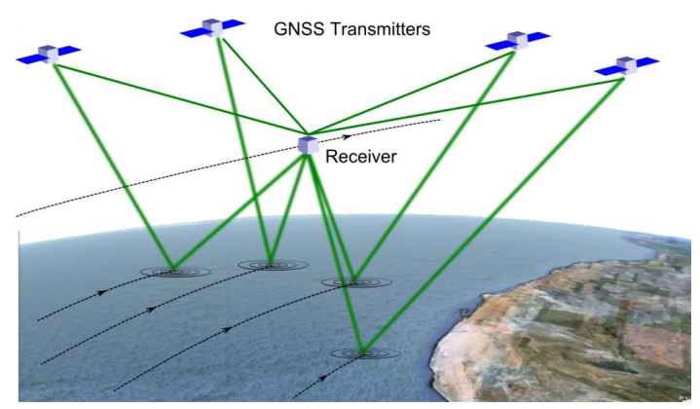
Introduction
GNSS-R uses reflected signals from Global Navigation Satellites
GNSS-R ocean missions have typically targeted retrieval of wind speed
E.g. NASA’s CyGNSS mission (a constellation of 8 satellites)
We assessed GNSS-R ocean geophysical dependencies
Reference datasets:
ECMWF ERA-5 reanalysis model - Wind / SWH / SST / Precipitation
SMOS - SSS
Global Precipitation Climatology Product (GPCP)
Notes:
GNSS-R what is
Constellation = large volumes of data
Wind speed primary target

Slide 3
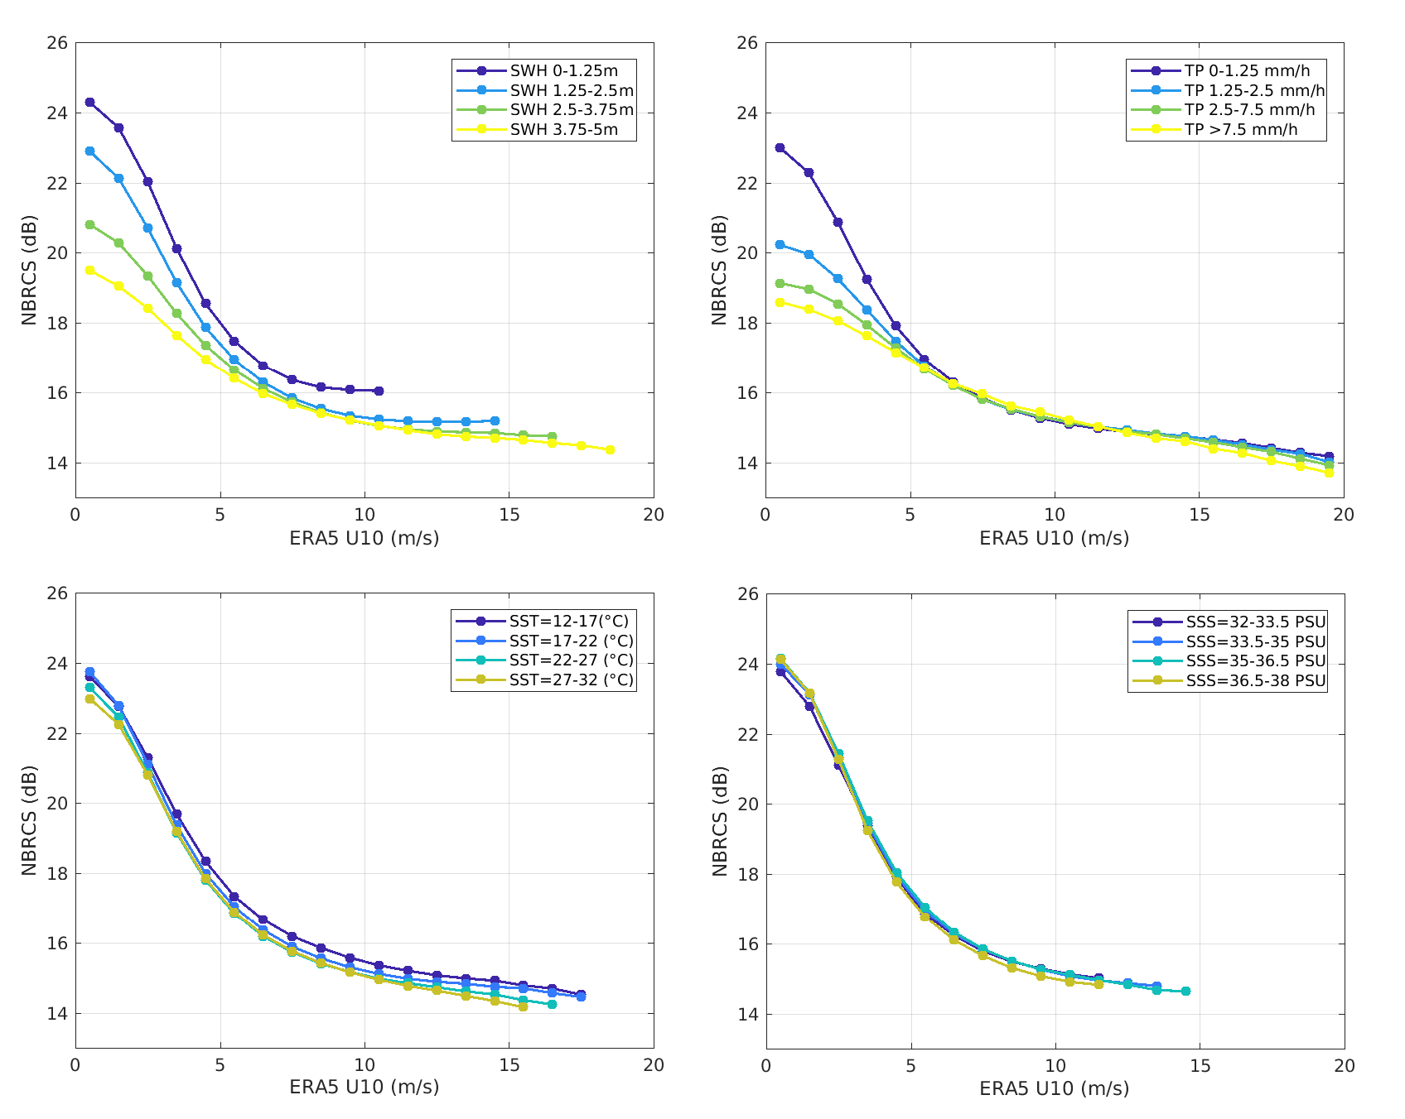
Impact of Geophysical Dependencies
Investigate impact on CyGNSS observable (NBRCS) over ocean
Across a range of wind speeds
Strong sensitivity to:
Significant wave height
Precipitation
At low wind speeds
Low sensitivity to SST
At all wind speeds
After SWH effect removed
No apparent sensitivity to SSS

Slide 4
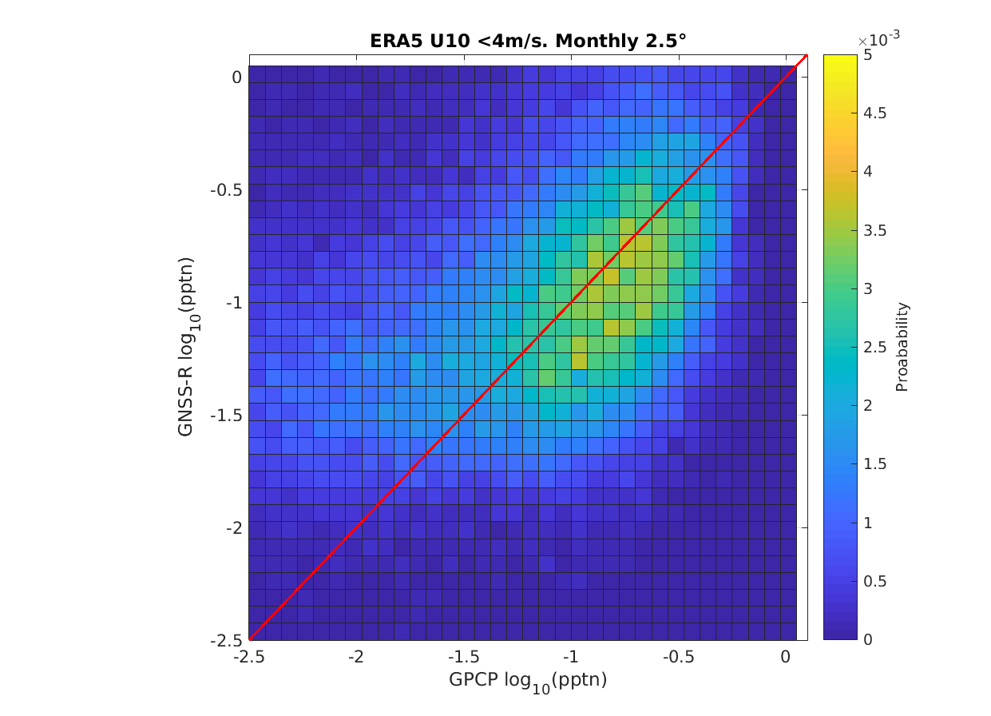
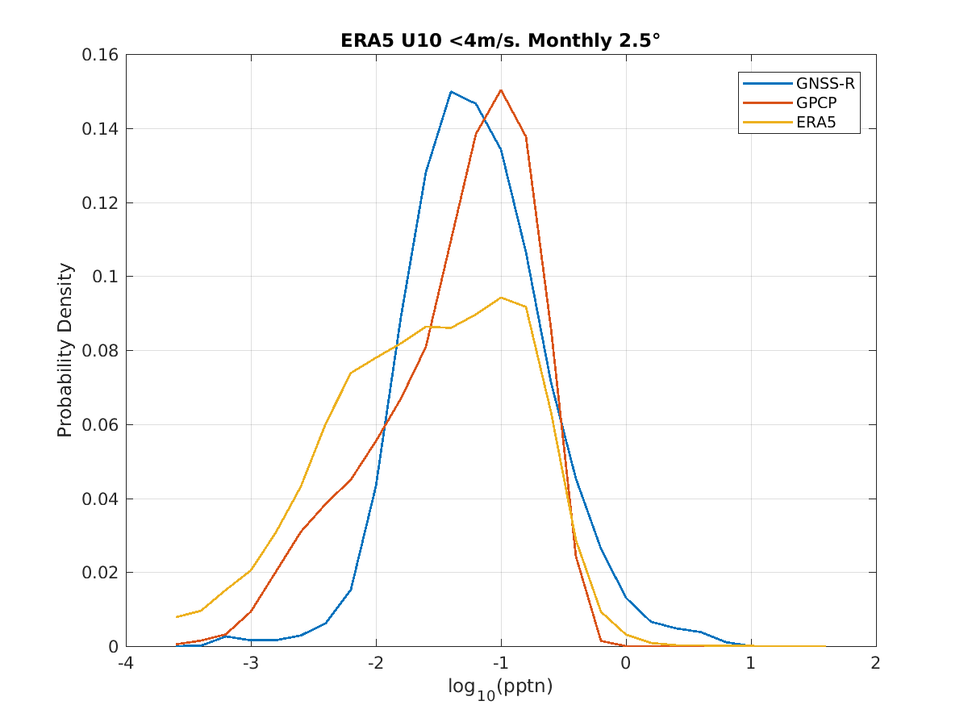
GNSS-R Precipitation Retrieval
Strong relationship seen between GNSS-R retrieval and GPCP dataset across range of rainfall values

Slide 5
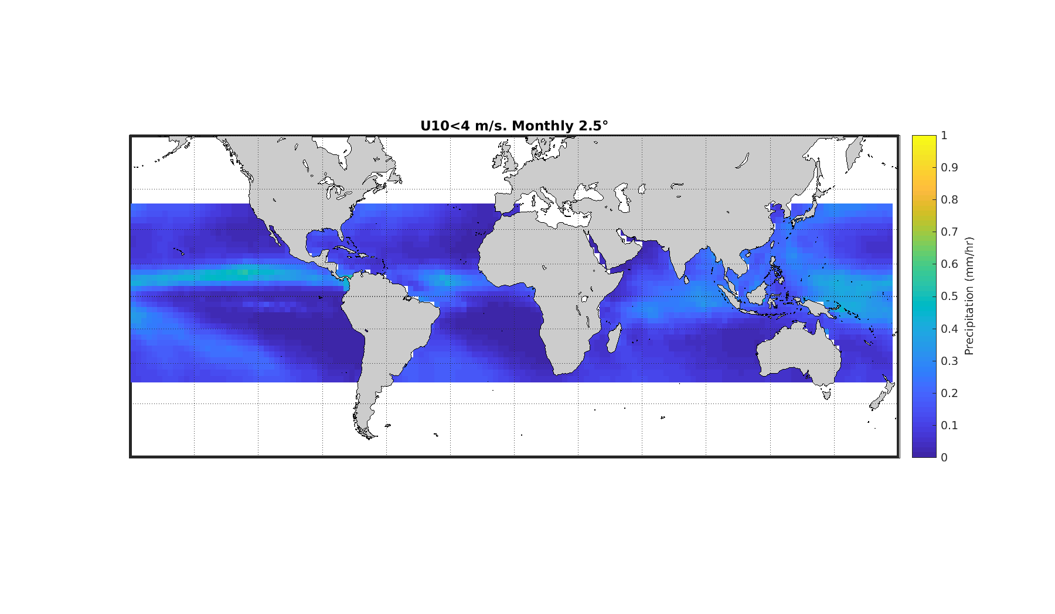
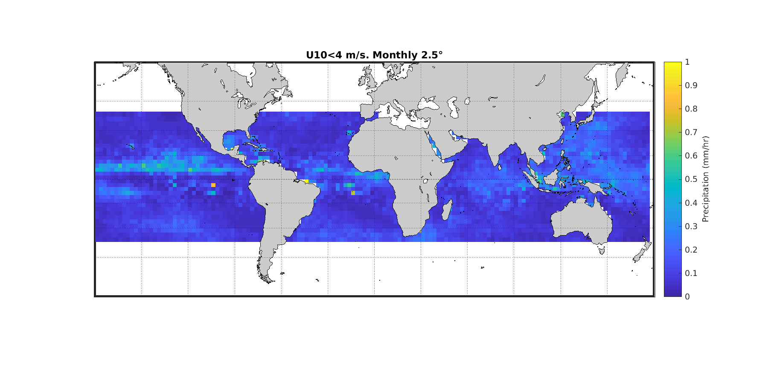
Global Retrieval Comparison
Global comparison of GNSS-R retrieved rainfall patterns with GPCP product
Large similarity in patterns of precipitation
GNSS-R retrievals currently more noisy
Some increased discrepancy around islands (e.g. South East Asia)
Likely from assumed swell-wind wave relationship
GPCP
GNSS-R
Notes:
ITCZ,

Slide 6
Summary
A number of geophysical dependencies affect GNSS-R signals over ocean (especially at low wind speeds)
SWH (up to 4dB)
SST (~0.5 dB, all wind speeds)
Precipitation (up to 4dB)
Precipitation can be retrieved using GNSS-Reflectometry
At low wind speed
With knowledge of impact of other geophysical parameters
GNSS-R can provide new source of precipitation information
Different scattering mechanism
Constellations can provide frequent revisits
Supplement established approaches
Notes:
Note different scattering form
Precipitation highly spatially / temporally variable

