Slide 1
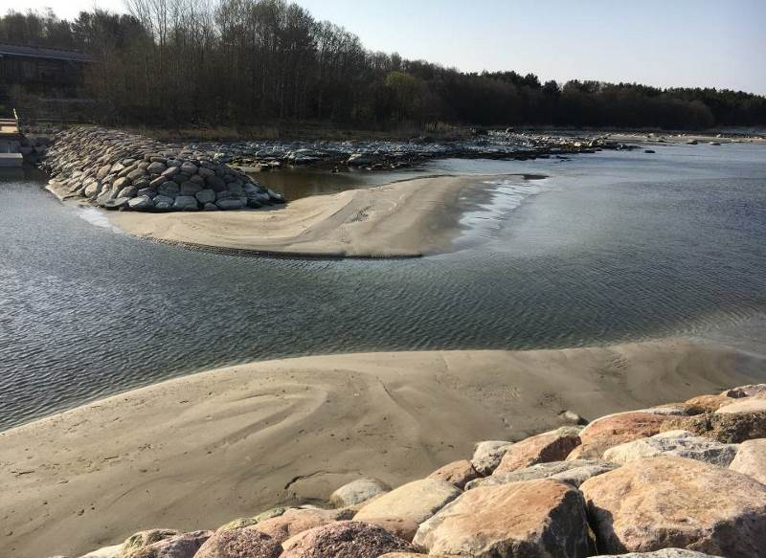

Marina planning in regions of dynamic coasts - ecologically safe and economically efficient approaches for the future
Hannes Tõnisson, Rain Männikus, Sten Suuroja, and Are Kont
EGU 2022

Slide 2
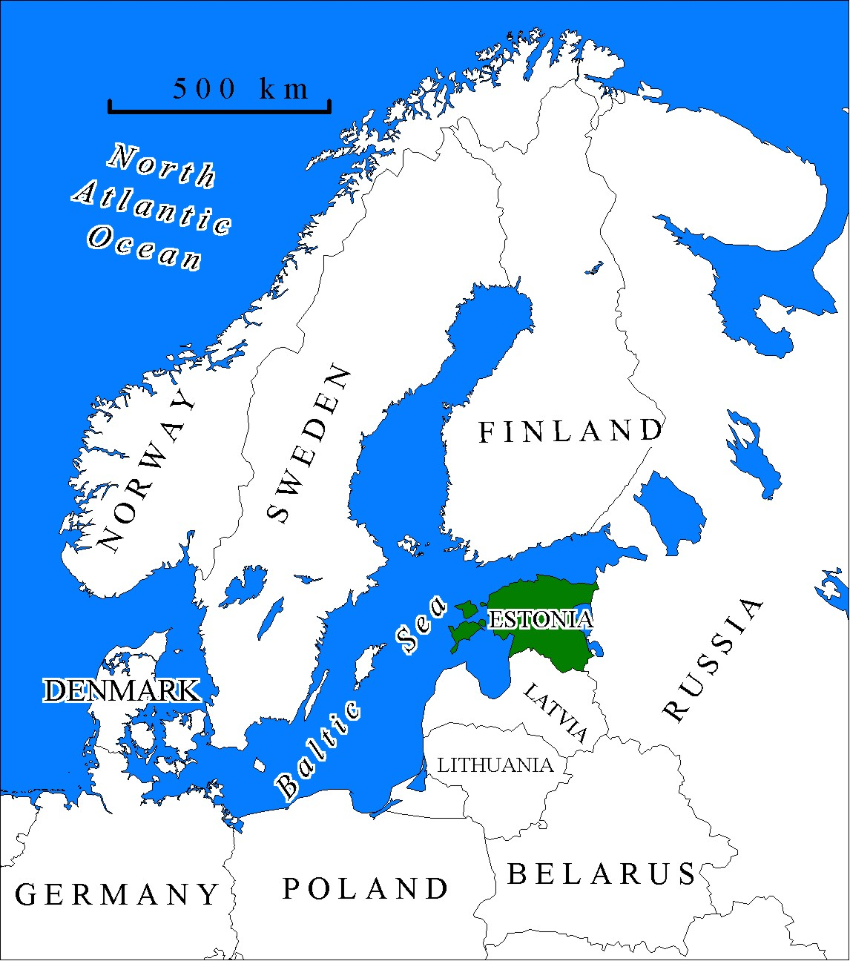
Background data:
Postglacial land uplift (up to 3.5 mm/y);
tidal range is less than 5 cm (can be neglected);
range of sea level fluctuation (-1.2...+2.8 m);
we have 6 geologically different natural shore types with high spatial variability. Number of them are very dynamic and even changing from one type to another;
locally very active sediment transport, mainly sand, due to fine and very fine sand grains.
there is rapidly increasing need of small harbors as the popularity of leisure boating is also increasing.

Slide 3
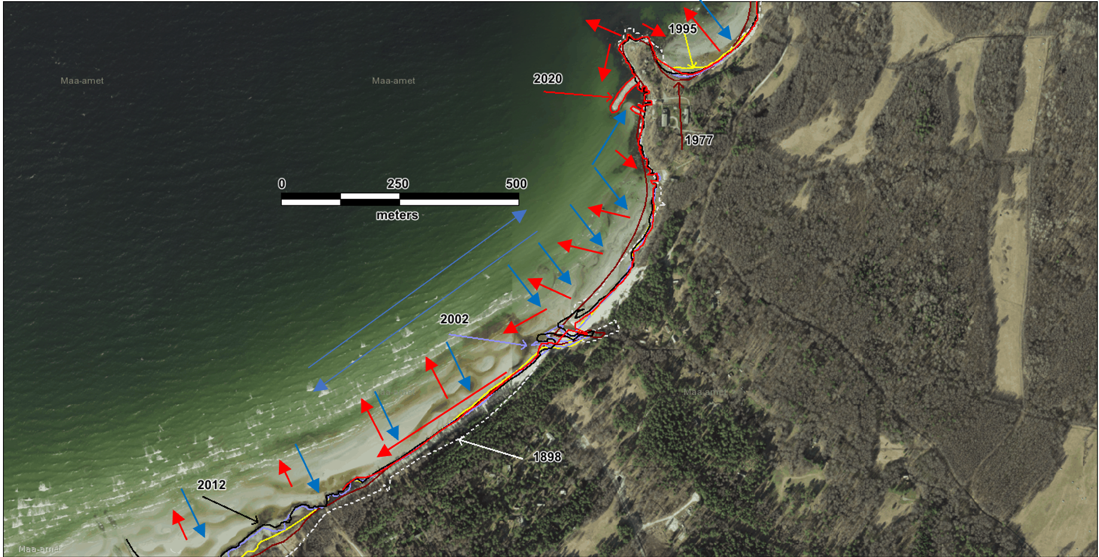
New harbor was erected a few years agom but…
Accumulation
Erosion
Harbor
Sand infilling harbor and navigation channel
Accumulated sand will be cut off from local sediment transport system, possible threat for local beach (in long term)
Insuficcient investigations of background conditions during harbor development process

Slide 4
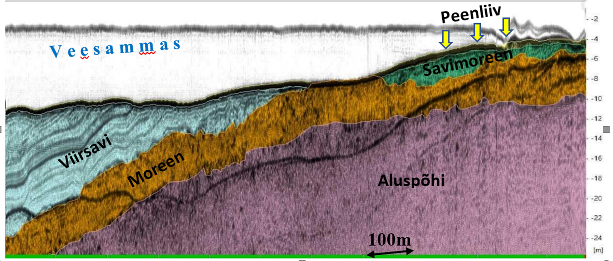
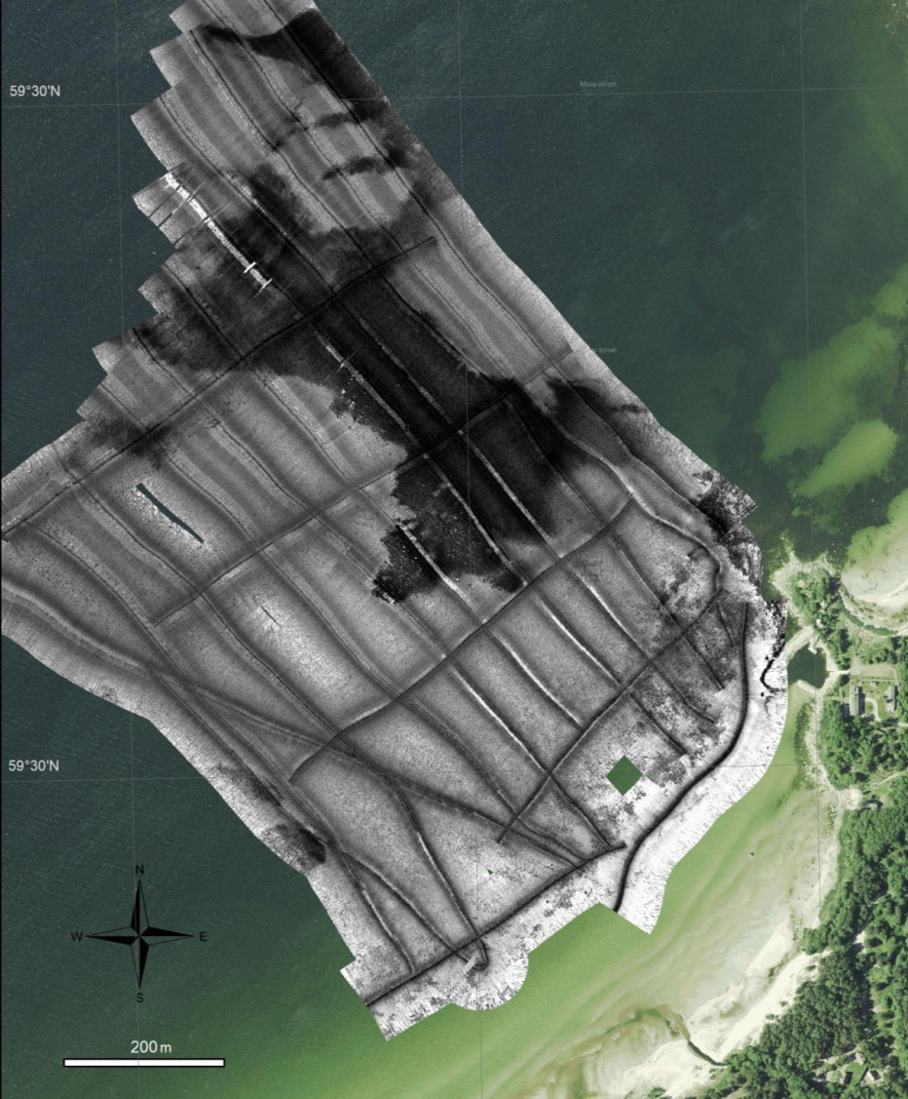
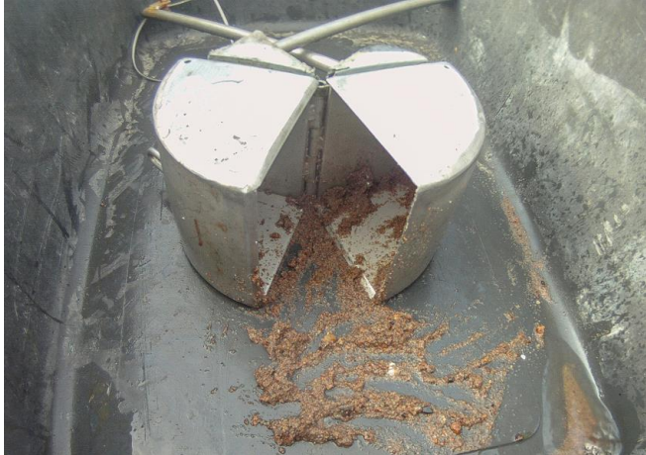
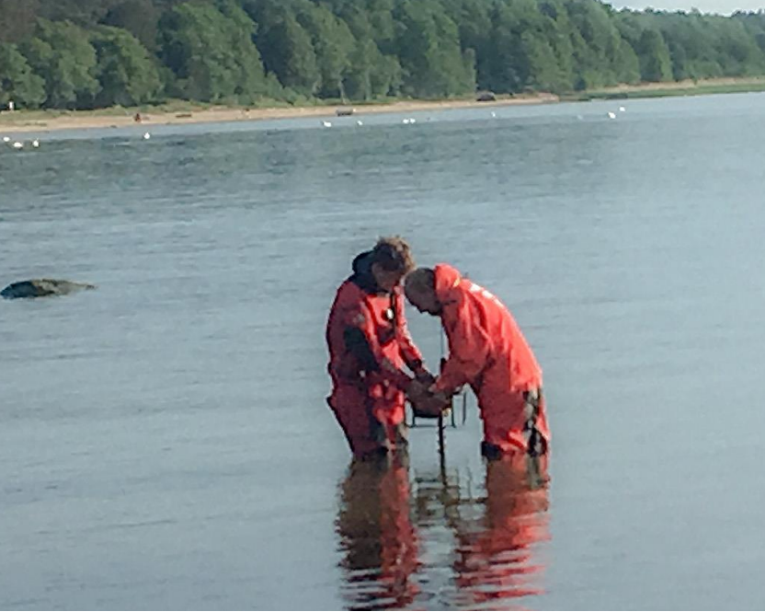
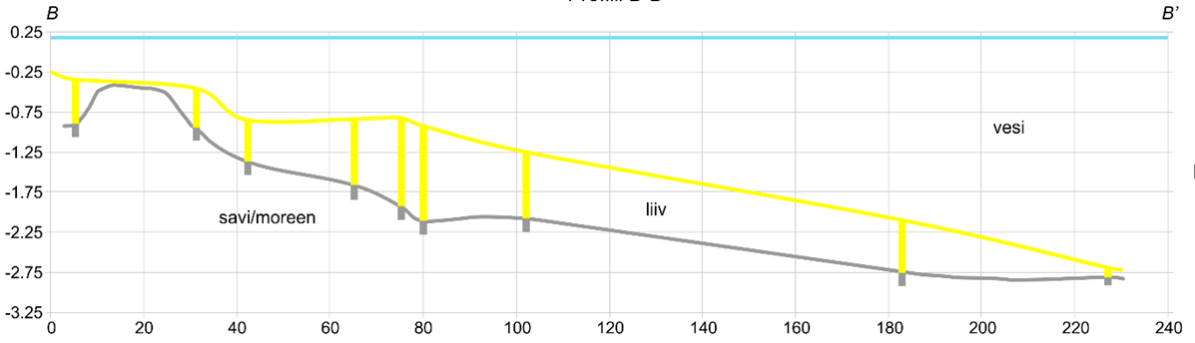
Extensive field campaign was carried out:
Map analyses
Geophysical investigations
Supporting drilling
Surface sediment samples (grain size analyses)
Cross shore profiles and surface sediments mapping
Fine sand
Water column
C l a y t i l l
Varved clay
T i l l
B e d r o c k
T i l l
S a n d
Water
Silt/till
S a n d

Slide 5
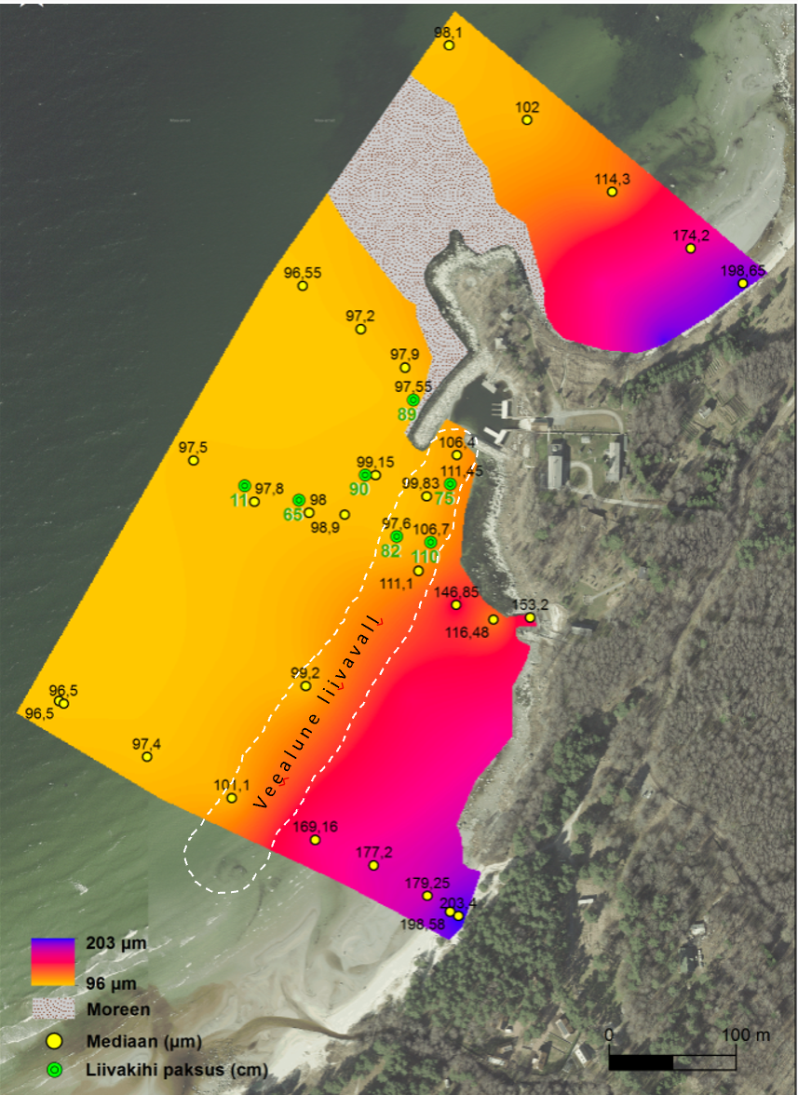
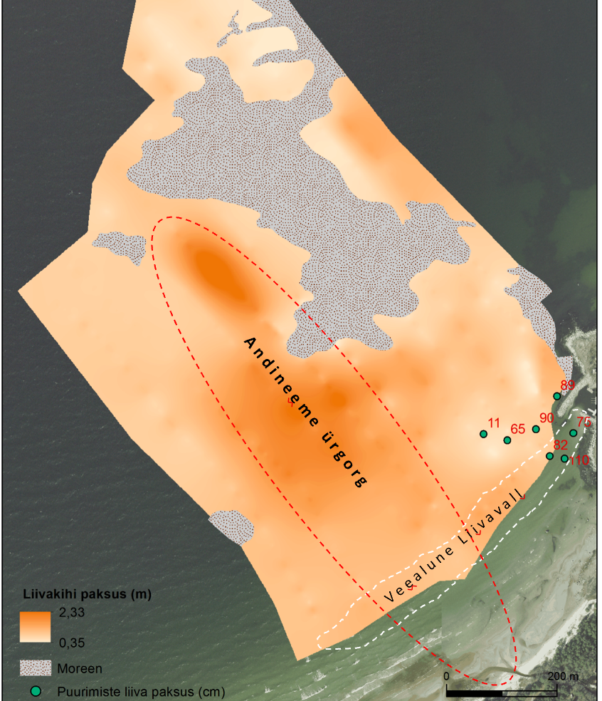
Results:
Sediment grain size and type
Up to 2.5 m thick sand layer in ancient valley
Sandy sediments are very fine and easily movable
Underwater sandbar reaching directly to the harbor
No sand on the shoreline and rocky surface gave false impression on low dynamics of sediments
Sand thickness and sediment type
Underwater sandbar
Ancient buried valley
Underwater sandbar
Sand thickness (m)
T i l l
T i l l
Sand thickness (drilling, cm)
Sand thickness (cm)

Slide 6
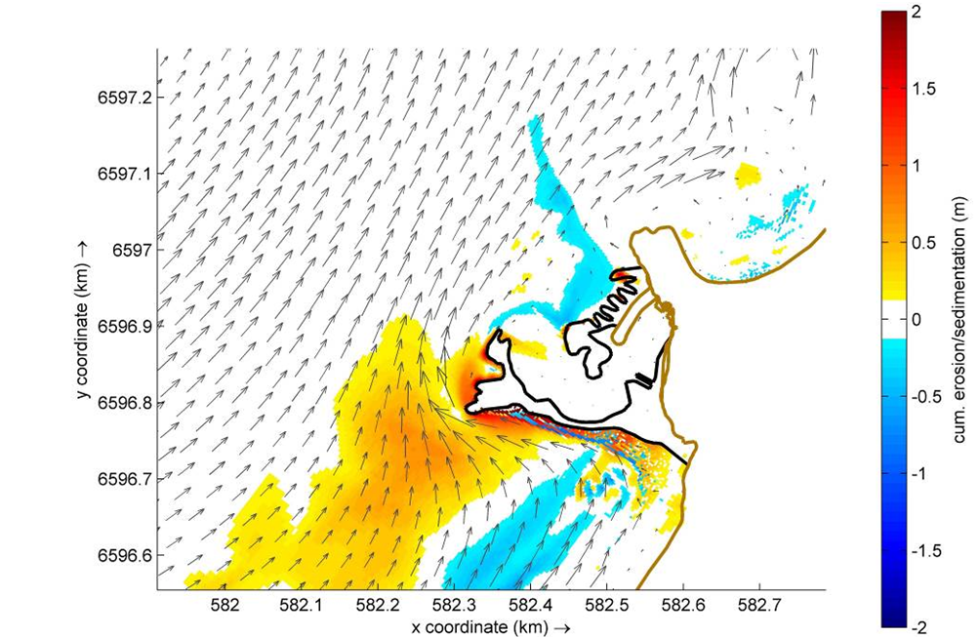
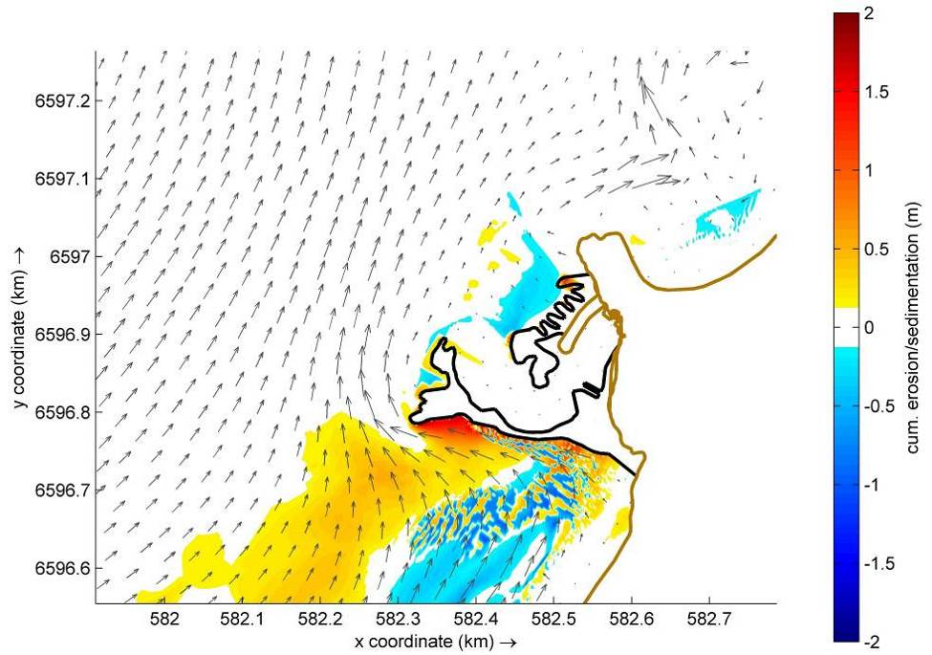
Several new configuration were projected, and sediment transport modelled with varying wind conditions.
Every next configuration was improved based on previous modelling Configuration 1:

Slide 7
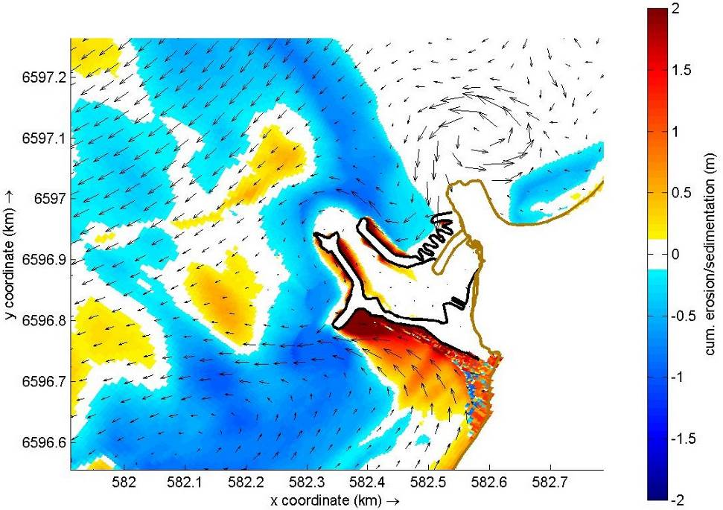
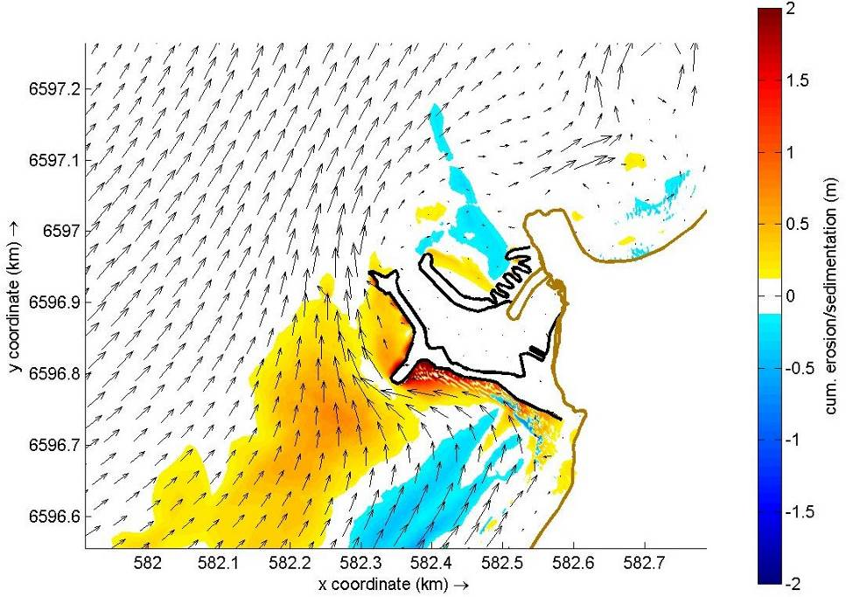
Configuration 2
Reduce sediment influx; increased harbor area

Slide 8
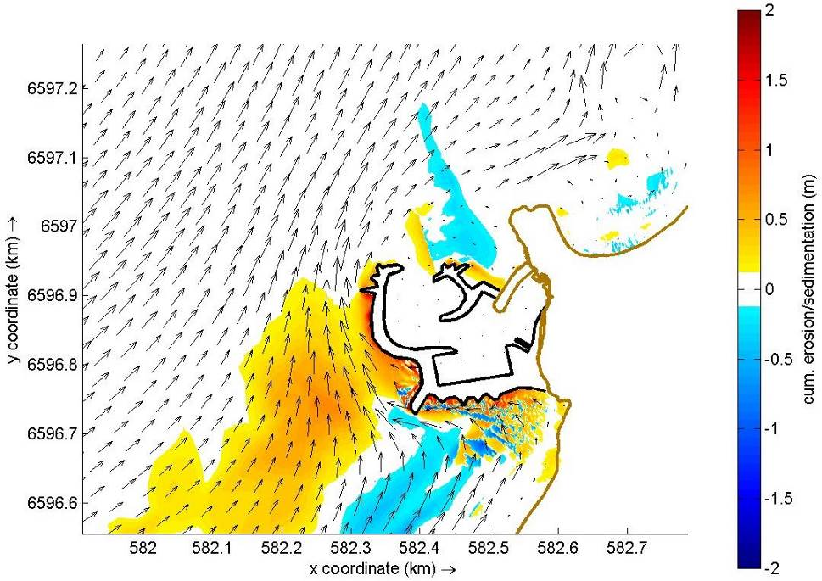
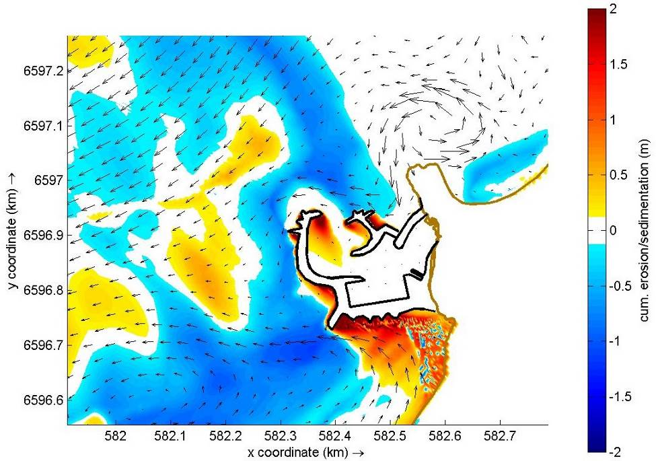
Configuration 3
Maximize harbor area, reduced building volume;
Still some influx with extreme condition
Compensation dredging proposed

Slide 9
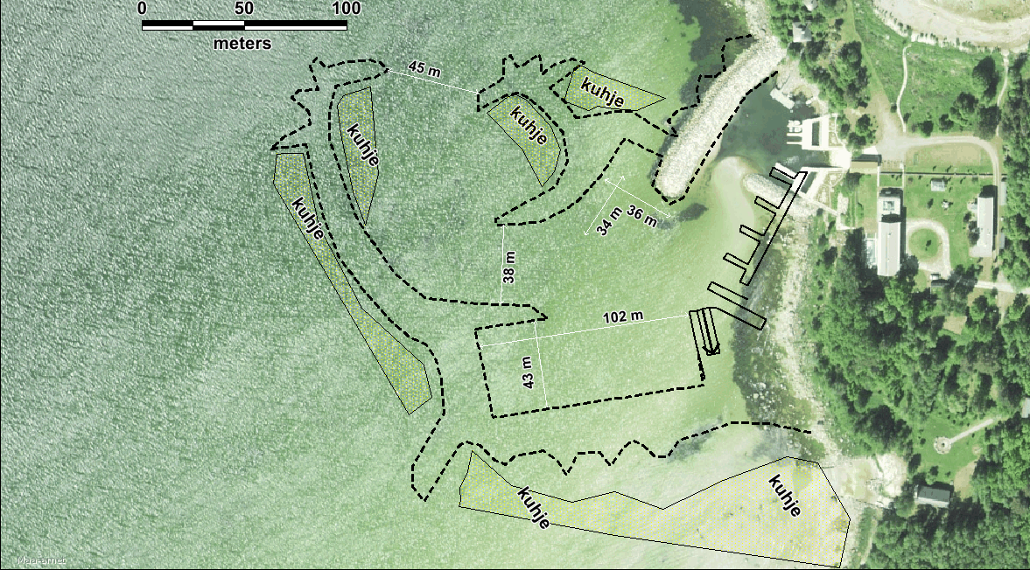
Conclusions
Thank you!
Final configuration should:
Natural “till shore look” from outside;
reduce the costs of dredging to minimum;
keep water exchange in satisfactory level;
minimal construction volume with maximum harbor extent;
keep the sand on the beach and beach in healthy state even in the light of increasing sea level;
dredged sand from the harbor to fill the beach;
create good preconditions for Natura 2000 habitats.

