Slide 1

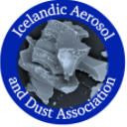

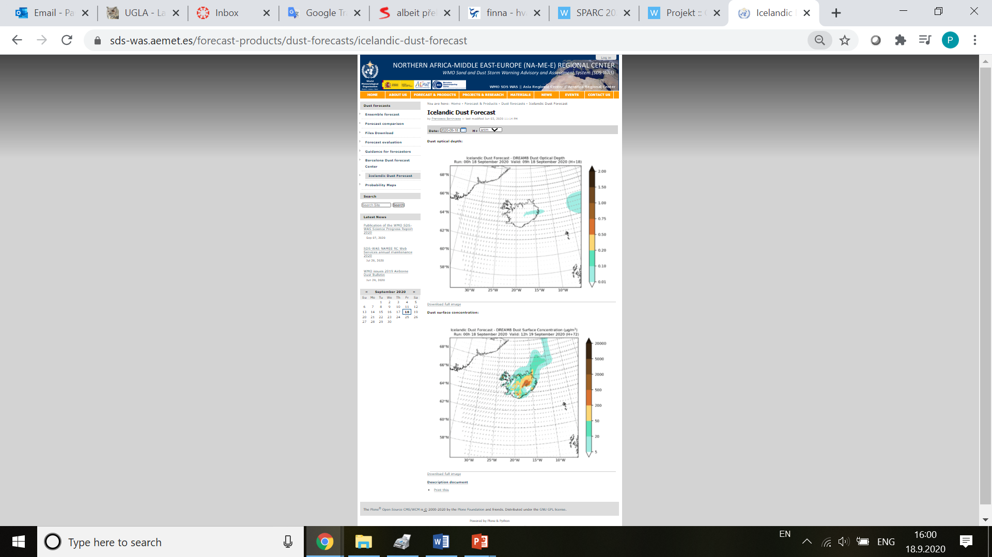
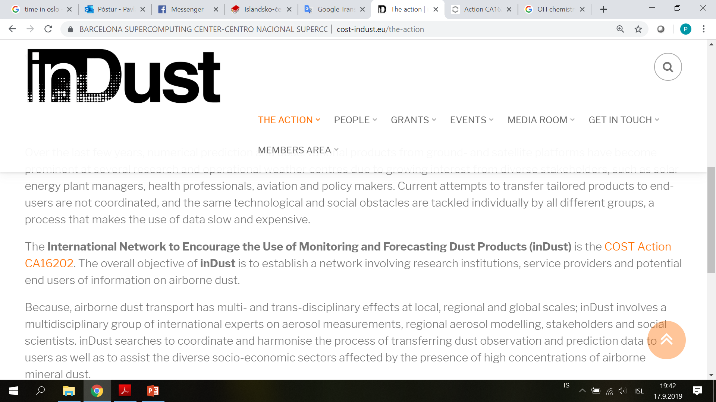

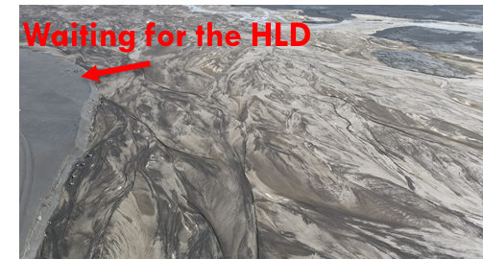
The role of High Latitude Dust in changing climate: Severe dust storm observations in Iceland and Antarctica in 2020-2021
PAVLA DAGSSON-WALDHAUSEROVA
O. ARNALDS, J-B Renard, A. Vukovic, S. nickovic, O. MEINANDER, J. Kavan, B. Cvetkovic, N. Burdova, B. Moroni, Fragment and Hilda teams, and more
EGU 2022
Vienna, Austria, 23-27 May 2022
Dyngjusandur Aug 2022, courtesy of Oli Arnalds

Slide 2
HLD TALK outline
general updates on HLD: New hld sources and their estimated area
HLD research – update from Iceland and antarctica
Saharan dust in Iceland
Icelandic aerosol and dust association (ICEDUST)

Slide 3
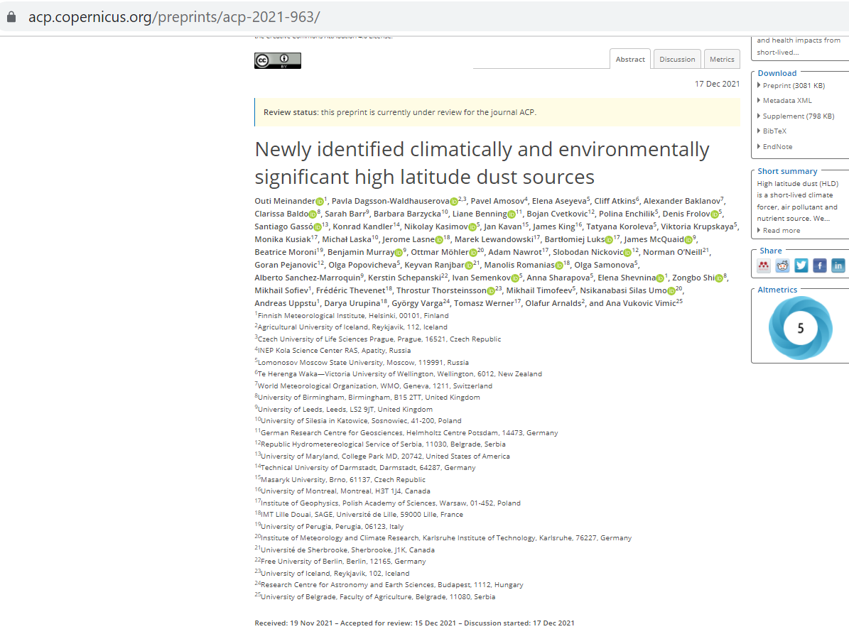
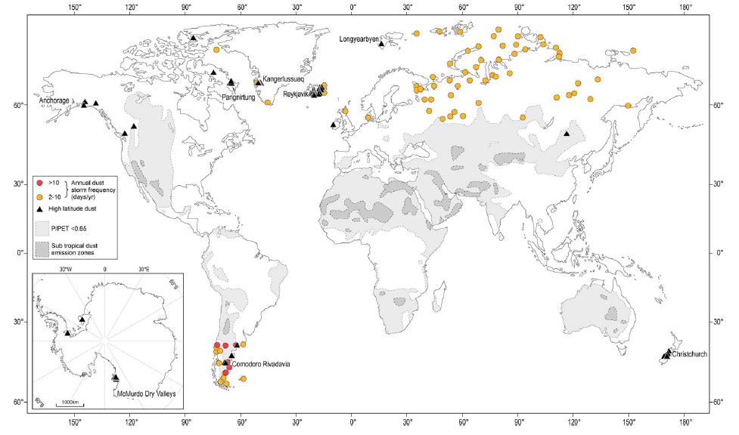
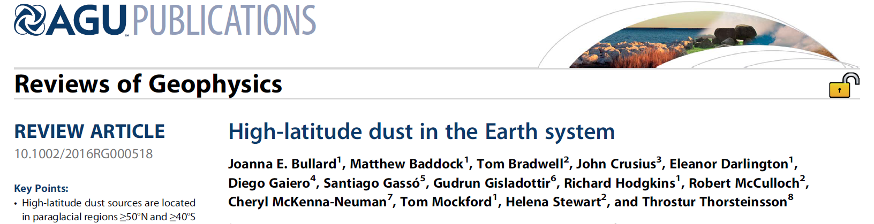
High latitude dust areas – updates on the sources
> 60 new locations

Slide 4
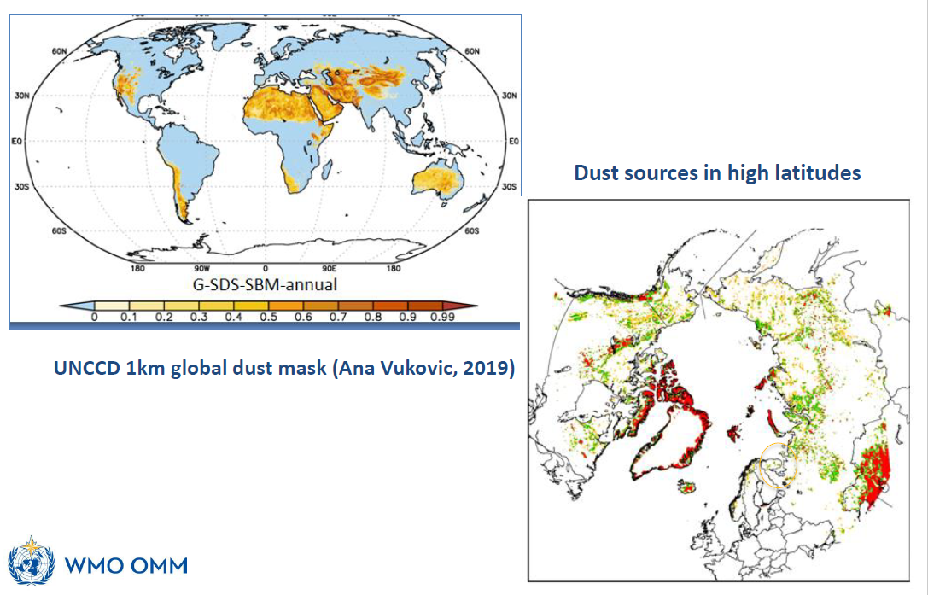
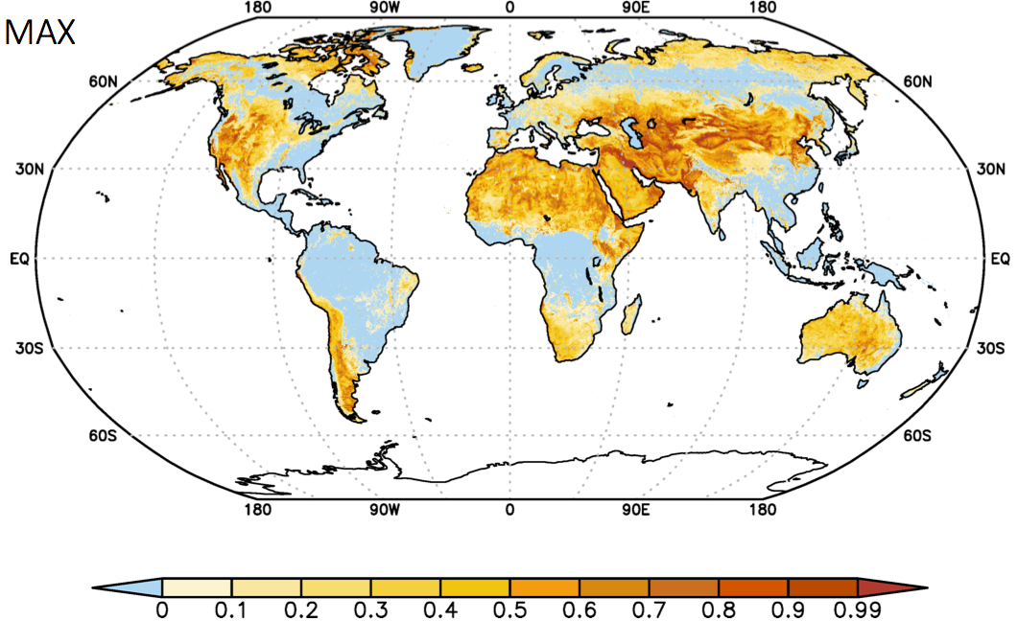
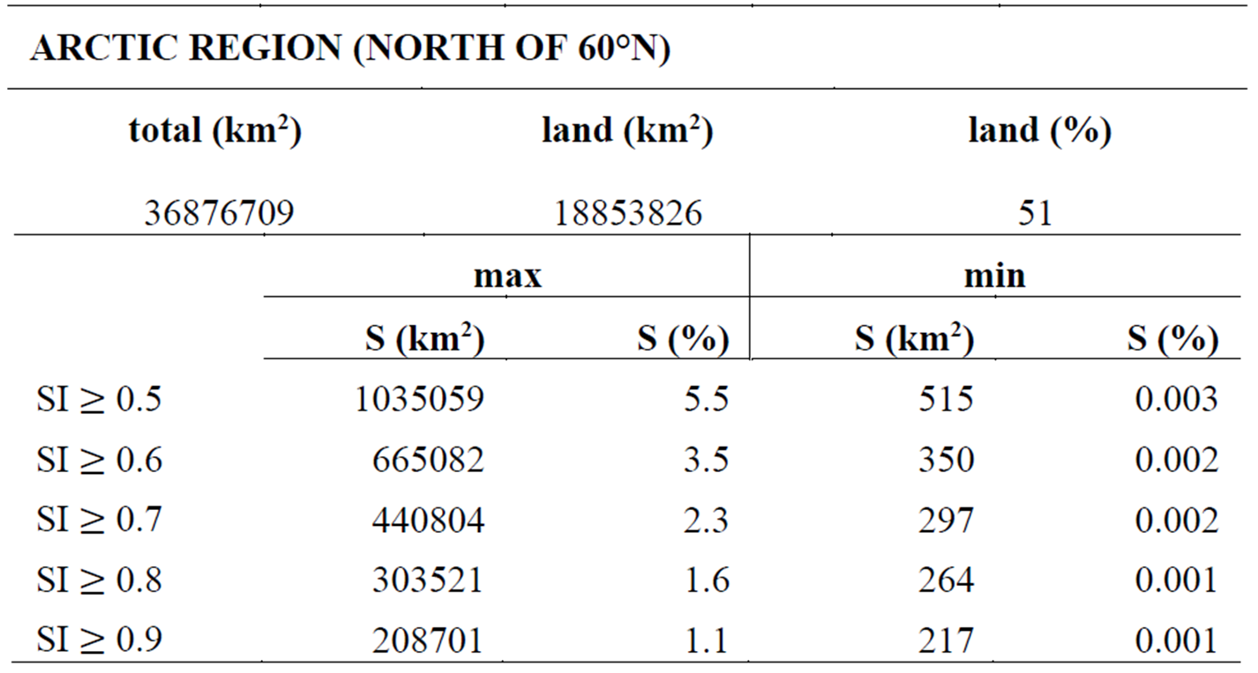
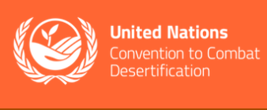
High latitude dust areas
Vukovic, 2019. Sand and Dust Storms Source Base-map
https://maps.unccd.int/sds/
SDS index = Source Intensity (SI)
- includes seasonal variability!
Dust enhanced activity years

Slide 5
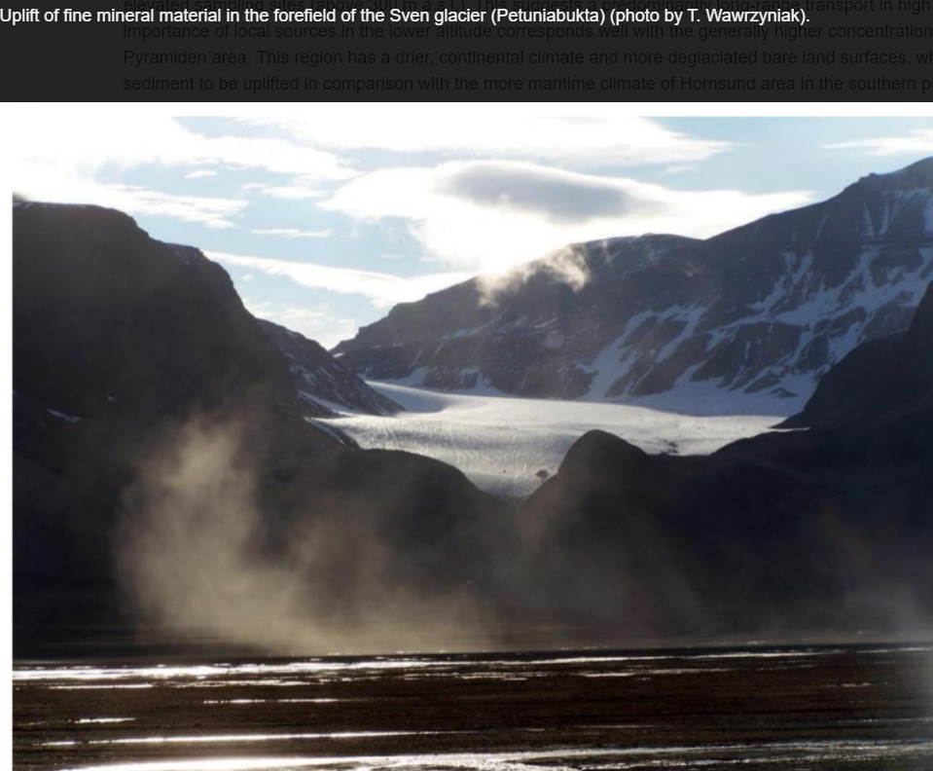
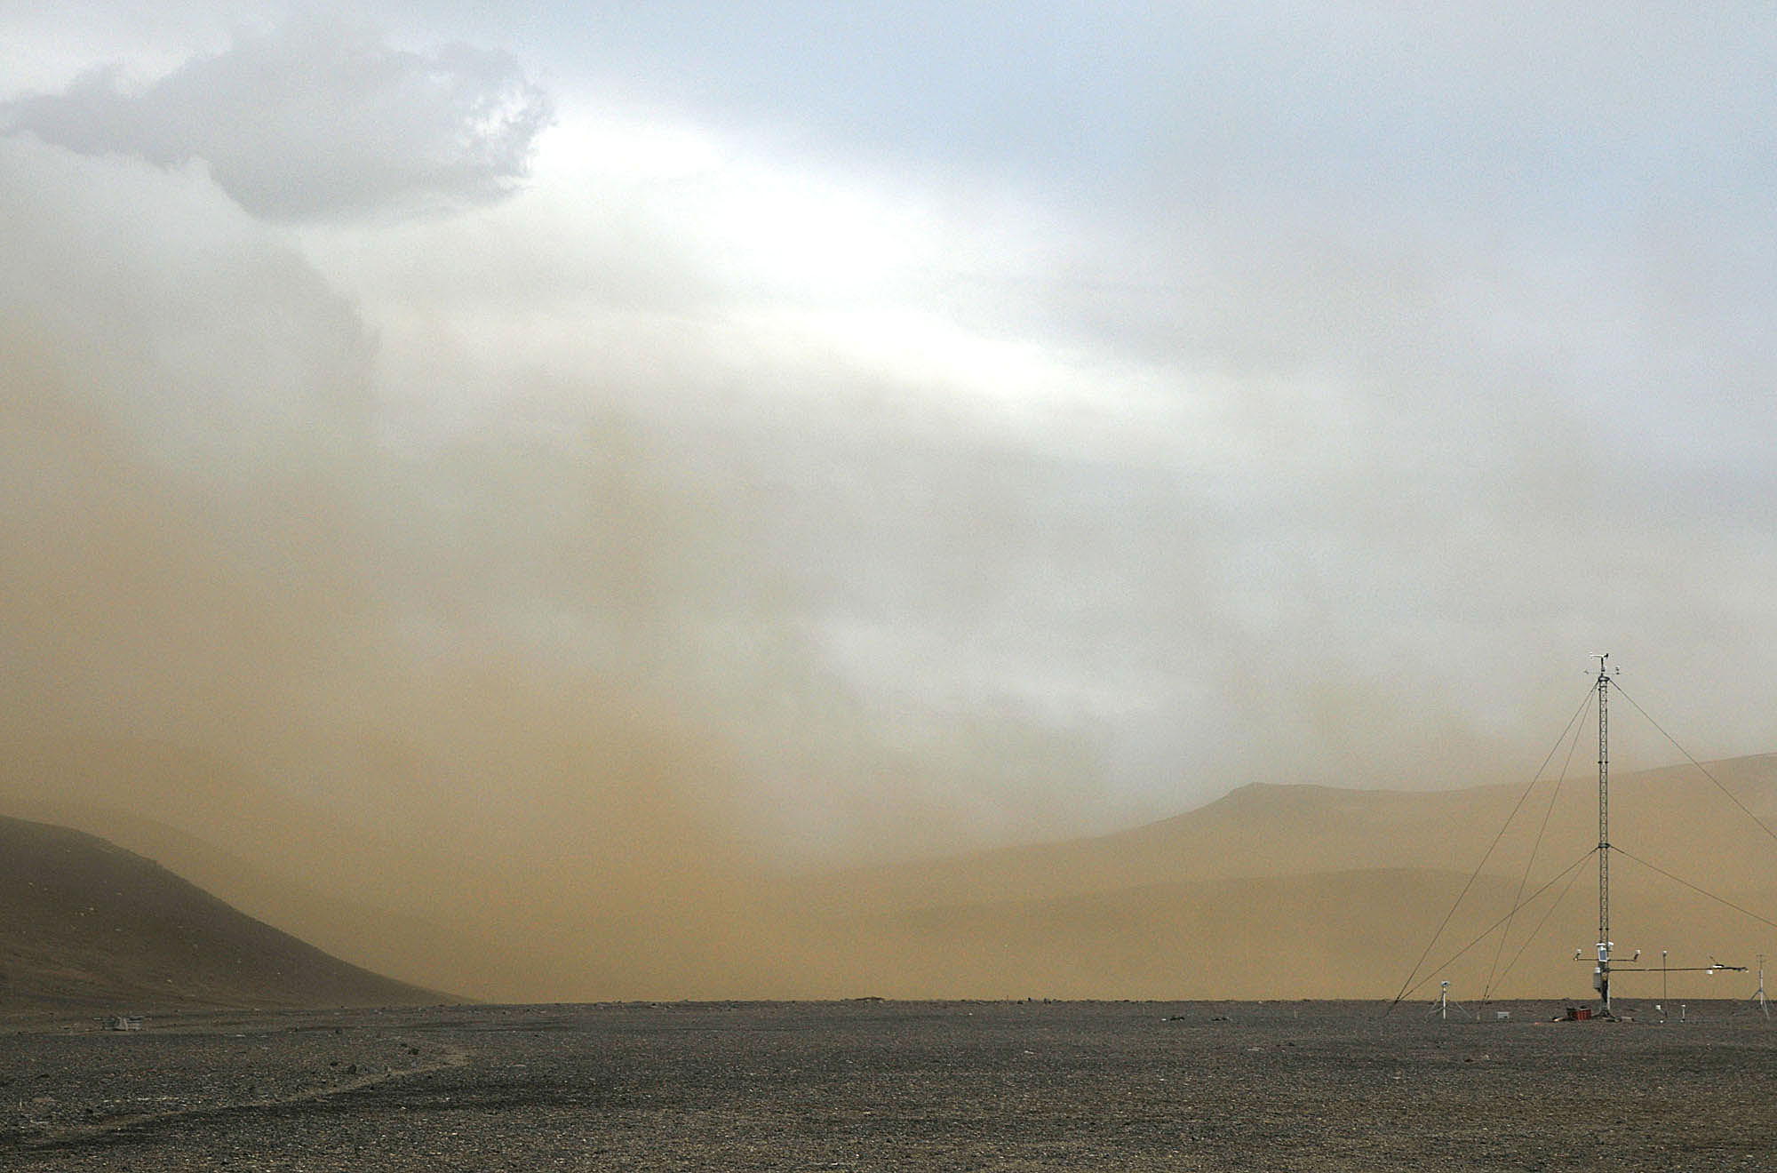
Evidence from the newly indentified HLD sources provided
SVALBARD
ANTARCTICA 2021
Kavan et al. (2020)
Photo by Kamil Laska

Slide 6
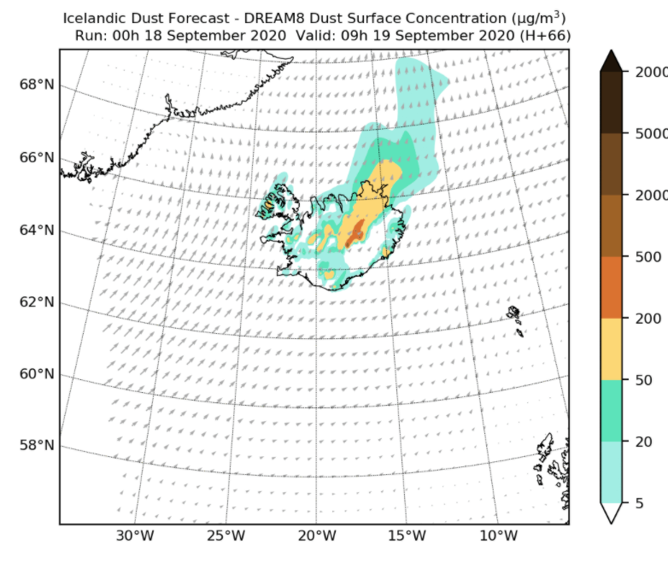
First HLD operational forecast under WMO SDS-WAS
Officially launched in September 2020
https://sds-was.aemet.es/forecast-products/dust-forecasts

Slide 7
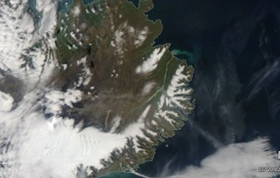
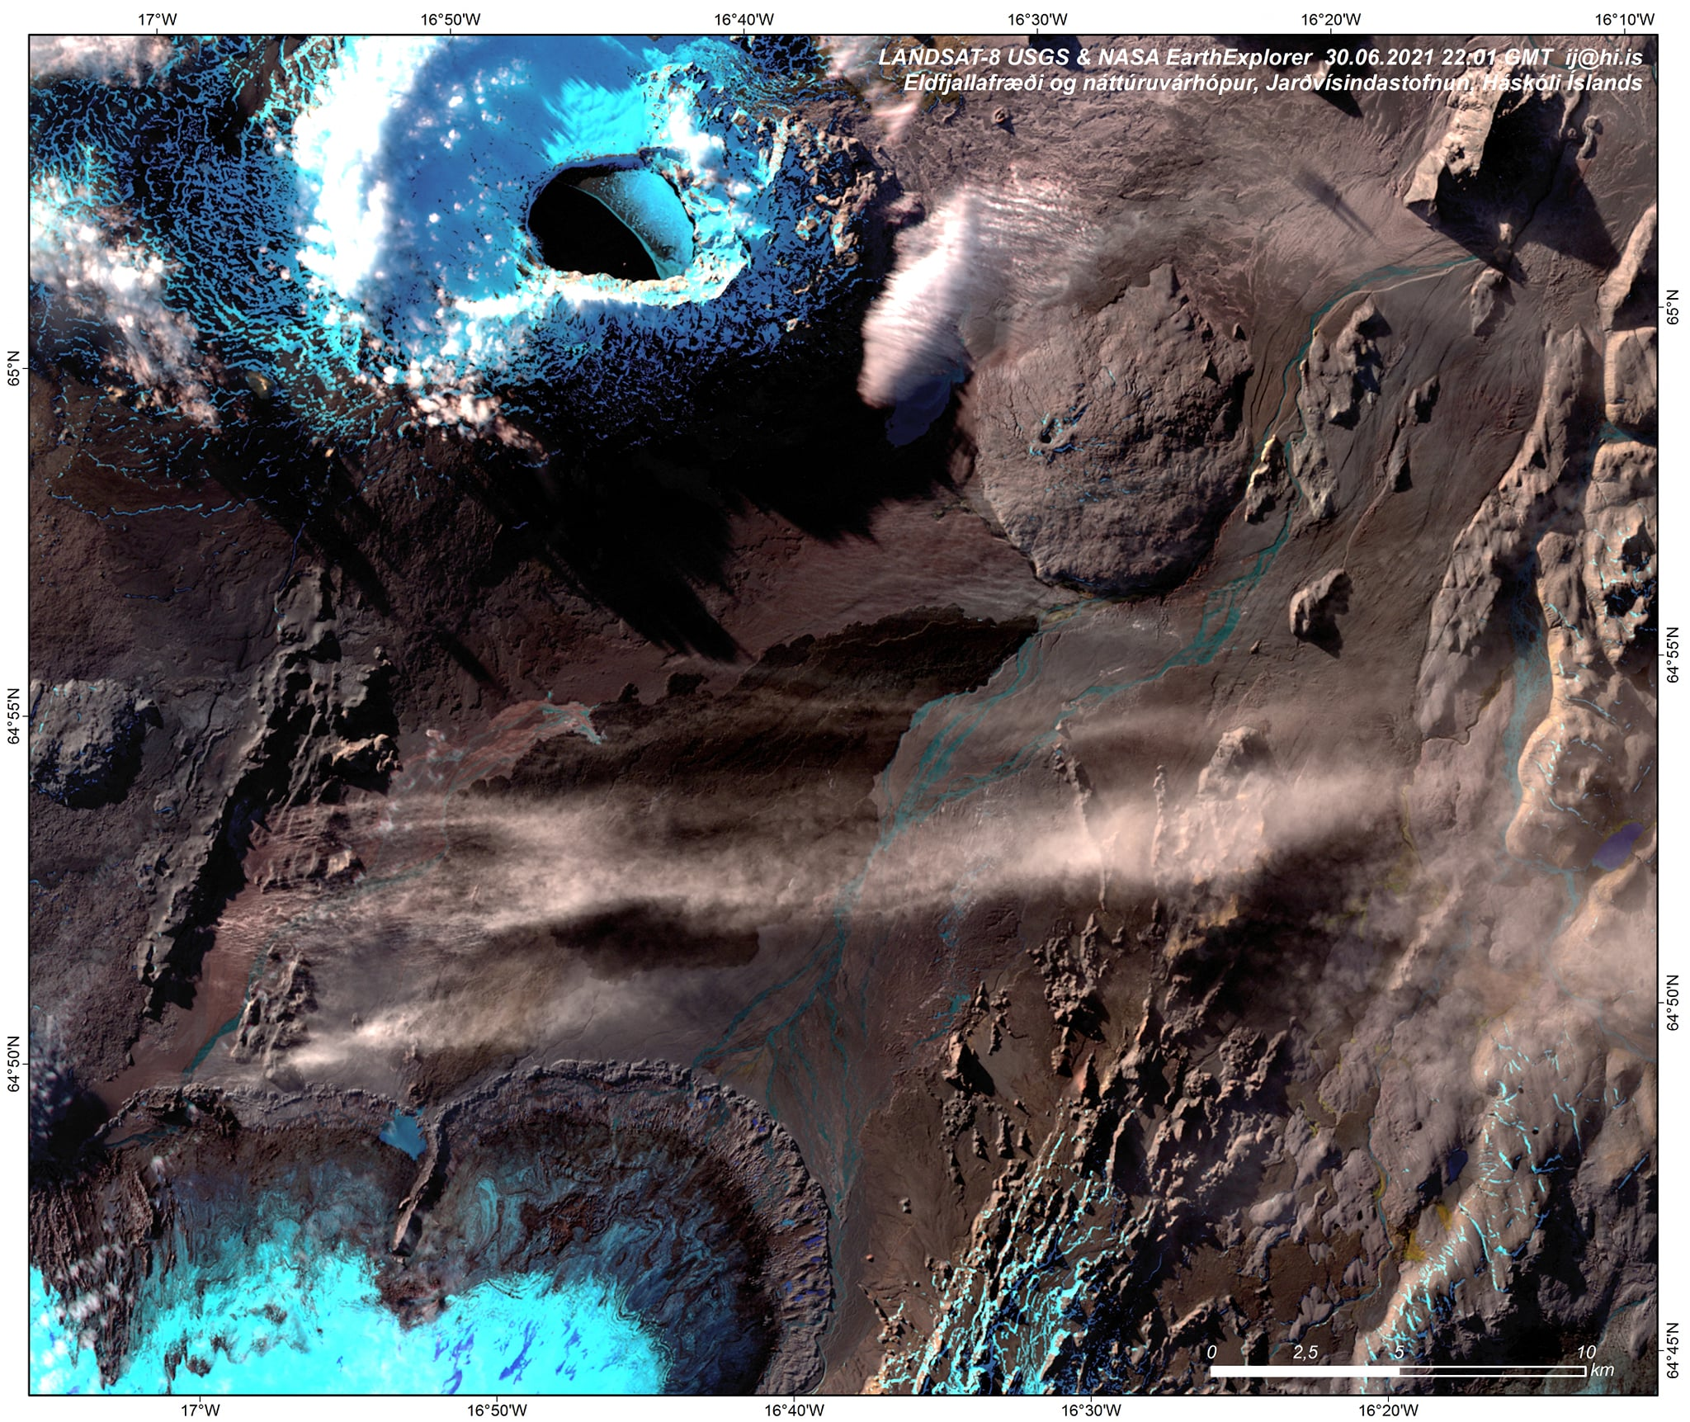
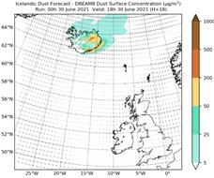
international HLD field caMpaign 2021

Slide 8
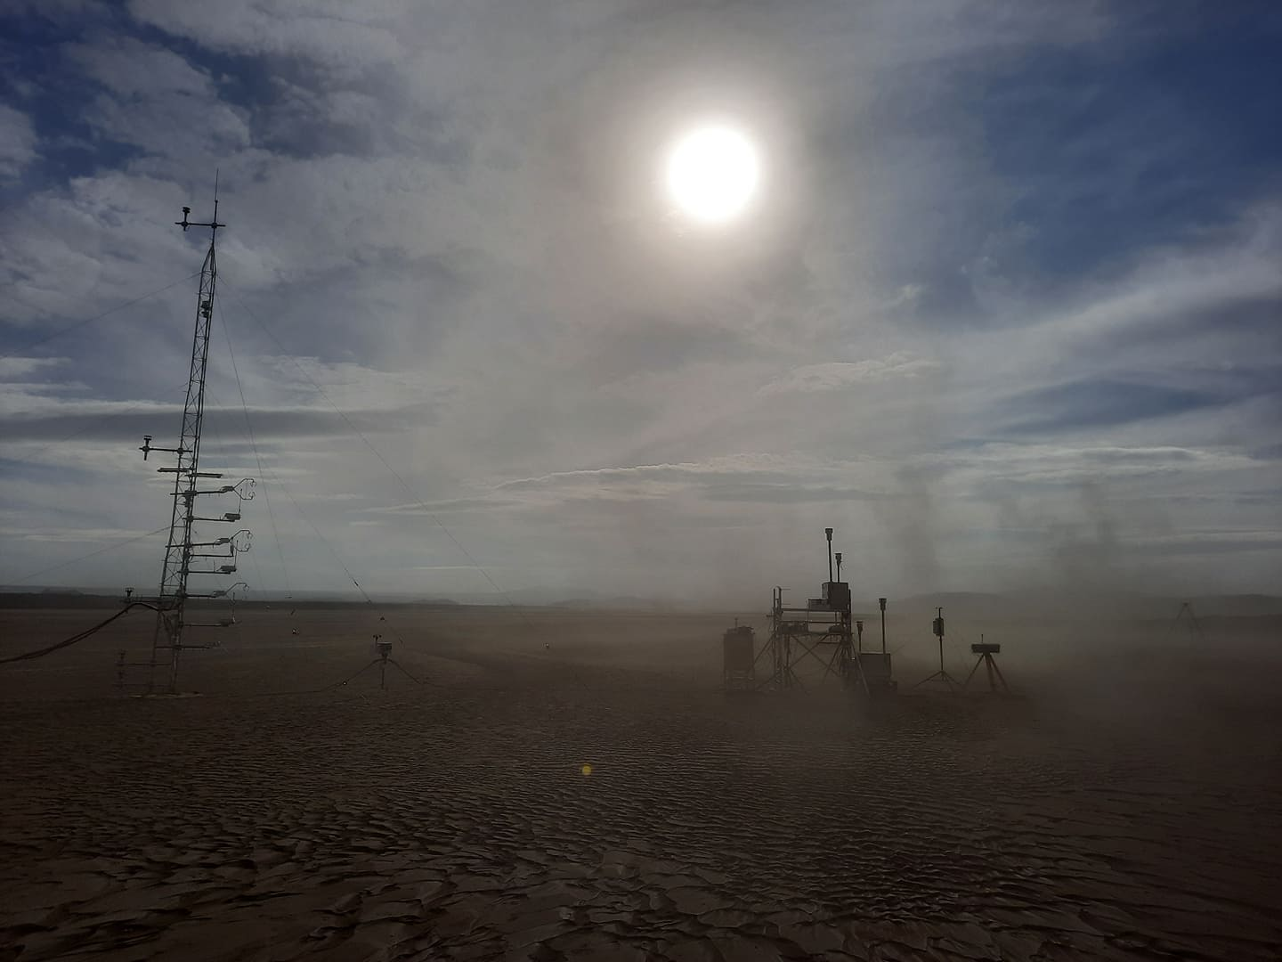
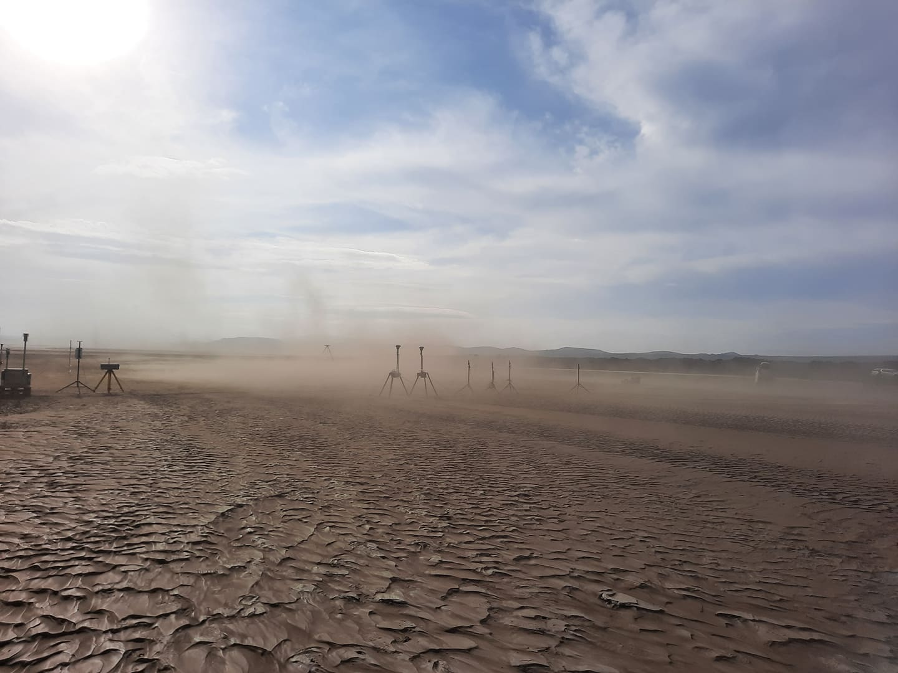
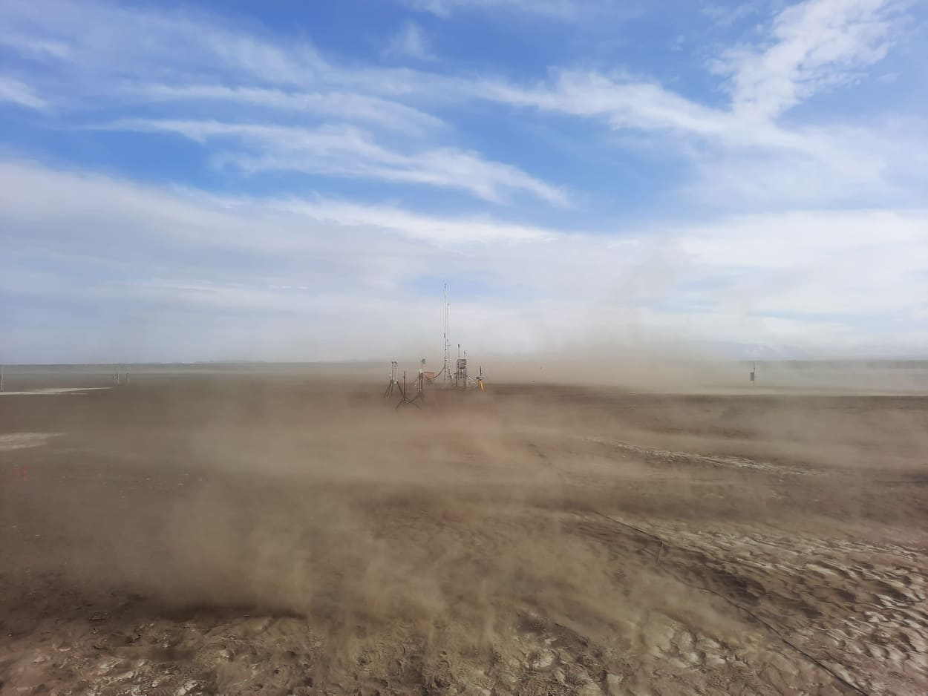
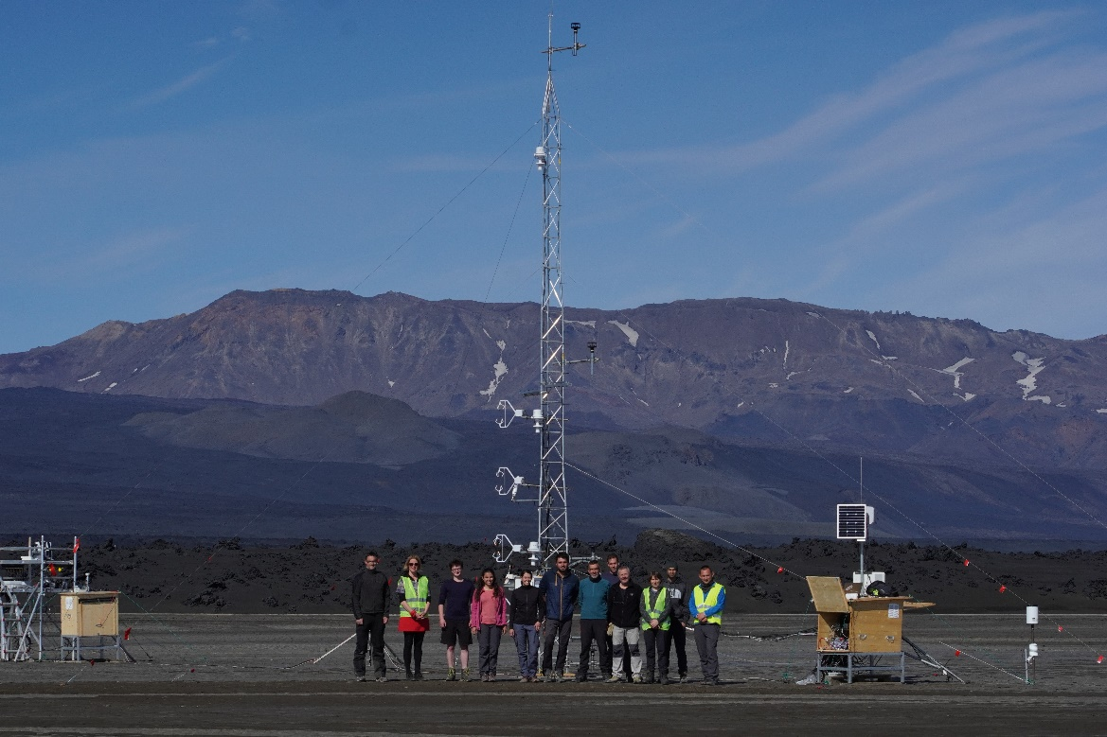
Dyngjusandur dust campaign > an analogue for mars?
Participants institutions:
Barcelona Supercomputing Center (BSC)
Environmental Assessment and Water Research – Spanish Research Council (IDAEA-CSIC)
Technical University Darmstadt, Germany
Freie Universität Berlin
Karlsruhe Institute of Technology, Germany
CALTECH, JPL, NASA
National Research Institute for Agriculture, Food and Environment (INRAE), France
Agricultural University of Iceland
Czech University of Life Sciences Prague
https://icedustblog.wordpress.com/2021/08/17/dust-experts-meet-in-dyngjusandur-to-conduct-the-largest-field-campaign-in-iceland/

Slide 9
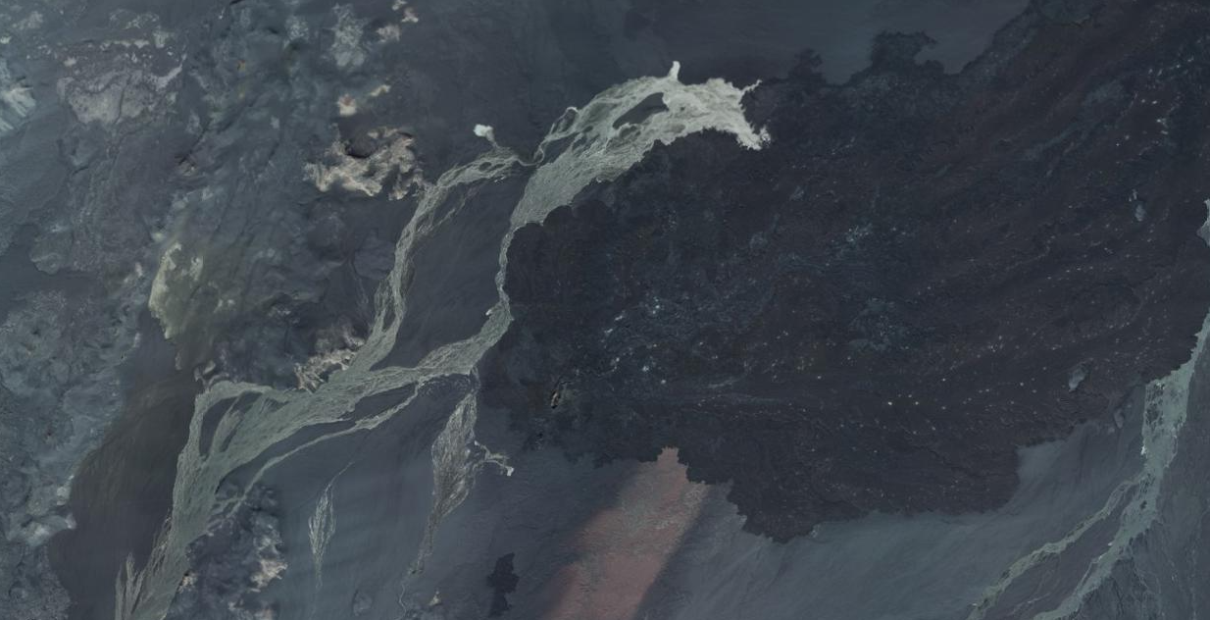
CAMERA
TOWER
SCIENTIFIC ROAD

Slide 10
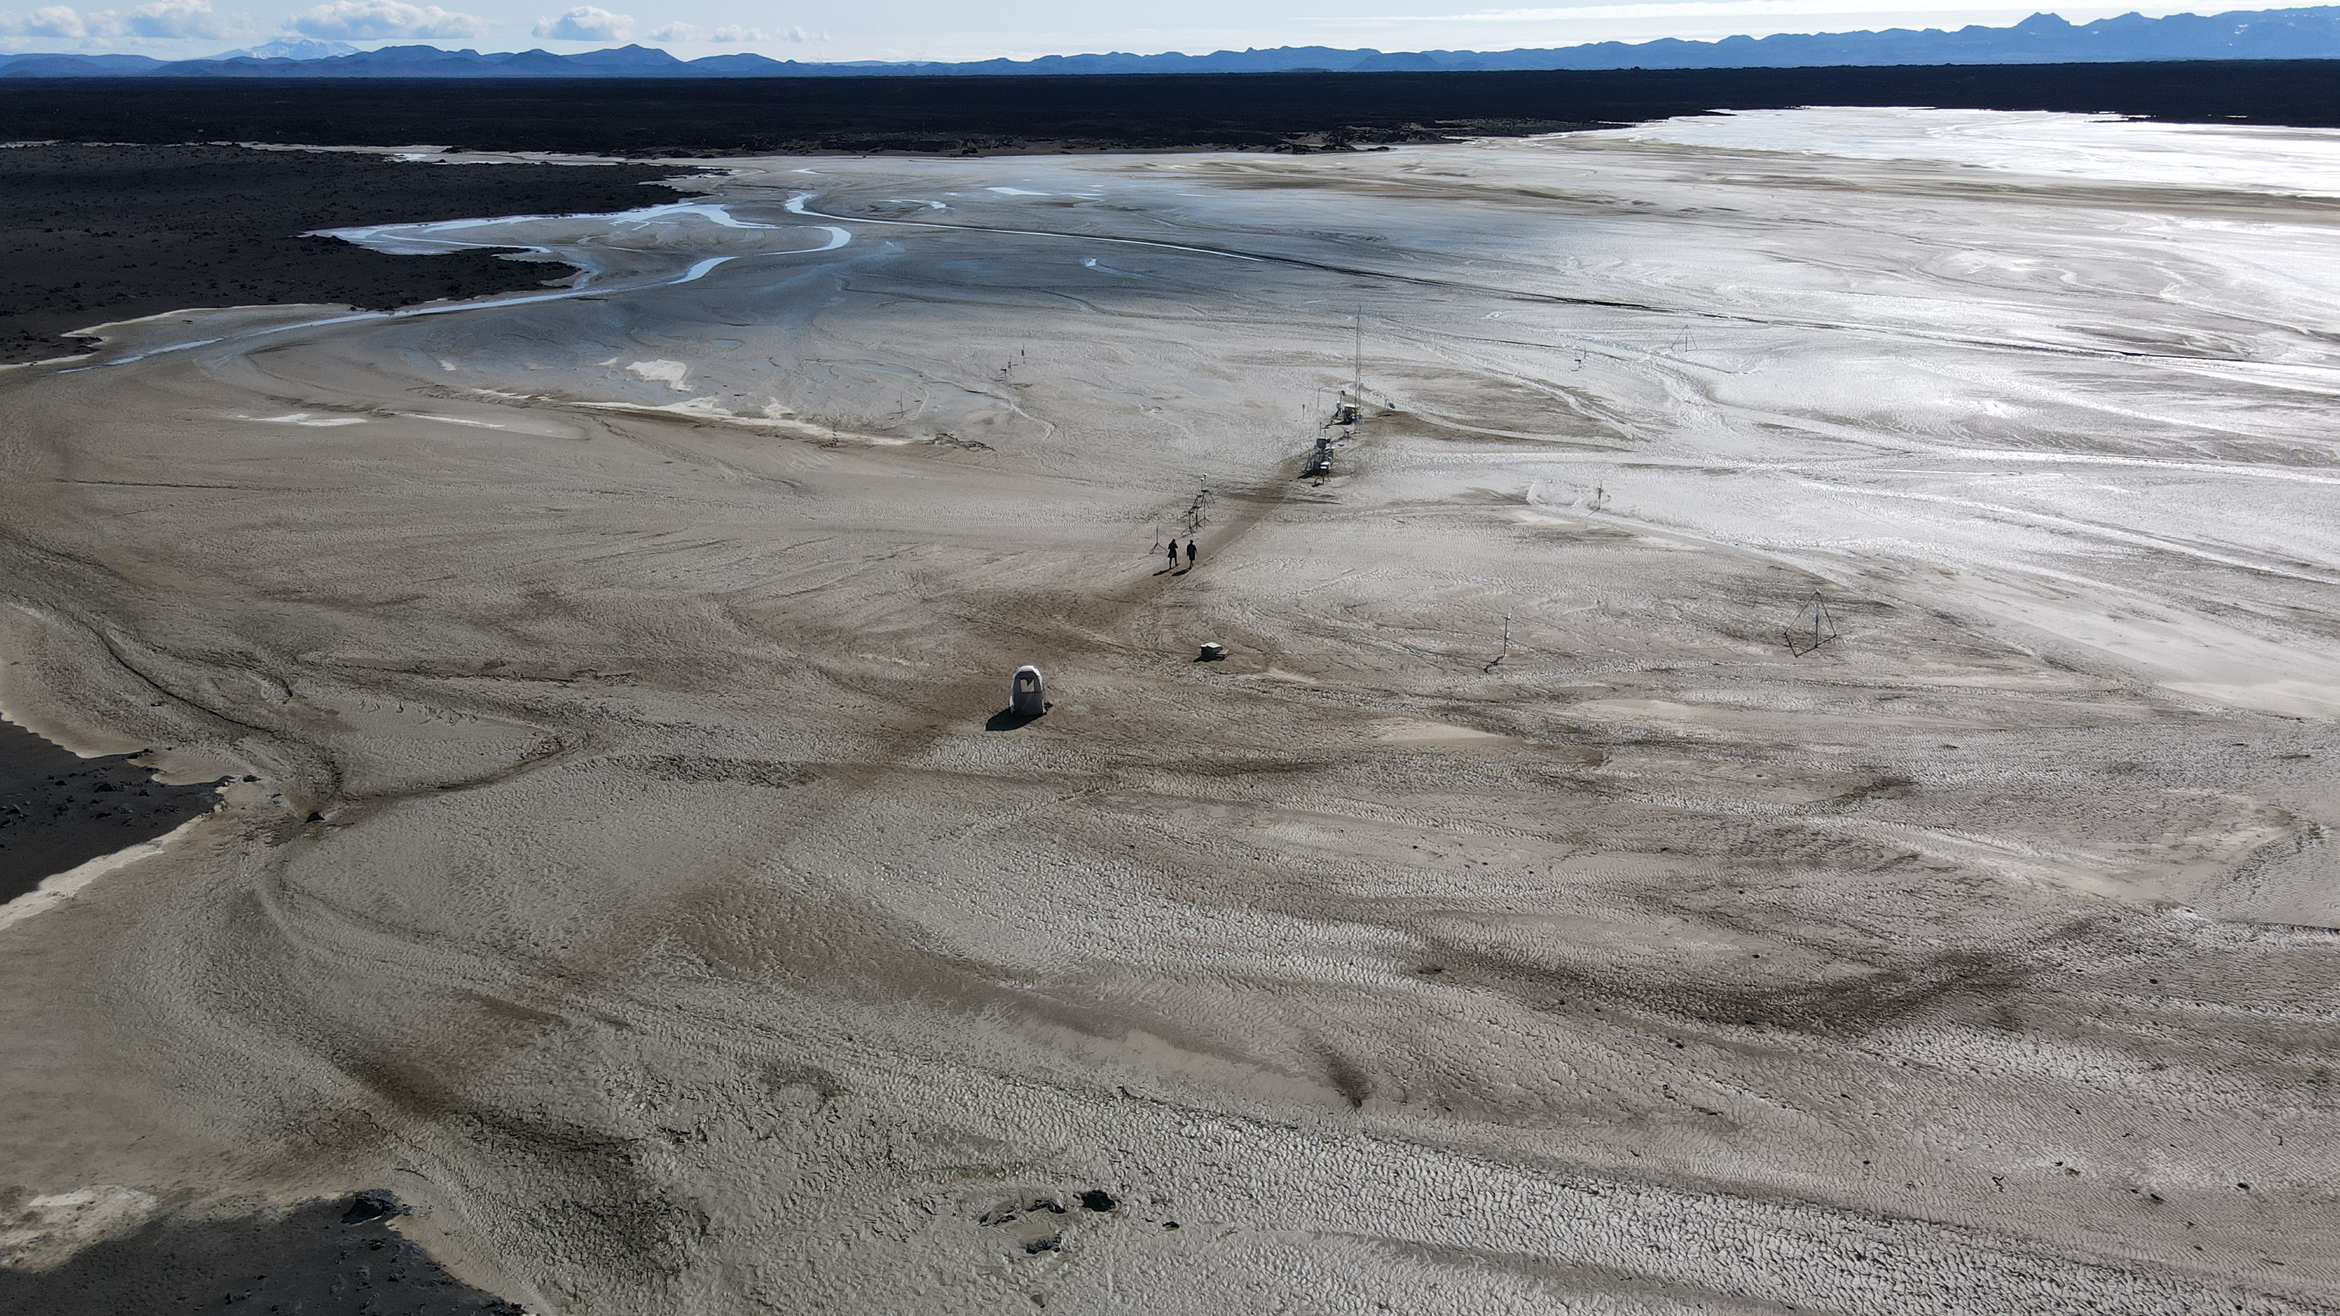
TOWER
Courtesy of Oli Arnalds

Slide 11
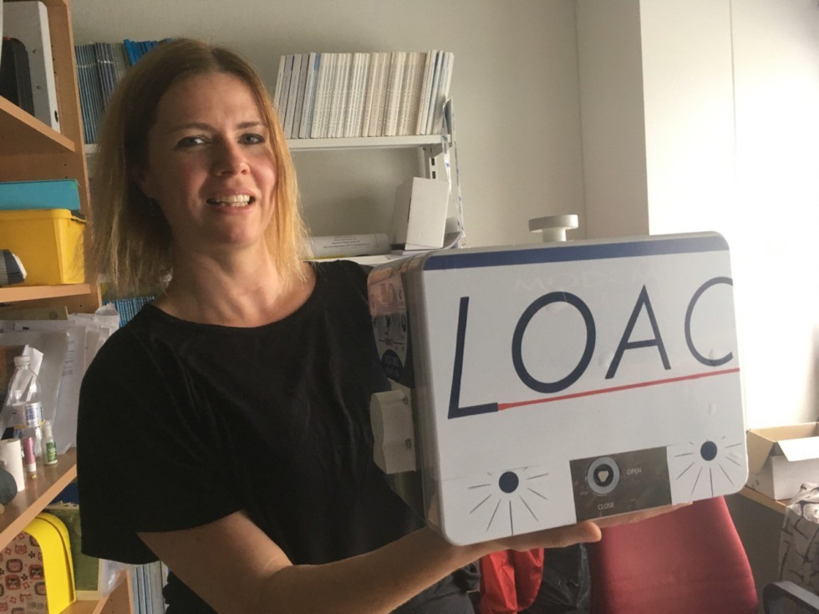
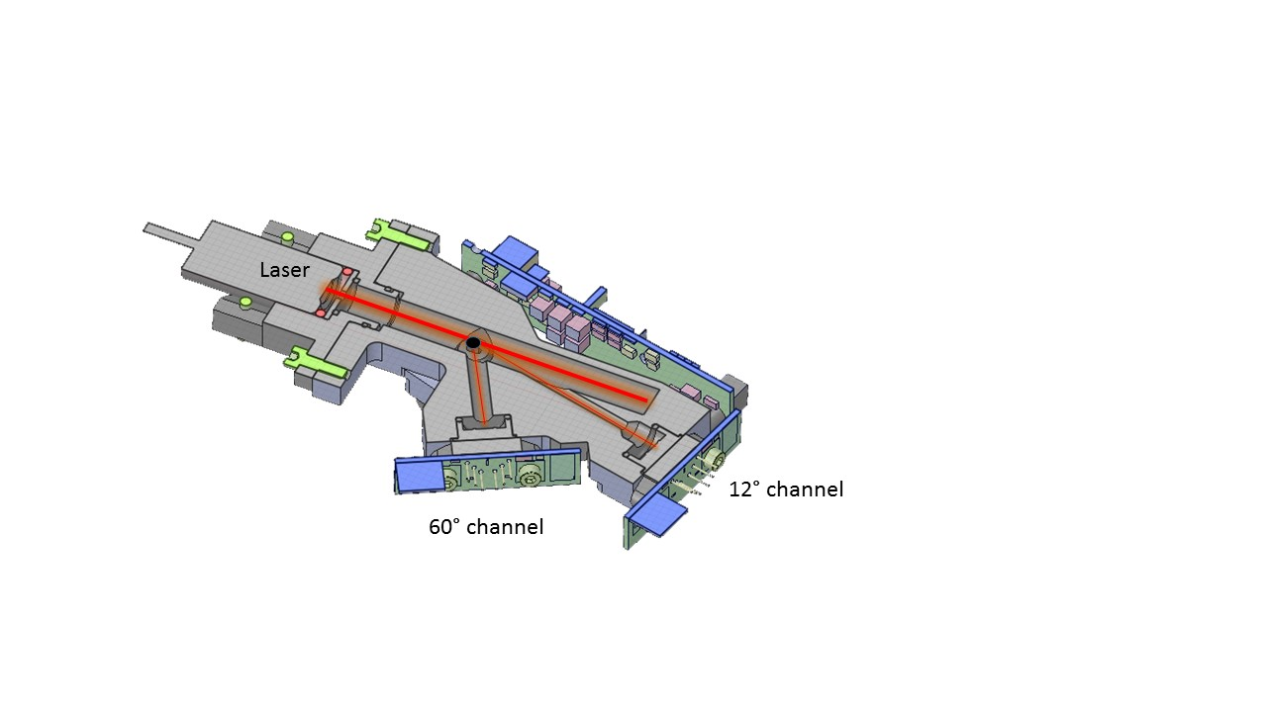
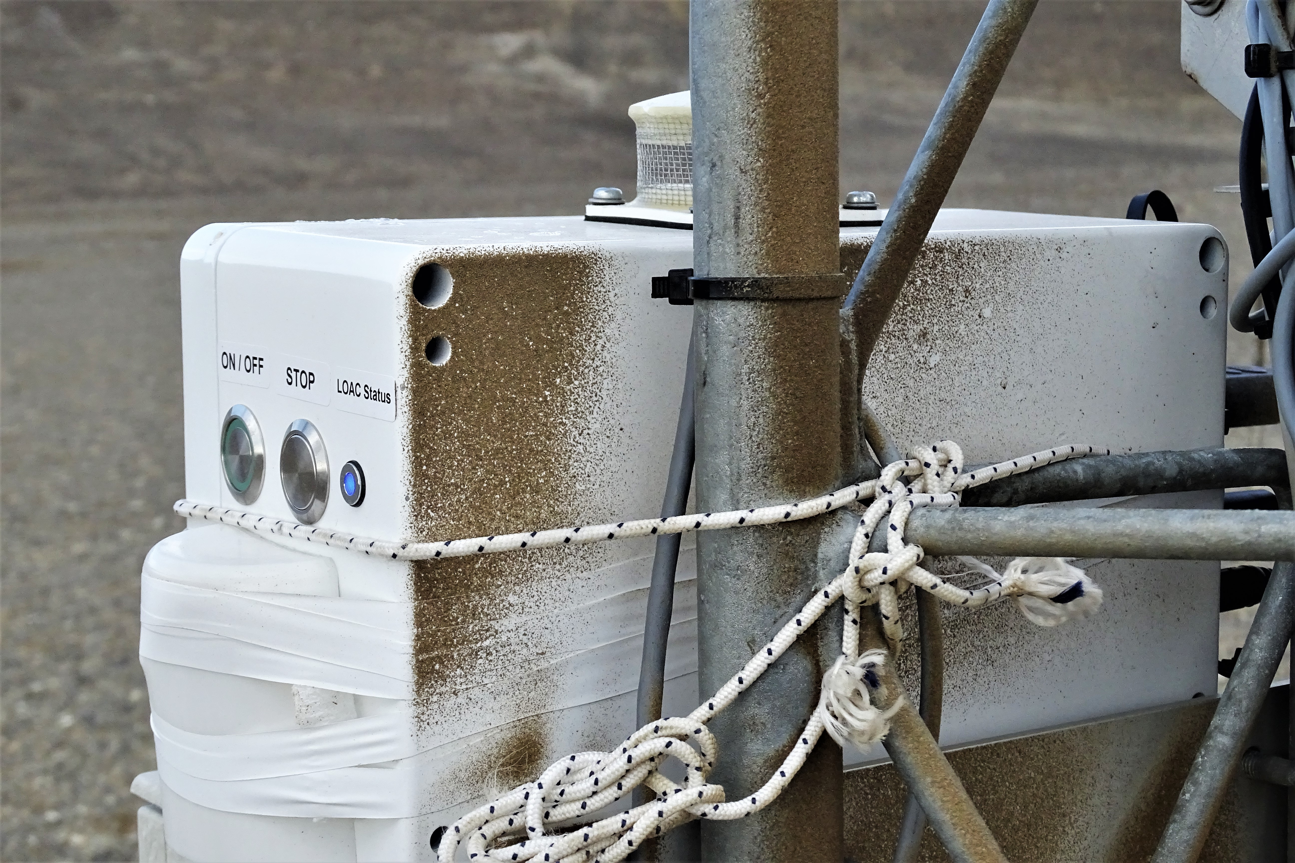
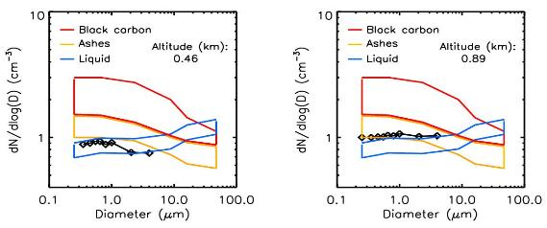
Light Optical Aerosol Counter (LOAC)
particulate matter (PM) number concentrations (particles/cm³)
19 size bins for particles 0.2 and 100 um
estimate aerosol typology (Renard et al., AMT, 2016)
Measurements at 2 scattering angles :
~12°, insensitive to refractive index of the particles (mainly diffraction) => accurate size and counting
~60°, sensitive to the refractive index of the particles => indication of the nature of the particle (typology)
Typology-particle type and size

Slide 12
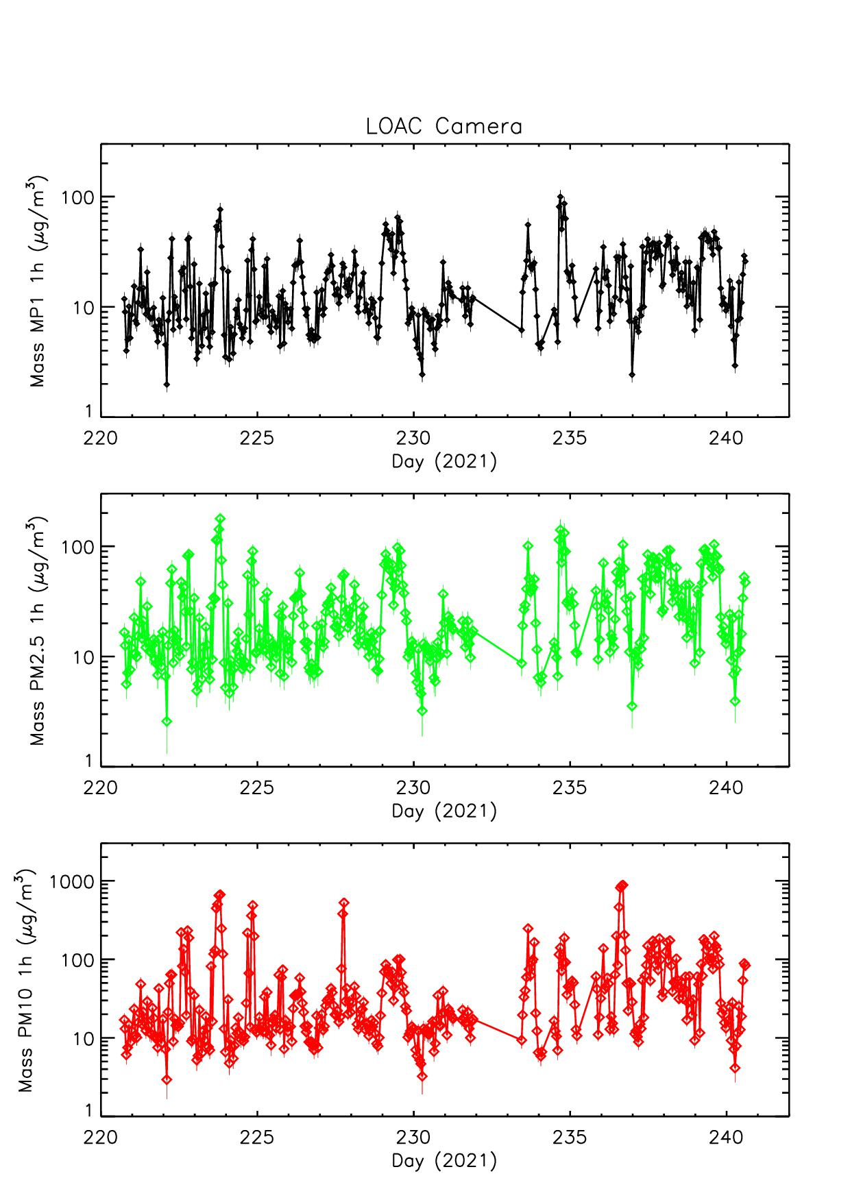
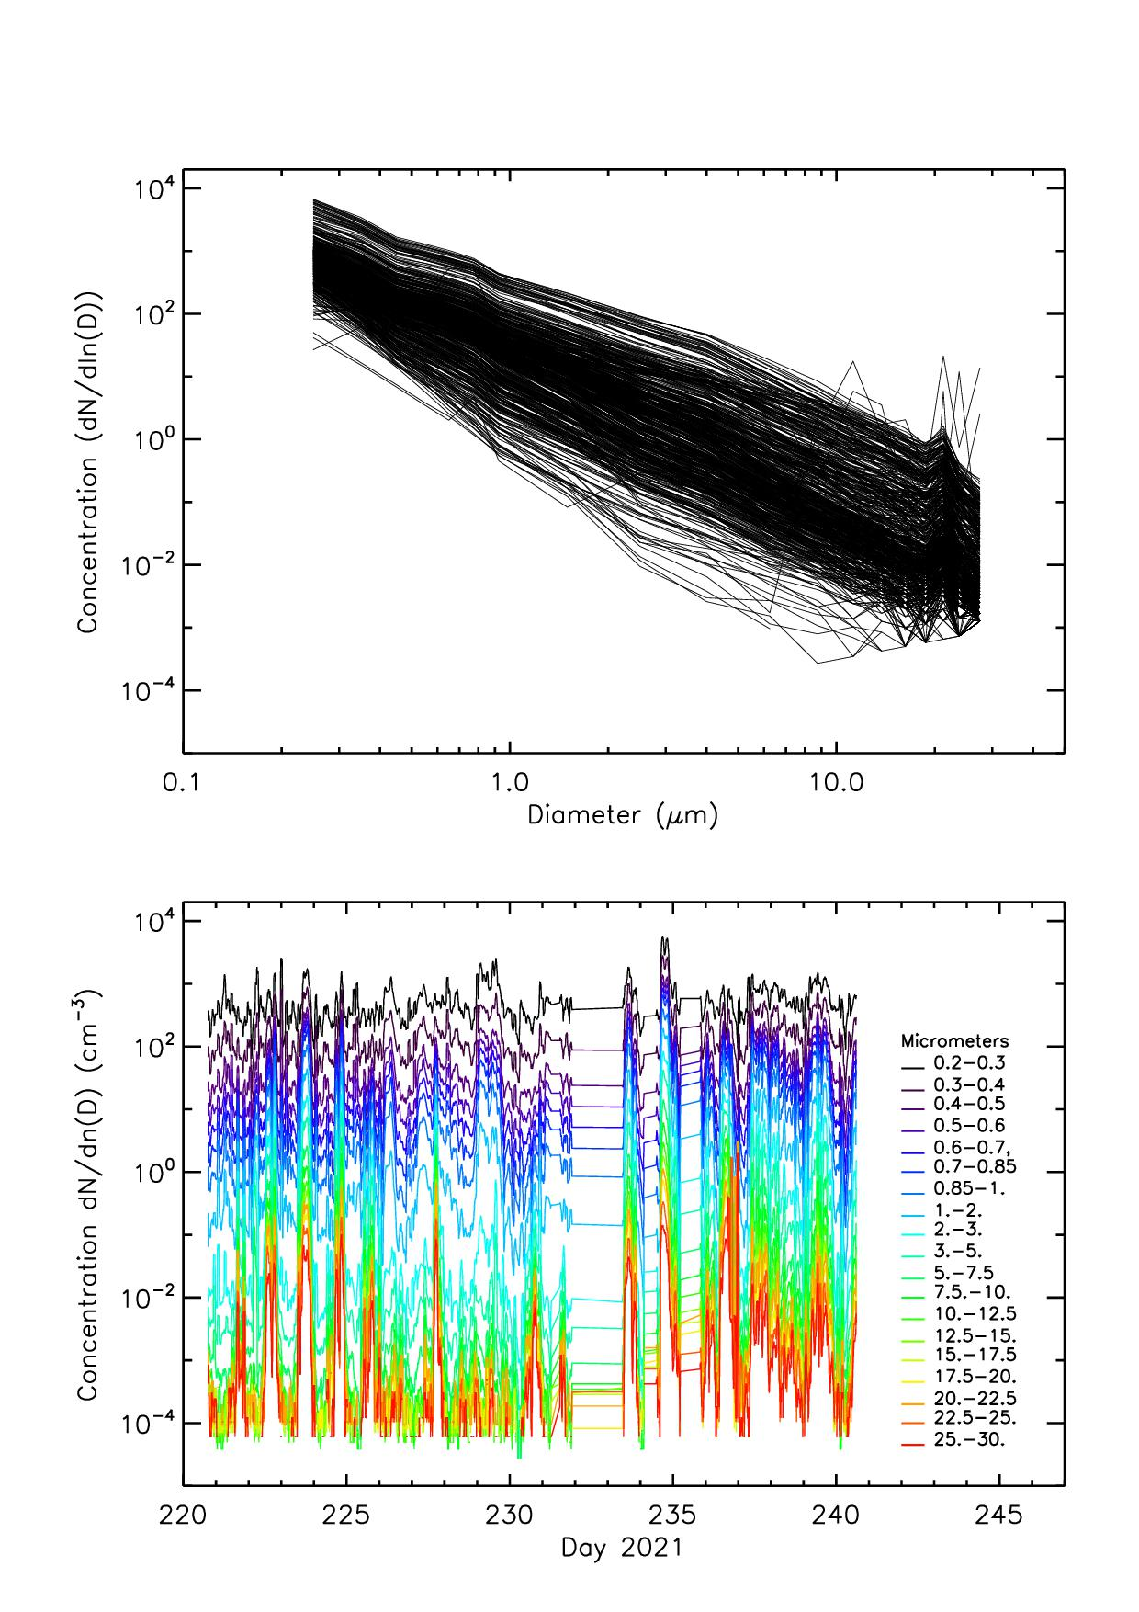
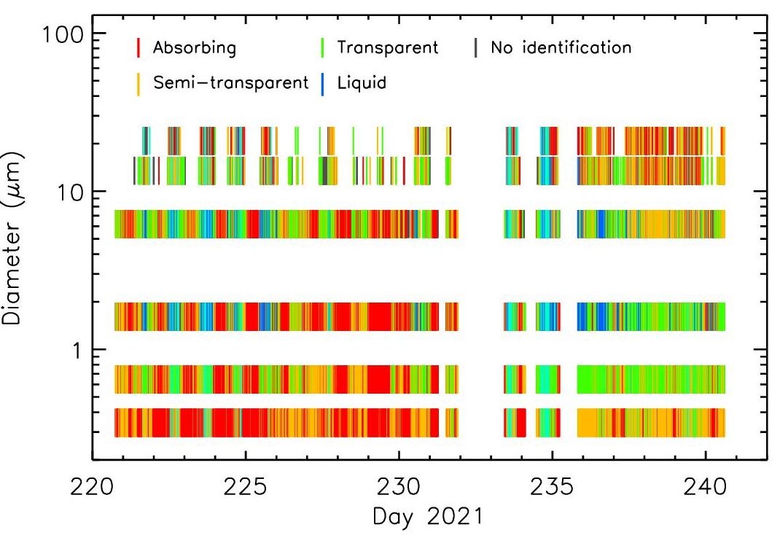
LOAC camera
PM mass concentrations AUG 2022
Particle Size Distributions and PM number concentrations
Gaps

Slide 13
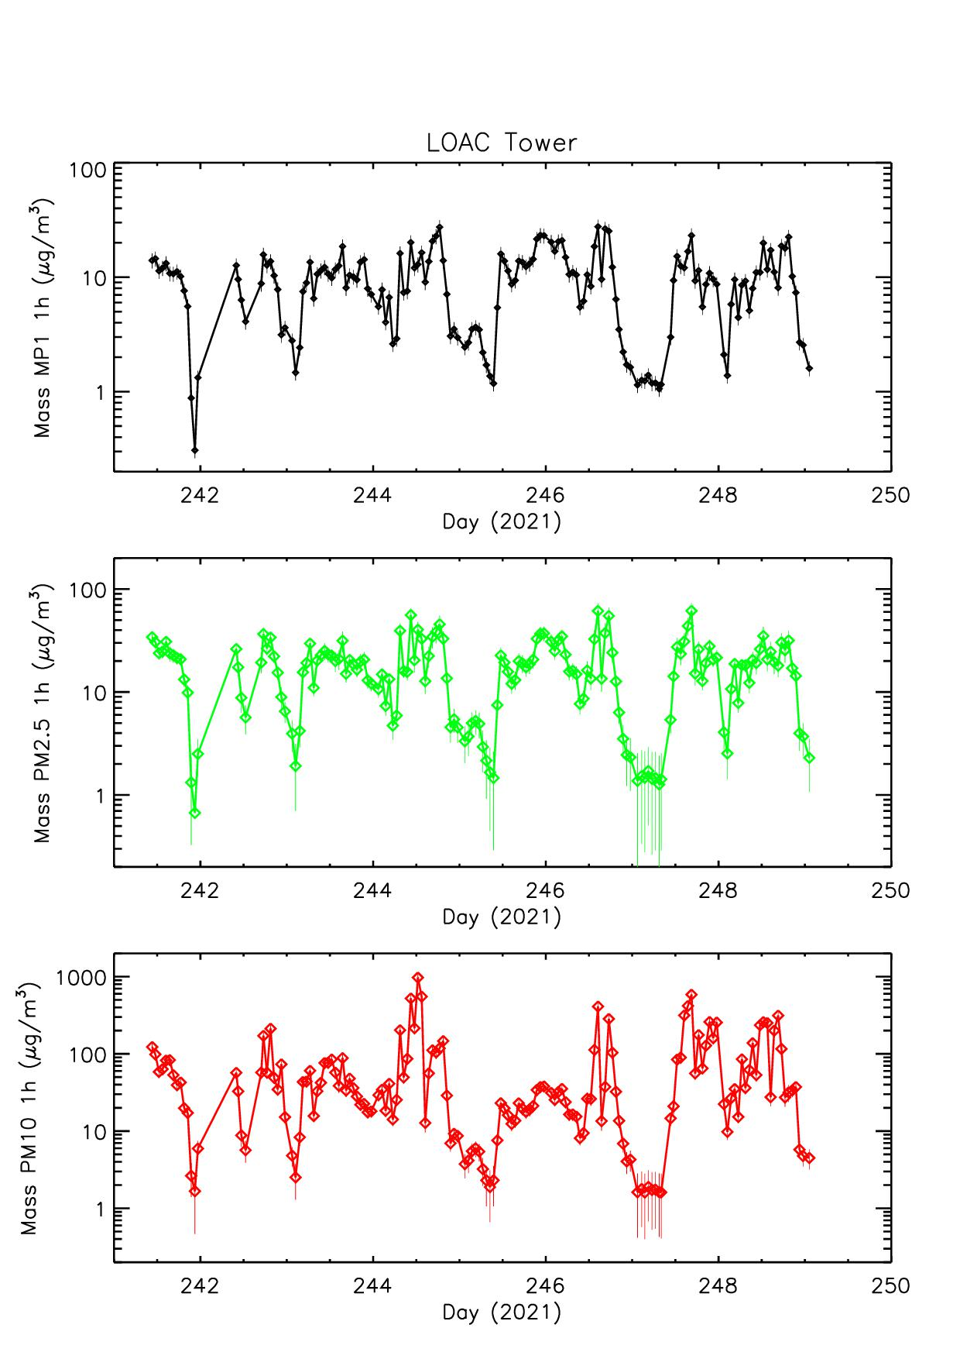
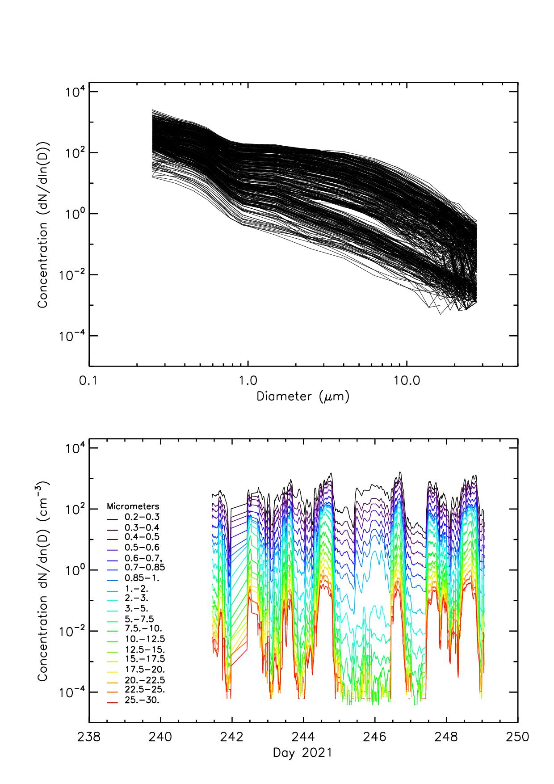
LOAC tower
PM mass concentrations 29 AUG to 6 SEP 2022
PM number concentrations AUG 2022
Particle Size Distributions

Slide 14
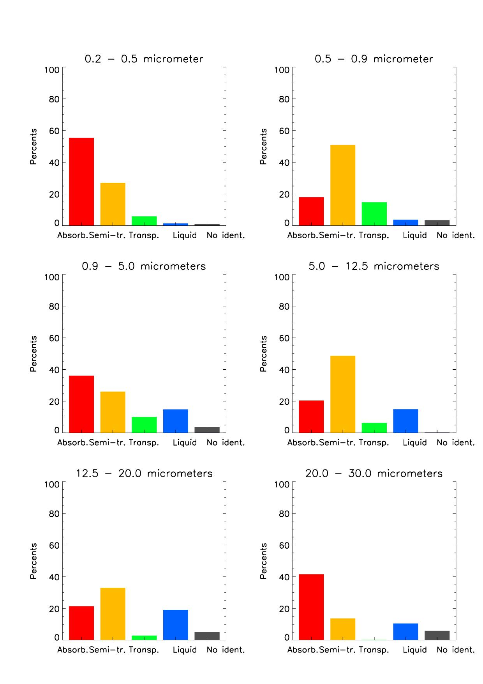
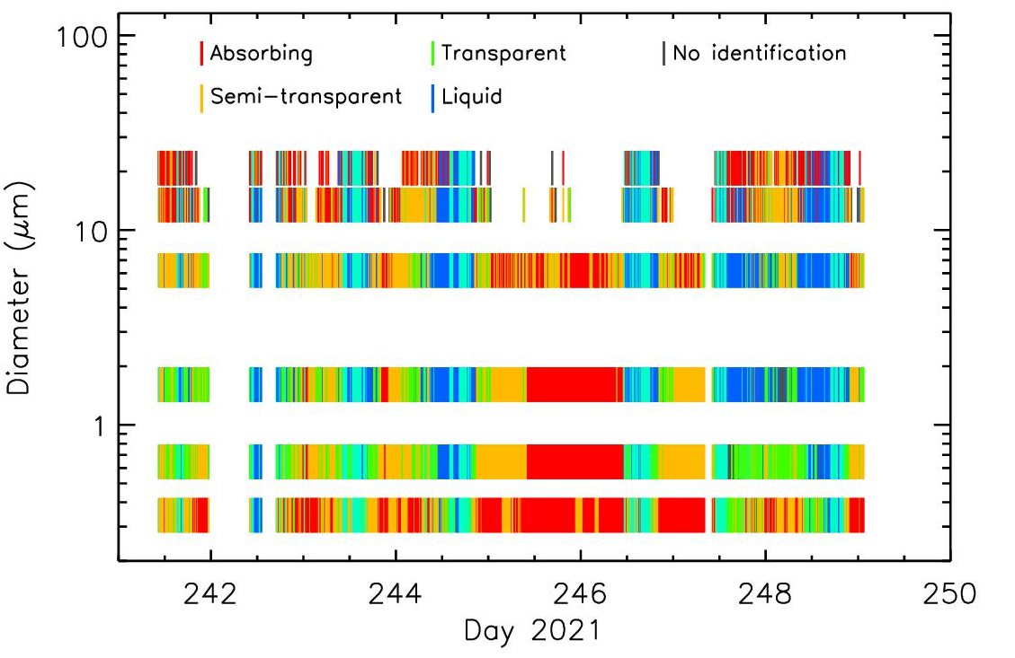
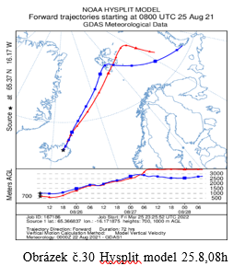
LOAC tower
After 24.8. towards Svalbard

Slide 15
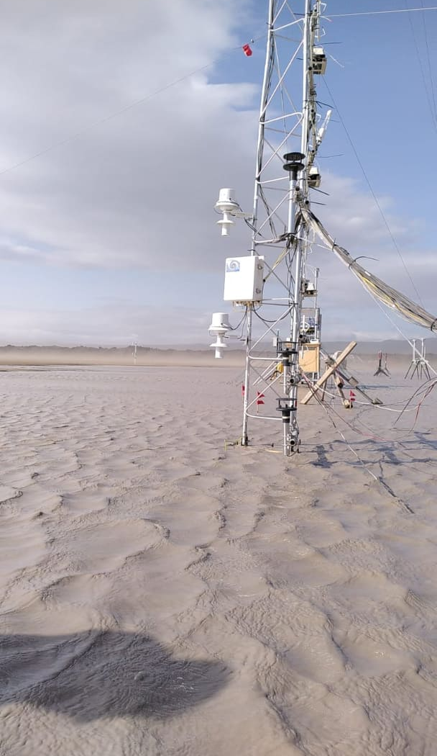
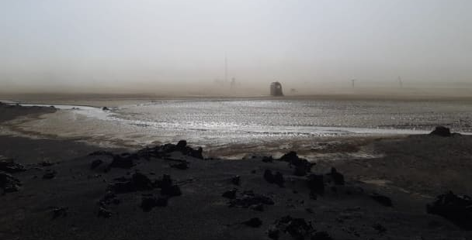
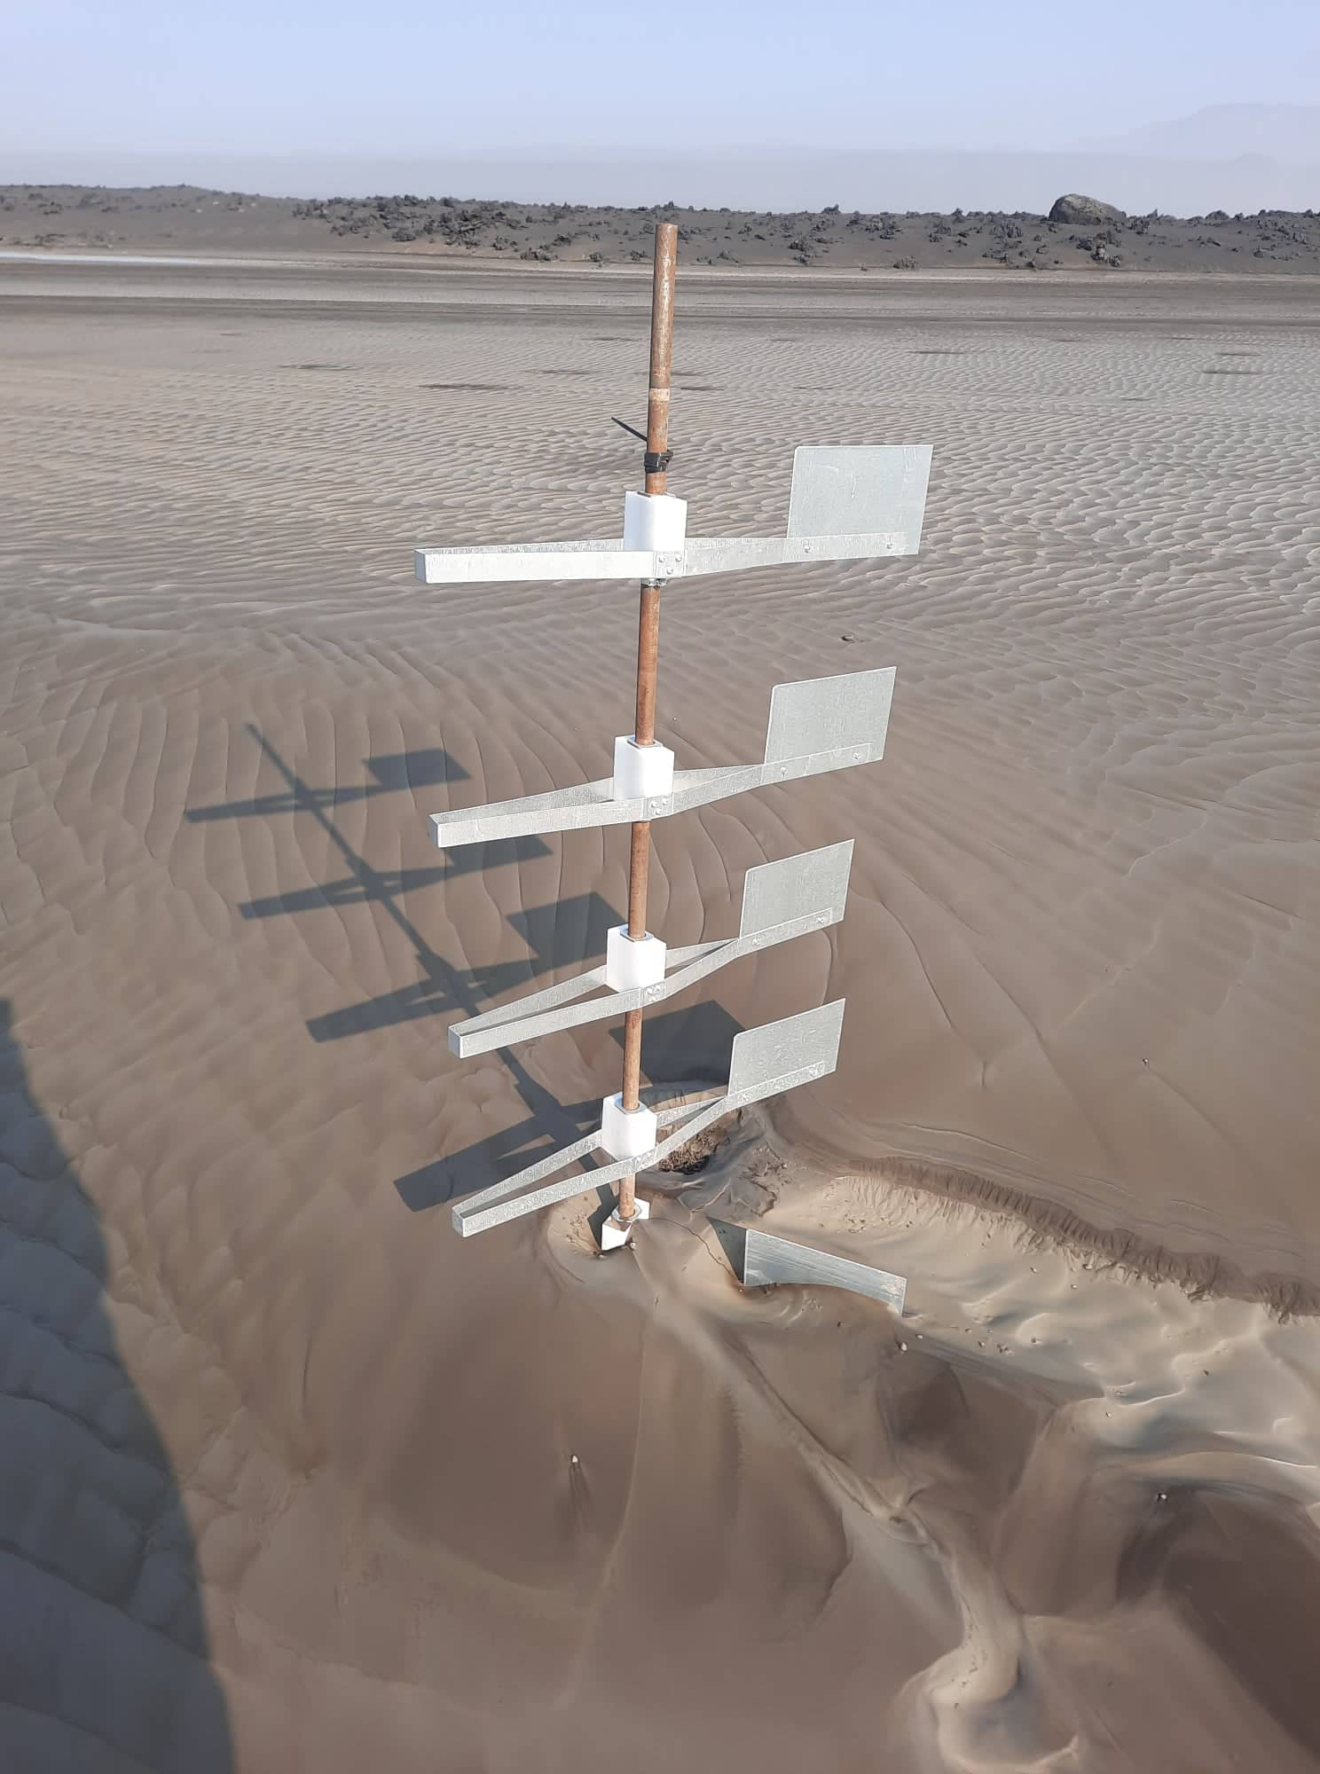
Flooding in the desert
> 25 cm of new material after one night

Slide 16
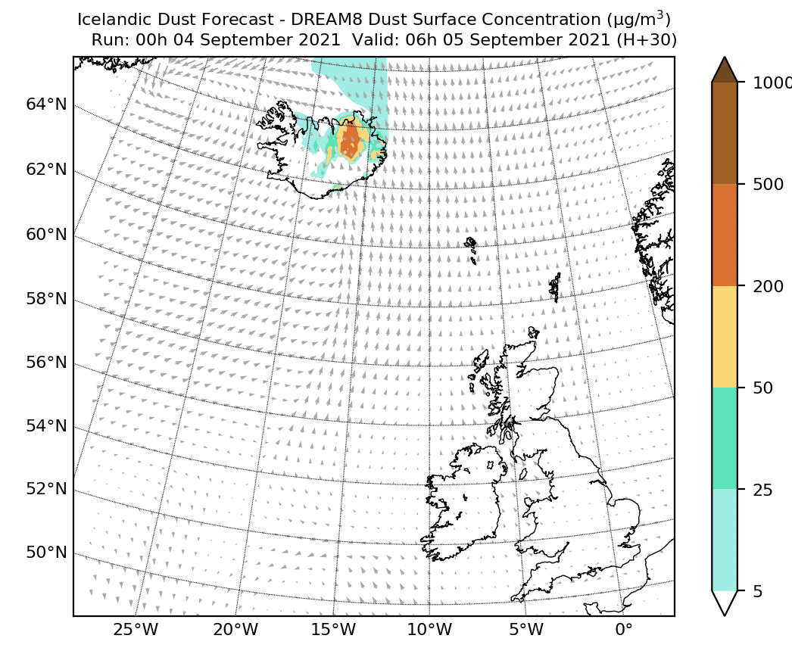
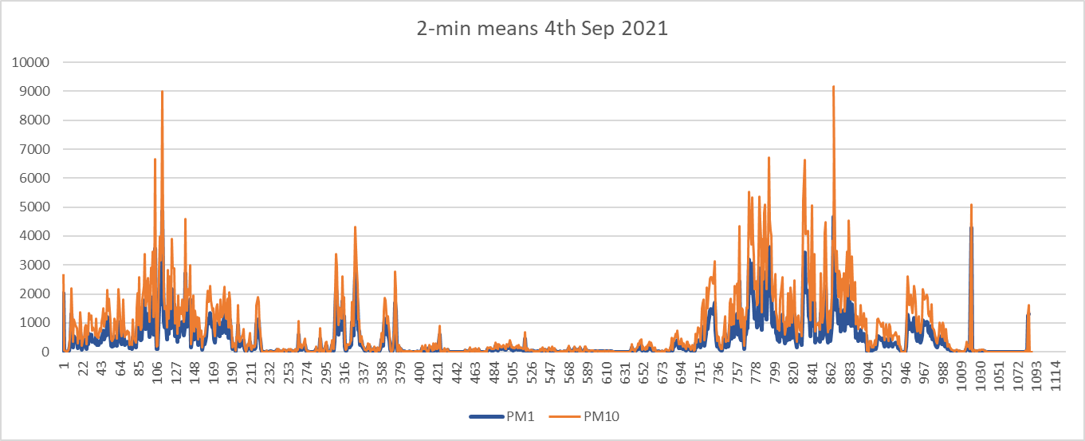
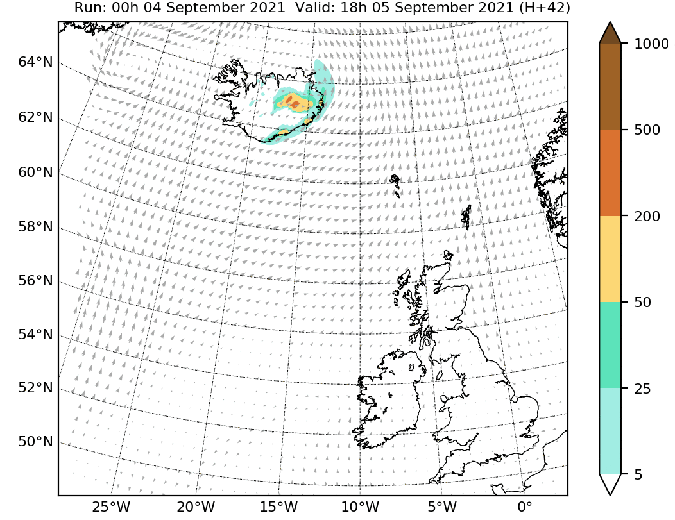
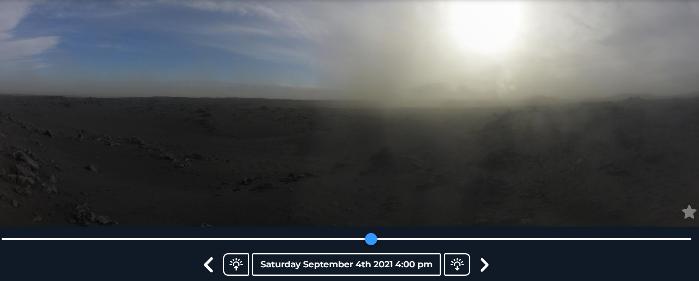
Dustrak DRX Tower
PM mass concentration (µgm⁻³)
Peaks up to 22 000 µgm⁻³
- same as 2020 measurements

Slide 17
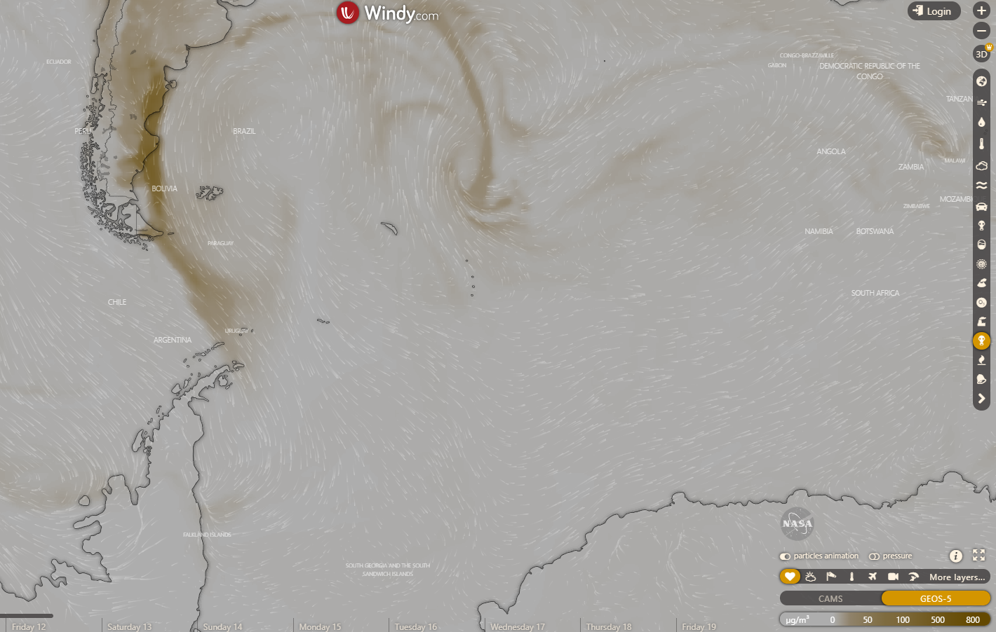
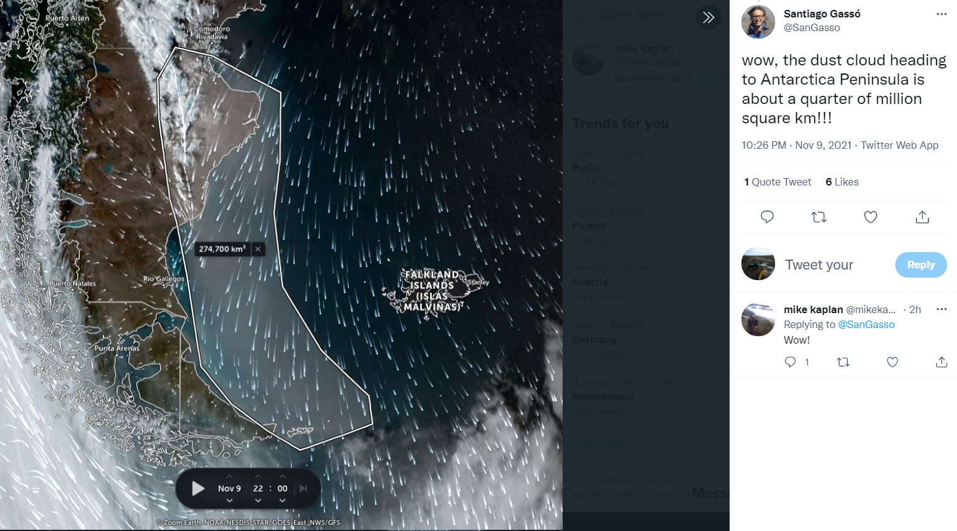
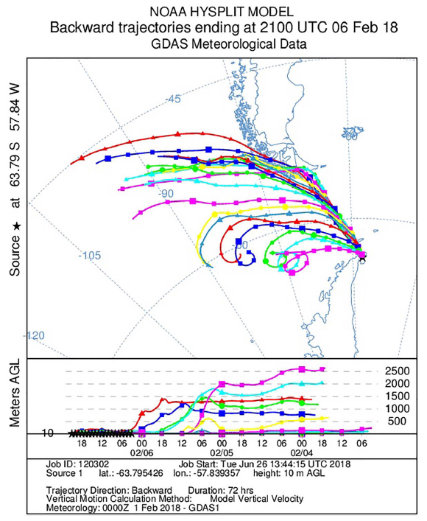
Let´s go to antarctica

Slide 18
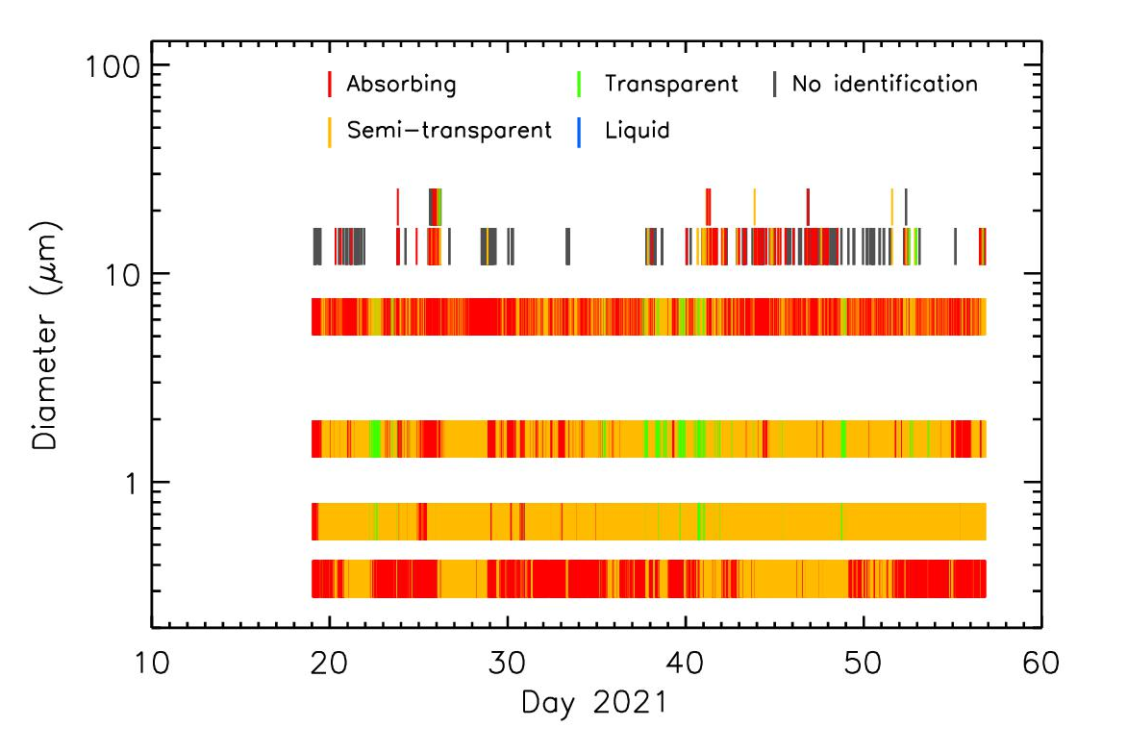
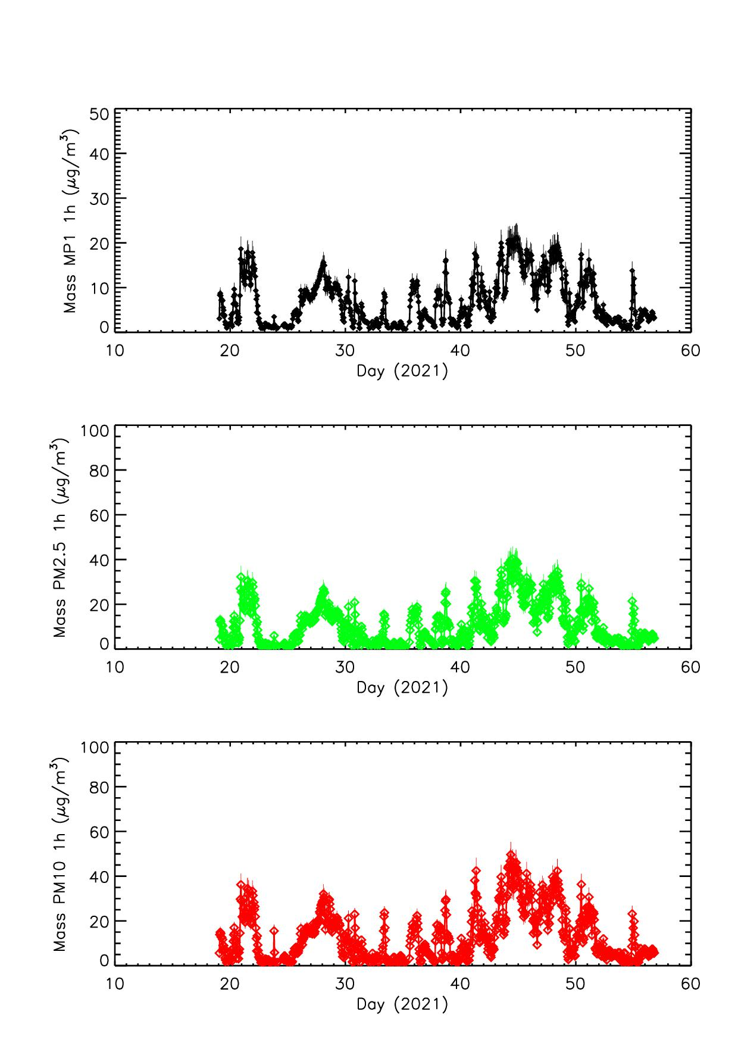
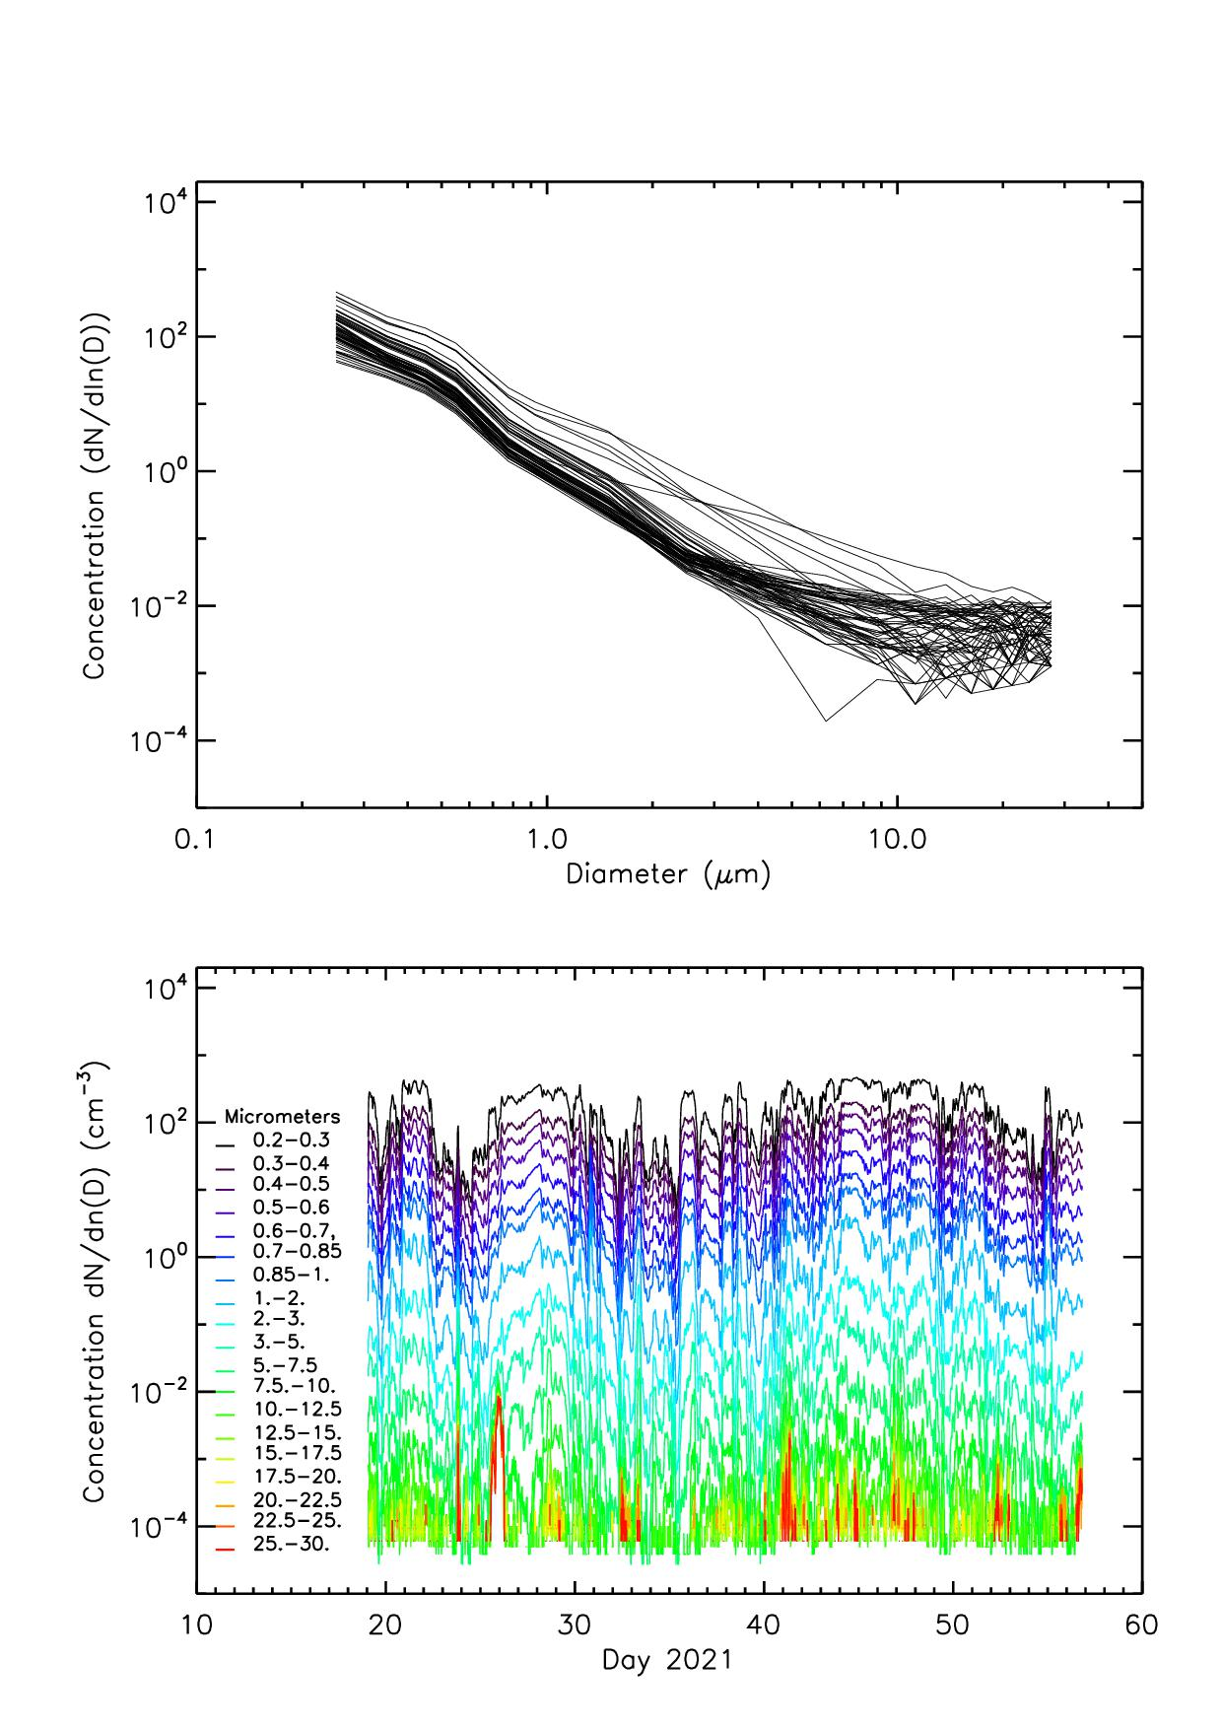
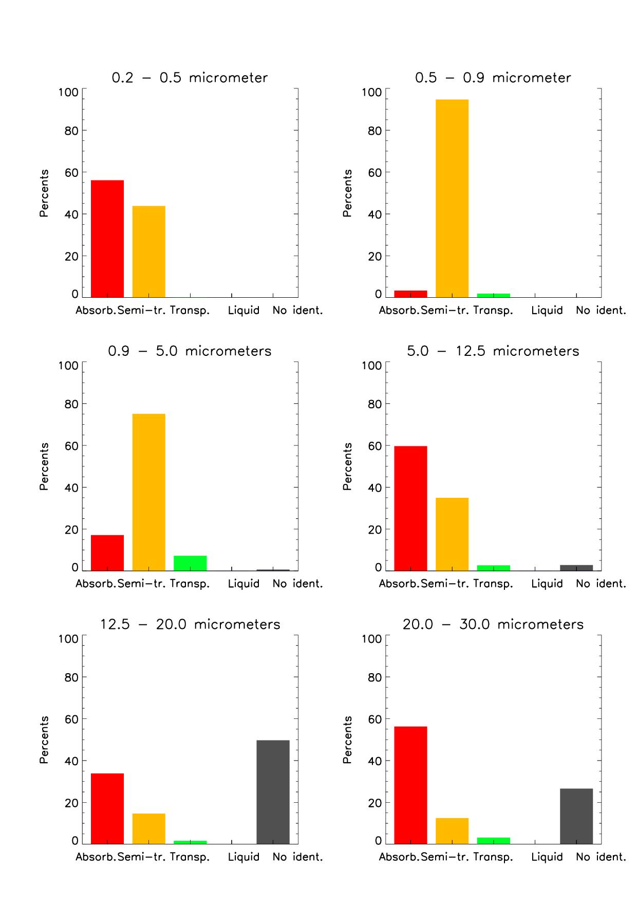
James Ross isle Antarctica 2021

Slide 19
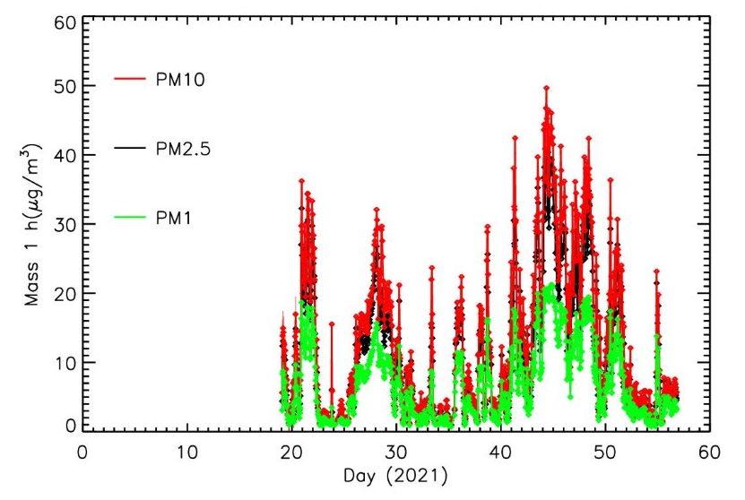


ANTARCTICA 2021 – preliminary results
Daily concentrations much higher than 6 ug m-3

Slide 20





IN SITU MEASUREMENTS 2018-2022
PM10 in Antarctica similar to North Europe!
Mean (median) mass concentrations:
PM₁₀ were 6.4 ± 1.4 (3.9 ± 1) μgm⁻³
PM_{2,5} were 3.1 ± 1 (2.3 ± 0.9) μgm⁻³
for the period January-March 2018
No long term measurements for PM>1μm
Patagonian dust detection

Slide 21



Dust from Iceland or dust to Iceland?
Giant quartz particles traveling > 4,500 km
→ 15 Saharan dust events in Iceland in 2008-2020

Slide 22




CONCLUSIONS
HLD Workshop VII
February 14-15 2023
Reykjavik
49 research institutions
from 19 countries
100 members
> 60 scientific papers published
EAA member since 2022
https://icedustblog.wordpress.com/

Slide 23


Dyngjusandur, NE Iceland
= Bodele of the North
Waiting for the HLD
Thank you for your attention!
pavla@lbhi.is
Geldingadalur eruption, 19.3.2021

