Slide 1
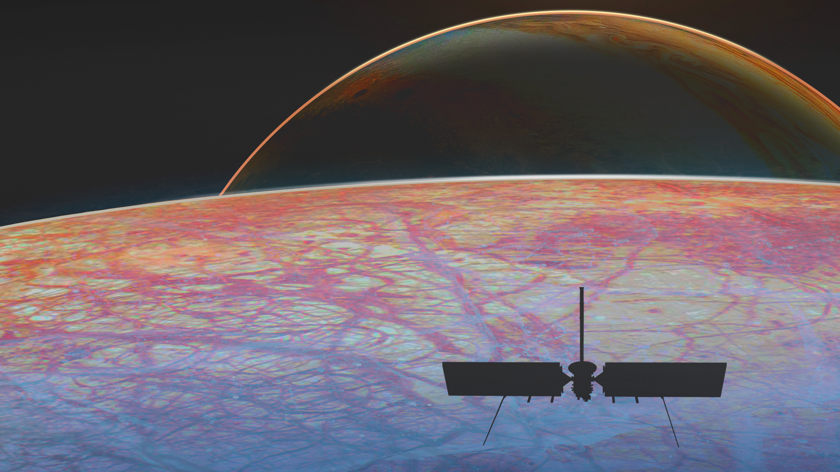




Geophysical Investigations of Celestial Bodies through the Combination of Radio Science and Altimetric Crossover Data
E. Del Vecchio, F. Petricca, A. Genova, E. Mazarico
Vienna, Austria | 23-27 May 2022

Slide 2
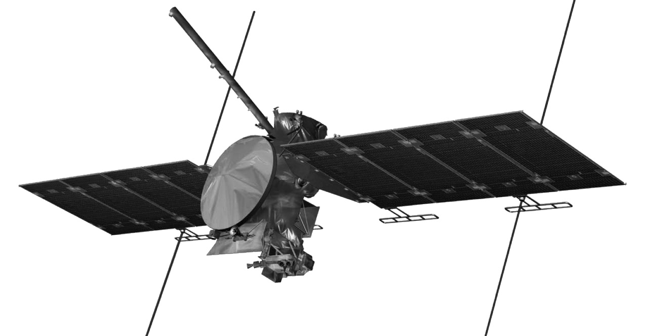
Overview
Objective: Enhancement of the Scientific Return of Gravity / Radio Science investigations of celestial bodies through the Combination of radio tracking data with datasets provided by the other spacecraft instruments
Focus on Altimetric Crossover Measurements
Case study: NASA’s Europa Clipper
Fan beam antennas to establish X-band radio links and acquire Doppler radio tracking data during the closest approaches of Europa
REASON radar altimeter to penetrate Europa’s ice shell, studying its internal structure and searching for the suspected subsurface ocean

Slide 3
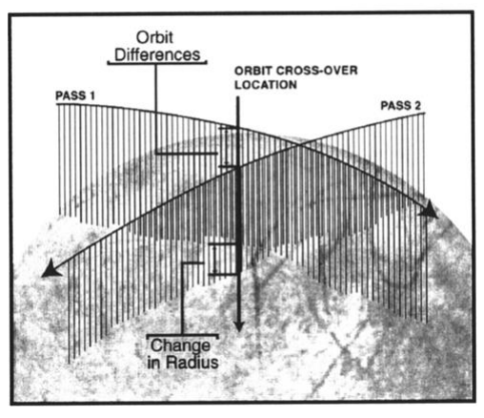
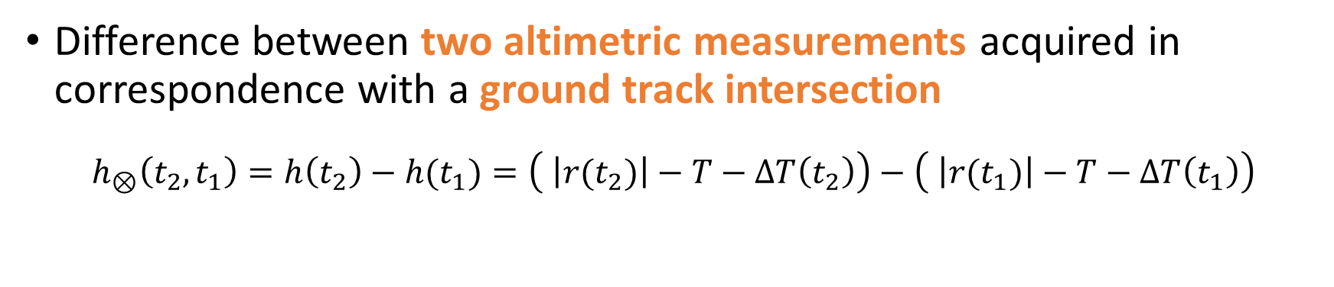
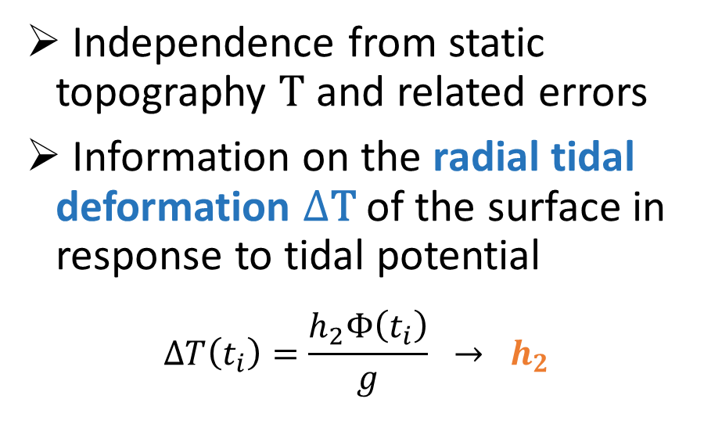
Altimetric Crossover Measurements
Difference between two altimetric measurements acquired in correspondence with a ground track intersection
$$h_{⊗}\left(t_{2},t_{1}\right)=h\left(t_{2}\right)−h(t_{1})=\left( \left|r(t_{2})\right|−T−ΔT\left(t_{2}\right)\right)−\left( \left|r(t_{1})\right|−T−ΔT\left(t_{1}\right)\right)$$
Independence from static topography T and related errors
Information on the radial tidal deformation $Δ$T of the surface in response to tidal potential
$$ΔT\left(t_{i}\right)=\frac{h_{2}Φ\left(t_{i}\right)}{g} → h_{2}$$
[Neumann et al., 2001]

Slide 4
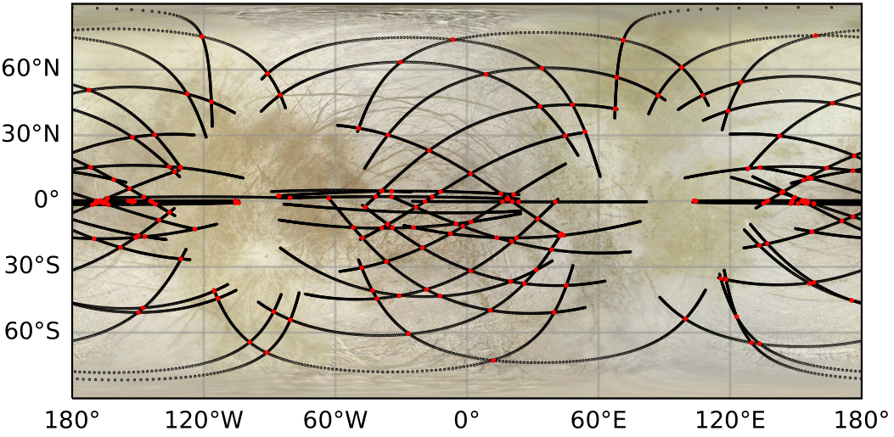

Crossover Points
Europa Clipper Tour
$$N_{crossovers}=190$$

Slide 5
Methodology
Simulation of Europa Clipper mission scenario; generation and processing of synthetic Doppler radio data and nadir-pointed altimetric measurements
Covariance Analysis with weighted least squares approach
Measurements uncertainties:
Radio Science: 0.1 mm/s at 60 seconds for Doppler data
Altimetric Crossovers: 10 m for a conservative approach considering instrument intrinsic errors, pointing errors and interpolation errors

Slide 6
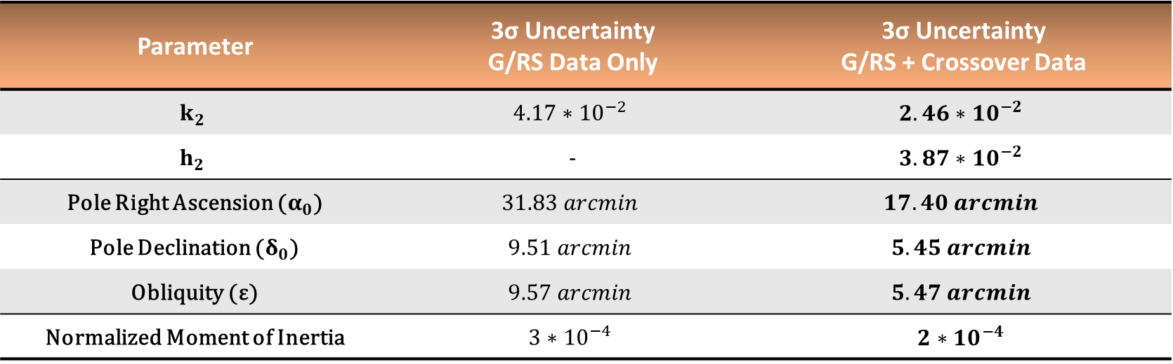
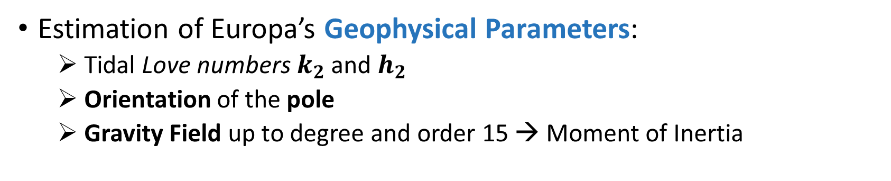
Estimation
Estimation of Europa’s Geophysical Parameters:
Tidal Love numbers $k_{2}$and $h_{2}$
Orientation of the pole
Gravity Field up to degree and order 15 → Moment of Inertia
Parameter | 3σ Uncertainty G/RS Data Only | 3σ Uncertainty G/RS + Crossover Data
$$k_{2}$$ | $$4.17∗{10}^{−2}$$ | $$2.46∗{10}^{−2}$$
$$h_{2}$$ | - | $$3.87∗{10}^{−2}$$
Pole Right Ascension ($α_{0}$) | $$31.83 arcmin$$ | $$17.40 arcmin$$
Pole Declination ($δ_{0}$) | $$9.51 arcmin$$ | $$5.45 arcmin$$
Obliquity (ε) | $$9.57 arcmin$$ | $$5.47 arcmin$$
Normalized Moment of Inertia | $$3∗{10}^{−4}$$ | $$2∗{10}^{−4}$$

Slide 7
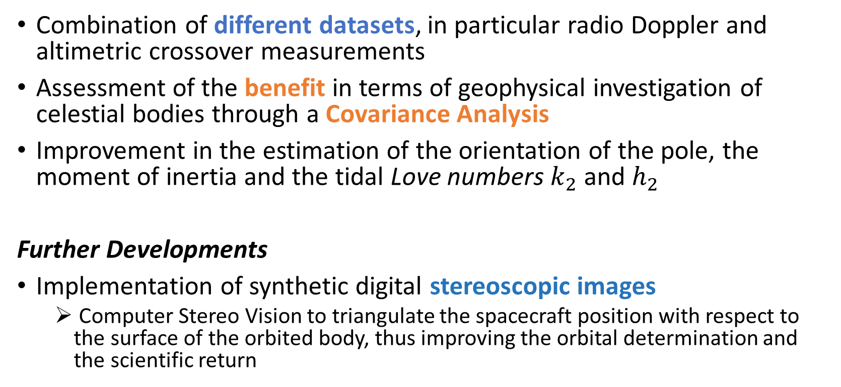
Conclusions
Combination of different datasets, in particular radio Doppler and altimetric crossover measurements
Assessment of the benefit in terms of geophysical investigation of celestial bodies through a Covariance Analysis
Improvement in the estimation of the orientation of the pole, the moment of inertia and the tidal Love numbers $k_{2}$and $h_{2}$
Further Developments
Implementation of synthetic digital stereoscopic images
Computer Stereo Vision to triangulate the spacecraft position with respect to the surface of the orbited body, thus improving the orbital determination and the scientific return

