Slide 1

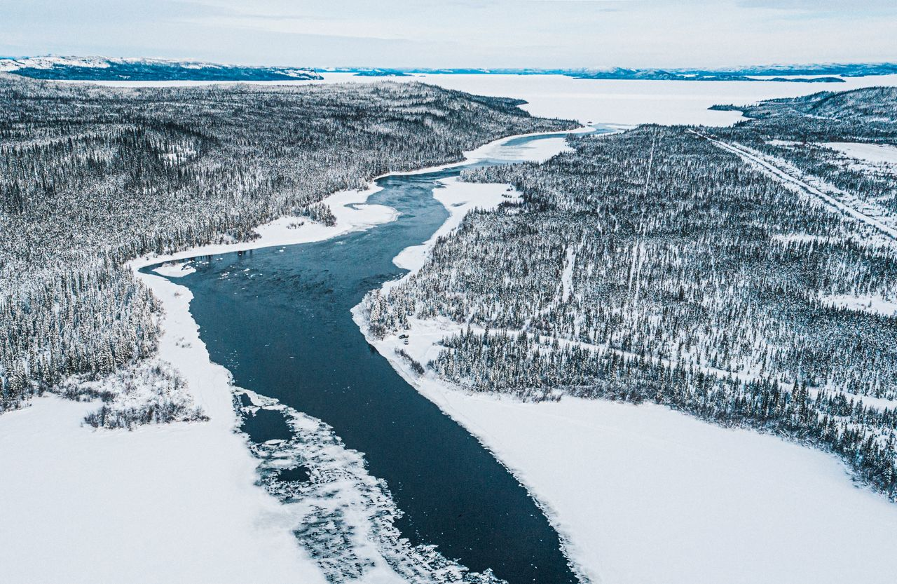

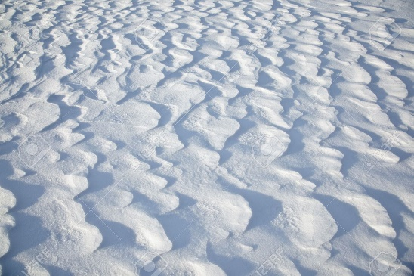
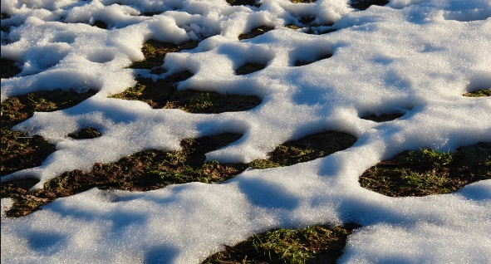
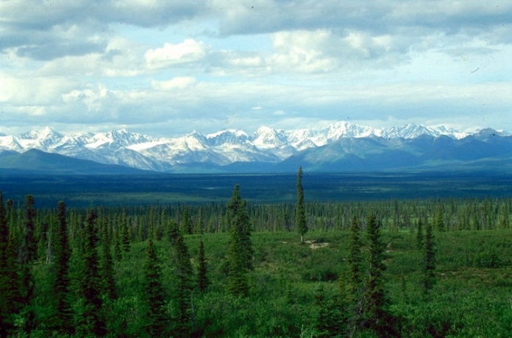
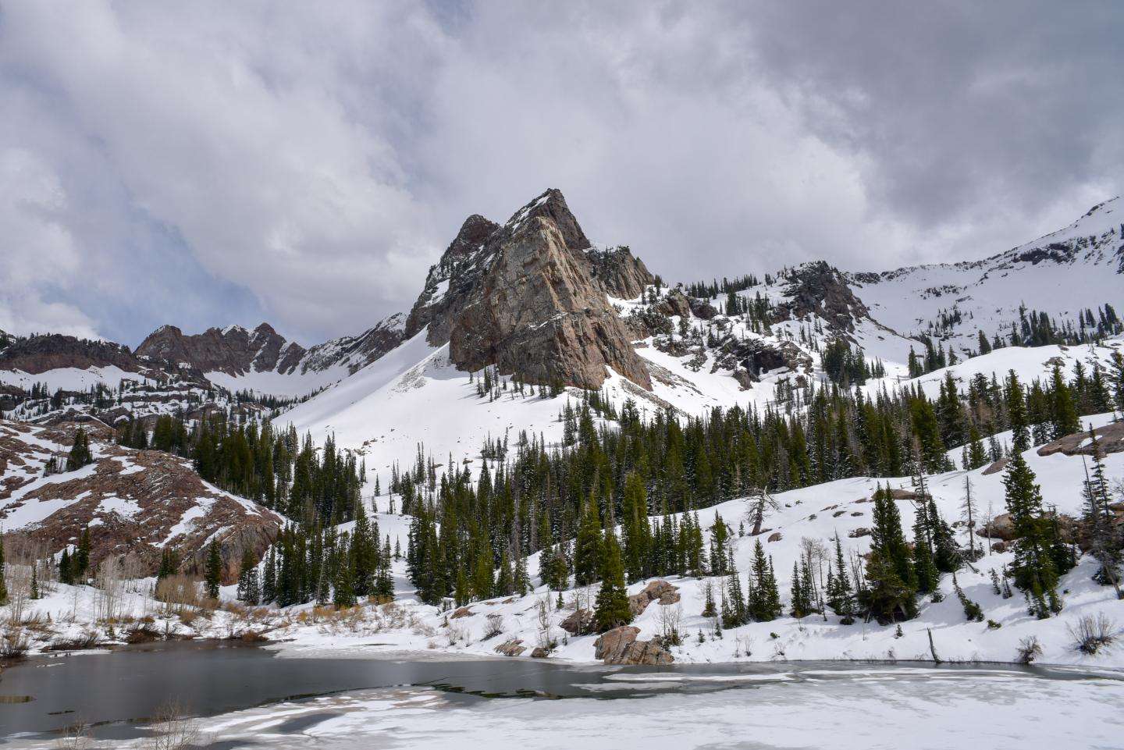
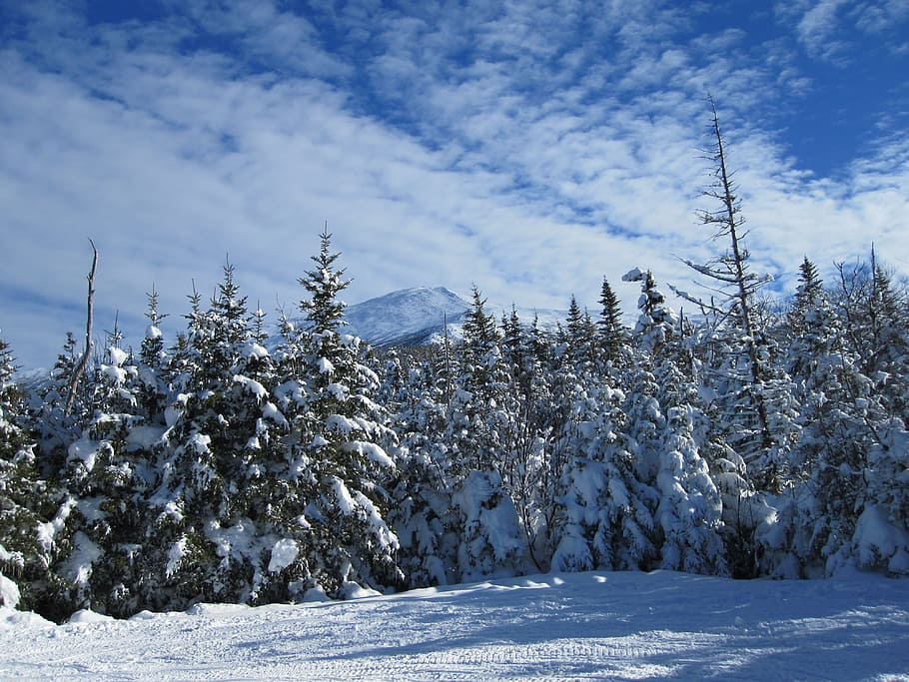


Global Snow Water Equivalent Observations from Space
Ana P. Barros, Carrie Vuoyvich, Michael Durand, Leung Tsang, Paul Houser, HP Marshall, ED Kim, Dorothy Hall

Slide 2

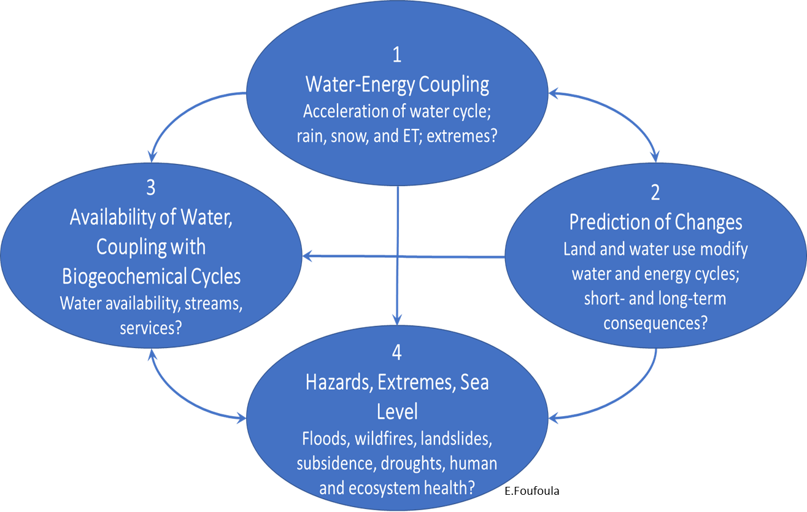
Toward an Earth Observing System framework
using satellite observations and models

Slide 3
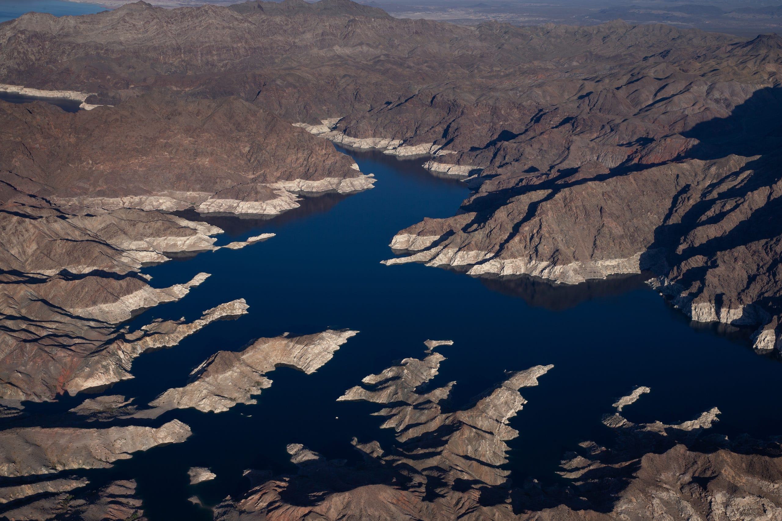
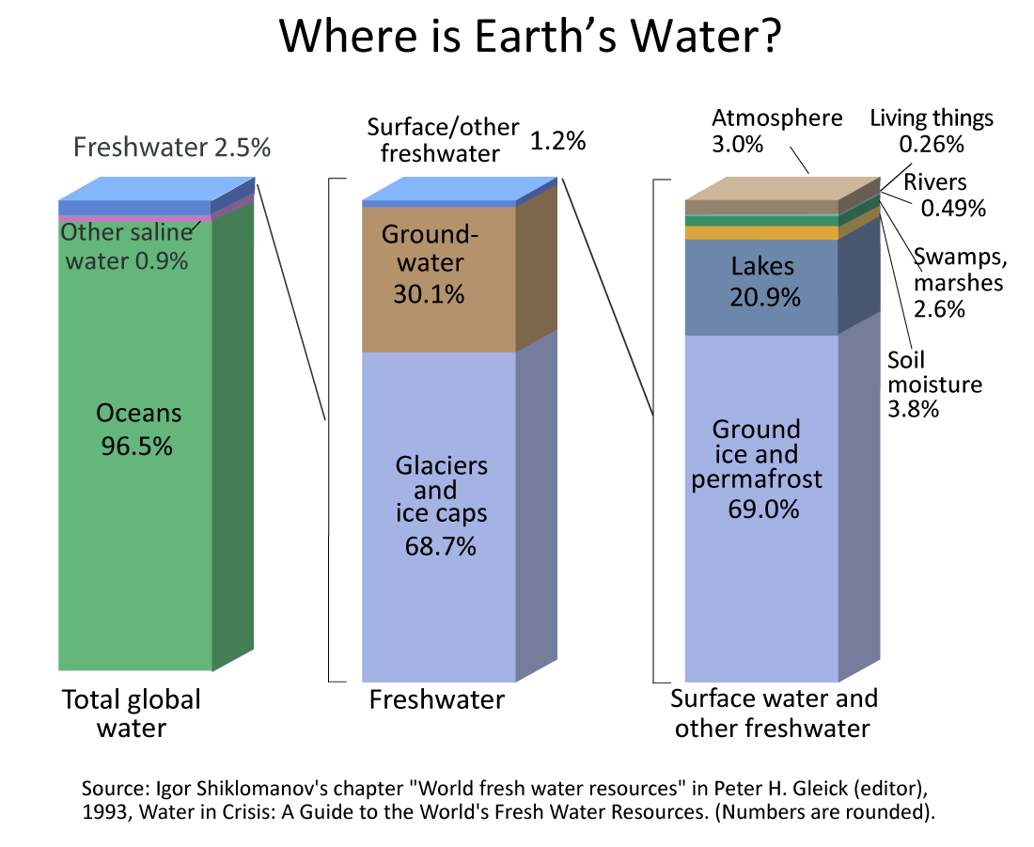
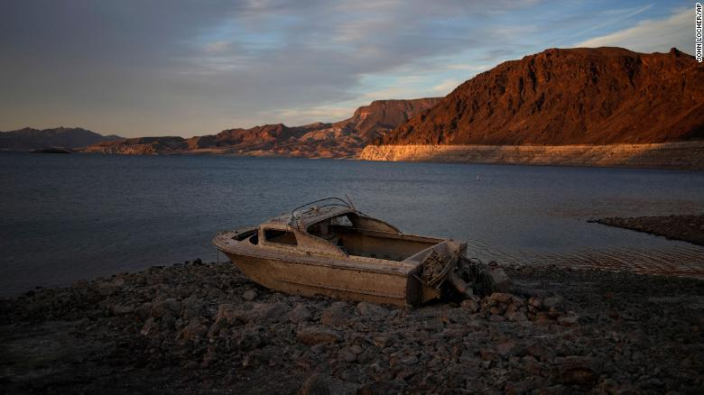
Water Availability
~1.4 volume of Lake Mead/decade
Seasonal Snow
0.25% ±0.08 %
- 46 km³/decade
5/24/2022
1Gt~1k³
Pulliainen et al. 2020
https://www.cnn.com/2022/05/24/us/lake-mead-water-level-climate/index.html
USGS Factsheet, Perelman et al., 2019

Slide 4

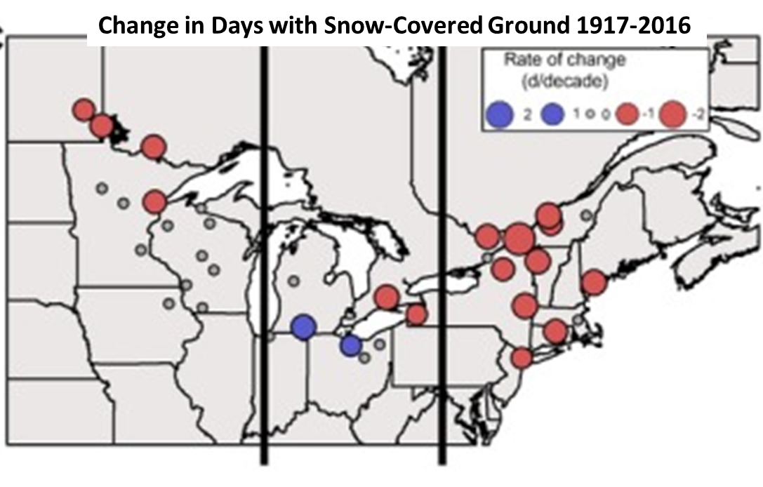
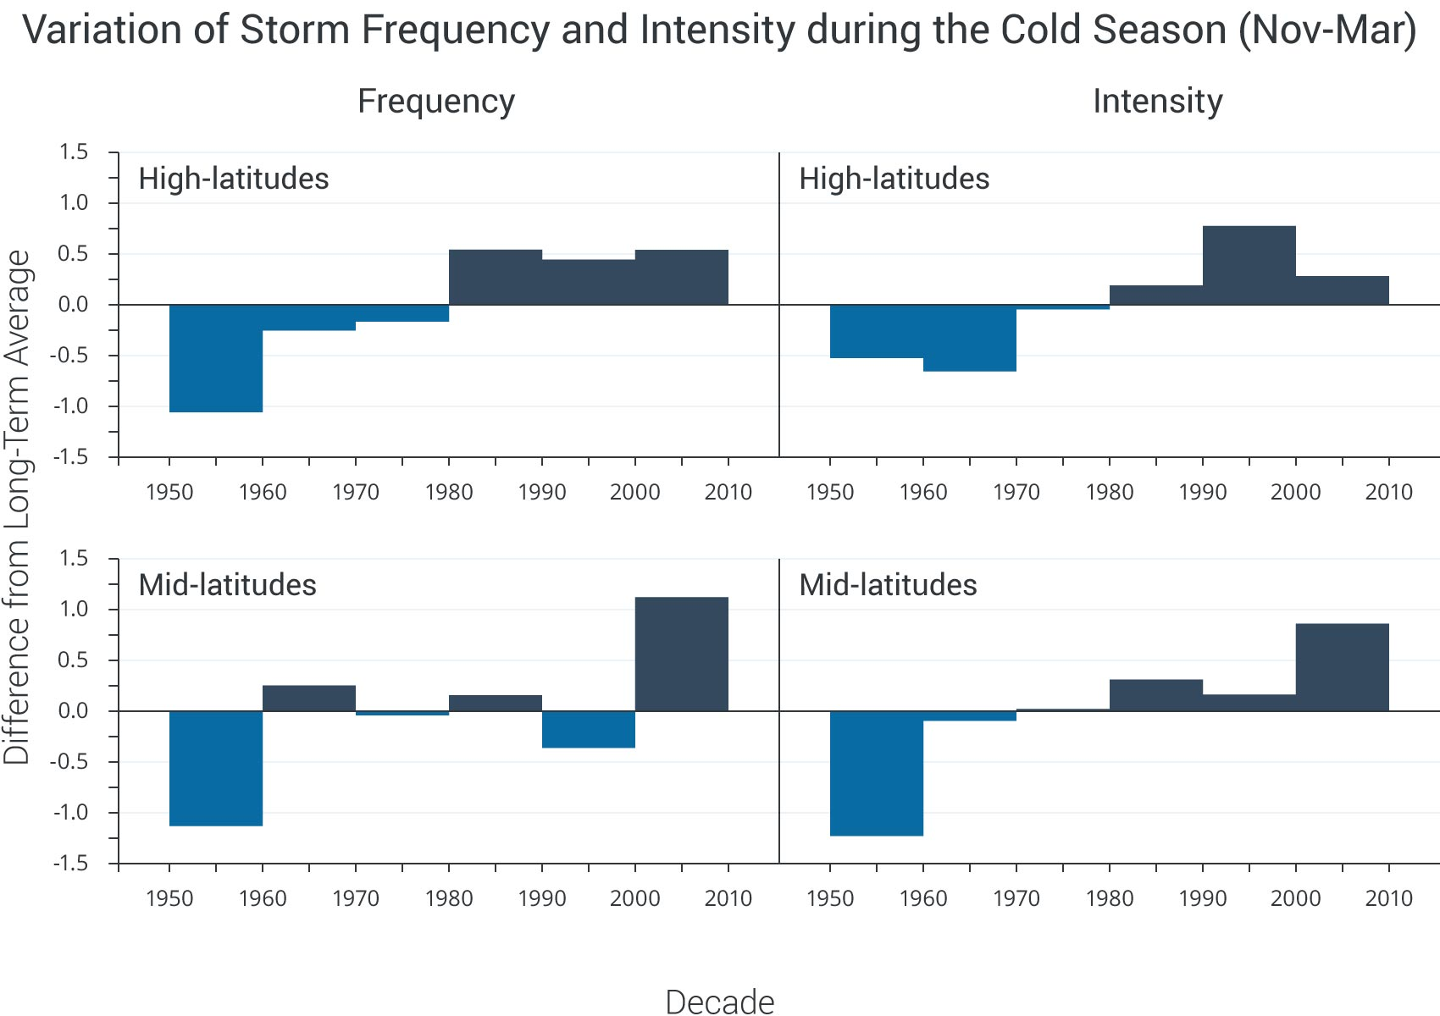
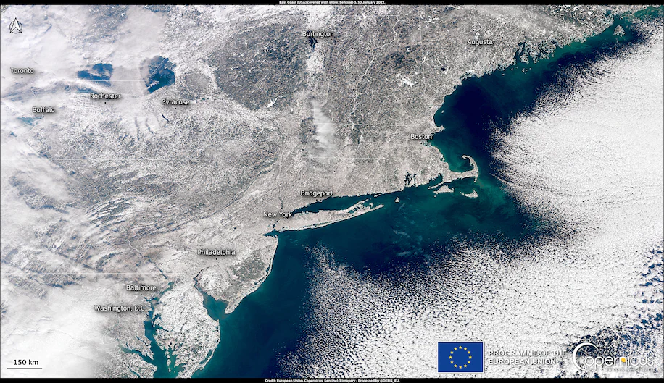
Climate 1 : The cold branch of the water cycle is accelerating
Fewer snowstorms
Changes in mean daily snowfall
(rel. 1851-1920)
Lake-Snow Effects
More extreme
2020-2030
Quante et al. 2021
2015
2050-2060
Jan30,2022
NCA 2014
Number of Blizzards
2090-2100
Coleman et . 2017
Season

Slide 5

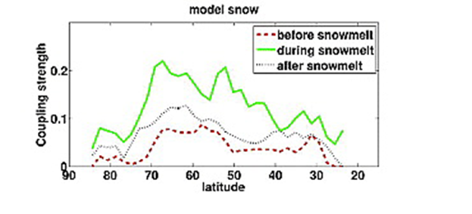
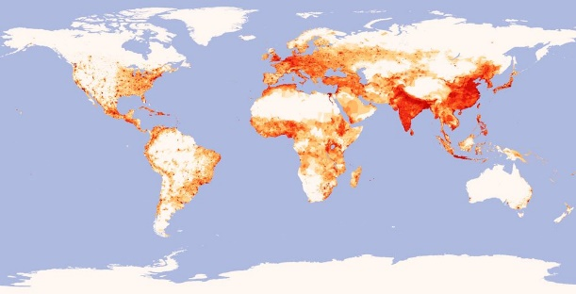

Climate 2 : Snow-Atmosphere Coupling
Persistence of MODIS Snow Covered Area (SCA)
>2 months
< 2 weeks
SWR: 300 - 800 Wm⁻²
Albedo: 0.15-0.4
0.4 - 0.8
Population
2-m Air Temperature
SCA
Snow-Atmosphere
Coupling Strength
Bowen Ratio
75ºN
25ºN
Xu and Dirmeyer, 2011

Slide 6
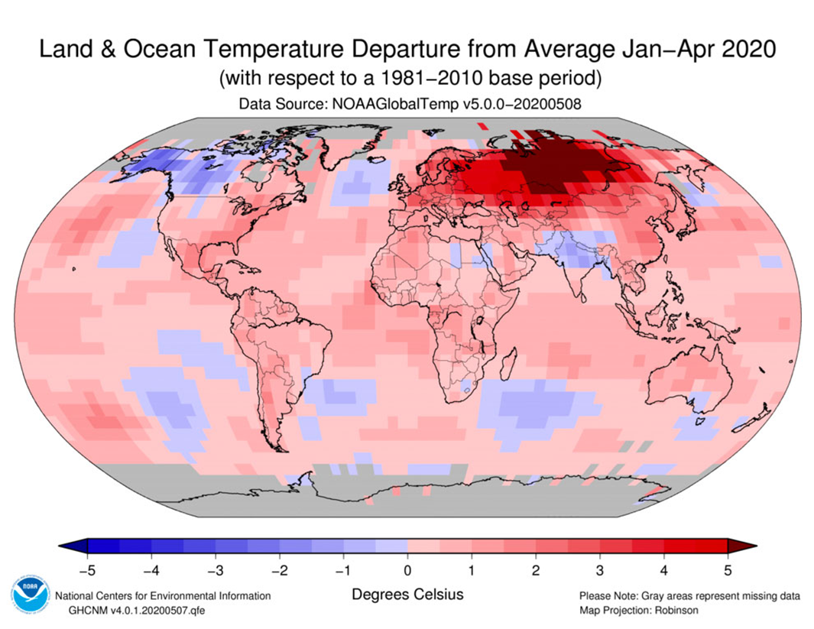
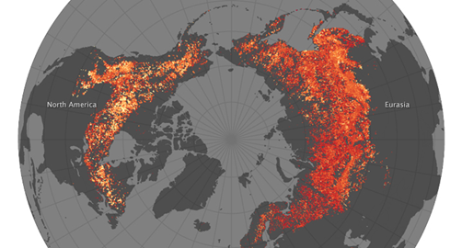
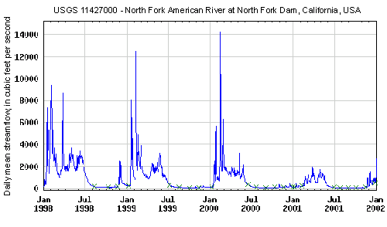
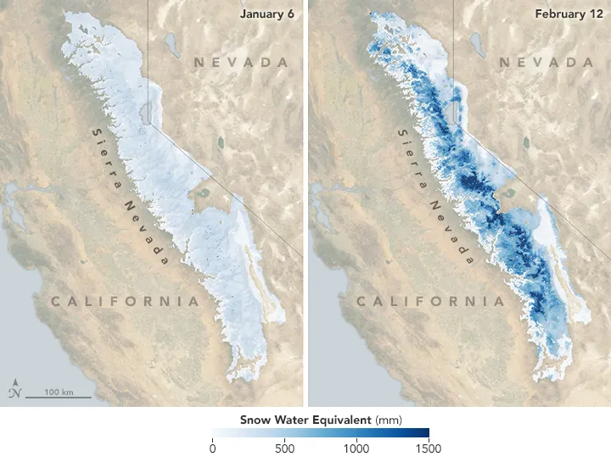
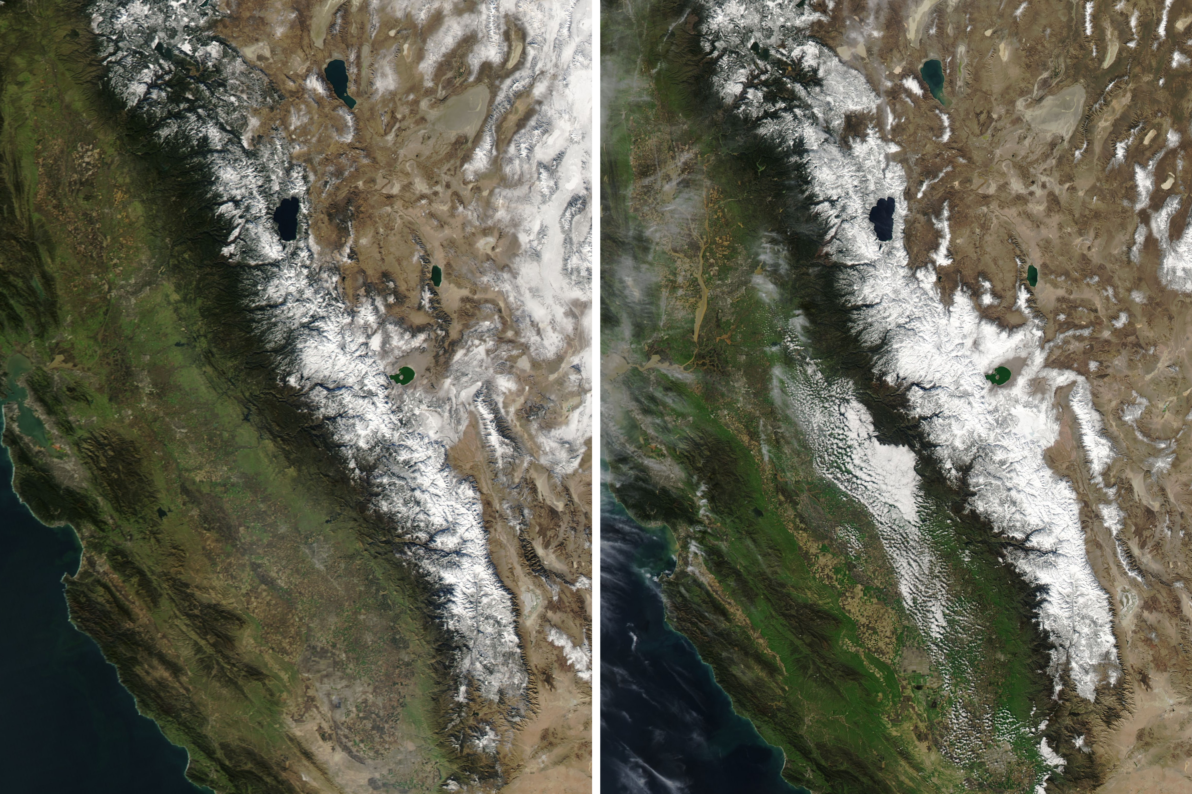
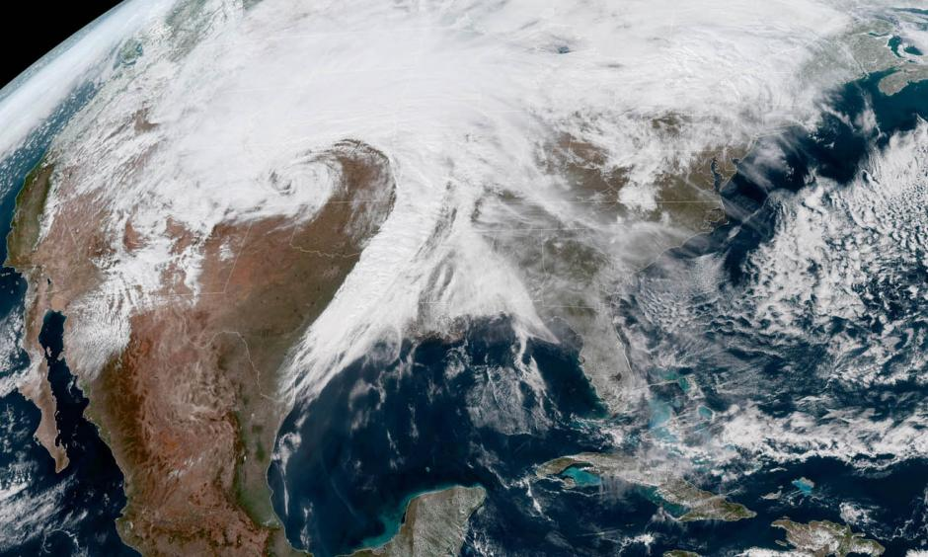
Snow Drought Hazard
Capture (Intermittent)
Store ( Seasonal )
Release and Control
Mackenzie River Basin
USGS 11427000 – North American River at North Fork Dam, California, USA
Heat waves
Rain-On-Snow
Wildfires
14000
8000
2000
0
2017
Daily Mean Streamflow ft³/s
Bomb cyclones
$45 billion
NASA Earth Observatory images by Joshua Stevens, using Snow Melt Equivalent data courtesy of Leanne Lestak/UC Boulder and NASA LANCE/EOSDIS Rapid Response.
1998 1999 2000 2001 2002
O’Hara et al. 2009
Wang et al. 2017

Slide 7
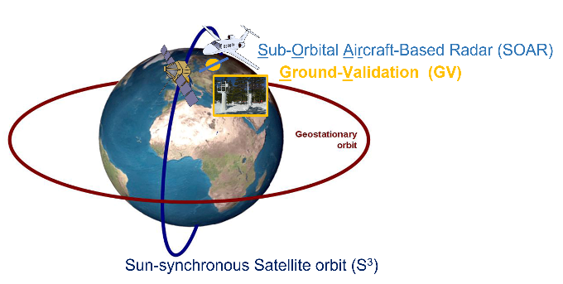
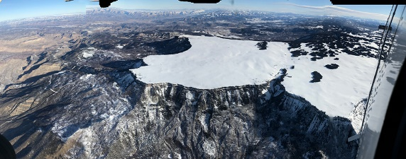
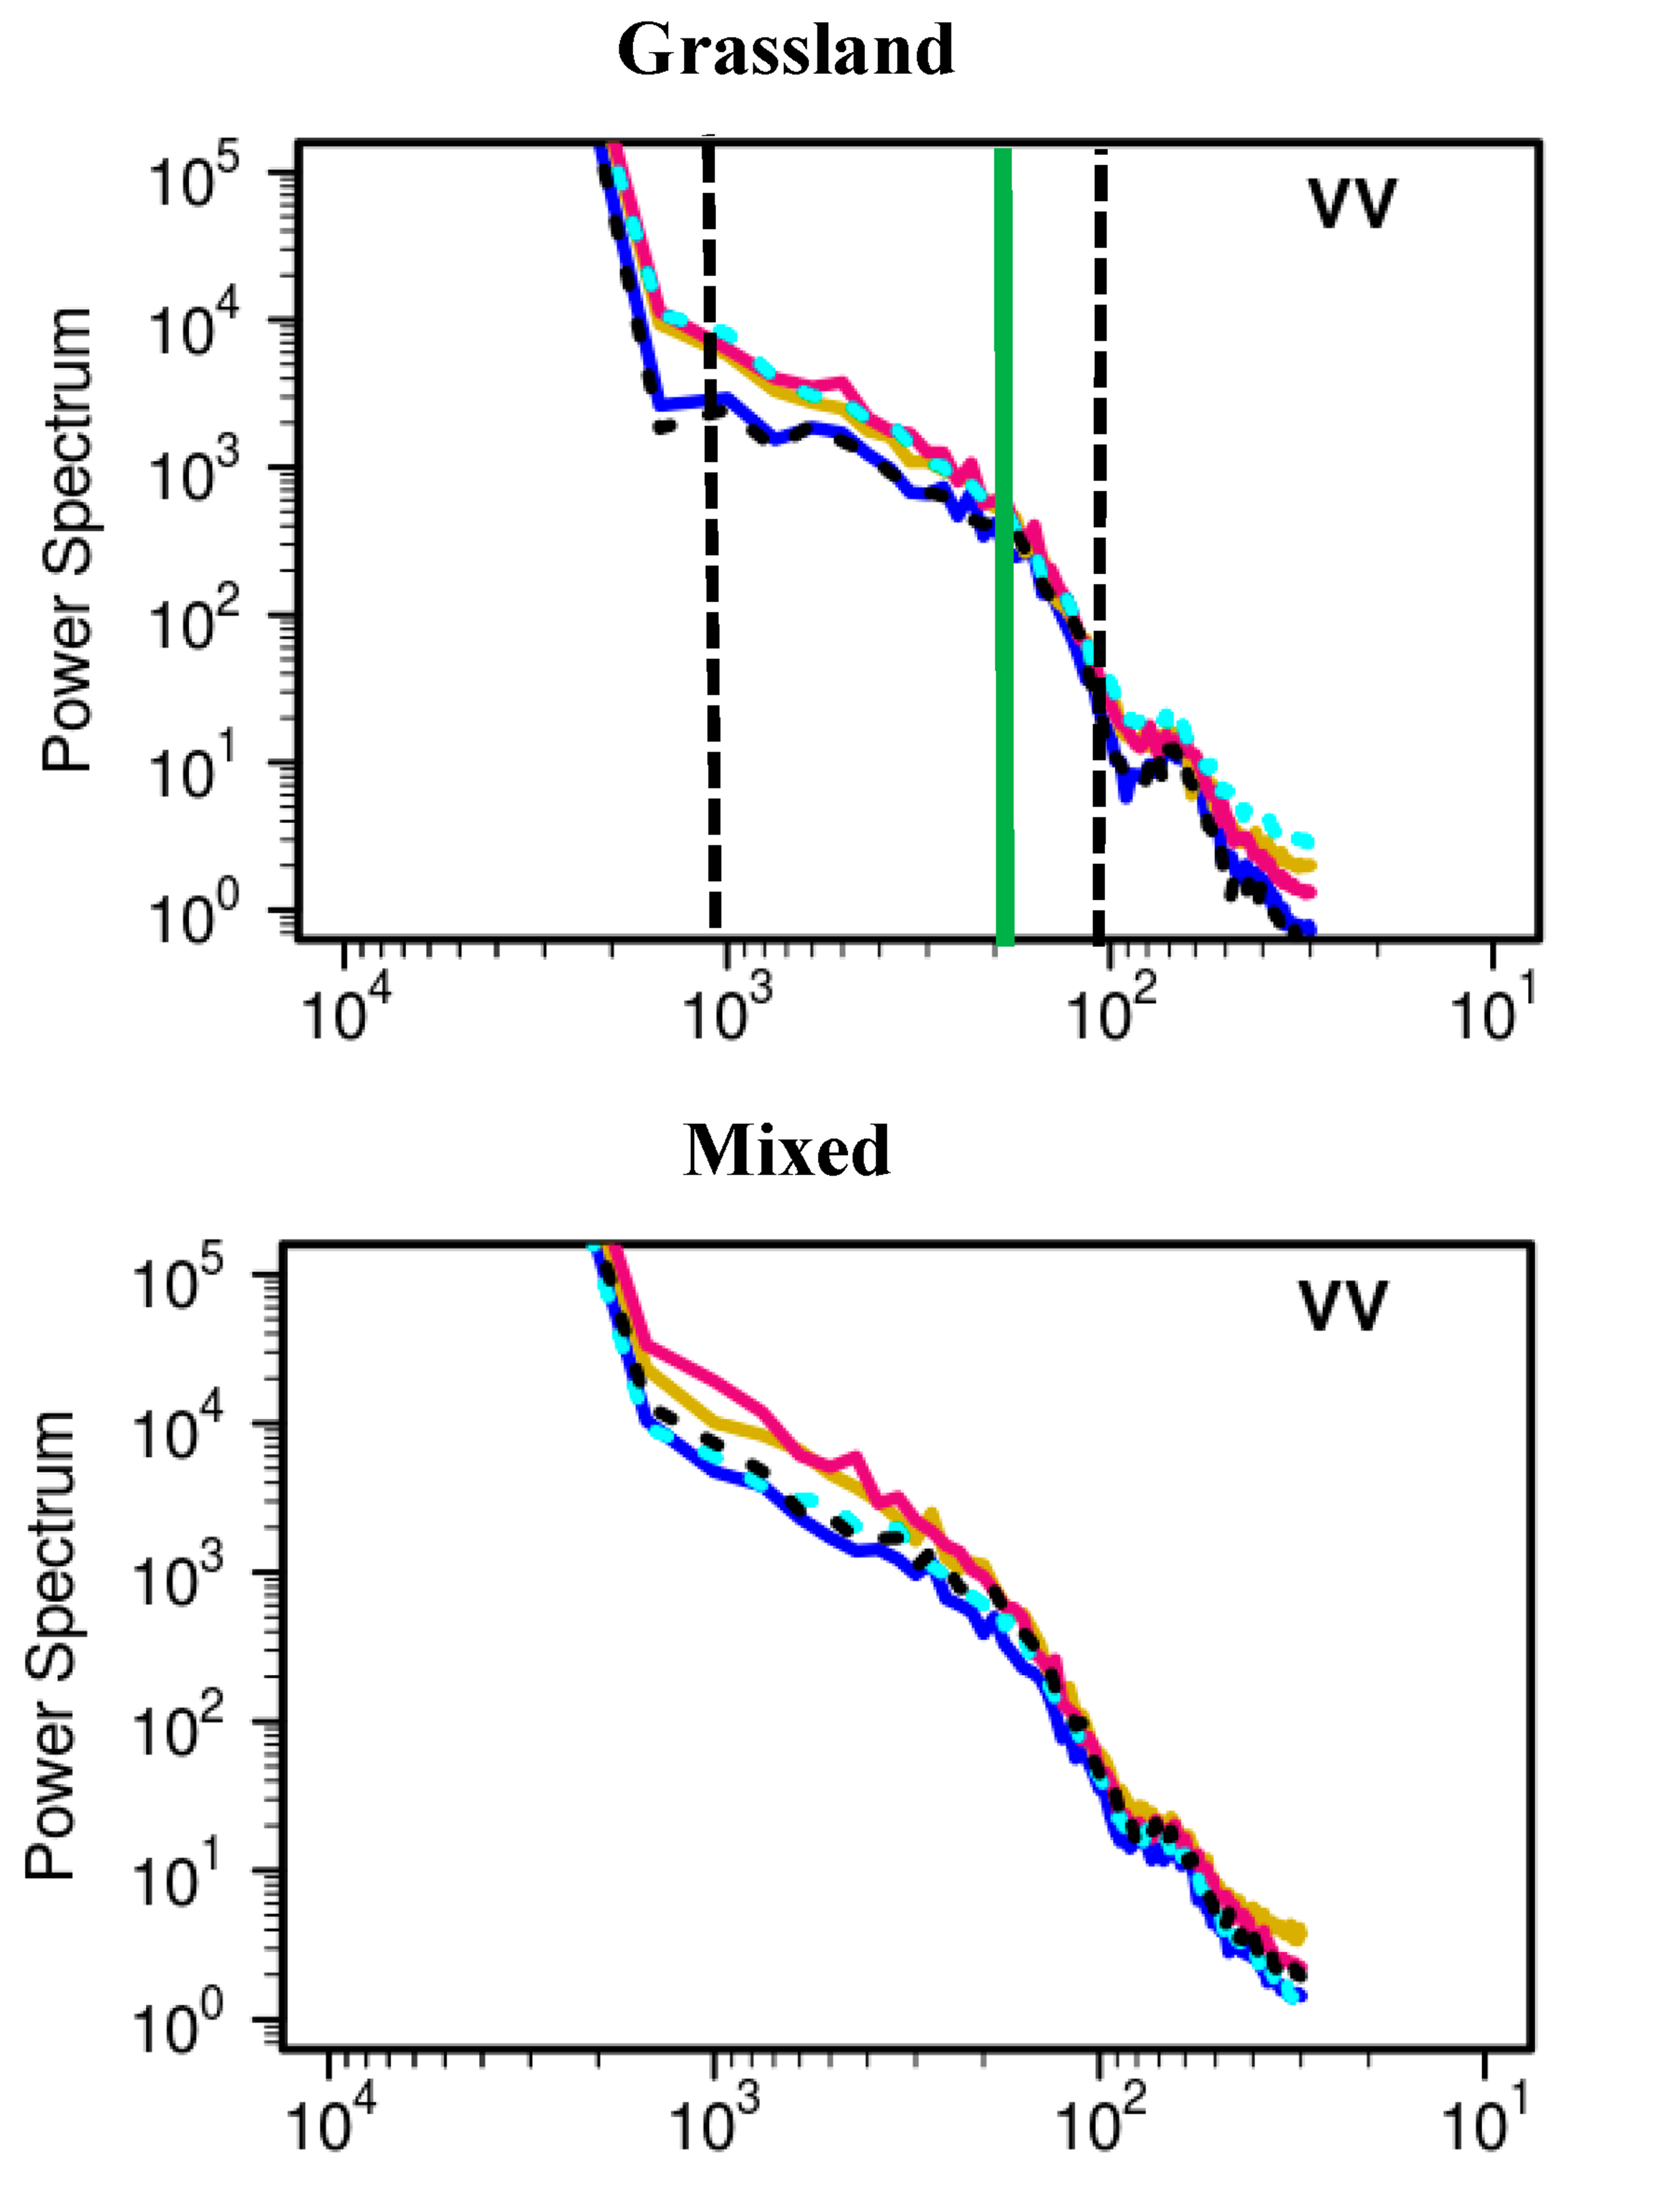

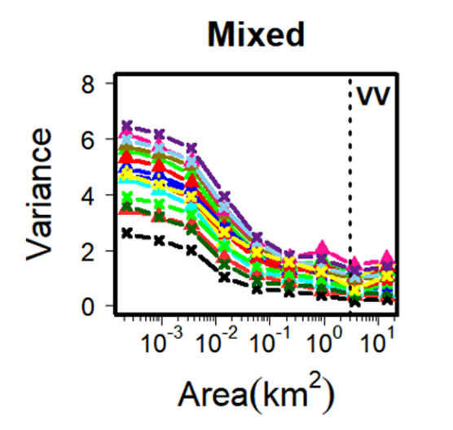
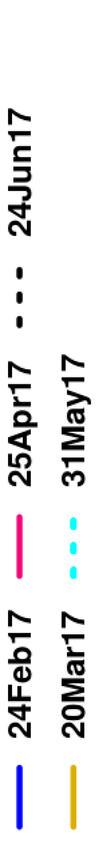

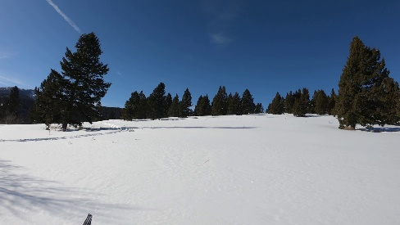

What do we need to address the science?
Global Observations of SWE (Peak Snow Mass)
SWE Change at Inter-Storm Frequency (3-5 days)
Snowmelt Patterns and Intermittency
Process Scales
ESA Sentinel-1 C-Band SAR
100 ~ 250 m
1km
100 m
Manickam and Barros (2020)

